Slide 1




Animal welfare and agroforestry in Ethiopia
Rebecca Doyle
Animal welfare scientist
International Livestock Research Institute & University of Edinburgh
Improving animal welfare to ensure food security and safety
5th Africa Animal Welfare Conference
2 November 2021

Slide 2
Animal welfare & agroforestry
Integration of trees with vegetation or livestock
Can offer alternative feed resources during periods of low forage availability
Climate-resilient livestock production system

Slide 3
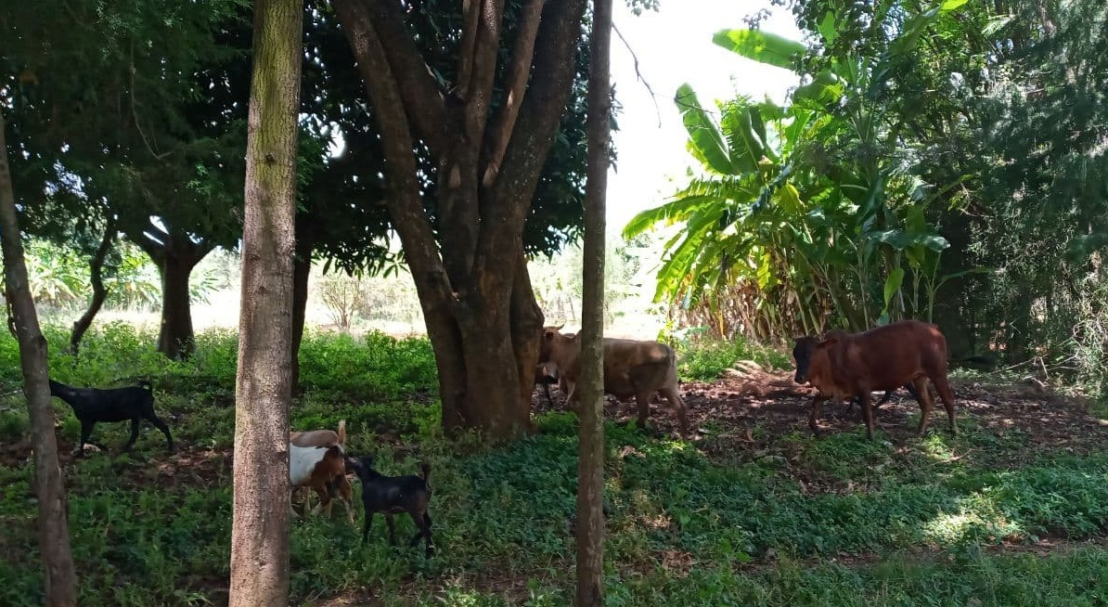

Bossa Wanche, Humbo district (good tree access)

Slide 4
Agroforestry and livelihoods
District | Tree access | Mean income sources (#) | Mean agroforestry income ETB (US$)
Dugda | Limited | 4.6 | 1,562 (33)
 | Good | 5.6 | 32,091 (676)
Humbo | Limited | 3.4 | 52 (1)
 | Good | 5.9 | 4,887 (103)

Slide 5
Agroforestry and animal welfare
District | Tree access | Skinny cattle % (count) | Hair loss % (count)
Dugda | Limited | 33 (13) | 10 (4)
 | Good | 18 (6) | 3 (1)
Humbo | Limited | 32 (17) | 15 (8)
 | Good | 16 (7) | 4 (2)

Slide 6
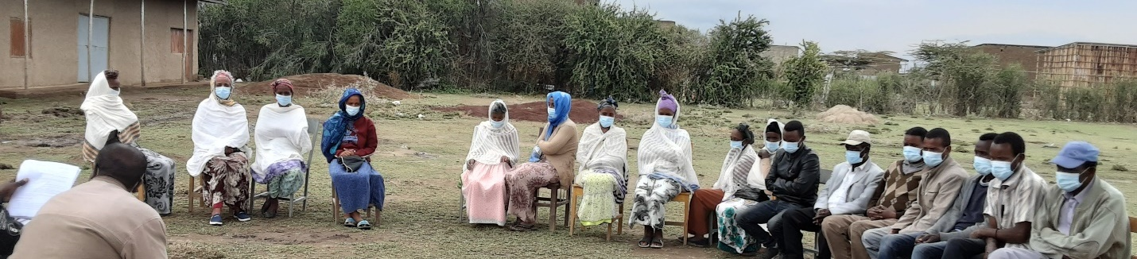
Agroforestry and One Welfare
Strong consensus between all groups on the connection between good animal welfare and improved household food security & benefits of agroforestry to animal welfare and livelihoods
Community conversation participants at Girba Koree Addi, Dugda district, Oromia, Ethiopia (limited tree access)

Slide 7
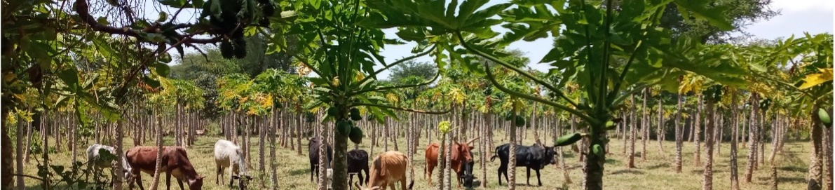
Barriers
Skills | Resources
Managing young trees with grazing stock Which tree/plant species were appropriate Addressing animal welfare issues | High initial investment cost for seedlings Time lag for return Market connection

Slide 8
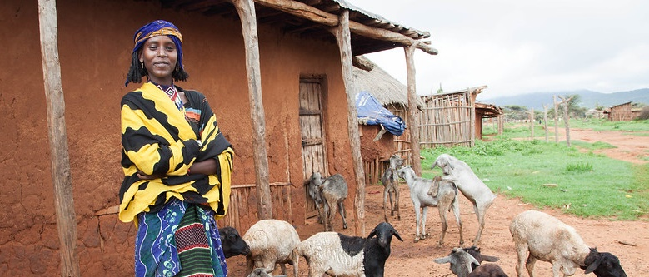
Opportunities & next steps
New value chains & income sources
Climate resilient production + livelihoods
Animal welfare opportunities
A young Borana woman with her goats
(photo credit: ILRI\Zerihun Sewunet)

Slide 9
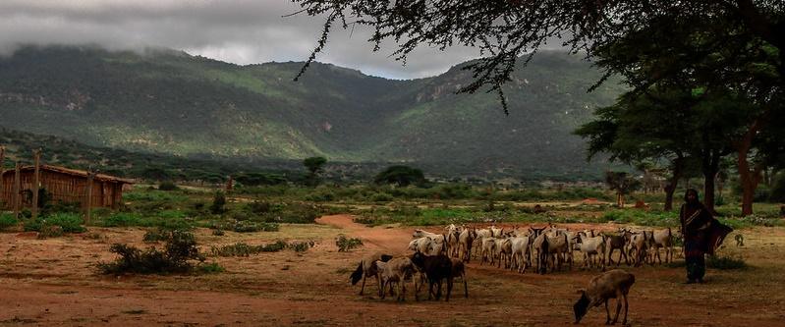
What is needed to support animal welfare?
Capacity development of livestock/veterinary support staff
Resourcing of quality veterinary care
Animal welfare + production + sustainability
Yabello Ethiopia
photo credit: ILRI/ Camille Hanotte
A young Borana woman with her goats
(photo credit: ILRI\Zerihun Sewunet)

Slide 10

Animal welfare resources
Animal welfare education resources: introductory resources, CPD, MSc
Collaboration with veterinary schools for capacity development & Day One competencies
Animal welfare science excellence
rebecca.doyle@ed.ac.uk

Slide 11
