Slide 1
Biosciences eastern and central Africa – International Livestock Research Institute (BecA-ILRI) Hub: Its role on enhancing science and technology capacity in Africa
AAAS Annual Meeting, Vancouver, Canada, 16-20 February 2012
Appolinaire Djikeng
BecA-ILRI Hub, Nairobi, Kenya
http://hub.africabiosciences.org/
http://www. Ilri.org/
Notes:
Developed under framework of Centres of Excellence for Science and Technology
Project between ILRI and NEPAD
…aims to employ modern biotechnology to improve agriculture and the overall livelihood in eastern and central Africa
World-class facilities (CIDA)

Slide 2
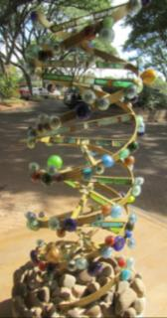
Background
AU/NEPAD – Africa Biosciences Initiative (ABI): Creation of four regional networks:
1. BecA (Biosciences eastern and central Africa) for countries in eastern and central Africa
2. SANBio (Southern African Network for Biosciences) for southern African countries
3. WABNet (West African Biosciences Network) consisting of ECOWAS countries
4. NABNet (North African Biosciences Network) for the countries in North Africa.

Slide 3
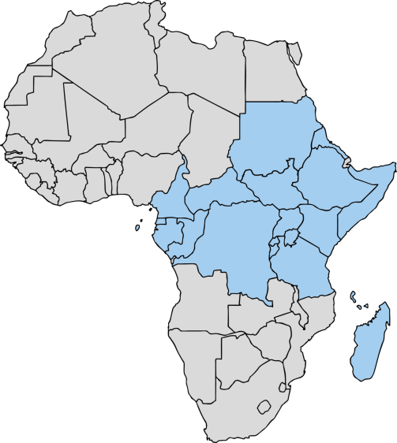
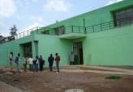
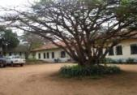
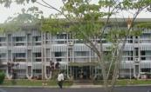
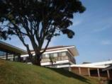
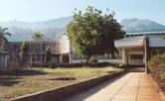
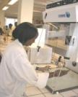
BecA Countries
Biotechnology Centre, Ethiopian Institute Agricultural Research (EIAR), Ethiopia
National Agricultural Biotechnology Centre, Kawanda, Uganda
University of
Buea, Cameroon
BecA-ILRI Hub, Nairobi
Sokoine University of Agriculture
Tanzania
Kigali Institute of Science and Technology (KIST), Rwanda

Slide 4
Key Messages
1 - Uniqueness of BecA
2 - Where we are now and where we plan to go
3 - Investment/funding opportunities

Slide 5
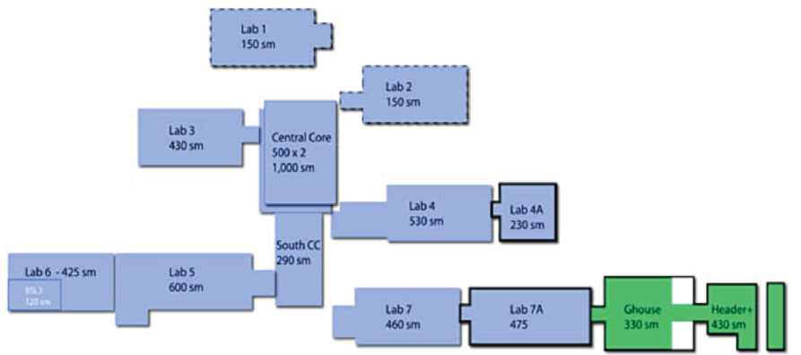

Laboratory facilities for the Hub
Seven laboratories (>6000 m²) to provide for livestock, crop and microbial research and training.
Laboratory upgrade and construction:

Slide 6









































Partners
2011
2010
2009
2008
Biosciences eastern and central Africa partners
2007
2006
2005
2004
2003
Rural Development Administration of the Republic of Korea
and more …

Slide 7
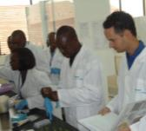
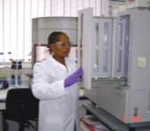
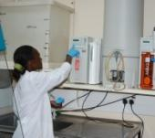
Building a Critical Mass of Scientists to Tackle Major Agricultural Issues
35 core scientific and technical support staff of BecA Hub
45 scientists and technical staff from ILRI’s Biotech Theme
18 scientists and technical staff from 4 CGIAR crop centres (CIP, CIMMYT and IITA)
A number of affiliated prominent scientists located globally (e.g. Cornell University, Washington State University, Kenyatta University, University of Uppsala, etc)

Slide 8

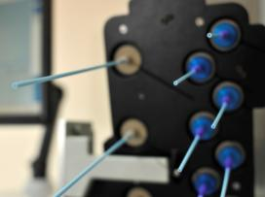
BecA Hub Core competencies
Genomics/Metagenomics
Bioinformatics
Genetic engineering
Diagnostics
Molecular breeding
Vaccine technology/Immunology
Mycotoxins
Notes:
These are the core competencies we have at the moment and we are in the process of expanding these competencies. These are all on plants, animals and microorganisms. We conduct research and provide services, capacity building on all these competencies.
(Note: RNAi is a competency we can use now in any system where we can express a transgene or infect with a recombinant virus (to express the microRNAs) and have sequence information about what we want to silence.)

Slide 9
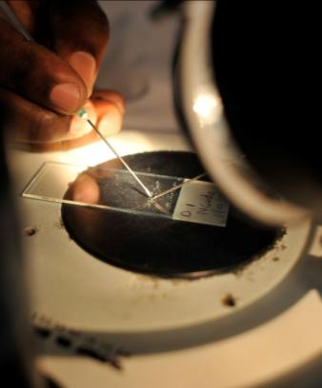
BecA Hub: Core activities
1. Research
Capacity building and training
Research and Technology-related services
Focal point for the agricultural research community in eastern and central Africa
Promotion of product development and delivery
Notes:
For research, we support, lead and co-lead
I’m focusing on research, others covered by colleagues.
Leading research is critical to make BecA relevant, retain staff and attracting the best staff, users and partners; it’s essential to the sustainability of the Hub.

Slide 10
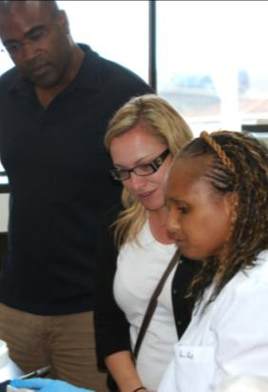
Current Major Funding Agreements
Syngenta Foundation for Sustainable Agriculture (USD 5M; 2009-14)
The BecA-CSIRO partnership is part of the Australia/Africa Food Security Initiative (AUD$ 14M; 2009-13): AusAID
The Bill & Melinda Gates Foundation core support to BecA Hub (USD 2M, 2011-14)
The Swedish Ministry of Foreign Affairs/SIDA (USD 12M, 2012-2015)
In addition to many other investors supporting our partners, graduate students, etc.

Slide 11


BecA-CSIRO partnership
Research Projects
Capacity building through
African Biosciences Challenge Fund
Courses and workshops
Visiting Scientists
Institutional Capacity Building
Animal Health R&D
Food & Nutrition Science
ASF
Aflatoxin
Amaranth
PPR
CBPP
Mushrooms
Domestic cavies
Co-investment and CSIRO/Australian scientific collaboration
Core support

Slide 12
BMGF Funding to BecA
Key staffing/Core support
Genomics
Bioinformatics
Crop Breeder
Capacity building through
African Biosciences Challenge Fund
Courses and workshops
Visiting Scientists
Institutional Capacity Building

Slide 13

Swedish partnership
Research projects
Capacity building through
African Biosciences Challenge Fund
Courses and workshops
Visiting Scientists
Institutional Capacity Building
Harnessing genetic diversity for improving goat productivity in Africa
Molecular diagnostics of crops and livestock diseases
Tissue culture and plant transformation methods for addressing food security in Africa
Bioinformatics platform enhancement
Core support
Staffing

Slide 14
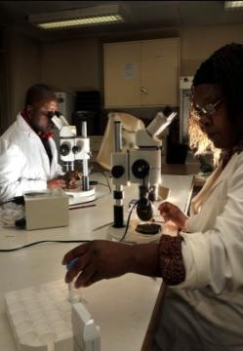
Research at BecA
I. Livestock
Improving animal health (diagnostics, … ), Zoonoses
Infectious diseases (viruses, bacteria, protozoa),
Livestock genetic resources (for improved productivity)
Small livestock development
II. Crop Improvement
Diversity studies
Marker assisted selection (productivity and stresses …)
Transformation and regeneration
III. Microbial sciences
Metagenomics studies
IV. Prevention and control of agriculture- associated diseases (food safety)
Aflatoxins (Mycotoxins)

Slide 15
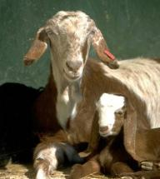
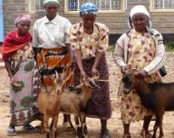
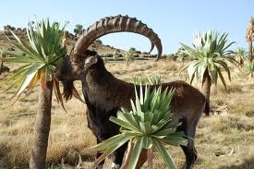
Small livestock (SL) development
Poultry, rabbits, guinea pigs, sheep, goats, pigs… are the animals of the poorest. Why?:
  Even landless can keep them (sometime they are their only asset)
  SL reproduce fast
  SL efficiently transform roughages, shrubs, kitchen waste… into highly valuable food
  Produce manure which is often the only input for crop production
  No need for big starting capitals
  Easily sold or bartered
  Highly mobile in case of crisis/disaster
  Socio-cultural value

Slide 16
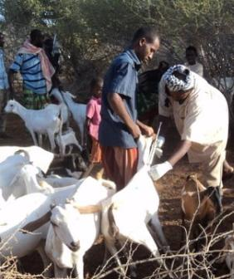
Development of Improved Control Interventions for
Peste des Petits Ruminants (PPR)
Justification: PPR is an important disease of small ruminants with challenges in vaccine delivery (cold chain,…).
Objectives:
1: To thermostabilize existing PPR vaccine
2: To pilot vaccine delivery models
Partners:
ILRI/BecA Hub
AU-IBAR
Australia: CSIRO
Pathway to impact:
Research embedded in development (ILRI and AU-IBAR) and piloting of vaccination/new institutional models will help ensure delivery of an improved vaccine.

Slide 17
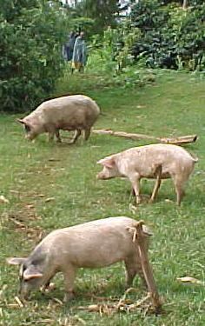
Africa Swine fever Virus (ASF)
Justification: Pig rearing has considerable potential for raising the incomes of resource poor farmers in certain African countries. But this potentially revolutionary livestock activity is threatened by ASF which is extremely lethal with a mortality rate of 50% and above.
Objectives:
1. Comprehensive epidemiological survey (ASF prevalence, virus diversity and transmission)
2. Lab-based studies: Direct link between the spectrum of clinical symptoms observed in domestic pigs in the field and variation in the viral genomes.
3. Capacity building
Partners:
ILRI/BecA, DVS (Kenya), Makerere University, MAAIF (Uganda)
LANAVET (Cameroon), CISA-INA (Spain)
Pathway to impact: Development of new tools for better control of
ASF (diagnostics, vaccine development, etc…)

Slide 18
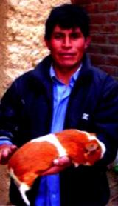
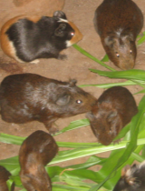
Harnessing Husbandry of Domestic Cavies for Alternative and Rapid Access to Food and Income (Cameroon and Eastern DRC)
Justification: Domestic cavies and other short cycle alternative livestock have great potential to contribute to addressing food security challenges in developing countries.
Objectives:
Generate and integrate genetic diversity data with other breeding information to design a sustainable cavies production system.
Establish cavies innovation platforms for improve production system, information dissemination and capacity building.
Partners:
ILRI/BecA Hub, CIAT (International Center for Tropical Agriculture),
Cameroon: University of Dschang and Min of Livestock, Heifer Prog International, Farmers’ Voice
DRC: Universite Evangelique en Afrique, Women for women
Australia: CSIRO
Pathway to impact: Improved husbandry practices will be disseminated for a sustainable cavies production linked to
market and consumption.

Slide 19
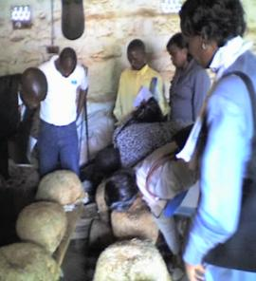
Domestication of wild edible mushrooms in E. Africa
(Nat’l Program-Led)
Justification: Income generation.
Objectives:
Collect and characterize wild edible mushrooms.
Domesticate them on agro-wastes (eg. rice straw)
Nutritionally profile domesticated varieties.
Farmer training.
Partners:
University of Dar es Salaam, Kenya Industrial Research and
Development Institute (KIRDI), University of Burundi, CSIRO, BecA Hub at ILRI
Pathway to impact:
Existing mushroom domestication and training programs at each institution will be expanded to include these indigenous varieties.

Slide 20

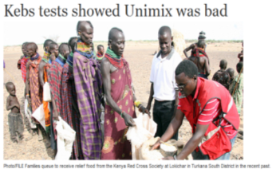
Capacity and Action for Aflatoxin Reduction in Eastern Africa (CAAREA)
Justification: Aflatoxin is a major agricultural related human health threat.
Objectives:
1. Establish mycotoxin diagnostics platform at BecA
Characterize Aspergillus flavus from around Kenya
  and Tanzania
Identify maize germplasm resistant to aflatoxin
accumulation in specific environments (field trials and
postharvest experiments)
National breeders leading field trials will affect subsequent
changes to Kenyan and Tanzanian maize breeding programs
Partners:
ILRI/BecA Hub
Kenya (KARI, UoN), Tanzania (OUT, ARI) USA (Cornell U, U Minnesota) Australia
(CSIRO, U Queensland/QAFFI, Harvest Choice)
Pathway to impact:
Platform will extend the impact by enhancing capacity to address
mycotoxins in the region.

Slide 21
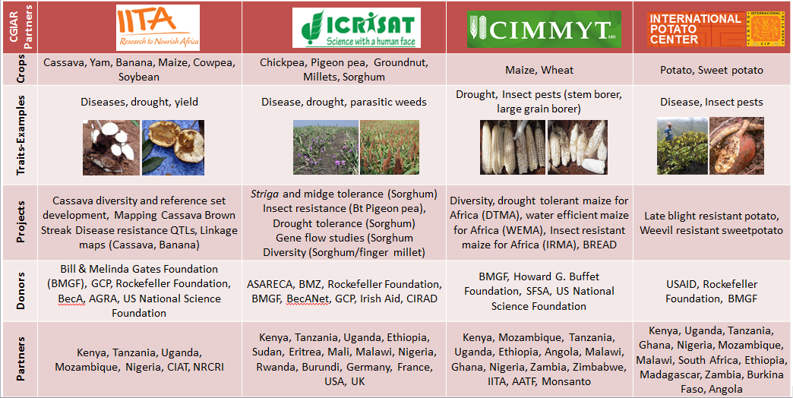
BecA Hosted Institutions Crop Research

Slide 22
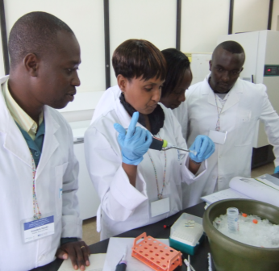
Capacity Building and Training at the Beca Hub
Objectives
Strengthen capacity of individuals and institutions to harness the latest biosciences technologies to improve agriculture in Africa
Support African scientists efforts to lead and sustain biosciences research in Africa
Promote access to world-class research and training facilities at the BecA Hub

Slide 23
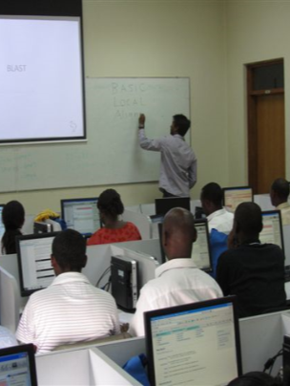
Capacity Building and
Training at the at BecA Hub
  Activities
  Research placements
    Graduate students
    Visiting scientists
  Individual/small group training
  Training workshops
  Conferences
  Institutional capacity building
  Linkages, information, creating awareness of BecA Hub
BLAST

Slide 24
Training workshops
Annual practical training workshops organised by the BecA Hub
  Science paper writing
  Introduction to molecular biology and bioinformatics
  Advanced bioinformatics
  New for 2012: Laboratory management & equipment maintenance
Hosted by the BecA Hub
  2007-2011: 42 training workshops
  Example (2011):
    Marker Assisted Breeding (ICRISAT)

Slide 25
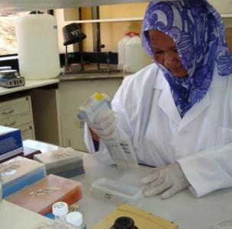
Building capacity through research
Major focus
  Post graduate research projects (up to 3-4 yrs)
      Students registered at many universities
  Visiting scientist placements (up to 6 months)
      Employees from NARIs and Universities
ABCF: African Biosciences Challenge Fund

Slide 26





Making the ABCF possible
Syngenta Foundation for Sustainable Agriculture (SFSA)
BecA-CSIRO partnership funded by the Australian Agency for International Development (AusAID)
The Bill & Melinda Gates Foundation (BMGF)
Ministry for Foreign Affairs, Sweden, through the Swedish International Development Cooperation Agency (SIDA)

Slide 27

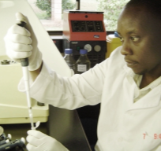
ABCF Research Fellowships
Large demand for use of BecA Hub: inadequate funds
Enable African scientists access Hub facilities and services, for high quality research addressing African agricultural problems
Researchers from national research institutes and African universities
3-6 months at the Hub
Competitive basis or targeted ‘fast track’

Slide 28

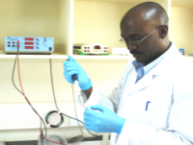






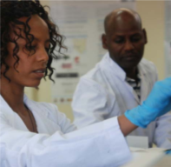


ABCF Research Fellows
Charles Masembe
Department of Zoology, Makerere University, Uganda
Pig diseases and food security: Next-generation DNA sequencing of African swine fever virus (ASFV) in Uganda
Selamawit Bedane (Haramaya University, Ethiopia)
Sisay Alemu (Holetta Agricultural Research Center, EIAR, Ethiopia)
Molecular characterization of enset from Ethiopia using banana microsatellite markers
Notes:
Dr . Charles Masembe, Senior Lecturer, University of Makerere, Uganda
Also linked with BecA-CSIRO ASFV project.
Objective: Molecular epidemiology for designing effective strategies for ASF control
Method:
Longitudinal survey of ASFV in domestic pigs (outbreaks and healthy herds)
Combination of PCR of selected genes and whole genomes and 454 sequencing
Shotgun sequencing for pathogen discovery
Results:
Inter-epidemic genetic similarity of ASFV
Similarity between epidemic ASFV and the virus carried by healthy pigs
Conclusions:
Similar source of the virus in Uganda
Different susceptibility to ASFV among pig populations?
Pathogen discovery in domestic pigs: Ndumu virus discovered: first time it has been discovered in pigs, a potential zoonotic pathogen –publication soon
Sisay (research scientist) and Selamawit (PhD student)
Enset is

Slide 29
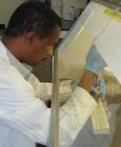








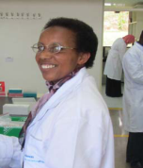







ABCF Research Fellows
Dia Hassan
Central Veterinary Research Laboratories, Khartoum, Sudan
Theileria parva genotyping to support control of East Coast fever, an emerging disease in South Sudan
Dora Kilalo
Department of Plant Science and Crop Protection, University of Nairobi
Passion fruit woodiness disease diagnostics
Notes:
Dia Hassan:
Baseline study of T. parva diversity in South Sudan, where ECF is an emerging disease, before a live vaccine is deployed in S Sudan:
Established techniques can support deployment (e.g. in finding out about breakthrough strains)
Has led to a joint project with South Sudanese, Ugandan and Tanzanian scientists –which will be supported by ABCF, and work will be done at the Hub.
Can the work be done in the home institutes? theoretically yes (using a gel system [instead of ABI Genetic Analysers], and we will be doing this as part of the next study)
Dora Kilalo
Assistant Lecturer
University of Nairobi
Dora Kilalo is an Assistant Lecturer in the Department of Plant Science and Crop Protection, University of Nairobi, Kenya. Currently, she is a graduate student who is also assisting in teaching undergraduates on Agricultural Entomology. Previously, she has served as a civil servant at the Ministry of Agriculture where her duties included agricultural extension work and the registration of new pesticides in the country. Dora is trained in crop protection and her research revolves around understanding factors causing crop damage, with emphasis on insects, and contributes toward efforts of developing management strategies
of the same.
Dora’s studies entail identification of viruses causing woodiness disease in passion fruit and evaluation of some methods of managing the viruses and their vectors. When carrying out preliminary work it emerged that it was difficult to obtain clean planting material. Therefore, some offshoot work from the studies being undertaken involve the optimization of passion fruit in‐vitro regeneration to clean and mass produce disease free planting material. In serving the community, she promotes production of fruits, African leafy vegetables and mushrooms as means of diversifying from the traditional cereal and legume production. This is because small scale farmers are so dependent on the cereals and any shortfall during a season implies food insecurity for a family, village, community, region or the Nation. In the process of doing all this, she earned a two year fellowship from Gender and Diversity‐AWARD Program from 2008. Dora has great hope for the future to apply the knowledge to efficiently identify viral diseases and their vectors and to contribute in fighting the same for improved food security and livelihoods of the small
scale farmers.
AWARD OFFERS TAILORED, TWO-YEAR FELLOWSHIPS designed to fast-track the careers of African women scientists and professionals delivering pro-poor agricultural research and development that benefits rural communities, especially women

Slide 30
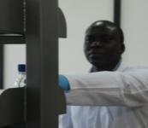



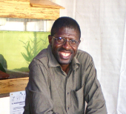







ABCF Research Fellows
Alexander Bombom
Department of Agricultural Production, Makerere University
Molecular characterization of maize-sorghum hybrids
Félix Meutchieye
University of Dschang, Cameroon
Molecular characterization of Cameroon indigenous goats and sheep
Notes:
Alex
Serendipitous discovery: Generation of maize-sorghum hybrids, now has F1, F2, F3 populations.
This is the first time this has been achieved despite numerous attempts described in the literature.
Using Sorghum (female) and Maize (male)
SSR analysis - 30 sorghum & 30 maize markers available at the BecA Hub@ILRI
Will extend his ABCF fellowship to next year, and will try a number of new expts, including using diverse maize and sorghum to check repeatability of crosses.
A unique opportunity to increase the diversity of maize and sorghum, and introduce novel traits: this work is innovative, and hopefully will lead to some interest with donors to support.
Felix
Cameroon Ministry of Livestock launched national small ruminant improvement programme in 2007
Consolidate phenotyping studies with molecular data for monitoring and exploiting existing genetic potential
Genetic diversity and phylogeny in Cameroon goats and sheep using SSRs markers and mtDNA analysis
Genetic diversity among and within Cameroon’s caprine populations (ecotypes) is relatively high, and therefore constitutes high potential for breeding programmes
This project has led to a significant small ruminant project funded through Swed Min for Foreign Affairs & SIDA, this is an example of how an ABCF fellowship can lead to a larger, well-funded project.

Slide 31
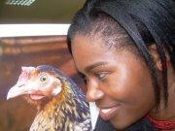
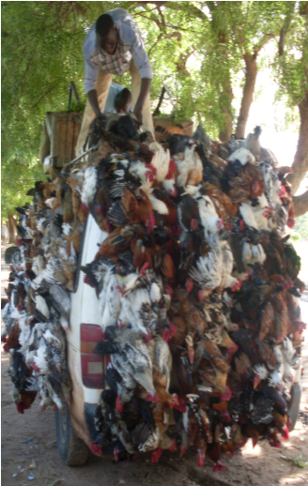





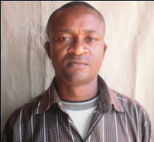







ABCF Research Fellows
Sheila Ommeh
Biosciences eastern and central Africa (BecA) Hub
Mapping mendelian traits of three chicken ecotypes in Kenya (adaptability, growth rate, egg production, …)
Christian Keambou
University of Buea, Cameroon
Molecular characterization of Cameroon indigenous chicken ecotypes
Notes:
Alex
Serendipitous discovery: Generation of maize-sorghum hybrids, now has F1, F2, F3 populations.
This is the first time this has been achieved despite numerous attempts described in the literature.
Using Sorghum (female) and Maize (male)
SSR analysis - 30 sorghum & 30 maize markers available at the BecA Hub@ILRI
Will extend his ABCF fellowship to next year, and will try a number of new expts, including using diverse maize and sorghum to check repeatability of crosses.
A unique opportunity to increase the diversity of maize and sorghum, and introduce novel traits: this work is innovative, and hopefully will lead to some interest with donors to support.
Felix
Cameroon Ministry of Livestock launched national small ruminant improvement programme in 2007
Consolidate phenotyping studies with molecular data for monitoring and exploiting existing genetic potential
Genetic diversity and phylogeny in Cameroon goats and sheep using SSRs markers and mtDNA analysis
Genetic diversity among and within Cameroon’s caprine populations (ecotypes) is relatively high, and therefore constitutes high potential for breeding programmes
This project has led to a significant small ruminant project funded through Swed Min for Foreign Affairs & SIDA, this is an example of how an ABCF fellowship can lead to a larger, well-funded project.

Slide 32
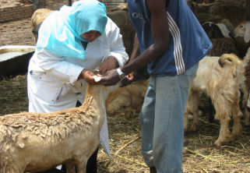
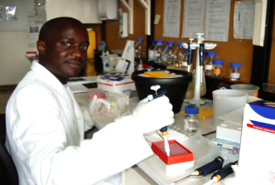
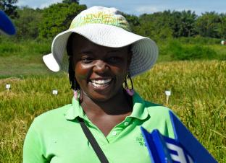
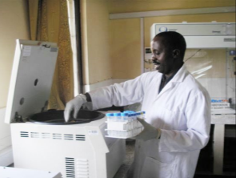
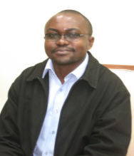
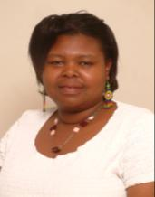
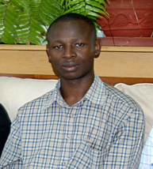
BecA Alumni :
Where are they now?

Slide 33
Research related services at BecA
Two core units
Sequencing genotyping and oligonucleotide (segolip) unit
Central Core Unit (CCU)
A state of the art genomics platform
Capillary Sequencing (ABI 3130, 3730 and 3500)
Next generation sequencer: Roche 454 pyrosequencer
A state of the art Bioinformatics platform
Genome assembly and annotation
Nutrition analysis platform (under development)

Slide 34
Segolip Unit: Current services
Current Services
a. DNA sequencing
Sanger sequencing (capillary – low to medium throughput)
Pyrosequencing (next generation – high throughput)
b. Genotyping
Full genotyping 01 (DNA extraction, PCR, fragment analysis)
Full genotyping 02 (PCR, fragment analysis)
Partial genotyping (fragment analysis)
c. Oligonucleotides

Slide 35
Segolip Unit: Current users
1. Projects at the Hub facilities
BecA activities
ILRI Biotech Theme
Hosted CGIAR crop centers
2. Generation Challenge Program (GCP): 2011 Work Order
09 countries (South Africa, The Philippines, Kenya, Ghana, Ethiopia, Uganda, India, Burkina Faso, Mexico)
10 crops (maize, rice, sorghum, cowpea, chickpeas, cassava, sweet potatoes, beans, finger millet, pearl millet)
3. Other users (African NARS, universities, international research institutes and regional programs, USA, Latin America, Middle East and Asia)

Slide 36
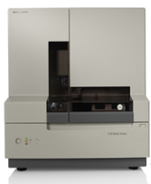



BecA Genomics Platform
Opportunities for genomics and metagenomics research
Capillary sequencing
ABI 3130-xl ABI 3730-xl ABI 3500-xl
Next generation sequencing
1 sample = 1 library
= 1 plate
500 mb/run
1/2 cassava genome
1/8 human genome
454 GS pyrosequencer

Slide 37
BecA Genomics Platform
Highlights of applications
Genomics (microbial and other organisms)
Large genomes sequencing and re-sequencing
Viral genomics (African Swine Fever, Rift Valley Fever, blue tongue virus, equine encephalitis virus)
Functional genomics
Metagenomics
Pathogen discovery, tracking and surveillance of zoonotic diseases (e.g. RVF)
Microbiome analysis; environmental metagenomics (e.g. aquatic environment)

Slide 38
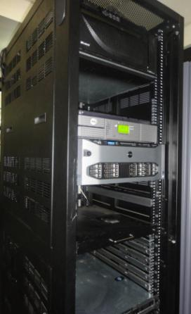
The Bioinformatics Platform
High-performance computing server:
  32 total processing cores
  128GB of memory (RAM)
  8TB of disk space
  25TB LTO4 tape backup library
Linux cluster
  32 CPUs (AMD 64-bit)
  128 Gigabyte RAM
>10 terabytes disk storage
Grid computing
Parallel applications:
  > Genome assembly (Newbler, MIRA, Celera, velvet, CAP3. …)
  > Genome annotation (glimmer, …)
  > Phylogenetic analysis (Beast, Mr Bayes)
  > Other sequence analysis tools (BLAST, clustalw, HMMER, R)

Slide 39
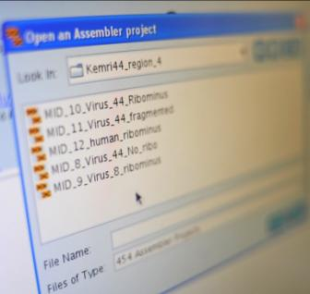
Other Platforms
Expanding our research, capacity building and service opportunities
1. Diagnostics platform (from sequence to impact):
Animal and crop diseases
2. Mycotoxin detection platform
3. Online data integration and analysis platforms

Slide 40
Key messages
1 - Uniqueness of BecA
Key player in enhancing agricultural science and technology capacity in Africa
2 - Where we are now and where we plan to go
State of the art facility for use to engage the scientific community to focus on Africa agricultural issues
3 - Investment/funding opportunities
Research
Capacity building
Product development

Slide 41
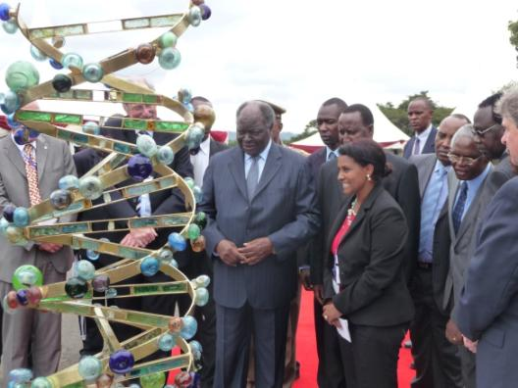

BecA in the news
Bill Gates (Dec. 2009)
The President of Kenya (Nov. 2010)
Chancellor of Germany Angela Merkel (July 2011)
More than 1,500 visitors/year

Slide 42

The BecA Hub team
08 countries, 17 females, 19 males
Australia, Benin, Cameroon, England, Ethiopia, Italy, Kenya, USA

Slide 43

Acknowledgements
The Government of Kenya
Canadian International Development Agency (CIDA)
Syngenta Foundation for Sustainable Agriculture
AusAID/CSIRO
The Bill & Melinda Gates Foundation
Swedish Ministry for Foreign Affairs
SIDA
Roche
Rockefeller Foundation
Gatsby Charitable Foundation
Doyle Foundation
Many others

