Slide 1


Experiences From PPP Models Tested Under HERAD project, Oromia Region
Restoration of Livestock Services in Drought Affected areas of
Oromia Region (RESTORE)
Dr Desalegn Jarso
Oromia Region
Public-Private-Partnership for the delivery of veterinary services
Review and validation of PPP models for scaling out
ILRIETH campus, Azage Auditorium, Addis Ababa 27 March 2025

Slide 2
PRESENTATION OUTLINE
1. Introduction
2. PPP models tested in Oromia Region
3. Partners
4. Roles of stakeholders/partners
5. Types of services provided
6. Number of Animal Vaccinated and households served
7. Perception of partners
8. Lessons and challenges
9. Recommendations for sustainability
10. Scaling out strategy and planning

Slide 3
1. Introduction
Veterinary Services Delivery in the Region
The veterinary services in the Region is delivered in two major ways
  Public veterinary services delivery
  Private veterinary services delivery

Slide 4
1. Introduction cont….
1. Public veterinary services delivery
Most of these services, except vaccination, are provided in public veterinary clinics
The service provided in the clinics does not exceed a radius of 30 kms
Therefore, The current state of public veterinary service coverage is not in line with the public needs

Slide 5
1. Introduction cont….
Animal Health service providers in the region
No | Clinic Type | Required | Available | Coverage
1 | B | 216 | 128 | 60%
2 | C | 264 | 324 | 100%
3 | D | 6419 | 2335 | 37%
 | Total | 6899 | 2805 | 41%

Slide 6
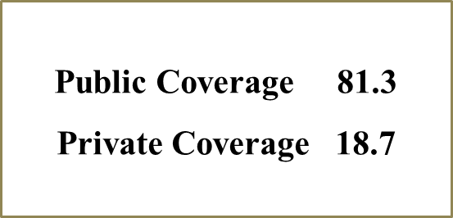
  1. Introduction cont….
2. Private veterinary services delivery
The provision of private veterinary services is largely based on drugs selling.
There are very few private practitioners that open clinics and provide services.
Similar to public, private veterinary service coverage is also low
Private Clinic | Pharmacy
324 | 696

Slide 7
1. Introduction cont….
1.3.
1.3. Relationships between public and private vet cervices providers
Treating each other as opponents rather than working together
Lack of policy that can ensure public private cooperation and collaboration
Private practitioners are limited to drug shop and in-clinic treatment

Slide 8
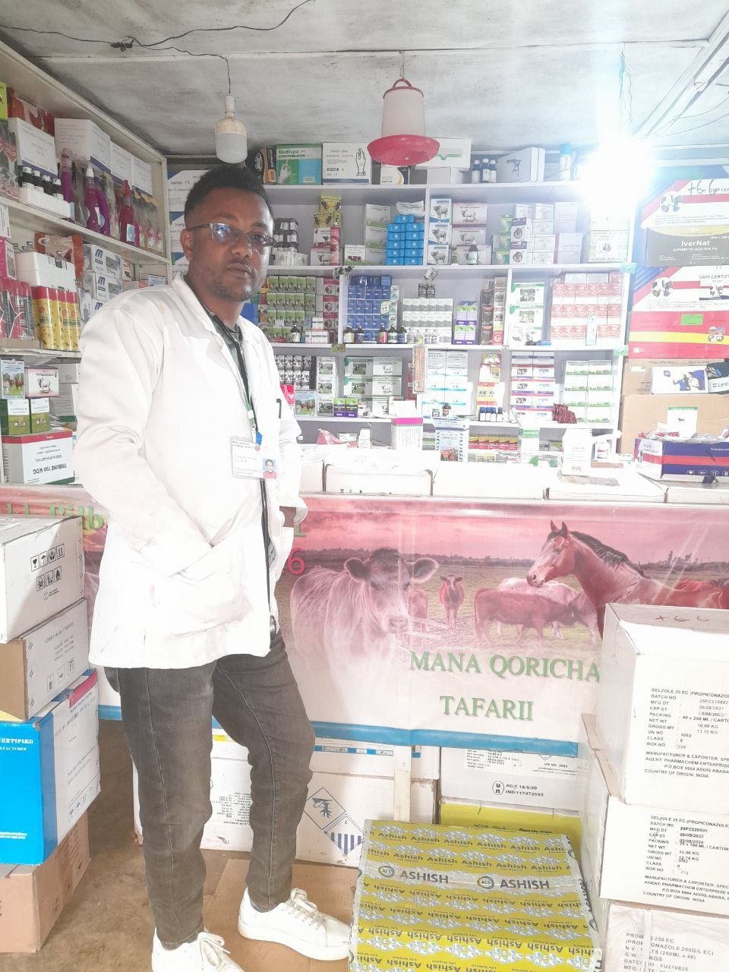
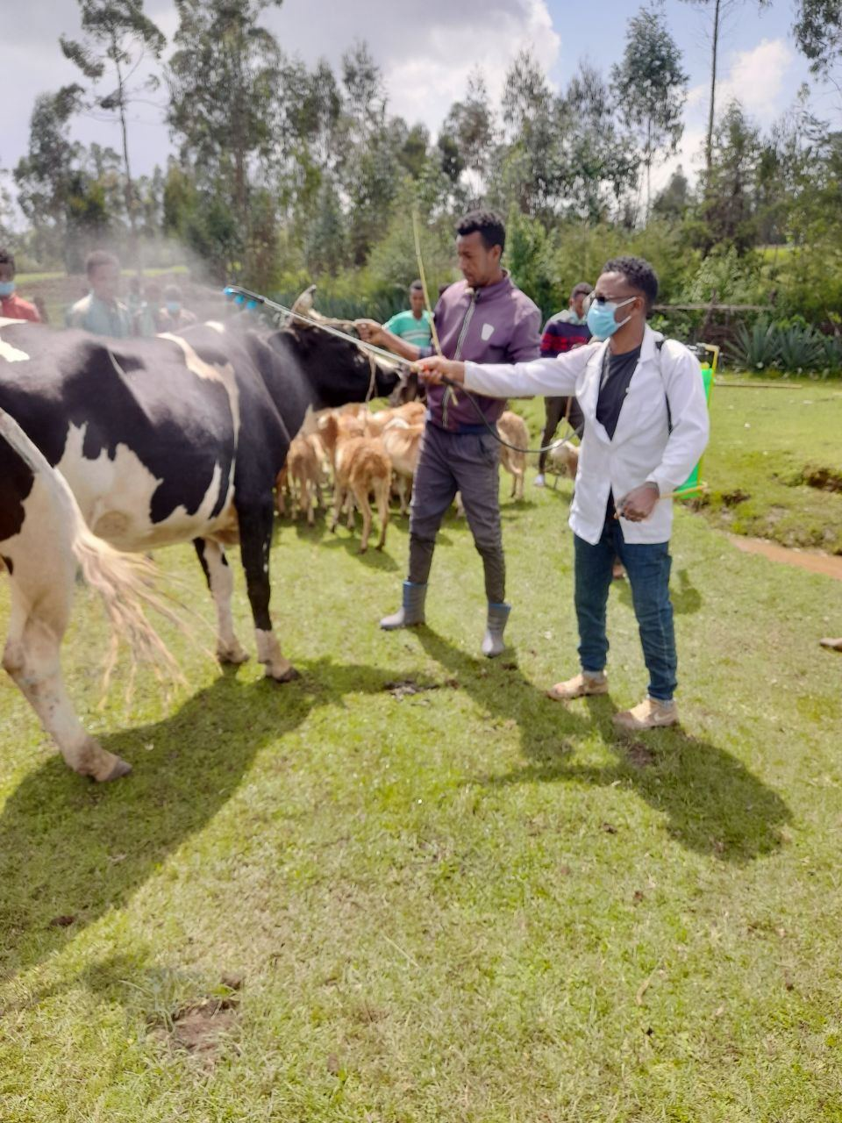
2. PPP models tested in Oromia Region
Model I: Private vaccination service:
Model IV: Mobile clinical service
Model VII: Strategic community-based endo- and ecto-parasite control by private service providers:

Slide 9
3. Model I, IV and VII Partners
Bureau of Agriculture, Oromia regional State;
International Livestock Research Institute (ILRI)-Ethiopian Veterinary Association (EVA);
Asela Regional Veterinary Laboratory (ARVL)
Dirre Inchini Woreda Administration, Agriculture office;
Negelle Arsi Woreda Administration, Agriculture office;
Teferi Kebede Private Veterinary shop
Firomsa Private Veterinary Clinic
Nageso Private Mobile Clinic;
Buze Private Veterinary Pharmacy

Slide 10
4. Roles of stakeholders/partners
Roles of Bureau of Agriculture
Recognized and support the private partner (certificates) to deliver vaccination services against the selected diseases;
Supplied the selected vaccines ahead of implementation for the privet partner
Enforced public regulations to ensure implementation of the pilot model intervention;
Provided the necessary support to the regional taskforce to closely oversee the implementation of the pilot model

Slide 11
4. Roles cont…
Collaborated on monitoring and evaluation in close consultation with ILRI/EVA and regional veterinary laboratories;
Through the Asela RVL, conducted sero-prevalence ahead of the commencement of the pilot intervention and sero-conversion after the pilot intervention for the selected diseases;
Submitted findings of the diagnostic surveys to ILRI/EVA after the completion of the surveys;

Slide 12
4. Roles cont…
2. Role of ILRI/EVA
Provided the necessary diagnostic Kits to conduct laboratory diagnosis for pre-and-post intervention surveys;
Covered authorized costs for private partner upon provision of legal vouchers collected from livestock owners;
Provided awareness creation and/or trainings relevant to the intervention
Conducted monitoring and evaluation of the pilot model intervention, with support from BoA and with active participation of “Regional Laboratory”;
Covered all authorized, pre-agreed costs which are incurred by the regional laboratory during diagnostic surveys

Slide 13
4. Roles cont…
3. Role of Woreda Agriculture office
In collaboration with “the Bureau”, enforced public regulations associated to the implementation of the pilot intervention;
Facilitated supply of vaccines, transporting and storage facilities
Provided vaccination calendar and associated information to the private sector,
Played leading role in the mobilization of the communities during vaccination campaigns, data collection, awareness creation, cost-recovery strategies of vaccination,
Strongly collaborate with ILRI/EVA, the Bureau and RVL during monitoring vaccination campaigns, and pre-and post-intervention surveys;

Slide 14
4. Roles cont…
4. Role of Teferi Kebede Private Veterinary Shop
Provided vaccination services against (Ovine and Bovine Pasteurellosis) to farmers on the days of vaccination campaign;
Provided periodic report and other necessary information and of the vaccination campaign to the woredas agriculture office;
Provided voucher to ILRI/EVA, receipt, relevant attachments and other necessary information before the issuance of authorized payments;

Slide 15
4. Roles cont…
5. Role of Nageso Private Mobile Veterinary Clinic
Provided mobile clinical services to livestock owners, through a door to door service delivery method;
Provided vaccination services against (Anthrax, Blackleg and Bovine Pasteurellosis) to farmers, based on pre-arranged mutual consent with the public sector
Provided periodic reports and other necessary information and of the vaccination campaign to the woredas agriculture office;
Provided voucher, receipt, relevant attachments and other necessary information to ILRI/EVA before the issuance of authorized payments;

Slide 16
4. Roles cont…
6. Role of Buze Private Veterinary Pharmacy
Supply the necessary veterinary drugs, formulations, supplies and equipment to Nageso, based on negotiation between the two parties;
Facilitate transportation issues for timely stocking of veterinary drugs from authorized and reliable pharmaceuticals supplier/s;
Share experiences and best practical lesson to Nageso in the area of input supply, customer care, business expansion and management, etc.

Slide 17
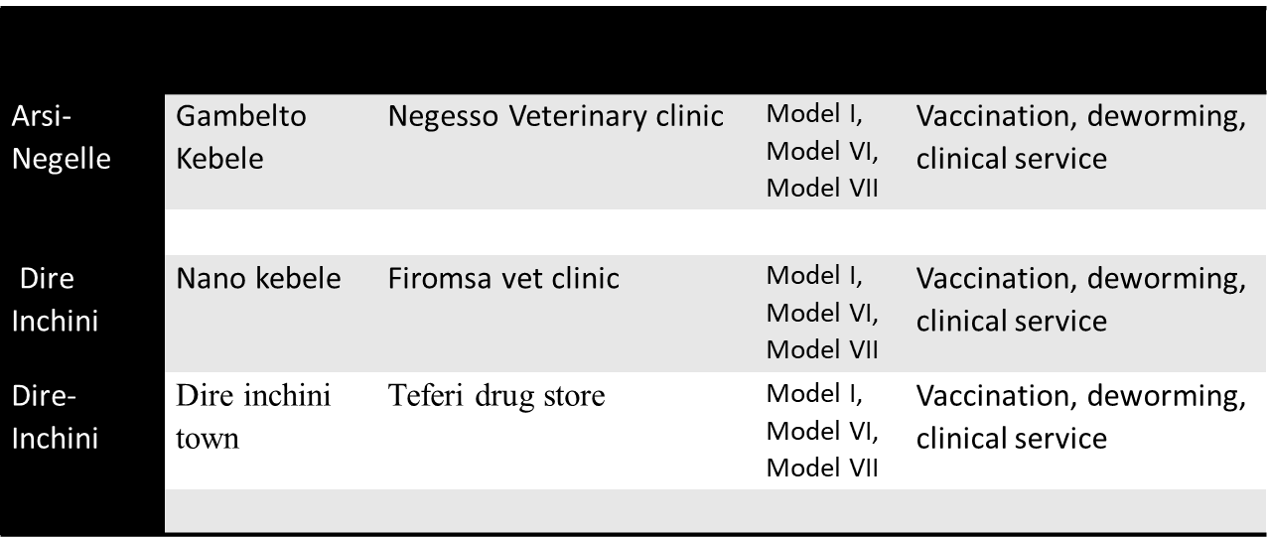
5. Types of services provided

Slide 18
6. No of Animal Vaccinated and households served
PPP model | Service | Negelle-Arsi |  | Dirre Inchini |  | Total
 |  | #Animals | #HHs | #Animals | #HHs | #Animals | #HHs
1) Model-I: Private vaccination | Cattle ( 4 diseases) | 34,319 |  | 23611 |  | 57, 930
 | Shoats (2 diseases) | 21,968 |  | 20551 |  | 42,519
 | Equine | 0 |  | 1500 |  | 1500
 | Poultry | 0 |  | 3000 |  | 3000
 | Total vaccination | 56,287 | 39,142 | 48,662 | 21,429 | 104,949 | 60,571

Slide 19
6. No Animal Vaccinated and households served
PPP model | Service | Negelle-Arsi |  | Dirre Inchini |  | Total
 |  | #Animals | #HHs | #Animals | #HHs | #Animals | #HHs
2) Model-IV: Mobile clinical services | Bovine, Shoats, Equines | 91,889 |  | 16221 |  | 108,110
 | Total | 91,889 | 34,308 | 16,221 | 0 | 108,110 | 34,308

Slide 20
6. No Animal Vaccinated and households served
PPP model | Service | Negelle-Arsi |  | Dirre Inchini |  | Total
 |  | #Animals | #HHs | #Animals | #HHs | #Animals | #HHs
3) Model-VII: Endo (Ectoparasites) control | Bovine-deworming | 54,164 |  | 89,426 |  | 143,590
 | Bovine-spraying | 2,974 |  | 16,236 |  | 19,210
 | Shoats-deworming | 16,730 |  | 74,284 |  | 91,014
 | Shoats-spraying | 3,984 |  | 6,594 |  | 10,578
 | Sub-total | 77,852 | 26,109 | 186,540 | 43,851 | 264,392 | 69,960
 | Overall Total | 226,028 | 99,559 | 251,423 | 65,280 | 477,451 | 164,839

Slide 21
7. Perception of the partners
Livestock keepers have high need for three of the services
  Require high productive cows
  Need to have healthy animals
  Easily accessed
Farmers willing to pay for services, including for services previously provided for the free models
The private service providers say they were profitable with all the three services
scan0198.pdf

Slide 22
7. Challenges
Security problem in the region
There was a dispute among The private service providers and ILRI/ EVA regarding payment
Initially, there was lack of coordination between the OBoA and ILRI/EVA.

Slide 23
8. Lessons learnt
Created strong linkage between the public and private sector
We observed that taskforce created sustained collaboration between stakeholders
Bureau of Agriculture and woreda offices providing full support
The PPP implementation framework contributing to future implementation
Farmers were willing to pay for services, including for services previously provided for free
Community-based ectoparasite control helped users (more than usual)

Slide 24
9. Recommendation
The Agriculture bureau need to own the project initiations and incorporate into the region’s development plan
The PPP taskforce need to continue as a platform for interaction between the public and the private sector
There should be more alternative arrangements (farmers to pay full cost) of PPP models should be developed

Slide 25
9. Recommendation cont…
Continue to engage the private sector in community-based vaccination, ectoparasite control and mobile clinic service which contributes to sustained reduction of disease infestations (linking regional and woreda service providers, Model I, VI and VII)
  Transfer some of the veterinary services to private practitioners
Devise cost-recovery mechanism in the region to ensure sustainable provision of veterinary services at cost

Slide 26
10. Scaling out strategy and planning
The region has planned to implement cost-recovery mechanism in the region to scale out the PPP models
Collaborations with ILRI/EVA on RESTORE PPP will continue as before.
We will develop an action plan together

Slide 27
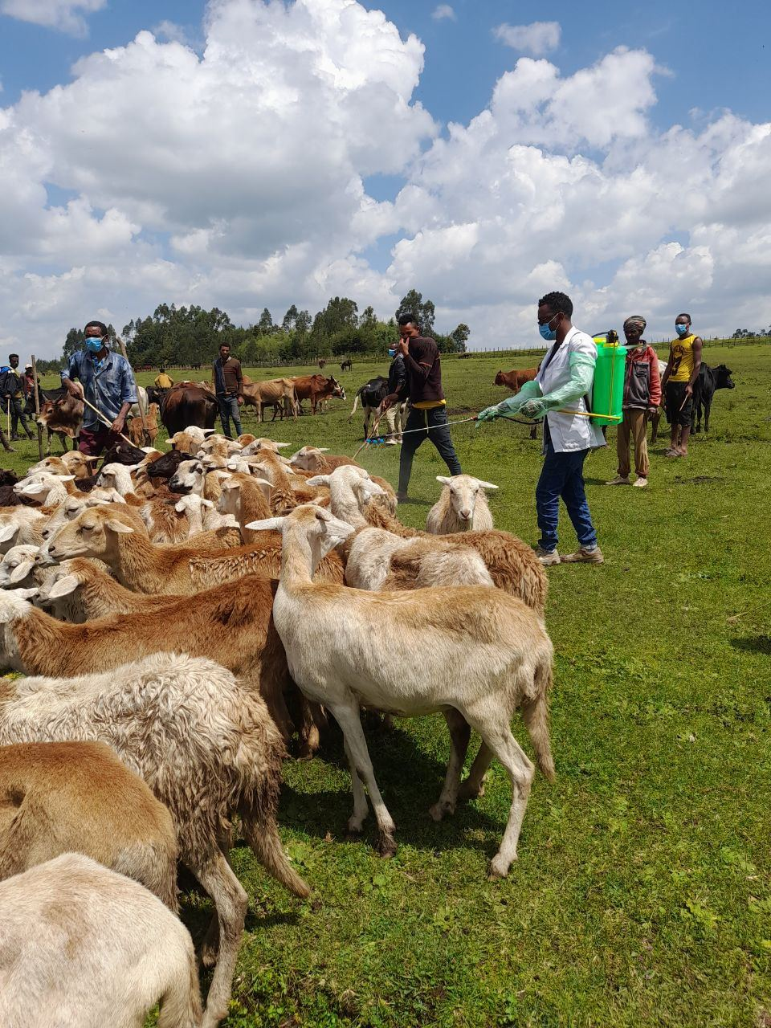
Thank You

