Slide 1
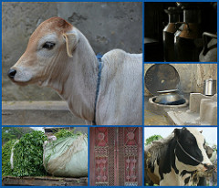
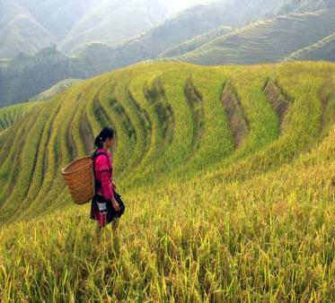
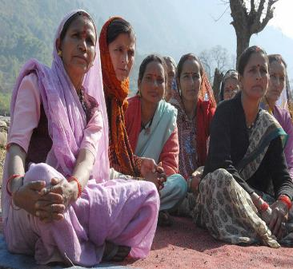




Innovation platforms for agricultural development case studies
- The MilkIT innovation platform in India -
Notes:
There MUST be a CGIAR logo or a CRP logo. You can copy and paste the logo you need from the final slide of this presentation. Then you can delete that final slide
To replace a photo above, copy and paste this link in your browser: http://www.flickr.com/photos/ilri/sets/72157632057087650/detail/
Find a photo you like and the right size, copy and paste it in the block above.

Slide 2
Objectives of the session
Key themes covered
Institutional innovation: Productivity innovation.
Multi-stakeholder participation.
Well-designed platform innovation functions leading to impact.
Key learning outcomes
1. Use a real life case to understand how an IP created productivity innovations in dairy farming by boosting market linkages and improving feedstock.
2. Understand how to create grassroots-powered IPs through well-designed platform functions.
3. Learn how IPs can facilitate multi-stakeholder participation and engagement, in order to create robust Innovative Platforms that solve complex challenges.
4. Discuss how collaboration and communication between multiple stakeholders can be increased to create positive outcomes within an Innovation Platform (IP).

Slide 3
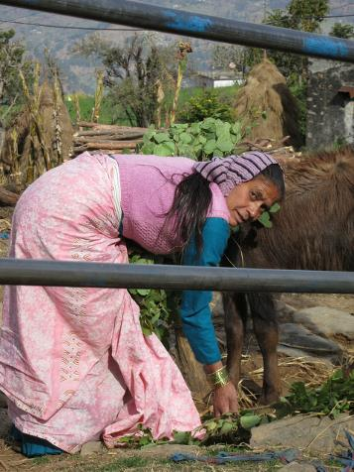
Introduction: What’s this case about?
Who is our protagonist?
What keeps her up at night?
Notes:
Introduce the Case through the protagonist—Tulsi Devi. Ask the question: what keeps her up at night? This helps frame the central narrative and dilemma of the case.

Slide 4
Tulsi Devi
Tulsi Devi is a 39-year-old widow from Uttarakhand, India.
She was left with just 2 low-yielding dairy animals after her husband’s death and was far removed from the markets.
Before the MilkIT IP, she struggled to pay school fees for her children and even had to send her 15 year old son away to a bigger city to find work.
After joining the MilkIT IP, she was able to generate a regular income and send her children to school.
Notes:
Our protagonist is Tulsi Devi, a beneficiary of the MilkIT Innovation Platform (IP).
Tulsi Devi is a 39-year-old widow from the Baseri village in the Himalayan hills of Uttarakhand, India.
After the death of her husband, she was left with just one cow, a buffalo and barely enough land to grow crops to feed her family. She was far off from the local market, making it impossible for her to sell any surplus milk. Seeing no other option, she sent her eldest son, who was only 15, to Delhi to work in a factory and struggled even to send the rest of her children to school.
After joining the MilkIT IP, she was able to generate a regular income and send all her children to school. Te IP helped her sell more milk and gave her a source of regular income.

Slide 5
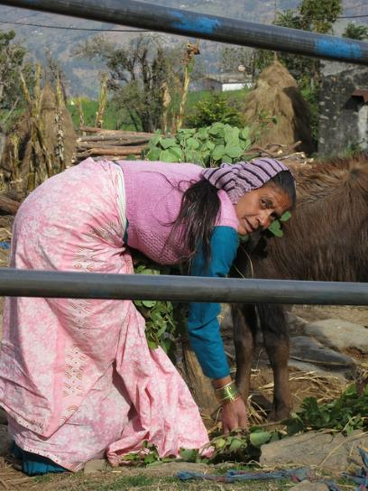
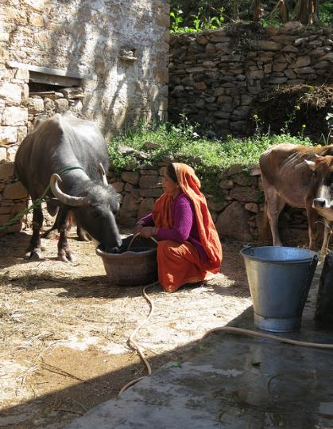
Many others like Tulsi Devi
Notes:
Mostly women worked in dairy farming and got little or no cash income
There are many other women like Tulsi Devi, whose lives and livelihoods have been transformed by the MilkIT IP.

Slide 6
Two problems the MilkIT IP set out to solve
Two reasons for this:
  Poor quality livestock feed meant low milk yield.
  Farmers lived in remote villages thus incurring huge costs for transporting and selling milk to markets.
Past solutions had been poorly adopted because they had not catered to women and had not connected farmers to markets.
Notes:
Why were women like Tulsi Devi not able to earn a decent living despite having assets (cows) that produced milk?
There were two key reasons for this low income. First, poor quality livestock feed in the region led to low milk yield. Second, these villages were far away from milk buyers so dairy farmers faced huge costs for transporting milk.
Past efforts to solve these two problems of low yield and high costs had not catered to the specific needs of the women, who are a majority in the Uttarakhand dairy industry. These solutions had also not done much to connect farmers to markets and were thus poorly adopted.

Slide 7
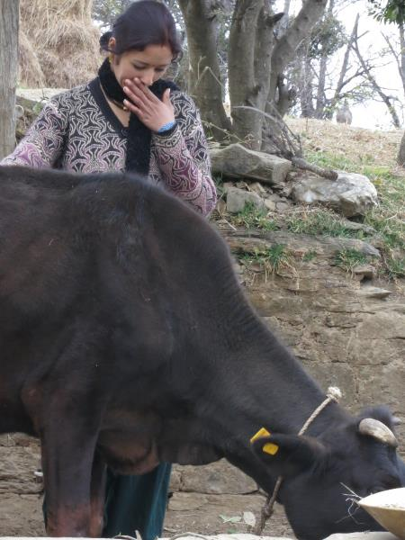
A dairy farmer in Uttarakhand
Notes:
24-year-old Anita Fartiyal tends to her milk buffalo in a village in Lambgara Block, Almora District, in India's northern state of Uttarakhand

Slide 8
Insert questions
Each facilitator can pick MCQs, discussion questions or class activities, based on the needs and level of the learners, from the exhaustive list provided in the Teaching note.
We have placed this slide here as a reminder to modify the deck to include questions as slides, to enhance the overall learning experience.

Slide 9

Formation of the IP
The MilkIT IP was formed by ILRI.
Beginning of 2013
Covered 1,244 families in Himalayan region of Uttarakhand.
Main beneficiaries were women.

Slide 10
MilkIT’s impact
Leveraged multi-stakeholder engagement and participatory action research to implement two solutions, developing market linkages and improving dairy feed, that boosted milk sales.
Increased income for over 600 households.
Empowered women to earn a regular income.
Facilitated better collaboration and engagement among local development stakeholders.
Notes:
The Impact of the MilkIT IP
The IP leveraged a multi-stakeholder strategy and participatory action research to identify two efficient approaches for dairy development--developing market linkages, and innovating with dairy feed.
This boosted milk production and sales.
As a result, over 600 households in Uttarakhand increased their income
The major beneficiaries were women, who were empowered to earn a regular income through their assets (cows).
In the process of empowering dairy farmers, the IP also facilitated better collaboration among local development institutions and influenced key policy makers in the region.
The Importance of the MilkIT IP case (aka WHY should we study the MilkIT case?)
The MilkIT IP case study not only presents valuable lessons for the dairy industry, but also highlights the best practices of multi-stakeholder participation, detailed documentation and robust facilitation that are crucial for the success of any innovation platform. Thus, studying the MilkIT IP case can be a source of learning and reflection among IP practitioners and development stakeholders.

Slide 11
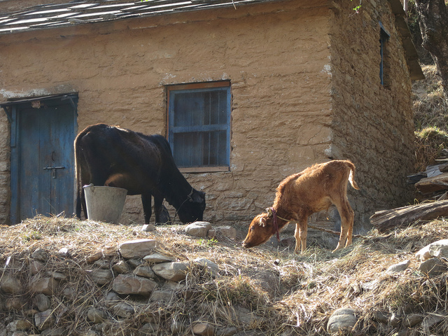
Cows in Uttarakhand, India

Slide 12
How MilkIT designed a robust IP
Harnessed the power of collective action by forming village clusters.
Involved multiple stakeholders for whom MilkIT’s goals were a strategic priority.
Conducted village outreach and training sessions to involve more farmers intimately.
Clearly documented and shared all meetings to boost trust and transparency.
Notes:
The Story of how well-designed platform functions created a grassroots-powered IP
The starting point for setting up the MilkIT IP was organizing several villages into units called clusters, to leverage the power of collective action. Private stakeholders, who would not have paid attention to individual villages, were now attracted to the strength in numbers of village clusters.
The second crucial step was including multiple stakeholders for whom the MilkIT IP would be a strategic priority. The IP conducted detailed interviews with diverse stakeholders, including Government, private development organizations and NGOs. They also looked at the intervention history of the last decade to select actors who would have a direct stake in dairy development.
They held a variety of meetings (core IP meetings, follow-up meetings at village level and participatory training sessions) to reach a larger number of farmers as not all farmers could attend the regularly scheduled IP meetings. These outreach meetings in villages invoked a sense of ownership and participation amongst farmers. As a result, more farmers understood implications of key issues, took informed collective decisions and communicated with the IP more intimately. These meetings also built the capacity of farmers to apply and adopt new technologies. Much of the success of the MilkIT IP can be traced back to these grassroots meetings.
Lastly, the IP documented all meetings in great detail and shared them on an online platform for multiple stakeholders to access. This made the IP's workings transparent, and boosted the trust of its members. Clear documentation is crucial for laying the groundwork for a robust IP.

Slide 13
Constraints and solutions
Challenge 1: Long distances, low yield and lack of market linkages
Solution 1: Formed a self-help cooperative to boost market linkages
Solution 2: Boosted financial support to farmers
Solution 4: Attracted the private sector
Solution 3: Overcame power dynamics and taboos
Notes:
Constraint 1: Long distances, small yields and lack of sales opportunities [15 mins]
Long distances between villages raised the transaction costs for transporting and selling milk.
Each producer kept only a few dairy animals, with low yields.
Their only option for selling milk had been the State dairy cooperative 'Aanchal,' however this option too had become unfavourable due to management and pricing issues created by Aanchal.
Solution 1: Forming a self-help cooperative to boost market linkages
Farmers set up their own independent, self-help cooperative known as the Jeganath dairy cooperative.
The cooperative, which was started in April 2013, covered 8-10 villages and quickly grew to over 100 farmers in just six months.
From establishing a physical stop to contracting a vehicle for milk delivery, the farmers took many steps to develop market linkages.
They also elected group secretaries in each village, who received monetary compensation as an incentive for collecting milk.
Solution 2: Boosting financial support to farmers
Using the power of collective bargaining, the IP was able to get credit for its members to buy higher-yielding animals.
This credit was based on group liability instead of asset liability.
It was only due to robust facilitation that the IP was able to match creditors with lenders and implement an effective financial solution.
Solution 3: Overcoming power dynamics and taboos
Distorted power dynamics and existing social constraints can inhibit innovation in an IP, which is why it is important to counteract these in innovative ways.
MilkIT IP overcame taboos, local issues, hierarchy and social norms that were holding its members back by making practical changes (like changing the venue of its meetings).
Solution 4: Attracting the private sector
Due to the financial support to purchase cross-bed cows, the IP members were able to boost their yield and negotiate robust deals to sell their milk to private traders.
Farmers also leveraged their bargaining power to get wholesale prices for feed from a private feed company.

Slide 14
Constraints and solutions
Constraint 2:
Fodder scarcity
Solution 1: Reduced Wastage through participatory action research
Solution 2: Increase fodder production through dual purpose crops
Notes:
Constraint 2: Fodder Scarcity
Dairy farmers faced regular fodder shortage due to reasons like variable rainfall, wastage and lack of alternative feeding practices.
Solution 1: Participatory action research−how to reduce wastage
The IP interviewed key farmers and development actors to analyze the past interventions made in the region and discovered that many previously-distributed solutions were lying unused in farmers' homes.
Through participatory research, the IP developed its own low-cost, simple tools to improve feeding practices and lessen the burden on women.
IP facilitators did not impose these technologies on farmers, which could have had an adverse effect on adoption rates. Instead, they sought to promote joint learning-- a prerequisite for successful innovation--and showcased benefits of the tools through participatory trials and publicity campaigns.
Solution 2: Increase fodder production through dual purpose crops
The IP used demonstration plots to showcase some suggestions from its technical partners, like dual-purpose cereal crops, to improve the availability of green forage in the off-season. These real-life demos led to widespread adoption by farmers.

Slide 15
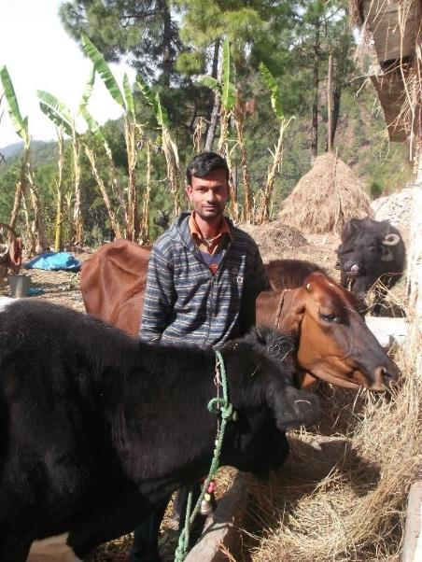
Impact of the MilkIT IP
Mahesh Tiwari , 23, doubled his income through Jeganath dairy cooperative.
Was thinking of leaving for Delhi to find work.
Joined Jeganath cooperative and got a subsidized loan from NABARD.
Purchased new cows and now earns INR 12,000−15,000 per month (USD 200−220), twice his factory wages.
Another MilkIT beneficiary Devki Devi says: ‘Now I earn more than 1500 rupees per month through transport of milk from my village to road. This income is helping me to get nutritious food for my kids and builds my confidence.’
Notes:
These most significant change (MSC) examples enhance the impact stories and emphasize the human angle of the IP's work.
Mahesh Tiwari’s Story
Mahesh Tiwari , 23, doubled his income through the Jeganath dairy cooperative. For 2 years he was working in a Delhi factory after leaving school. Although his village was not selected for this project he started participating in the Bageshwar IP meetings. He soon joined the Jeganath Co-operative formed after the initial meetings. The new business opportunities led him to reconsider his plan to work in Delhi to support his family. Instead, he applied for a loan from Aanchal to purchase crossbred cows. This was refused but NABARD, the national development bank, agreed to provide a loan with subsidised interest. He purchased two crossbred cows and built a cattle shed with technical support from the KVK, the national extension organization. Currently, he has increased his herd through purchasing 2 more cows with savings from his milk sales over the past 14 months. He is currently earning INR 12,000−15,000 per month (USD 200−220), twice his factory wages. He can be seen as an informal innovation champion (Klerkx et al., 2010), stimulating other farmers to engage in the dairy business as a livelihood option after seeing his success.

Slide 16
Impact of the MilkIT IP
Increased income, employment & savings
Over 100 farmers earn between INR 600 to 6000 per month selling milk.
Most income goes to women who invest in their children’s education.
7 people are directly employed in milk selling.
In Sult, over 100 households use dairy collection centres.
Families attending IP meetings saved 5 times more than other families.
Farmers attending IP meetings fed animals improved forage for 50 days compared to 12 days for non-participating households.
Increased communication between stakeholders
The IP identified producer representatives and communicated feedback of IP meetings back into villages through them.
Women had unprecedented opportunity to communicate with higher-level officers of stakeholder institutions.
Stakeholder institutions could efficiently engage with larger groups of development-oriented smallholder producers through the IP.
Notes:
Impact of the MilkIT IP [15 mins]
Two areas of impact:
Increased Income, Employment and Savings
Facilitated greater communication between stakeholders (created institutional change)
However, there are some limits to the impact. State level actors still did not engage with the project and stakeholders did not take initiative to collaborate with each other.
Increasing communication is an important goal of an IP, so facilitators may choose to linger on this topic.

Slide 17
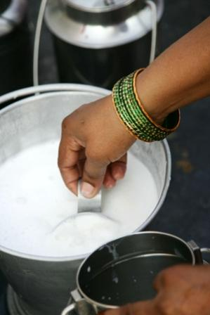
Factors that contributed to impact
Desire of smallholder producers to generate income through dairy production.
Supportive institutional landscape.
Introduction of complementary technologies.
Notes:
Desire of smallholder producers to generate income through dairy production
For IPs to function well, the motivations of its stakeholders need to be aligned with the aims of the IP.
Supportive Institutional Landscape
IPs need the support of other institutions and stakeholders including government bodies to adopt and share the technologies, interventions, resources and approaches identified by the IP.
The Case suggests that financial institutions had as significant a role in stimulating change as any other development organization.
This will likely hold true in many other situations where upfront credit and investment is required to grow assets or improve productivity.
Introduction of complementary technologies
The introduction of cross-bred cows enabled a huge boost in productivity, which showcases how beneficial it can be when active stakeholder institutions introduce complementary technologies, inputs and services.

Slide 18
Future and forward linkages
The animal husbandry (AH) department adjusted its policy to support construction of fodder troughs, grassland improvement and improved buffalo breeding.
Organizations like the AH department and IFAD loan projects are interested in promoting the adapted fodder chopper and feed troughs.
Stakeholder NGOs and the AH department have widely acknowledged the potential of dual purpose crops.
Aanchal is looking into wider application of how the village co-operative regulations adapted to the local situation. It is also looking at improved targeting of potential supplier communities and realizes that improved monitoring and transparency of payment systems is required to regain the trust of smallholder producers.
Notes:
More important than specific interventions is the process of deriving and implementing interventions. Re-emphasize how MilkIT’s well designed platform functions enabled it to create impact.
Because it kept all stakeholders actively informed and engaged with the process of change, many stakeholders created forward linkages to carry on its work. These technologies and institutional changes including the following:
The animal husbandry (AH) department has adjusted its policy formulation to include support for construction of fodder troughs, grassland improvement and improved buffalo breeding.
Various organizations such as the AH department and IFAD loan projects have expressed their interest in promoting the adapted fodder chopper and feed troughs.
The potential of dual purpose crops has been widely acknowledged by stakeholder NGOs and the AH department.
Aanchal is looking into wider application of how the village co-operative regulations adapted to the local situation. It is also looking at improved targeting of potential supplier communities and realizes that improved monitoring and transparency of payment systems is required to regain the trust of smallholder producers.

Slide 19
Takeaways: Content matter
Institutional changes in milk marketing provided a major incentive for farmers to invest in feed and breed improvements despite the associated higher input costs.
In regards to feeding, simple interventions like fodder troughs and concentrate feedings, resulting in near-immediate benefits, were more attractive to farmers initially than more complex packages with longer time horizons (such as grass-land development).

Slide 20
Takeaways: Process
Actual changes differed considerably between the platforms, thus highlighting that the platforms should be left free to decide which interventions to prioritize.
It is important to support interventions through consistent documentation if they are to have wider acceptance.
It is crucial for IPs to enable farmers to have their voice heard, which will lead to more efficient development efforts.
The longer-term effects of IPs are chalked down not to any specific intervention but to better communication and collaboration between the various stakeholders.
IP partners have identified certain key lessons from the projects and are changing their own activities and approaches while investing in wider dissemination, thus creating massive out-scaling potential.

Slide 21



