Slide 1
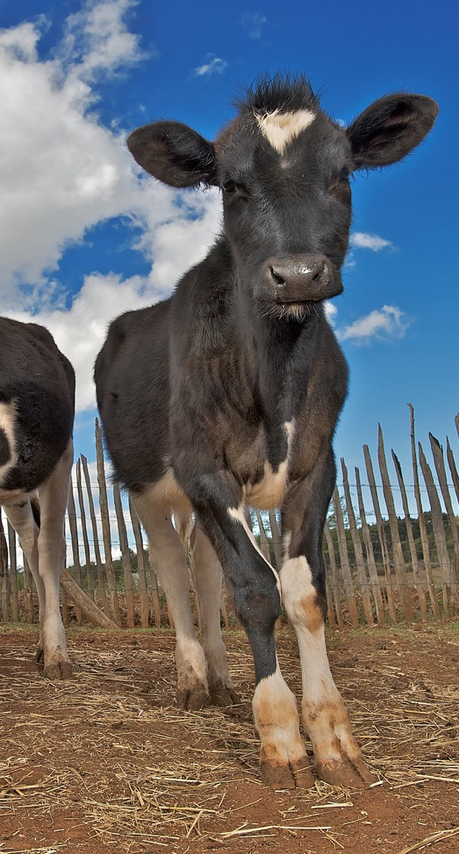
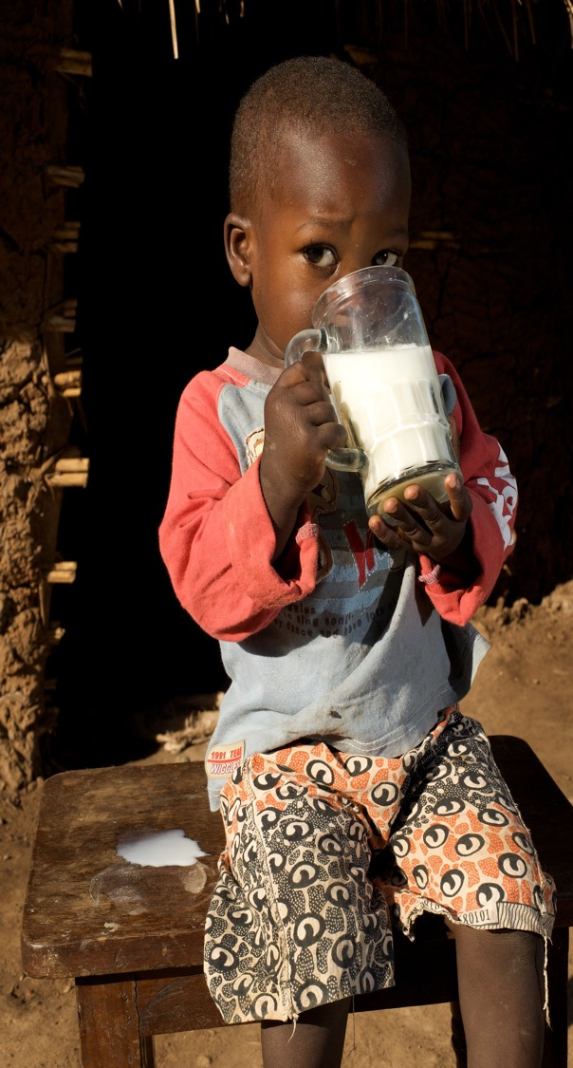
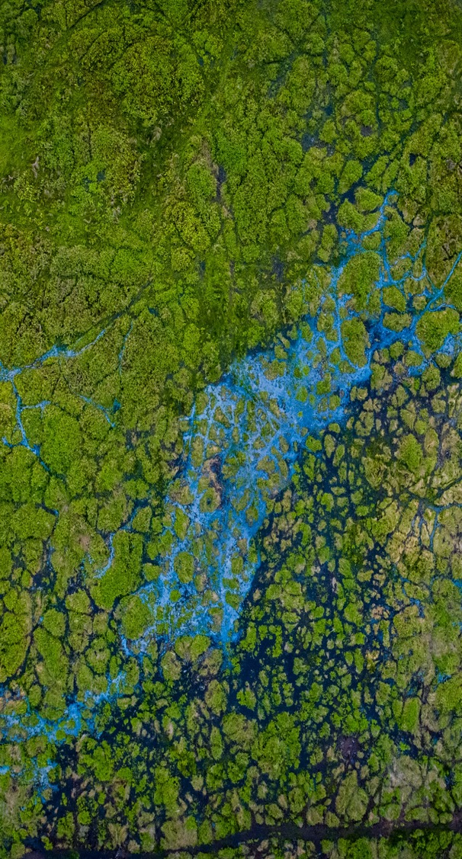
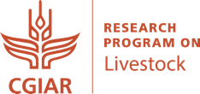
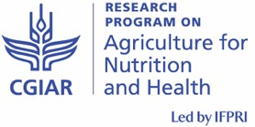
CRP Soundbites:
COVID-19 and One Health
John McDermott, Director
CGIAR Research Program on Agriculture for Nutrition and Health
Thomas Randolph, Director
CGIAR Research Program on Livestock Agri-Food Systems
Based on a presentation
to the CGIAR System Council workshop on COVID-19
12 June 2020

Slide 2
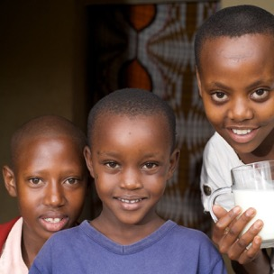
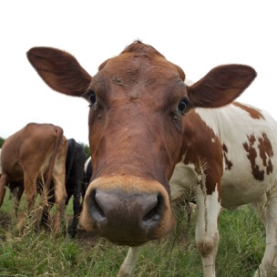

CGIAR research relevant to Covid-19
Challenge of protecting food systems from emerging disease
  Reduce public health risk of spill-over events
  Avoid demonizing market systems the poor rely on
CGIAR has responded with research to:
  Understand agriculture-related drivers of emerging disease
  Better disease diagnostics, vaccines, and surveillance
  Strengthen biosecurity
  Improve food safety
  Focus on informal systems in public resource-constrained contexts
Applying the One Health approach
  Preventing zoonoses and potential pandemics: HPAI (bird flu), MERS, swine flu, Rift Valley fever
  Promoting cross-sector institutional innovation to be cost-effective
  Embodied in A4NH and Livestock CRP shared agenda
human
One Health
animal
environment
CGIAR is uniquely positioned and actively promoting One Health in lower- and middle-income countries
Photos: Cow and children by Neil Thomas/EADD; Faizal Abdul Aziz/CIFOR

Slide 3

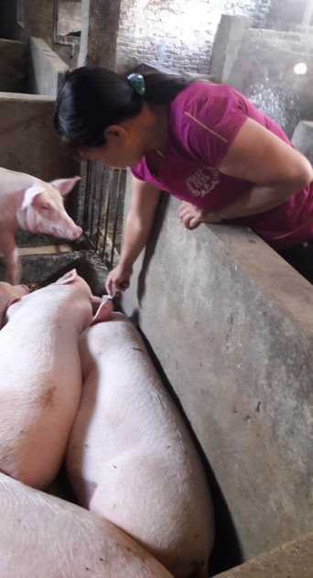


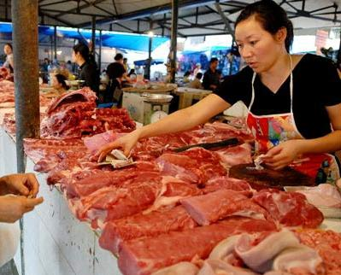
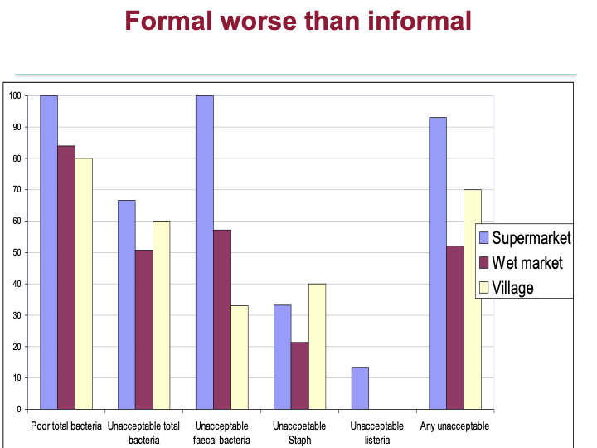
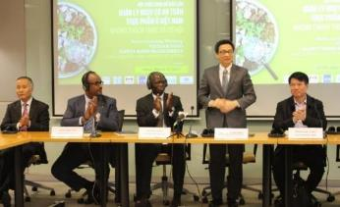
CGIAR working to make pork food systems safe in Vietnam
Training and cutting board technology reduces risk in wet markets
Pork sold in wet market safer than in supermarket
Bio-security
on-farm
Simple technology to improve hygiene in small-scale slaughterhouses
Deputy Prime Minister announces major investment to roll out food/pork safety recommendations

Slide 4
CGIAR in current response and looking forward
Immediate actions
  ILRI Nairobi laboratory temporarily re-purposed and processing Covid-19 tests for Kenya Ministry of Health
  ILRI-CIAT team advising Ethiopia Ministry of Health on pooled sampling and targeting methodologies to increase testing efficiency and reduce cost
  ILRI contributed excess supercomputing power to model protein structures in Covid-19 vaccine discovery effort
  Exploring opportunities to support rapid training of national lab technicians
  Ongoing and planned surveys incorporating harmonized data tool to monitor impact on households and value chains; capture role of livestock assets in household and community resilience with a gender lens
  Directly advising various donors and international partners (e.g. WHO, OIE)
Establishing and consolidating capacity to contribute even more
  CGIAR AMR Hub established at ILRI in Nairobi in 2019 leading efforts on role of agriculture
  One Health Research Outreach Awareness Centre for Africa currently being established at ILRI in Nairobi
  New multi-sectoral partnership established with UNEP– joint rapid assessment report on environment perspective in One Health approach to reducing future pandemic risk [July 7th]

Slide 5
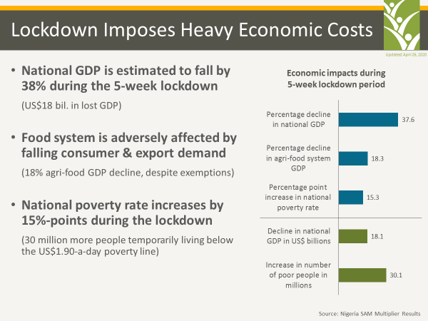
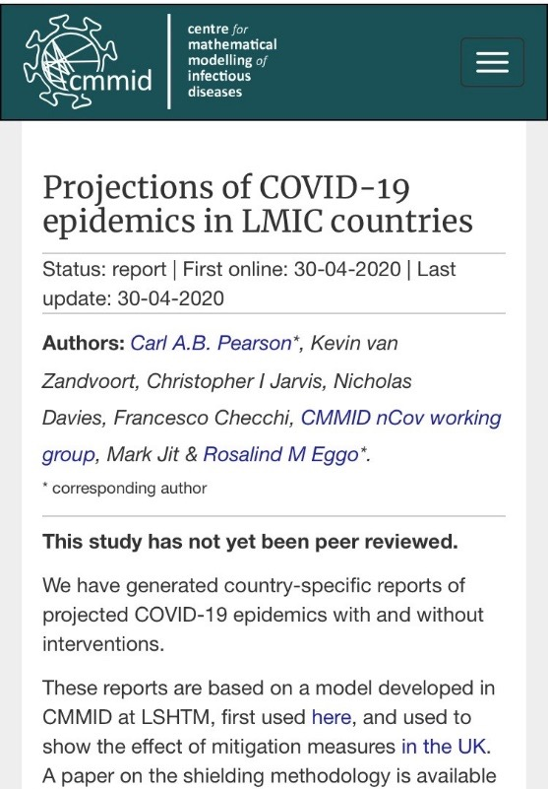

COVID-19: Aligning Health, Food and Socio-Economic Actions

Slide 6
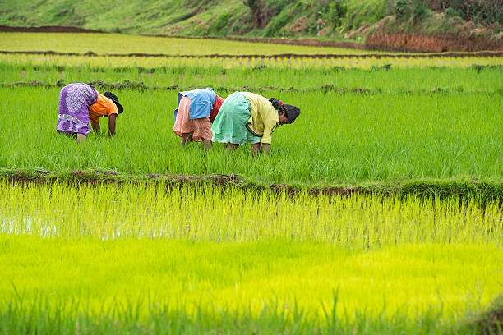
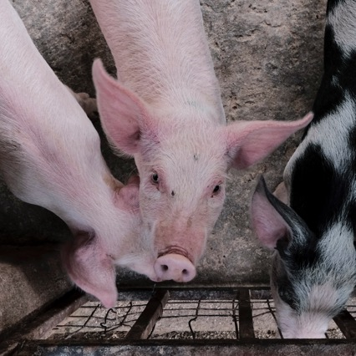
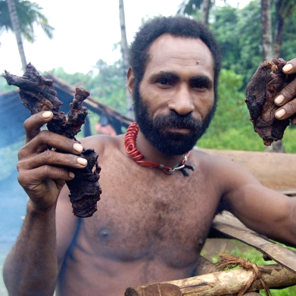
One Health in Sustainable Agriculture Intensification
Intensification of irrigated rice production
Wellcome Trust-funded program;
A4NH/LSHTM/Africa Rice in Cote d’Ivoire
Risks of disease emergence amplified by expanding pig production
ILRI and partners in Vietnam and Uganda
Forest communities and disease emergence from bushmeat
CIFOR/FTA work in Central Africa

Slide 7
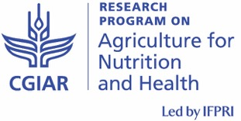
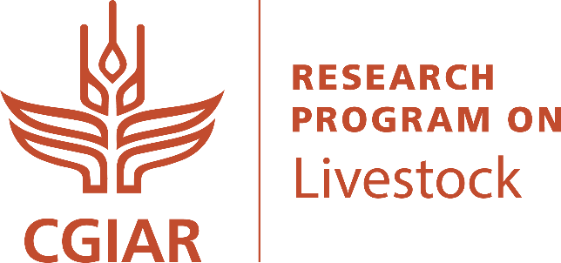
Integrating One Health into Food Systems: Additional Resources
One Health
  ILRI One Health Centre www.ilri.org/research/facilities/one-health-centre
  CGIAR AMR Hub: amr.cgiar.org
  A4NH Improving Human Health Flagship: http://a4nh.cgiar.org/our-research/flagship-5/
COVID-19
  A4NH Researchers Address COVID-19: bit.ly/2REEUJ9
Food Systems
  The Food Systems Resource Center: bit.ly/A4NHFSRC
  The Food Systems Idea Exchange: bit.ly/FSIEBlog

Slide 9
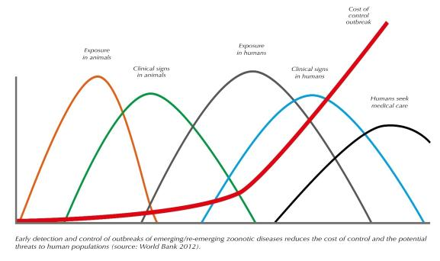
One Health is cost-effective to reduce the likelihood of future pandemics
Better animal disease surveillance, and a One Health approach could save billions by limiting spill-over of disease from animals as timely ‘sentinels’ to protect people’s health
A global investment of US$25 billion over 10 years in One Health could generate benefits worth at least US$125 billion
World Bank. 2012. People, Pathogens and Our Planet. Volume 2. The Economics of One Health. Report No. 69145-GLB.
Notes:
Grace, D., 2014, ‘The business case for One Health’, Onderstepoort Journal of Veterinary Research 81(2), Art. #725, 6 pages. http://dx.doi. org/10.4102/ojvr.v81i2.725

