Slide 1
Building SI on a Rock: Is a Systems Perspective Essential for Integrated Crop Livestock Systems?
Peter Thorne¹ and Sieglinde Snapp²
¹International Livestock Research Institute,²Michigan State University (MSU)
2019 ASA-CSSA-SSSA International Annual Meeting
12 November 2019, San Antonio, Texas, USA

Slide 2
What is Sustainable Intensification?
[Sustainable Intensification is occurring when] yields are increased without adverse environmental impact and without the cultivation of more land ]
Reaping the benefits: Science and the sustainable intensification of global agriculture. Royal Society, 2009

Slide 3
How can we “measure” SI?
Intensification: Output : Input
e.g. grain yield: quantity produced / unit area
Sustainability: development that meets the needs of the present without compromising those of future generations (Brundtland Commission, 1987)
Multi-dimensional: Environment, Economic, Human, Social, Production (SI Assessment Framework).

Slide 4
Component research vs. systems research

Slide 5
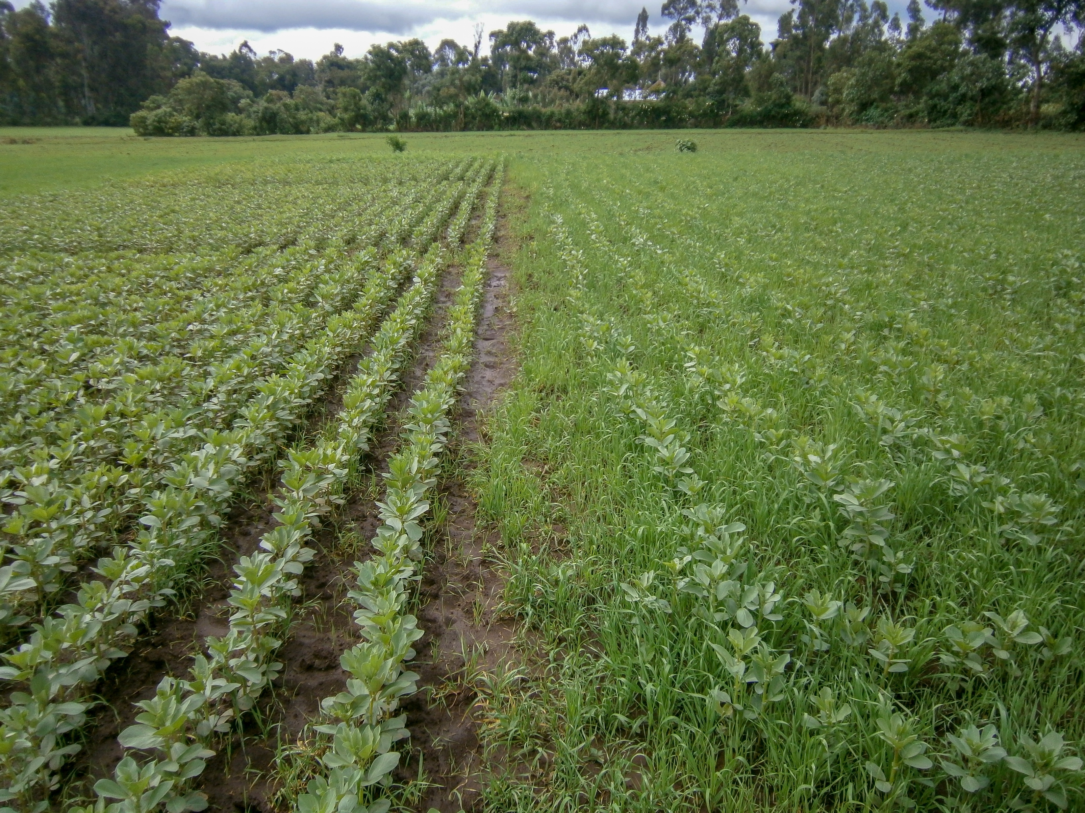
Component research solution
Biophysical outcomes
Increase in grain yield (t ha⁻¹) | 0.31
Increase in residue biomass (t ha⁻¹) | 0.57
Loss of weed biomass (t ha⁻¹) | 2.15
Cost benefit analysis
Total incremental return (ETB) | 5,790
Increase in labour cost (ETB) | 1,440
Net incremental return | 4,350
Opportunity cost of feed (ETB) | 4,300
Value cost ratio (VCR) | 1.01

Slide 6
Systems research solution

Slide 7
Doubled up legume: GRAIN for food & income, BIOMASS for fodder, fuelwood & fertility for the soil
SI Systems gradient, intermediate multipurpose ‘doubled up legume’ rotation provides farmer-approved solution.

Slide 9
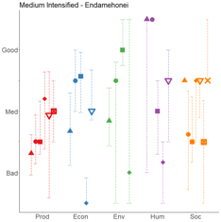
Indicators of Sustainable Intensification
27 indicators quantified across 5 sustainability domains from 880 household interviews
Indicators re-scaled according to locally defined thresholds
Medians and IQRs plotted, allowing for disaggregated analysis (see figure)
Indicators can be aggregated across domains
Households can be aggregated, for example along a spectrum of agricultural intensification (production per unit of land and per unit of livestock).

Slide 10
Indicators along an intensification gradient

Slide 11
Thank You

