Slide 1

Microbial contamination at slaughter and retail points of the pork value chain in Uganda
Velma Kivali^{1,2}, Ian Dohoo⁴, Sinh Dang-Xuan¹, Uwe Rösler², Lordrick Alinaitwe¹, James Bugeza¹, Denis Mugizi¹ , Clovice Kankya³, Kristina Roesel¹ and Elizabeth Anne Jessie Cook¹
¹International Livestock Research Institute, ²Freie Universität Berlin, ³Makerere University, ⁴ University of Prince Edward Island
SafePork Conference
New Orleans, Louisiana, 15–17 May 2023

Slide 2

Outline
Background
Materials and methods
Findings
Conclusions

Slide 3
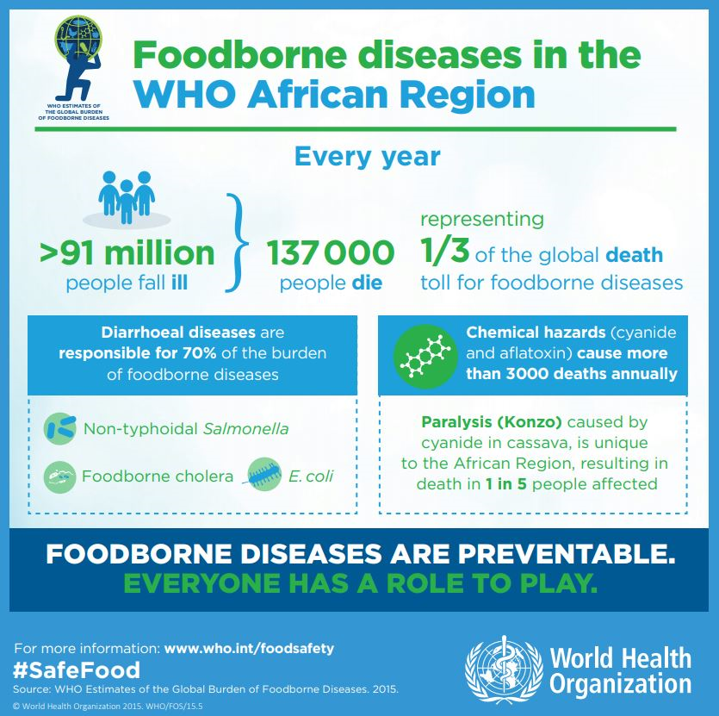
Background/1
Unsafe foods remains a global health concern
Animal source foods most implicated
Bacterial pathogens among leading causes of FBDs
(Havelaar et al., 2015, Thomas et al., 2020, WHO 2020)

Slide 4
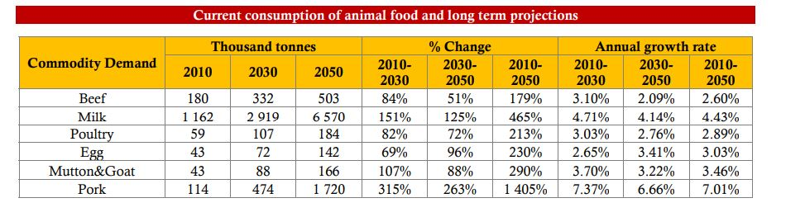
Background/2
Source: FAO stats (2017) Africa Sustainable Livestock 2050 , country brief Uganda

Slide 5
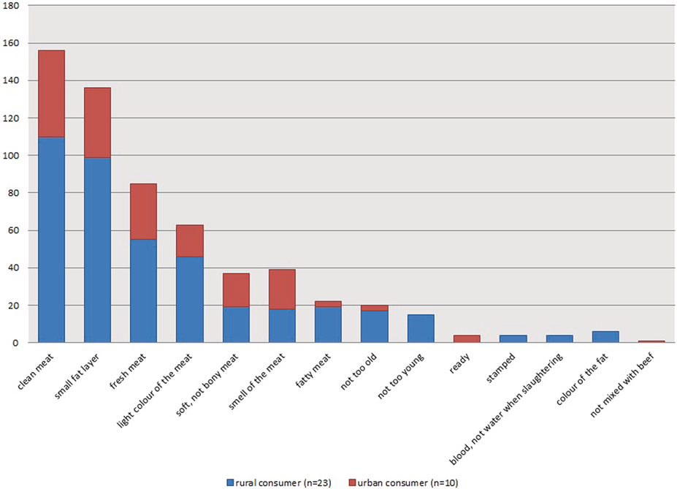
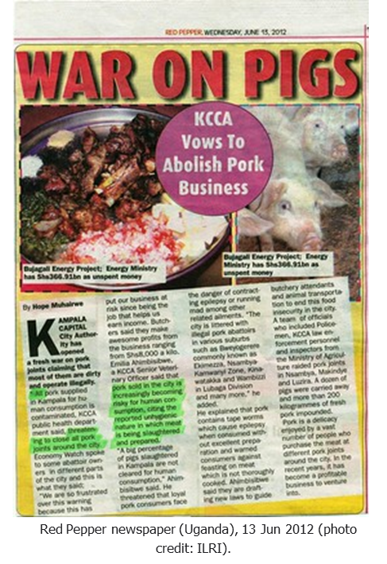
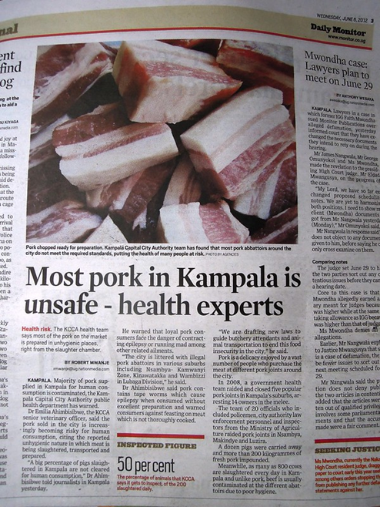
Background/3
Roesel et al 2019

Slide 6
Aim?
Determine contamination levels with total bacterial count (TBC) in samples at slaughter and retail points of the pork value chain in selected districts in Uganda
Establish the association between contamination levels with infrastructure, pork handling and hygiene practices*

Slide 7
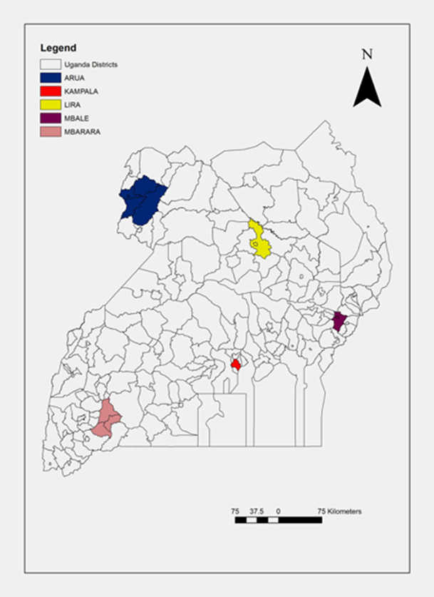
Study design
Single slaughter unit value chain
Multiple slaughter units value chain
Repeat cross- sectional study design
Map of Uganda highlighting the study sites

Slide 8


Data collection
1. Microbial analysis
2. Observational tool

Slide 9
Microbial analysis
No | Sample type | TBCs (n= 1233) | NTS (n= 1535)
1 | Water sample | 137 | 137
2 | Floor swab | 137 | 137
3 | Carcass swab | 151 | 151
4 | Hand swab at slaughter | 147 | 147
5 | Raw pork | 151 | 151
6 | Chopping surface | 151 | 151
7 | Hand swab retail | 148 | 148
8 | Cooked pork | 151 | 151
9 | Vegetables (kachumbari) | 60 | 60
10 | Mesenteric lymph node | - | 151
11 | Faecal sample | - | 151

Slide 10
Descriptive results/1

Slide 11
Descriptive results/2

Slide 12
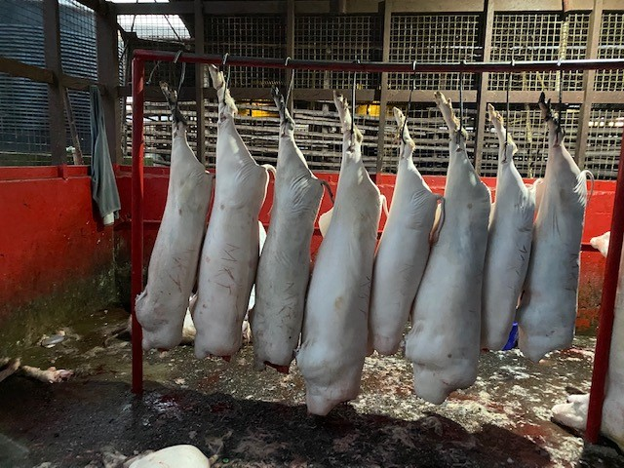
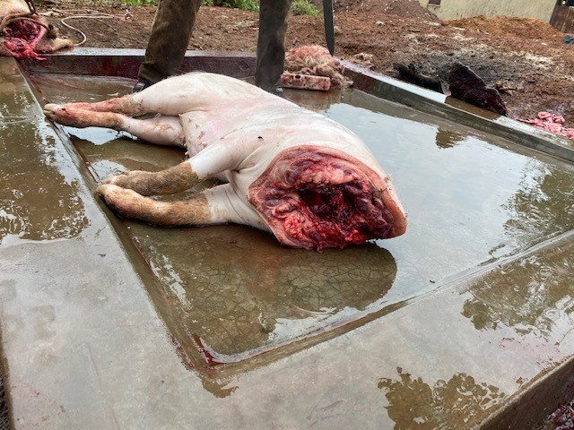
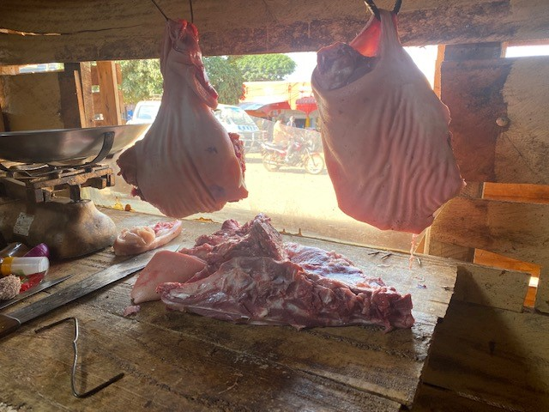
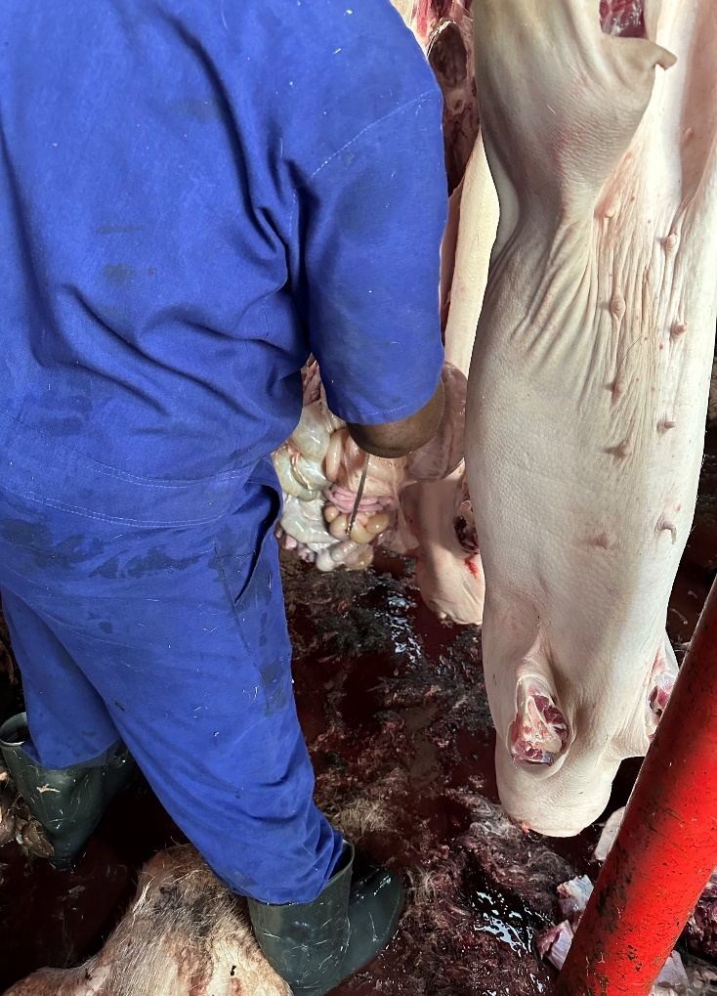
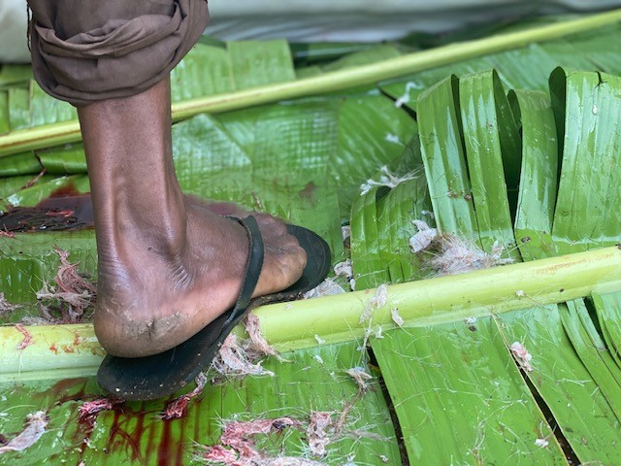
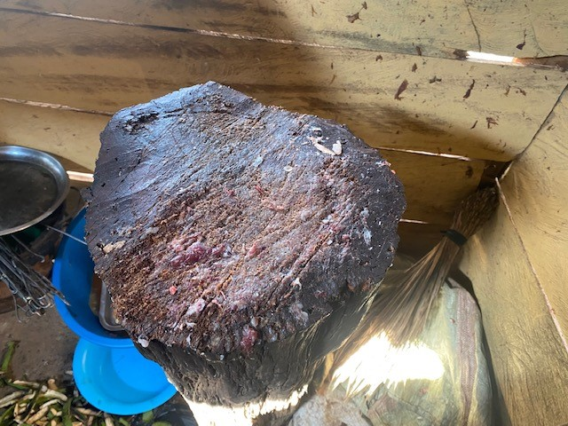
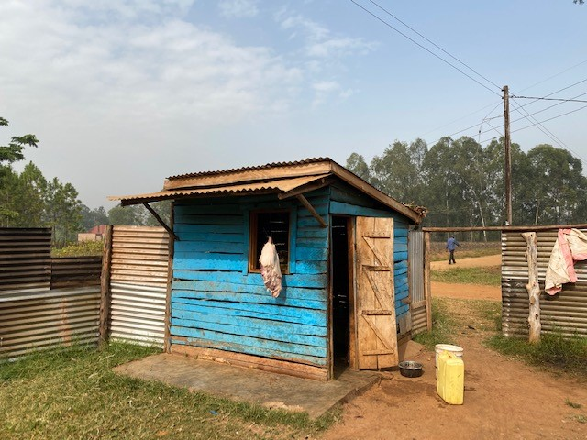
Pork handling and hygiene practices
1
2
3
4
5
6
7

Slide 13
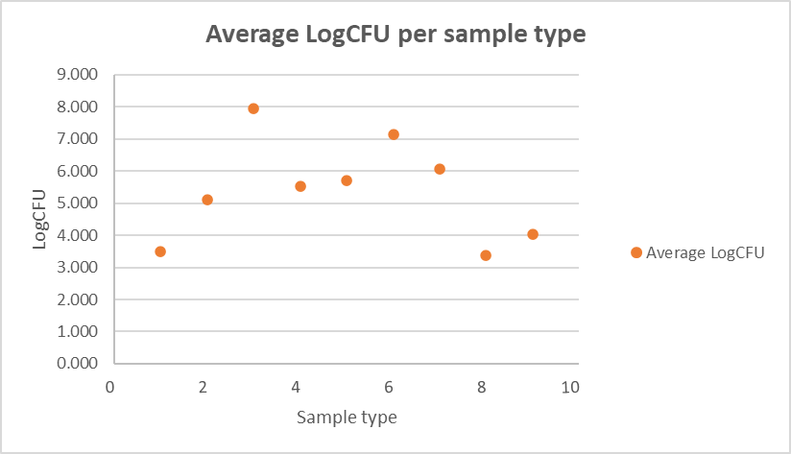
Total bacteria counts

Slide 14
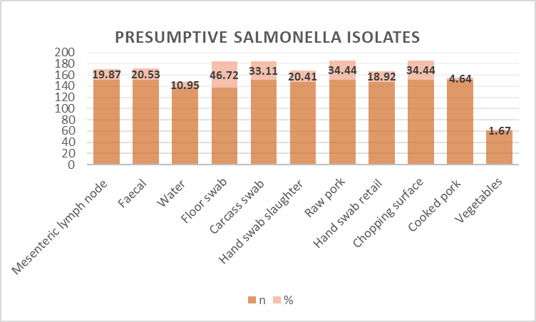
Salmonella

Slide 15
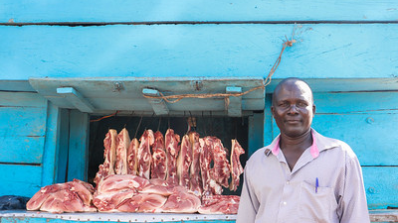
Conclusion
Is pork safe?
What does this mean?

Slide 16

Work in progress
Salmonella characterization
Statistical analysis

Slide 17







Acknowledgements

Slide 18
THANK YOU

Slide 19
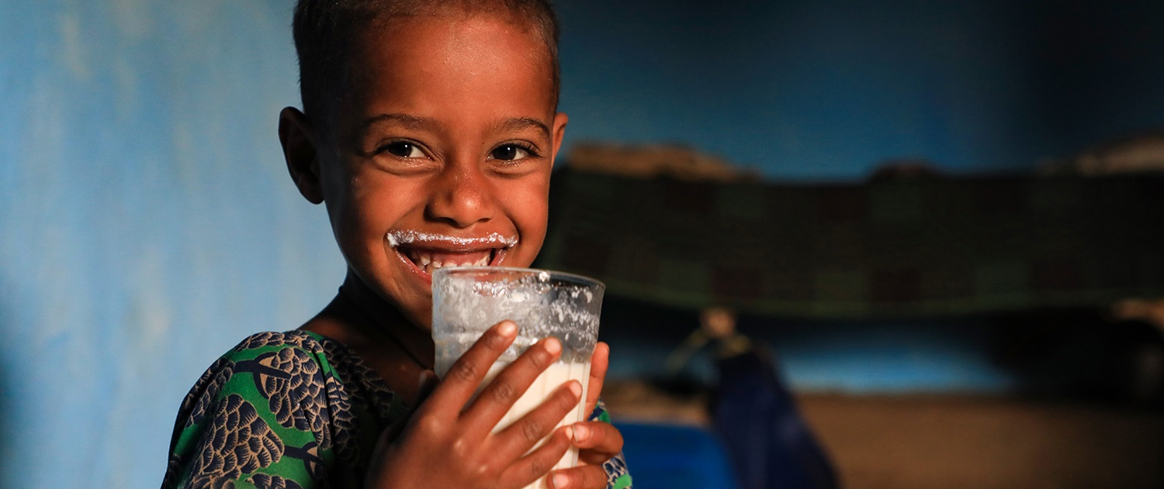
THANK YOU

