Slide 1





Tomato supply chain and food safety challenges in Ethiopia: Testing interventions
Kebede Amenu¹, Biruk Alemu Gemeda¹, Donya Madjdian², Gemma Tacken², Wubetu Legesse³, Getachew Dinede¹, Sisay Girma⁴, Bekele Megersa⁵, Claudia Ganser⁶, Coen van Wagenberg², Arie Havelaar⁶, Delia Grace¹ and Theo Knight-Jones¹
¹International Livestock Research Institute, ²Wageningen University & Research, ³World Vegetable Center, ⁴Haramaya University, ⁵Addis Ababa University, ⁶University of Florida
International Association for Food Protection (IAFP) 2024 annual conference
Long Beach, California, USA
16 July 2024

Slide 2
Contents of the presentation
Introducing “Urban food markets in Africa: Incentivizing food safety using a pull-push approach”
Evidence generation
  Tomato supply chain mapping and food safety risks
  Foodborne disease burden
Testing interventions based on evidence
  Consumer campaign
  Use of reusable plastic containers for long distance tomato bulk transport
Conclusion

Slide 3
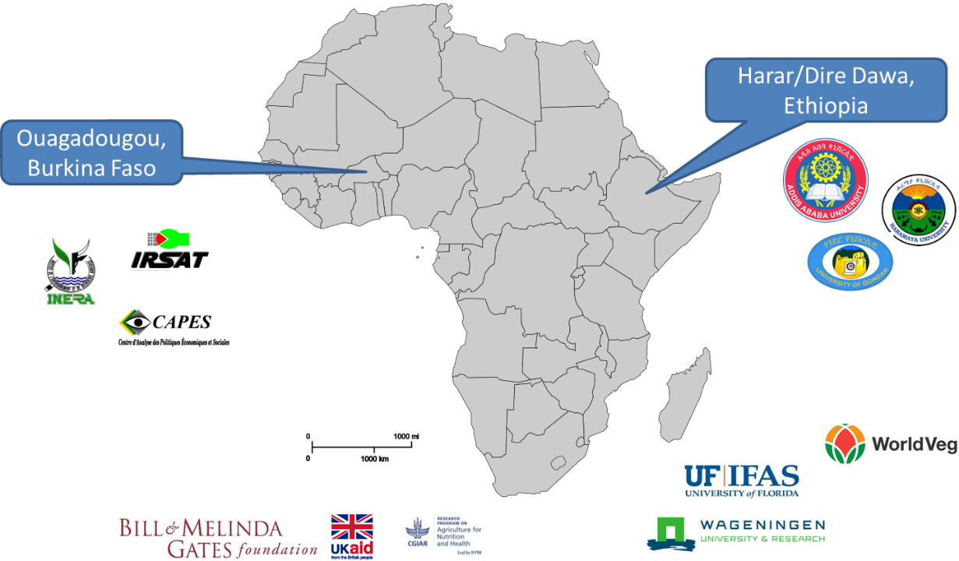
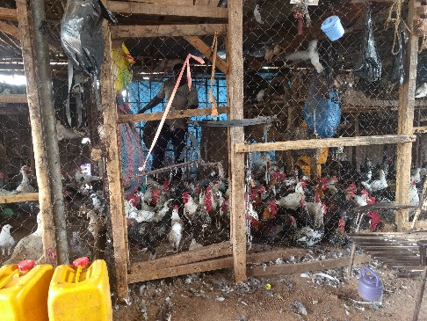
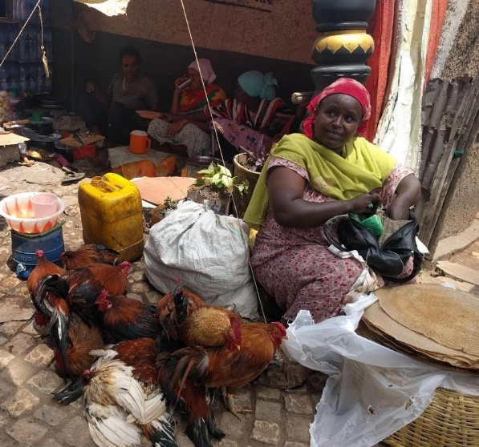
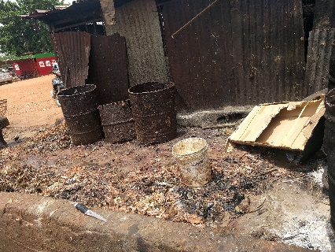
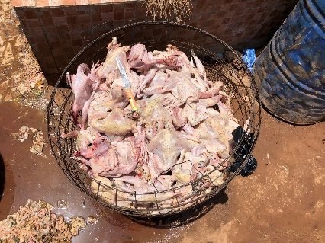

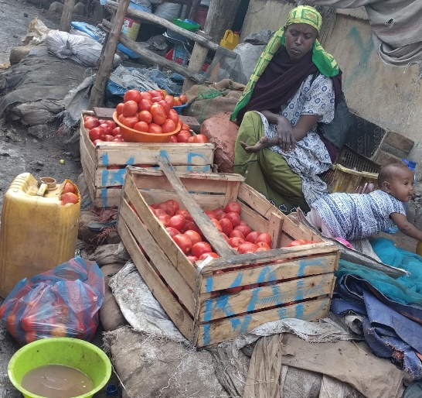
Pull-Push: Urban food markets in Africa
Incentivizing food safety using a Pull–Push approach
Chicken
Salmonella spp. and Campylobacter spp.
Vegetables
Salmonella spp. and enterotoxigenic E. coli
Key question: “Can consumer demand be harnessed to drive better food safety in African urban food markets?”
2019-2023
Focus on chicken and vegetables
Focus on key disease agents that cause much of the burden
Notes:
Note hygiene in these value chains is very poor, with poor infrastructure and facilities
Practices that cause massive microbial contamination are routinely performed

Slide 4
The Journey (2019-2023)
Understand food safety behaviours and beliefs, value chains
Identify risks to target
Measure and understand
Measure disease burden and cost
Design
interventions
Design and develop interventions to improve food safety
Model risks and possible interventions
Food safety consumer campaign
Implement and evaluate interventions
Food safety training for regulators
Trial value chain intervention

Slide 5
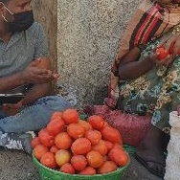
Understanding supply chains and food safety risks
Various participatory approaches applied (focus group discussion, key-informant interview, observations) to assess behavior
GIS mapping vegetable retailer shops (for quantitative survey)
Microbiological survey of tomatoes from vendor shops

Slide 6
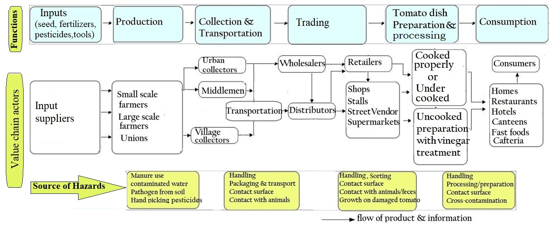
Difficult to understand vegetable supply chains
“Microbiological contamination risks along tomato supply chains, potentially including soil contamination, use of sewerage-contaminated irrigation water, untreated manure, unhygienic handling and storage conditions, and dirty contact surfaces during transportation and retailing”.

Slide 7
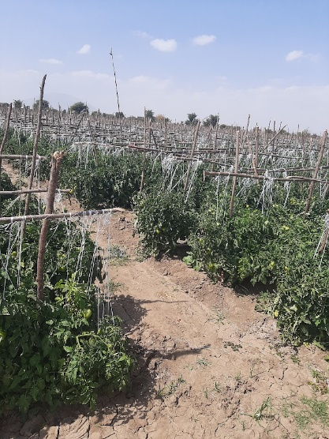
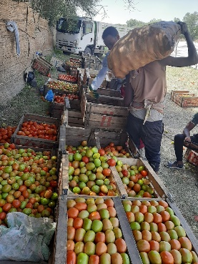
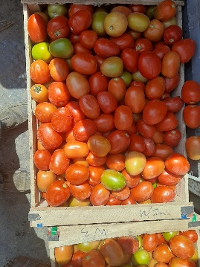
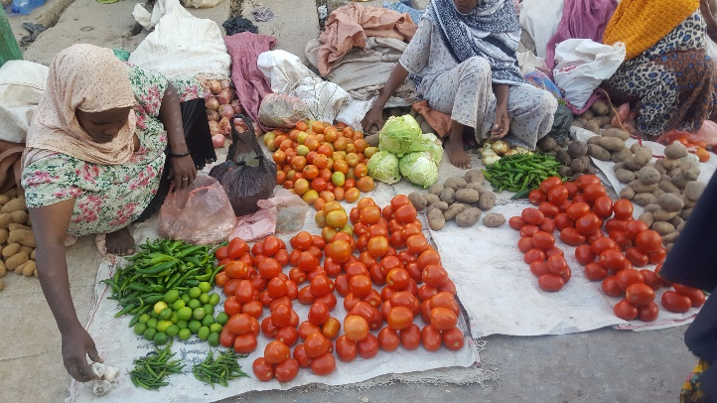
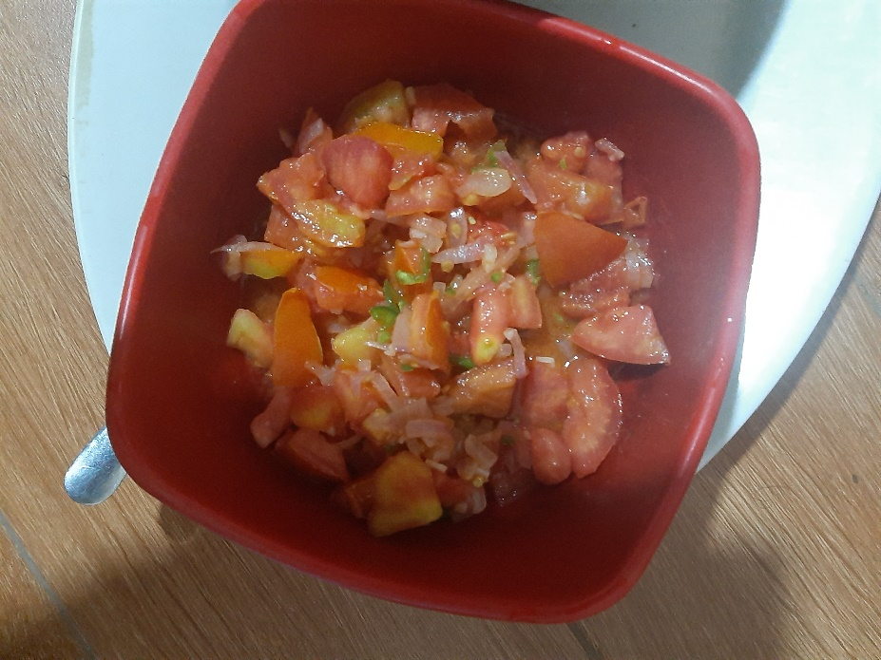
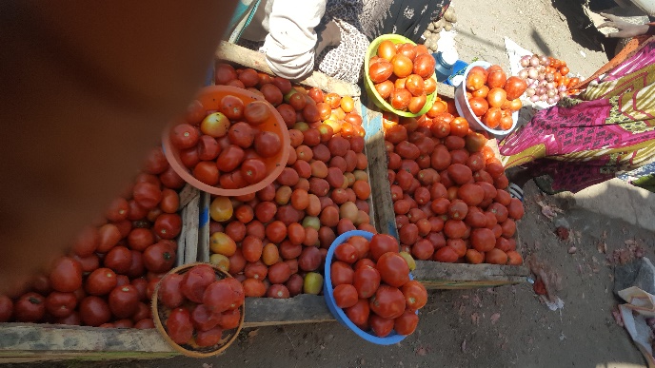
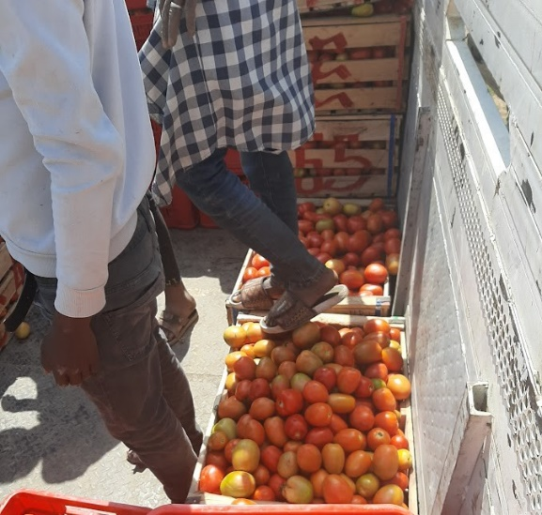
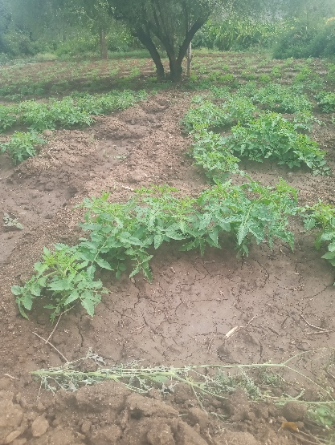
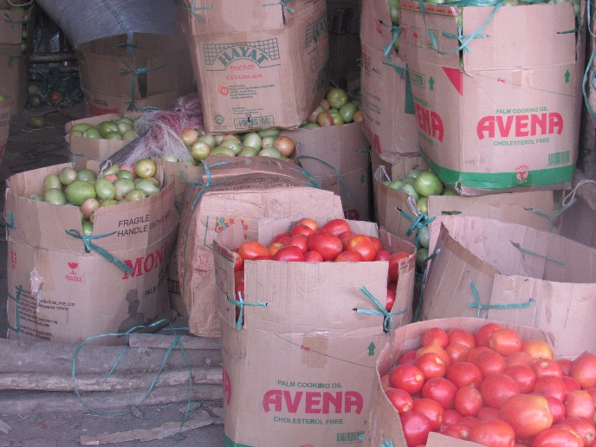
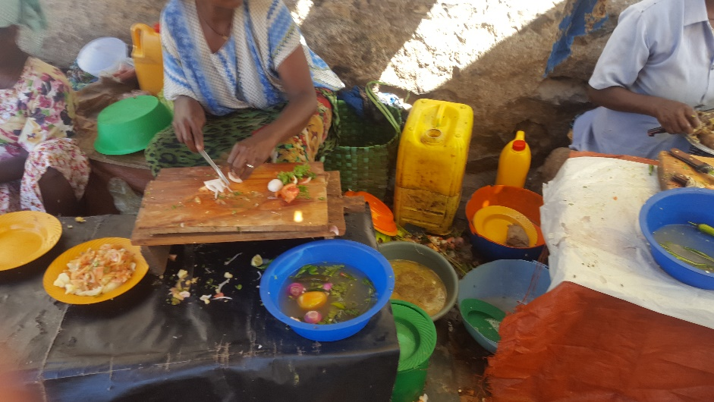
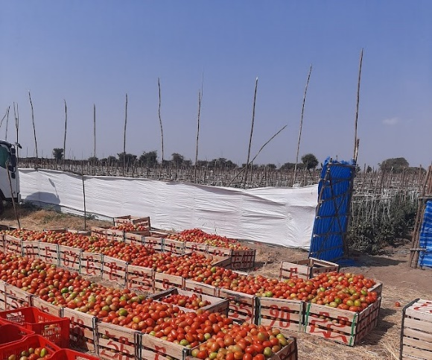
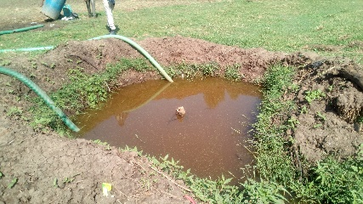
Tomato cultivation
Difficult to understand vegetable supply chains
Handling during harvesting and loading
Market level handling
Market level preparation and consumption

Slide 8
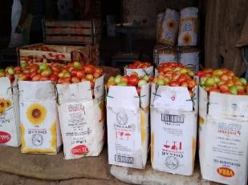
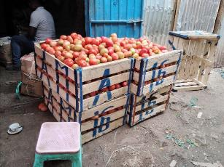
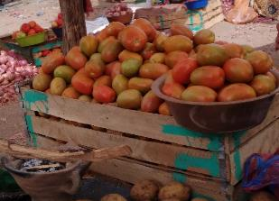
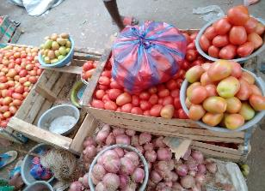
GPS mapping of vegetable markets
Type of retail market outlets
Retailers in a market: large retailers having stall in the main tomato market and supply in bulk using crates and cardboard box.
Retailers in a market, Deker, Harar
Stalls in the vicinity of market: fixed establishments in the vicinity of the main market where retailers who own the stall sell tomato.
Stalls in the vicinity of market, Dire Dawa and Harar

Slide 9
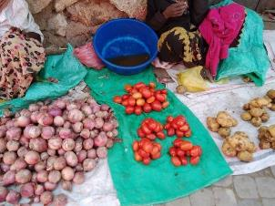
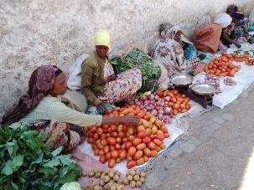
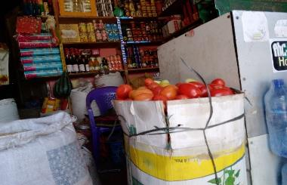
GPS mapping…
Street venders are not in or by a market: They sell tomatoes in public spaces special roadsides offering easy access to customers.
Street vendors in the street of Harar
Formal shops: are those retail outlets where a wide range of goods including tomato are offered for sell in a fixed establishment.
Formal shop in Harar

Slide 10
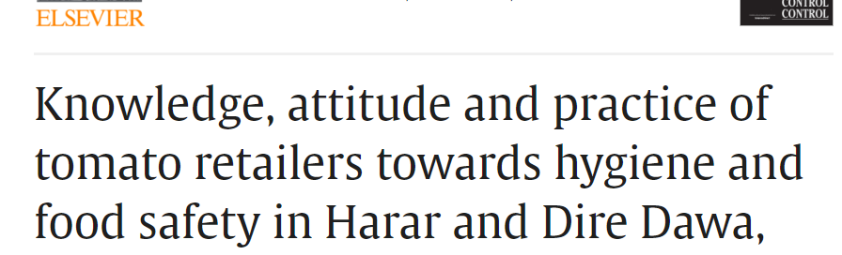
https://www.sciencedirect.com/science/article/pii/S095671352200634X
Basic infrastructures are lacking in the dominant informal food sector in Ethiopia.
We found 40% of tomato retailers did not have adequate toilet facilities.
Almost half did not have adequate access to clean water.
Stalls sell live chickens in proximity to vegetables, which are often eaten raw.
Food waste through damage was a problem for a quarter of retailers.

Slide 11
Microbial contamination
E. coli detected on 90.9 % of retail tomatoes with 65% having above acceptable microbial count concentrations (>100cfu/ml or >2 Log10cfu/ml)
The average E. coli colony count was significantly higher in severely damaged tomato compared to intact tomato (3.4 and 2.5 Log10cfu/ml, respectively, p = 0.001)
Contamination with non-typhoidal salmonella enterica was not detected on any of tomato samples
High prevalence of ETEC – detected on 21% of tomatoes (17% intact, 27% severely damaged tomatoes)

Slide 12
Pesticide contamination
Vegetable samples
  A total of 232 vegetable samples were collected.
  119 from food markets (75 cabbages, 36 tomatoes and 8 Swiss chard).
  113 from farmer’s fields (31 cabbages, 55 tomatoes and 27 Swiss chard).
Agrochemicals
  Vegetables were screened for 35 pesticides (16 organochlorine, 11 organophosphate, 3 pyrethroids, 2 carbamates, 3 other agrochemicals)
Sample preparation and pesticide detection
    Samples were extracted using QuEChERS method and detection done using Gas Chromatography/Mass Spectrometry (GC/MS) analysis

Slide 13
Pesticide contamination….
Nearly half of the vegetables contaminated with pesticides residues
Multiple pesticide residues were detected
Pesticide concentration varied between vegetables
About 15% of vegetables had pesticides above EU MRL but none were above Codex MRLs.
Awareness creation on safe use of pesticides is recommended
https://www.frontiersin.org/journals/sustainable-food-systems/articles/10.3389/fsufs.2023.1143753/full

Slide 14
Foodborne disease burden (FBD) in Ethiopia (three pathogens)
 | Incidence (illness) | Death | DALYs
Salmonella | 2,800,000 | 704 | 62,600
Campylobacter | 1,070,000 | 1,170 | 91,300
Enterotoxigenic E. coli (ETEC) | 1,110,000 | 1,420 | 101,000
Total | 4,980,000 | 3,294 | 254,900
 | ~1 in 20 | 3,300 | 260,000
Havelaar AH, Sapp AC, Amaya MP, Nane GF, Morgan KM, Devleesschauwer B, Grace D, Knight-Jones T, Kowalcyk BB. Burden of foodborne disease due to bacterial hazards associated with beef, dairy, poultry meat, and vegetables in Ethiopia and Burkina Faso, 2017. Front Sustain Food Syst (2022) 6:1024560. https://doi.org/10.3389/fsufs.2022.1024560

Slide 15
Cost of foodborne disease in Ethiopia based on WHO estimates updated to 2017
Three pathogens, all foods: 723 million Int$₂₀₁₇
0.9% of Gross National Income
  productivity losses 513 million (70%)
  deaths 192 million (29%)
  pain and suffering 18 million (4%)
Van Wagenberg CPA, Havelaar AH. Economic costs related to foodborne disease in Burkina Faso and Ethiopia in 2017. Front Sustain Food Syst (2023) 7: 1227430.
https://doi.org/10.3389/fsufs.2023.1227430

Slide 16
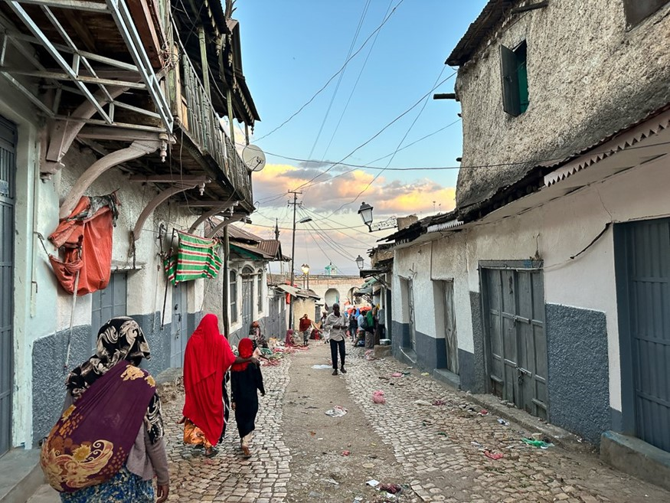


“Abo!
Eat the Good Ones”
Notes:
Communication campaign messages prepared in different languages

Slide 17

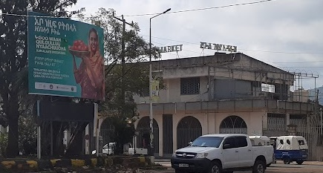

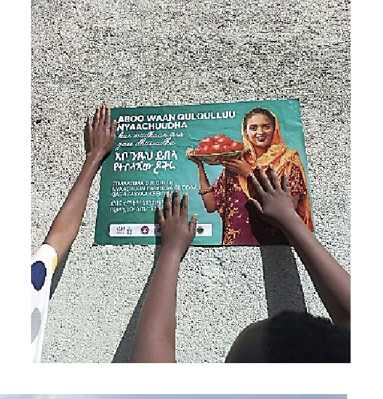

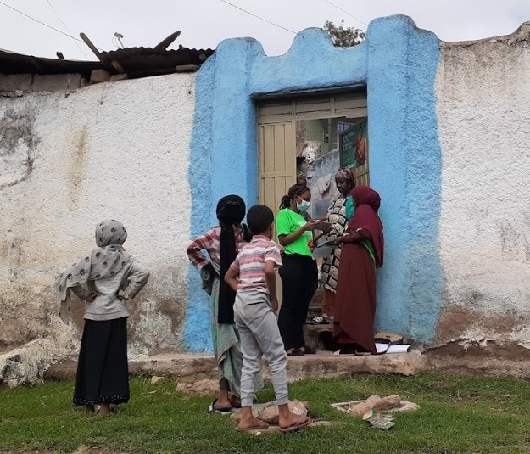

Consumer campaign
TV and radio adverts (718 spots)
Billboards
Facebook campaign (11m views)
Door to door campaign (35,000 people)

Slide 18



Study Design & Sample
Repeated measures / longitudinal consumer surveys
Same consumers interviewed at 2 time points (women, >18 years, residents of Dire Dawa and Harar)
Drop-out at endline: 28.5%
Baseline
Consumer surveys (N=1070)
Campaign
Endline
Consumer surveys
(N=765)
June ‘22 – Feb ’23
Feb-Mar ‘22
Jan-Feb ‘22
Feb | Mar | Apr | May | Jun | Jul | Aug | Sep | Oct | Nov | Dec | Jan | Feb
2022
2023
~ 9 months
https://doi.org/10.1016/j.foodcont.2024.110509

Slide 19
Campaign Coverage: prompted recall
78.3% consumer campaign recall
2.5 increased odds of reporting higher intentions to only buy intact tomatoes among campaign-aware consumers compared to unaware consumers (p=0.001)
Consumers who recalled the campaign had 3.44 increased odds of having greater worries about the safety of tomatoes consumed at home (p=0.004) compared to baseline
Consumers showed a 3.27 increase in higher perceived benefits of not using damaged tomatoes for cooking at compared to baseline (p=0.014)

Slide 20
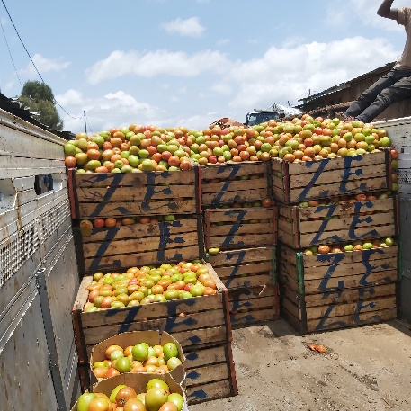
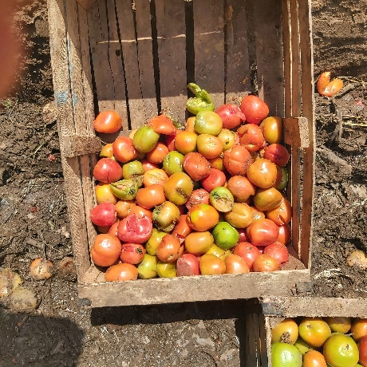
Reusable plastic crates
Look to reduce damage and waste through use of plastic crates for transportation
By reducing damage we reduce microbial contamination and improve safety

Slide 21
Conclusion
The fundamentals of food-safety are well known but cannot be widely implemented in Sub-Saharan Africa, leading to a massive health and economic burden.
Short-to-medium term improvements can be achieved with regulator-led outlet capacity building, whilst simultaneously improving consumer food-safety purchasing and preparation practices through multi-media campaigns.
We recommend that this Pull-Push approach is expanded.
However, major reduction in FBD requires support and incentives for improving food safety at all levels of the value chain, with long-term investment and upgrading of infrastructure.

Slide 22




Thank you!
Ethiopia Consortium: ILRI, Addis Ababa University, Haramaya University, Wageningen University and Research , University of Florida, WorldVeg

