Slide 1
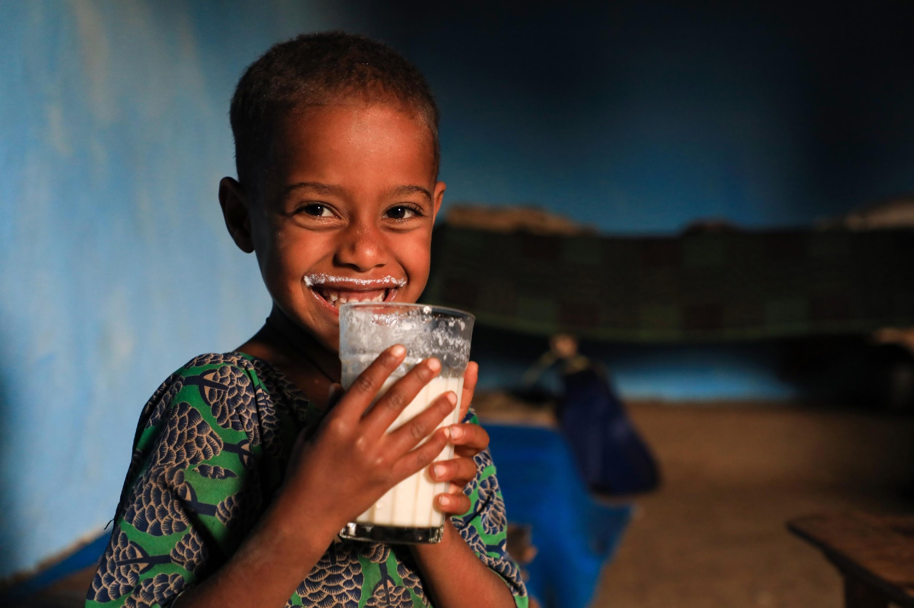

Livestock and climate solutions hub
Delivering an equitable transition to sustainable and net-zero emission livestock systems in low- and middle-income countries
Anthony Whitbread
High level convening on Towards an equitable transition to sustainable and low emission livestock systems in Africa, Kigali, 2 September 2024

Slide 2
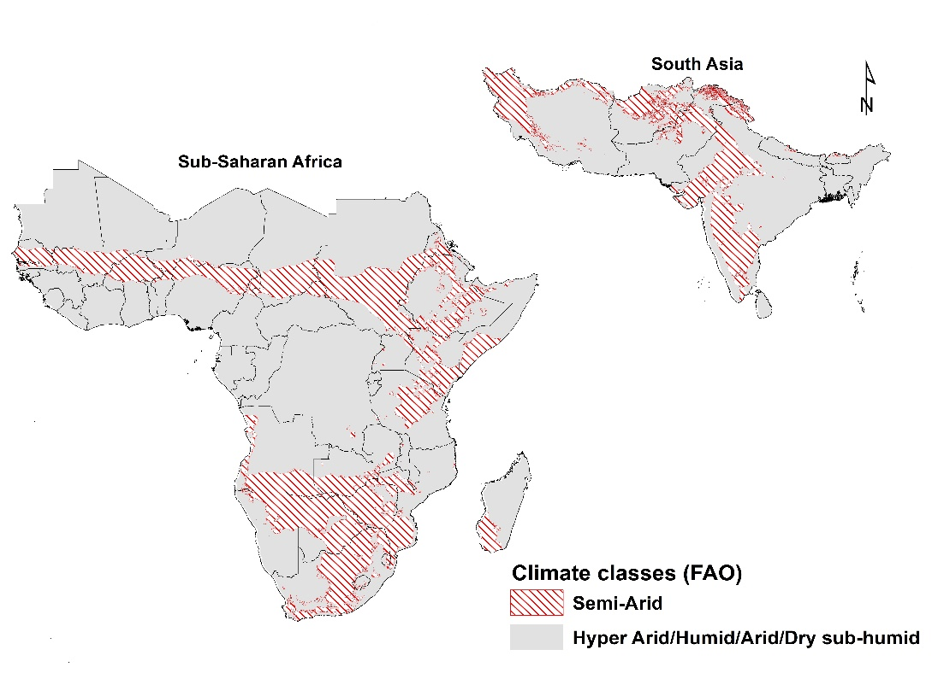
Outline
What is the Livestock and Climate solutions Hub?
The development challenge
Framing the climate smart livestock approach to the climate agenda
A climate smart livestock science snapshot.
Next steps

Slide 3
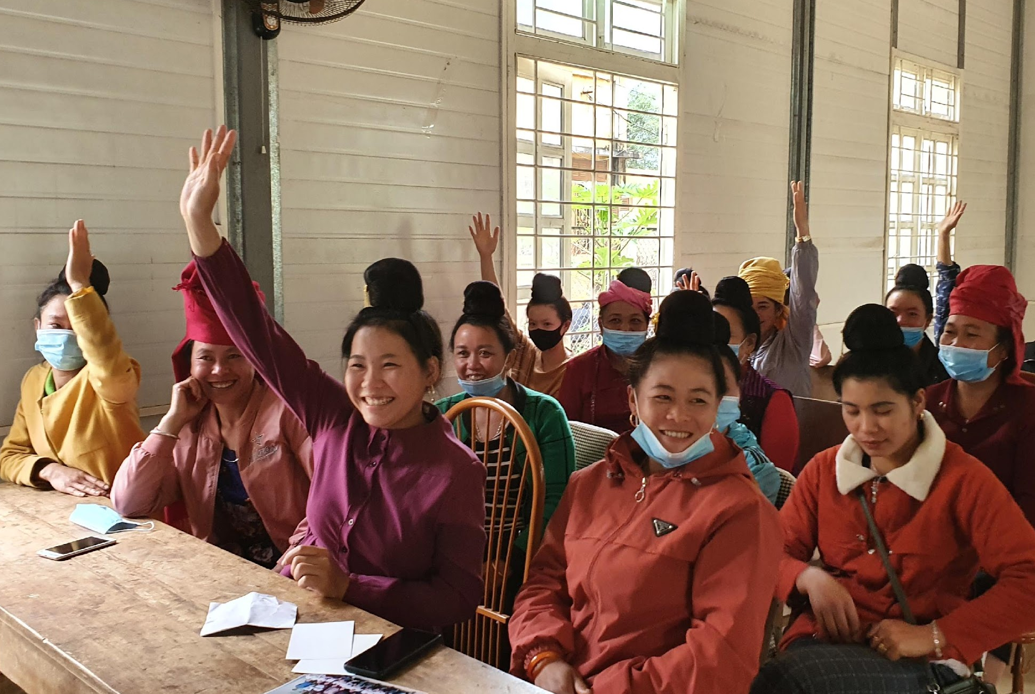
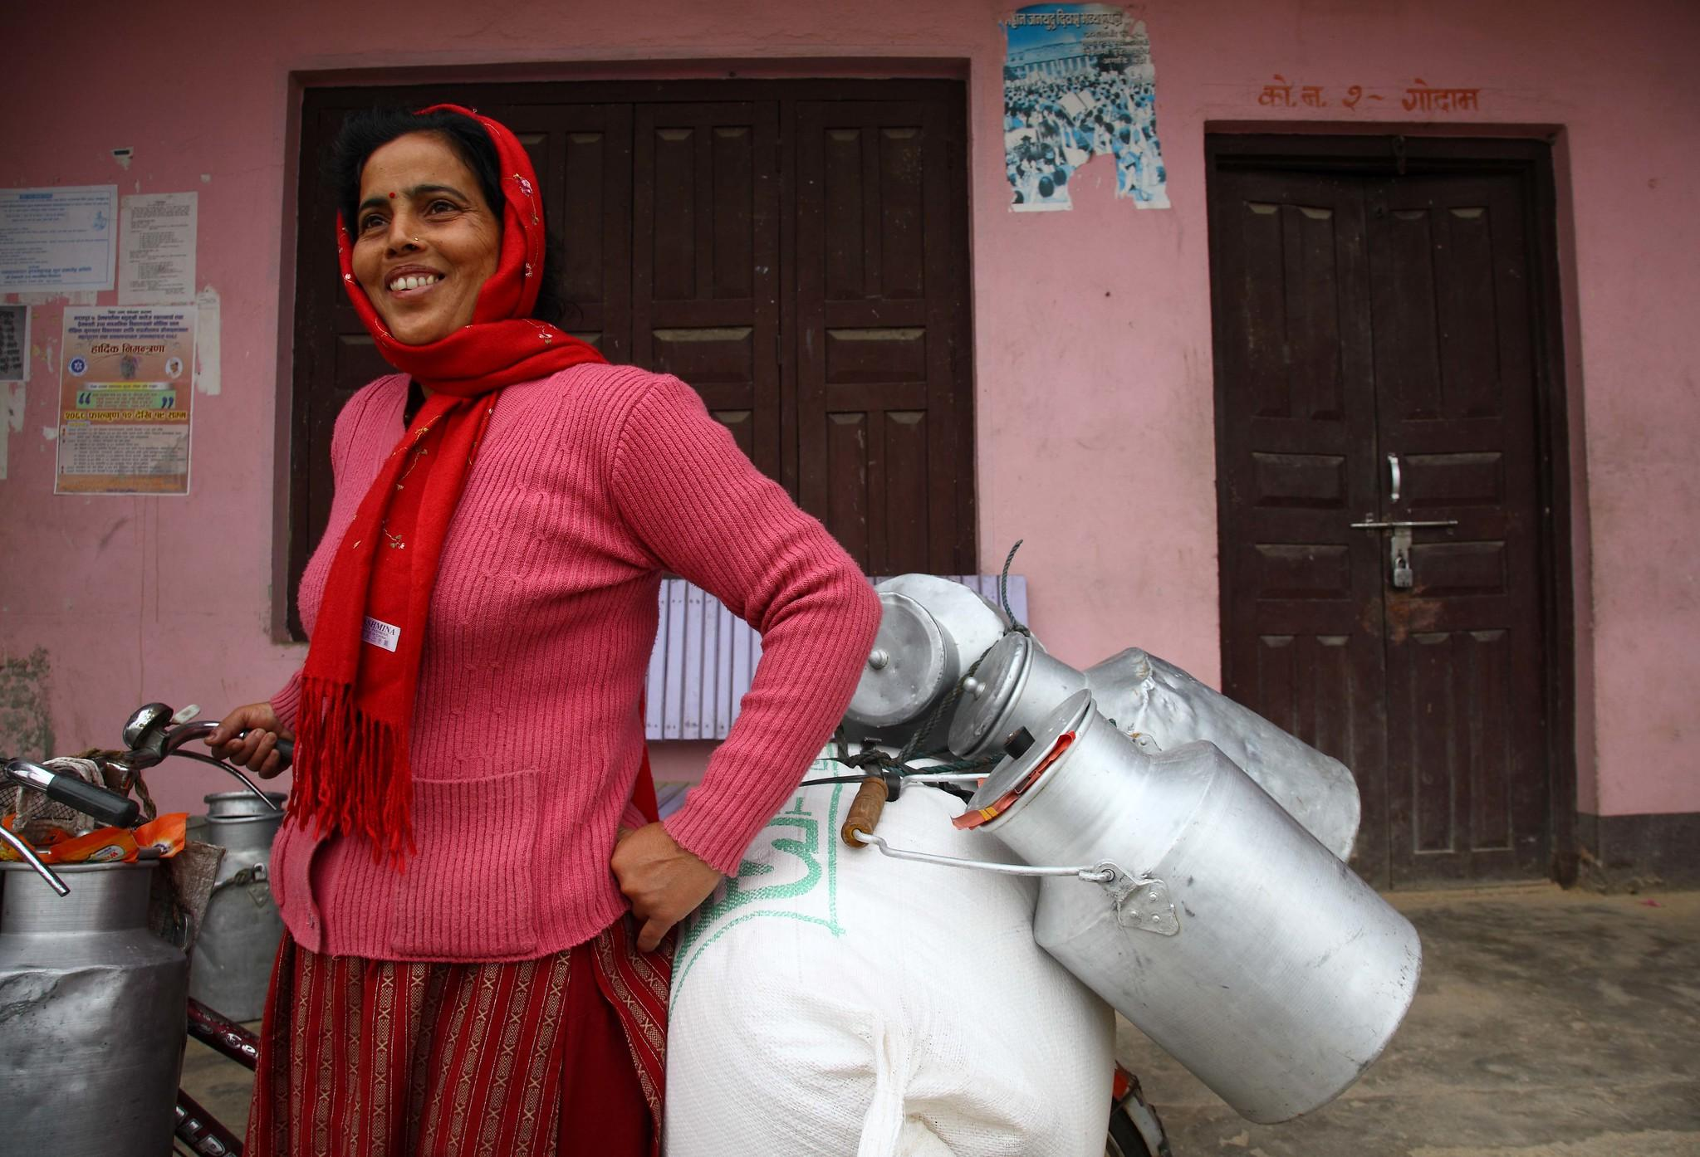
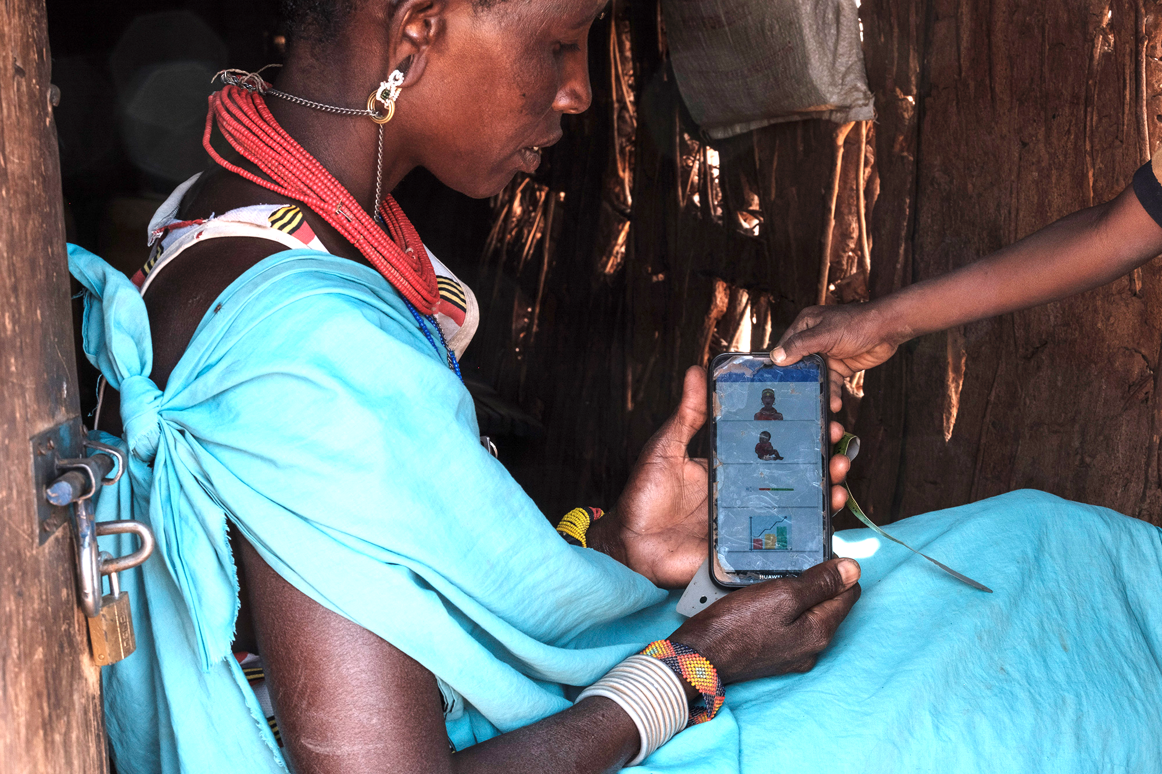
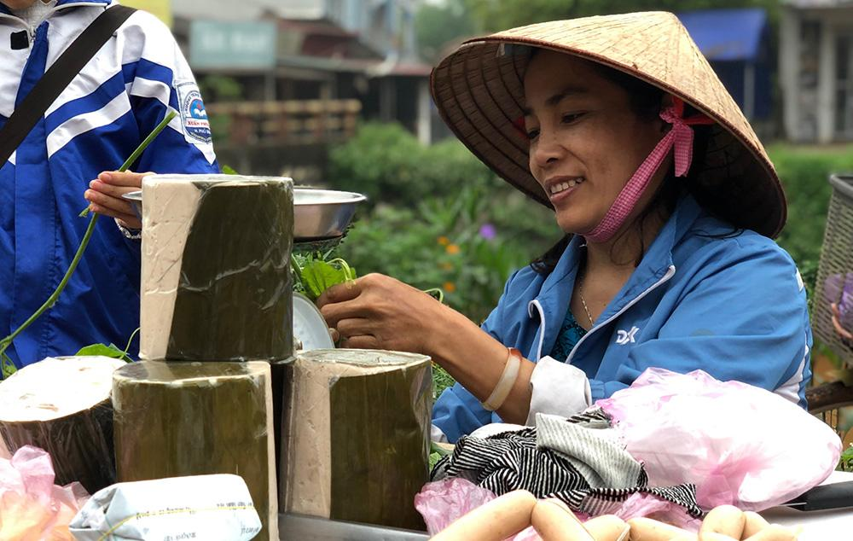
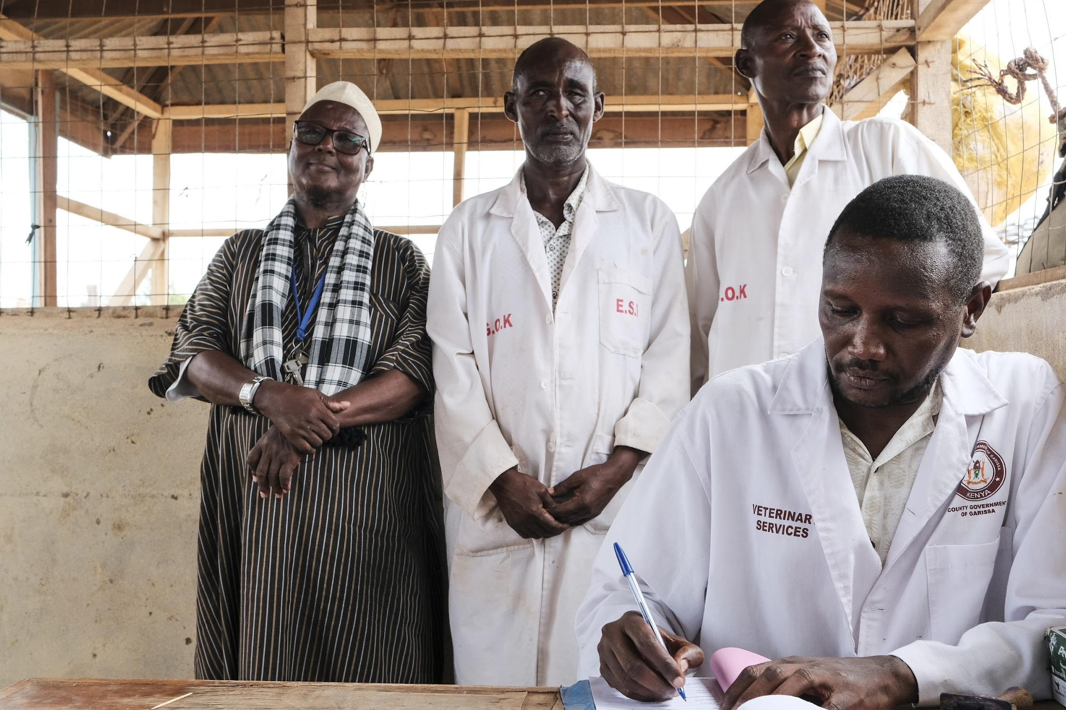
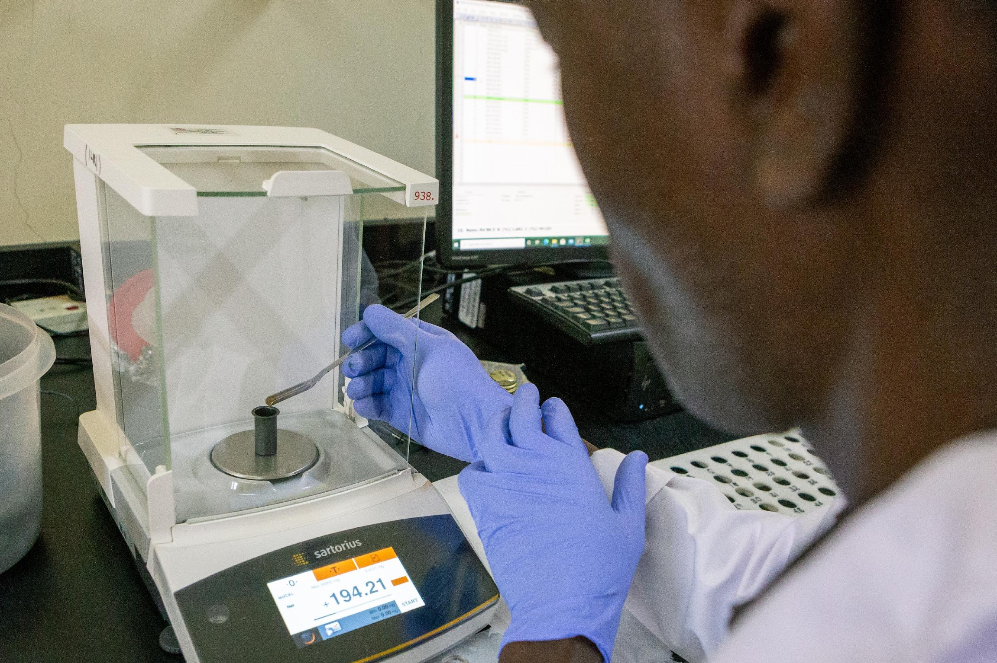
The livestock and climate solutions hub
A multi-stakeholder approach to transitioning LMIC’s livestock systems to net-zero, healthy, resilient, and profitable food systems by 2040
Our aim is to co-develop and scale net-zero emission livestock systems that build resilient, productive and equitable livelihood systems in LMICs
A convening multi-stakeholder platform for collaboration and sharing best practices
Co-design approaches to transformative low-emission livestock development
Bundling technologies to enhance productivity in genetics, animal health, and nutrition
Scaling demand-driven solutions through public, private, and NGO partnerships
Strengthening sustainable livestock policies and increasing investments
Measuring impact on GHG emissions and supporting NDC framework and IPCC targets

Slide 4
Research for climate smart Innovations
THE VISION
Livestock and Climate Solutions
Hub
Convening multistakeholder platforms
Policy and support for NDCs
Transitioning to climate-smart livestock systems through adaptation and mitigation
Scaling innovations through partnerships

Slide 5
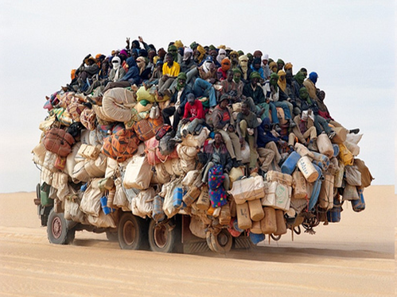
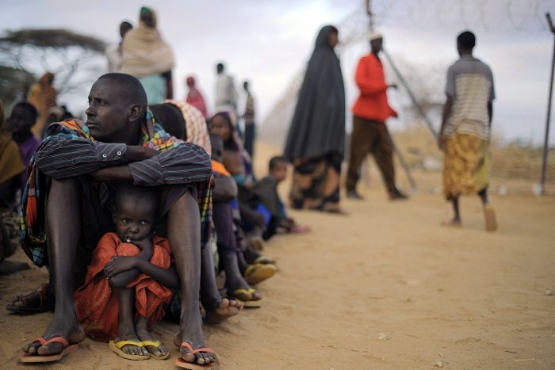
Rapid population increases
The development challenge
2050:
Asia 5.3 billion (+41%)
Africa 2.5 billion (+209%)
2100:
Asia 4.8 billion
Africa 4.5 billion
Urbanization
2018:
-55%
2050:
-68%
Demographic shifts
High income inequality
Climate change
Natural resource degradation

Slide 6
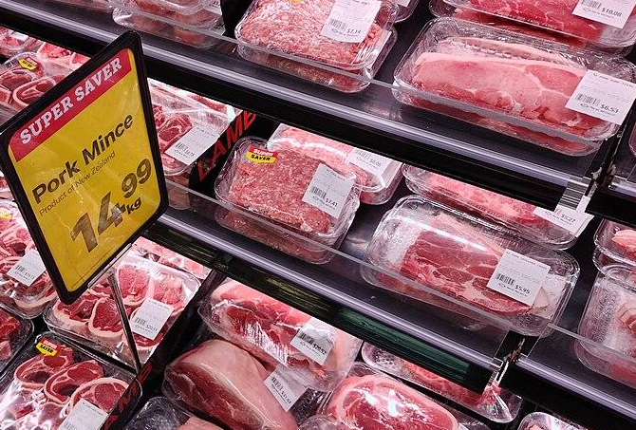
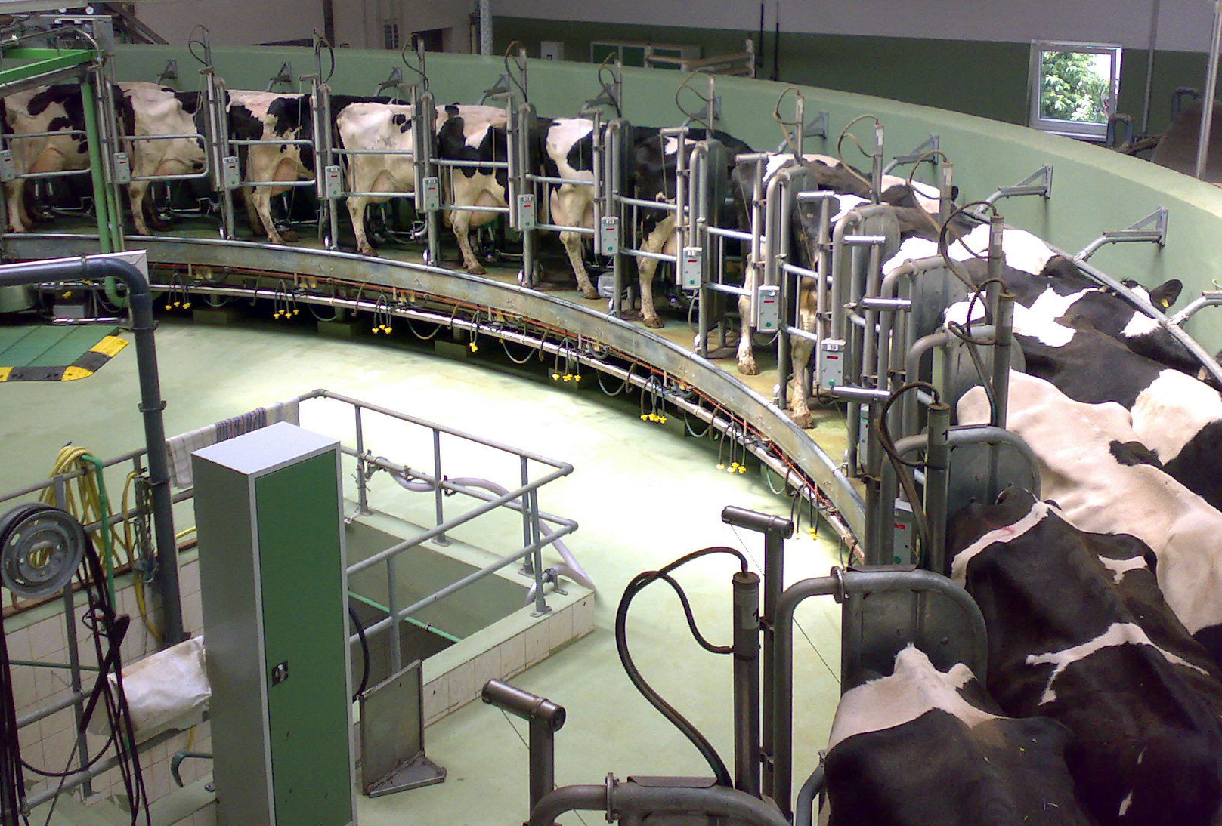
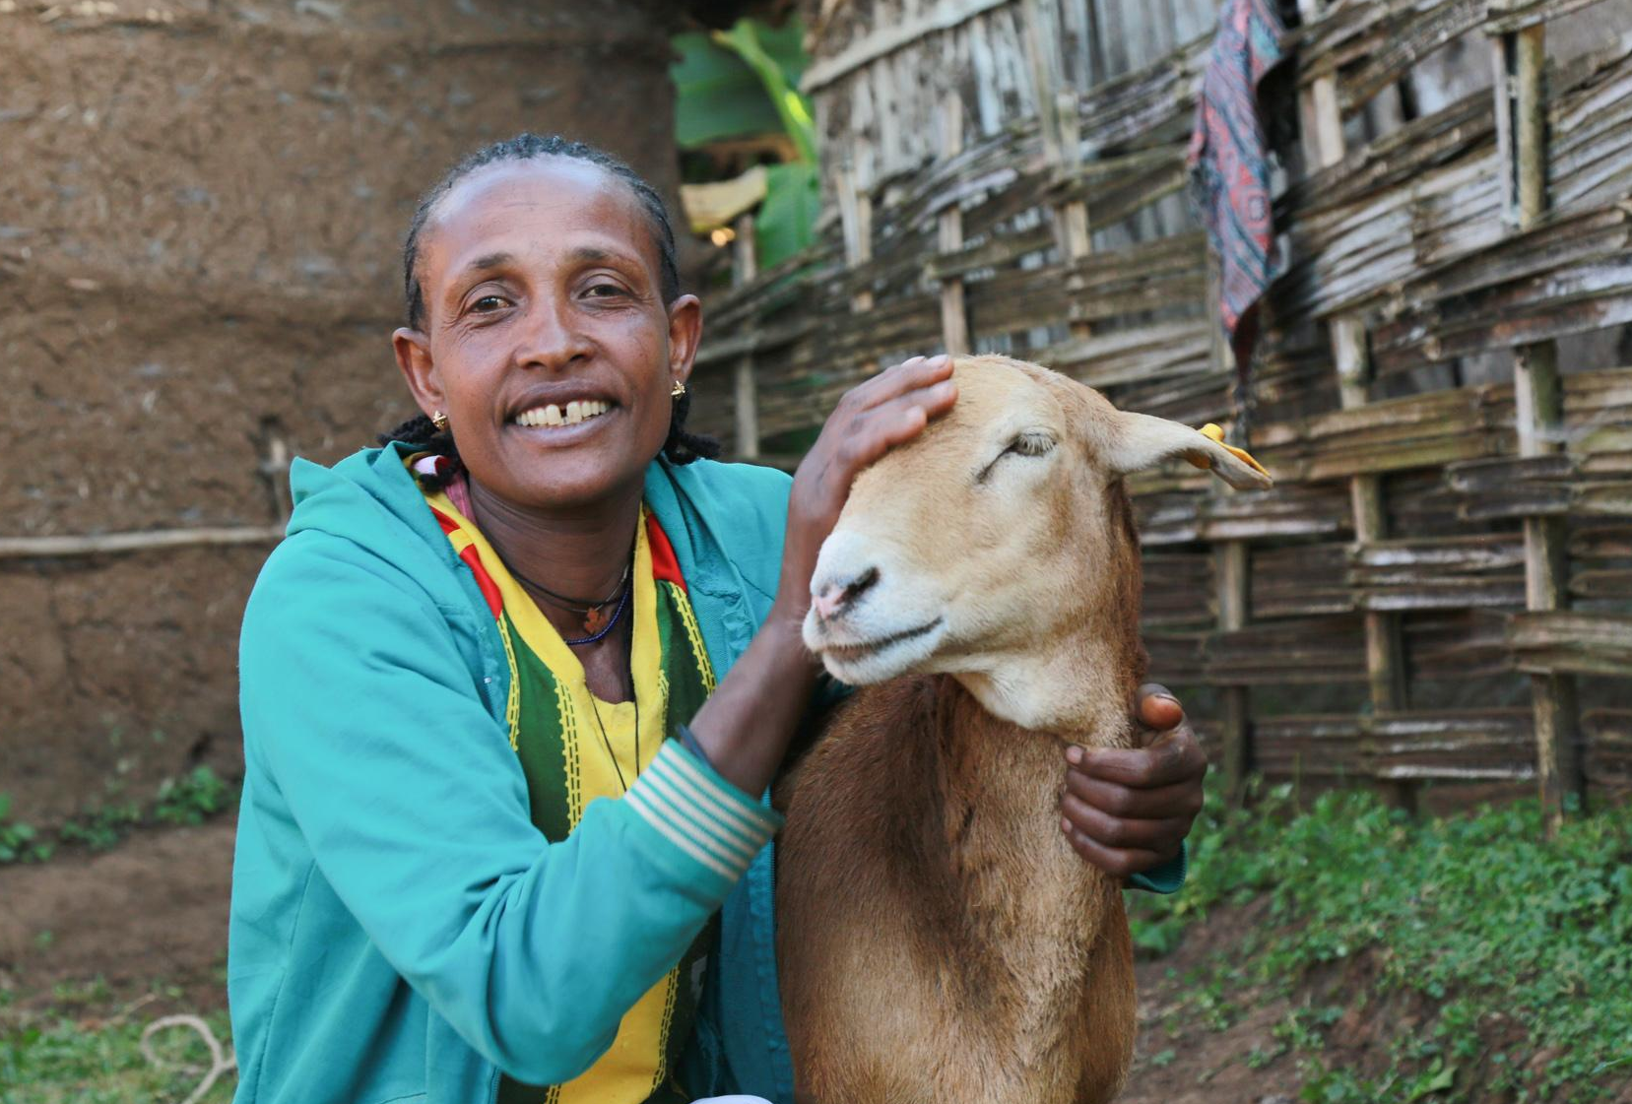
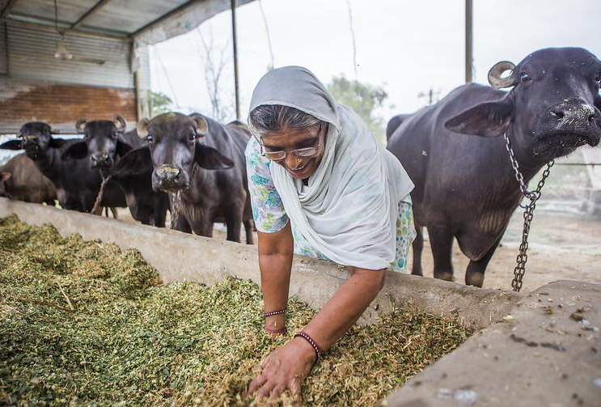
POTENTIAL PATHWAYS to meet the growing demand
DEMAND FOR FOOD WILL KEEP GROWING
Import livestock products
Import livestock industrial production know-how
Especially in LMICs
Demand for milk, meat, eggs is driven by population, rising incomes and urbanization
Projected demand (2010 to 2030)
Transform smallholder livestock systems
Beef & Poultry: >80%
Milk: >40%
Pork in SSA>150%
70% of livestock-derived foods consumed in LMICs are sourced in informal markets

Slide 7
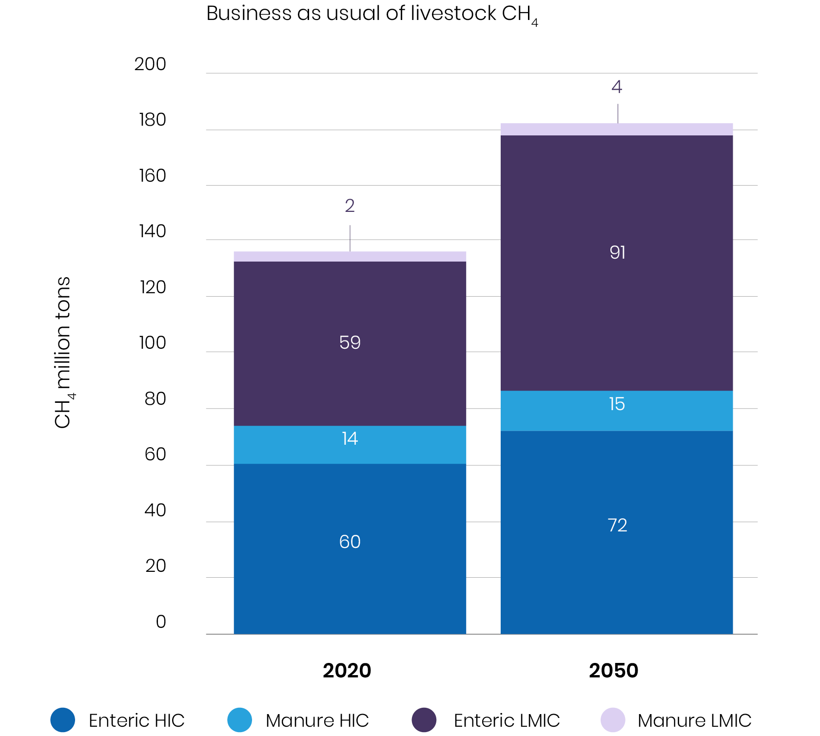
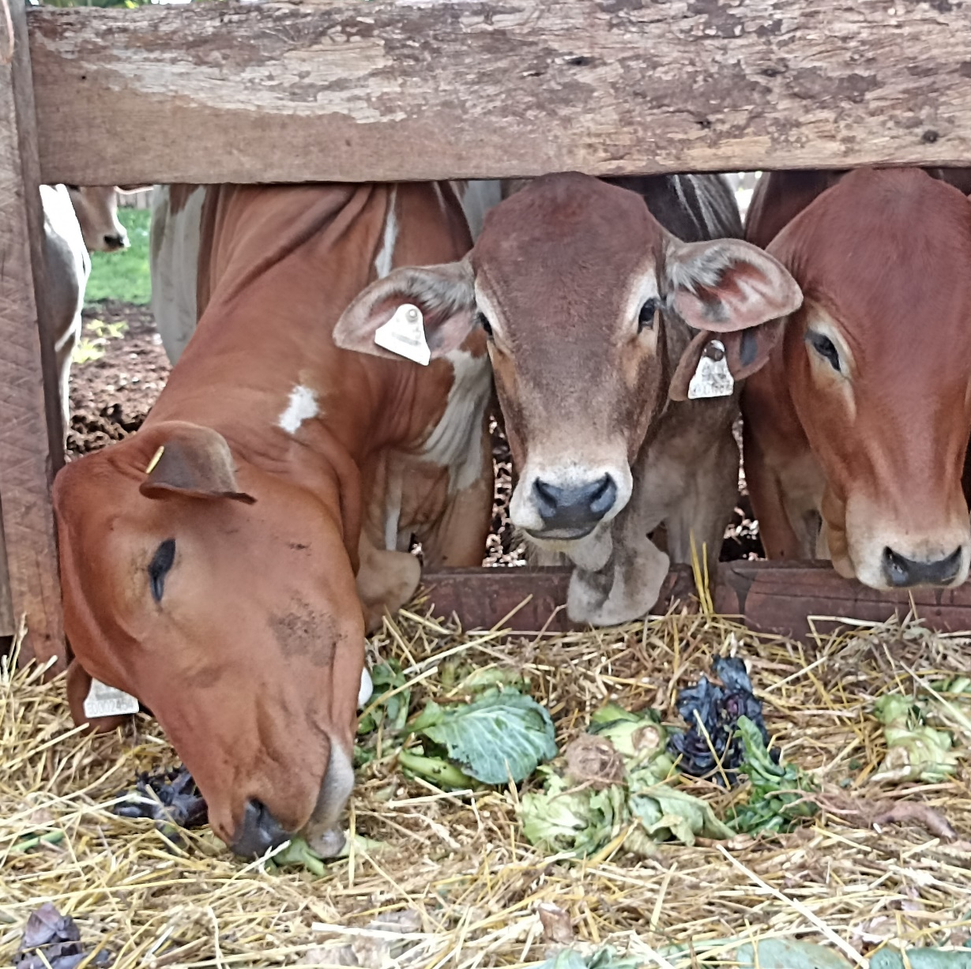
Reducing methane emissions from livestock

Slide 8
Strategy for solutions to climate change adaptation and mitigation in the targeted farming systems
Climate Smart Livestock Systems
Health, genetics, nutrition, environment, political economy, policy

Slide 9
Strategy for solutions to climate change adaptation and mitigation in the targeted farming systems
Climate Smart Livestock Systems
Health, genetics, nutrition, environment, political economy, policy
Mitigation
Adaptation
Carbon sequestration in landscapes
Emissions reduction through feeds
Efficient low emission ruminants in breeding targets
Animal health (e.g. vaccination, parasite control etc.)
Measurement, Reporting, Verification
Climate tolerance in breeding targets
De-risking measures (e.g. insurance, climate information)
Coping with shocks and extreme events
Prediction (e.g. early warning, vector and disease spread)
Scaling resilient livelihoods
Tradeoffs & co-benefits

Slide 10
Strategy for solutions to climate change adaptation and mitigation in the targeted farming systems
Climate Smart Livestock Systems
Health, genetics, nutrition, environment, political economy, policy
Mitigation
Adaptation
Carbon sequestration in landscapes
Emissions reduction through feeds
Efficient low emission ruminants in breeding targets
Animal health (e.g. vaccination, parasite control etc.)
Measurement, Reporting, Verification
Climate tolerance in breeding targets
De-risking measures (e.g. insurance, climate information)
Coping with shocks and extreme events
Prediction (e.g. early warning, vector and disease spread)
Scaling resilient livelihoods
Tradeoffs & co-benefits
Farming systems
Supporting uptake of innovations by livestock keepers and other actors
(semi)-intensive, crop-livestock, pastoral systems
Delivery systems of inputs and services
Private sector engagement
Trade-off analysis
Policy coherence
Inclusivity
Outcomes
Low emissions development that supports productive, equitable livelihoods

Slide 11
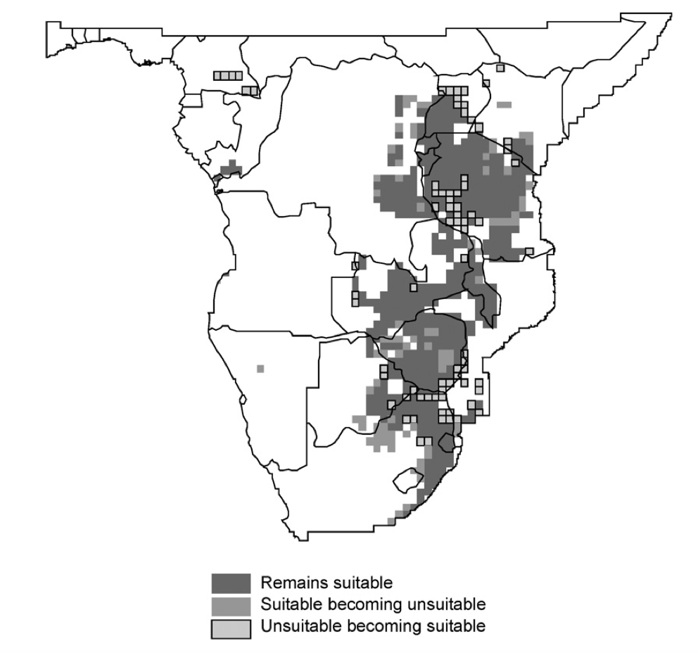

ANIMAL HEALTH SOLUTIONS
Comparing the distribution of ECF in year 2000s with that of 2030
Improved animal health and productivity
Managing infectious disease patterns
Vaccinations, parasite control increased GHG emissions intensity by 33-40%
Reducing abortion/calf mortality decrease emissions by 6-14%
Rift Valley fever epidemics in East Africa – models show 50 million people at risk
Anthrax in Kenya – limited local shifts but new communities facing higher risks
Baseline data on animal health-link to GHG
Develop and scale herd management packages
Risk mapping and epidemiological analyses
Climate-disease forecasting for early detection

Slide 12
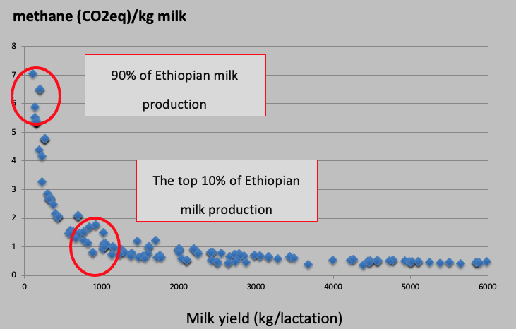

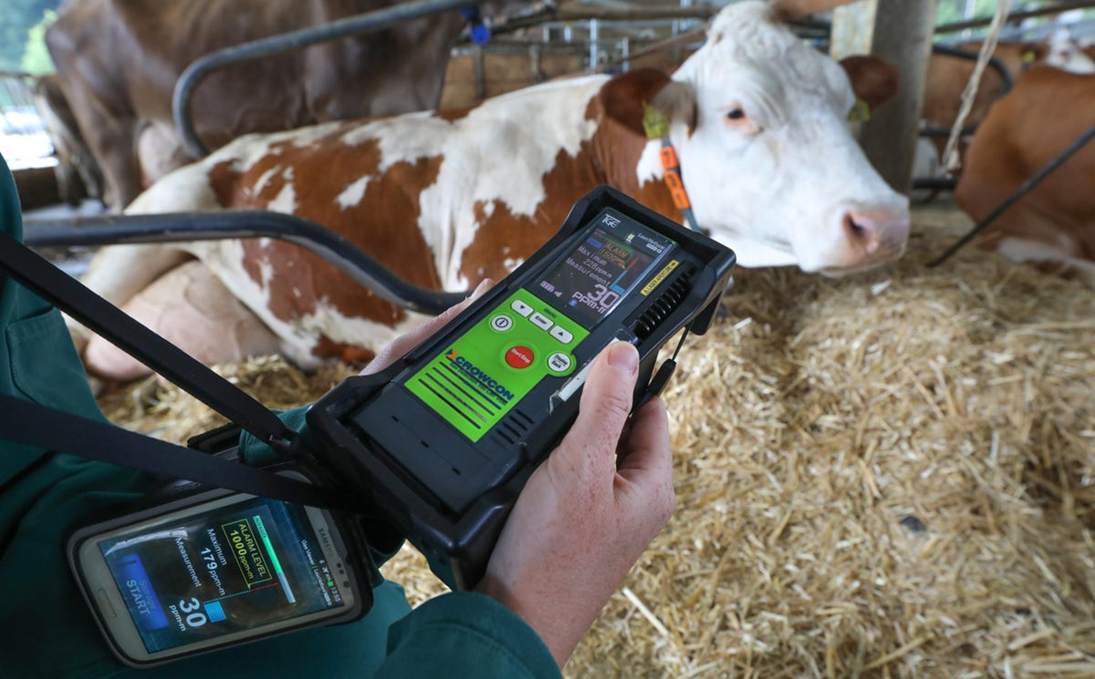
FAO, Herrero et al 2013
GENETIC SOLUTIONS
Productivity and feed efficiency
Direct selection for lower methane emissions
Heat stress reduces milk production by 4-14%.
Genetic differences in animal response linked to temp-humidity index.
Heritability estimates ~ 0.20 for CH4 ppm, direct selection is feasible.
Accuracy of indirect prediction of CH4 from milk fat%, protein% (MIR) 0.43 so prediction of CH4 is feasible.
Scalable digital platforms and tools
Scalable genomic prediction pipelines
Partnerships and networks
On-farm detection of methane emissions using a handheld laser methane detector

Slide 13
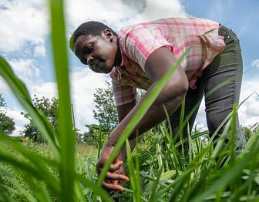





ANIMAL NUTRITION SOLUTIONS
Genetic improvement of feeds and forages
Feeding systems
Discovery, development and deployment of 'low-methane forages’
Testing feeds/forages and their impact on emissions
High throughput methane screening (SRUC)
Genomics-assisted plant breeding (ILRI + partners)
Balanced feed rations and feeding systems
Converting crop residues into high quality animal feed
Exploiting crop germplasm for better quality residues
Scaling application of digital ‘feed’ tools
Scaling feed processing
Release of new feed/food, forage cultivars and varieties
Seed systems

Slide 14

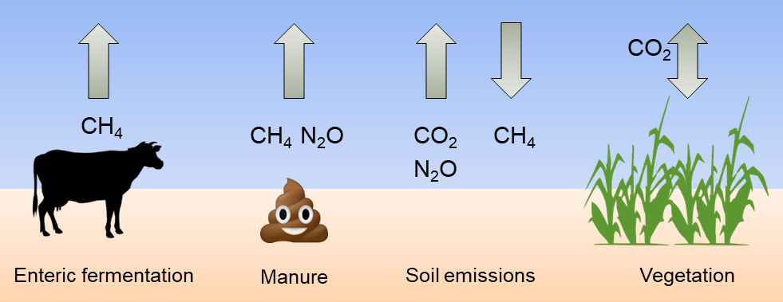
ENVIRONMENTAL SOLUTIONS
Establishing local emission factors and inventories
Ecosystem CO2, CH4 and H2O exchange in savanna
Supports national GHG inventory development & accounting
Identifies effective mitigation strategies
Established MRV systems
‘Sees’ incoming and outgoing C and H2O fluxes
temporal dynamics of C sink or source strength effects of climate change (long-term)
Baseline data from local breeds and systems.
Test interventions that increase animal productivity, decrease emission intensities.
Building local capacity in activity data, farm to national inventory, MRV.
Scaling integrated systems and circular economy approaches

Slide 15
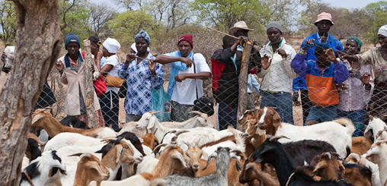
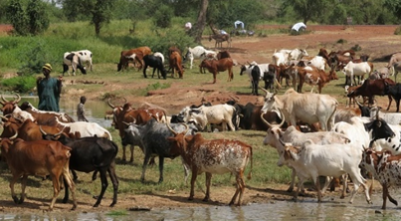
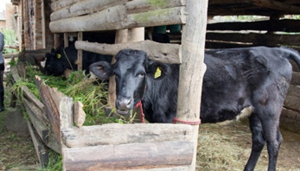
Ballmer Group investment
LIVESTOCK GENETICS AND PRODUCTION SOLUTIONS
RESTORE AND SUSTAIN PASTORAL COMMUNITIES AND RANGELANDS
CLIMATE SMART LIVESTOCK SYSTEMS: emissions & circularity
Enhancing herd/flock productivity and mitigating methane emissions
Digital livestock performance recording and extension services
Genetic solutions in feeds (crop residues) and forages.
Enhancing livestock and forage seed systems, specifically the delivery aspects
Rangeland dynamics (prediction of pasture, herds, production).
Build the climate resilience of pastoralists.
Low emissions development – especially carbon sequestration.
GHG emission factors
Support national GHG inventories, accounting and MRV
Mitigation strategies

Slide 16
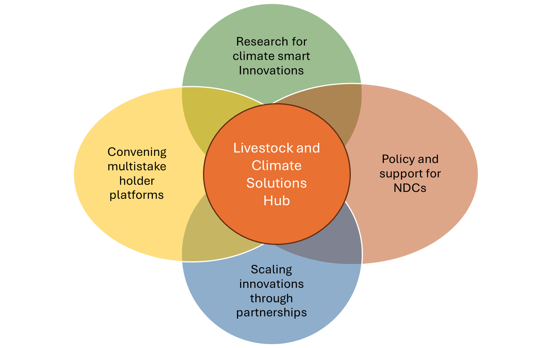


What next
Crowd in interested partners and stakeholders
Discuss with other emerging alliances around livestock and climate how to add value
Co-develop the vision, the potential scale and modalities

Slide 17
The livestock and climate solutions hub
A multi-stakeholder approach to transitioning LMIC’s livestock systems to net-zero, healthy, resilient, and profitable food systems by 2040
Our aim is to co-develop and scale net-zero emission livestock systems that build resilient, productive and equitable livelihood systems in LMICs
A convening multi-stakeholder platform for collaboration and sharing best practices
Co-design approaches to transformative low-emission livestock development
Bundling technologies to enhance productivity in genetics, animal health, and nutrition
Scaling demand-driven solutions through public, private, and NGO partnerships
Strengthening sustainable livestock policies and increasing investments
Measuring impact on GHG emissions and supporting NDC framework and IPCC targets

Slide 18
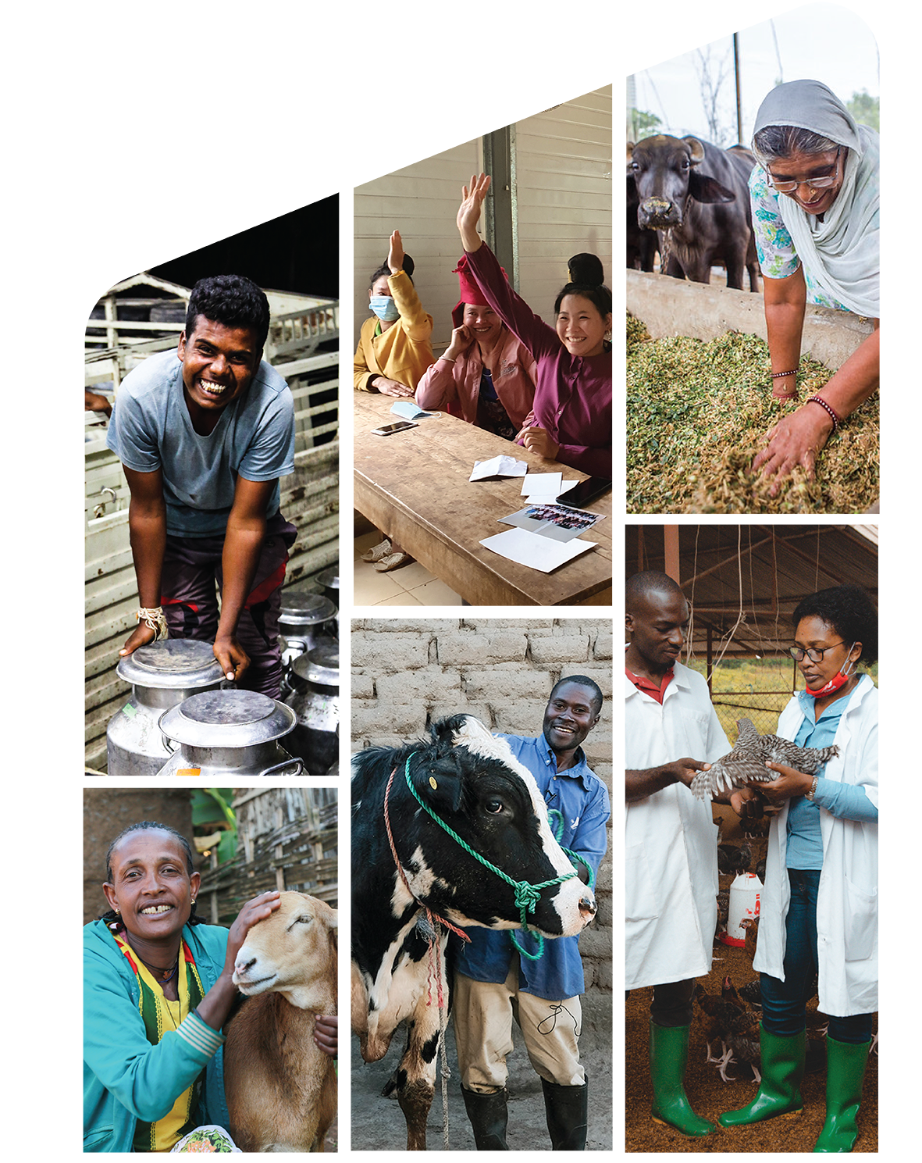

The International Livestock Research Institute (ILRI) works to improve peoples’ lives in low- and middle-income countries through livestock science that contributes to equitable and resilient livestock systems in order to deliver food systems transformation with climate and environmental benefits. Co-hosted by Kenya and Ethiopia, it has regional or country offices throughout Africa and Asia.
ILRI.org | CGIAR.org

Slide 19

THANK YOU

