Slide 1
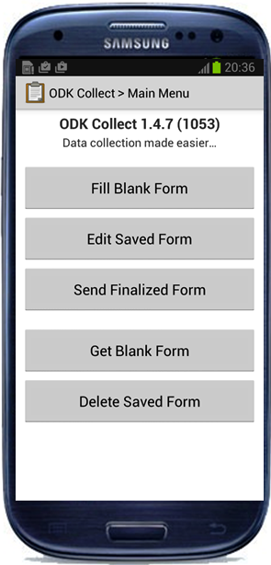
ODK FOR DATA CAPTURE
African Dairy Genetic Gains (ADGG)
Jennifer Gitau (ILRI)
Livestock Genetics Program
Event/meeting name: Training on ODK for data collection
Date: 18th -21st July 2021
Venue: Tick Hotel, Kawempe in Wakiso District

Slide 2
Training Objectives
Understand ODK App and its use in data collection
Understand the different types of data used in ODK
Demonstrate how to use ODK tool in collecting data

Slide 3
ODK-Open Data Kit
Open Data Kit (ODK) is a free and open-source mobile-based application which help organizations create digital data collection solutions through aggregate servers.
Developed in 2009 and has continually been upgraded to enhance user experience.
Its an application that runs on android smart devices only.
The mobile phone based ODK data capture solution is Simple, Secure, Flexible and smart

Slide 4
Getting Started With ODK
Recommended workflow
Get a Central server
Get the App from play store
Create XLS Form and upload it to Central
Download form from central onto device
Fill out a form and upload it to Central

Slide 5
DESIGNING A FORM IN ODK
DATA TYPES AVAILABLE IN ODK
Note
Text
Integer
Decimal
Select_one
Select_multiple
Date / Time
Geopoint
Image
Barcode
Calculation
Metadata

Slide 6
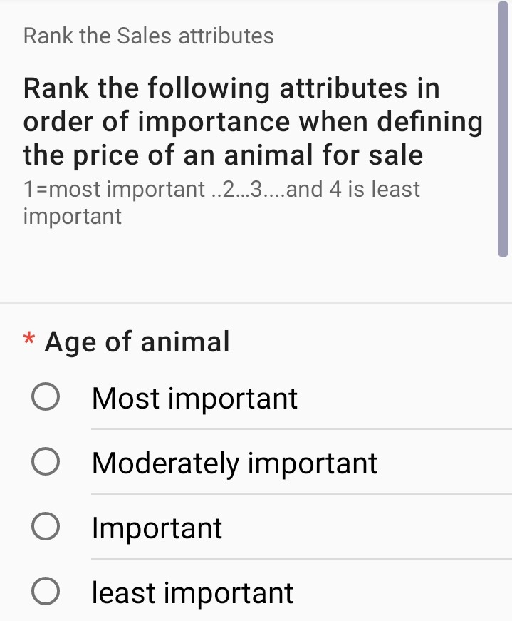
DATA TYPES IN ODK
Note
A Note provides instructions or information to guide you in entering data.
The note contains information that guides the respondent on how to rank attributes determining price of animals during sale.
Click and delete to replace this photo with another one

Slide 7
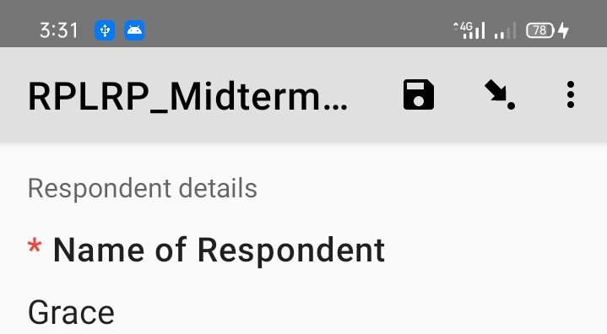
DATA TYPES IN ODK
Text
This is useful when collecting free text responses.
A text box is provided to enable you write your response. This is useful when different responses are possible
Click and delete to replace this photo with another one

Slide 8
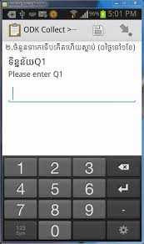
DATA TYPES IN ODK
Integer and Decimal
Integer boxes allow the entering of whole numbers only e.g., 8, 28, 100, 1257.
Decimal boxes allow entering of whole numbers and numbers with decimal points e.g., 1.2, 4.8, 20.3
Click and delete to replace this photo with another one

Slide 9
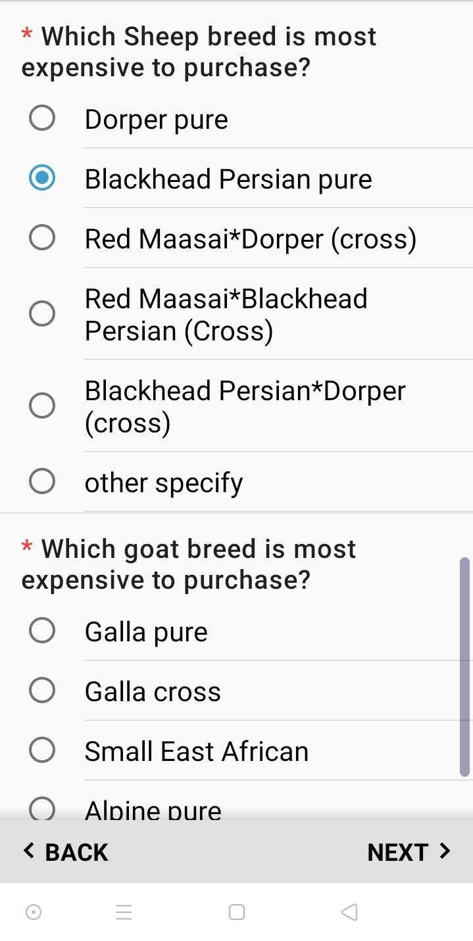
DATA TYPES IN ODK
Select One
This allows only one answer to be selected
The option selected is the one that will be saved as the response to the question
Click and delete to replace this photo with another one

Slide 10
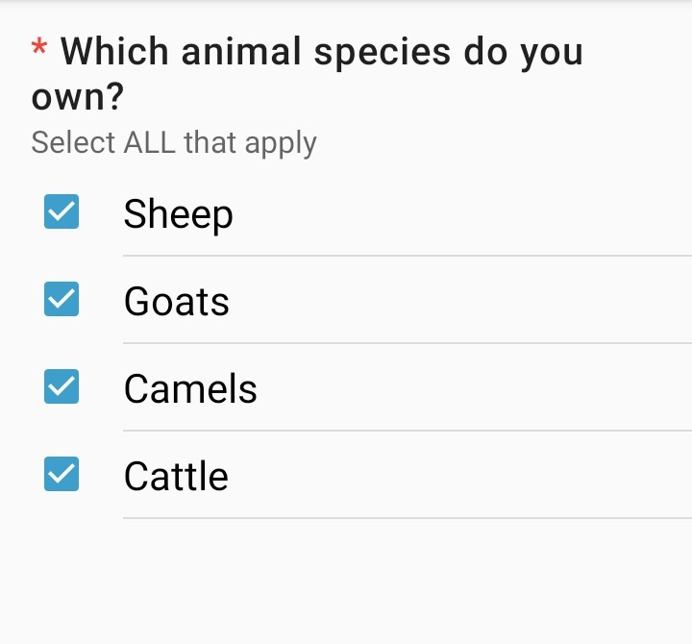
DATA TYPES IN ODK
Select Multiple
This allows more than one answer to be selected for a particular question.
The choices usually have a square beside them
Click and delete to replace this photo with another one

Slide 11
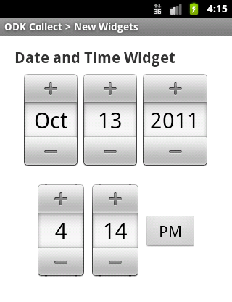
DATA TYPES IN ODK
Date and Time
Used to select a date or time entry
This ensures a valid date or time is entered
Click and delete to replace this photo with another one

Slide 12
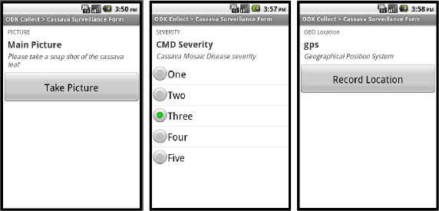
DATA TYPES IN ODK
Image
Used to take pictures which is linked with the data being collected e.g., Picture of ear tag taken while doing animal registration
It uses the camera of the device being used to collect the data
Click and delete to replace this photo with another one

Slide 13
DATA TYPES IN ODK
Geo Point
Used to collect GPS location where the data is being collected
GPS might not work when you try to collect when indoors
Click and delete to replace this photo with another one

Slide 14
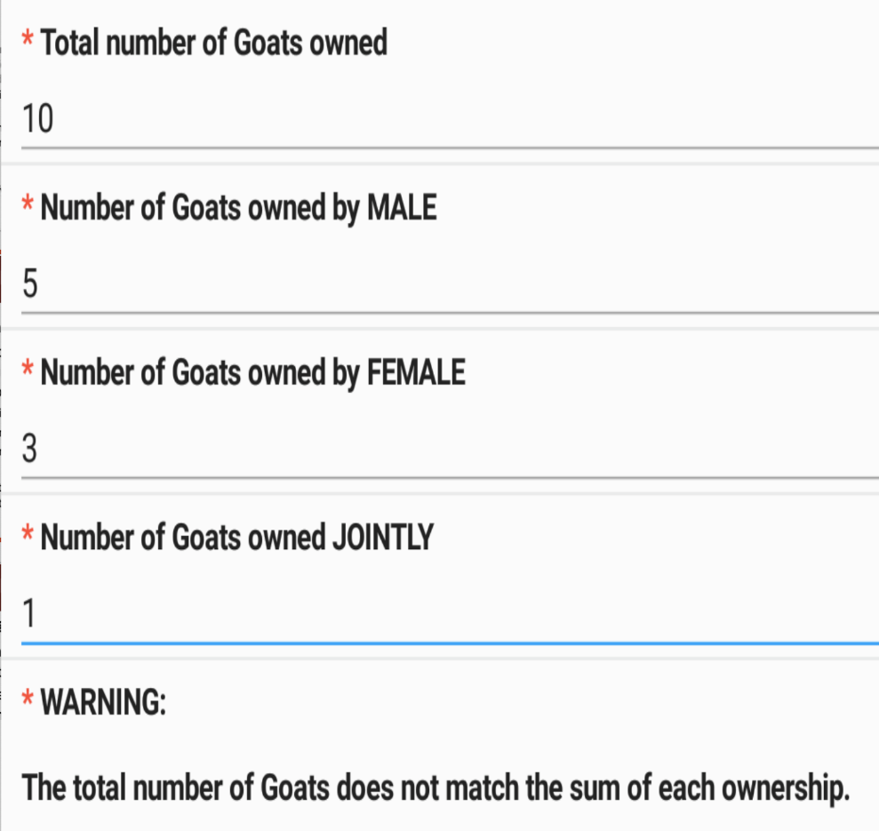
DATA CHECKS IN ODK
Calculation
Calculation are done automatically in the background of ODK to do a calculations based on previous entries e.g.
  Total number of animals in a farm. In the example the Total number of goats should be equal to the number owned by male, female and jointly. When the calculation is wrong, a warning will appear as shown.
Click and delete to replace this photo with another one

Slide 15
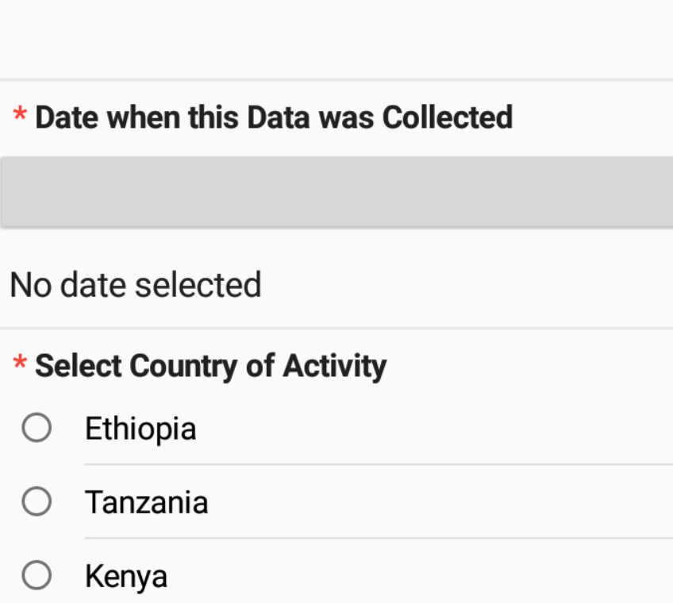
DATA CHECKS IN ODK
Required questions
These are questions that you cannot skip while entering the data. If you try to move to the next page without answering a message is displayed indicating the question is required
They usually have a red asterisk (*) as shown in the picture
Click and delete to replace this photo with another one

Slide 16
DATA CHECKS IN ODK
Relevant
This feature of XLS Form is the ability to skip a question or make an additional question appear based on the response to a previous question.
-If YES, the details of the breeds kept will be entered.
-If NO the details of the breeds will be skipped.
type | name | label | relevant
select_one yes_no | Keep_sheep | Do you rare sheep in your farm?
Select_multiple sheepbreeds | Sheep_breed | Breed of sheep kept | ${Keep_sheep}=‘yes’

Slide 17
DATA CHECKS IN ODK
Filtering
This is used to reduce selection and force specific selection of items.
E.g., When you select a specific region in a country, only the districts in that country will appear, then when you select the District only the Wards in that district will appear
When you select a village only the Farmers in that village appear in the list

Slide 18
DATA CHECKS IN ODK
Repeats
The feature allows the user to collect the same information for a set of questions a number of times.
Fixed repeats-the form designer specifys an exact number of repeats by using the repeat_count column.
Dynamic repeats-The repeat count can be set to an expression that refers to other fields in the form.

Slide 19
Configuring devices and using ODK

Slide 20
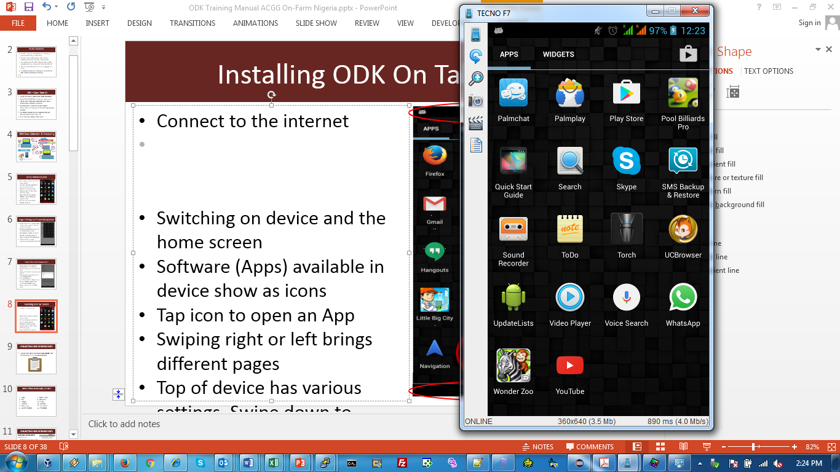

Installing ODK
Connect to the internet
Tap on Play Store to open Apps installer page
Search for ODK Collect
Choose install to install the App in the device
Installation should add ODK Collect icon in the list of Apps.
Click and delete the photos here to replace them with new ones

Slide 21
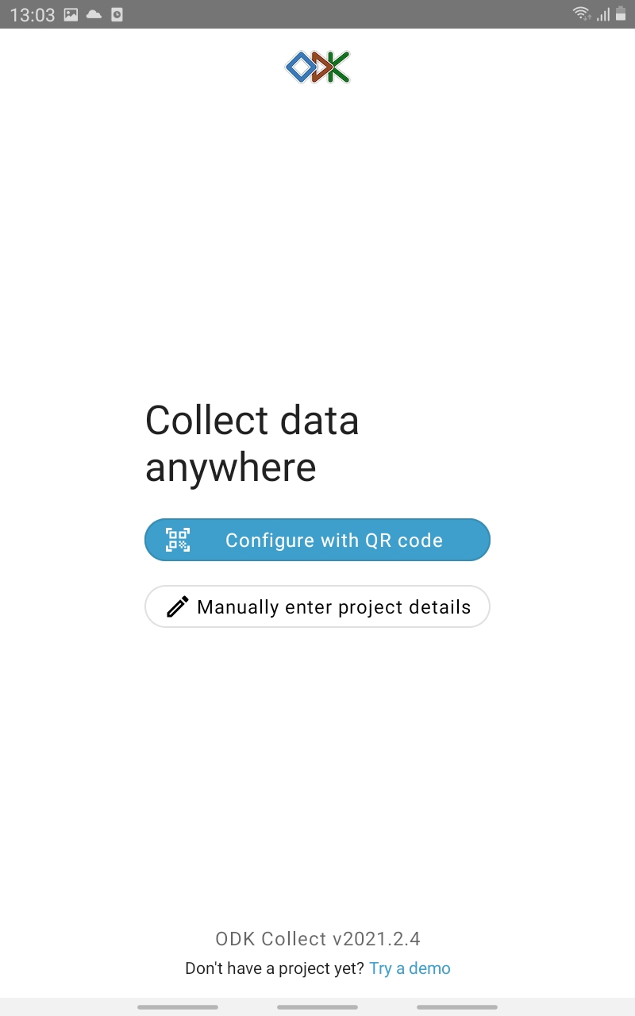
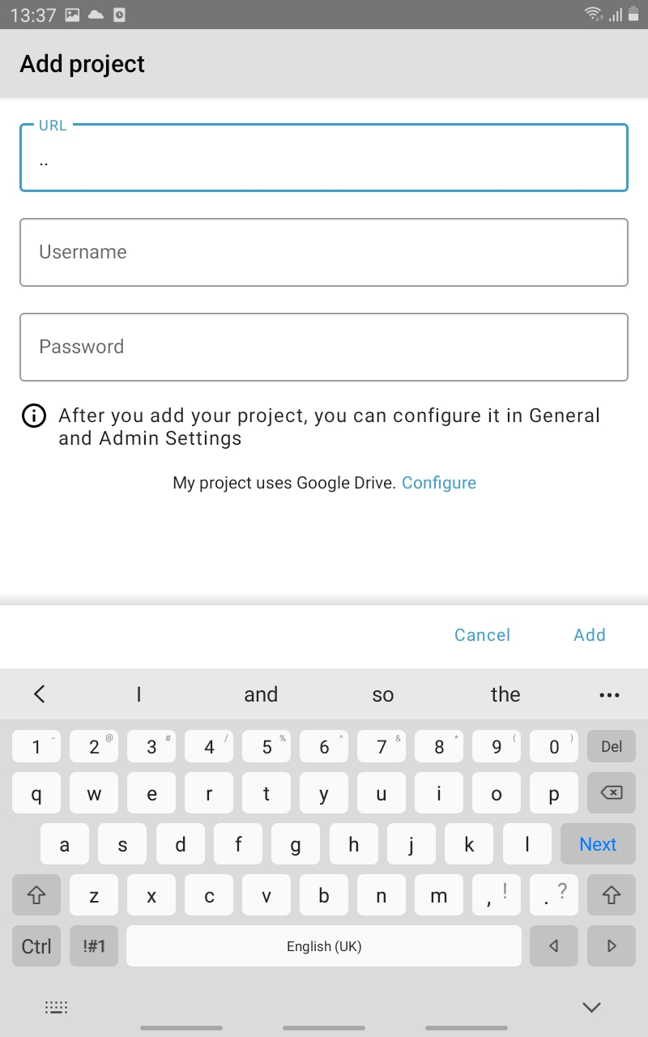
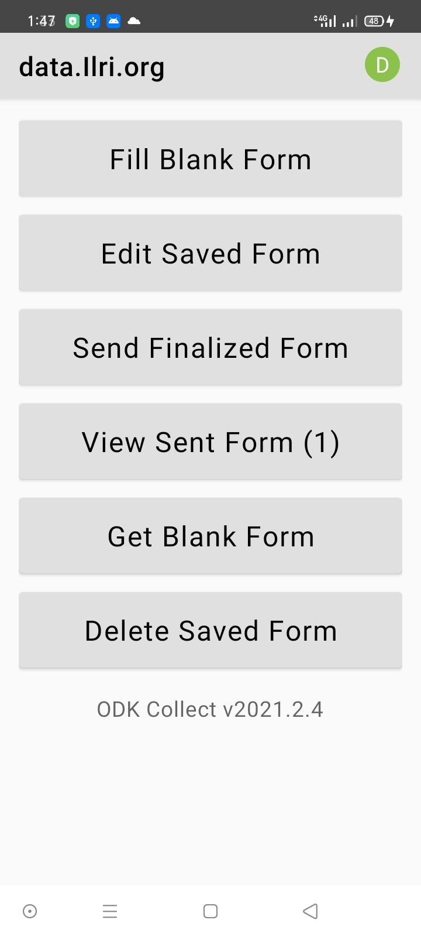
Customizing the ODK environment for use
Open ODK Collect and manually enter project details, and exit the settings page back to ODK Collect main screen.(Done Once)

Slide 22
Customizing the ODK environment for use
User Credentials
URL https://data.ilri.org/collect/adggplatformuganda

Slide 23
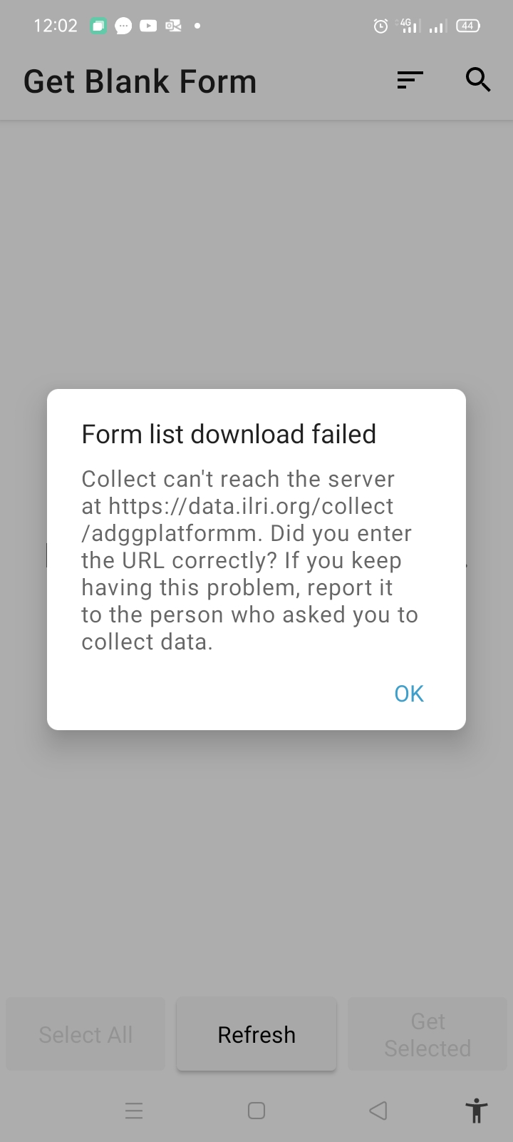
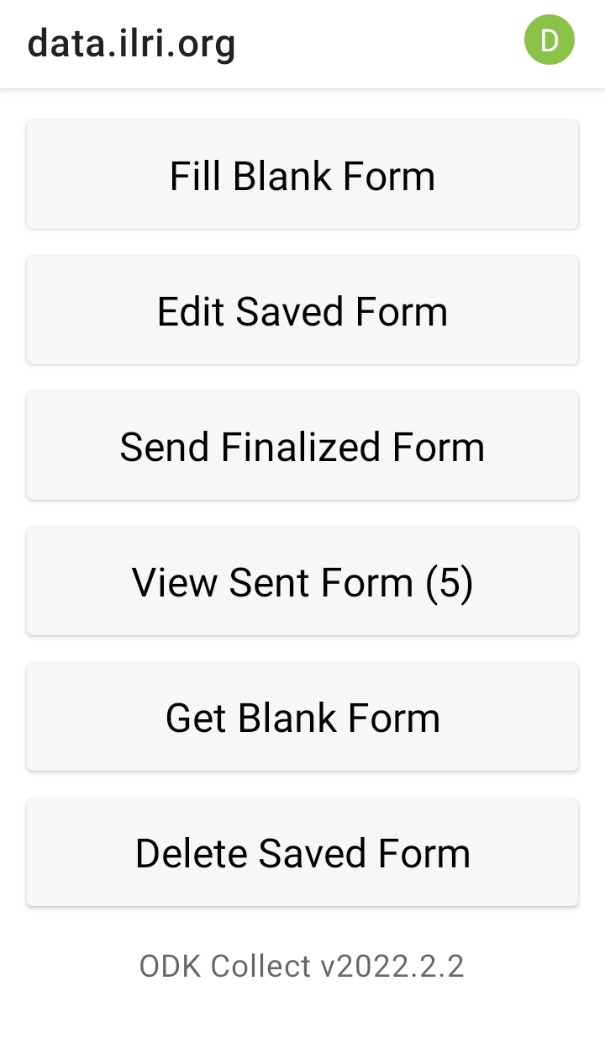
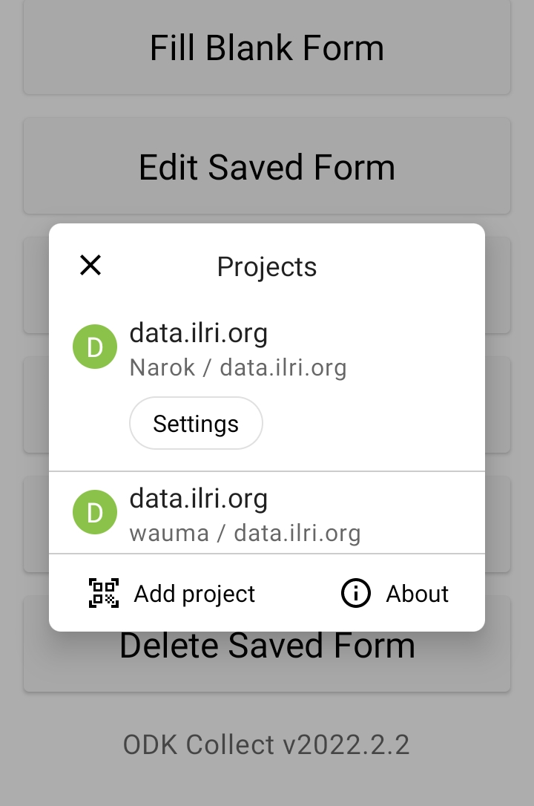
Error related to misspell of the URL 1
1
Solution
2

Slide 24
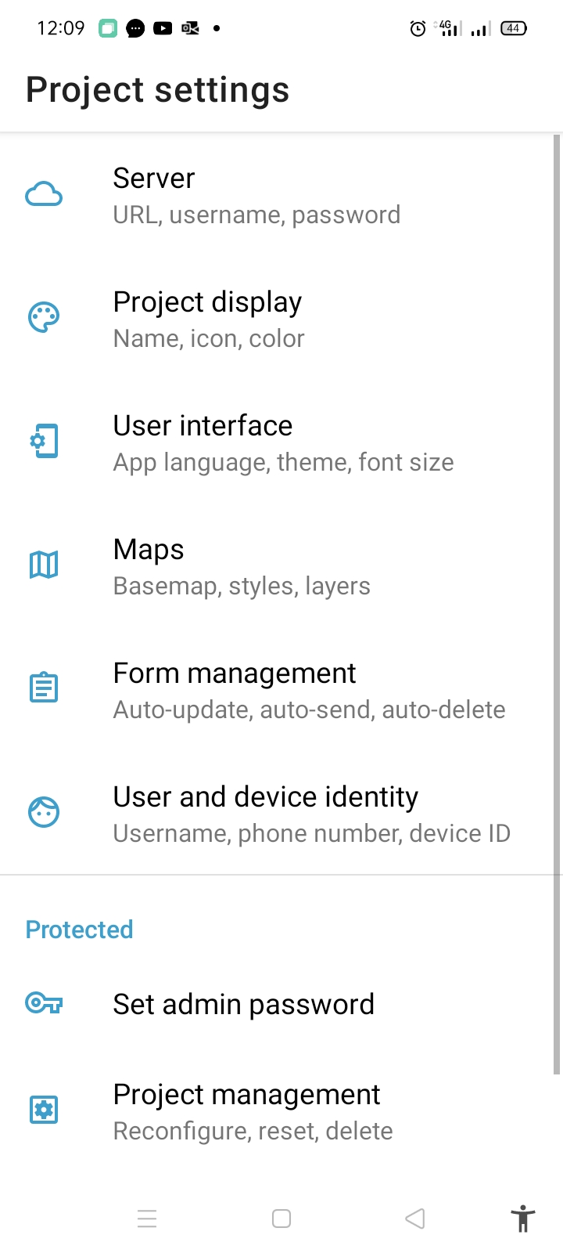
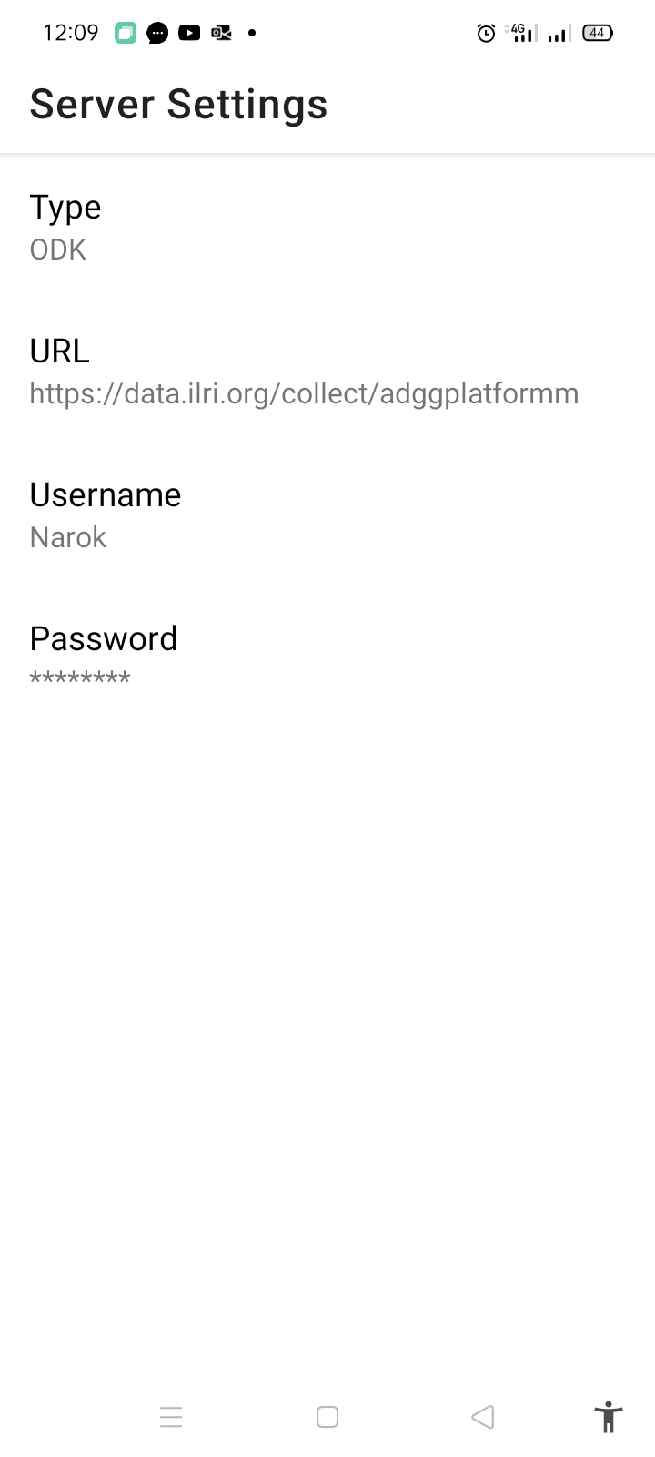
Error related to misspell of the URL…..cont
3

Slide 25
Landing page
Click and delete the photos here to replace them with new ones

Slide 26
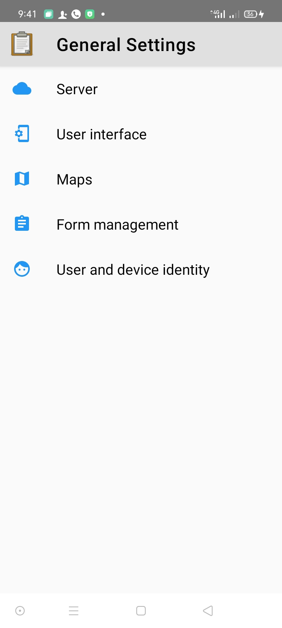
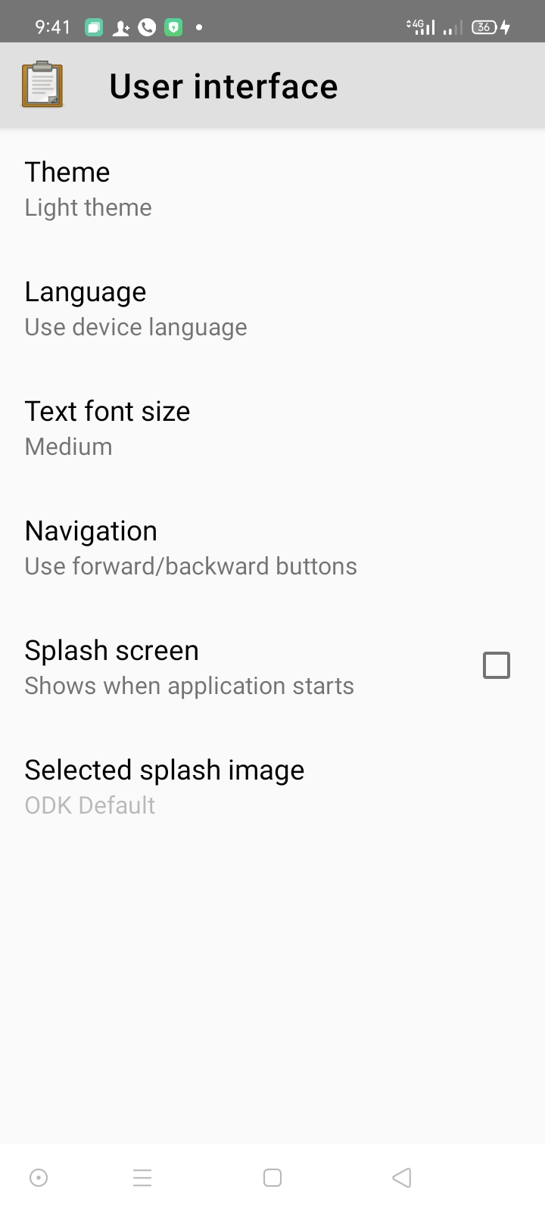
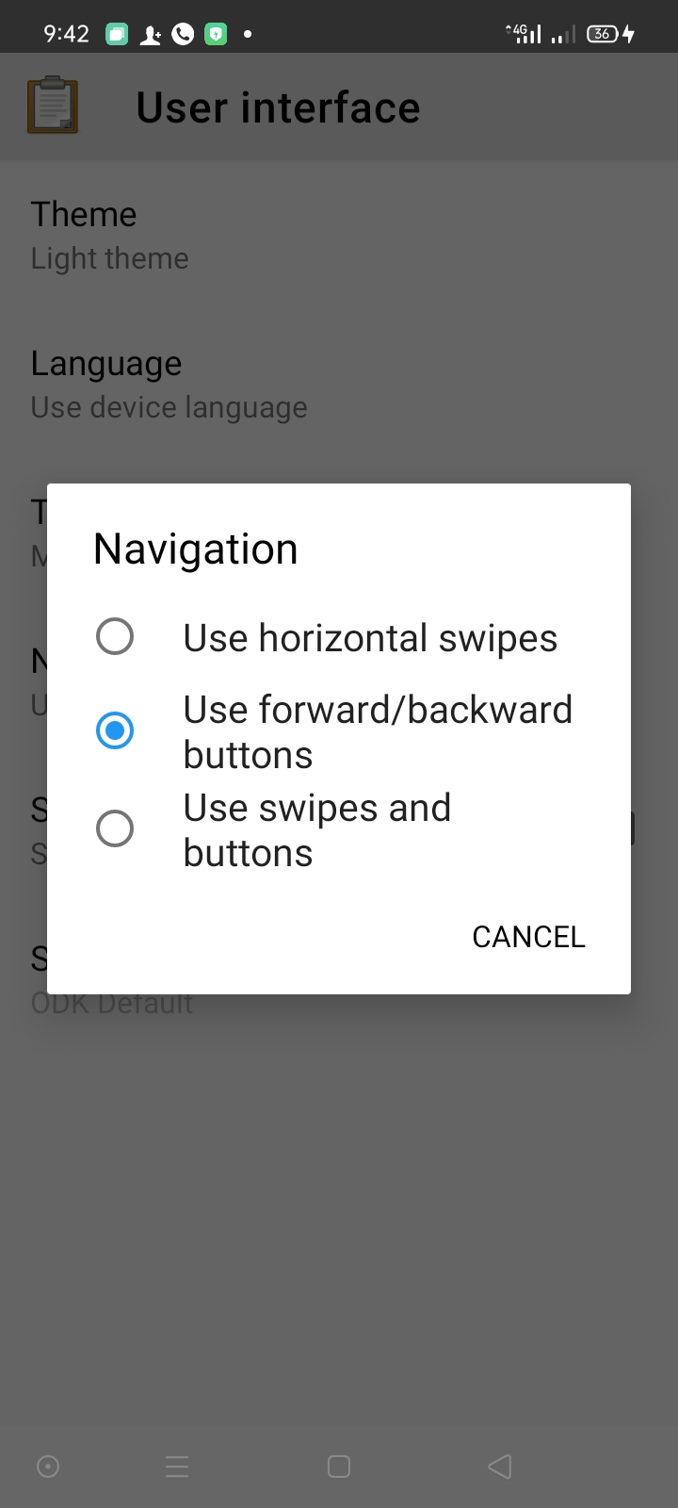
Customizing the ODK environment for use
3. Update the navigation to buttons. (Done once)

Slide 27
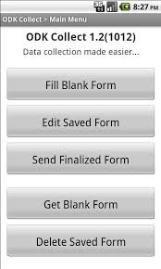
COLLECTING AND SENDING DATA
Get blank form
Button used to download form from ILRI Cloud server to tablet/phone.
Shows list of available data forms in the Server for download into the tablet.
Requires internet connection
Used to update lists of the data in the ODK forms.
ADGG Platform forces update of lists every 5 days

Slide 28
COLLECTING AND SENDING DATA
Fill blank form
Shows list of available forms in the tablet.
Select the form you want to use at that time to collect data.
When a new version released previous versions are invalid.
Does not require internet connection
Click and delete to replace this photo with another one

Slide 29
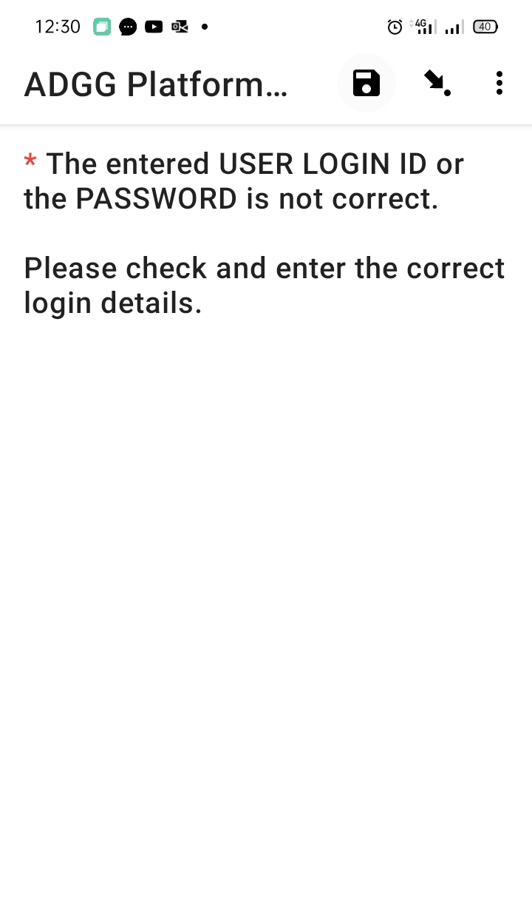
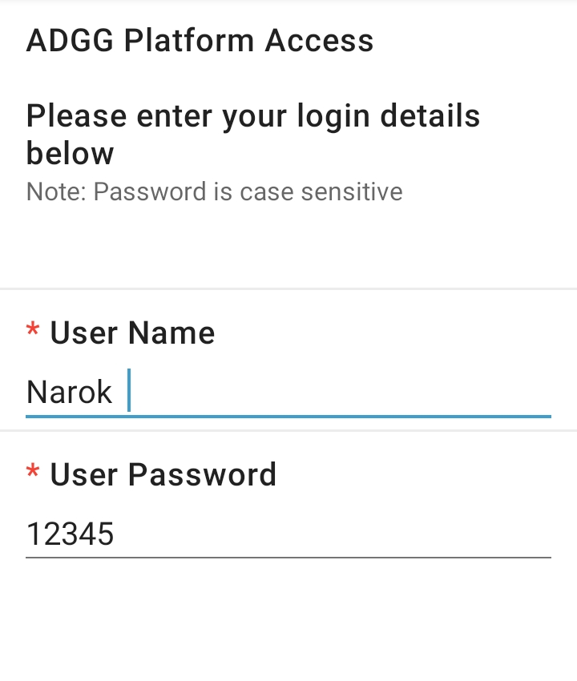
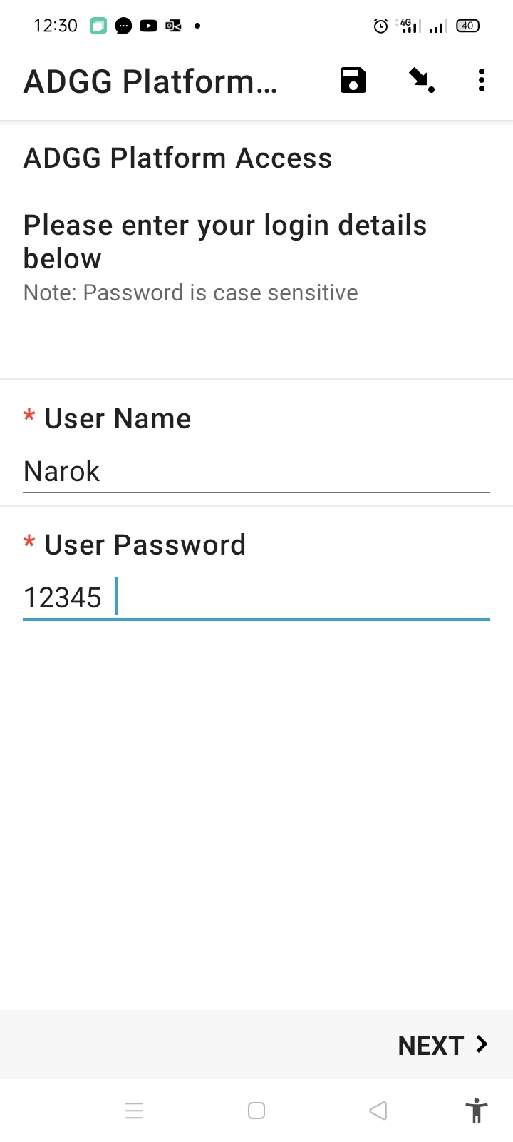
Error related to misspell or white spaces on the username and password
Error
Always ensure there are no spaces after the last letter or number on the username/password

Slide 30
COLLECTING AND SENDING DATA
Editing
Unfinalized forms appear in the editing button
Can choose the questionnaire and edit it to make changes.
Should be done when reviewing your entries on any issues.
Click and delete to replace this photo with another one

Slide 31
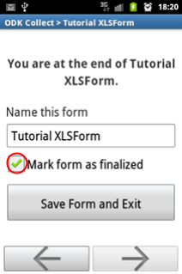
COLLECTING AND SENDING DATA
Finalizing, Editing and Sending Finalized
Finalizing form
Finalizing means setting the questionnaire as finished
Option at the end of the questionnaire
Used for setting the questionnaire as ready for sending to cloud server
Do not finalize immediately as it doesn’t allow to do any editing required
Click and delete to replace this photo with another one

Slide 32
COLLECTING AND SENDING DATA
Send finalized form
Used to upload a form to the cloud after it has been finished, edited and finalized
Please Note : After sending you cannot edit the form and resend
To send a finalized form you must have internet connection .
Select the forms to send and press “Send Selected”
Click and delete to replace this photo with another one

Slide 33
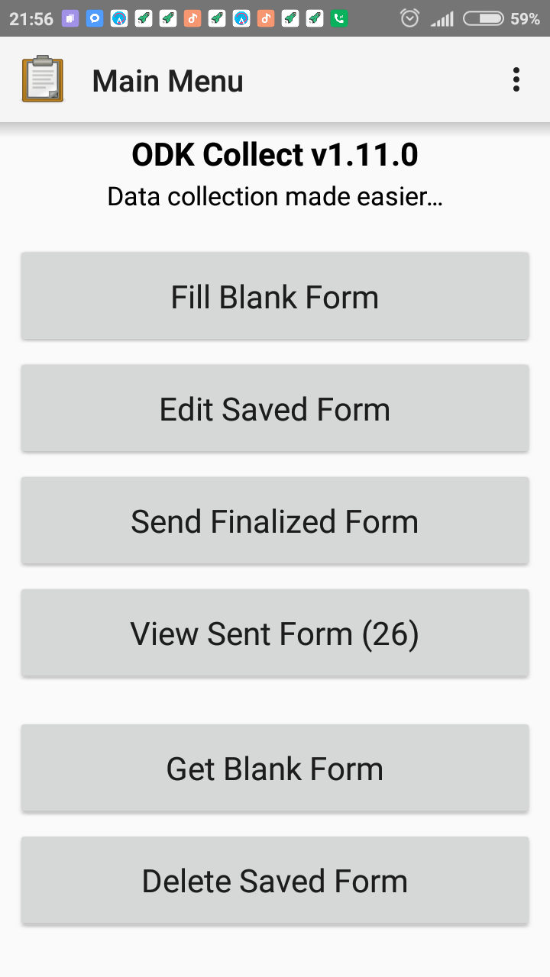
View Sent Form
COLLECTING AND SENDING DATA
View Form
Used to view details of data forms that you already sent
The data cannot be edited as it has been sent from the device

Slide 34
COLLECTING AND SENDING DATA
Delete form
Allows deleting any form in the device
Can delete saved forms or blank forms
Disclaimer!
DO NOT use this button for data forms that you need as you will loose any data

Slide 35
IN SUMMARY
Main ODK Collect screen
Get Blank Form
  Connects to server to download
Fill Blank Form
  Main activity for entering data
Edit Saved Form
  Review of the entered data
Delete Saved Form
  Deletes blank form or data form
Send Finalized Form
  Upload entered data to server
View sent form
  View sent data but can no longer change

Slide 36
KEY NOTES
T
Make sure you have a stable internet connection when performing internet-based activities like “Get Blank Form” and “Sending finalized forms”
New versions of data collection forms are uploaded which are an update of the existing.
Ensure you perform a “Get Blank Form” every morning to update your ODK Form. This ensures you have the most up to date list of farmers, animals and all recorded events.
Data uploaded is processed every 3hours so as to update lists used in the ODK for lookups.
To ensure GPS works well, ensure location setting on your device is active.

Slide 37
THANK YOU

