Slide 1
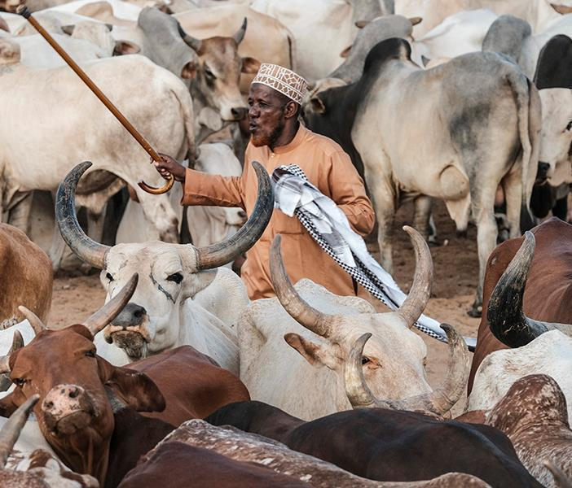
Accelerating sustainable smallholder dairy value chain development in Tanzania
Lusato R. Kurwijila, Sokoine University of Agriculture
CGIAR Livestock CRP and GASL joint side event on national partnerships for sustainable livestock systems at the 7th All-Africa Conference on Animal Agriculture, Accra, Ghana, 30 July 2019

Slide 2
OUR AIMS
The Tanzania dairy industry stakeholders aim to double per capita milk supply (consumption) from the present 47 litres/person/yr in the next five years
This implies doubling milk production from 2.7 billion litres/annum to about 5 billion per year through:
  Accelerated productivity improvement per cow through better dairy genetics, feeding and all year round availability of feeds; health care and breeding and reproduction
  Stronger partnerships in R4D and market linkages

Slide 3
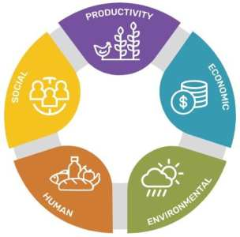
SUSTAINABILITY
The key pillars of sustainable intensification of the dairy subsector implied in the Tanzania livestock master plan (TLMP) has five elements
  Productivity: Increase per cow productivity from current 400 litres/annum by growing the dairy herd ( at the expense of the less productive local cattle).
  Economic: improving profitability of smallholder dairying by ensuring year- round availability of quality feeds and feeding; improving reproductive efficiency (shorter CIs), good animal husbandry practices; better and inclusive access to inputs, advisory and financial services as well as output markets.
  Environmental: By enhancing productivity, fewer cattle will be required to support farmers’ livelihoods, leading to a reduced greenhouse gases carbon foot print for every kg of milk.
  Human: Increasing per capita dairy consumption will improve household food security, nutrition status, reduce stunting among children under 5 years and improve their cognitive and learning capacities.
  Social: Dairying facilitates more inclusive development by targeting gender equity, offering youth employment opportunities, and promoting collective action through milk bulking groups and cooperatives.

Slide 4
The Maziwa Zaidi Partnership for R4D
Vision: an inclusive and sustainable development of the dairy value chain.
The principal goals are:
  Smallholder farmers have reliable and consistent access to quality inputs and services in order to efficiently achieve high milk productivity
  Smallholder farmers have access to reliable, well co-ordinated and efficient marketing arrangements resulting in improvement in household income and livelihoods and
  Poor consumers have improved access to quality, safe and nutritious dairy products at affordable prices to increase per capita consumption and realise the health and nutrition benefits.
These goals are in line with national agricultural sector priorities
These goals require sustained investment over a period of 10-15 years) and enduring and productive partnerships between different stakeholders

Slide 5
Integrating R&D actors into the Tanzania dairy value chain
Multi-stakeholder innovation processes
Private Sector Investors
SUA /TALIRI
Heifer,
Faida Mali
TDB, Ministry
Advanced Research Institutions
ANSAF
Public Investors (Govt, Donors)
Public investors (Govt, Donors)
ILRI /
Other CG partners
Research
Development

Slide 6
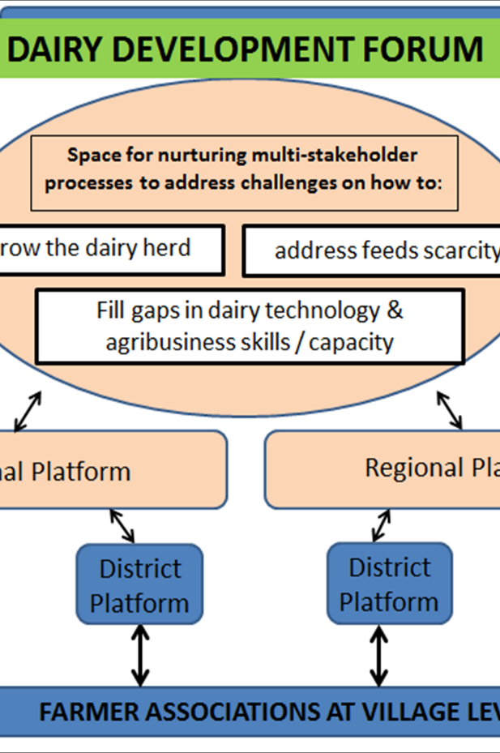
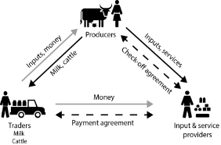
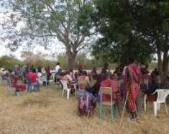
RESULTS
Maziwa Zaidi Phase 1 tested complementary multi-stakeholder processes (hubs and innovation platforms) to increase use of inputs and services, including CGIAR innovations to upgrade the dairy value chain
Focused on market linkages to over come market barriers; increase participation, revenue/income; improve livelihoods
Targeted pre-commercial marginalized cattle-keeping men and women in study sites

Slide 7
PARTNERSHIPS
ILRI
Sokoine University of Agriculture
TALIRI
FAIDA MALI
Heifer Project International Tanzania
Local Government
Value chain actors (Milk traders)
Farmer groups
Lead institution; coordinating research, methodology development
Coordination of site research, and data/sample collection; linkages with local government; postgraduate students research supervision
Participation in research sites activities/ data collection
Business development services; Farm groups capacity building business skills training
Farm group formation and capacity strengthening
Field work facilitation/logistics
Milk bulking from individual farmers; Dairy hub service provision, credit in kind to farmers (vet drugs)
Market access/ milk bulking

Slide 8
SELF-ASSESSMENT
Involving NGOs took care of the development aspect of our R4D interventions
Dairy Development Forum (DDF) at national level and other platforms at regional level enhanced stakeholder engagement with policy makers (and each other).
The hub model that integrates different business services and actors is a useful entry point to strengthen business development and market linkages

Slide 9
RECOMMENDATIONS
Ensure that the contributions of each partner to an intervention are clearly spelt out from the beginning
Involve all partners envisaged to participate in an intervention (including potential beneficiaries) in its formulation; and not bring them in later at inception

