Slide 1
Youth engagement in livestock production and marketing in East Africa
8th KIPPRA annual regional conference
Nairobi, 23rd May 2025
Isabelle Baltenweck
International Livestock Research Institute
Reference: Bullock, R.M., Auma, J.O., Baltenweck, I., Dione, M., Okeyo Mwai, A., Ndiwa, N., Omore, A., Ouma, E. and Yami, M. 2023. Youth engagement in livestock production and marketing in East Africa. Outlook on Agriculture 52(4): 424–433. https://doi.org/10.1177/00307270231215368

Slide 2
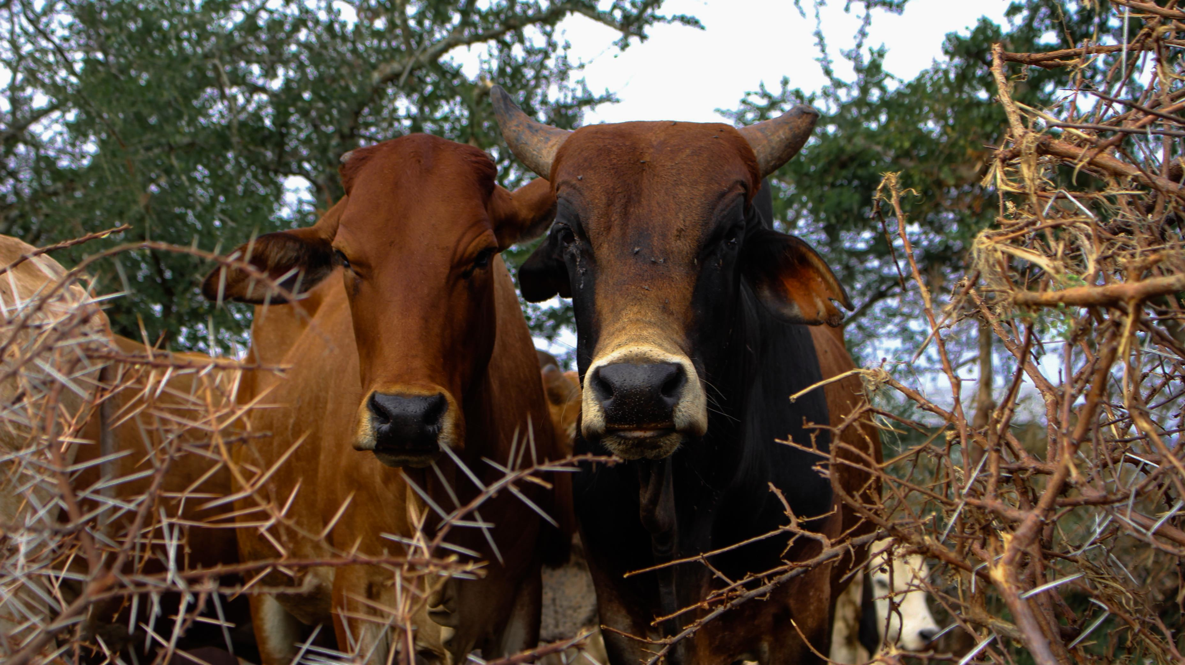
Introduction
The study conducted in 2023 to assess youth engagement in livestock production and marketing in East Africa.
It compares youth (18-35 years old) to non-youth in livestock asset ownership, access to services, use of improved practices, and market participation across dairy, extensive livestock, pig, and chicken systems in Kenya, Uganda, Tanzania, and Ethiopia.
The main objective of the survey was to better understand youth engagement in the livestock sector through commercialization and market participation.
Comparison of youth to non-youth was made in four areas: livestock asset ownership, access to and use of services and improved practices and lastly, market participation.
Notes:
Alary, V., Corniaux, C. and Gautier, D. (2011) Livestock’s Contribution to Poverty Alleviation:
How to Measure It? World Development,

Slide 3
Background
There is limited evidence about how youth engage in livestock production in East Africa.
A better understanding of youth engagement in the sector is needed.
Livestock contributes to national GDPs, household incomes and also provides animal source foods.
Youth unemployment is a major political and socio-economic challenge
Africa is experiencing socio-economic growth, however jobs remain elusive for the youth in the formal wage sector.
The study uses a plausible pathway by which livestock could support youth through greater income security.
Notes:
Alary, V., Corniaux, C. and Gautier, D. (2011) Livestock’s Contribution to Poverty Alleviation:
How to Measure It? World Development,

Slide 4
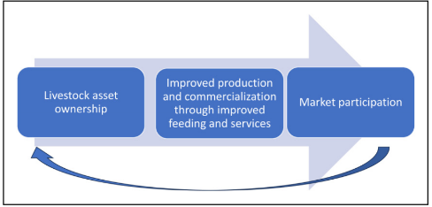
Background (cont)
The pathway uses comparison of youth to non-youth to identify where bottlenecks exist.
The principle of asset-based approaches in reference to asset transfer or asset building is used.
Livestock are an important asset in the East African context.
Young farmers are, however, disadvantaged due to a lack of access to land and high-value animals.
Commercialization is viewed as the gradual shift from integrated farming systems to specialisation to support and increase income and profit opportunities for youth.
Market participation contributes significantly but is influenced by factors such as access to assets, infrastructure, age and educational status.
Notes:
Alary, V., Corniaux, C. and Gautier, D. (2011) Livestock’s Contribution to Poverty Alleviation:
How to Measure It? World Development,

Slide 5
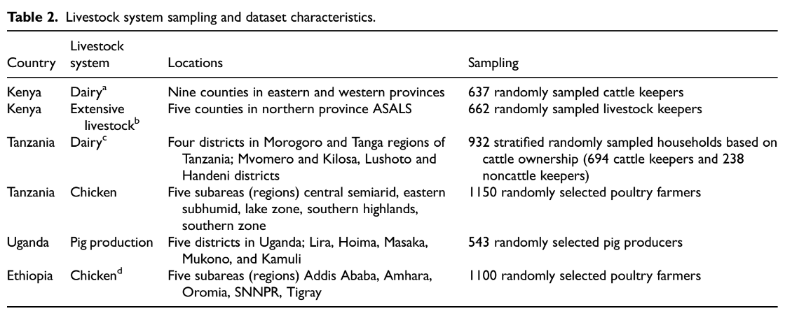
Methodology
Quantitative data was collected through surveys conducted in Ethiopia, Kenya, Uganda, and Tanzania.
Random sampling techniques were used to select a total of 5,447 survey respondents engaged in livestock production.
Statistical significances between youth and non-youth were measured using t-tests.
Notes:
Alary, V., Corniaux, C. and Gautier, D. (2011) Livestock’s Contribution to Poverty Alleviation:
How to Measure It? World Development,

Slide 6
Findings
There were no systematic youth-specific trends across the asset ownership, levels of commercialization or market participation.
Asset accumulation and commercialization can support market participation, but other factors may mediate these opportunities for youth.
Asset ownership did not necessarily correlate with market participation among youth. Instead, factors such as education and improved practices were associated with higher market participation.
Significant differences were found between youth and non-youth in four systems: Kenya dairy, Kenya extensive, Uganda pig and Tanzania dairy.
  Youth owned significantly higher numbers of local cattle in Kenya and Tanzania
  Youth owned significantly fewer livestock in the extensive pastoral system, e.g. in Kenya, non-youth-owned significantly higher numbers of local cattle than youth.
  There were no significant differences in youth and non-youth for goats, pigs, sheep and chickens.
  Youth owned more local cattle while non-youth owned more improved cattle
Notes:
Alary, V., Corniaux, C. and Gautier, D. (2011) Livestock’s Contribution to Poverty Alleviation:
How to Measure It? World Development,

Slide 7
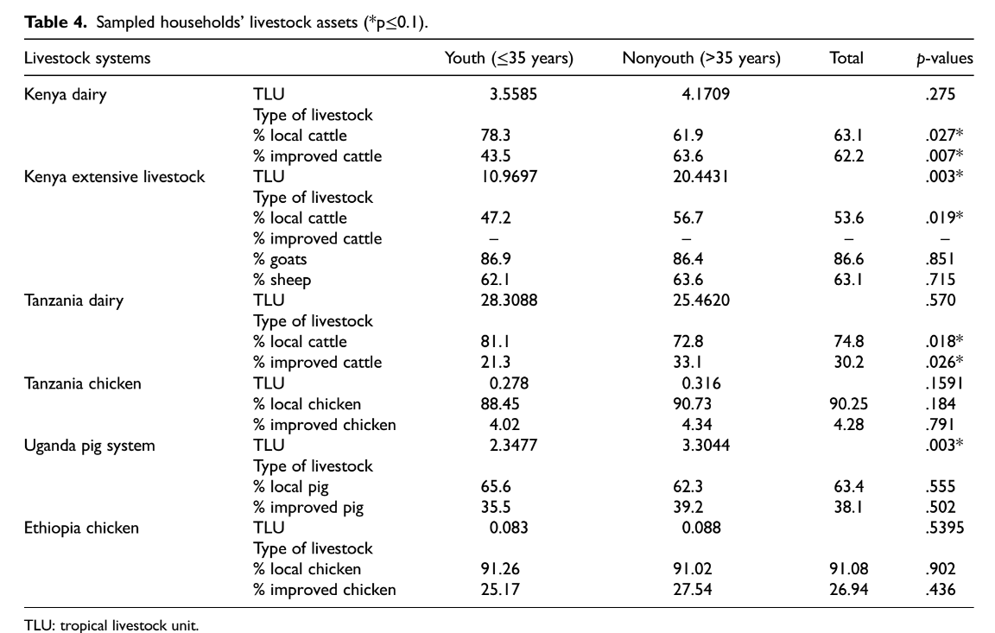
Findings

Slide 8
Findings
The use of improved feeding practices significantly differs between youth and non-youth in Kenya dairy, Uganda pigs and Tanzania dairy.
In the case of Uganda’s pig system, youth uptake is higher than that of non-youth, 89% compared to 76%.
Access to extension services was generally low, with no significant differences between youth and non-youth.
The rates of youths seeking or receiving credit ranged from a low 1% in Tanzania dairy to 37% in Kenya dairy.
In Ethiopia, non-youth seek credit at significantly lower rates than youth.
A logistic regression model was developed to better understand the market participation determinants:
  Age and gender are not significant in explaining market participation
  Education significantly increased the probability of market participation
  Market participation of youths was higher than that of non-youth in the Uganda pig system.
Notes:
Alary, V., Corniaux, C. and Gautier, D. (2011) Livestock’s Contribution to Poverty Alleviation:
How to Measure It? World Development,

Slide 9
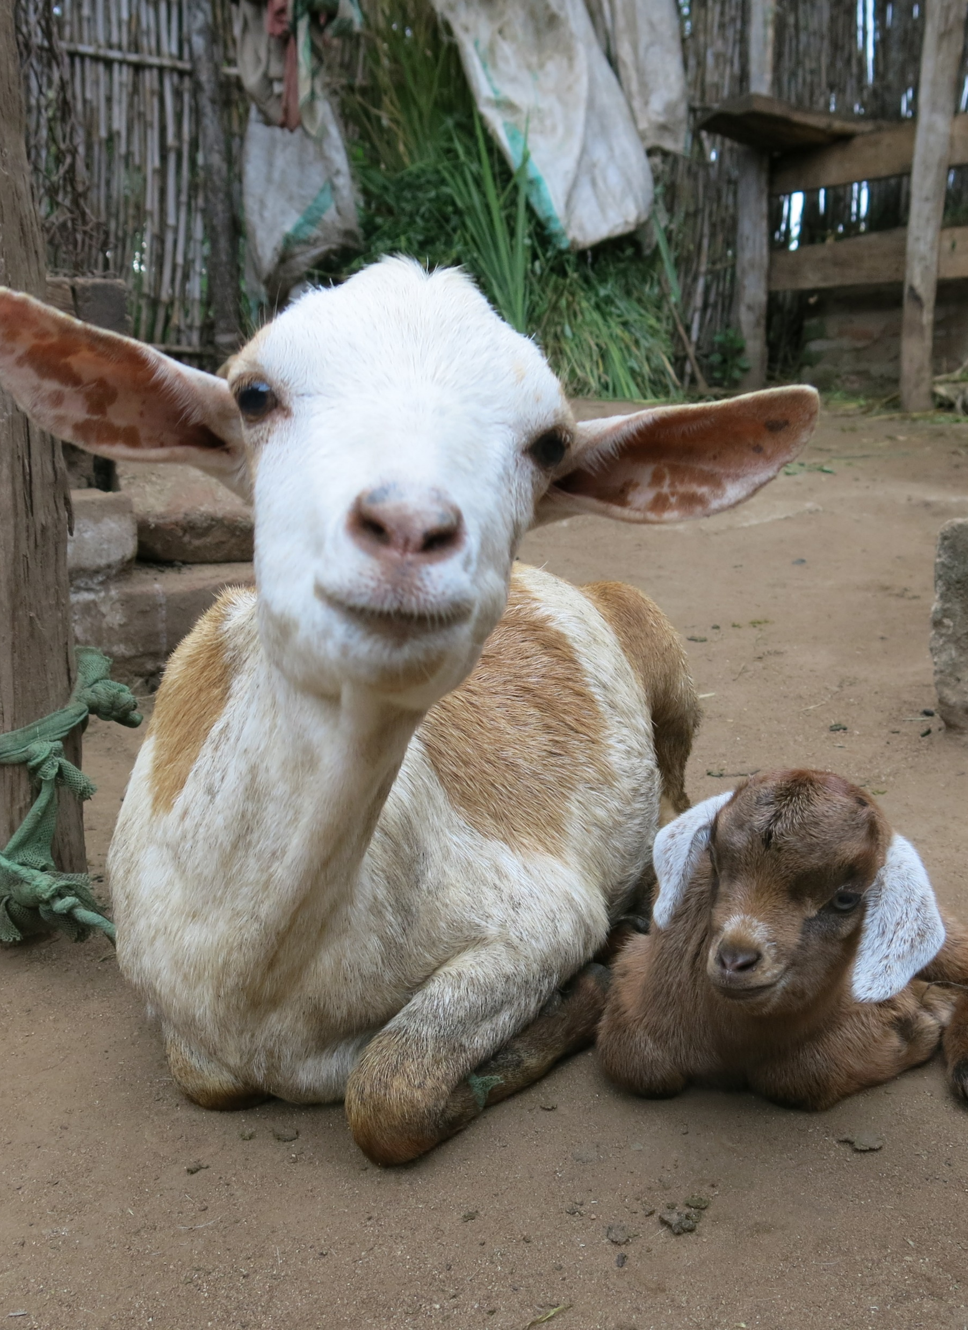
Recommendations
Further research into how livestock are acquired and the implications on asset-based approaches to better understand the potential of livestock as a source of income during youth transitions in different livestock systems.
Further research to inform and tailor policy approaches to better support equitable opportunities in the livestock sector.
Further research into understanding how social factors, including gender, shape youth opportunities and constraints, is needed.

Slide 10
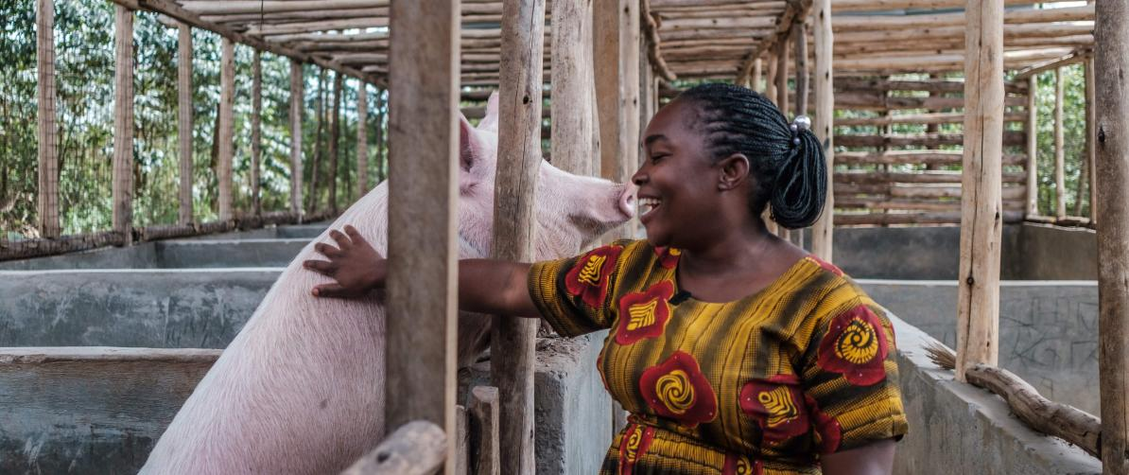
THANK YOU
Thank you!

