Slide 1
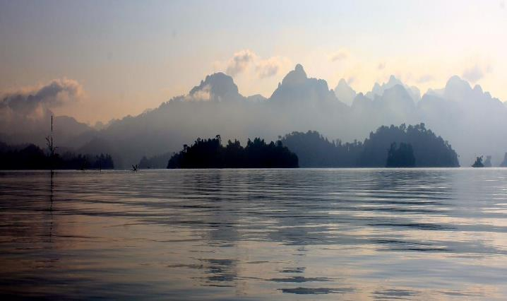
Nexus Gains Initiative: trade-offs and synergies
WEF Nexus Advanced School
Matthew McCartney
Amman, 04/02/24
Notes:
realizing multiple benefits across water, energy, food and ecosystems

Slide 2
Water/Energy/Food/Environment (WEFE) Nexus Challenges in a Climate Crisis
Source: Headey and Hirvonen (2022) using data from FAO, the World Bank and the IMF.
Notes:
It seems that joint food and energy crises have become the norm: Three have now occurred in just the last 15 years, driven by poor bioenergy policies, climate extremes, and other bad human decisions, leading to crisis triggers and multipliers, such as COVID-19 and the Russia- Ukraine war.
The three recent food-fuel price crises demonstrate that food and energy systems are interlinked and that these systems, in turn, are affected by continuing degradation of the environment and water resources.
All three crises dramatically pushed up food and energy prices, as well as those of fertilizers, leading to an increase in the number of undernourished people worldwide. In 2021, 150 million more people hungry in 2021 compared to 2019.
The initiative analyzes alternative, practical interventions at different scales – from farms to watersheds to river basins – to enhance water, energy and food security and environmental sustainability. It seeks to improve understanding of WEFE interdependencies and trade-offs, engaging vulnerable groups such as women, youth and other marginalized communities that bear the brunt of poorly managed WEFE systems and have little say in decisions that affect them. NEXUS Gains is using integrated biophysical and socio-economic tools to support policy design, investment planning and improved governance.

Slide 3

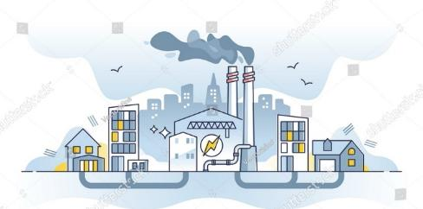
Pursuing single sector objectives often hinders development
Example: Increasing electricity production
More abstraction of water for cooling
Less water for other sectors and the environment
Increased GHG emissions
Less water security
Less environmental security
Example: Increasing agricultural production
More land used for growing food
Competition over land resources (eg.biofuels vs. crops as food)
More use of agrochemicals
Contamination of water resources
Increased GHG emissions
Less water security
Less environmental security
→Need for a systematic WEF Nexus approach!
Notes:
Without consideration of other sector goals

Slide 4
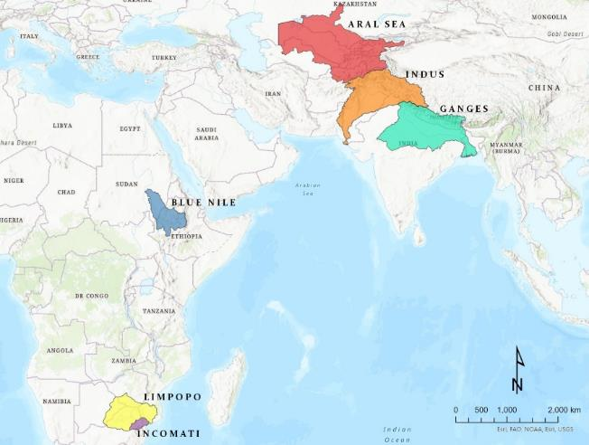
NEXUS Gains
Analyzing and scaling NEXUS interventions Foresight methodologies and trade-off analyses across sectors
Boosting water productivity and integrated storage management across scales Decision support to enhance water use in agriculture
Energizing food and water systems Business and finance models promoting inclusive access to clean energy
Strengthening multi-stakeholder governance Improving multistakeholder governance across WEFE systems
Developing WEFE capacity, including emerging women leaders Training resources for including on gender equality and social inclusion in nexus approaches
Focus Basins: Limpopo/Incomati, Blue Nile, Aral Sea, Indus and Ganges
Target countries: Ethiopia; India; Nepal; Pakistan; South Africa; Sudan; Uzbekistan; Zimbabwe
Notes:
Five WPs – all going well – all marked green in the traffic lights of the annual report
Co-developing and scaling NEXUS innovations using foresight methodologies and trade-off analyse;
Boosting water productivity across scales (farm to watershed to basin) and sectors using a whole systems lens;
Energizing food and water systems sustainably and inclusively;
Strengthening cross-sectoral, multi-stakeholder governance at community, national and regional levels; and
Develop technical (WEFE) and leadership capacity of emerging woman leaders

Slide 5
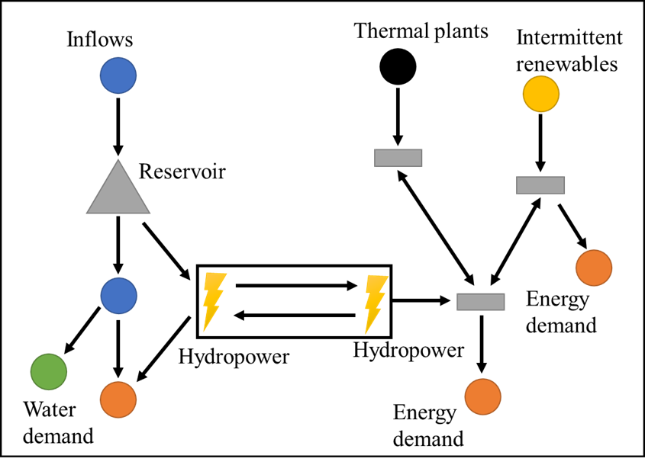
EOI1: Tradeoffs and synergies
Water resource system simulator (Pywr)
Pywr can simulate combined water and energy systems.
Two-way communication between power system (electrical grid) simulation and water model.
Investigate how hydropower & other technologies (thermal, wind, solar, biomass, hydrogen) reduce costs and increase reliability of essential and high value water and energy services.
Operational (management) and long-term planning (infrastructure investment) can be optimized.
Links to multi-objective optimization
Notes:
Water and energy modelling in the Incomati, Aral Sea and Indus basins. Climate change and development scenarios
User provides hydrological flows and water demands, the model simulates flow, storage, and water management (allocation, demands, infrastructure, regulation, etc.)
Allows fast multi-scenario simulation for robust decision-making studies

Slide 6
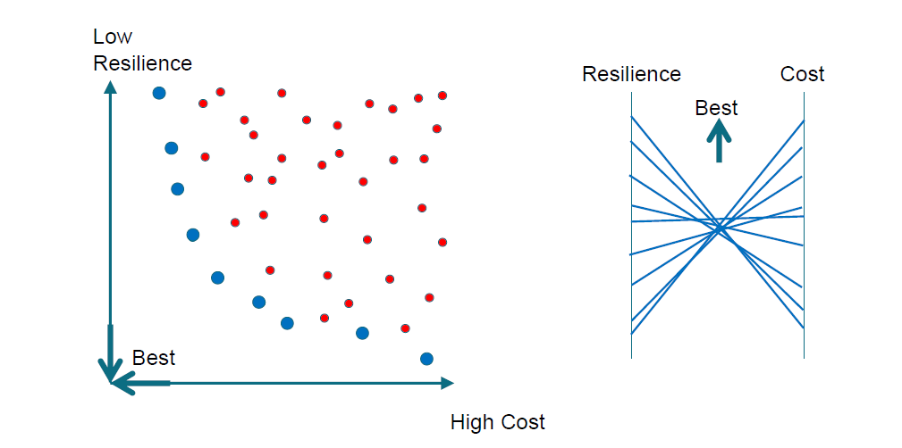
Searching for the best available trade-offs

Slide 7
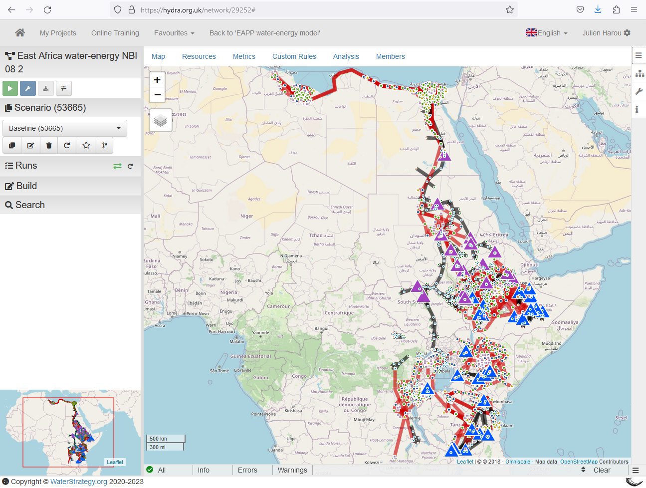
Nile and East Africa Power Pool
NBI water organization and the EAPP (East African Power Pool) use Pywr to rethink how to invest in East Africa’s combined water-energy system.
Benefits of optimized synergies are in the billions of dollars, in addition to climate adaptation and mitigation gains.
Electrical grid
Water resources

Slide 8
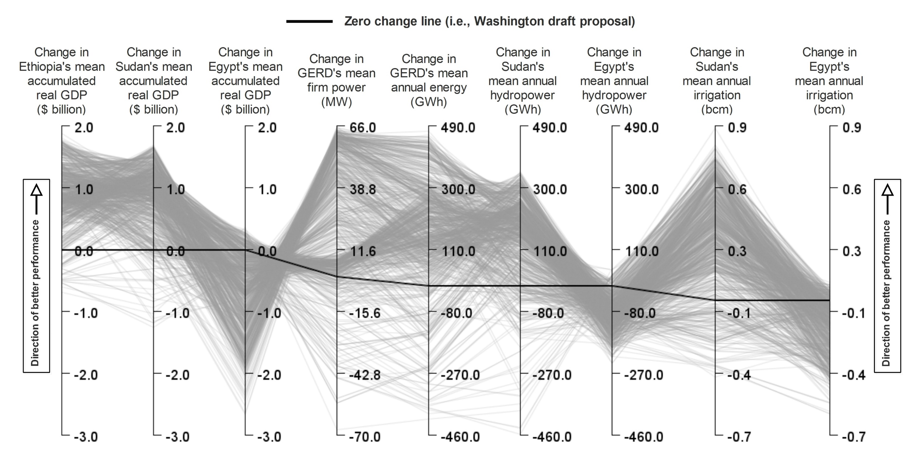
Multi-criteria optimization

Slide 9
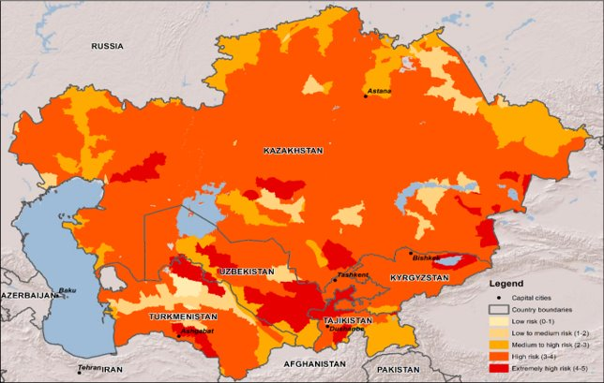
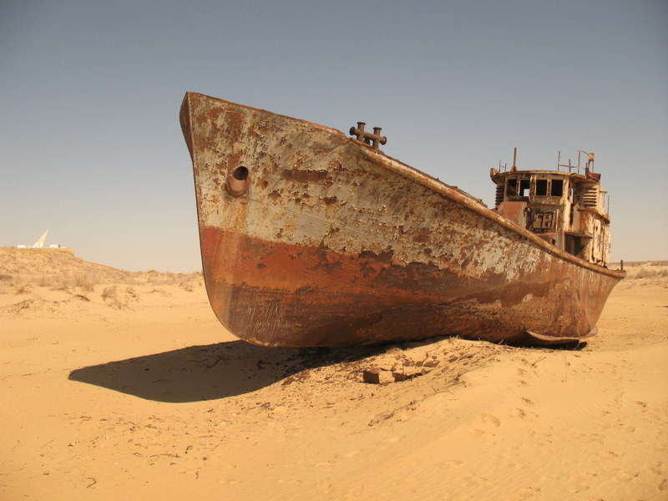
Improved Irrigation efficiency to save water, reduce GHG emissions and cut pollution in Uzbekistan
Current Water Risk Level in CA

Slide 10
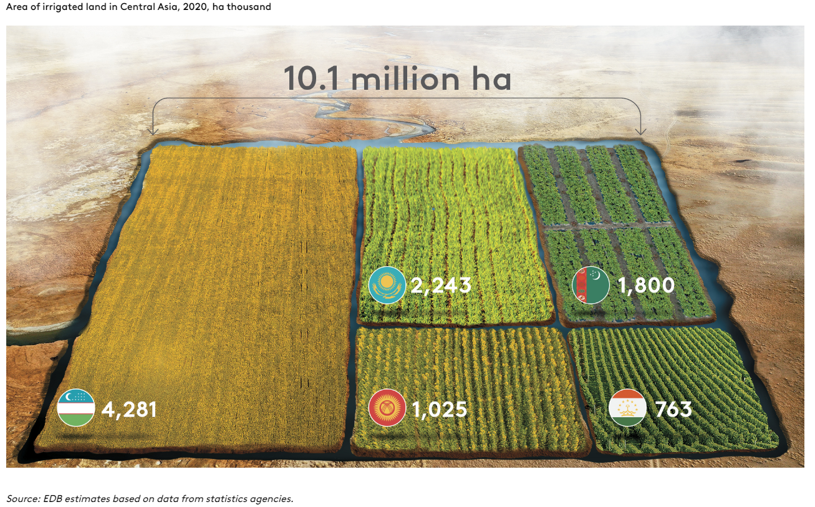
Irrigated land In Central Asia

Slide 11
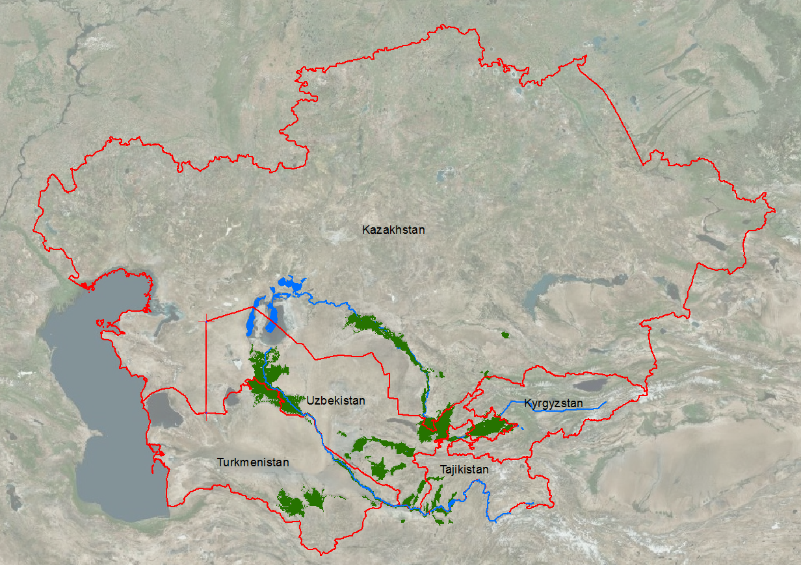
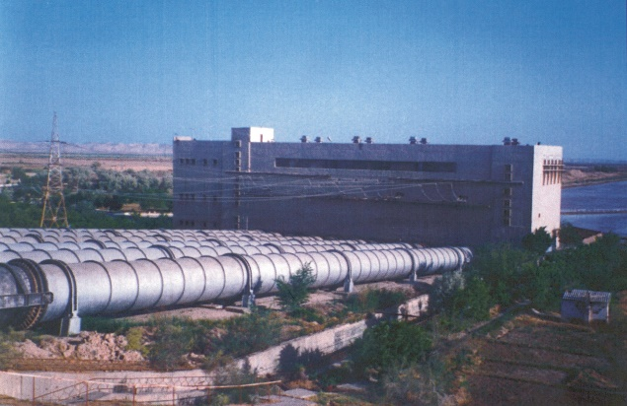
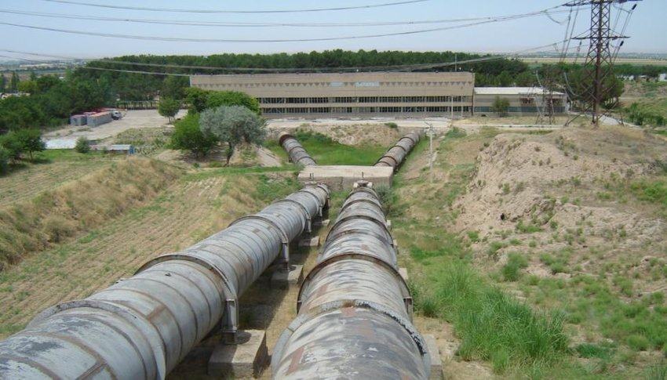
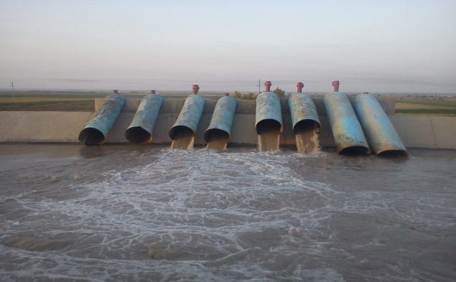
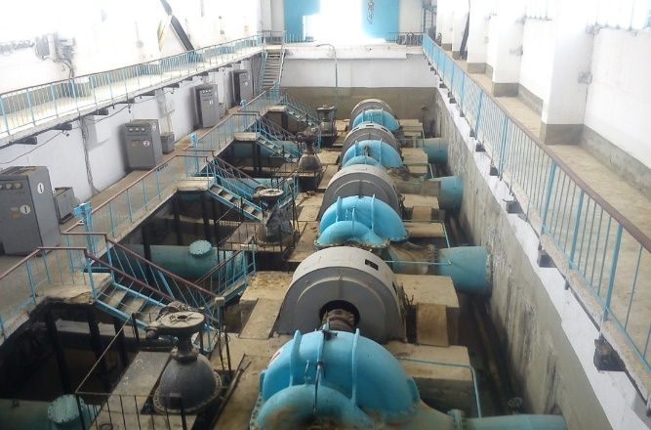
Lift irrigated areas in Aral Sea Basin
  Approximately 70% of the budget for the Ministry of Water Resources (MWR) in Uzbekistan is allocated for electricity consumption by pump stations.
Zafarabad Irrigated Area
Fergana Valley
Amu-Bukhara Canal
Amu-Zang
Karshi Main Canal

Slide 12
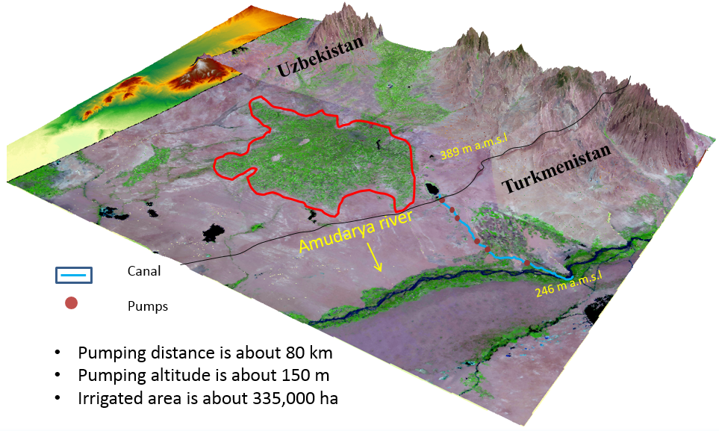
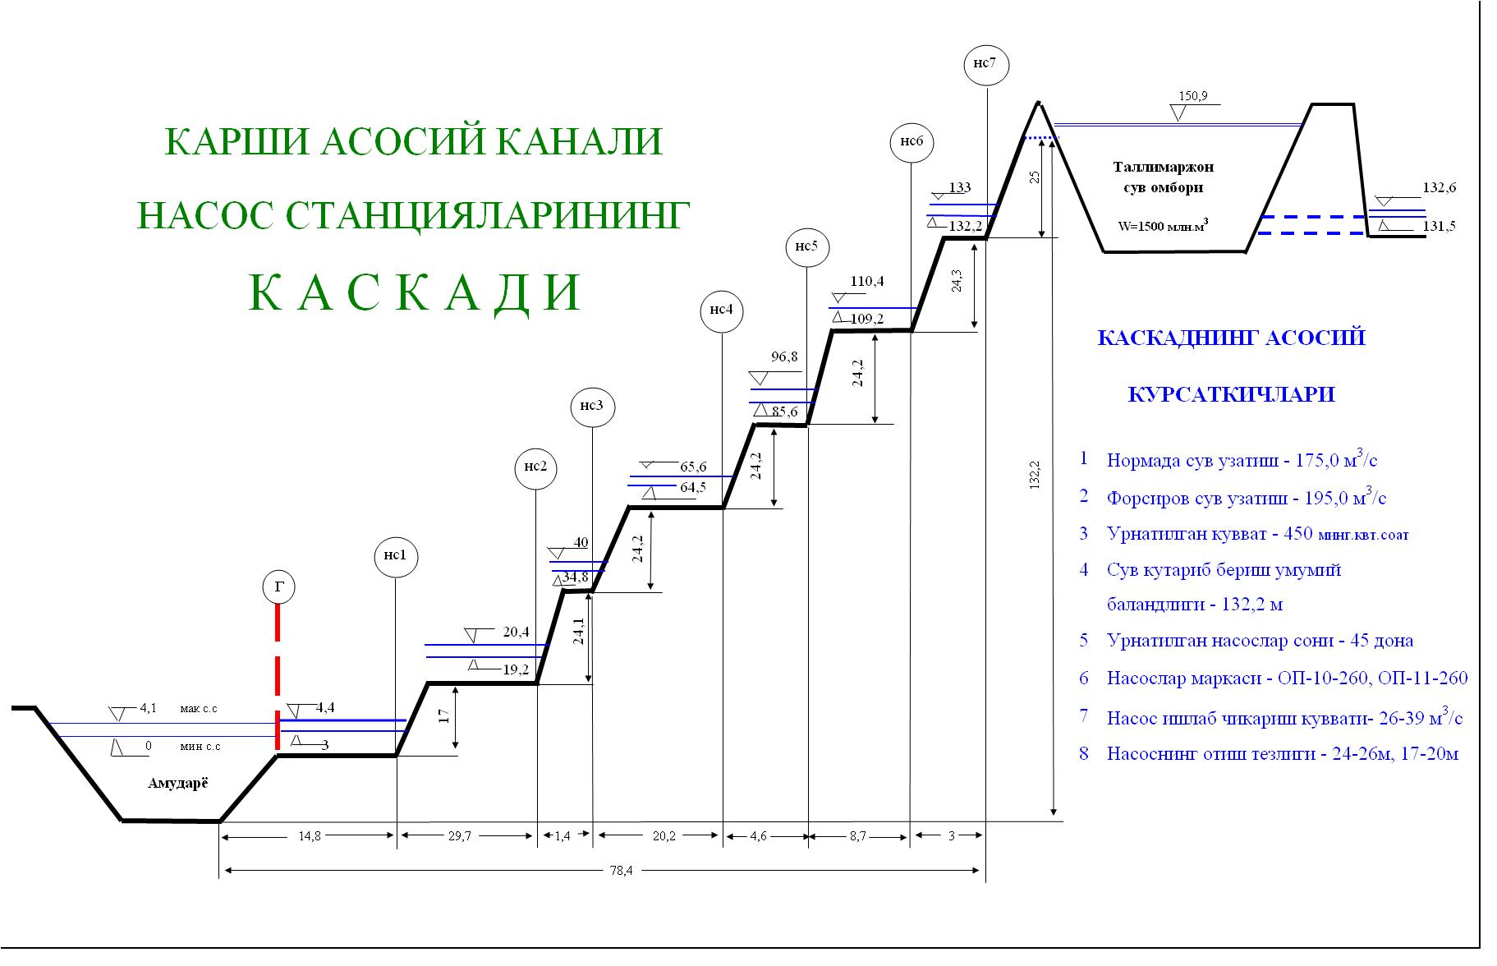
Karshi Steppe lift irrigation
Current irrigation practices are energy-inefficient and create return flow, waterlogging, and salinity problems
These pumping consumes 20% of the country’s power, and to keep power affordable for farmers and other users, the government puts US$450 million into energy subsidies every year
Cascade pumps
Government of Tajikistan uses more than 700 million (M) kWh of electricity per year to lift about 1355 Mm3 of water of Syrdarya River for irrigation purposes in northern Tajikistan
Notes:
How can we reduce energy use

Slide 13
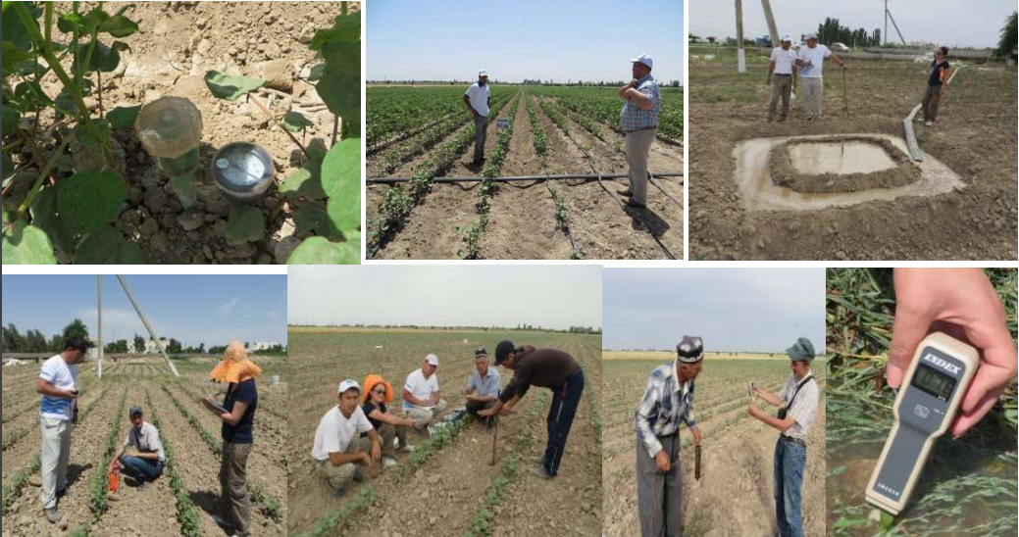
Case Study: Transition from conventional irrigation methods to cutting-edge irrigation technologies

Slide 14
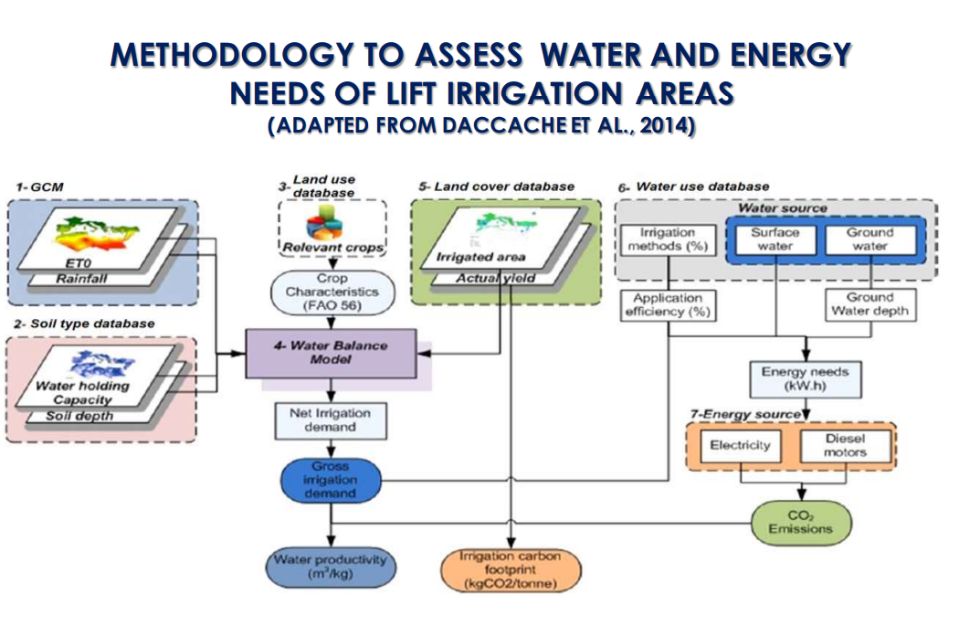

Slide 15
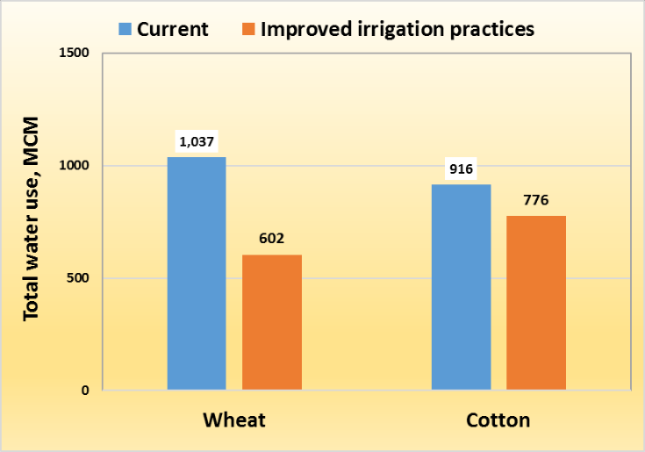
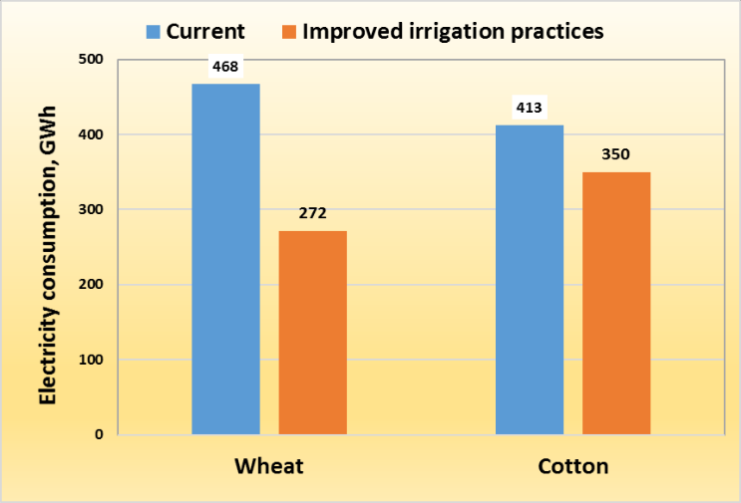
Total water use, water and energy consumption saving under improved irrigation practices (Karshi)

Slide 16
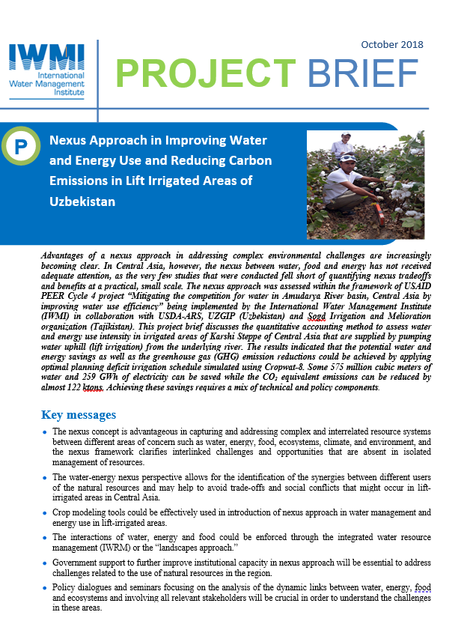
Policy recommendations
MAIN POLICY RECOMMENDATIONS
• Promote the use of GIS and RS/EO based maps by decision makers as an evidence-based tool to identify need areas and to devise targeted interventions;
• Quantify the costs and benefits of using water- and energy-efficient technologies to the government, farmers and society as a whole and strengthen the evidence-base to promote their widespread adoption and use;
• Educate farmers and relevant stakeholders by sharing project findings and demonstrating the benefits of employing water- and energy-efficient methods and technologies;
Notes:
Problem – electricity company wants to sell electricity and 70% is for irrigation. Farmers don’t have to pay for water so no incentive to use less.

Slide 17
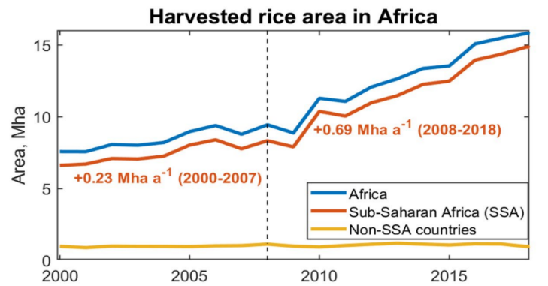
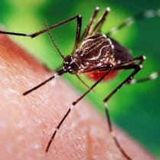

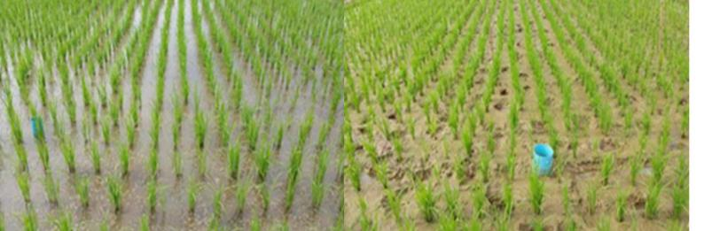
Managing rice irrigation to reduce GHG emissions, save water and reduce malaria
12%
Of GHG emissions globally come from irrigated rice
AWD – potential to reduce CH4 emissions and malaria transmission and save water without affecting yields IF weed growth can be controlled.

Slide 18
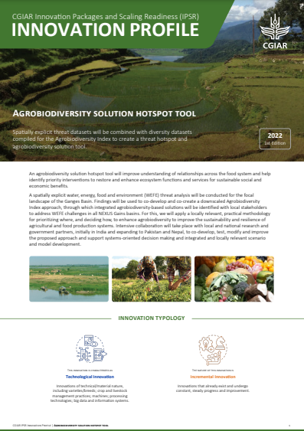
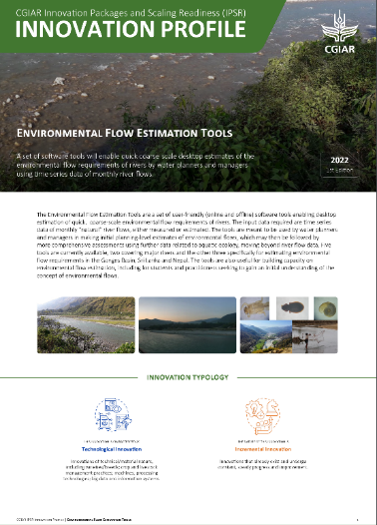




Thank you!
More information at:
cgiar.org/initiative/nexus-gains
Contact: M.McCartney@cgiar.org
This work was carried out under the CGIAR Initiative on NEXUS Gains, which is grateful for the support of CGIAR Trust Fund contributors: www.cgiar.org/funders
© 2024 International Water Management Institute. Some rights reserved.
This work is licensed under a Creative Commons Attribution-Noncommercial 4.0 International Licence (CC BY-NC 4.0).

