Slide 1
Vietnam:
Initial ideas for Integrated Core Project
Sabine Douxchamps, CIAT
Livestock CRP Priority Countries Planning Meeting
26 – 27 March 2019
Nairobi, Kenya

Slide 2
What we have learned so far
Our focus value chain was on pigs
Achievements & lessons from Livestock & Fish
  GAHP for Vietnam, adoption analysis
  Smallholder pig value chain development
  Pig breeding schemes
  Food safety, One health (antibiotic use and resistance)
  Sunsetting the pig value chain: use channels to upscale results (LIFSAP, SAFEGRO), link with current projects (e.g. SafePork, PigMaize,…)
Notes:
Page title minimum of 30 points and maximum
of two lines
Main point 6 point smaller than slide title
Bullet points 4 point less than main point
Font type is Calibri
It is advised in one slide maximum 6 bullets
We recommend you use images on slides
You can change partner logos on front page
You have to duplicate this slide for more inside pages

Slide 3
New focus
Middle-income country: demand for livestock products ↑, consumers awareness ↑, high food safety and environmental issues
Small scale farmers in the highlands, ethnic minorities, less developed areas, poor: Beef cattle high potential, integrated crop-livestock system (incl. pigs findings and poultry)
Medium scale intensified areas: for certain aspects (environment, food safety, animal health…)
→ Do we know enough to design an intervention?
No, need for scoping studies around potential interventions
→ What could we reasonably expect to achieve as outcomes by December 2021?
Increased share of local, quality and healthy ASF in urban markets in North Vietnam, decreased environmental footprint
Notes:
Page title minimum of 30 points and maximum
of two lines
Main point 6 point smaller than slide title
Bullet points 4 point less than main point
Font type is Calibri
It is advised in one slide maximum 6 bullets
We recommend you use images on slides
You can change partner logos on front page
You have to duplicate this slide for more inside pages

Slide 4
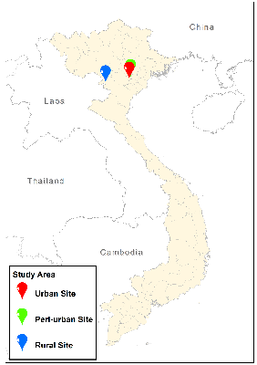
What an integrated intervention could look like
Title: Viet meat goes green and healthy
Target groups: rural and peri-urban producers, + traders
Integrating our best bets
  Feeds & Forages: improved feeds and forages baskets + post harvest/dry/cold season options (cubing,…)
  Environment: decrease GHG emissions (LCA) and water footprint
  Genetics: local breeds
  Health: AMR intervention, food safety
  A4NH: food system perspective with A4NH benchmark sites, consumer preferences, product and business development
  LLAFS: institutional/organizational innovation for livestock-based livelihoods; foresight and policy work
  Gender and youth: engagement and benefit sharing
  Capdev
Key challenges: staff posted abroad,…
Notes:
Page title minimum of 30 points and maximum
of two lines
Main point 6 point smaller than slide title
Bullet points 4 point less than main point
Font type is Calibri
It is advised in one slide maximum 6 bullets
We recommend you use images on slides
You can change partner logos on front page
You have to duplicate this slide for more inside pages

