Slide 1






Livestock research for livelihoods: the case of LMPs
Tropentag 2021:
Towards shifting paradigms in agriculture for a healthy and sustainable future
September 15 - 17, 2021,
organized by
University of Hohenheim, Germany
Sirak Bahta, Francis Wanyoike, Braja Swain and Nils Teufel
International Livestock Research Institute (ILRI)
Notes:
Apologies for not being able to be there in person. I will present results from Nairobi together with my colleague John Mutua, senior research associate at Alliance Bioversity Int and CIAT
This research started a few years ago, and is fed from several scientific publications, stakeholder workshops and MSc thesis – summary is in policy brief in your folder
We acknowledge the technical review and endorsement by Deogracious Wonekha MAAIF and Derrick Senyonga MWE
We will show you why heat stress in pigs is an important issue for Uganda and should feature high on the adaptation agenda, what future heat stress exposure we expect, who will be impacted and how, and what can be done to adapt.

Slide 2

Impact pathways
Evidence synthesized & communicated
Why LMP?
Why LMP?
Cases made for more & better investment in livestock
Chronic under investment
Chronic under investment
Chronic under investment
Chronic under investment
Lack of evidence base
Lack of evidence base
Lack of evidence base
Lack of evidence base
In adequate analytical Capacity
In adequate analytical Capacity
In adequate analytical Capacity
In adequate analytical Capacity
Decisions supported by Evidence
Efficient use of resources
Growth in investment & policy support

Slide 3







What a LMP will tell us about the livestock sector
Completed LMP
ETHIOPIA
Livestock Master Plan (LMP) seeks to provide Government policymakers, private investors, and development partners with reliable quantitative facts on:
Current contributions and constraints of the livestock sector
Potential of the sector to contribute to national development objectives
Priority livestock commodities and value chains and proposed investment options (combined technologies and policies)
How better targeted investment in livestock can improve economic performance the sector, and improve lives in the sector
Capacity development of National/state and County governments for fact-based, quantitative planning
TANZANIA
RWANDA
UZBEKISTAN
BIHAR STATE, INDIA
Ongoing LMP
KENYA
ODISHA STATE, INDIA
THE GAMBIA

Slide 4
LMP Deliverables
Baseline/Livestock Sector analysis (LSA)
15- year Livestock Sector Strategy (LSS)
5-year investment plans/ Roadmaps

Slide 5
Productivity

Slide 6
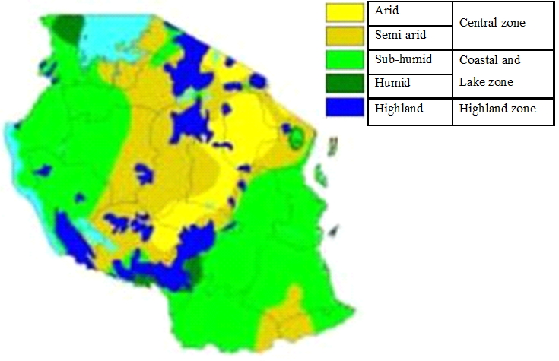







Livestock production zones and Species
Livestock production zone classification
PRODUCTION SYSTEMS
Small
GRASSLAND
BACKYARD
Medium
MIXED CROP-LIVESTOCK
Small
INTERMEDIATE
Medium
Medium
INDUSTRIAL
COMMERCIAL
Large
FEEDLOT
RAIN-FED
IRRIGATED
Sere and Steinfeld

Slide 7
Production level analysis
Data needed
The starting point is the section on typology of livestock farming systems in the LSIPT tool where we provide information on:
  Livestock populations,
  Average herd/flock sizes and
  Number of herds/flocks
Additional information needed in order to perform the analysis include:
  Dynamics in livestock herds/flocks including age classes of animals, duration in each class, reproduction, mortality and offtake rates
  Production (live weight, meat (dressing percentage), milk (length of milking period, quantity per day), hides and skins (kg/animal), wool (kg/animal) and organic matter(kg/animal)
  Production costs and expenses
  Value of products etc.
Analysis- LSIPT results include levels of production (15 years), HH income, Contribution to GDP
Demand analysis

Slide 8
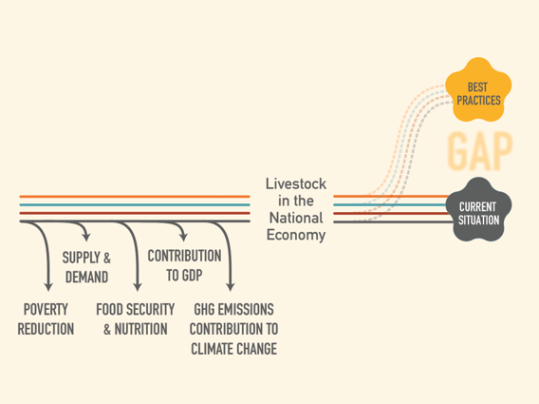
With intervention
Analysis also features a comparison of BAU situation versus case when some interventions are instituted
Areas of interventions
  Breeding
  Feed
  Animal health

Slide 9
Gender

Slide 10
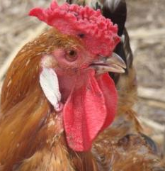
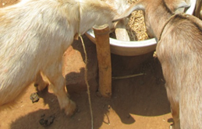
Gender analysis – Odisha LMP
The present LMP Model doesn’t allow the disaggregation on gender specific.
In Odisha, households having less 10 goat and backyard poultry are owned by the women.
In livestock sector analysis under LMP these two groups are assigned as gender specific.
  Data on different aspect of farming having collected.
Any investment towards these species will directly improve the livelihood of women

Slide 11
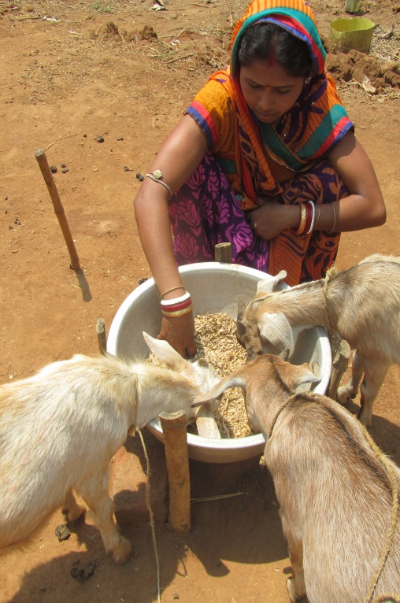
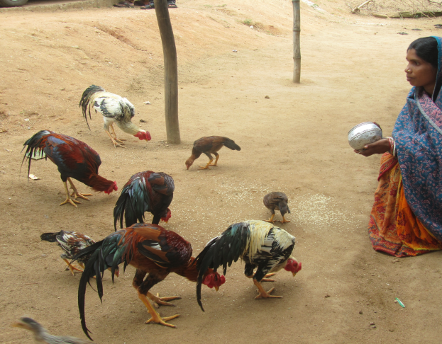
Research questions in Odisha LMP
To what extent are women involved in the livestock sector of an LMP (current or candidate) country? How does this compare to participation by men and to participation in non-livestock and non-agricultural sectors?
What resources, skills or abilities will be needed to engage with planned LMP investments and to what extent do women have access to these
- How will expected outcomes of LMP interventions (such as income, price changes) impact, positive or negatively, on women?

Slide 12
Next steps on Gender analysis
What will participating and non-participating women get out of livestock interventions?
How do the intervention options impact differently on (different categories of) women?
What are potential trade-offs and how large are they?

Slide 13
Preparing the Investment Plan

Slide 14
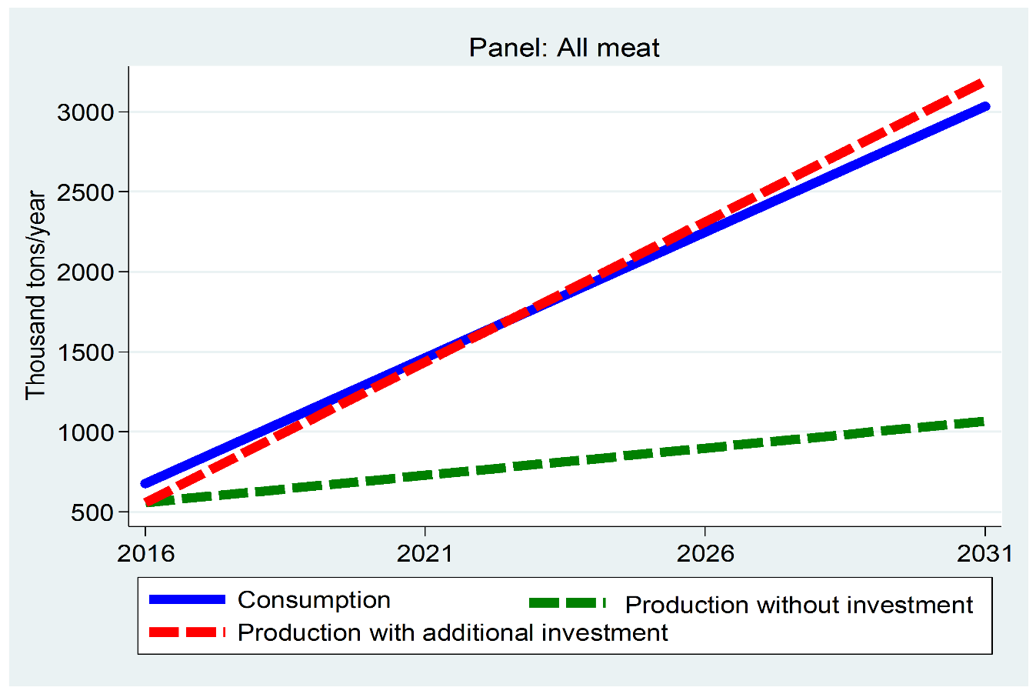
Tanzania LMP: Meat projection
Livestock Sector Strategy (15- year strategy)
Estimate future demand
Develop scenarios (What if?), interventions
Assess the impacts
Road Map for investment (5 –year Investment plan)

Slide 15

A snapshot from Tanzania Road map

Slide 16
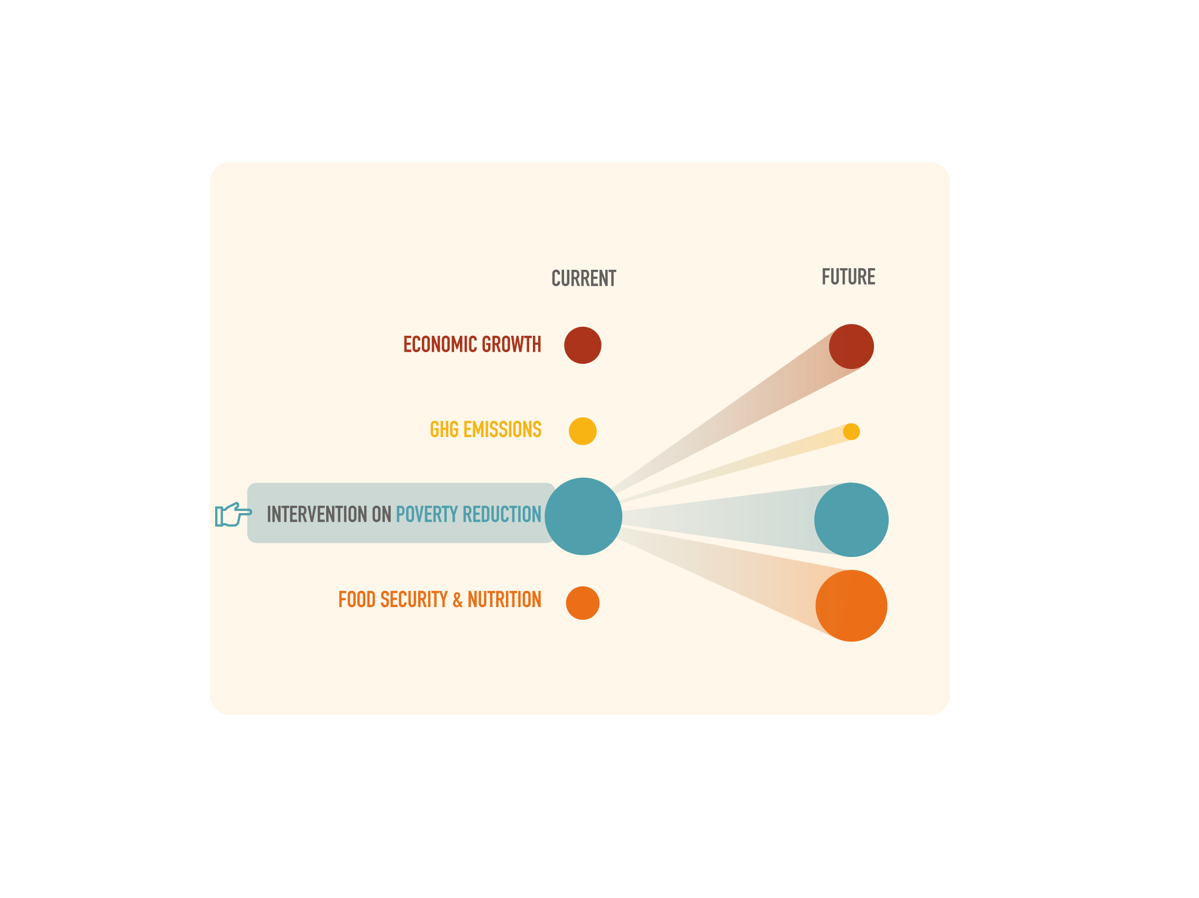
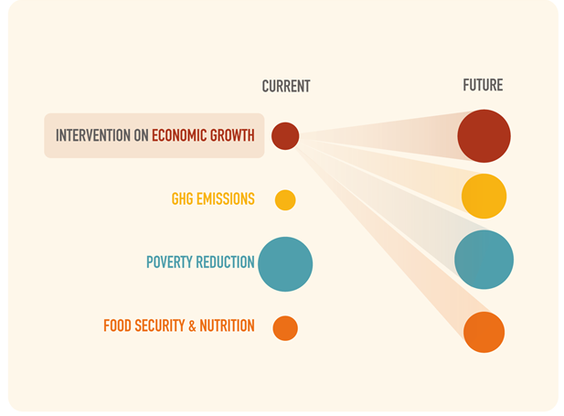
Scenario setting
Highlighting the tradeoffs

Slide 17

THANK YOU

