Slide 1
TH1.1: The woman has no right to sell a livestock
The role of gender norms in Northern Ghana’s small ruminant value chains and implications for transformative interventions
Kipo Jimah and Gundula Fischer
(International Institute of Tropical Agriculture)
Cultivating Gender Equality Conference
12-15 October 2021

Slide 2
Outline of presentation
Context of the study
Methodology
Outline of actors involved
Selling of small ruminants
Constraining gender norms
Implications and recommendations

Slide 3
Context of the study
Research gap: Participation and benefits of women and youth in livestock value chains
Objectives
  To assess women and youth’ participation in and benefits from value chain activities
  To capture social norms and institutions that promote or hinder equitable value chain participation and benefits
  To inform discussions and decisions on gender transformative strategies and practices that will facilitate and increase inclusiveness

Slide 4
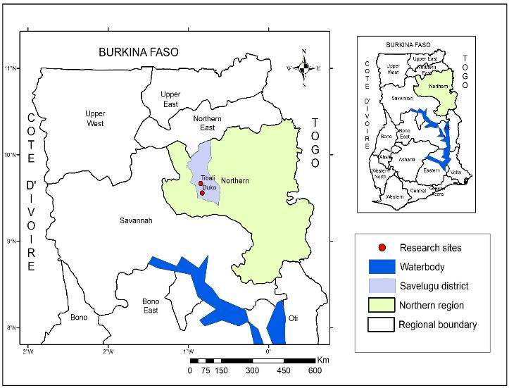
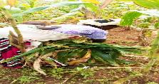
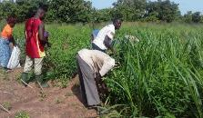
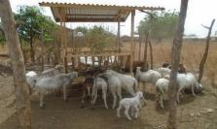
Context of the study
Leaf stripping
Map of Ghana showing the study area
Fodder cultivation
Feeding troughs

Slide 5
Methodology
  Data collection methods: Used a mixed methods approach (Questionnaire; Focus Group interviews; individual interviews)
  Sample:
Data analysis: Atlas.ti (qualitative data) and Stata
(quantitative data)
Type of actor | Men | Women | Male youth | Female youth | Total
Farmers | 18 | 18 | 4 | 3 | 43
Livestock traders/butchers | 1 | 1 | - | - | 2
Feed traders (Soya bran) | - | 3 | - | 1 | 4
Veterinary service providers | - | 2 | - | - | 2
Food vendors | - | 3 | - | - | 3
Kebab seller | - | - | 1 | - | 1
Feeding troughs fabricators | 1 | - | 3 | - | 4
Total | 20 | 27 | 8 | 4 | 59

Slide 6
Outline on actors involved

Slide 7
Selling of small ruminants
Level of involvement of household members in decision to sell
A man livestock keeper:
“..decisions regarding selling is with your wife but if your wives’ children are of age, then their mothers’ hands is not inside, is between you and your children who will make the decisions”

Slide 8
Selling of small ruminants
Level of involvement of household members in selling of small ruminants
A woman livestock keeper:
For we Dagombas, it is forbidden. We don’t accept it even if you own them and live in your own house, when you want to sell you would have to give it to a man to sell for you

Slide 9
Constraining gender norms
“It is acceptable for a married woman to go to the market to sell livestock”
A man livestock keeper:
“…the woman cannot just go and catch a sheep or a goat and take it to the market or call somebody to come and buy it. She cannot do that”

Slide 10
Constraining gender norms
Men are primarily responsible for earning income for the household:
  Men: 61% ; Women: 57% agree or strongly agree
It is disrespectful for a married woman to say that she owns livestock:
  Men: 61%; Women: 73% agree or strongly agree
A woman cannot leave home without the permission of her husband:
  Men: 82%; Women: 93% agree or strongly agree
Men are primarily responsible for getting veterinary services:
  Men: 86%; Women: 73% agree or strongly agree
Women are capable of making important decisions by
themselves:
  Men: 89%; Women: 67% disagree or strongly disagree

Slide 11
Implications
Negative effect on women social standing in household and
community
Women blurred ownership of small ruminants
Men decision making on use of livestock and income
Limited participation of women and youth in small ruminant marketing and limited control of benefits from small ruminants
Under reporting of income from sale of small ruminants by men

Slide 12
Recommendations for gender-transformative interventions​ to enhance inclusiveness​
Use of community conversations to change gender norms (Mulema et al. 2020; FAO, 2020)
  Changes in gender relations (Division of labour)
  Changes in decision making in households on handling and consumption of animal-source foods
  Ownership and control of livestock and income
  Increased harmony, trust, and collaboration in households
Communicate results to farmers, traders, extension agents, policymakers and development actors

