Slide 1




Challenges and opportunities for genetic improvements in smallholder dairy systems in the tropics
Julie Ojango, R. Mrode, G. Gebregziabher, E. Chinyere and A.M. Okeyo
International Livestock Research Institute, Nairobi

Slide 2

Introduction
Drivers of progress in dairy production in developed countries
Socio-cultural and Infrastructure
Technologies
Business
Rapid information exchange with strong networks
Comprehensive data recording and monitoring systems
Transportation
Awareness of social goods and bad
Environmental services
Markets and marketing systems
Large Artificial Insemination companies willing to invest in innovation and technology
Value addition beyond the farm gate
Precise biotechnical interventions
‘Omic’ (genomic, phenomic…) revolution
Rapid diagnostics and analyses tools

Slide 3
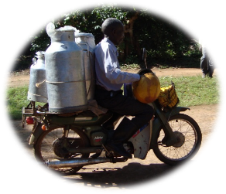

Developing countries
Socio-cultural and Infrastructure
Opportunities through dairy
Increasing human population, expanding demand for products
Social obligations and cultural values associated with animals
Movement and exchange of information, knowledge sharing and learning in community groups
Limitation in economies of scale (large number of smallholders producing >80% of national milk)
Impacts of epidemics and Pandemics
Improved nutritional outcomes for vulnerable groups through dairy products
Community development and changing behavior among different gender groups
Employment and income generation options for youth and women in communities.

Slide 4





Technologies
i) Information and communication technologies (ICT)
Digital platforms for large-scale data management at regional and continental levels
Digital tools for herd recording and monitoring
Crowd sourcing information
Electronic training and learning resources
Digital sensors for monitoring behavior and physiological changes
Simultaneous provision of management information and feedback on performance data for farmers
Recording and monitoring
Crowd sourcing information
Electronic learning resources
Management and feedback

Slide 5
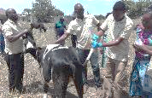
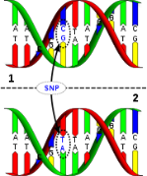
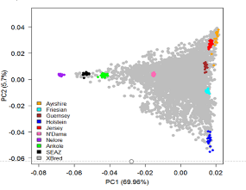

ii) Genomic Technologies
Low-Cost SNP genotyping platforms
Large-scale sampling of diverse cattle populations for genotyping
Non-invasive sample collection for DNA extraction
Genetic/ genomic profiling and characterization of traits
Matching breeds/ genotypes to environments
Genomic prediction equations to accelerate genetic gains
Tools and algorithms
Evolving evaluation and data integration methodologies
Precision breeding adapting reproductive technologies
Smart tools and applications for precision breeding

Slide 6
iii) Phenotyping
iv) Environment management
Characterization and definition of new traits for monitoring e.g. Adaptation, Resilience
Phenotypic parameters associated with productivity
Technologies to facilitate product quality assessment at the smallholder farm level
  Mid-infra Red techniques to determine milk quality
  Tools for optimal and objective body condition scoring
Certification systems for best-bet “seed” animals
Green house gas emissions baselines in smallholder systems, identify mitigation solutions
Climate adaptation approaches:
Production practices that enhance environmental health (eg manure and waste management)

Slide 7
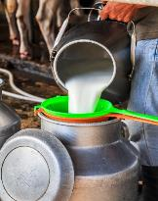
Business
Services
Markets
Private partner involvement is limited
Cooperatives, dairy business hub approach, contract farming
Equitable access
to services
Market intelligence: Balance informal marketing
Transformation of milk markets to produce Safe milk and milk products for all at affordable prices
Last mile delivery:
Develop Livestock Master Plans to guide supportive policies

Slide 8

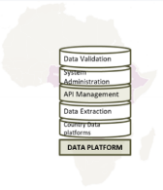
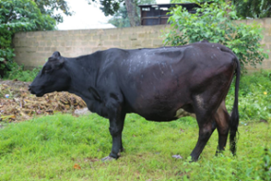

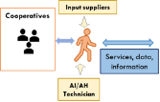





Example from Africa Dairy Genetic Gains
Data collation, management and feedback
Market development support
  Animal identification Trait definitions, Dairy product measurement and evaluation
  Cross-bred dairy cattle linked to natural sire and AI-based delivery systems; sire selection & mating for productivity gains
  Tropically adapted & productive dairy cattle
  Herd recording and feedback systems; digital education; electronic tools linking producers to service providers
  Certified dairy seedstock adopted at scale; close the last mile gap leveraging commodity platforms
Characterization and identification
Genomic selection based breeding programs

Slide 9




















Partners
National/regional Institutions/govts.
Dairy Farmers & Farmer organizations

Slide 10


Thank you

