Slide 1
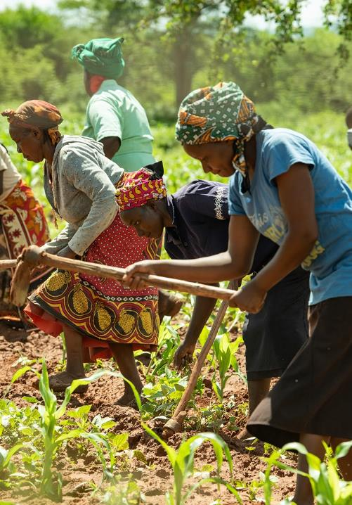



Photo: Kelvin Trautman
TH4.2: Family ties: Insights on the effects of male out-migration on gender relations, farming investments and women’s wellbeing
Mary Crossland, Ana Maria Paez Valencia, Tim Pagella, Christine Magaju, Esther Kuira, Leigh Winowiecki, Marlene Elias
Cultivating Equality Conference
14th October 2021
Session 4.2 Moving beyond the “Feminization” of Agriculture
Photo: Kelvin Trautman

Slide 2



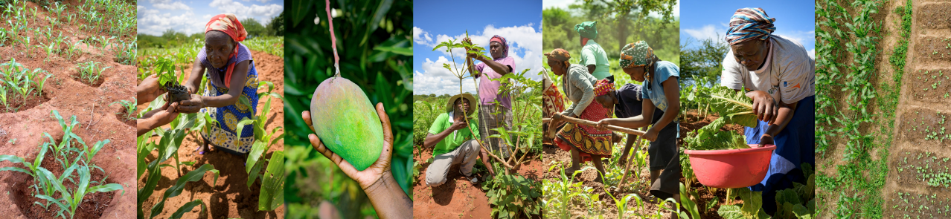
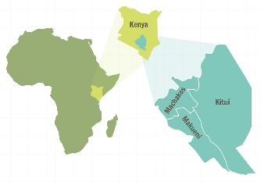


Dryland Restoration Project
Over 2500 farmers across three counties in eastern Kenya
“Restoration of degraded land for food security and poverty reduction in East Africa and the Sahel: taking successes in land restoration to scale”
74%
of project farmers were women
Survey of 1008 project households
7 focus group discussions
In-depth interviews & timelines
n = 247 n = 761
n = 27 n = 38
n = 7 n = 34
Photos: Kelvin Trautman

Slide 3
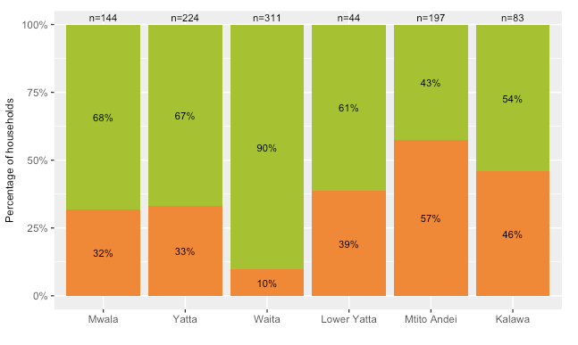

Migration patterns & trends
34% of households had migrants who leave the household for some months of the year.
Mostly young men (household head or son) leaving for urban centres, returning only for a few days every month.
Migration increased over the past five years due to unreliable rainfall, increasing poverty and land scarcity.
75%
of migrants are male
Migration often part of a discussed household strategy in order to support the family

Slide 4
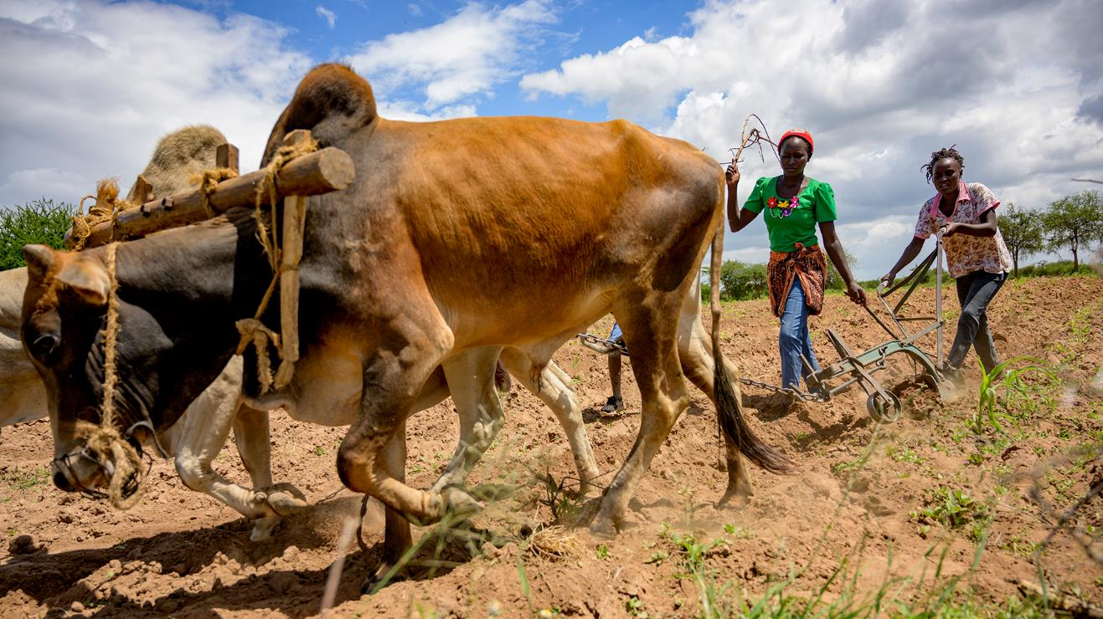
94%
of households with migrants received remittances. These are mainly used for food, school fees but also hiring labour and farm inputs
compared
80%
considered remittances ‘extremely important’ for their household
Photo: Kelvin Trautman

Slide 5
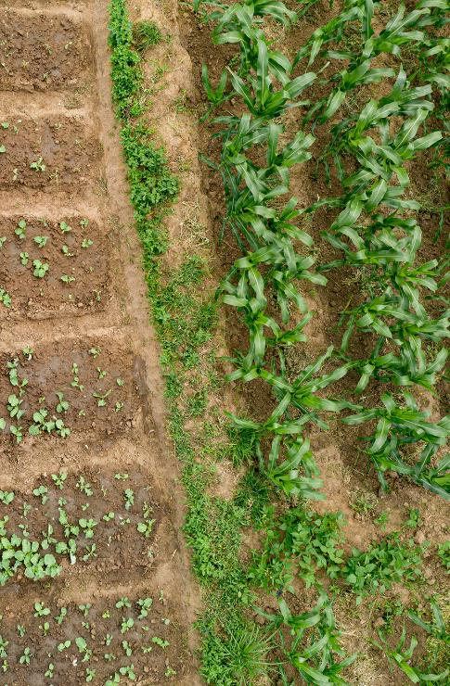

Decision-making & knowledge
78%
Of migrants still involved in farm decisions
Women with migrant husbands tended to have increased control over farming and household decisions …
“…sometimes, I can call my spouse to discuss farming issues, but he might seem not to understand what I am saying. In such cases I make decisions such as what to plant on what plot, digging of the planting basins and also terraces”
Photo: Kelvin Trautman

Slide 6
Decision-making & knowledge
78%
Of migrants still involved in farm decisions
Women with migrant husbands tended to have increased control over farming and household decisions …
“…sometimes, I can call my spouse to discuss farming issues, but he might seem not to understand what I am saying. In such cases I make decisions such as what to plant on what plot, digging of the planting basins and also terraces”
… Yet increased this increased autonomy often came with increased responsibilities and workloads and even emotional stress.
Photo: Kelvin Trautman

Slide 7
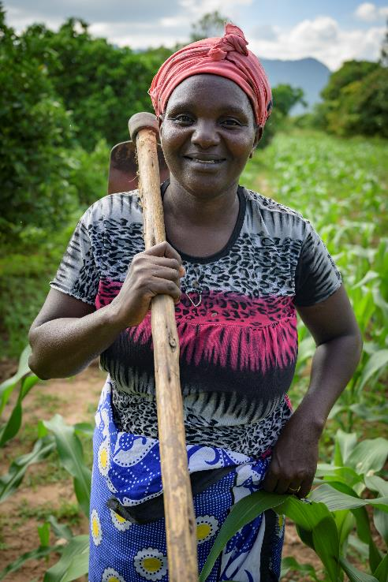

Key messages
1
Experiences are diverse! Impacts are mediated by who leaves, who stays, and the strength of personal relationships between migrants and their households
Migration as an extension of the household rather than separation – even though migrants may ‘step out’ of farming, they often still invest capital back into the farm
2
3
Migration can create conditions for increased independence for women, it may also come with the price of increased emotional stress, workloads and responsibility.
Mary Crossland
Livelihood Systems Associate Scientist
CIFOR-ICRAF
Email: m.crossland@cigar.org
Photo: Kelvin Trautmanh

