Slide 1
International Livestock Research Institute: Our work, what I do, opportunities
Theo Knight-Jones
Principal scientist
Animal and Human Health program, International Livestock Research Institute
Invited lecture at the Faculty of Veterinary Science, University of Nottingham
Nottingham, United Kingdom, 15 August 2023

Slide 2
ILRI strategy
WHY ILRI exists
ILRI’s mission is to improve food and nutritional security and to reduce poverty in developing countries through research for efficient, safe and sustainable use of livestock — ensuring better lives through livestock
WHAT ILRI delivers
ILRI strategic objectives
…develop, test, adapt and promote science-based practices….
…provide compelling scientific evidence…
…increase capacity amongst ILRI’s key stakeholders

Slide 3
ILRI offices and staff worldwide
ILRI HQ Kenya and Ethiopia
Offices in 8 other countries in Africa (Burkina Faso, Burundi, Mali, Nigeria, Senegal, Tanzania, Uganda and Zimbabwe); 4 countries in Asia (China, India, Nepal and Vietnam).
600 permanent staff
$100m annual budget

Slide 4
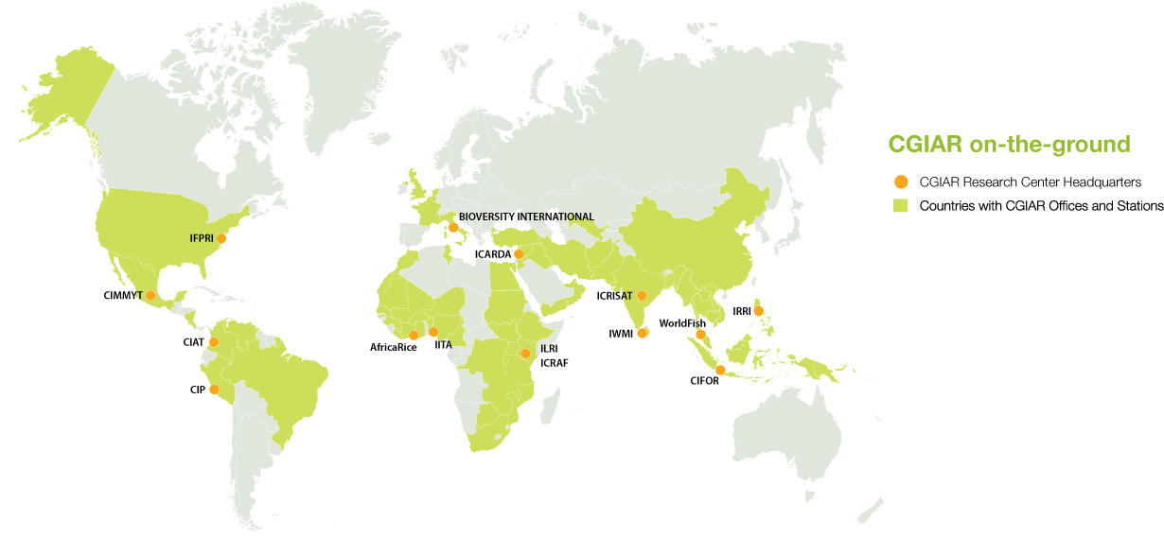
ILRI is part of CGIAR: a global research partnership for a food-secure future, transforming food, land, and water systems in a climate crisis.
15 Research centres in over 70 countries

Slide 5
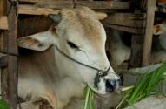
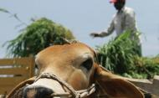
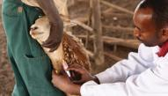
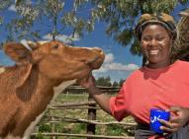
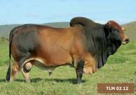

ILRI’s livestock research: solutions for food and nutritional security, poverty, environmental and human health
Feed and Forage Development
Sustainable Livestock Systems
Animal and Human Health
Better nutrition for improved animal productivity
Mitigating climate change, enhancing resilience and increasing livestock productivity
Impact at Scale
Delivering solutions for livestock, zoonotic and foodborne diseases
Livestock Genetics
Policies, Institutions & Livelihoods
(including gender)
Taking livestock solutions to scale for inclusive development
Improving genetics for better productivity and profitability
Efficient livestock production driving inclusive growth and employment
Capacity development; communications; knowledge management

Slide 6
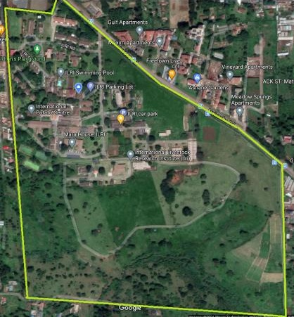
Nairobi Campus
Biosciences for Africa
  Animal Research Facilities:
    Biological Safety Level 2+ animal containment facility
    Biological Safety Level 3 labs
  High end biosciences facilities for CGIAR researchers and NARS
Mazingira (environmental) research centre
  First accurate verifiable greenhouse gas emission parameters for crops, livestock and land-use changes in Africa
One Health Centre in Africa
  Improving the health of humans, animals and ecosystems
    Capacity building
    Strengthening local, regional and global networks
    Evidence-based policy advice
CGIAR Antimicrobial Resistance Hub
  Evidence linking antimicrobial resistance in agriculture and public health outcomes
  Development of locally relevant and applicable evidence-based interventions
CGIAR GENDER Impact Platform
  At CG level, synthesize and amplify gender research
  Fill evidence gaps in gender research
  Set directions to enable impact on gender inequities

Slide 7
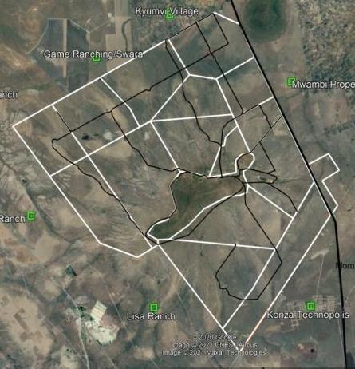
ILRI’s Kapiti Research Station and Wildlife Conservancy
Run as a livestock research station, commercial livestock ranch (since 1980s) and wildlife conservancy (since 2020)
13,000 hectares (32,000 acres or 150 km²)
85km East of Nairobi in Machakos County
Semi-arid lands
Thousands of wildlife species including various species of carnivores and herbivores as well as birds and reptiles

Slide 8
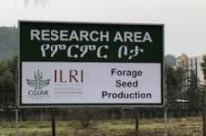
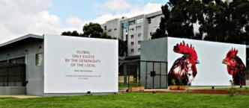
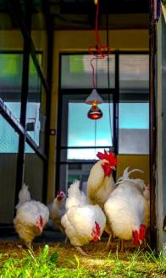
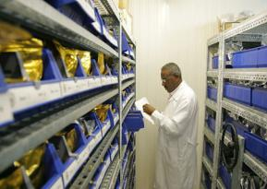

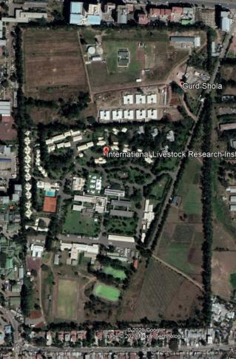
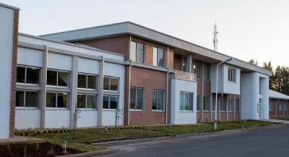
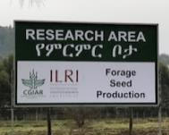
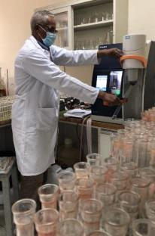
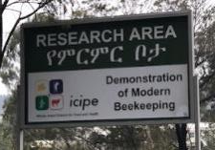
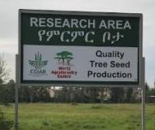
ILRI Addis Ababa,
Campus Facilities
Research fields
Poultry
Research
Facility
Research fields
Nutrition
Lab
Genebank
Lab including Biosafety Level 2
Notes:
34 hectares (84 acres or 344,571 m²)
88 buildings, 31,876 m² office space

Slide 9
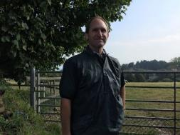
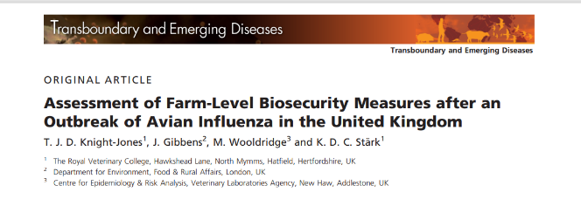
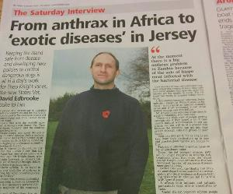
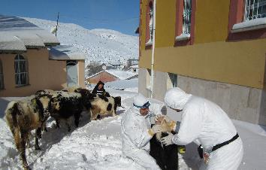
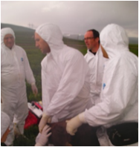
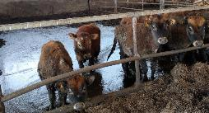
Who am I?
Local boy
Became a vet
Became a veterinary epidemiologist
Became a specialist – DipECVPH, PhD
Increasingly working overseas
Expert in Transboundary Animal Diseases
Chief Vet for Jersey
Now…

Slide 10
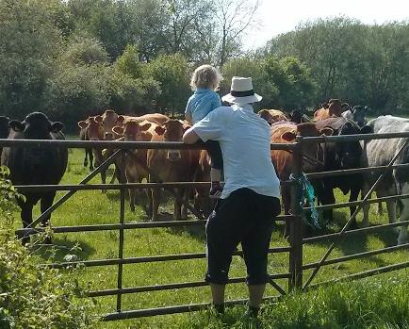
Now…
Principal Scientist – Team Leader – Animal and Human Health Programme
The International Livestock Research Institute, CGIAR
  Reducing poverty, enhancing food and nutrition security, and improving natural resources and ecosystem services
  >$100million annual budget
Based in Tanzania but working across Africa

Slide 11
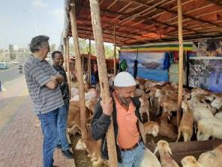
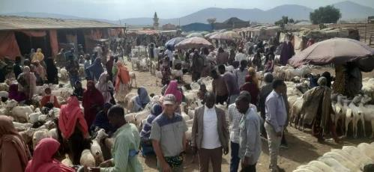
My Research
Principal Scientist – Team Leader – Animal and Human Health Programme
Lead team of 30 staff as well as PhD and MSc students
$4million annual budget
Research focus:
  Food systems and food safety
  Herd Health and welfare
  One Health – balancing the health of humans, animals and ecosystems

Slide 12
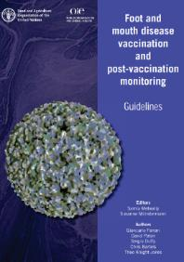
Expertise, teaching, publications
Expertise
  Veterinary Public Health and Epidemiology, Economics
  UN FAO/Global Steering Committee Meeting of the GF-TADs – and FMD, PPR
  Editor for Transboundary and Emerging Disease IF – 5
  Wrote FMD, PPR and Influenza strategies for Southern Africa
Background:
  Royal Veterinary College
  The Pirbright Institute
  FAO

Slide 13




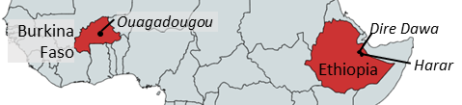





Pull-Push
Urban food markets in Africa: Incentivizing food safety using a Pull-Push approach
$4.7million - 2019-2023
Understand risks and practices:
Value chain assessments – Retailer KAPs surveys
  Burkina – chicken value chain has many problems
  Ethiopia – variable meat consumption – special occasions only
  Microbial hazards are critical – but consumers worried about chemicals
    Microbial and pesticide surveys
      65% pesticide contaminated 1/3 with DDT – 1/5 > international limits
    QMRA – Burden of disease studies
Interventions: Develop and trial
Regulator training – Online course
RCT of restaurant hygiene package
Pilot improved tomato packaging
Consumer awareness campaign

Slide 14
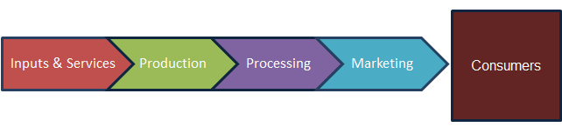
Harness consumer demand to drive safer food up the value chain
Value chain oversight: Capacitate food safety regulators
Increase capacity to provide safer food
Receive reduced price for low hygiene products, or have unsold stock
Create food safety awareness
Source better quality suppliers
Increased consumer preference for hygienic products – better price or bigger market share for safer products

Slide 15
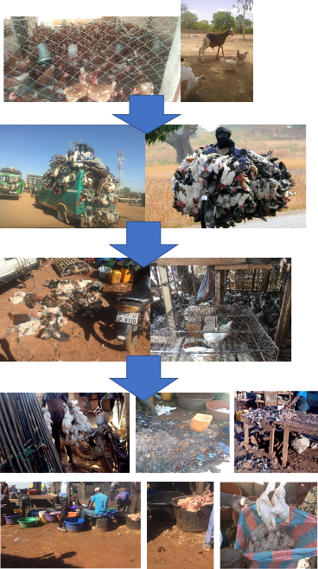
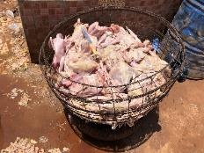
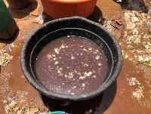
Chicken consumption in Ouagadougou, Burkina Faso
FARM
  High poultry consumption in Burkina Faso - 8kg poultry meat consumed per year per person-higher in Ouaga
  Low consumption in Ethiopia 0.66kg per person/year
  (UK 50kg, East Africa average 1.64kg) (FAO, 2019)
TRANSPORT
MARKET
25% of outlets report rats contact food preparation surfaces
40% cats
Yet little cleaning is done
Carcass:
50% Salmonella
70% Campy
Wash water:
100% Salmonella
(Kagambega, 2018)
SLAB SLAUGHTER
Poor hygiene, husbandry and animal health brings production loss, food safety risks and poor welfare (8% mortality in transport and markets)
FBD caused by NTS, CAMP and ETEC USD391million - 3% of gross national income - half burden falls on children under 5yrs
Notes:
Poultry consumption is high in Burkina Faso, especially in the capital Ouagadougou
Poor welfare and husbandry in transport and markets is an issue and causes big economic losses with 8% mortality in these stages=USD5million/year in losses

Slide 16


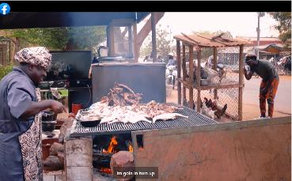


Consumer food safety awareness campaign
Before (n=1103) –After (n=765) evaluation - Ethiopia
Most consumers recalled campaign
Consumer food safety knowledge improved
Some improvements in purchasing safe, quality tomatoes
Consumers report better food hygiene practices at home
Analysis ongoing
Example Burkina Faso – Implemented by advertising agency – 9 months
Campaign goals
  To empower consumers in Ouagadougou make safe choices regarding choosing chicken for out-of-home and home consumption
  Key approach: emphasize with a positive message that there is a safe choice available that reduces foodborne diseases in their family
TV and radio adverts
30 billboards around city
Facebook capsules by an influencer “Moussa Petit Sergent” >1.4m views and climbing

Slide 17
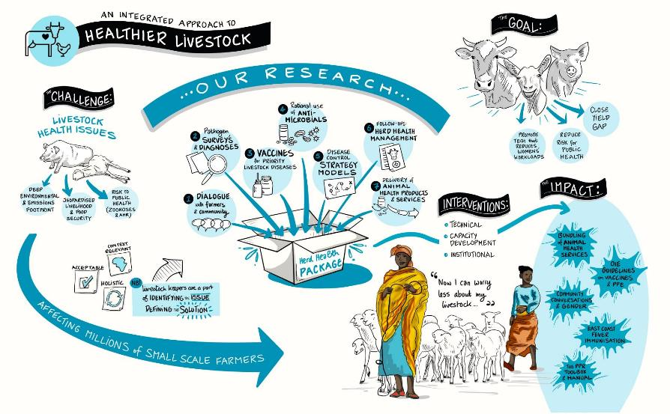
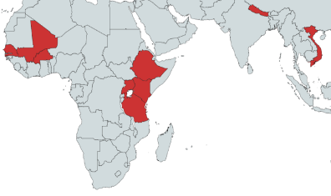
ILRI – Herd Health
Failings in animal health pose a massive constraint to livelihoods in LMICs
Our Projects:
Eco-PPR - Epidemiology and control of peste des petits ruminants in East and West Africa
ELE: Evaluation of Livestock Emergencies – Vaccination and Disease Surveillance
GBADs: Global burden of animal diseases
HEARD - Health of Ethiopian Animals for Rural Development
POLOH - Poultry Losses and One Health
SAWA: Synergies of animal welfare and agroforestry to benefit farming systems in Ethiopia
SAPLING: Sustainable Animal Productivity for Livelihoods, Nutrition and Gender Inclusion
SEFASI: Selecting efficient farm-level antimicrobial stewardship interventions from a One Health perspective
Tested approaches for sustainable delivery of animal health
Where we work
Measures of livestock disease burden
Approaches to improved animal welfare and environments
Burkina Faso Ethiopia
Kenya Mali
Nepal Senegal
Tanzania Uganda
Vietnam
Tech tools for health management
Evaluation & guidance for vaccination programmes

Slide 18
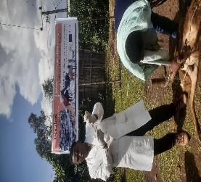
Health of Ethiopian Animals for Rural Development (HEARD)
Poor access to animal health services
  Example: Only 4.5% of households access private vet
Issues:
  Animal health is largely delivered by public sector
  Veterinary profession is young and poorly institutionalized (1st vet school 1979)
Solutions delivered in HEARD
  Pilot animal health service delivery through Public-Private Partnerships

Slide 19
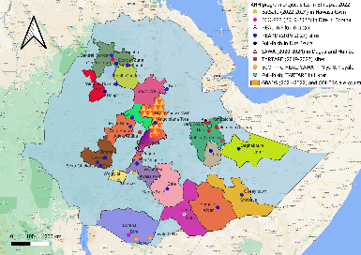
Ppp ACTIVITY
Models | Region | Services
Model I (private vaccination service) | Amhara, Oromia | Vax: Rabies, Anthrax, Black leg, O. & B. Pasteurellosis
Model II (SANITARY MANDATE WITH DISTRICT PRIVATE SECTOR) | Somali | Vax: Camel pox, O. Pasteurellosis
Model III (SANITARY MANDATE WITH LINKED REGIONAL-WOREDA-KEBELE PRIVATE SECTOR) | Somali | Vax: Camel pox, bovine Pasteurellosis, Shoat pox, CCPP
Model IV (MOBILE CLINICAL SERVICE) | Oromia | Clinical service
Model V (CLINICAL SERVICE BY LINKED REGIONAL-WOREDA-KEBELE PRIVATE CLINICS) | Somali | Clinical service
Model VI (COMMUNITY-BASED WOMEN VACCINATORS FOR Newcastle Disease CONTROL) | Amhara | Vax: Newcastle Disease
Model VII (STRATEGIC COMMUNITY-BASED ENDO- AND ECTO-PARASITE CONTROL) | Somali, Oromia, Amhara | Camel & shoat ectoparasite control Cattle and sheep deworming service
Model VIII (LEASING AHPs TO unemployed VETERINARY GRADUATES) | Amhara
>30,000 livestock vaccinated, >30,000 worm, ticks
70-100% accessed service
85% access ambulatory service
Most happy to pay service charge

Slide 20
Ppp ACTIVITY
Interim evaluation: Focus group discussions (FGDs) and key informant interviews (KIIs) with different partners (livestock
keepers, private service providers and district and region level private sector), plus field observations.
Models | Region | Services
Model I (private vaccination service) | Amhara, Oromia | Vax: Rabies, Anthrax, Black leg, O. & B. Pasteurellosis
Model II (SANITARY MANDATE WITH DISTRICT PRIVATE SECTOR) | Somali | Vax: Camel pox, O. Pasteurellosis
Model III (SANITARY MANDATE WITH LINKED REGIONAL-WOREDA-KEBELE PRIVATE SECTOR) | Somali | Vax: Camel pox, bovine Pasteurellosis, Shoat pox, CCPP
Model IV (MOBILE CLINICAL SERVICE) | Oromia | Clinical service
Model V (CLINICAL SERVICE BY LINKED REGIONAL-WOREDA-KEBELE PRIVATE CLINICS) | Somali | Clinical service
Model VI (COMMUNITY-BASED WOMEN VACCINATORS FOR Newcastle Disease CONTROL) | Amhara | Vax: Newcastle Disease
Model VII (STRATEGIC COMMUNITY-BASED ENDO- AND ECTO-PARASITE CONTROL) | Somali, Oromia, Amhara | Camel & shoat ectoparasite control Cattle and sheep deworming service
Model VIII (LEASING AHPs TO unemployed VETERINARY GRADUATES) | Amhara
To do
To quantify benefits and sustainability
Refine and scale effective and cost-effective PPP models
>30,000 livestock vaccinated, >30,000 worm, ticks
70-100% accessed service
85% access ambulatory service
Most happy to pay service charge

Slide 21





Global Burden of Animal Diseases (GBADs)
Animal Disease Decision Making
Courtesy of Delia Grace

Slide 22
GBADs - Analytical structure
Farm-level Burden
Social & Economy Burden
Livestock
populations
Animal Health
Loss Envelope
Attribution by disease,
health problem and accidents
Impact across
the economy
Their biomass and the inputs
Value of the animals and their outputs
How much are we losing
How much are we spending
Absolute burden due to each disease
Relative burden compared to total burden
Who across society is affected
Rushton et al 2021

Slide 23
3. Animal health loss envelope (AHLE)- Farm level disease burden
-
Ideal Gross margin
Current Gross margin
  Mortality = 0
  Reproduction
  Offtake
  Growth rate
  Yield
  ------
  Feed
  Labour (- % on health)
  Healthcare = 0
Mortality
Reproduction
Offtake
Growth
Yield
------
feed
Labour
Healthcare
Parameters from existing data from central statistical agency and meta-analysis of literature data
Ideal parameters are derived form expert elicitation workshop using Cooke’s method
Difference
AHLE

Slide 24
AHLE Ethiopia 2021
Initial animal health loss envelope has been estimated for Ethiopia
  for cattle (US$17billion/yr)
  small ruminants (US$2.8billion/yr)
  and poultry (US$2.5billion/yr)
  with production and population estimates made for working equids and camelids.
  Overall, this loss equates to 20% of Ethiopian GDP (all 2021 figures).
  This represents all production losses arising from suboptimal animal health
  In reality these losses cannot be eliminated in their entirety, but they give a measure of the full scale of livestock disease burden.
  For reference, livestock currently contribute nearly 20% of Ethiopian GDP.

Slide 25
Cattle AHLE components
0.3% Animal Health Expenditure
13% deaths
86% Production Loss

Slide 26
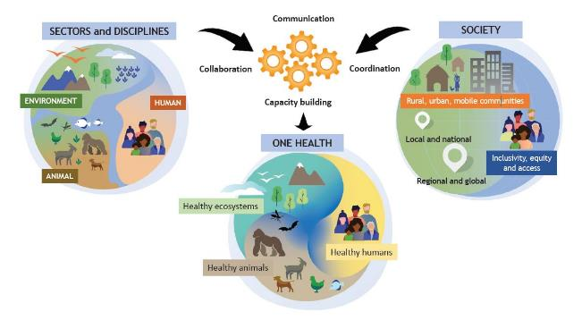
One Health – Definition
FAO, OIE, WHO, UNEP One Health High Level Expert Panel (OHHLEP)
“One Health is an integrated, unifying approach that aims to sustainably balance and optimize the health of people, animals and ecosystems.
It recognizes the health of humans, domestic and wild animals, plants, and the wider environment (including ecosystems) are closely linked and inter-dependent...”
OH Game Theory
  Society wins with cross-disciplinary, holistic approaches
Costs of dog vaccination and human rabies control are cheaper than human control alone

Slide 27
The drive for better One Health - example
Complex challenges with massive impact
Need One Health collaborative approach

Slide 28
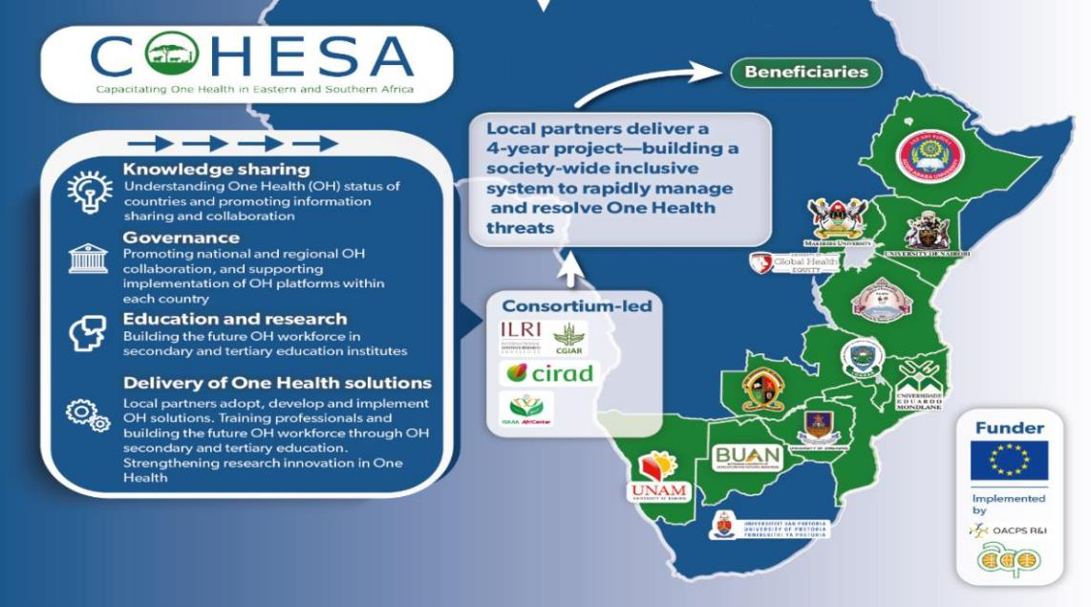
$10million

Slide 29
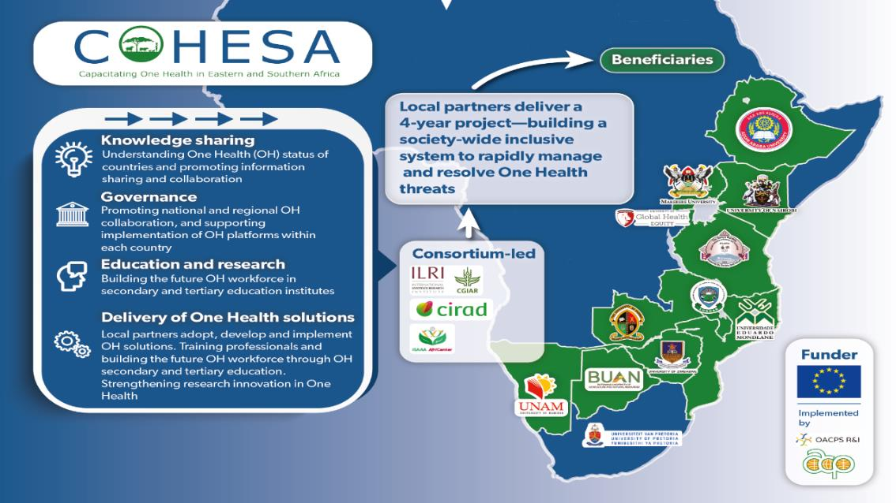
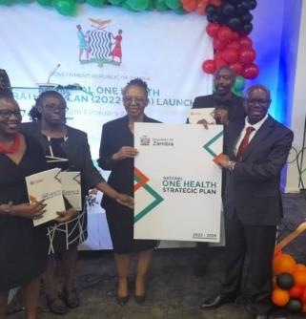
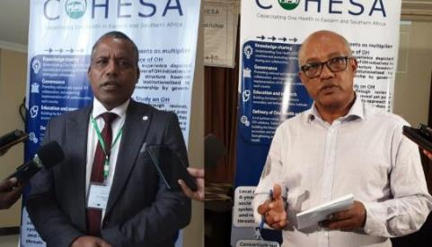
$10million

Slide 30
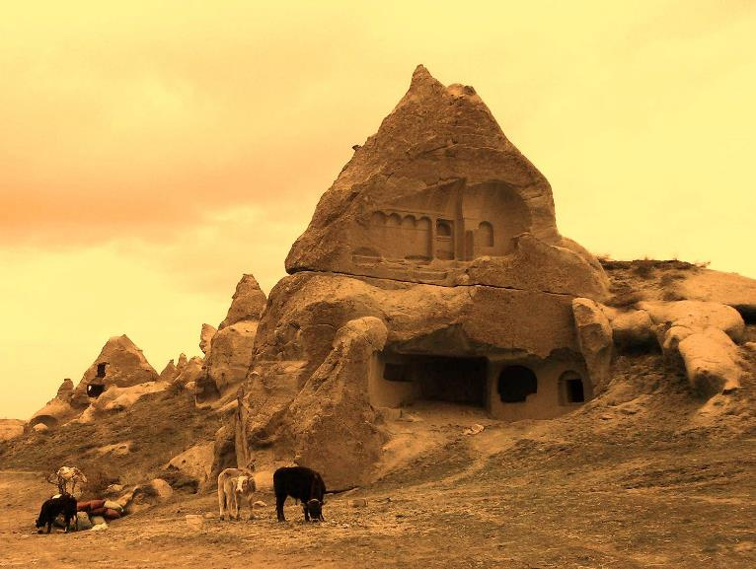
Enough about me…
Prof Peter Doherty:
Breakthroughs come when bring new approaches to a problem and when disciplines mix…

Slide 31
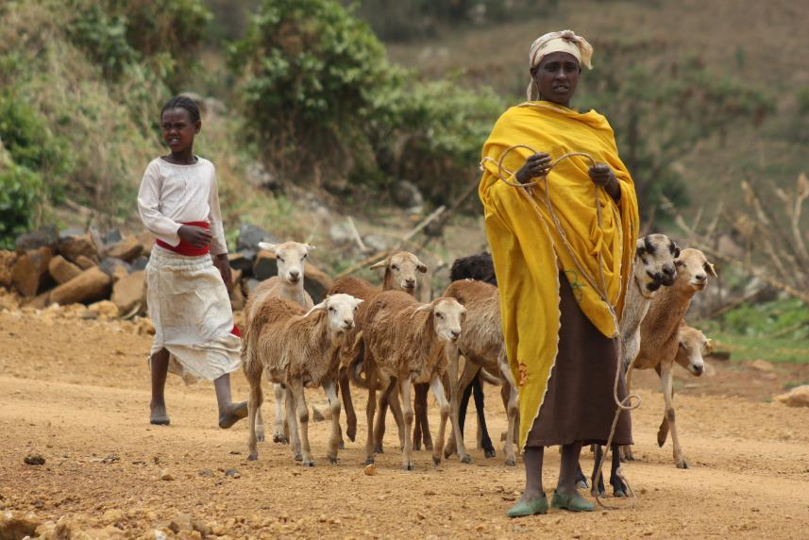
Questions
Acknowledgements:
Michel Dione, Wudu Temesgen, Shauna Richards, Kebede Amenu, Delia Grace, Arie Havelaar, Coen vanWagenberg, Jonathan Rushton, Solomon Gizaw, Getachew Dinede, Hiwot Desta, Alexandre Caron, Margaret Karembu, Hung Nguyen and more…

