Slide 1
Overview of the ADGG Data Platform
J.M.K. Ojango*,R. Mrode, C. Ekine, E. Oyieng, D. Mogaka and A.M. Okeyo
*Senior Scientist
Livestock Genetics, ILRI-Biosciences
Workshop with National partners in livestock production Kenya
Kenya Agricultural and Livestock Research Organization,
Naivasha, 20th May 2021
Notes:
I now present statistics at a glance on the Africa Dairy Genetic Gains platform

Slide 2
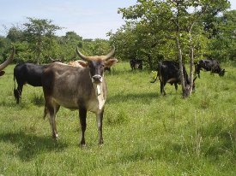
Conceptual framework of the ADGG data platform
Individual farmers
User management
National governments
Farm Data Capture
Livestock stakeholders
Extension personnel
Service providers
Big Data systems
Data Analytics
Mobile applications
ODK
API
i-Cow
ADGG
Designed apps
SRUC
Web applications
ADGG LSF
i-Cow
i-Cow
Data Validation
API
Interherd
API
System Administration
API Management
API
Data Extraction
API
Country Data platforms
Other Database integration
Data feedback systems
DATA PLATFORM
ADGG
KLBA, AVCD
i-Cow
i-Cow
Interherd
Cooperatives
API = Application Program interphase
Notes:
Data collected can also be filtered to show the different breeds of animals from which data is being captured
For example we have the well known European dairy breeds, and those that are called by indigenous names
Graphs are used to present the number of milk records in the database from each breed type. It is also possible to get a glimpse of the average daily milk production for a typical animal of a given breed type within each country

Slide 3
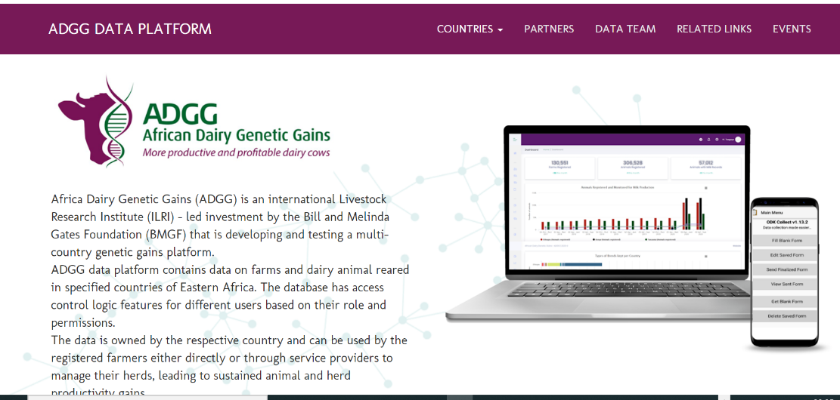
https://portal.adgg.ilri.org/
Notes:
You access the Africa Dairy Genetic Gains data platform through the link at the top of this slide
This is the landing page
On the top bar are options with drop down menus reflecting what is available through the platform

Slide 4
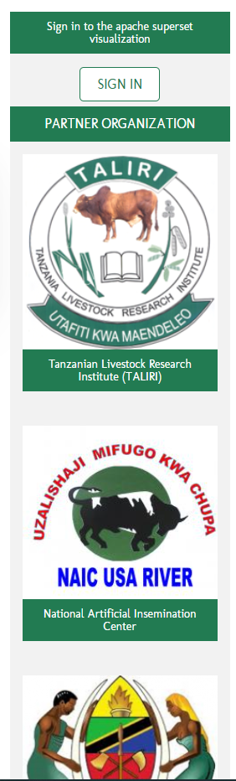
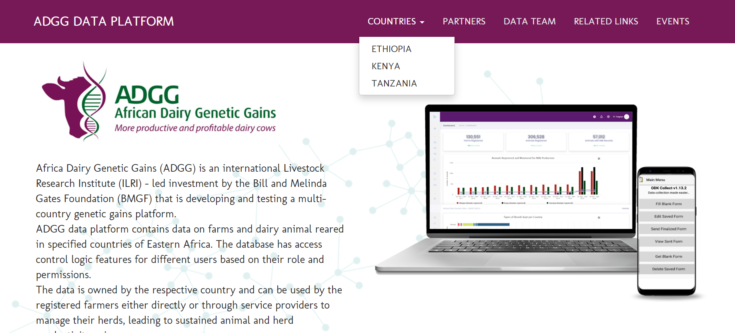
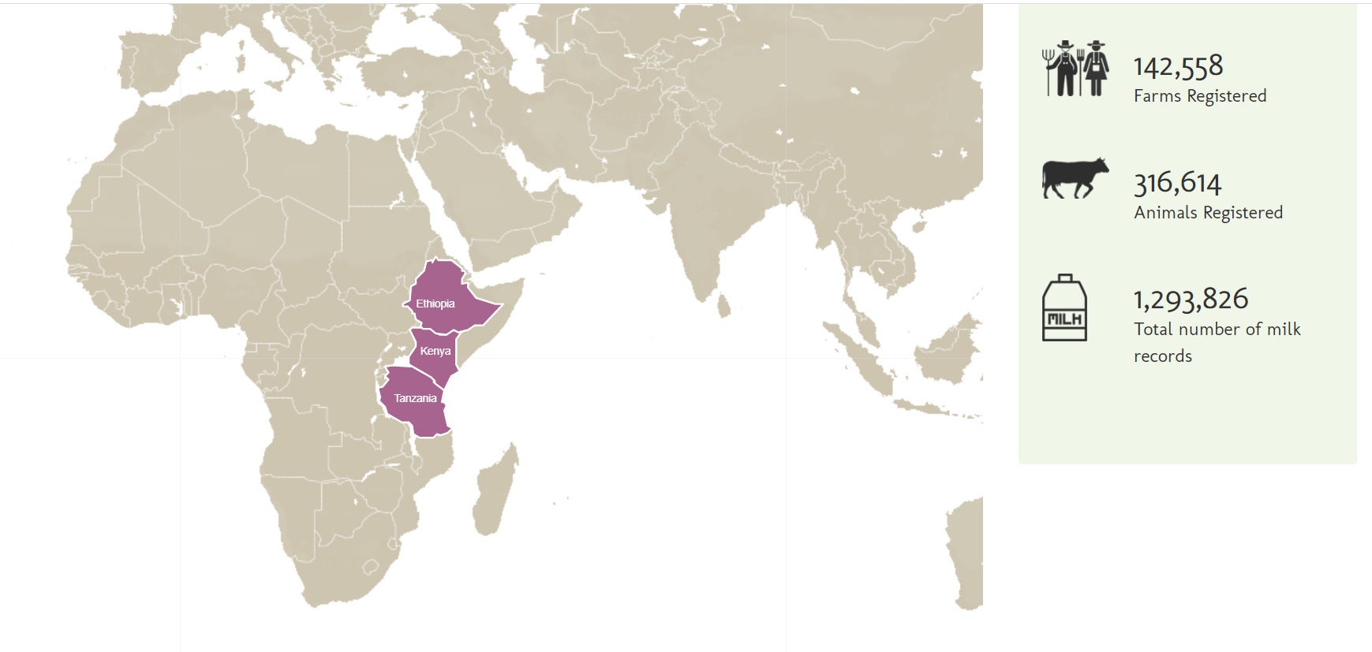
Country Access to ADGG Platform
Notes:
As you scroll down the front page you see which countries have their data recorded on the platform, and get a glimpse on the quantity of data available from each country

Slide 5
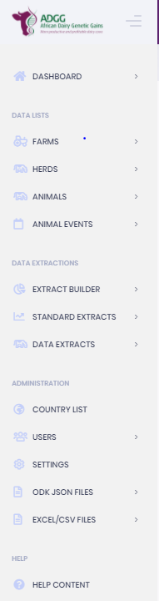
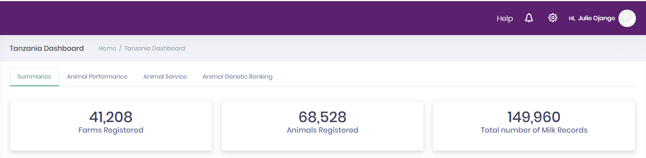
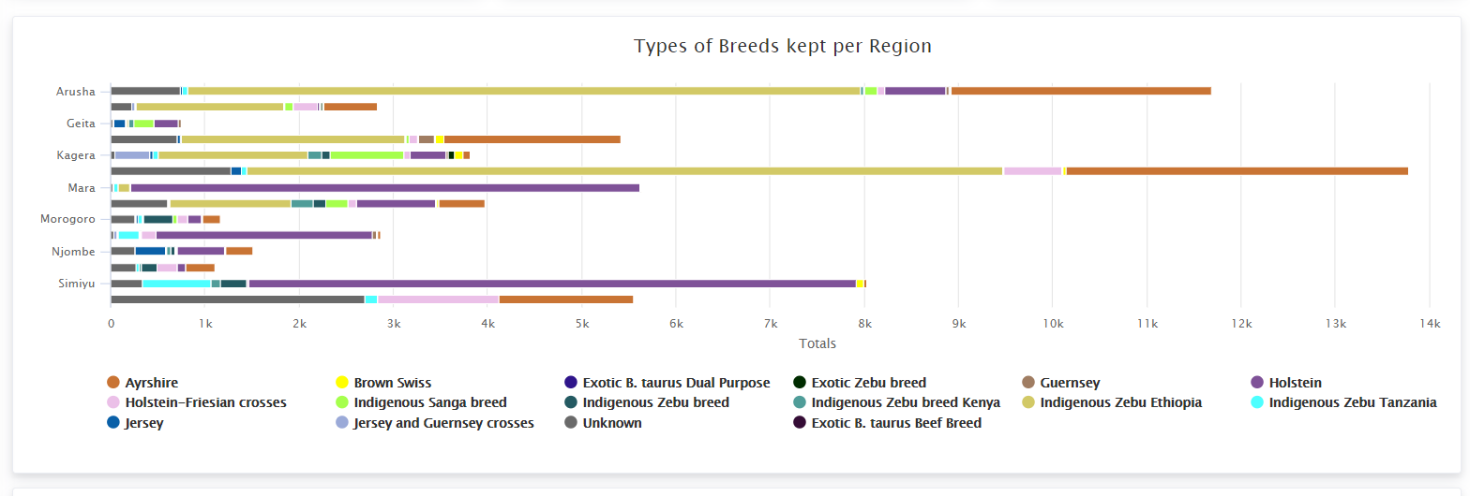
Notes:
Data collected can also be filtered to show the different breeds of animals from which data is being captured
For example we have the well known European dairy breeds, and those that are called by indigenous names
Graphs are used to present the number of milk records in the database from each breed type. It is also possible to get a glimpse of the average daily milk production for a typical animal of a given breed type within each country

Slide 6
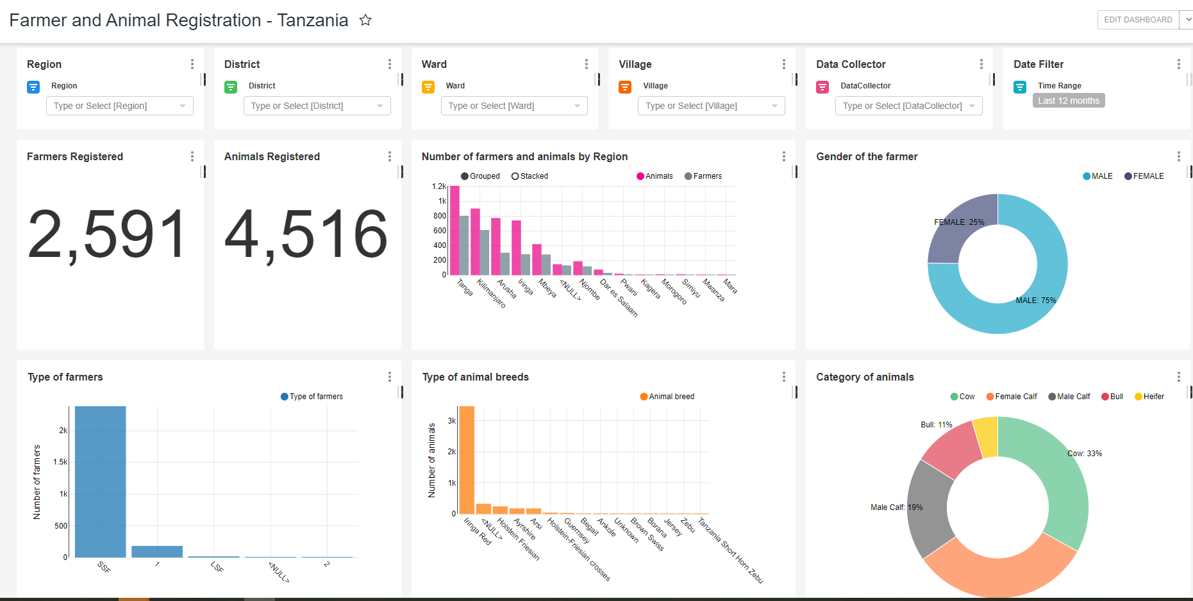
Example from Tanzania- 2 months

Slide 7
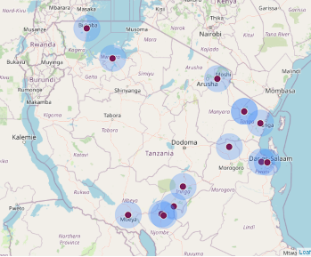
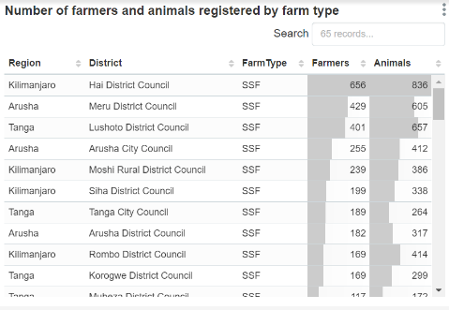
Country Data- details available for accredited users
Notes:
Access to details on data for each country is only available to individuals who have been given user rights through their ICT personnel
For example looking at data from Tanzania you see how many farms are registered on the platform; how many animals have their data recorded; how many milk data points are available based on animals already registered in the platform
As the data is collected in real-time using digital tools you get a map with the GPS points showing where the data was collected. This is one of the main checks in the platform to ensure that the data came from real farms

Slide 8
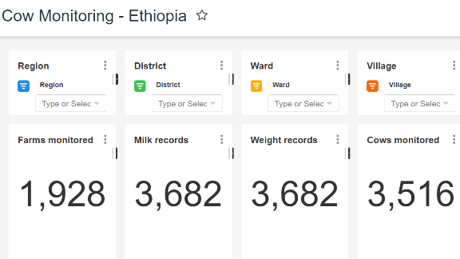
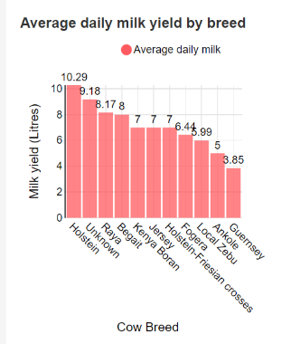
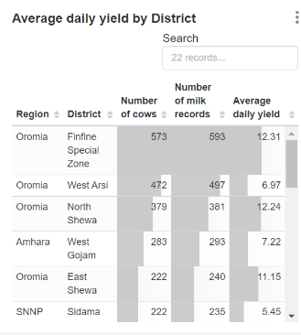
Filtering specific information in a country
Notes:
Data collected can also be filtered to show the different breeds of animals from which data is being captured
For example we have the well known European dairy breeds, and those that are called by indigenous names
Graphs are used to present the number of milk records in the database from each breed type. It is also possible to get a glimpse of the average daily milk production for a typical animal of a given breed type within each country

Slide 9
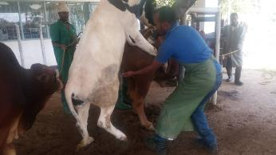
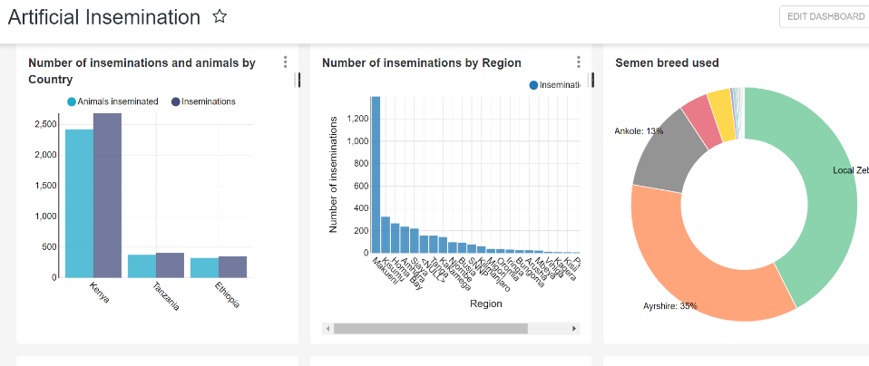
Services: Artificial Insemination
Notes:
Services provided for the different animals on farms registered through data capture tools can be monitored over given time-lines.
Graphs and charts are present inseminations performed within specific regions, and the breed-type of semen used when providing the artificial insemination
The same information is available on bulls used for natural service

Slide 10
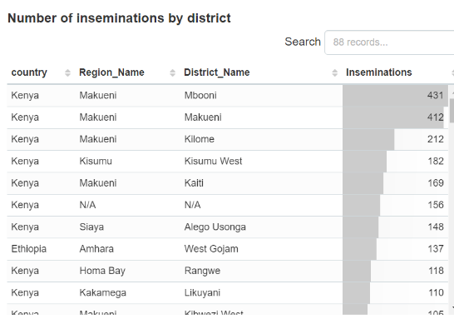
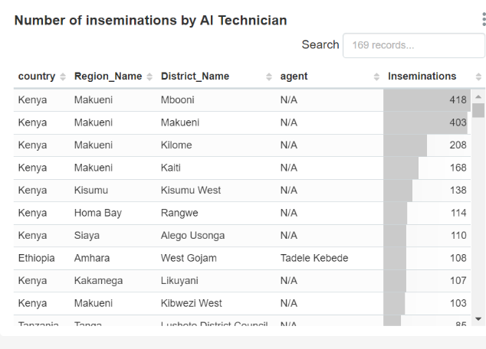
Monitoring Artificial Insemination services
Notes:
When monitoring the performance of those providing the artificial insemination service it is possible to get a quick overview of the number of services provided by each individual inseminator within each region on any given day

Slide 11
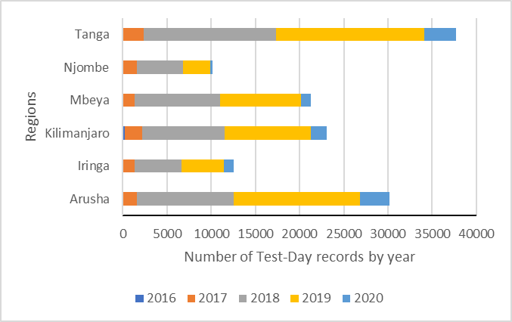
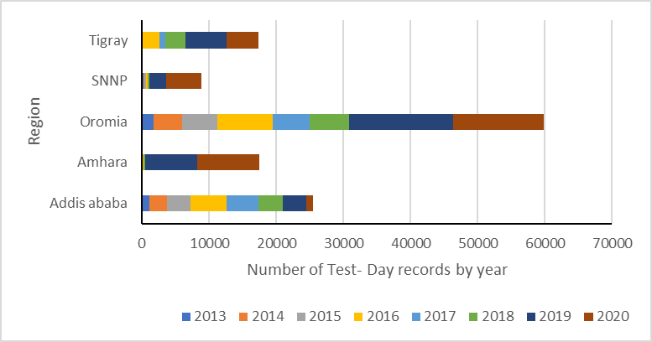
An overview of milk records captured each year
Tanzania
Ethiopia
Notes:
One can also get a very quick overview of the total number of milk data points captured each year within each region within each country
Such summaries are relevant for policy-makers and decision-makers
A lot is more available on the platform, and different types of summaries can be produced depending on the demands or the needs of the user

Slide 12
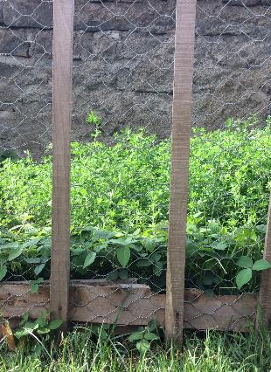




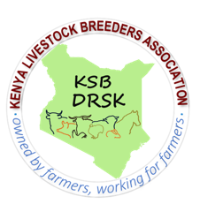







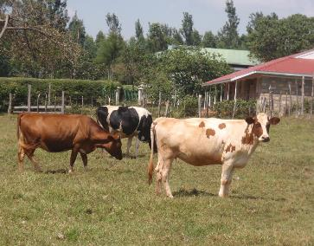





The project team
National/regional Institutions/govts.
Dairy Farmers & Farmer organizations
Notes:
Developing this platform and providing all this information is a collective effort of many partners, many institutions and the dairy Farmers.
Thank you to everybody who has contributed and enabled us to have data from all types of dairy farmers in Africa all in one portal.

Slide 13
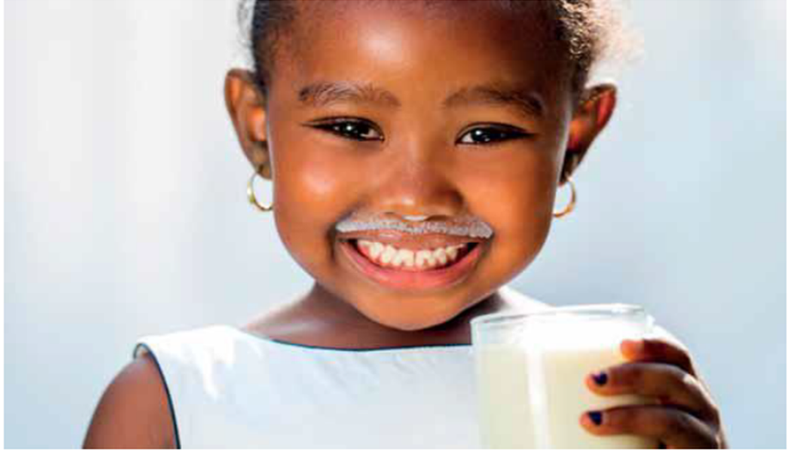
THANK YOU

