Slide 1

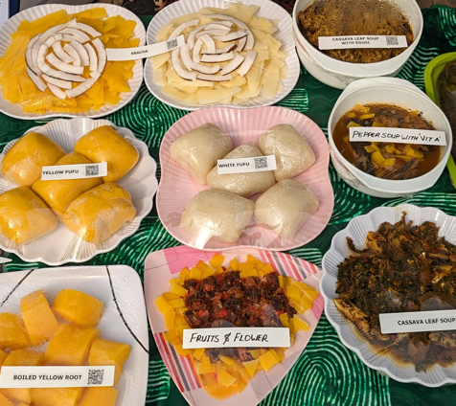
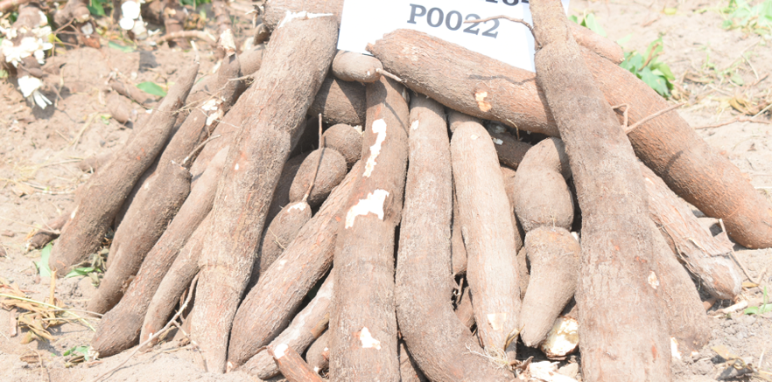
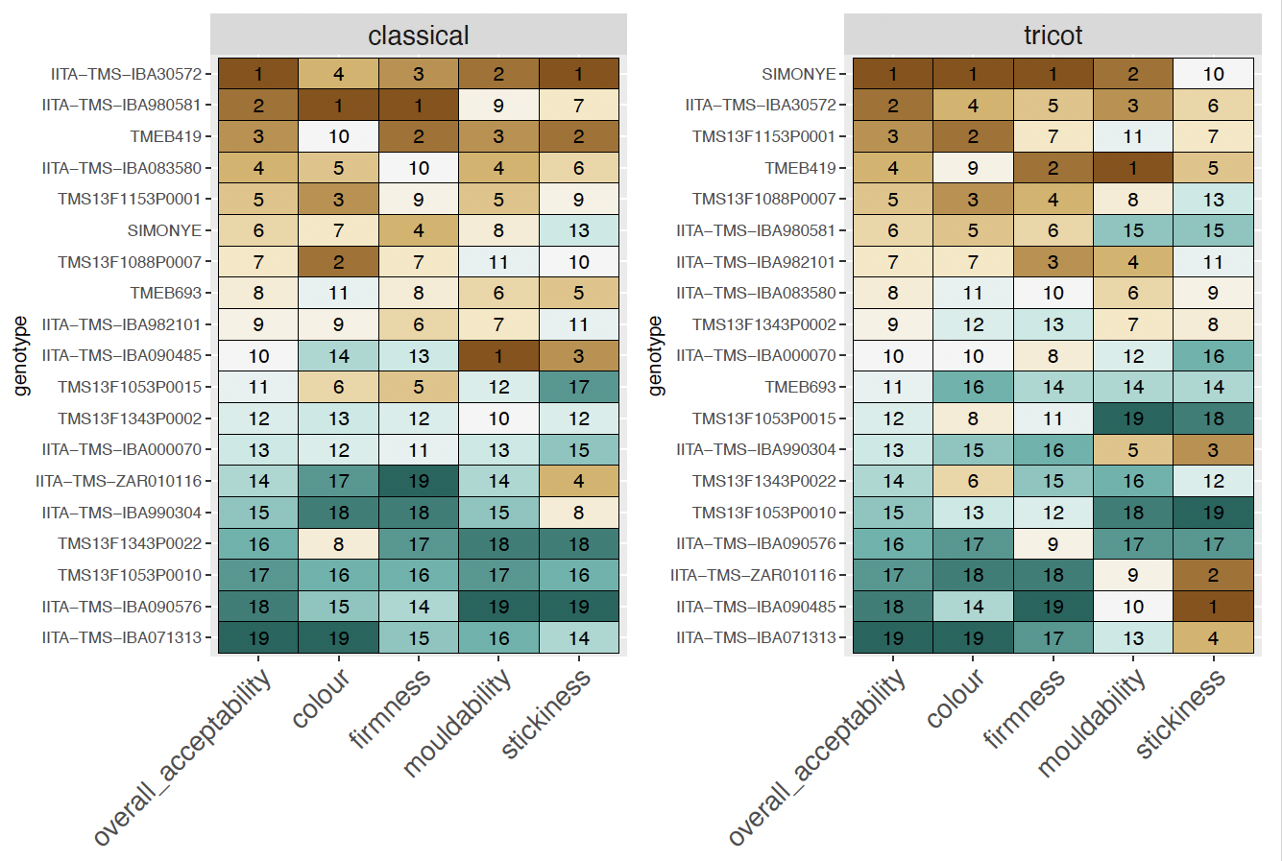
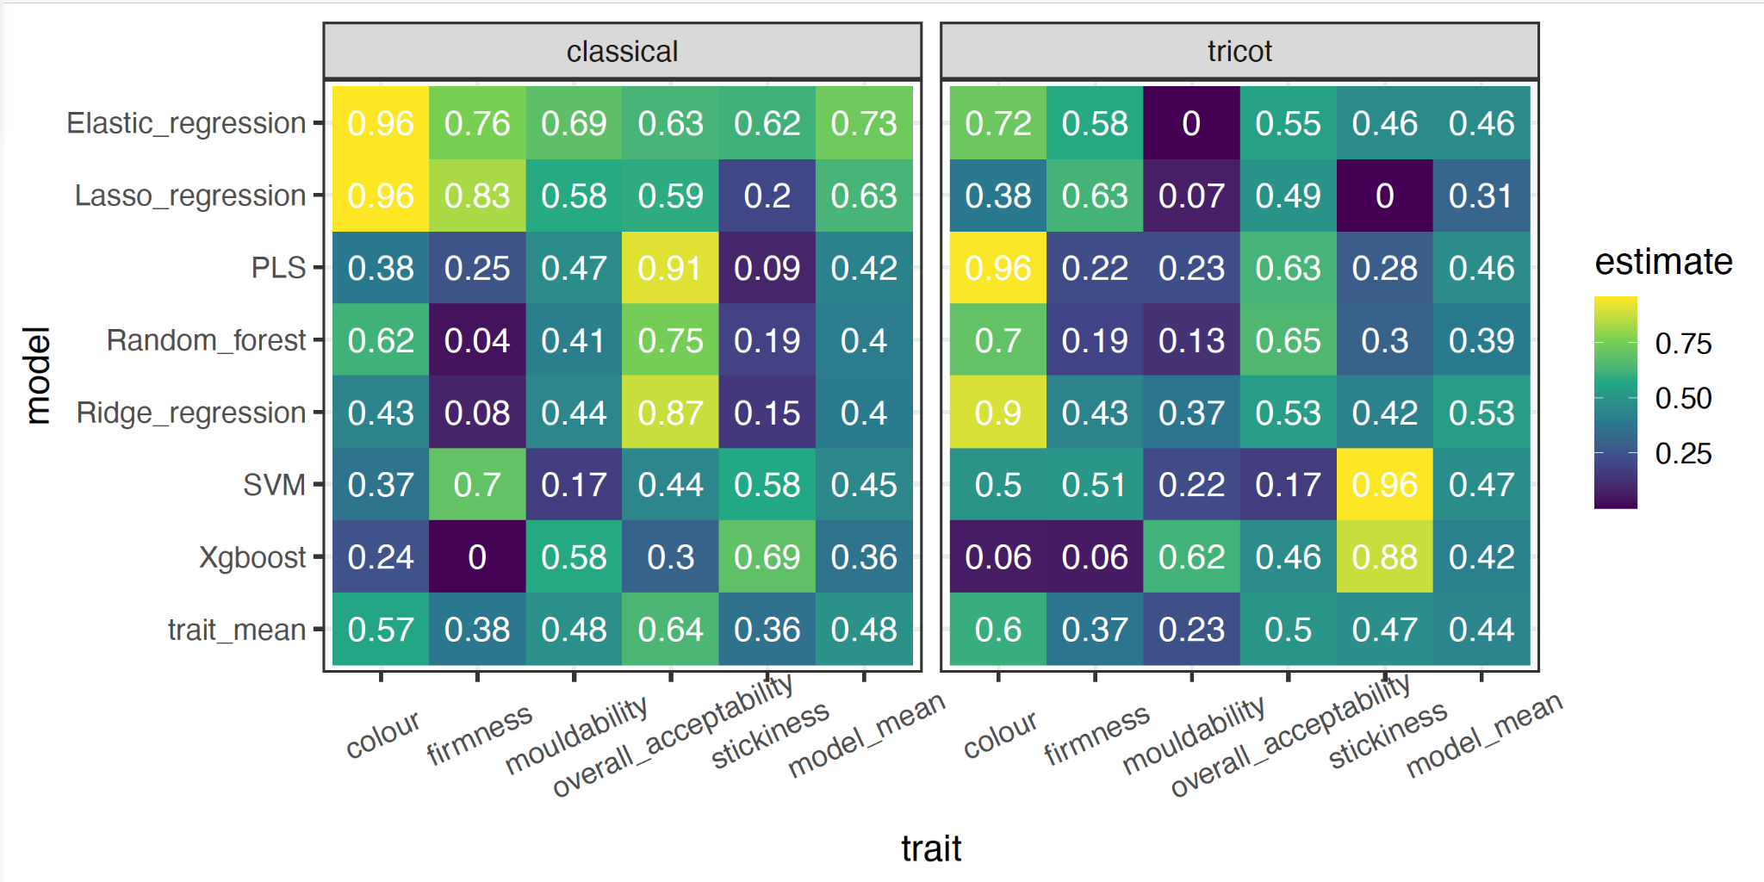
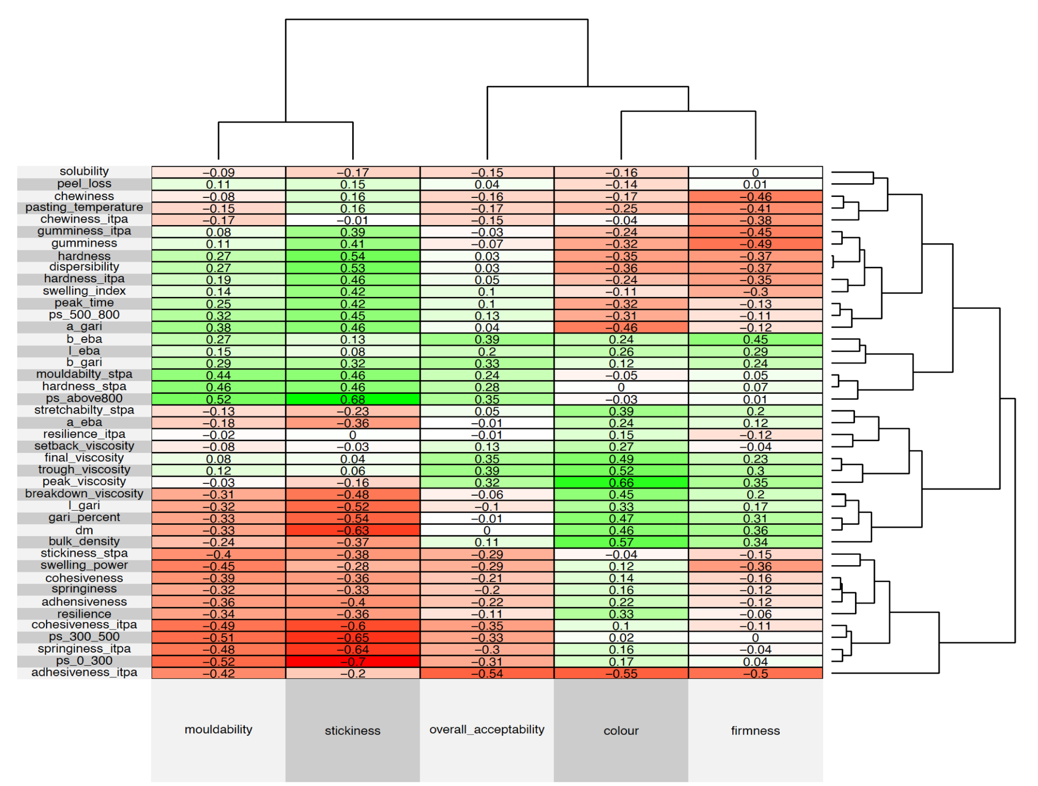
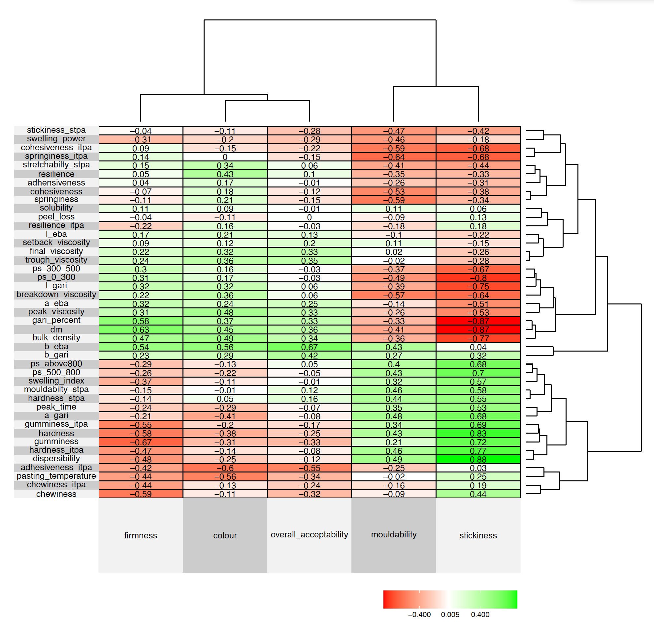



https://orcid.org/0000-0003-0244-3975
Evaluating Consumer Preferences for Eba Using Hedonic Scoring and TRICOT Ranking: Integrating Biophysical Traits in Cassava Breeding
Cynthia Idhigu Aghogho *^{2,3}, Chike E Ugoji¹, Omotola Dorcas Olaoye^{1,2}, Bussie Maziya-Dixon¹, Elizabeth Parkes¹, Micheal Adesokan ¹, Ibnou Dieng¹, Bela Teeken¹, Bello Abolore¹, Rachel Abioye¹, Abiodun Moyore¹, Olamide Olaosebikan¹, Elohor Mercy Diebiru-Ojo¹, Edwige Gaby Nkouaya Mbanjo¹, Mushoriwa Hapson^{1,} Ismail Y. Rabbi¹
¹ International Institute of Tropical Agriculture (IITA) PMB 5320, Oyo Road Ibadan, Oyo State, Nigeria
² West Africa Centre for Crop Improvement (WACCI), College of Basic and Applied Sciences University of Ghana, PMB LG 30, Legon, Ghana.
³ Crop Soil and Environmental Sciences, Auburn University Alabama, USA Corresponding Author email: I.Rabbi@cgiar.org
Introduction
Consumer preferences for cassava products like eba are influenced by texture, flavor, appearance, and cooking properties, which vary widely among users. Integrating these preferences into cassava breeding objectives can enhance adoption and impact. This study compares two consumer testing methods—Hedonic (Likert) scores and TRICOT ranking—to assess preference patterns and correlate them with biophysical attributes of fresh roots, gari, and eba. The objectives were:
Develop an indirect phenotyping approach that incorporates consumer preferences into breeding objectives using mid-throughput phenotyping and machine learning.
Identify key biophysical, textural, and sensory traits that correlate strongly with consumer preferences using Hedonic scoring and TRICOT ranking methods.
we
Materials and Methods
Survey Methods - Two distinct consumer testing approaches were used:
  Hedonic Scores - A 9-point Likert scale, evaluating 19 genotypes with 480 participants in 4 batches. Each participant assessed 7 samples, including 3 checks.
  TRICOT Ranking - Simple comparison and ranking of 19 genotypes by 720 participants in a block size of 3. Each sample was surveyed 120 times.
Data Collection - Consumer preference data were linked with biophysical measurements (e.g., dry matter content, color, texture) of fresh roots, gari, and eba.
Analysis - Machine learning models were applied to predict consumer preferences based on biophysical traits. Correlation analysis was conducted to compare the effectiveness of the two survey methods.
Fig 2: Ranking of 19 genotypes based on consumers preference scoring using classical hedonic and TRICOT ranking approaches.
Overview of comparison criteria for hedonic scores and TRICOT
Criteria for Comparison | Hedonic (Likert) Scores | Ranking
Experimental design | Incomplete Block Design (block size 8) | Incomplete Block Design (block size 3)
Number of Genotypes | 19 | 19
Number of Participants | 480 | 720
Number of batches | 4 | 720
Sample assessed per participant per session | 7 (3 are checks) | 3
Question mode | 9-point Hedonic/Likert scale | Simple comparison and ranks
Number of times a sample is surveyed | 120 | 120
Fig 3: Accuracy of predicting consumers preference from biophysical, textural and colour related data across a range of statistical and machine learning models for eba
Results and Discussion
Both methods consistently identified favorable genotypes; however, the TRICOT approach demonstrated stronger correlations between consumer preferences and biophysical traits (Figure 1). Preferences for color and firmness were more closely associated with overall acceptability than moldability or stickiness.
Biophysical Correlations - Dry matter content showed a positive correlation with firmness but was negatively correlated with stickiness preference.
Machine Learning Predictions - High prediction accuracy was achieved for overall acceptability, color, and firmness, while predictions for stickiness had lower accuracy (Figure 3).
Genotype Performance - The ranking of 19 genotypes using both methods was consistent, highlighting promising varieties for further evaluation (Figure 2).
Conclusion
This study highlights the value of correlating consumer preferences with biophysical traits in cassava breeding. The TRICOT method showed strong potential for identifying key sensory traits linked to consumer acceptability. Machine learning models provided useful insights for predicting preference traits, offering a promising approach for targeted breeding. Further optimization of the models can enhance their predictive power and aid in the development of consumer-preferred cassava varieties.
A
Biophysical measurements
B
Consumer scores
Biophysical measurements
Consumer ranking
Fig 1: Correlation coefficient matrix of biophysical and consumer preference from different survey method a: classical b: tricot survey method.

