Slide 1

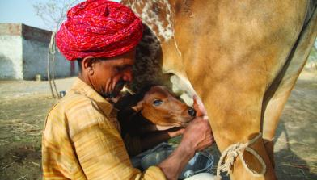
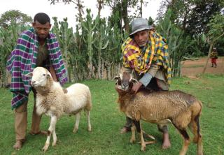


Genotyping by sequencing provides new insights into the molecular genetic diversity of Napier grass collections and identified candidate genes associated with important forage traits
Meki S Muktar, Ermias Habte and Chris S Jones
International Forage and Turf grass Breeding Conference (IFTBC), Florida, 24-27 March 2019
Notes:
There MUST be a CGIAR logo or a CRP logo. You can copy and paste the logo you need from the final slide of this presentation. Then you can delete that final slide
To replace a photo above, copy and paste this link in your browser: http://www.flickr.com/photos/ilri/sets/72157632057087650/detail/
Find a photo you like and the right size, copy and paste it in the block above.

Slide 2
Overview
Introduction
Napier grass population
Genotyping and genome-wide markers generation by GBS
Putative physical map position of markers
Diversity in the Napier grass populations
Estimated linkage disequilibrium across the Napier grass genome
GWAS and Identification of candidate genes/markers associated with important forage traits

Slide 3
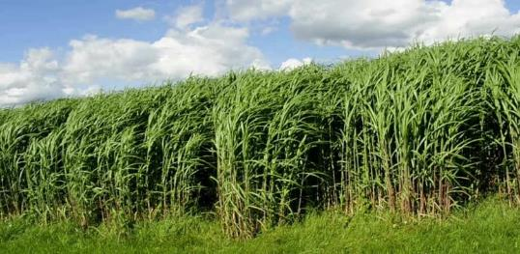
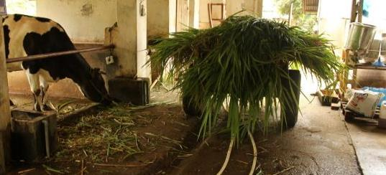
Introduction
  Napier grass (Cenchrus purpureus)
  Perennial grass
  Widely used in cut and carry feeding
  High yield, per unit area
  Ability to withstand repeated cuttings
  Resistance to most pests and diseases
  Tolerance to intermittent drought
  A potential energy crop

Slide 4
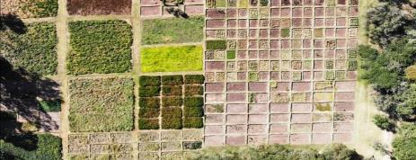
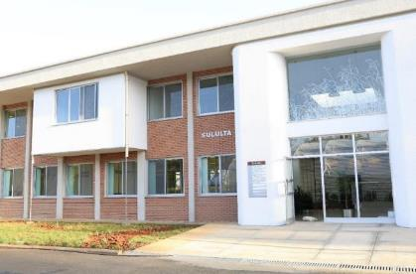

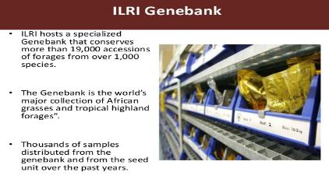
Napier grass population
In Situ conservation
Napier grass population used in the study
ILRI collections |  | EMBRAPA collections
C. purpureus | Hybrid (purpureus x glaucum) | Elite lines | Accessions
52 | 8 | 25 | 20
Ex Situ conservation

Slide 5
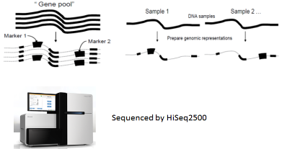
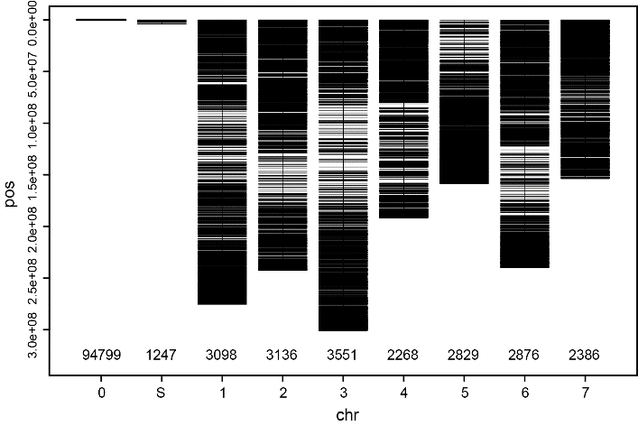
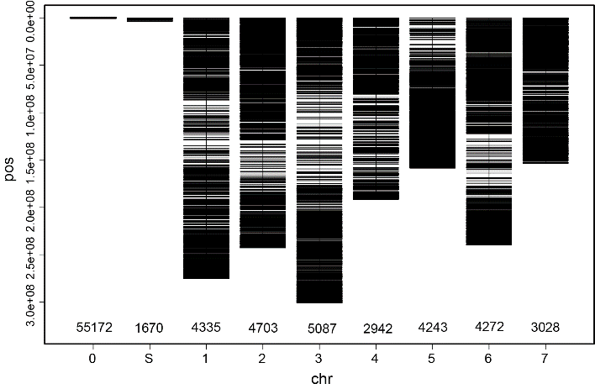
Genotyping of Napier grass accessions
GBS-DArTseq
Putative physical map position of markers using reference genome
of pearl millet (P. glaucum)
SilicoDArTs = 116,190
SNPs = 85,452
SilicoDArTs
Total markers = 116,190
Mapped markers = 20,144 (17 %)
SNPs
Total markers = 85,452
Mapped markers = 28,610 (33 %)
Bennetzen et al., 2012

Slide 6
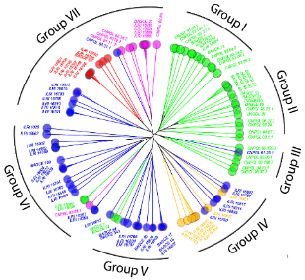
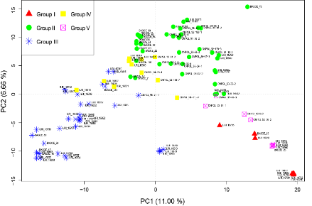
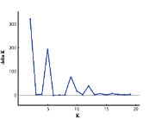
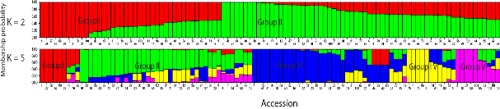
Diversity in the Napier grass populations
A
B
Diversity and population structure analysis
  Selected set of SNP markers
    UPGMA
    PCA
    STRUCTURE software
    AMOVA
C
D
Clusters of the 104 Napier grass accessions using 980 selected SNPs. (A) UPGMA tree showing seven groups; (B) PCA plot for PC1 and PC2; (C) The delta K suggesting two major groups and up to 5 subgroups; (D) Bar plots based on the admixture model in STRUCTURE, for K = 2 and K = 5. The colors are according to the STRUCTURE k = 5.

Slide 7
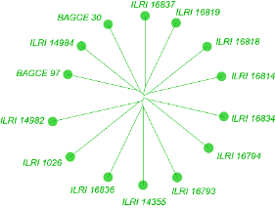
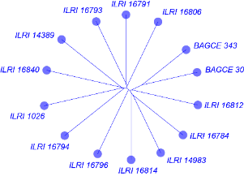
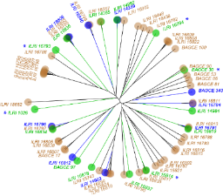
Diversity in the Napier grass populations
A
B
C
UPGMA tree for the subsets under optimal-water (A) and water-deficit (B) conditions. In (C), the positions of the subsets in the whole collection is shown by colors, accessions not selected for the subsets are shaded a tan-color. Accessions common in the two subsets are showed by asterisks.

Slide 8
Estimated linkage disequilibrium across the Napier grass genome
A
B
LD-decay in 104 Napier grass accessions (blue), 45 EMBRAPA accessions (orange) and 59 ILRI accessions (red) (A). In (B), the LD-decay per chromosome is shown

Slide 9
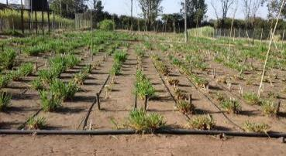
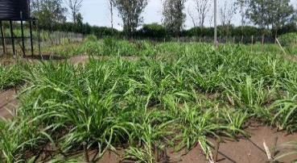
Field phenotyping of the Napier grass population
Irrigated 1 |  |  |  |  |  | Non irrigated 1 |  |  |  |  |  | Irrigated 2 |  |  |  |  |  | Non irrigated 2
Block 1 |  |  |  |  |  | Block 2 |  |  |  |  |  | Block 3 |  |  |  |  |  | Block 4
 | Column 1 | Column 2 | Column 3 | Column 4 |  |  | Column 1 | Column 2 | Column 3 | Column 4 |  |  | Column 1 | Column 2 | Column 3 | Column 4 |  |  | Column 1 | Column 2 | Column 3 | Column 4
Row 1 |  | 6 | 12 |  |  | Row 1 |  | 6 | 12 |  |  | Row 1 |  |  |  |  |  | Row 1
Row 2 |  |  |  |  |  | Row 2 |  |  |  |  |  | Row 2 | 9 |  |  | 3 |  | Row 2 | 9 |  |  | 3
Row 3 | 3 |  |  | 9 |  | Row 3 | 3 |  |  | 9 |  | Row 3 |  |  |  |  |  | Row 3
Row 4 |  |  |  |  |  | Row 4 |  |  |  |  |  | Row 4 |  | 12 | 6 |  |  | Row 4 |  | 12 | 6
Row 5 |  | 5 | 11 |  |  | Row 5 |  | 5 | 11 |  |  | Row 5 |  |  |  |  |  | Row 5
Row 6 |  |  |  |  |  | Row 6 |  |  |  |  |  | Row 6 | 8 |  |  | 2 |  | Row 6 | 8 |  |  | 2
Row 7 | 2 |  |  | 8 |  | Row 7 | 2 |  |  | 8 |  | Row 7 |  |  |  |  |  | Row 7
Row 8 |  |  |  |  |  | Row 8 |  |  |  |  |  | Row 8 |  | 11 | 5 |  |  | Row 8 |  | 11 | 5
Row 9 |  | 4 | 10 |  |  | Row 9 |  | 4 | 10 |  |  | Row 9 |  |  |  |  |  | Row 9
Row 10 |  |  |  |  |  | Row 10 |  |  |  |  |  | Row 10 | 7 |  |  | 1 |  | Row 10 | 7 |  |  | 1
Row 11 | 1 |  |  | 7 |  | Row 11 | 1 |  |  | 7 |  | Row 11 |  |  |  |  |  | Row 11
Row 12 |  |  |  |  |  | Row 12 |  |  |  |  |  | Row 12 |  | 10 | 4 |  |  | Row 12 |  | 10 | 4
Row 13 |  |  |  |  |  | Row 13 |  |  |  |  |  | Row 13 |  | 3 | 9 |  |  | Row 13 |  | 3 | 9
Row 14 | 12 |  |  | 6 |  | Row 14 | 12 |  |  | 6 |  | Row 14 |  |  |  |  |  | Row 14
Row 15 |  |  |  |  |  | Row 15 |  |  |  |  |  | Row 15 | 6 |  |  | 12 |  | Row 15 | 6 |  |  | 12
Row 16 |  | 9 | 3 |  |  | Row 16 |  | 9 | 3 |  |  | Row 16 |  |  |  |  |  | Row 16
Row 17 |  |  |  |  |  | Row 17 |  |  |  |  |  | Row 17 |  | 2 | 8 |  |  | Row 17 |  | 2 | 8
Row 18 | 11 |  |  | 5 |  | Row 18 | 11 |  |  | 5 |  | Row 18 |  |  |  |  |  | Row 18
Row 19 |  |  |  |  |  | Row 19 |  |  |  |  |  | Row 19 | 5 |  |  | 11 |  | Row 19 | 5 |  |  | 11
Row 20 |  | 8 | 2 |  |  | Row 20 |  | 8 | 2 |  |  | Row 20 |  |  |  |  |  | Row 20
Row 21 |  |  |  |  |  | Row 21 |  |  |  |  |  | Row 21 |  | 1 | 7 |  |  | Row 21 |  | 1 | 7
Row 22 | 10 |  |  | 4 |  | Row 22 | 10 |  |  | 4 |  | Row 22 |  |  |  |  |  | Row 22
Row 23 |  |  |  |  |  | Row 23 |  |  |  |  |  | Row 23 | 4 |  |  | 10 |  | Row 23 | 4 |  |  | 10
Row 24 |  | 7 | 1 |  |  | Row 24 |  | 7 | 1 |  |  | Row 24 |  |  |  |  |  | Row 24
Blocks 1 and 3 = well watered
Blocks 2 and 4 = reduced water

Slide 10
Field phenotyping of the Napier grass population
  Data have been collected every 8 weeks of plant regrowth
Morphological traits
  Plant height
  No of tillers per plant
  Leaf length
  Leaf width
  Stem thickness
Forage quality traits
  Dry matter/Ash content
  Crude protein content
  Neutral detergent fibre(NDF)
  Acid detergent fibre(ADF)
  In Vitro organic Matter Digestibility(IVOMD)
Soil parameters
  Organic matter
  Available K, P, N
  CN ratio
  CEC
  Soil moisture content using Delta soil moisture probe (HD, England)
Agronomic traits
  Total fresh weight (g)
  Total dry weight (g)
  Leaf/Stem ratio

Slide 11
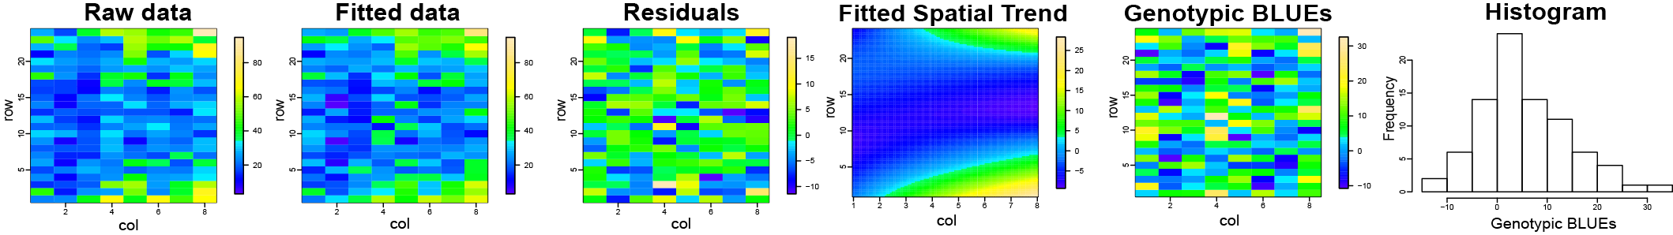
Phenotype data analysis
  Phenotype data corrected for spatial heterogeneity (SpATS R-package, Rodríguez-Álvarez et al., 2018)
  Fixed factors = Soil moisture data and other soil nutrient measurements

Slide 12
GWAS in mixed model
Napier grass population
Phenotype = morphological and agronomic data for 3 different conditions (each an average of two harvests);
  Wet season (rainy season)
  Dry season
    Well-watered
    Reduced-water
Markers = SNPs and SilicoDArTs, polymorphic markers
Population structure and kinship/relatedness in the population

Slide 13
GWAS in mixed model
GWAS
Q + K linear mixed model (Yu et al., 2006; Kang et al., 2008)
y = Xβ + ZSt + ZQv + Zu + e
Multiple testing corrected by FDR

Slide 14
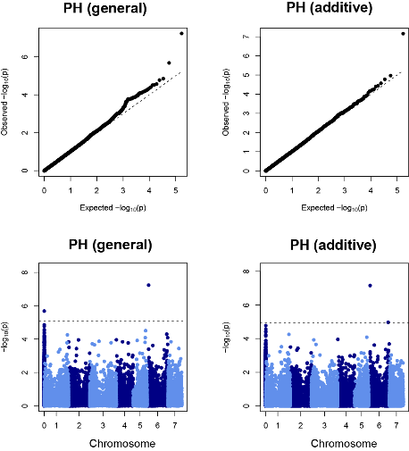
GWAS in mixed model
  Dry season, reduced water condition
5
16

Slide 15
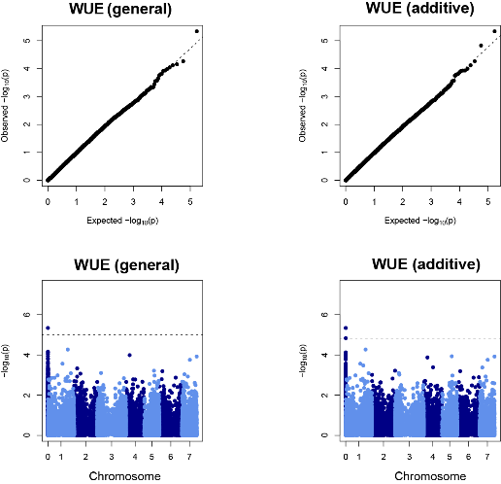
GWAS in mixed model
  Dry season, reduced water condition

Slide 16
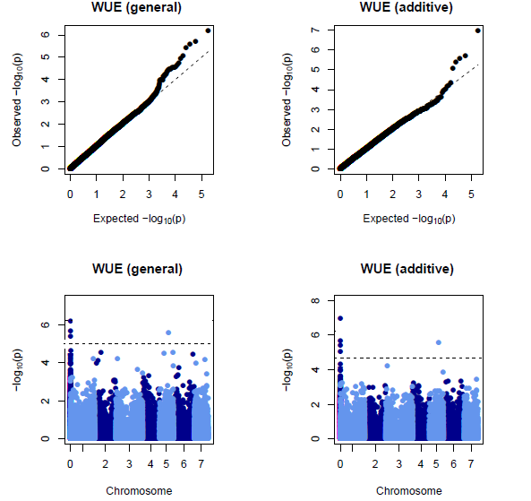
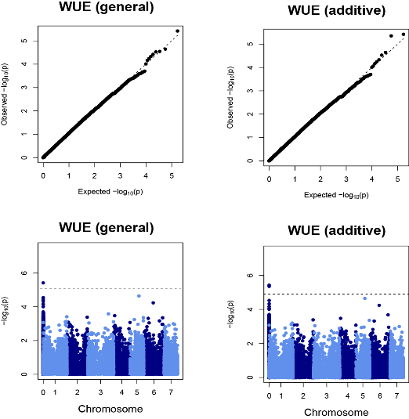
GWAS in mixed model
  Dry season, well watered condition

Slide 17
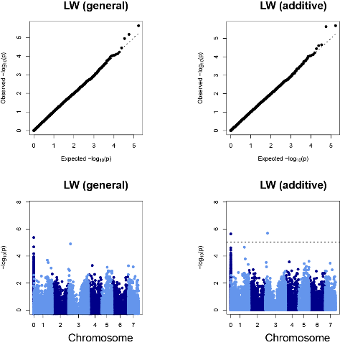
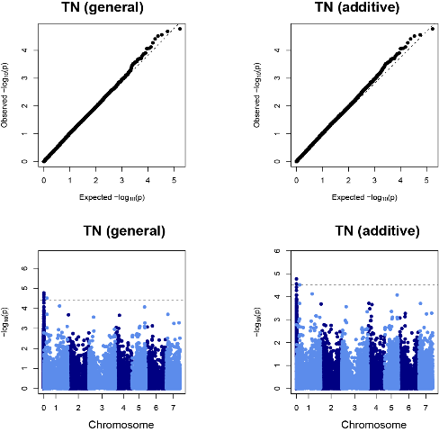
GWAS in mixed model
  Dry season, well watered condition

Slide 18
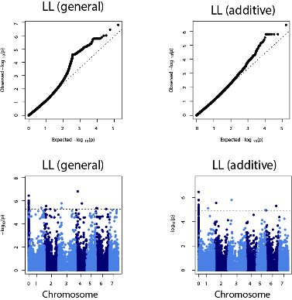
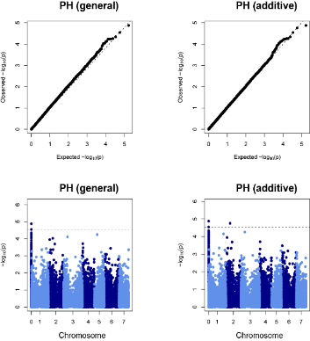
GWAS in mixed model
  Wet season

Slide 19
ACKNOWLEDGMENTS
Rural Development Administration (RDA) of the Republic of Korea, project on the development of new forage genetic resources and their utilization
Germany-GIZ-Deutsche Gesellschaft für Internationale Zusammenarbeit, Gap Funding for Forage Selection and Breeding Activities
Federal Ministry for Economic Cooperation and Development (BMZ), Genebank uplift Funding from Germany
The CGIAR Research Program on Livestock
EMBRAPA

