Slide 1
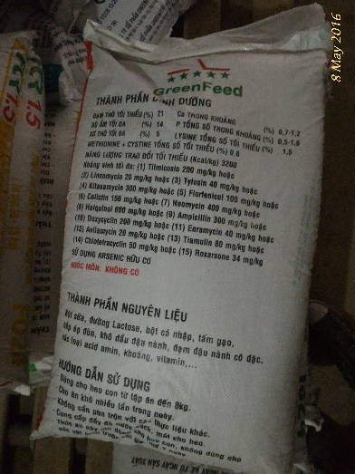
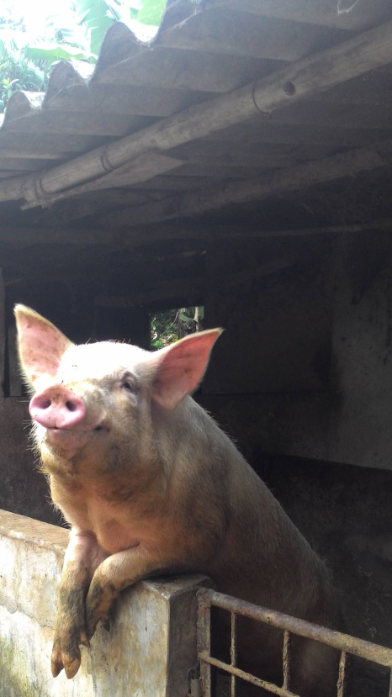
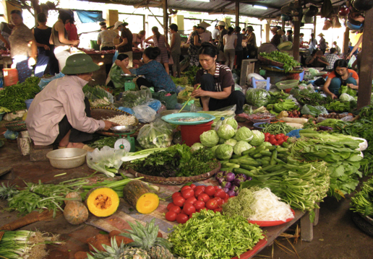

ILRI research on foodborne diseases and antimicrobial resistance associated with pigs
D. Grace , F. Mutua, F. Unger, J. Lindahl, K. Roesel, R. Deka, S.X. Dang, B Wieland, H. Nguyen-Viet
ILRI Vietnam, Kenya, Ethiopia
Regional Pig research symposium, Hanoi, 28 March 2019

Slide 2
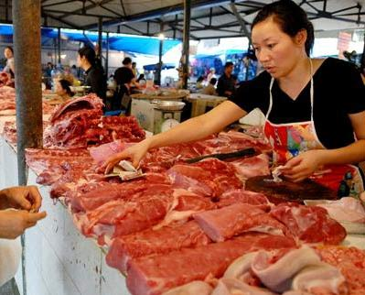
Food Safety

Slide 3
Growing concern about food safety
In low and middle income countries:
Many/most reported concern over food safety (40-97%)
Willing to pay 5-10% premium for food safety
Buy 20-40% less during animal health scares
Younger, wealthier, town-residing, supermarket-shoppers willing to pay most for safety
Grace (2015), IJERPH

Slide 4
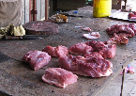
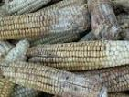
FBD- a new priority
Millions DALYs lost per year (global)
Burden LMIC
31 hazards
600 mio illnesses
420,000 deaths
33 million DALYs
Havelaar et al., 2015

Slide 5
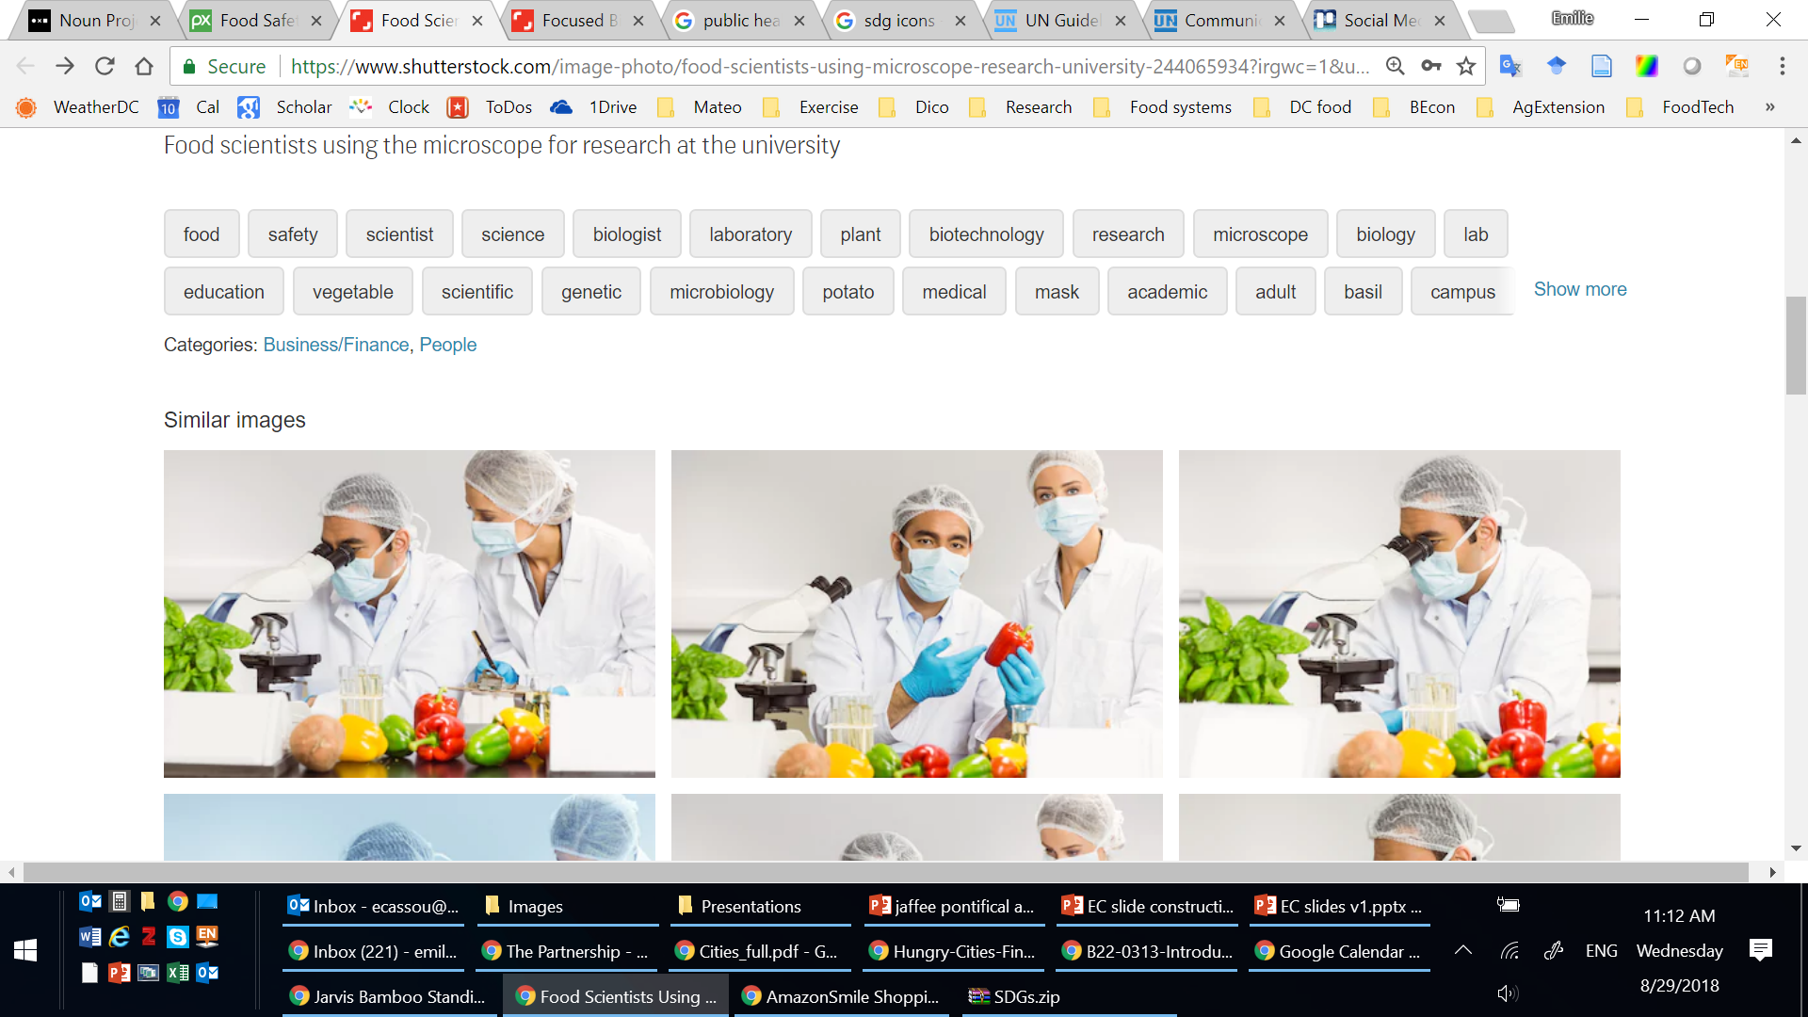

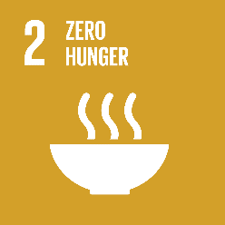





Food safety is integral to the SDGs
Food Safety critical to ACHIEVING the SDGs
Traditional Image of Food Safety
Food safety is integral to:
Food safety (practice) contributes to:

Slide 6
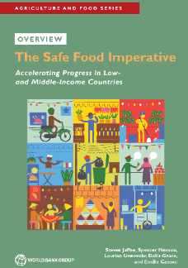
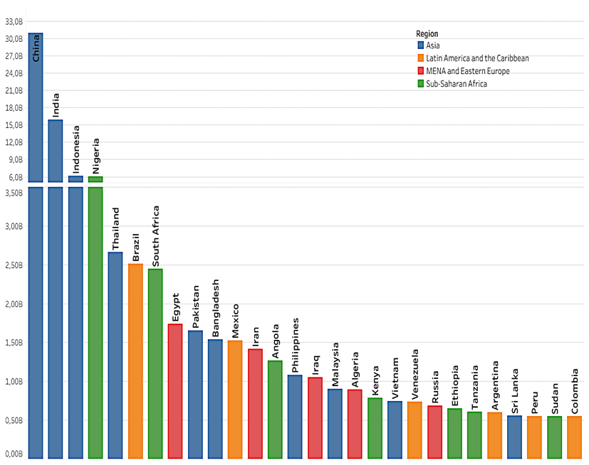
Domestic costs may be 20 times trade costs
Download here
‘Productivity Loss’ =
Foodborne Disease DALYs x Per Capita GNI
Cost estimates for 2016 (US$ billion)
Productivity loss | 95
Illness treatment | 15
Trade loss or cost | 5 to 7
Illness treatment =
US$27 x # of Estimated foodborne illnesses
Trade loss or costs =
2% of developing country high value food exports
Based on WHO/FERG & WDI Indicators Database

Slide 7
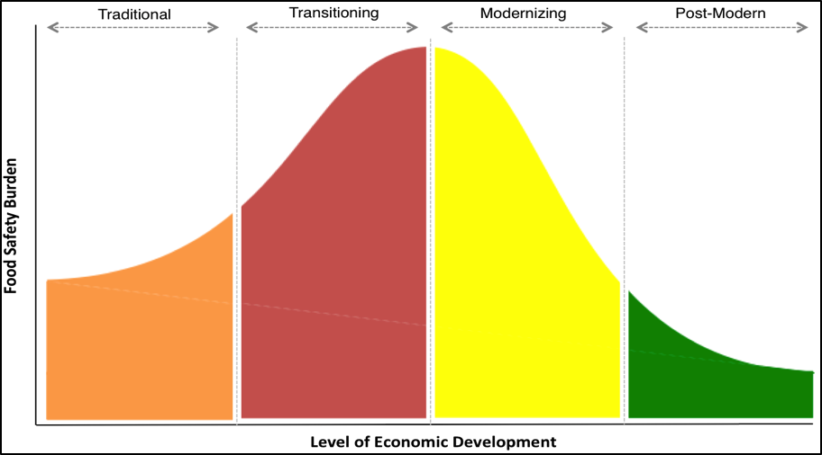
The economic burden of unsafe food is systematically linked to the processes of economic development and dietary transformation:
the Food Safety Lifecycle
Formal sector responds
to consumer demands
Growing public capacity
Stronger incentives
Rapid diet diversity
New market channels
Changing risks
Lagging capacity and
incentives
Mature demand
Risks well-managed
Periodic failures lead
to rapid response
Low diet diversity
Weak incentives
Weak capacity
Reflects the relationship or gap between food safety needs and actual capabilities and incentives
Today’s lower middle income countries represent the world’s food safety ‘hotspot’
Jaffee, 2018, World Bank

Slide 8
Research approach
Situational analyses of food safety
Capacity building on risk-based approaches
Proof of concept: participatory risk assessment
Pilot testing interventions

Slide 9
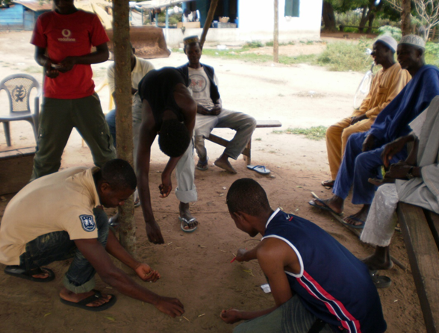
Approach: risk analysis or risk-based decision making
Hazards vs Risk
Can it be present in food? Can it cause harm?
Hazard identification
What harm does it cause?
How does harm depend on dose?
How and to what extent does it get from source to victim?
Hazard characterization
Exposure assessment
What is the harm?
What is its likelihood?
Participatory methods
fit well
Risk characterization
Risk communication

Slide 10

Food safety in Vietnam
Food safety among the most pressing issues, more important than education or health care
Vietnam has a modern food safety legislation system but the use of risk based approach is limited.
  Risk perception towards chemical hazards is important, issue of risk communication
  Food exports relatively well managed but deficits in domestic markets.
  Vietnam government is actively responding to high food safety concerns

Slide 12
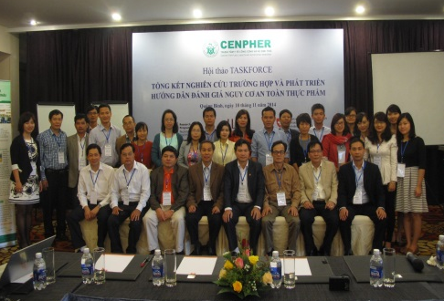
Taskforce of Risk assessment for food safety in Vietnam
Linking research to policy
Taskforce: composed by experts from universities, research institutes, policy makers from the ministries (health, agriculture)
Risk analysis capacity development for researchers and policy makers
Taskforce now institutionalized and sustainable
Notes:
A Food Safety Risk Taskforce (taskforce) has been established with support from the CRP Agriculture for Nutrition and Health (A4NH). The task force aims to assist the Ministry of Health (MOH) and Ministry of Agriculture and Rural Development (MARD) of Vietnam to strengthen the capacity of making decisions on management of food safety using risk assessment and to strengthen local capacity of partners in research related to the use of risk based approaches for food safety management. The task force brought together risk assessment experts from universities and research institutes with representatives from the ministries of health, agriculture and rural development. Through this connection, policymakers and implementers are gaining a better understanding of why risk assessment is useful and how it can be used to effectively manage food safety. Established in 2013, the taskforce organized a ten day advanced risk assessment training was conducted with participants of the taskforce members in September 2014. Two other trainings on risk assessment for Department of Animal Health (DAH/MARD) for veterinary staff were organised in December 2014 on the request of DAH. To apply risk assessment into practice, a series of case studies using risk assessment to assess health risk were conducted to characterize some health risks related to food in the context of food production-environment and health interaction. This included i) Assesses health risks of vegetables and fish grown/caught in wastewater; ii) Assesses health risks related to chemical hazards (antibiotic residues) in pork; and iii) Interacts with stakeholders, disseminates research results and advocates for the use of risk assessment as a tool in food safety management. Results from case studies were published in journal papers and policy briefs. The taskforce will be to continue the discussion with MARD and MOH how to institutionalize the taskforce as a unit of a large program on risk assessment of Vietnam for sustainability purpose of the group.

Slide 13
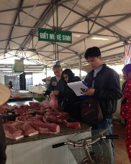
Capacity building impact: curriculum development & trainings
Guidelines on FS risk assessment: more accessible and understandable in use in 17 universities, 7 cities
Curriculum developed to teach 200 students per year: majority of future food safety human resources
Trainings for veterinary and public health staff at ministry level
Hand-on training on risk assessment for researchers, students
Notes:
A Food Safety Risk Taskforce (taskforce) has been established with support from the CRP Agriculture for Nutrition and Health (A4NH). The task force aims to assist the Ministry of Health (MOH) and Ministry of Agriculture and Rural Development (MARD) of Vietnam to strengthen the capacity of making decisions on management of food safety using risk assessment and to strengthen local capacity of partners in research related to the use of risk based approaches for food safety management. The task force brought together risk assessment experts from universities and research institutes with representatives from the ministries of health, agriculture and rural development. Through this connection, policymakers and implementers are gaining a better understanding of why risk assessment is useful and how it can be used to effectively manage food safety. Established in 2013, the taskforce organized a ten day advanced risk assessment training was conducted with participants of the taskforce members in September 2014. Two other trainings on risk assessment for Department of Animal Health (DAH/MARD) for veterinary staff were organised in December 2014 on the request of DAH. To apply risk assessment into practice, a series of case studies using risk assessment to assess health risk were conducted to characterize some health risks related to food in the context of food production-environment and health interaction. This included i) Assesses health risks of vegetables and fish grown/caught in wastewater; ii) Assesses health risks related to chemical hazards (antibiotic residues) in pork; and iii) Interacts with stakeholders, disseminates research results and advocates for the use of risk assessment as a tool in food safety management. Results from case studies were published in journal papers and policy briefs. The taskforce will be to continue the discussion with MARD and MOH how to institutionalize the taskforce as a unit of a large program on risk assessment of Vietnam for sustainability purpose of the group.

Slide 14
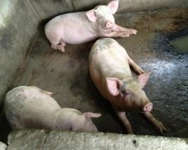
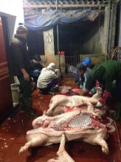
PigRISK: Pork safety in Vietnam (2012-2017)
PigRISK project (2012-2017)
Food safety risk assessment along the pork value chain
Microbial and Chemical Risk Assessment
Salmonella risk pathways developed for producers, slaughterhouse and consumers, quantitative microbial risk assessment (QMRA) risk for consumer
Chemical risk assessment: antibiotic residues, banned chemicals, heavy metals
Farm
Transportation to SH
Slaughterhouse
Retailer
Consumers
Feed in bags, remaining feeds at the cages, environment
Liver
Kidney
Pork
Consumption survey
1,275 samples (farms, slaughterhouse, market) collected during 1 year

Slide 15
PigRISK - microbial contamination
Actor | Sample type | Prev (%)
Producer | Drink-FA | 19.4
Producer | Floor Swab-FA | 36.1
Producer | Waste Water-FA | 38.9
Slaughter house | CarcassM Swab | 38.9
Slaughter house | Feces | 33.6
Slaughter house | Mesenteric LN | 35.6
Slaughter house | SwabFlo-SH | 22.4
Slaughter house | Water-SH | 20.4
Market | Overall | 34.1

Slide 16
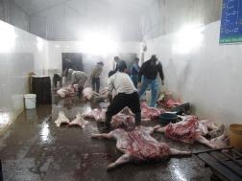
PigRISK – QMRA for salmonellosis
Age and gender groups | Estimated annual salmonellosis incidence rate (Mean (90% CI)) (%)
Children (under 5 years old) | 11.18 (0 – 45.05)
Adult female (6-60 years old) | 16.41 (0.01 – 53.86)
Adult male (6-60 years old) | 19.29 (0.04 – 59.06)
Elder (over 60 years old) | 20.41 (0.09 – 60.76)
Overall | 17.7 (0.89 – 45.96)
The annual incidence of foodborne salmonellosis in the Asian region including Vietnam was 1% (range 0.2-7%) (Havelaar 2015)
Dang Xuan Sinh et al, 2016, IJPH

Slide 17
Economic impact of food borne diseases
Costs per treatment episode and per hospitalization day for foodborne diarrhea case were US$ 106.9 and US$ 33.6 respectively.
51.3%: Indirect cost (costs of times to patient, their relatives due to the patient’s illness)
33.8%: Direct medical costs
14.9%: Direct non-medical costs (patient and their relatives)
Hoang Van Minh et al, 2015, JKMS

Slide 18
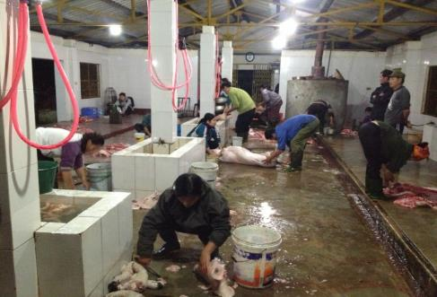
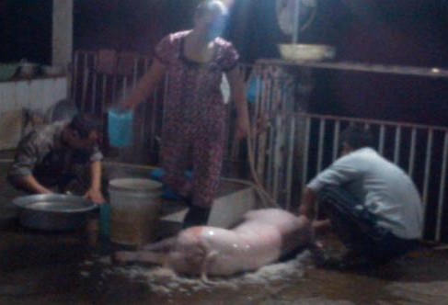
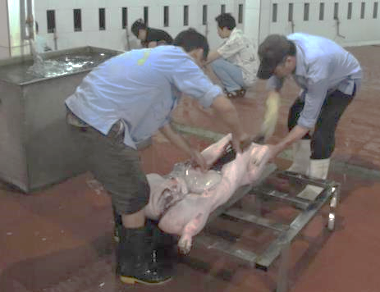
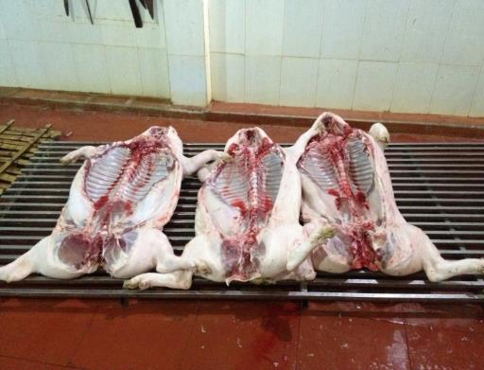
Pilot intervention option at medium slaughterhouse
- Separate dirty (before de-hairing) & clean (after de-hairing) zones
On grid (instead of on floor) from evisceration till transport to market
Clean rinsing water
Better practices

Slide 19
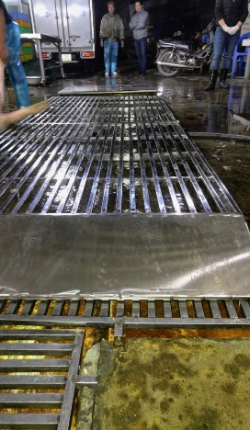
Investments in FS can save lives and $$$
94 million people
Cases of foodborne diseases by Salmonella in pork at 17%: 16 million get sick
Cost $ 107 to treat a case: $ 1,709 million (0.8% GDP)
Intervention to reduce 20% burden: $ 340 million SAVED

Slide 20
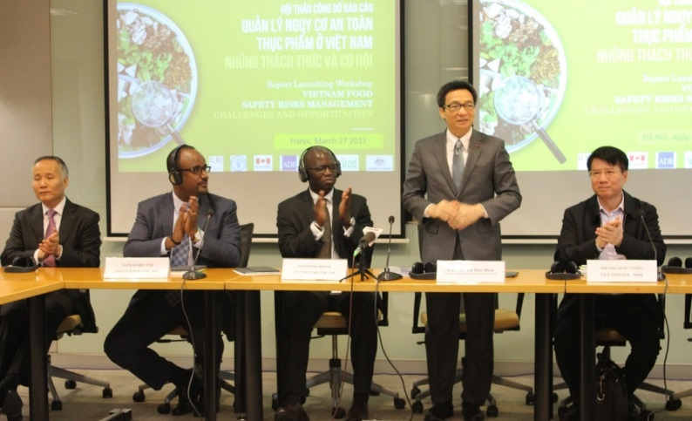




Policy impact: translational research for interventions in modernizing food system
CGIAR/ILRI niche - risk assessment and policy / regulatory analysis for fresh foods in domestic markets
World Bank convenes overall support to government: ILRI led technical works
Upcoming projects based on WB report we led will improve food safety for 20 million people in major cities of Vietnam

Slide 21
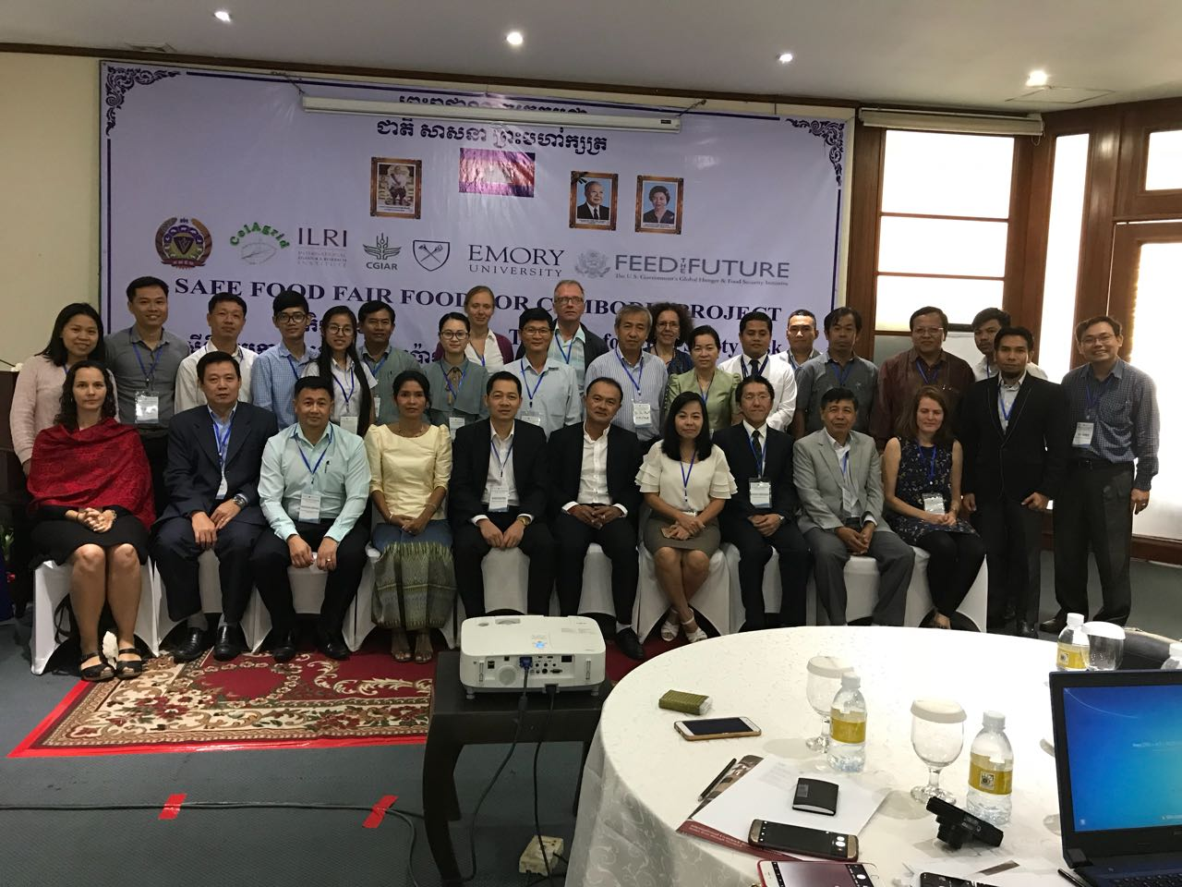
Safe Food Fair Food for Cambodia
Support existing food safety technical working group of Cambodia
Risk assessment expertise and case studies
Linking to other projects of food safety
Training
Avoid duplication effort

Slide 22
SFFF Cambodia: primary results
Province | N# of Sample | N# Positive Sample (%)
 |  | Salmonella | S. aureus
Phnom Penh | 24 | 3 (12.5) | 2 (8.3)
Siem Reap | 24 | 18 (75.5) | 8 (33.3)
Takeo | 16 | 6 (37.5) | 6 (37.5)
Kampong Cham | 16 | 6 (37.5) | 10 (62.5)
Tbong Khmom | 16 | 8 (50.0) | 6 (37.5)
Kep | 16 | 10 (62.5) | 4 (25.0)
Kampot | 16 | 10 (62.5) | 5 (31.3)
Kampong Speu | 16 | 6 (37.5) | 10 (62.5)
Kandal | 16 | 6 (37.5) | 3 (18.8)
Kampong Chhnang | 16 | 9 (56.3) | 7 (43.8)
Oddor Meanchey | 16 | 7 (43.8) | 0 (0)
Total | 192 | 89 (46.4) | 61 (31.8)

Slide 23
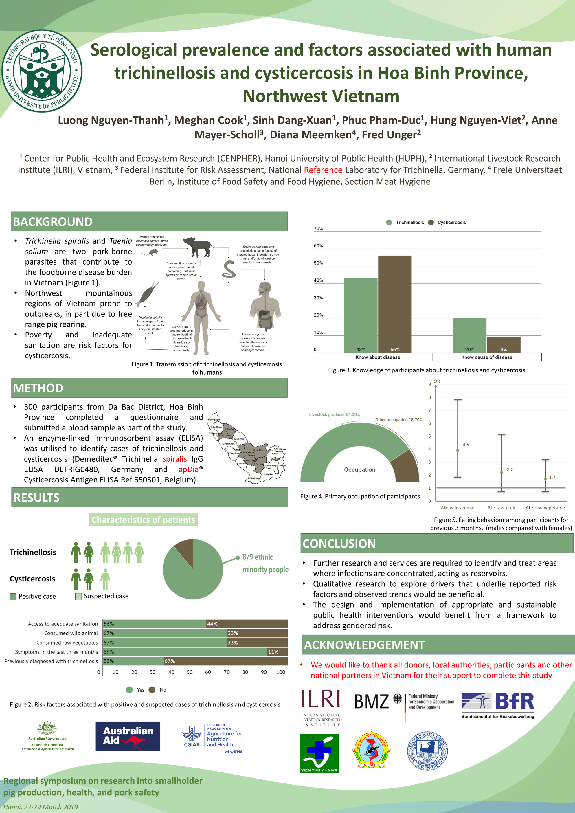

Slide 24
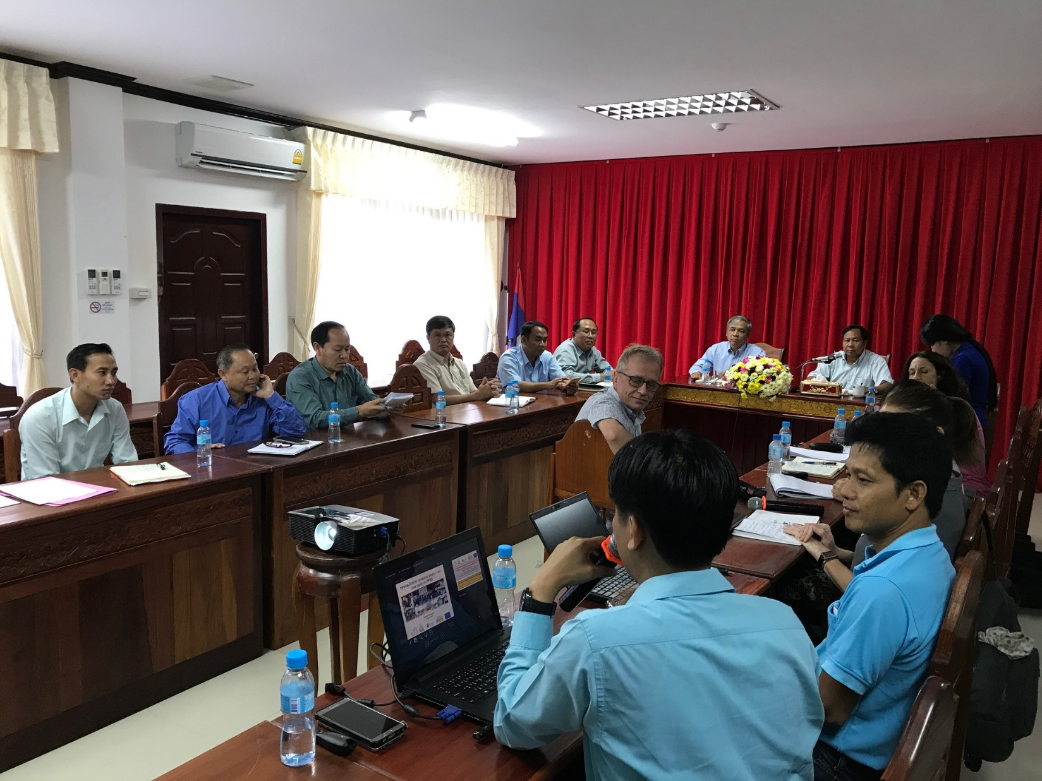
Savanakhet, Laos
Foodborne parasitic disease research 10. 2017
Decision makers
Public health (MD, army health)
Scientists
Vets

Slide 25
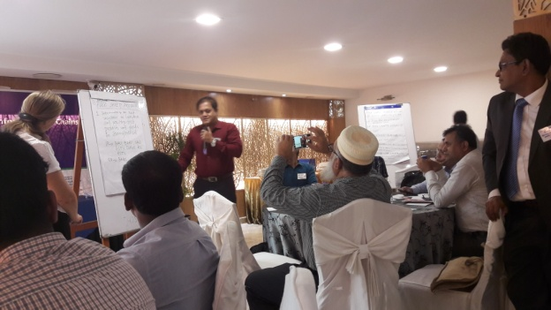
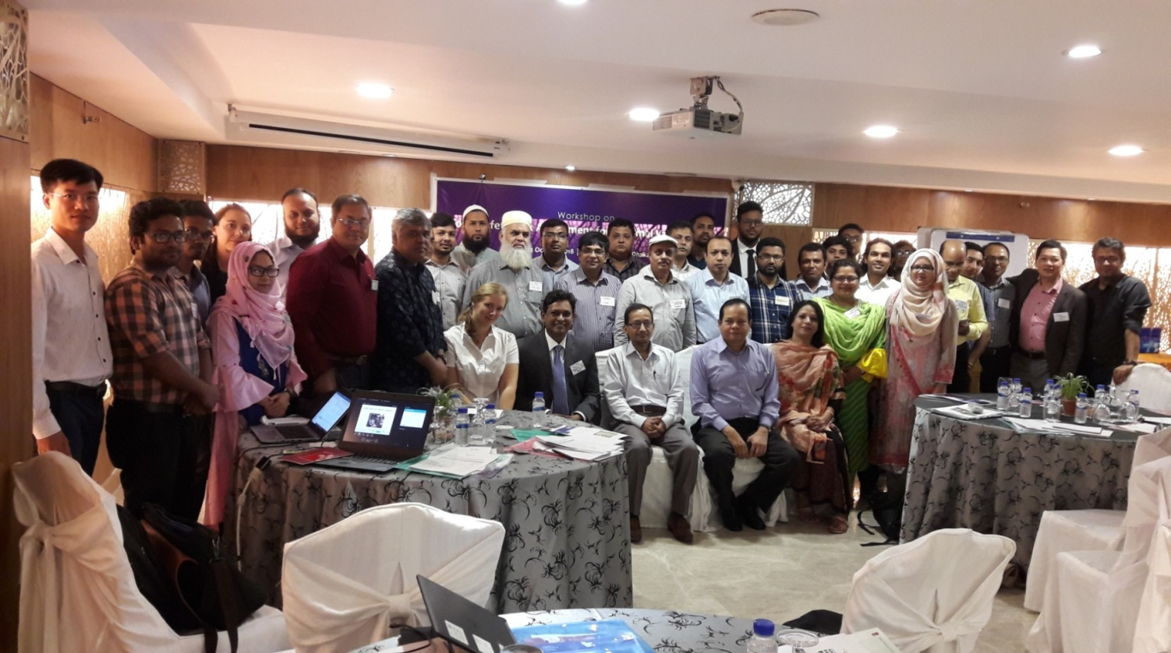
Bangladesh: capacity building on risk-based approaches
Risk assessment workshop in Dhaka 22-24 October 2018: 33 participants

Slide 26
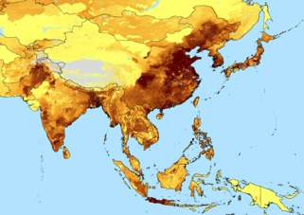
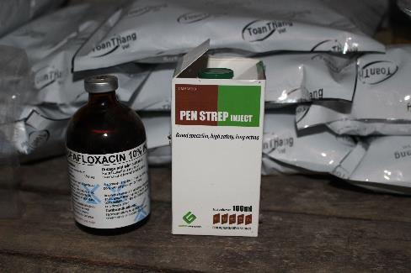
Antimicrobial use (AMU)
Antimicrobial resistance (AMR)

Slide 27
AMU at global level
(Population Correction Unit)
Van Boeckel et al. 2015. PNAS

Slide 28
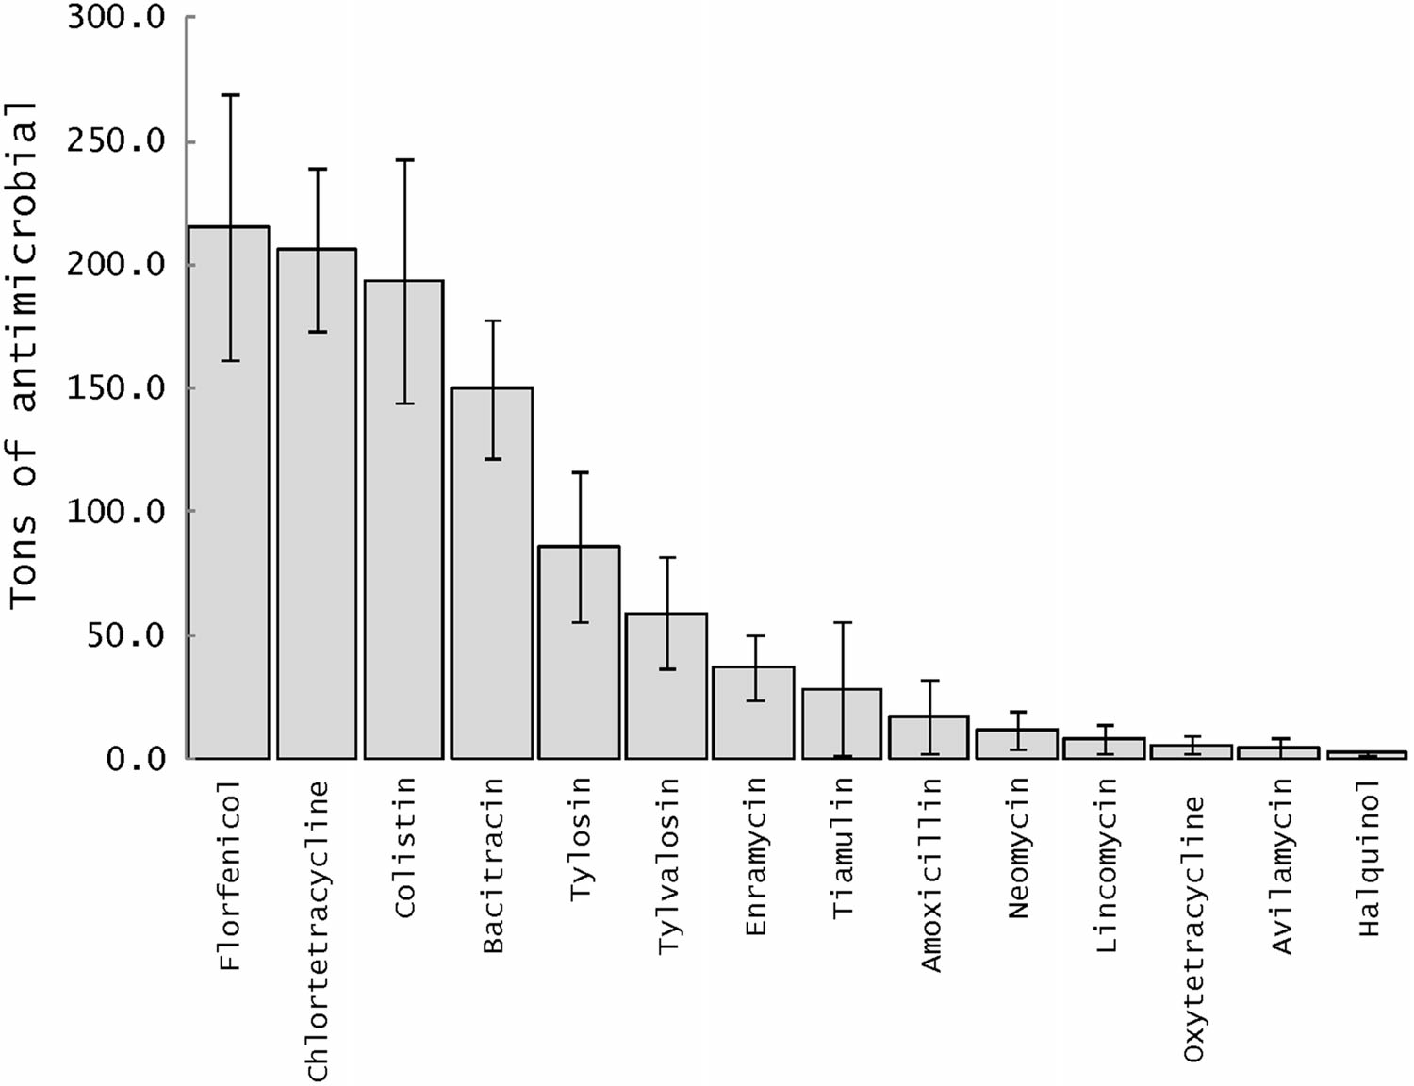
AMU consumption for chicken and pig medicated feeds
77.4 mg and 286.6 mg of in-feed antimicrobials were used to raise 1 kg of live chicken and pig, respectively.
1023 tons and 981 tons for Vietnamese chicken and pig production, respectively.
Nguyen Van Cuong et al. 2016. EcoHealth

Slide 29
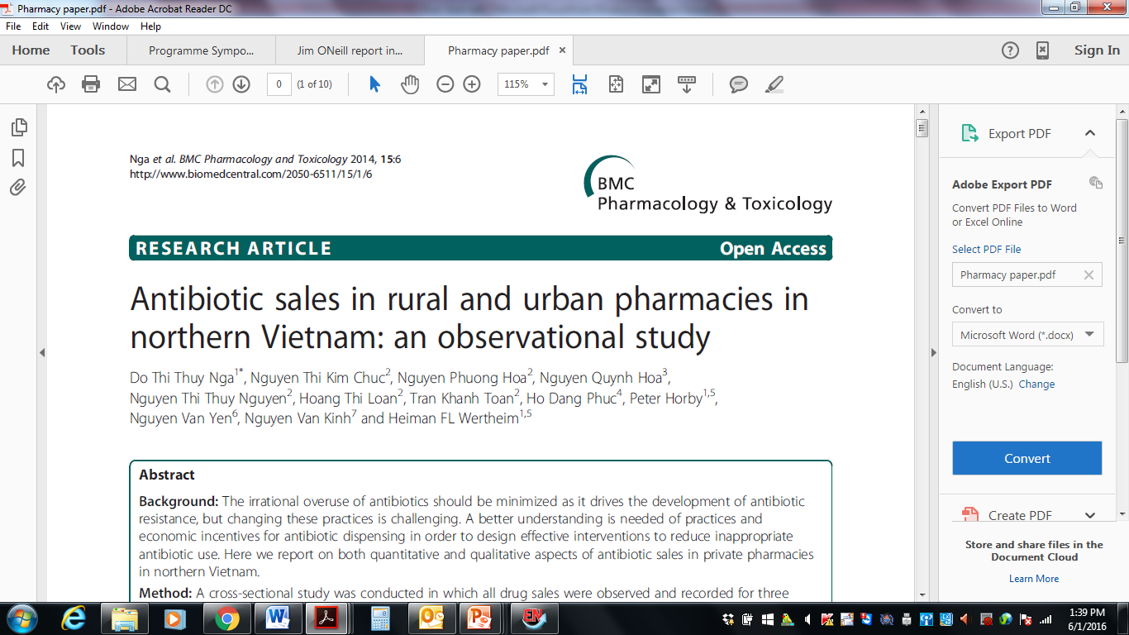
90% AB sold without prescription
Dispensed by inexperienced staff
25% of sales is AB sales
More rural domestic drug sales
High demand from buyer -> public awareness campaigns
Strong incentive for AB dispensing -> room for intervention

Slide 30
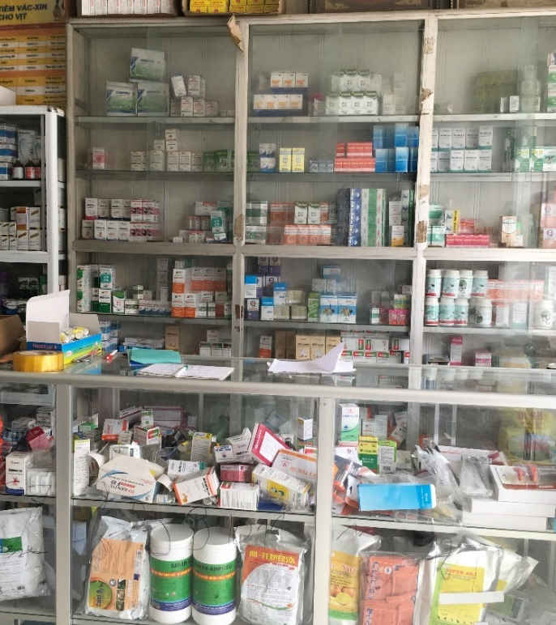
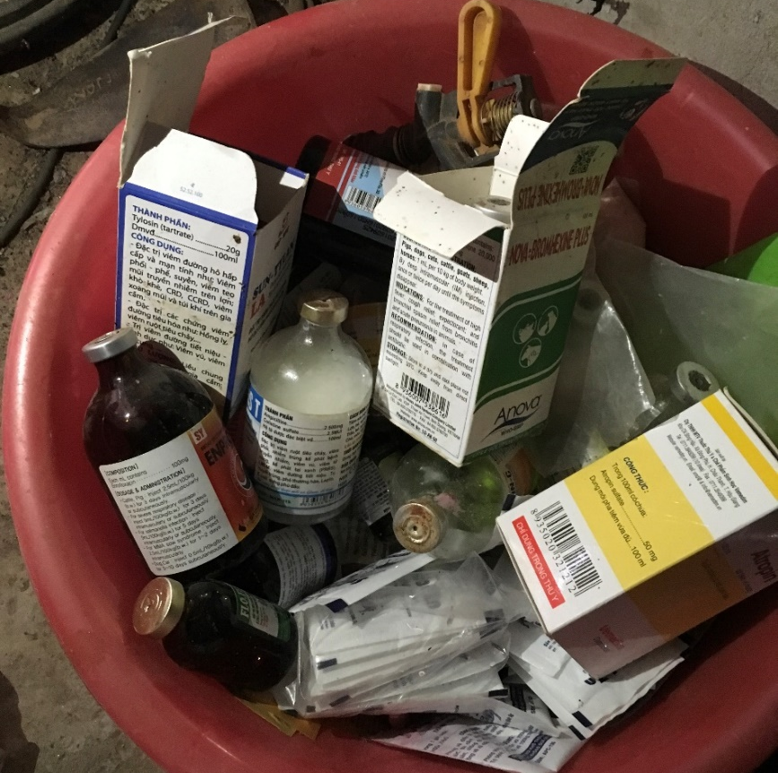
Veterinary pharmacy, Northern Vietnam

Slide 31
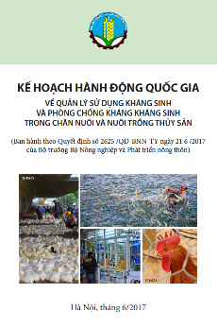
National action plan for AMU and AMR in livestock production and aquaculture
Strengthen governance of AMR and AMU management
Improve legal basis for AMR and AMU management
Enforce the legislation in place
Implement good treatment and husbandry practices
Monitor AMR, AMU and antibiotic residue
Strengthen inter-sectoral collaboration in AMR management
Increase awareness of AMU and risk of AMR

Slide 32






Antimicrobial
Resistance
Hub
www.amr.cgiar.org

Slide 33
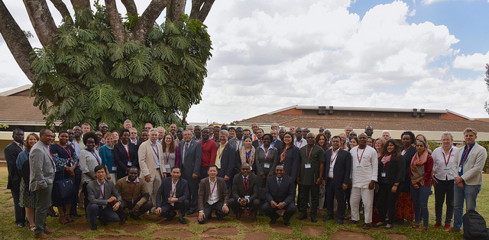
CGIAR Antimicrobial Resistance Hub launch meeting, Nairobi 21-22 February 2019

Slide 34
AMR in the CGIAR: Activity focus
Partnerships
AM use and value chains
Transmission dynamics
Interventions
Enabling policy
Capacity

Slide 35

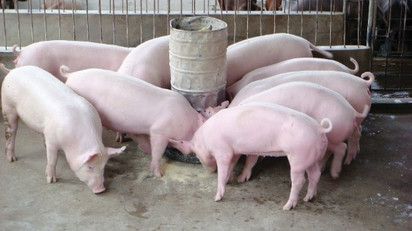


VIDA-PIG PROJECT
Health and Antibiotics in Vietnamese Pig Production
One Heath
Veterinary drug use among pig farmers
Antibiotic resistance in pigs and antibiotic residues in pork products
2
3
Pig health and health management practices
Effective interventions for improving pig health management
1
4
Rational use of AM, reduced AMR, safer food
Improve understanding of drug use and strengthen capacity in AMR /AMU surveillance
Pig farms, feed mills, abattoirs, veterinarians, etc.
Hung Nguyen et al. 2018

Slide 36

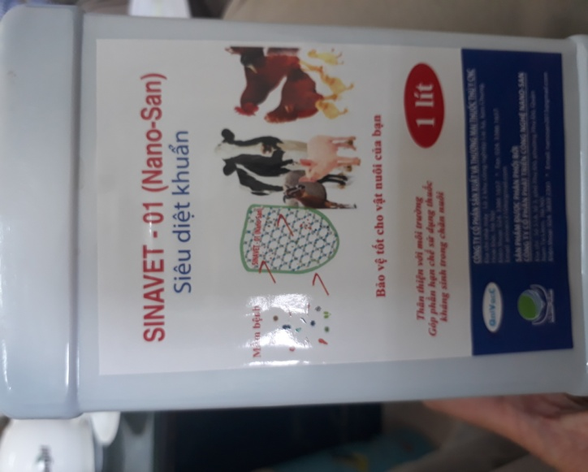
Intervention for AMR in Vietnam
Alternatives to AM: nano-silver in Vinh Phuc/probiotics
Treatment
Feed without AM
Nano silver 0.3%/kg
Control
Business as usual
Medicated feed with Amoxicillin, 300 ppm
30 piglets of 35 days for 4 months in 6 farms, 5 pigs/farm
30 piglets of 35 days for 4 months in 6 farms, 5 pigs/farm
Weight measurement (T0, T2, T4)
AMR of E. coli: test of sensitivity to 10 most commonly used AM, monthly faeces and floor pool samples in each farm
Mortality, morbidity
AM residue in feeds and pork at T4

Slide 37
Other studies
Exploring the One Health approach to AMR surveillance in Vietnam (Marisa Mitchell)
Globally standardized tool for AMU (AMUSE) (Hu Suk Lee)
Antimicrobial stewardship (Tarni Cooper)

Slide 38
Take home messages
Food safety:
Huge health and economic burden of foodborne disease
Previous investments not in line with modern understanding
Interventions successful in short term
Long term, wide-reaching impacts likely require i) training & technology, ii) incentives, and ii) enabling environment
Timely, persistent contacts with policy makers and opportunistic
AMR:
Understanding of AMR drivers and solutions
CGIAR AMR hub: new platform for AMR research and intervention through partnership.

Slide 39
Call for a One Health approach to address food safety and AMR

Slide 40
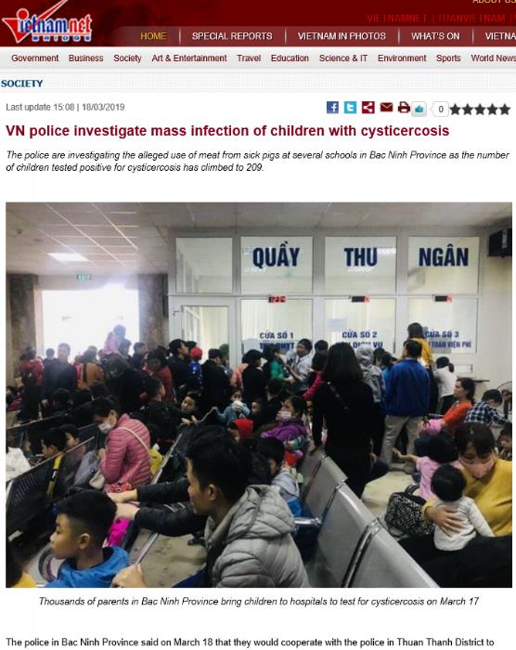
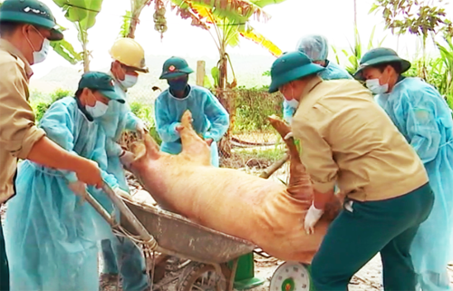
Research into use: Risk communication and management
Risk communication and management problem
Cysticercosis in schools in Bac Ninh
African swine fever and food safety

