Slide 1

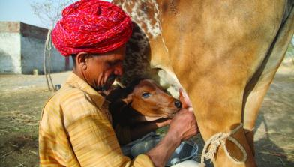
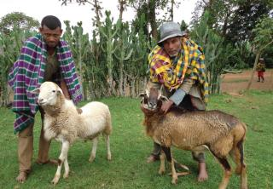



Informing Sustainable and Resilient Development of Pastoral and Agro-Pastoral Production Systems in Ethiopia
Berhanu Gebremedhin, Mengistu Woldehanna, Fiona Flintan, Barbara Wieland and Jane Poole
ILRI
Workshop on Developing Dryland Areas in Ethiopia,
Addis Ababa, 7-8 March 2019
Notes:
There MUST be a CGIAR logo or a CRP logo. You can copy and paste the logo you need from the final slide of this presentation. Then you can delete that final slide
To replace a photo above, copy and paste this link in your browser: http://www.flickr.com/photos/ilri/sets/72157632057087650/detail/
Find a photo you like and the right size, copy and paste it in the block above.

Slide 2
Objective
To Show that context specific interventions may be need for sustainable and resilient development of the pastoral and agro-pastoral areas

Slide 3
Presentation outline
Some figures worth noting
Livestock ownership
Household cash income
Livestock market participation and market access
Causes of livestock deaths
Food security
Key conclusions

Slide 4
Data base
Total of 4830 households surveyed
Regional Pastoral Livelihoods Resilience Project (RPLRP)
  Afar region, Somali region, Borana, South Omo, Bench Maji
  Sample size: 1300
  Reference period: 2015/16
Pastoral Community Development Project (PCDP)
  Afar region, Somali region, Borana, Guji, Bale, West Hararghe, South Omo, Bench Maji, Kaffa
  Sample size: 2300, reference period: 2014/15
Drought Resistance and Sustainable Livelihoods Project II (DRSLP II)
  Borana, Guji, South Omo, Bench Maji, Kaffa
  Sample size: 870
  Reference period: 2016/17
Drought Resilience and sustainable livelihoods Project –Afar
  6 woredas in Afar region (Amibara, Dawe, Telalak, Chefra, aura and Gewane)
  Sample size: 360
  Reference period: 2016/17

Slide 5
Some figures worth noting

Slide 6
Female headed households (%)
DRSLP-II | 9.0 | Evidence of statistically higher female headed households in pastoral than in agropastoral households
DRSLP-Afar | 18.6
RPLRP | 10.0
PCDP | 22.5

Slide 7
Youth (18-29 years old) headed households (%)
DRSLP-II | 16.0 | No evidence of statistical difference by livelihood zone
DRSLP-Afar | 17.2

Slide 8
Age of household heads (years)
DRSLP-II | 42 | No evidence of statistical difference by livelihood zone
DRSLP-Afar | 40
RPLRP | 44
PCDP | 39

Slide 9
Household size (number)
DRSLP-II | 7.0 | Evidence of statically higher household size in agropastoral than in pastoral households
DRSLP-Afar | 7.0
RPLRP | 6.4
PCDP | 7.2

Slide 10
Claims of having a permanent residence (years)
DRSLP-II | 24.2 | Evidence of statically higher years of residence in agro-pastoral than in pastoral households
DRSLP-Afar | 18.7
RPLRP | 34

Slide 11
School enrolment (% of population)
DRSLP-II | 35.0 | Evidence of statistically higher enrolment in agropastoral than in pastoral households Evidence of statistically higher enrolment for males than females
DRSLP-Afar | 20.9
RPLRP | 29.6

Slide 12
Population: female to male ratio (%)
DRSLP-II | 87.0 | No evidence of statistical difference between pastoral and agro-pastoral zones
DRSLP-Afar | 86.0
RPLRP | 89.0

Slide 13
Results from RPLRP data set

Slide 14
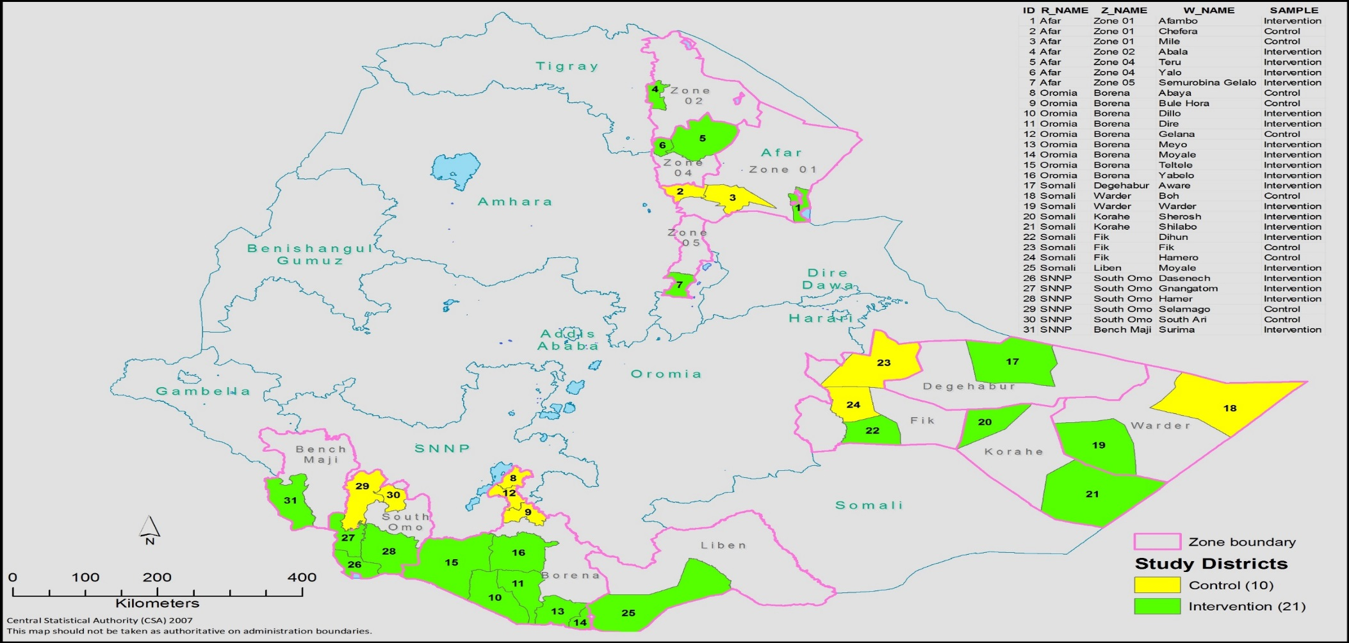
RPLRP Sample Woredas

Slide 15
Livestock Ownership

Slide 16
Mean livestock holding - TLU
Region | Cattle | Sheep | Goat | Camel | Total TLU
Afar | 9.38 | 2.89 | 5.64 | 4.42 | 26.75
Borana | 18.66 | 1.58 | 2.41 | 1.70 | 26.04
Somali | 2.85 | 4.19 | 5.38 | 4.65 | 21.73
S. Omo and B. Maji | 35.32 | 2.70 | 5.39 | 0 | 43.41

Slide 17

Livestock ownership - Number
Region | Number
 | Cattle | Sheep | Goat | Camel
Afar | 13.39 | 28.92 | 56.44 | 4.42
Borana | 26.65 | 15.84 | 24.10 | 1.70
Somali | 4.07 | 41.92 | 53.77 | 4.65
S. Omo and B. Maji | 50.45 | 27.04 | 53.92 | 0.00
Importance of species varies by region

Slide 18

Proportion of households who own livestock by species
Region
 | cattle | sheep | goat | camel
Afar | 65.65 | 67.69 | 91.84 | 44.22
Borana | 98.41 | 52.65 | 82.80 | 20.63
Somali | 40.70 | 80.86 | 95.42 | 34.50
S. Omo & B. Maji | 98.81 | 46.43 | 81.35 | 0.00

Slide 19
Household Cash Income

Slide 20
Average household cash income
Region | Pastoral | Agro-pastoral | Total
 | Mean | Mean | Mean
Afar | 28,432 | 17,950 | 24,474
Oromia | 30,962 | 22,779 | 24,360
Somali | 25,464 | 17,616 | 23,180
SNNP | 25,896 | 25,611 | 25,695
No significant difference in average household cash income across regions
Wide cash income difference across households
Cash income higher in pastoral areas only in Somali.

Slide 21
Average cash income structure of households
Region
 | Livestock sales | Livestock products and services | Other on-farm activities | wage employment | Business activities | Other income sources
Afar | 18,672 | 966 | 1,267 | 887 | 464 | 2,217
Borana | 16,306 | 959 | 3,573 | 1,276 | 1,236 | 1,009
Somali | 14,436 | 1,020 | 186 | 453 | 4,122 | 2,961
Omo and B. Maji | 16,253 | 2,287 | 4,181 | 305 | 260 | 2,408
Cash income from the sale of livestock most important source
Other important sources of cash income vary from region to region

Slide 22
Contribution to Income of the different sources (%)
 | Livestock | Livestock products | Other on-farm | wages | business | other
Afar | 76 | 4 | 5 | 4 | 2 | 9
Borana | 67 | 4 | 15 | 5 | 5 | 4
Somali | 62 | 4 | 0.8 | 2 | 18 | 13
S. Omo & B. Maji | 63 | 9 | 16 | 1 | 1 | 9

Slide 23
Cash income from livestock sales by livelihoods
Region | Pastoral | Agro-Pastoral
 | Mean | Mean
Afar | 23,363.66 | 10,936.31
Borana | 28,236.30 | 13,450.05
Somali | 15,951.44 | 10,746.10
S. Omo & B. Maji | 19,119.19 | 15,061.59
Cash income from livestock sales numerically much higher in pastoral than agro-pastoral areas
However, difference is statistically significant only in Borana, S. Omo & B. Maji

Slide 24
Cash income of non-livestock on-farm activities
Region | Pastoral | Agro-Pastoral
 | Mean | Mean
Afar | 538.81 | 2,467.88
Borana | 0.03 | 4,427.85
Somali | 102.75 | 391.70
S. Omo & B. Maji | 194.62 | 5,837.89
Cash income from non-livestock on-farm activities significantly higher in agropastoral than pastoral areas

Slide 25
Cash income from business activities by livelihoods
Region | Pastoral | Agro-Pastoral
 | Mean | Mean
Afar, | 473.55 | 450.45
Borana | 164.38 | 1,492.13
Somali | 4,857.12 | 2,332.77
S. Omo & B. Maji | 47.30 | 349.16
Cash income from businesses statistically higher in agro-pastoral areas in Borana, S. Omo & B. Maji
Cash income from businesses statistically higher in pastoral than agro-pastoral areas in Somali

Slide 26
Livestock Market Participation and Access to Market

Slide 27
Proportion of households who sold livestock
Region | Total
 | cattle | sheep | goat | camel
Afar | 38.78 | 49.32 | 91.84 | 15.99
Borana | 64.81 | 26.19 | 82.80 | 4.23
Somali | 11.05 | 52.83 | 95.42 | 12.13
S. Omo & B. Maji | 84.92 | 30.56 | 81.35 | 0.00
Highest market participation in goats in all regions
Higher proportion of households in Borana, S. Omo and B. Maji sold cattle than other study areas
Higher proportion of households in Afar and Somali sold sheep than other areas

Slide 28
Proportion who sold livestock by drought and normal years (%)
Region | Total
 | Cattle |  | Sheep |  | Goats |  | Camel
 | Drought | Normal | Drought | Normal | Drought | Normal | Drought | Normal
Afar | 39.8 | 25.3 | 49.7 | 36.9 | 82.0 | 52.6 | 16.3 | 9.6
Borana | 74.3 | 50.0 | 36.5 | 28.0 | 59.7 | 45.1 | 6.2 | 3.6
Somali | 12.7 | 8.6 | 49.9 | 60.9 | 58.5 | 73.6 | 13.2 | 7.3
S. Omo & B. Maji | 83.7 | 71.4 | 34.9 | 31.8 | 76.2 | 70.2 | 0.0 | 0.0
Overall pattern is that higher proportion of households sell livestock in drought than in normal years

Slide 29
Average market distance (walking time) from homestead
 | adjacent | less than 1 hour | 1 - 3 hours | 3 - 5 hours | 5 - 8 hours | 1 day | 2 days | >2 days
Afar | 0.0 | 6.67 | 29.9 | 26.2 | 13.1 | 7.0 | 10.0 | 7.6
Borana | 0.0 | 6.8 | 38.3 | 21.2 | 13.2 | 7.5 | 10.4 | 2.1
Somali | 0.0 | 33.7 | 19.9 | 15.6 | 5.9 | 4.5 | 5.0 | 15.0
SNNP | 0.4 | 22.0 | 28.9 | 24.4 | 12.9 | 7.0 | 4.5 | 0.00
Total | .06 | 16.2 | 30.3 | 21.4 | 11.3 | 6.5 | 7.9 | 6.2
Market access a challenge
  About a quarter in Afar and Somali travel for more than 1 day
  About one-fifth in Borana travel for more than 1 day
  About 10% in S. Omo & B. Maji travel for more than a day
Overall about one-fifth travel for more than a day
Market access more of challenge in pastoral than in agro-pastoral areas in Afar, Borana, S. Omo & B. Maji

Slide 30
Causes of livestock Deaths

Slide 31
Death reasons in cattle

Slide 32
Reasons of death in sheep

Slide 33
Reasons of deaths in goats

Slide 34
Causes of deaths in equines and camels

Slide 35
Food Security
(Based on the DRSLP-II and DRSLP-Afar Data)

Slide 36
Methodology
Based on the Household Food Insecurity Access Scale (HFIAS) methodology
Household food Insecurity Access-Related conditions
  Specific and disaggregated information about the perceptions of surveyed households
Household food insecurity access-related domains
  Summary information on the prevalence of households experiencing one or more behaviours
Household food insecurity access scale score
  Continuous measure of the degree of food insecurity in the household
Household food insecurity access prevalence
  Categorical indicator of food insecurity status

Slide 37
Food insecurity months
Least food insecurity months: August - November
Mild food security months: December – January and June- July
Sevier food insecurity months: February - May

Slide 38
Categorization of food insecurity
Food secure household experiences none of the food insecurity (access) conditions, or just experience worry
Mildly food insecure household worries about not having enough food sometimes or often, and/or is unable to eat preferred food and/or eats some food considered undesirable, but does not cut back on quantity
Moderately food insecure household sacrifices quality more frequently, eats undesirable food, and/or starts to cut back on quantity by reducing meal size, number of meals
Severely food insecure household has graduated to cut back on meal size or number of meals often, and/or experiences conditions of running out of food, going to bed hungry, or going a whole day and night hungry

Slide 39
Food insecurity prevalence
 | Food Secure | Mildly Food Insecure | Moderately Food Insecure | Severely Insecure
Borana | 28.1 | 4.1 | 32.2 | 35.6
Guji | 36.7 | 3.3 | 20.4 | 39.6
South Omo | 34.4 | 6.7 | 24.4 | 34.4
Bench Maji | 55.6 | 4.4 | 22.2 | 17.8
Kaffa | 43.3 | 15.0 | 26.7 | 15.0
Total | 38.2 | 4.9 | 25.3 | 31.6

Slide 40
Food insecurity prevalence by livelihood zone
 | Pastoral |  |  |  | Agro-pastoral
 | Food Secure | Mildly Food Insecure | Moderately Food Insecure | Severely Food Insecure | Food Secure | Mildly Food Insecure | Moderately Food Insecure | Severely Food Insecure
Borana | 27.4 | 3.5 | 33.2 | 35.8 | 31.8 | 6.8 | 27.3 | 34.1
Guji | 21.2 | 6.1 | 24.2 | 48.5 | 41.7 | 2.5 | 19.1 | 36.8
South Omo | 35.2 | 6.8 | 22.7 | 35.2 | na | na | na | na
Bench Maji | 35.5 | 3.2 | 32.3 | 29.0 | 59.7 | 4.7 | 20.1 | 15.4
Kaffa | 26.3 | 26.3 | 26.3 | 21.1 | 51.2 | 9.8 | 26.8 | 12.2
Total | 28.6 | 5.6 | 29.3 | 36.5 | 47.5 | 4.3 | 21.4 | 26.8

Slide 41
Food security prevalence in Afar survey woredas
 | Food Secure | Mildly Food Insecure | Moderately Food Insecure | Severely Food Insecure
Amibara | 41.7 | 6.7 | 43.3 | 8.3
Chifera | 45.0 | 1.7 | 41.7 | 11.7
Dawe | 43.3 | 6.7 | 35.0 | 15.0
Telalak | 46.7 | 8.3 | 36.7 | 8.3
Aura | 46.7 | 3.3 | 38.3 | 11.7
Gewane | 45.0 | 6.7 | 28.3 | 20.0
Total | 44.7 | 5.6 | 37.2 | 12.5

Slide 42
Key conclusions
Attention needed to the emerging category of female-headed and youth-headed households
Differentiated interventions by pastoral and agro-pastoral livelihood zones required
Projects/programs need to take regional/zonal differences into account.

