Slide 1
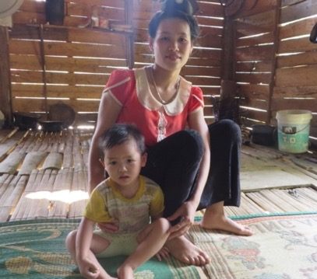
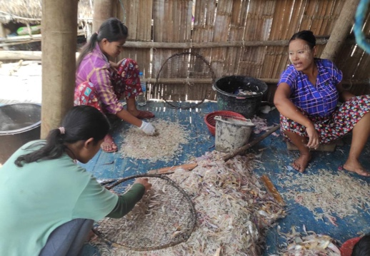
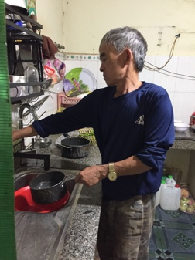










COVID-19, a crisis of capitalism and gender:
Insights from women agri-entrepreneurs’ experience in Myanmar and Vietnam
1/14
© N.Kawarazuka
© Moe Kyaw Kyaw
© Pham Thi Hoa
Presented by Nozomi Kawarazuka (CIP) n.Kawarazuka@cigar.org
15 February 2022
The team: Esther Achandi (ILRI), Surendran Rajaratnam (WorldFish), Deepa Joshi (IWMI)
Htet Yin Tun, Naw Tha Ku Paul, Win Nandar Htay, Greg Antos (Point B, Myanmar)
Pham Thi Hoa, Le Thi Huyen, Dao Duy Tung, Bui Trang (Vietnam)
Notes:
Hi everyone. Today I am going to present our study on women’s agri-business during the COVID in Myanmar and Vietnam. I present this on behalf of the team from other centers and local partners.

Slide 2


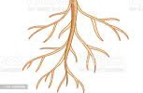
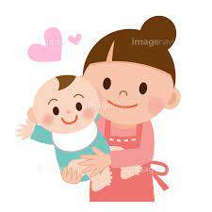
2/14
What are feminist political economy approaches?
<Economic activities>
Non-economic activities and natural resources are neglected from accounts of how capitalist systems work.
market
labour
capital
This ideology allows the capitalist economy to create multiple hierarchies in research disciplines, the society and the household.
water
care
In this study, we explore interdependent relations between economic and non-economic activities.
natural resources
food preparation
<Non-economic activities>
(Collard and Dempsey 2019,, Mezzadri, 2019; Prugl 2020, Sultana 2021, Das and Mishra 2021)
Notes:
This study employed feminist political economy approaches as theoretical framework. I briefly explain about it. Please look at the figure on the right. Capitalist systems look at relationships between labour, capital and market. Actually, economic activities depend on non-economic elements such as natural resources, women’s labour for child care and food preparation but they remain invisible and unrecognized as if they are forever free resources. (Click) Therefore, those non-economic aspects are neglected from accounts of how capitalist systems work both conceptually and methodologically. This is a contradiction of capitalism (Click) This ideology allows the capitalist economy to create multiple hierarchies in research disciplines, the society and the household.
(Click) In this study, we explore interdependent relations between economic and non-economic activities.

Slide 3
3/14
Feminist critique of the pandemic as a crisis of capitalism (Stevano et al., 2021)
The fragility of social provisioning comes from the contradiction of capitalism. (Rao 2021, Khanal and Rodoriva 2021)
An understanding of the crisis within the capitalist economy and its thinking is too narrow. We need to explore overall crisis tendencies inherent in structural features. (Curty 2020)
COVID-19 and climate change are overlapping in terms of causes and consequences (Sultana 2021)
In the past, global responses to crises reinforced gender gaps because of male-privileged crisis management policies and practices (Seguino 2010, Griffin 2015)
Notes:
In the previous slide I explained the contradiction of capitalism. Next, I explain how it played out in the pandemic. The pandemic itself is part of a crisis of capitalism that exploits natural resources and reproduces inequality. (Click) The fragility of social provisioning comes from the contradiction of capitalism. (Click) An understanding of crisis within the capitalist economy and its thinking is too narrow. We need to explore overall crisis tendencies inherent in structural features. (Click) When you look at the crisis tendency of climate change, we observe the root of the problem is the same. (Click) In the past, global responses to crises reinforced gender gaps. We therefore need critical thinking. This study builds on those literature and contribute through empirical evidence from the global South.

Slide 4
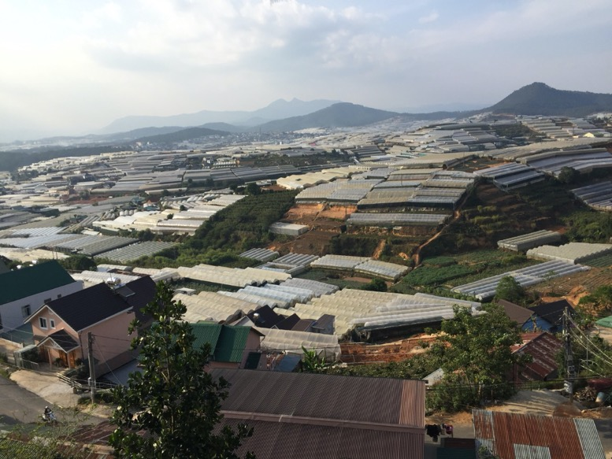
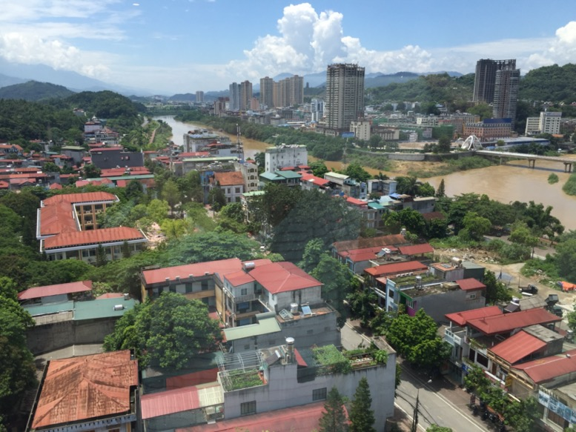
Research contexts and the impacts of COVID
Vietnam
4/14
Lam Dong: the horticultural industry
Lao Cai: Chinese borders
China
© Pham Thi Hoa
© N.Kawarazuka
Horticultural entrepreneurs
Cross-border traders and local retailers (livestock, fish)
Supply chain disruption (export and domestic)
Decreased demand (flowers, high-value export veg)
Supply chain disruption (border closure)
Long-term economic recession (unemployment)
Decreased demand of meat and fish
Notes:
We conducted fieldwork in two sites in each country. Lam Dong province is the largest horticultural industry in Vietnam. We interviewed women entrepreneurs such as seed importers, vegetable exporters, agricultural tourism operators. The impact of COVID on their business was mainly supply chain disruption and decreased demand. Lao Cai province is located in Chinese borders and we looked at cross-border traders and local retailers mainly livestock and fish. The impact of COVID was derived from closing the borders and subsequent economic recession.

Slide 5
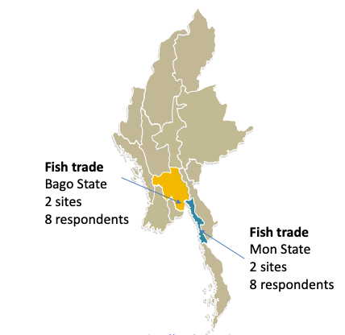
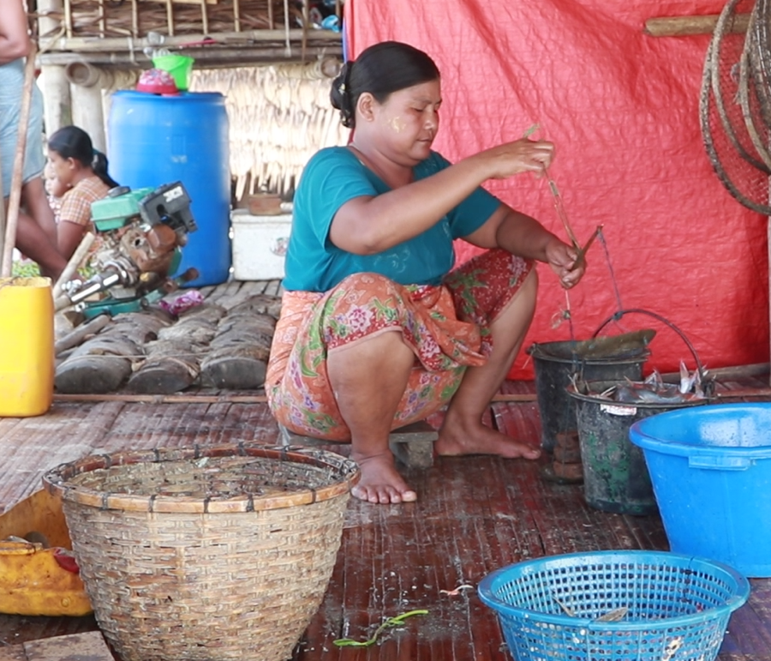
Research contexts and the impacts of COVID
Myanmar
5/14
Fish dealers (input suppliers)
Fish retailers
Supply chain disruption
Mobility restriction
Economic recession (youth unemployment)
A military coup on 1 February 2021
© Kyaw Soe Hein
Notes:
In Myanmar, the focus was fisheries in coastal states. In addition to COVID, they had the military coup last year and it affected very seriously on their livelihoods as well as our research methods.

Slide 6
Methods: In-depth interviews with 30 women entrepreneurs*¹
6/14
Location | Commodities | Methods | Respondents
Lao Cai, Vietnam | Livestock | Face-to-face | 8
Lam Dong, Vietnam | Horticulture | Hybrid | 8
Mon, Myanmar | Fish | Online*² | 7
Bago, Myanmar | Fish | Online*² | 7
Business Types
The informal sector | 20
Cooperative | 6
The formal sector | 4
*¹ Purposive sampling (Patton 1990) A narrative approach in entrepreneurship research (Hamilton 2006)
*² Guides for doing fieldwork online in pandemic (Lupton 2021)
Notes:
This is a qualitative research. We conducted in-depth interviews with 30 women. Due to COVID restriction, the half of the interview was hybrid in Vietnam (that one local researcher visited them while I was connected online from Hanoi). For Myanmar, we did all interviews online.

Slide 7
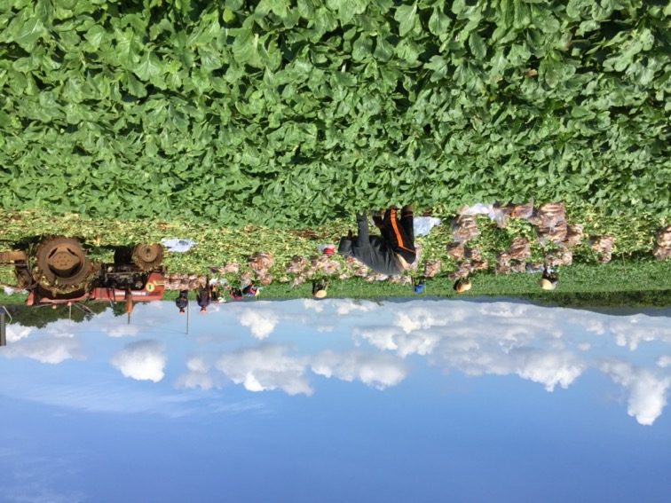
Finding 1: Women’s economic activities are essentially embedded in the family (labour, connections and their husbands’ and in-law’s support)
7/14
Husband's disagreement and feeling of guilt
*All names of respondents were changed
Van* (32) A cross-border fish/fruits trading company
“When my husband suggested that I quit my job, I thought about it over and over, but I decided to continue. I feel sorry for my children. I am wondering if my children are disadvantaged because I am busy all the time and I cannot be with them”.
Trang (35) An organic veg production and agri-tourism
“I divorced my husband because he disagreed with taking out a loan to expand my business, saying that running a small business was enough for a woman”.
© Pham Thi Hoa

Slide 8

Finding 1: Women’s economic activities are essentially embedded in the family (labour, connections and their husbands’ and in-law’s support)
8/14
Key messages
<Economic activities>
market
It is the patriarchy which constrains women’s business, but not necessarily individual women’s lack of capital, knowledge and skills
labour
capital
What are our goals of women’s (economic) empowerment? How should we conceptualize economic activities?
care
The relevant literature
Family embeddedness of women’s entrepreneurship:
Bock 2004, Ekinsmyth 2014, Gustavsson 2021
Feminist approaches to entrepreneurship
Ahi 2006; Hughes et al 2012
Water/climate
food preparation
Husband’s and in-law’s
support and connections
Implications: The (male-oriented) concepts and methodologies in agribusiness research need to be reframed.
Notes:
When women engage in economic activities, they cannot separate themselves from their identities as a mother, wife and daughter-in-law. They stand between. The feminist literature suggests that male entrepreneurs can separate their business from the family. The research framework focusing on economic activities was originally designed to understand men’s experience but not women’s. Key messages here is that (Click) It is the patriarchy which constraints women’s business, not necessarily individual women’s lack of capital, knowledge and skills. (Click) What are our goals of women’s (economic) empowerment? How should we conceptualize economic activities? (Click) Methodological implications are here: the (male-oriented) concepts and methodologies in agribusiness research need to be reframes.

Slide 9


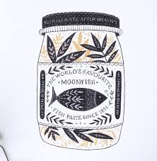
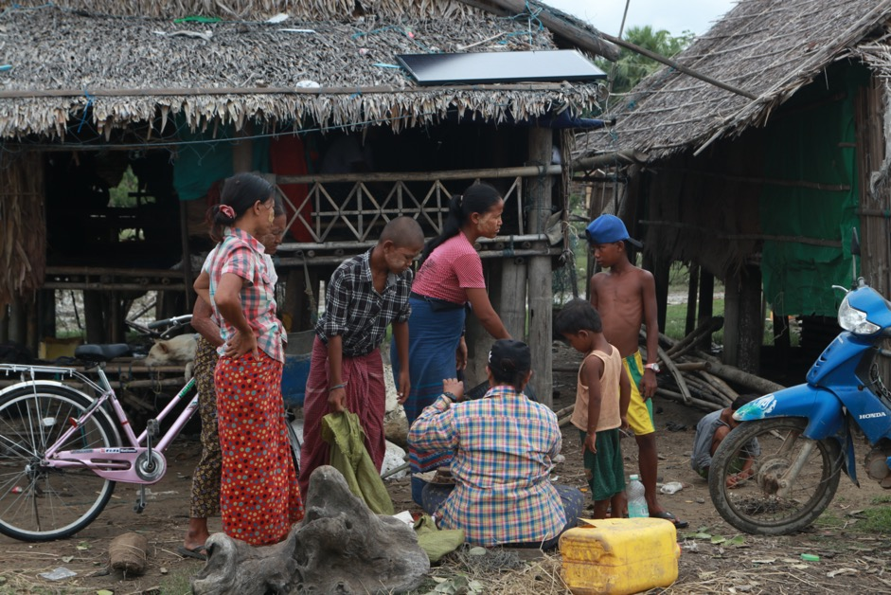
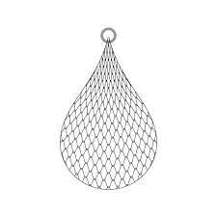
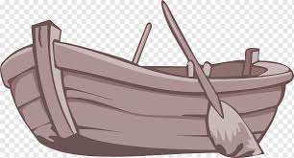
9/14
Finding 2: Informal agribusiness has its own safety nets based on reciprocal support
Daw Tin Tin Fish dealer
[although I cannot sell fish due to COVID] I still provide credit to fishers, as I consider them part of my family.
Whole sellers
Father
Daughters
Sons
Sons-in-law
Fish paste
Women fish dealers
Husband
Sons
Male relatives
Male fishers
© Kyaw Soe Hein
Notes:
I explain it from the relationship between women fish dealers and male fishers. Fish catches are uncertain. Fishers cannot go to fishing without credit. They therefore borrow money from women fish dealers and (Click) return the money by fish. (Click) Women fish dealers also receive financial and material support from their family to invest in productive assets to lend. (Click x 2) Male fishers are often the friends of their male relatives therefore they have trust relations. During the COVID, fishermen keep borrowing money from their fish dealers to survive, or provide rice instead of money to fill the immediate needs. (Click) A fish dealer Daw Tin Tin said ”I still provide credit to fishers as I consider them part of my family”. This shows that their business is deeply embedded in family relations.

Slide 10

Finding 2: Informal agribusiness has its own safety nets based on reciprocal support
10/14
Key messages
<Economic activities>
market
Women need to invest in maintaining reciprocal support relationships for maintaining their livelihoods which are often neglected in economic analyses.
Non economic activities are equally valuable for women to sustain economic activities.
labour
capital
Fish/livestock/veg
enterprises
In-law
daughters
sons
The relevant literature
The social dimensions of informal economy (Overa 2003, Harris-White 2015)
Diverse economies (Gibson-Graham 2008)
trust relations with producers
Implications: Research on informal food systems need pluralistic approaches – as compared to research on formal food systems.
Notes:
Women’s agribusiness stands between an economic activities and non-economic activities. Therefore research on understanding women’s agri-business need to look at both sides. (click) key message is that women need to invest in reciprocal support relationships for maintaining their livelihoods which are often neglected in economic analyses. Non economic activities are equally valuable for women to sustain their own business.
Methodological implication is Research on informal food systems need pluralistic approaches – as compared to formal food systems which take places in isolation from family relations.

Slide 11
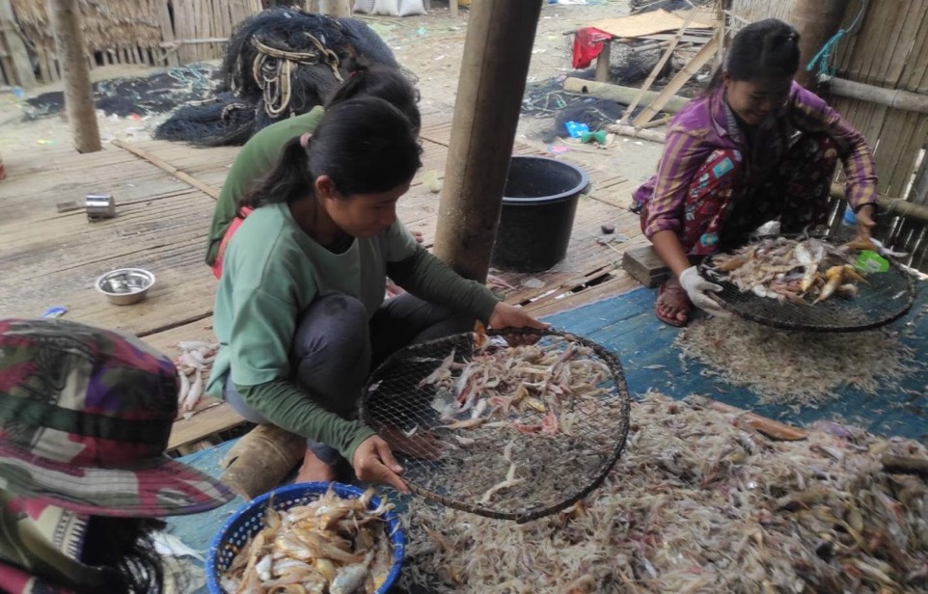
11/14
Finding 3: COVID-19 affects not only economic activities but also non-economic activities. The latter has a significant implication for women’s agribusiness
Ohm Mar (45)
Fish dealer with 2 school-aged daughters
“I feel that my husband passed away because of a shortage of doctors and medical services due to the political crisis… [When I resumed my work after my husband’s death,] I was exhausted as I had to weigh fish till 11 p.m., and I couldn’t sleep at all. I felt depressed, and I didn’t want to continue working. I even thought of giving up this livelihood, but I couldn’t do so in reality [as I am responsible for providing for my daughters]”.
© Moe Kyaw Kyaw
Notes:
I introduce a story of Ohm Mar who lost her husband in acute diabetes suddenly. Her husband was her business partner, providing not only physical labour but also business connections with fishers.

Slide 12


12/14
Finding 3: COVID-19 affects not only economic activities but also non-economic activities
Key messages
<Economic activities>
Without addressing social provisioning for the poor, especially for women, agricultural development alone cannot make agriculture resilient to on-going overlapping crises
market
Covid-19
labour
capital
“Women’s empowerment” should not be simply involving more women in market-oriented agri-food systems.
water
care
The relevant literature
natural resources
food preparation
Alternative methodologies/concepts: Collard and Dempsey 2019, Mezzadri, 2019, Prugl 2020, Sultana 2021, Morinville and van Lier 2021
Women empowerment: Chant and Sweetman, 2021, Hickel 2014, Wilson 2015, Cornwall, 2018
Climate Change
Covid-19
Patriarchy
Implications: Transdisciplinary approaches to research and development is required to put more emphasis and value on understanding non-economic socially valuable activities.
Notes:
The processes in which women’s agribusiness are affected by COVID is very complicated because their non-economic activities are also affected by COVID. In the global North, childcare was highlighted but in the global south, it is far more than the issue of child care. (Click) Key message here is without addressing social provisioning for the poor, especially for women, agricultural development alone cannot make agriculture resilient to on-going overlapping crises (Click) “Women’s empowerment” should not be simply involving more women in market-oriented agri-food systems. We all know it but I very often see this message that women increased incomes and empowered. This message creates discursive power implicitly as if we do not care about women’s other roles. Methodological implication is Transdisciplinary approaches to research and development is required to put more emphasis and value on understanding non-economic socially valuable activities.

Slide 13

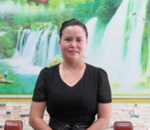



13/14
Conclusions
Feminist political economy approaches allow us to look at root causes of poverty and inequality hidden in underground, which is social and political, as well as the economic outcomes of them (flowers).
How can we change dominant discourses and increase value of research on non-economic activities which are subordinated by research on economic activities? How can we incorporate those women’s experiences into the Post-COVID-19 development planning?

Slide 14
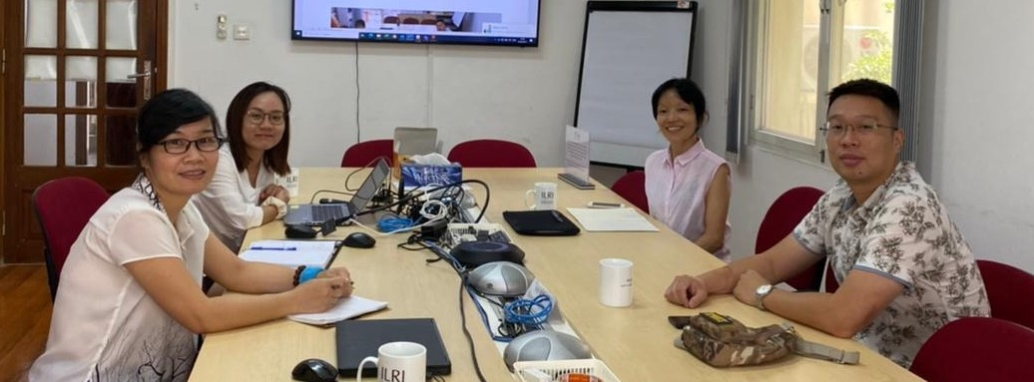
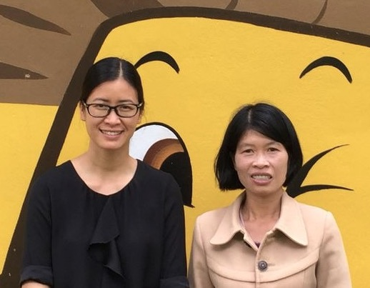
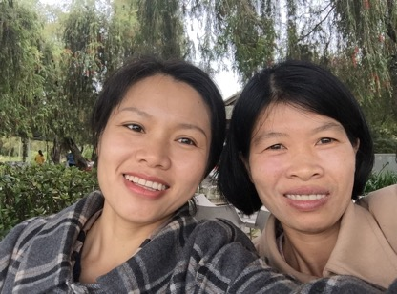
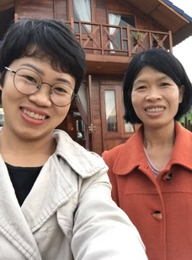
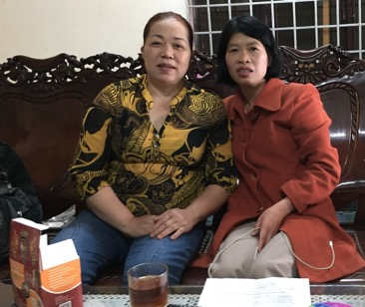
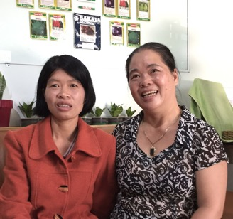
Acknowledgement
14/14
Cynthia McDougall, Haku Arumina, Pham Thi Loan, Pham Thi Hoa, Le Thi Thanh Huyen, Dao Duy Tung, Bui Trang, Htet Yin Tun, Naw Tha Ku Paul, Win Nandar Htay, Greg Antos

Slide 15
References
Ahl, H. (2006). Why Research on Women Entrepreneurs Needs New Directions. Entrepreneurship Theory and Practice, 30(5), 595–621.
Bock, B. B. (2004). Fitting in and multi‐tasking: Dutch farm women's strategies in rural entrepreneurship. Sociologia ruralis, 44(3), 245-260.
Chant, S., & Sweetman, C. (2012). Fixing women or fixing the world? ‘Smart economics’, efficiency approaches, and gender equality in development. Gender & Development, 20(3), 517–529.
Collard, R.-C., & Dempsey, J. (2020). Two icebergs: Difference in feminist political economy. Environment and Planning A: Economy and Space, 52(1), 237–247.
Cornwall, A. (2018). Cornwall, A. (2018). Beyond “empowerment lite”: Women’s empowerment, neoliberal development and global justice. Cadernos Pagu, 52.
Curty, G. (2020). Rethinking Capitalism, Crisis, and Critique: An Interview With Nancy Fraser. Critical Sociology, 46(7-8), 1327-1337.
Ekinsmyth, C. (2014). Mothers' business, work/life and the politics of ‘mumpreneurship’. Gender, Place & Culture, 21(10), 1230-1248.
Gibson-Graham, J. K. (2008). Diverse economies: performative practices forother worlds'. Progress in human geography, 32(5), 613-632.
Griffin, P. (2015). Crisis, Austerity and Gendered Governance: A Feminist Perspective. Feminist Review, 109(1), 49–72.
Gustavsson, M. (2021). The invisible (woman) entrepreneur? Shifting the discourse from fisheries diversification to entrepreneurship. Sociologia Ruralis, soru.12343.

Slide 16
References
Hamilton, E. (2006). Whose story is it anyway? Narrative accounts of the role of women in founding and establishing family businesses. International Small Business Journal, 24(3), 253-271.
Harriss-White, B. (2010). Globalization, the Financial Crisis and Petty Commodity Production in India’s Socially Regulated Informal Economy. In Globalization and Labour in China and India (pp. 131-150). Palgrave Macmillan, London.
Hickel, J. (2014). The ‘girl effect’: liberalism, empowerment and the contradictions of development. Third World Quarterly, 35(8), 1355-1373.
Hughes, K. D., Jennings, J. E., Brush, C., Carter, S., & Welter, F. (2012). Extending Women’s Entrepreneurship Research in New Directions. Entrepreneurship Theory and Practice, 36(3), 429–442.
Huq, A., Tan, C. S. L., & Venugopal, V. (2020). How do women entrepreneurs strategize growth? An investigation using the social feminist theory lens. Journal of Small Business Management, 58(2), 259–287.
Lupton, D. (2021). Doing fieldwork in a pandemic (crowd-sourced document) (D. Lupton, Ed.).
Mezzadri, A. (2019). On the value of social reproduction Informal labour, the majority world and the need for inclusive theories and politics. Radical Philosophy, 2(4), 33–41.
Morinville, C., & Van Lier, N. (2021). On Nature, Degradation, and Life-Making in Late Capitalism. Capitalism Nature Socialism, 1-19.
Overa, R. (2003). Gender ideology and manoeuvring space for female fisheries entrepreneurs. Institute of African Studies Research Review, 19(2), 49-62.

Slide 17
References
Patton, M. Q. (1990) Qualitative Evaluation and Research Methods. London: Sage.
Prügl, E. (2020). Untenable dichotomies: de-gendering political economy. Review of International Political Economy, 28(2), 295-306.
Rao, S. (2021). Beyond the Coronavirus: Understanding Crises of Social Reproduction. Global Labour Journal, 12(1).
Seguino, S. (2010). The global economic crisis, its gender and ethnic implications, and policy responses. Gender & Development, 18(2), 179-199.
Stevano, S., Franz, T., Dafermos, Y., & van Waeyenberge, E. (2021). COVID-19 and crises of capitalism: intensifying inequalities and global responses. Canadian Journal of Development Studies, 42(1–2), 1–17.
Stevano, S., Mezzadri, A., Lombardozzi, L., & Bargawi, H. (2021). Hidden Abodes in Plain Sight: the Social Reproduction of Households and Labor in the COVID-19 Pandemic. Feminist Economics, 27(1–2), 271–287.
Sultana, F. (2021). Climate change, COVID-19, and the co-production of injustices: a feminist reading of overlapping crises. Social & Cultural Geography, 22(4), 447–460.
Werner, M., Strauss, K., Parker, B., Orzeck, R., Derickson, K., & Bonds, A. (2017). Feminist political economy in geography: Why now, what is different, and what for? Geoforum, 79, 1–4.
Wilson, K. (2015). Towards a Radical Re-appropriation: Gender, Development and Neoliberal Feminism. Development and Change, 46(4), 803–832.

