Slide 1
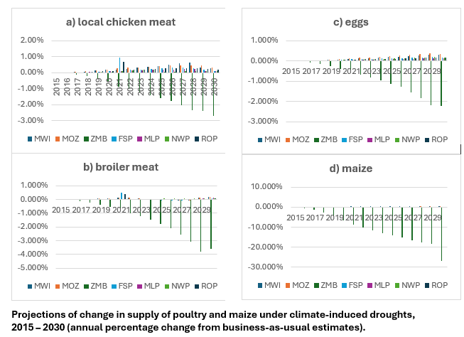
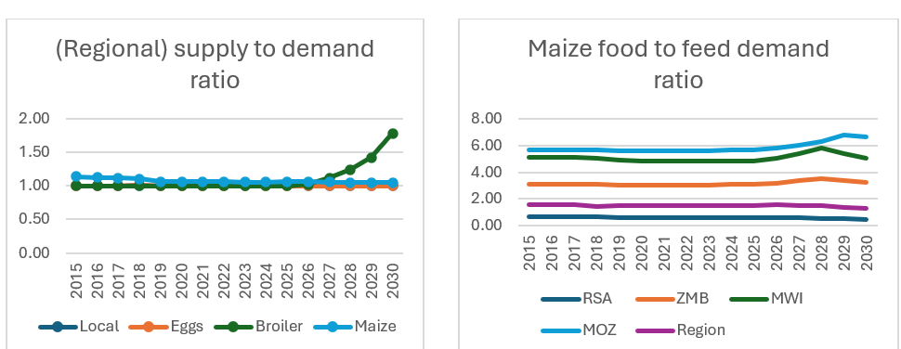
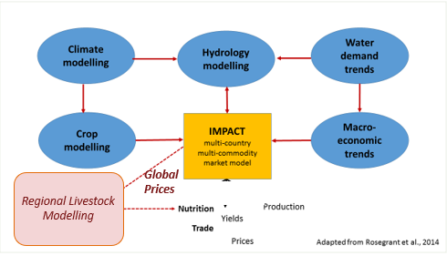


Projections of poultry and maize markets in Southern Africa under climate change
Preliminary Findings
Growth of per capita consumption of poultry meat been fastest in Malawi and slowest in South Africa. Meanwhile, maize (food) consumption per capita increased in one country only (Zambia).
Projections of poultry meat and egg demand are associated with higher demand for maize as feed. Drought conditions lower feed and poultry supply in some countries in the region.
Dolapo Enahoro, Charles Mensah
Background
Population, income growth & urbanization are driving meat demand growth in low-and-middle-income countries
In Southern Africa, meat demand growth is strongest for poultry, and linked to livestock grain demand and food-feed competition
Market-based economic modelling can explore interactions of dietary changes, meat/grain markets & imports, climate change.
Methodology
A livestock economic model specified as a multi-market, spatial equilibrium model integrating grain and animal source food (ASF) markets, to solve for regional equilibrium levels of:
  Crop areas, yields, and total domestic crop supply
  Animal numbers, yields and total domestic ASF supply
  Food demand, livestock feed demand
  Intra-regional trade volumes & prices, costs, taxes;
Regional livestock model was linked to IMPACT to simulate global climate change (as temperature & precipitation changes)
Poultry meat demand grows more than 9X across the region, maize food demand 200%, and maize feed demand 137%
Ratio of poultry/maize supply to demand is < 1.0 for some countries and worsened under the drought climate
Net supply is positive at regional level showing potential of markets to move supplies from surplus to deficit areas.
The IMPACT model simulates global agricultural sectors of 159 countries using derived demand and supply equations
Post-model calculations quantify outcomes on consumer prices, producer incomes, food security and nutrition.
Relevance of results and methods
The study’s abstraction of a regional approach to livestock and feed sector interactions in southern Africa highlights the potential key role of markets in smoothening region-wide challenges related to the growth of (animal source) food demand and the management of livestock resources. Our findings also highlight the needs for quantitative foresight analytical approaches and better data .
Application
Economic modelling generated country-level projections of food production, demand and trade of poultry (meat and milk) and maize under alternative scenarios
IMPACT model system linked to the multi-country regional model of livestock and grain sectors in Southern Africa
Four (4) countries simulated as a single regional trade bloc: Malawi, Mozambique, South Africa, Zambia
Seven (7) sub-regional units simulated (with four in South Africa)
(2015) baseline data obtained from FAO, country statistical services, surveys, and reports
Integrated model generated 15-year horizon for business-as-usual versus drought climate to 2030.
Acknowledgements
This work was undertaken by researchers at the International Livestock Research Institute (ILRI) with funding support from the CGIAR Initiative on Foresight and the predecessor CGIAR research program (CRP) on Policies, Institutions and Markets.
For more information:
Dolapo Enahoro (d.enahoro@cgiar.org)
August 2024
This document is licensed for use under a Creative Commons Attribution-NonCommercial-ShareAlike 4.0 International License

