Slide 1
IMPROVED RICE PRODUCTION TECHNOLOGIES: ACTIVITIES & ACHIEVEMENTS 2018/2019
CHARLES CHUWA, NDIMUBANDI MVUKIYE, DIDAS KIMARO
TANZANIA AGRICULTURAL RESEARCH INSTITUTE
AFRICA RISING - NAFAKA PROJECT ANNUAL REVIEW AND PLANNING MEETING
3 – 4 JULY 2019, DAR ES SALAAM, TANZANIA

Slide 2
SUMMARY DESCRIPTION OF KEY ACTIVITIES FOR RICE COMPONENT
Introduction of climate-smart agricultural innovations (intervention area 1)
Two main activities:
Establishment of demonstration sites (mother and baby) and model farms for promoting climate-smart technologies:
  Use of improved rice varieties [in this case, TXD306 (SARO5) and Komboka] together with judicious use of fertilizers
  Management of salt-affected soils (saline-sodic soils )by planting improved salt-tolerant rice varieties (in this case, SATO1 and SATO6) together with the use of soil amendments (Gypsum and/Farm yard manure)

Slide 3
Saving on irrigation water by alternating wetting and drying of rice fields (AWD) instead of continuous flooding.
Saving on labour and drudgery during planting rice seeds using simple locally-fabricated rice seeders.
Reduction of health hazards and drudgery associated with spraying herbicides in managing weeds in rice fields using simple locally fabricated herbicides applicators.
Management of residual soil moisture and enhancement of soil fertility by planting legumes as follow-up crops after harvesting rice.

Slide 4
Supporting production and marketing of seeds (QDS) of improved varieties of rice and legume crops (intervention area 2)
Achieved by:
  supplying initial seeds for QDS production
  training QDS producers on GAP for QDS production and
  facilitating the process of official registration for the produced QDS

Slide 5
Capacity building for better scaling (intervention area 3)
Three main activities:
Behavioral change communication
  Achieved by producing and distributing learning materials (training notes, technology briefs and other publications) and holding TV coverage of the technologies and accompanying GAP (during farmers field days)
Training lead farmers, VBAAs and VAEOs (as resident community trainers) on Good agricultural practices (GAP) for the rice crop.
Facilitating training of other farmers by the trained resident trainers

Slide 6
IMPLEMENTATION AND STATUS OF THE ACTIVITIES
1. Preparatory activities
1.1 Holding Inception/Training meetings
  To identify and familiarize with various stakeholders to be involved in implementing the project activities for the season
  For the stakeholders to acquaint themselves with the protocols for technologies to be demonstrated and on how to effectively collect pertinent data using the DCFs.
55 stakeholders attended and got trained (Table 1).

Slide 7
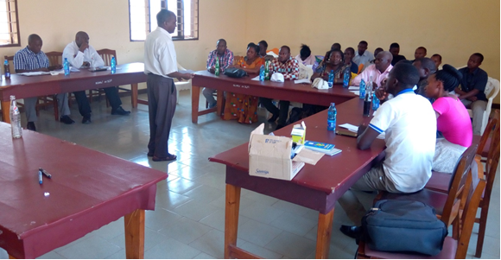
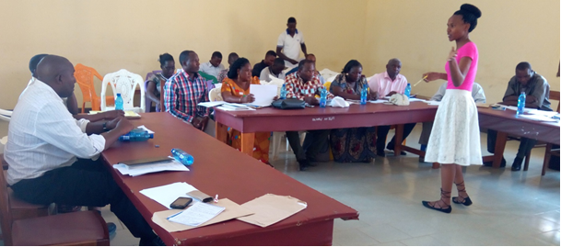
Plate 1. Participants in an inception meeting at Mbarali District Council Hall, Mbarali district, getting explanations from a member of the Rice Team on the protocols for the demonstrated technologies (Courtesy: Dr Charles Chuwa/TARI Dakawa).
Plate 2. Participants in an inception meeting at Mbarali District Council Hall, Mbarali district, getting explanations from a NAFAKA staff member on using various DCFs in collecting data (Courtesy: Dr Charles Chuwa/TARI Dakawa).

Slide 9
1.2 Visiting target districts and villages to reconfirm previous and new sites.
  A total of 47 model farm (one-acre field) sites were identified across the four districts: 20 in Mbarali (5 in Madibira, 15 in other areas of Chimala apex), 10 in Iringa Rural, 10 in Kilombero and 7 in Momba (Table 2).
  A total of 45 mother demonstration sites were identified/reconfirmed: 42 of which are Variety and fertilizer (Varfer), 3 are for management of salt-affected soils (SAS) and 1 are for proper water management (AWD) (Table 2).

Slide 10
Table 2: Number of mother and model farms established in each district.

Slide 11
1.3 Collecting soil samples and soil analysis for site characterization in view of fertilizer use.
Soil samples from all the model farm sites collected and made them analyzed by The National Soil Service Laboratory at TARI Mlingano, Tanzania, for determination of the need for, and optimal rates of, fertilizer for improved rice yields in the sites.
The amounts of fertilizers to apply for supplying especially the NPK nutrients in the model farms and mother demo sites calculated (based on the results of the analysis) and presented to respective farmers/farmer groups, VAEOs and VBAAs

Slide 12
1.4 Procurement and distribution of basic seeds, gypsum and fertilizers.
  9,483 kg of necessary basic rice seeds of improved varieties were distributed to all the demo-sites and to earmarked QDS producers, the amount and types of seeds depending on the nature of the demonstration plots to be established in each site (Table 3).
  A total of 10,888 farmers (5,124 women and 5,764 men) received the small packs of seeds (@ 200g) to establish their own micro-plots (Table 4).
  For the mother demos, 2282.3 kg of Urea, 496.4 kg of DAP and 31.0 kg of NPK were distributed(Table 5).

Slide 13
Table 3. Rice seed distributed per each district for mother and baby demos, QDS production, model farms and farmers’ micro-plots (in small packs).

Slide 14
Table 4: Number and gender of farmers who received seed packs of improved rice varieties for micro-plots per each district

Slide 15
Table 5: Amount and type of fertilizers distributed for mother demos per district.

Slide 16
2. Establishment of demonstration sites (mother and baby) and model farms for promoting climate smart technologies:
  Setting out of mother demo plots and model farms was initiated by organizing field practical (boot-camp) trainings to all VAEOs, NAFAKA staff, group lead farmers and model farmers in each project districts (Plate 3).
  In total the trainings were attended by 140 participants (Table 6).

Slide 17
Table 6. Number and gender of trainees per district who attended the Boot- camp/practical training on establishment of demo plots and model farms.

Slide 18
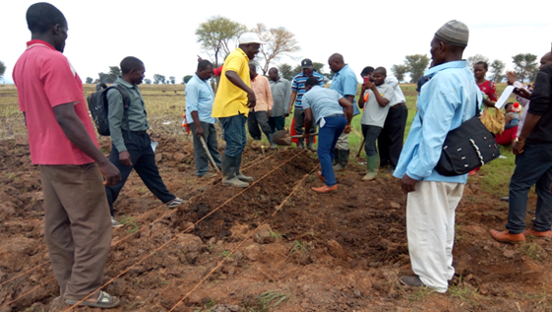
Plate 3. Participants practically constructing bund in one of the model farm at Nkala village, Momba district (Courtesy: Dr Charles Chuwa/TARI Dakawa).

Slide 19
Demonstration of a labour-saving and drudgery-reduction during planting rice seeds using simple locally-fabricated rice seeders.
  Demonstrated at Lipangalala site, Kilombero district (Plate 4).
  49 farmers (34 women and 15 men) participated in the demonstration (Table 7).
Table 7: Number and gender of farmers who participated in a demonstration for locally-manufactured direct paddy planter at Lipangalala village, Kilombero District.

Slide 20
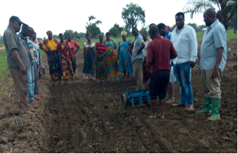
Plate 4:The demonstration of locally-manufactured direct paddy planter at Lipangalala village, Kilombero District (Courtesy: Mr Ndimubandi Mvukiye/TARI Dakawa)

Slide 21
Reduction of health hazards and drudgery associated with spraying herbicides in managing weeds in rice fields using simple locally fabricated herbicides applicators.
  Demonstrated at Ukwama village, Mbarali District (Plate 5).
  390 farmers (257 women and 133 men) from Ukwama and Mtamba villages participated in the demonstration (Table 8).
Table 8: Number and gender of farmers who participated in a demonstration of a herbicide application tool at Ukwama village, Mbarali District.

Slide 22
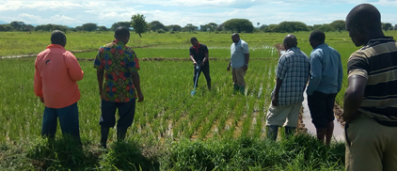
Plate 5: Farmers practicing use of locally manufactured herbicide application tool at Ukwama site in Mbarali district (Courtesy: Dr Charles Chuwa/TARI Dakawa)

Slide 23
3. Supporting production and marketing of seeds (QDS) of improved varieties of rice and legume crops.
  Supplying initial seeds for QDS production
  Training QDS producers on GAP for QDS production
  Facilitating the process of official registration for the produced QDS

Slide 24
Table 9: Number and acreage of rice (TXD 306) QDS farms established per district.

Slide 25
Table 10: Number and gender of legume QDS producers per district.

Slide 26
4. Capacity building for better scaling.
4.1 Training of resident community trainers on Good agricultural practices (GAP) for rice and/or seed production.
  training was conducted for lead and model farmers, individual rice QDS producers/VBAAs and VAEOs
  established mother demos and model farms as training venues
  A total of 126 (32 female and 94 male) trainers were trained (Table 5).

Slide 27
Table 5. Number and gender of local trainers (VAEOs, rice QDS producers/VBAAs, lead and model farmers) who attended the TOT training on GAP for rice production in the districts.

Slide 28
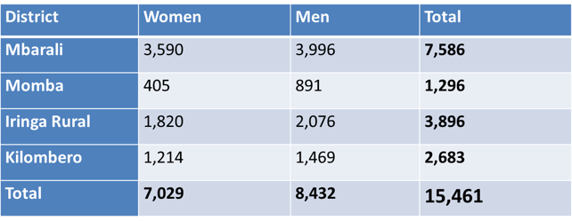
4.2 Training of other farmers on GAP by VAEOs and VBAAs in demos, model farms and micro-plots.
  A total of 15,461 farmers (7,029 and 8,432) were trained (Table ).
Table 7: Number and gender of farmers trained on GAP by VAEOs and VBAAs in demos, model farms and micro-plots per district

Slide 29
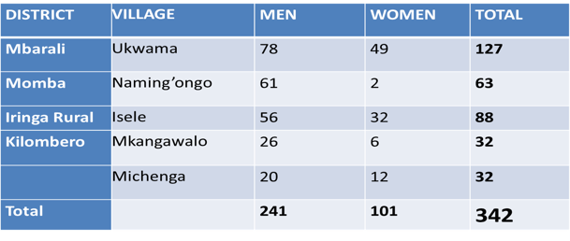
4.3 Conducting Farmers’ Field days
  A total of 342 farmers (241 men and 101 women) participated (Table )
Table : Number and gender of farmers who participated in the farmers’ field days across the districts.

Slide 30
CHALLENGES, CONSTRAINTS AND LESSONS LEARNED
Challenges
  Rainfall:
  Highly erratic rainfall in many sites
Lessons learned
  Participation of farmer groups is necessary for wider dissemination of the technologies
  Training of trainers make training more sustainable
  Involving Local government and other stakeholders in technology dissemination strengthens research – extension linkages
  Farmers learn more when classroom training is combined with field training
  Farmers could improve rice productivity even more by analyzing soils of their particular fields for their fertility status prior to planting (Soil analysis will enable them understand properties of their fields and consequently use fertilizers judiciously).

Slide 31
SCALING STRATEGIES
To sustain availability of improved seeds by training more farmers on QDS production.
To extend the technologies to more farmers by increasing the number of VBAAs and provide necessary facilitation for their work.
To strengthen linkages of farmers with agro-dealers and other agricultural extension service providers.

Slide 32
ACKNOWLEDGEMENTS
USAID
IITA
TARI
DISTRICT AGRICULTURAL STAFF
WILLING FARMERS

Slide 33












PARTNERS
Notes:
ESA Africa

