Slide 1
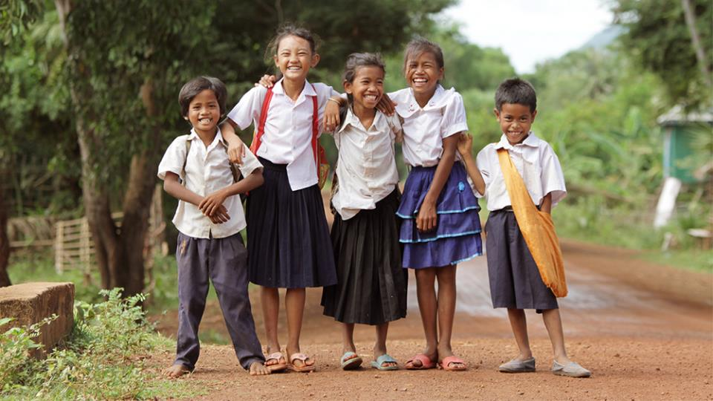
TU4.2: Gender Equality & Social Inclusion
Jacqueline Ogega
Cultivating Equality Conference
October 2021

Slide 2
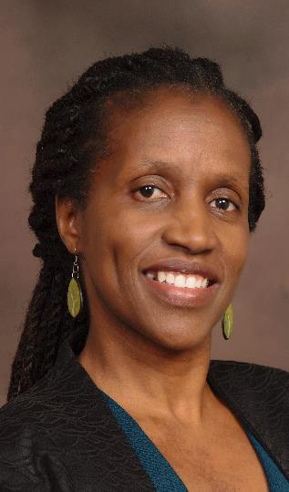

Dr. Jacqueline Ogega
Director
Gender Equality and Social Inclusion (GESI)
World Vision USA

Slide 3

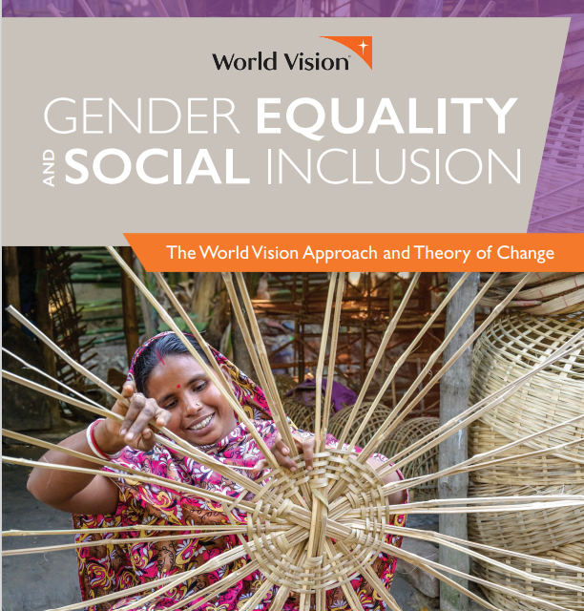
PRESENTERS
Dr. Jacqueline Ogega
Director
Gender Equality and Social Inclusion (GESI)
World Vision USA
Ms. Saeqah Kabir
Director Knowledge Management and Communications - Nobo Jatra
World Vision Bangladesh
Ms. Serena Stepanovic
Senior Director, Food Security & Livelihoods
International Programs Group
World Vision USA

Slide 4






GESI APPROACH
Access | The ability to access, use, and / or own assets, resources, opportunities, services, benefits, infrastructure.
Decision making | The ability to make decisions free of coercion at individual, family, community, and societal levels. This
can include control over assets and ability to make decisions in leadership.
Participation| The ability to participate in or engage in societal affairs and systems of power that influence and determine development, life activities, and outcomes.
Systems| The availability of equal and inclusive systems that promote equity, account for the different needs of vulnerable populations, and create enabling environments for their engagement.
Wellbeing | The sense of worth, capability status, confidence, dignity, safety, health, and overall physical, emotional, psychological, and spiritual well-being. This includes living free from gender-based violence, HIV, and all forms of stigma and discrimination.
GESI DOMAINS:
To advance Agency, Empowerment, and Transformation.

Slide 5
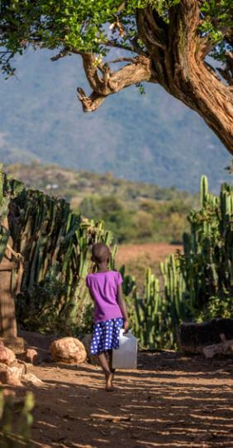
Agency.
Facilitative Empowerment
development participants as active agents of change, rather than mere victims
of exclusion or inactive beneficiaries of development..
Self-empowerment
self-empowerment—power to and power within—through individual consciousness
and the transformation of personal attitudes, self-perceptions and power relations.
Develop
capacities for self-understanding and control over their lives, resources, beliefs, values and
attitudes.
Collective empowerment
facilitates collective empowerment—
power with—through social cohesion, movement building and collective action for sustained change.

Slide 6

Empowerment.
Social model
Address how social construction disempowers or excludes individuals on the basis of disability, age, gender, economic status, etc.
Economic empowerment
Support economically marginalized groups to gain control
over economic, financial and material assets and resources.
Positive child and adolescent development
Build skills, assets and competencies; enhance child participation and engagement of adolescent girls and boys; foster healthy relationships; strengthen external supporting environments; transform systems.
Male engagement
Foster inclusive change and transformational shifts in gendered social norms and relations.
Empowering Women and Girls
Leadership development and socio-cultural, economic and political empowerment.

Slide 7

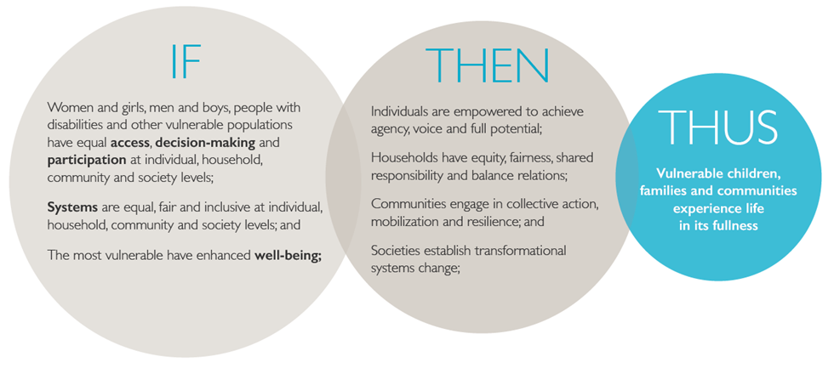
GESI Transformation Theory of Change.
Notes:
GESI is a Multi-faceted process of transformation that:
Promotes equal and inclusive access, decision-making, participation, and well-being of the most vulnerable;
Transforms systems, social norms, and relations to enable the most vulnerable to participate in and benefit equally from development interventions;
Builds individual and collective agency, resilience, and action; and
Promotes the empowerment and well-being of vulnerable children, their families and communities

Slide 8
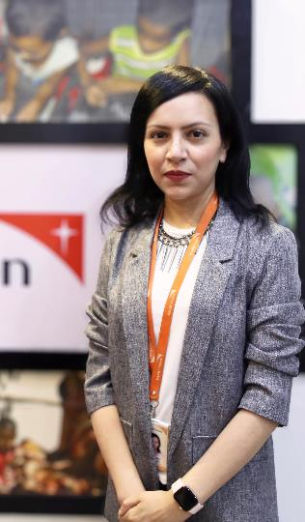
Saeqah Kabir
Director Knowledge Management and Communications - Nobo Jatra
World Vision Bangladesh

Slide 9


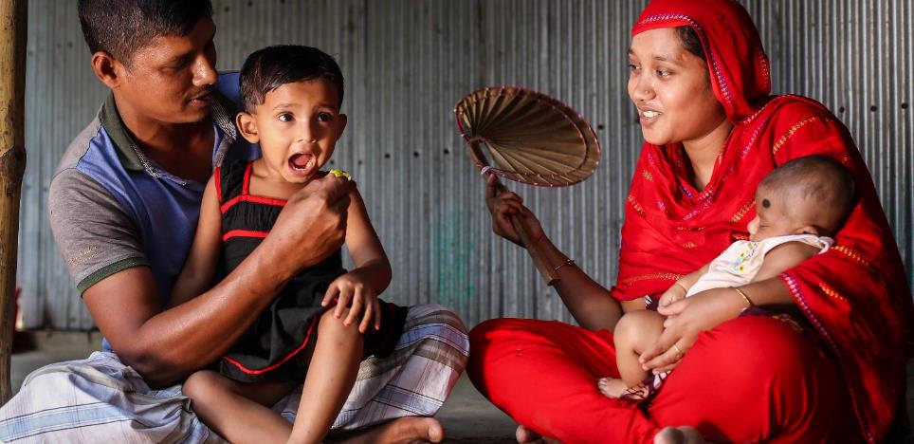

Nobo Jatra – New Beginning
USAID’s Resilience Food Security Activity

Slide 10


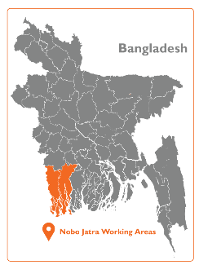
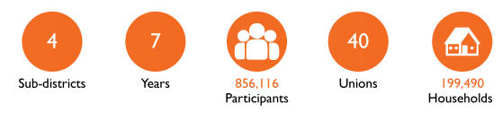

Nobo Jatra-New Beginning
A 7 year USAID Resilience Food Security Activity, implemented by World Vision Bangladesh in partnership with the Government of Bangladesh, in Koyra, Dacope, Shyamnagar and Kaliganj sub districts.
2015
2020
2021
2022
Implementation
sustainability, systems strengthening and transition
Notes:
OVERVIEW
Nobo Jatra – new beginning’ is a seven-year (2015-2022) USAID Bureau for Humanitarian Assistance (BHA) funded Resilience Food Security Activity, implemented by World Vision Bangladesh. Nobo Jatra is implemented in partnership with the Government of Bangladesh and Winrock International in Koyra, Dacope sub districts in Khulna district and Shyamnagar and Kaliganj sub districts in Satkhira district. From October 2020-September 2022, Nobo Jatra is in a two year cost extension focused on sustaining key outcomes and handover to Government of Bangladesh, private sector and communities themselves..

Slide 11


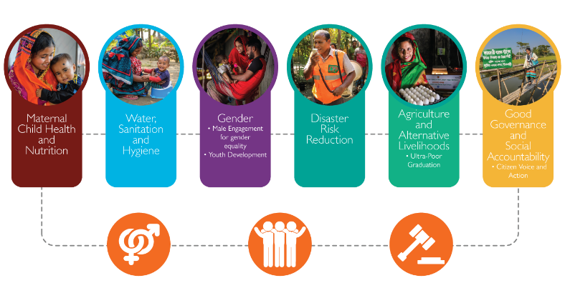

NOBO JATRA
Notes:
KEY COMPONENTS
Gender Equality and Social Inclusion are intersectional themes across all technical areas and activities.

Slide 12
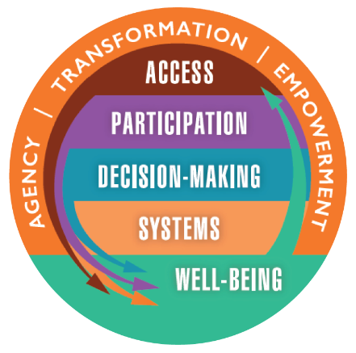
WVB Gender Equality and Social Inclusion Domains
Promotes equal and inclusive access, decision-making, participation, and well-being.
Transforms systems, social norms, and relations to enable the vulnerable to participate in and benefit equally from development interventions.
Promotes the empowerment of families and communities.
Notes:
As already presented by Jackie, WVB advances all of the GESI domains in our Nobo Jatra resilience food security activity.

Slide 13
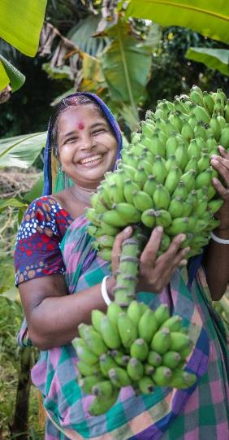
Nobo Jatra’s GESI approach
Economic empowerment
Support marginalized groups to gain control over economic and material assets.
Ultra Poor Graduation
Market systems development
Agriculture and Alternative Livelihoods
Financial Inclusion: Village Savings and Lending Associations
Male engagement for gender equality
Foster inclusive change and transformational shifts in gendered social norms and relations.
Adolescent and youth development
Build skills, assets and competencies; enhance participation of adolescent girls and boys; foster healthy relationships; strengthen external supporting environments.
Life Skills Education
Youth clubs
Skills and livelihoods
Empowering women and girls
Leadership development and socio-cultural, economic and political empowerment.
Leadership and participation

Slide 14
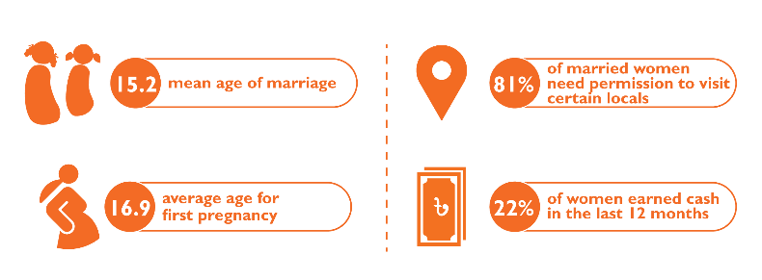
Local Context
*Nobo Jatra Baseline 2015

Slide 15
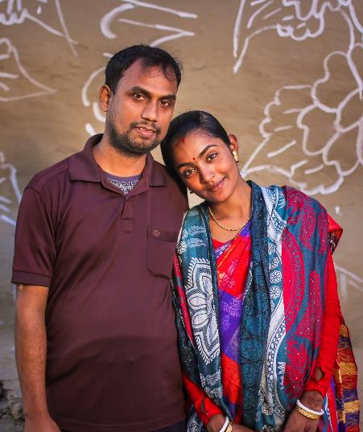
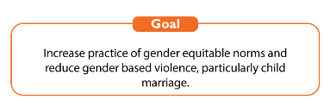
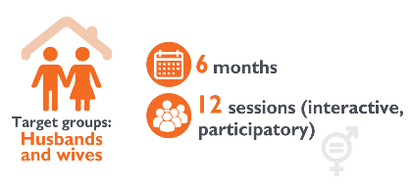
Male Engagement for Gender Equality

Slide 16
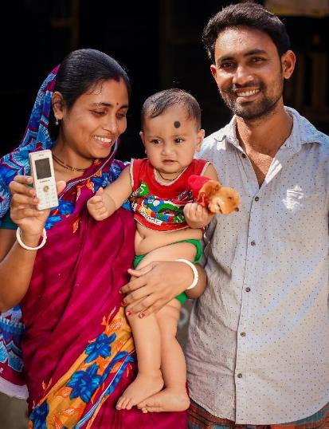
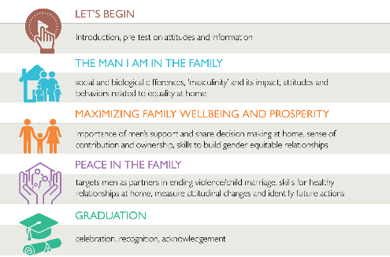
Modules

Slide 17
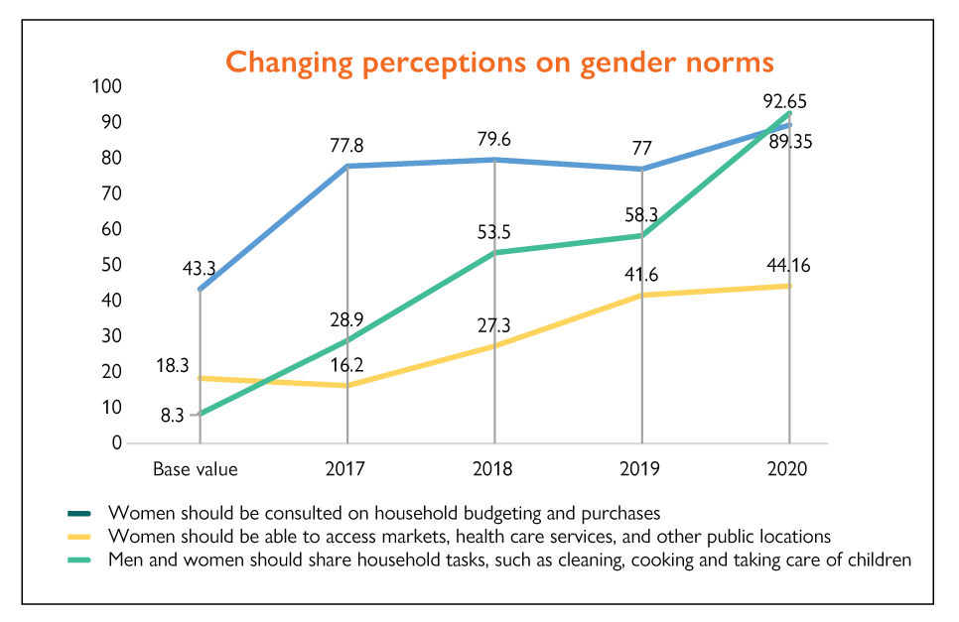
Outcomes
9,814 couples (husbands and wives) have graduated through male engagement sessions.
Couples become catalysts, sharing their knowledge with others in the area and setting a good example to their own children.

Slide 18
Integration
TIP: Male engagement is not a stand-alone activity! Couples also participate in a cross section of thematic activities across the project.
Notes:
N.B Will update these data points to show integration of male engagement – particularly with Ag & Livelihoods activities (producer groups, lead farmers, climate smart agriculture) – so we can show a more direct link to food systems.

Slide 19
Research on Sustained Impact
of Male Engagement
Wellbeing: Strengthened communications between husbands and wives to resolve disputes.
Over 95% of couples said they were taking joint decisions to solve family disputes.
Wellbeing: Over 95% of couples agreed that child marriage is harmful and a punishable offence by law. Over 95% of couples said investing in daughter’s education is important.
Participation: Women’s mobility has increased. At baseline 80.9% of women had to seek permission to visit certain locations in comparison to 50.5% now. 2,147 women are participating in economic resilience activities including Ultra Poor Graduation, and Village Savings and Lending Associations.
Participation: Men’s participation in caregiving and household chores has increased. 71% of men are doing housework in comparison to 38.2% at baseline. 90.2% of men spent up to 6 hours per day with their children
Decision making: For larger investments such as buying assets, land, livestock, 78% of decisions were taken jointly between couples. taken by the couples jointly. 83.8% couples

Slide 20
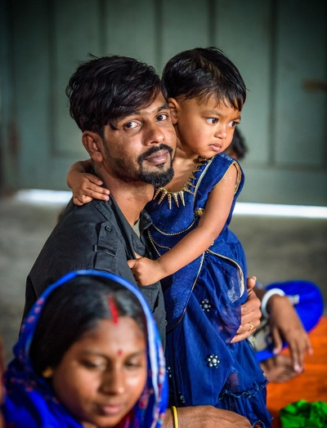
Learnings
Formative research to design a deeply contextualized module attuned to couples needs
A Gender Analysis and two rounds of formative research were undertaken to develop the male engagement module.
‘Pause and Reflect’ between pilot and scale up. Following USAID’s Collaborating, Learning and Adaptation framework.
Replicated in WV’s USAID Emergency Food Security Program in Cox’s Bazaar and other grants.
Sustain impact
Strategize early on how to sustain impact of male engagement. Invest in research and actualize recommendations during sustainability planning.

Slide 21
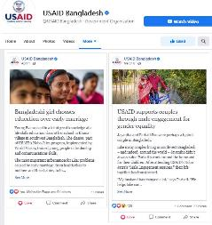
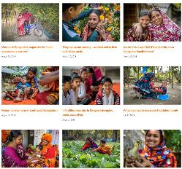
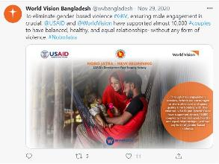
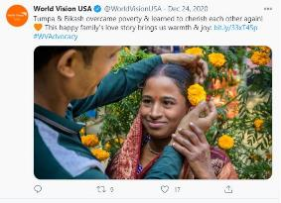

Slide 22
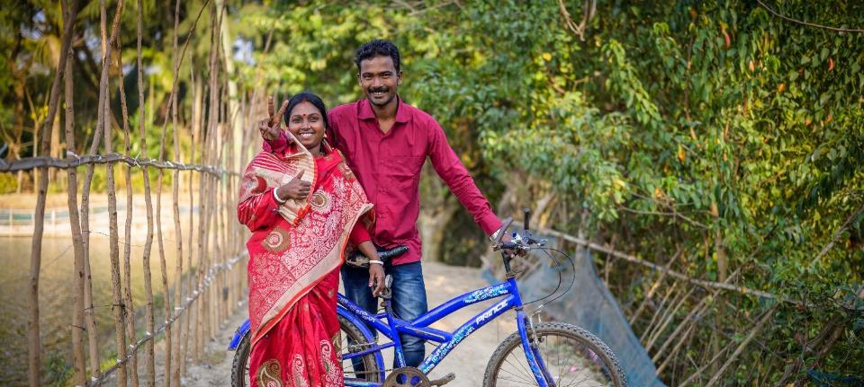
Think about a bicycle,” says Jayantha Das. “It has two wheels. If one wheel is damaged or leaky, it won’t work anymore.
The husband and wife are like the wheels of the bicycle. If someone doesn’t feel happy, the household could be damaged."

Slide 23

Serena Stepanovic
Senior Director
Food Security & Livelihoods
International Programs Group
World Vision USA

Slide 24
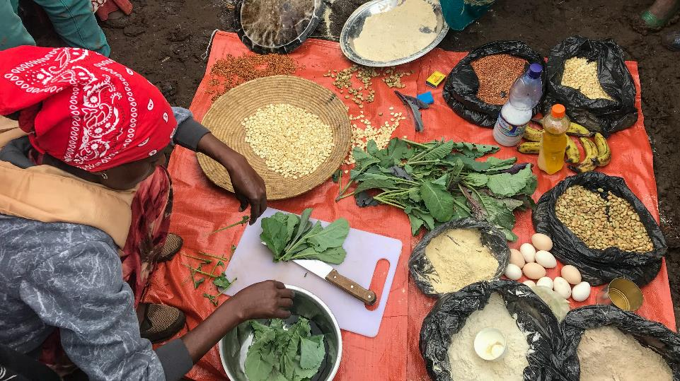
Future Directions
Optimizing Triple Development Outcomes through Gender Equality & Social Inclusion

Slide 25
Food Security & Livelihoods: Sector Priorities
Nexus Considerations
Organizational Commitments
Food Systems
1. Supply chains
2. Environments
3. Consumer behavior
Social & Behavior Change
1. Intersectional identity/roles Ideation
2. Architecture of decision making
Livelihoods & Resilience
1. Fragility & Resilience (Capacities & Capitals)
2. Livelihoods diversification & sustainability
3. Climate response & ecosystems
Harnessing the power of faith identity for development
Promoting child well-being
Working with the most vulnerable and in the most fragile contexts
Notes:
World Vision’s FSL approach works at the intersection of food systems, livelihoods and resilience and social and behavior change to achieve child well-being. The FSL strategy aims to reduce poverty,
Figure 2: The Food Security and Livelihoods Sector Strategy works at the intersection of Food Systems, Livelihoods and Resilience, and Social and Behavior Change to impact the well-being of children and their families.
increase household and community nutritional status and increase household and community food security through their programming. The FSL strategy considers the complexity of building resilience during the COVID-19 pandemic and in fragile contexts through a sector-wide approach.

Slide 26
Conceptual Framework
Systems Approach to Addressing Poverty, Malnutrition & Food Insecurity through Gender Quality & Social Inclusion

Slide 27
Conceptual framework: Systems Approach to Addressing Poverty, Malnutrition, and Food Security through Gender Equality & Social Inclusion
Biophysical & environmental drivers
Innovation technology & infrastructure drivers
Political & economic drivers
Sociocultural drivers
Demographic drivers
COVID/pandemics
Equitable & Inclusive Access, Participation & Decision-making related to natural & physical capital
Equitable & Inclusive Access & Participation related to physical & financial capital
Equitable & Inclusive Access, Participation & Decision-making related to political & financial capital
Equitable & Inclusive Access, Participation & Decision-making related to social capital
Equitable & Inclusive Access, Participation & focus on child well-being related to human & physical capital
Fostering risk-informed absorptive, adaptive & transformative capacities to absorb shocks
Food environments
Key Outcomes:
improved access and availability of food as measured by household and community production, income, and consumption
decreased stunting/wasting
more equitable distribution of intra household roles, responsibilities, and benefits between genders
more equitable and inclusive agricultural production systems and food markets
improved management/conservation of natural resources
Food supply chains
Food availability and physical access (proximity)
Economic access (affordability)
Promotion, advertising, and information
Food quality and safety
Production systems
Farmers, indigenous peoples, agribusiness, land and plantation owners, fisheries, financial entities
Consumer behavior
Choosing where and what food to acquire, prepare, cook, store, and eat
Diets
Quantity
Quality
Diversity
Safety
Storage and distribution
Transporters, agribusiness, distributors
Processing and packaging
Packing plants, food and beverage industry, small and medium enterprises
Retail and markets
Retailers, vendors, food outlet owners, traders, restauranteurs, wholesalers
adaptive management, monitoring, evaluation, and knowledge sharing

Slide 28
Operational Considerations: 2021-2022
Prioritizing
Prioritizing push & pull factors along critical impact pathways
Testing
Testing critical impact pathways between:
Systems drivers & system domains of stakeholder action
Combination of WV project models & under-evidenced approaches

Slide 29
Learning Priorities
Research Partners
  University of Illinois (AgREACH)
  Cornell
  University of Florida
  ODI
  Tulane
  ITAD
  TANGO
  American University
  Ideas 42
Emerging Areas of Inquiry
GESI and institutional change for poverty, malnutrition & food insecurity
Effects of including marginalized and youth groups in FSL-GESI programming
Intervention mix for greater causal links between FSL programs and women’s empowerment outcomes
Notes:
SERENA TO COVER THIS SLIDE: HEA will submit 8-10 applications, many of which will include DRR components, in the APRO region alone. On the dev side, we are actively pursuing opportunities in LAC, SARO and EARO, building upon existing bi lateral and privately funded work, to foster resilience through multi sectoral programs addressing climate change mitigation, food insecurity, malnutrition and sustainable livelihoods.

Slide 30
Resources & Contact
GESI TOC & Approach: https://wvusstatic.com/2021/landing-pages/gender-equality/Gender_Equality_and_Social_Inclusion_Approach_2021.pdf
GESI DME Toolkit: https://wvusstatic.com/2020/landing-pages/gender-equality/Gender_Equality_and_Social_Inclusion_DME_Toolkit_2021.pdf
Nobo Jatra Program: https://www.wvb-nobojatra.org/
Impact Stories: https://www.worldvisionadvocacy.org/bangladesh-stories/
Contact GESI Team : GESIteam@worldvision.org
Contact Director, GESI Team, Dr. Jacqueline Ogega : jogega@worldvision.org
Contact Sr. Director, FSL Team, Serena Stepanovic : sstepanovic@worldvision.org
by the couples jointly. 83.8% couples

