Slide 1

The Way Forward in KM4ARD
Unit 8 of the Knowledge management in agriculture and rural development (KM4ARD) course

Slide 2
Overview of Unit 8
Purpose:
Ask any remaining questions on KM in ARD and discuss them with others
Reflect on concrete entry-points for KM and how it connects with your work
Develop concrete outputs regarding what you can implement from KM in your work and obtain feedback
Provide feedback to improve the KM workshop in a formal evaluation
Provide an opportunity to share what you are doing

Slide 3
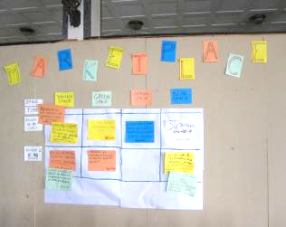
Open Space
Method for convening groups around a specific question and giving participants responsibility for creating both their own agenda and experience
The facilitator lays out the Open Space principles and rules, make sure the room is set up but the participants decide what they want to talk about and self-organize in small groups to discuss those topics
Can be challenging for organizations used to controlling interactions
Usually lasts 1-3 days
Small group report and action plans (individual or team) are the main outputs
Notes:
Trainers notes
Link from last slide:… now in order to see if there are any remaining questions on KM in ARD, we will be doing a mini-Open Space. If you recall, Open Space is a method…
Method…: in this method, the onus is on the participant to make it the best experience for themselves. It provides a lot of freedom, which some people love and others don’t feel comfortable with.
Can be challenging…: you need to make sure that management is on board before doing an Open Space. You cannot control what comes out of it so if certain outcomes are expected, don’t use this method. Asking people for their input and then ignoring the results can completely break down trust.

Slide 4
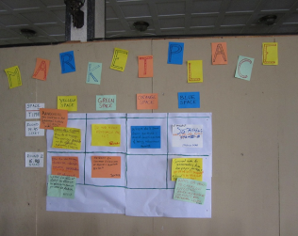
Mini-Open Space
Our mini Open Space: short brainstorming of questions that you would like to discuss with others, posting topics in Marketplace (15 minutes)
Choose the topics that you most want to discuss
2 rounds of discussion of about 30 minutes
Take down main points of the discussion to share in plenary (15 minutes)
Notes:
Trainers notes
Link from last slide:… we won’t have time to do a full Open Space so we are calling this a “mini-Open Space”. This is how we’ll go about it…
See Unit 8 Exercise notes

Slide 5

Open Space question
Are there any remaining questions or issues on knowledge management that you would like to raise and discuss with others?
Notes:
Trainers notes
Link from last slide:… here is the question that we will be asking ourselves:
See Unit 8 Exercise notes

Slide 6

Open Space debrief
What were some of the questions/issues raised and what were one or two main points of the discussion?
Popcorn debrief (10 minutes)
Notes:
Trainers notes
Link from last slide:… can we hear from a few of the topics that were raised during the Open Space?
See Unit 8 Exercise notes

Slide 7
Sense making exercise: part 1 (30 minutes)
Take the time to go through Units 1 through 7
As you do, think of your organisation or network, its strategic goals and its culture
Start to think of entry-points for KM - find concrete areas where KM can support your work (you may already be doing some of these)
For each of these areas, come up with KM processes, activities and tools that could benefit your team, project, organisation, etc. (work at the level you want)
You are not developing a KM strategy, just writing down some ideas !
Notes:
Trainers notes
Link from last slide:… right now, we want to give you a chance to reflect on what you’ve leaned in the last few days and how this impacts your work. For the first part of the exercise, I will invite you to take the time…
See Unit 8 Exercise notes

Slide 8

Sense making exercise: part 2 (30 minutes)
At your table, present your ideas to peers for feedback
Be concise when presenting, be constructive when giving feedback
Notes:
Trainers notes
Link from last slide:… now for the second part of the exercise, we would like to have a table discussion about what you’ve come up with. At your table…
See Unit 8 Exercise notes

Slide 9
Sense making exercise: part 3 (20 minutes)
Plenary discussion:
  What do you think of the ideas you’ve heard?
  Did you receive any interesting feedback?
  How do you feel about going forward in KM for ARD?
Notes:
Trainers notes
Link from last slide:… now let’s do a debrief in plenary. What do you think…
See Unit 8 Exercise notes

Slide 10
Questions? Comments?

Slide 11
Workshop evaluation and closing
Fill out the evaluation sheet and hand in (30 minutes)
Official closing (30 minutes)
  Thank you from organizers
  Certificates ceremony
Participants last words (30 minutes):
  We will be doing the “One-one-one” final closing
  Knowledge object is passed around the circle
  You can choose to remain silent and pass it along, or you can say one word, or you can say one phrase, or you can speak for one minute
Notes:
Trainers notes
Link from last slide:… to close the workshop, we would like to first hear from you more formally, by filling out this evaluation sheet. You will get a chance to express yourselves more informally at the end of the session.
See Unit 8 Exercise notes

Slide 12
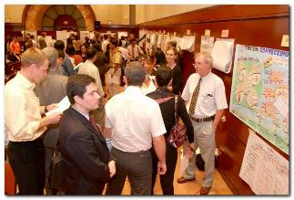
Knowledge Fair
Face-to-face event designed to allow numerous individuals to share their experience at a common venue with the help of visual aids and displays (e.g. posters, videos, etc.)
Everyone has a booth or space to share resources and good practice
The “Fair” concept is open and people move about freely
Facilitates networking
Helps people benefit from each other's experiences
Stimulates interest in future collaboration
Notes:
Trainers notes
Link from last slide:… today we will be doing a Knowledge Fair, which is a face-to-face event…
The “Fair” concept…: There are many ways to do Knowledge Fairs, you can also organize the movements a bit more, for e.g. in different rounds, or with people walking about as a group and giving each “booth” a certain amount of time to present (for e.g. 5-10 minutes).

Slide 13

Knowledge Fair
Booth set-up time: 60 minutes
  Decorate with photos, drawings, any visual aids
  Use materials available (markers, flipchart paper, etc.)
Knowledge fair time: 120 hours, two 60 minute time slots
  Welcome people at your booth
  Talk about your KM-related work (project, network, etc.), show short videos, etc.
  Bell rings when one hour is up: presenters become participants
Notes:
Trainers notes
Link from last slide:… this is how the morning will unfold, first, you will get a booth set-up time of 60 min…
See Unit 8 Exercise notes

Slide 14
Credits
This learning material was prepared by Lucie Lamoureux for CTA.
The Technical Centre for Agricultural and Rural Cooperation (CTA) is a joint international institution of the African, Caribbean and Pacific (ACP) Group of States and the European Union (EU). CTA operates under the framework of the Cotonou Agreement and is funded by the EU. For more information on CTA, visit www.cta.int
Disclaimer
This work has been made with the financial assistance of CTA. However, it remains under the sole responsibility of its author and never reflects CTA's nor the European Union's opinions or statements whatsoever. The user should make his/her own evaluation as to the appropriateness of any statements, argumentations, experimental technique or methods as described herein.
Copyright notice
Reproduction and the dissemination of these modules and supporting materials is encouraged under the terms of the Creative Commons Attribution License (https://creativecommons.org/licenses/by/4.0/legalcode), provided that appropriate acknowledgement is made:
  – of CTA's copyright, in accordance with the license Creative Commons 4.0, by including the name and the title of the article or chapter,
  – and that CTA's or the EU's endorsement of authors' views, products or services is not implied in any way, by including the disclaimer.
March 2015

