Slide 1
Lessons from Engaging with Dairy Cooperatives to Foster Irrigated Forages Development
Aberra Adie and Melkamu Bezabih
International Livestock research Institute
Public-Private-Partnership for delivery of veterinary services
Review and validation of PPP models for scaling out
ILRIETH campus, Azage Auditorium, Addis Ababa 27 March 2025

Slide 3
Background
ILSSI – small scale irrigated forages production
Project woredas:
Bahirdar Zuria, Lemo, Kedida gamela
  Phase I: 2014-2018
  Testing and validation of technology options
  Phase II: 2019 – 2023
  Scaling of validated technologies

Slide 4
Scaling of small-scale irrigated forage technologies
  Actor mapping and partner identification
  Need assessment
  Interventions
  Lessons and experiences

Slide 5
Actor Mapping
Partners : Research institutes, Livestock extension, Cooperatives development offices, Private sector, NGOs
Three dairy coops identified in Amhara and SNNPR - Sites where ILSSI’s phase I work on irrigated fodder has been done

Slide 6
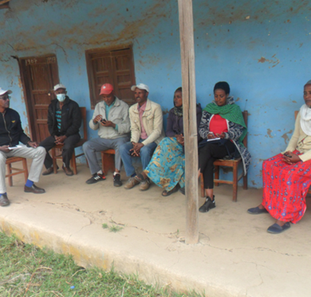
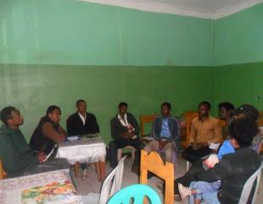
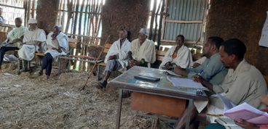
Need Assessment
Coop management skills
Forage seed supply
Facilities to collect, process
and sell dairy products
Feed production and utilization skills
Market outlet for products
Breed improvement

Slide 7
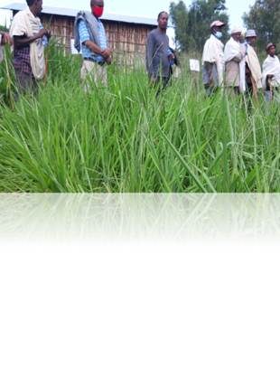
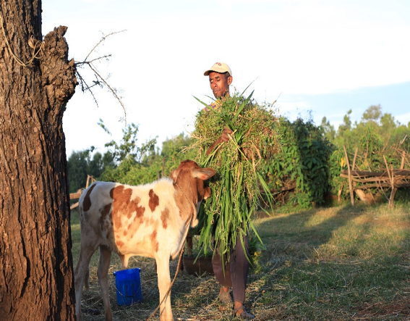
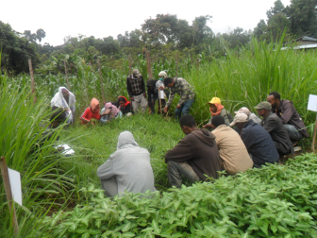
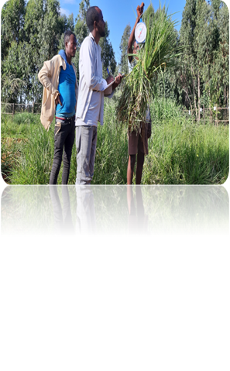
Interventions
Demonstration of validated forage technology options

Slide 8
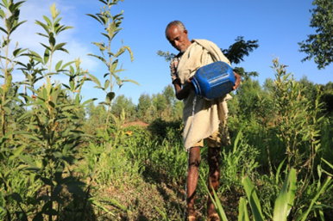
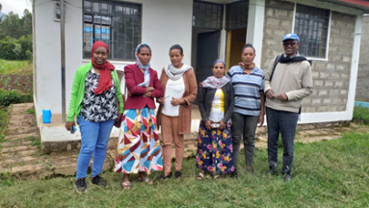
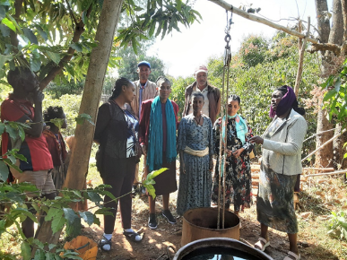
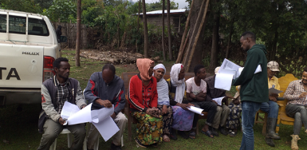
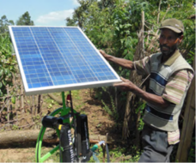
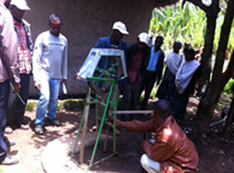
Interventions
Water - lifting technologies
Training to coop members and executives

Slide 9
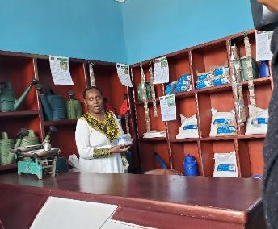
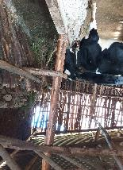
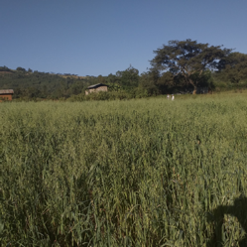
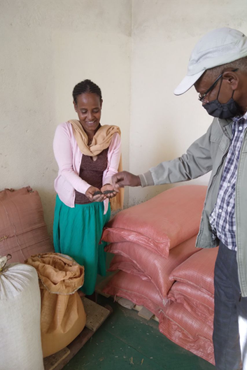
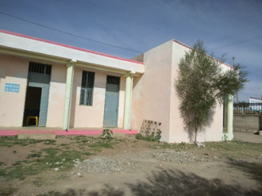
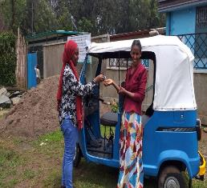
Interventions
Grants to fill physical capacity gaps
Coop - based seed production and supply system
Breed improvement

Slide 10
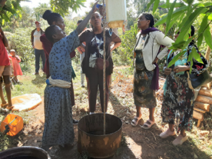
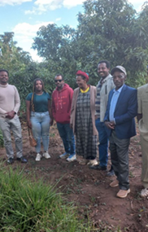
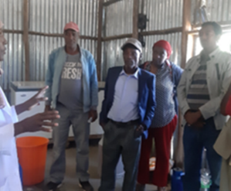
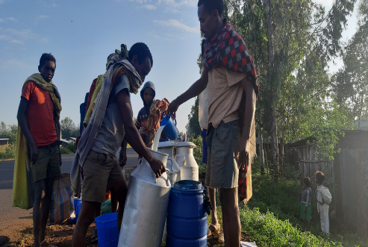
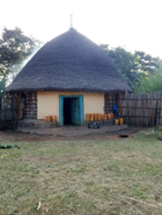
Interventions
Market linkages to sell
products
Experience sharing events

Slide 11
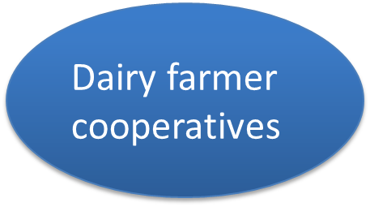
Progresses
Interventions
Target groups
Progresses
Diffusion of irrigated fodder production (from a dozen to thousand farmers)
Validated and packaged technologies
Capacity development
Market access for milk and milk products
Engagement in forage seed business
Trainings and advisory support
Learning platforms
Grants to fill capacity gaps
Diversifying activities: output and input market

Slide 12
Lessons and experiences
Engaging with private sector – coops which are already on the business helps to foster delivery of feed options but, Committee work is not easy as we know
Addressing the out put side is as important as addressing the input side to promote improved feed production -
If there is no strong market for feed or livestock products,…
Experience sharing motivates farmers to learn new ways of doing things – forage market is vibrant in the South; Irrigation experience is better in the North
Income source diversification from direct sales of planting materials, forages – A forage tech adopter may not necessarily be a livestock keeper

Slide 13

THANK YOU!

