Slide 1
Special thanks to…
117 authors and many other unnamed contributors who did the research and writing for our fantastic publication.
The wonderful publication team at Springer
Farmers and value chain actors, both women and men, who make all this possible and whose livelihoods we serve.

Slide 2
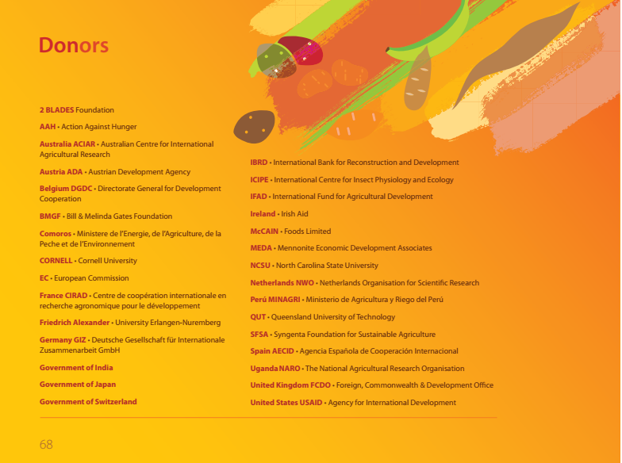

Slide 3





In particular
Our supporters!

Slide 4
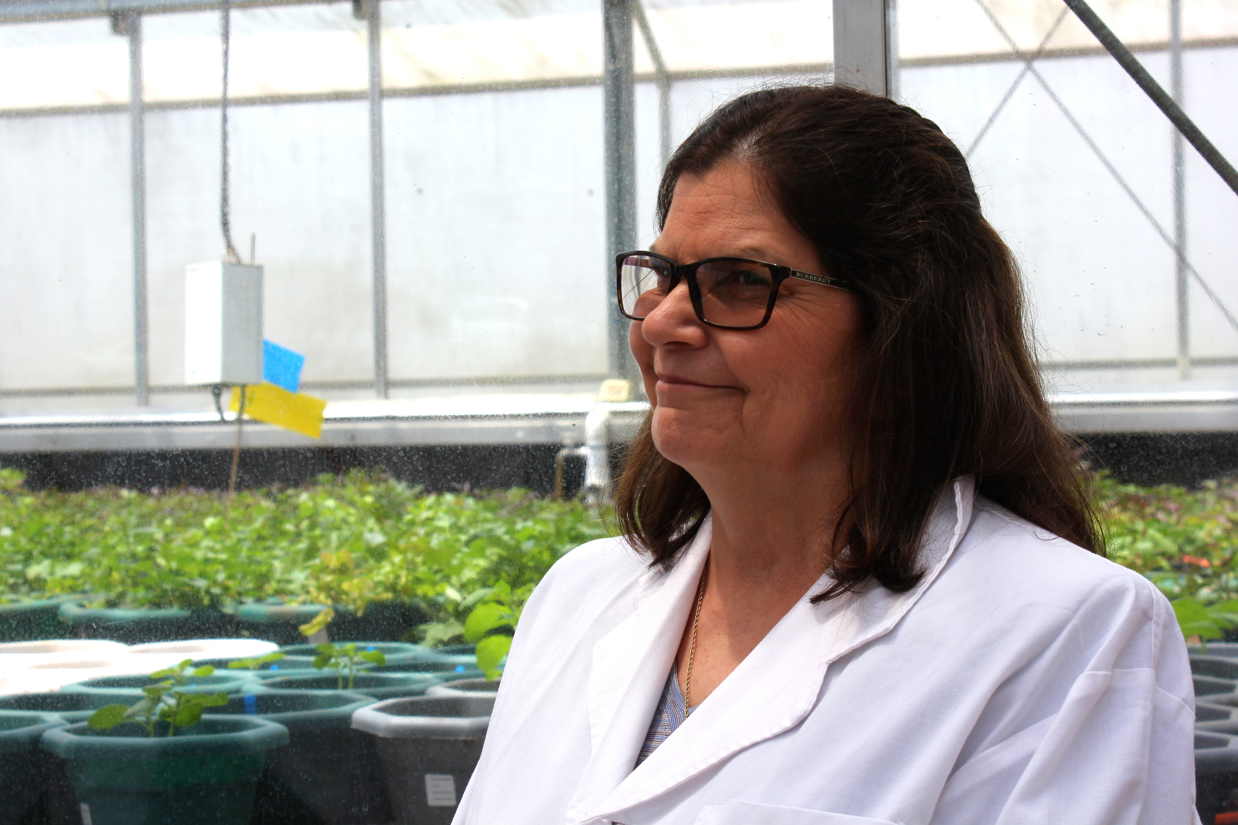
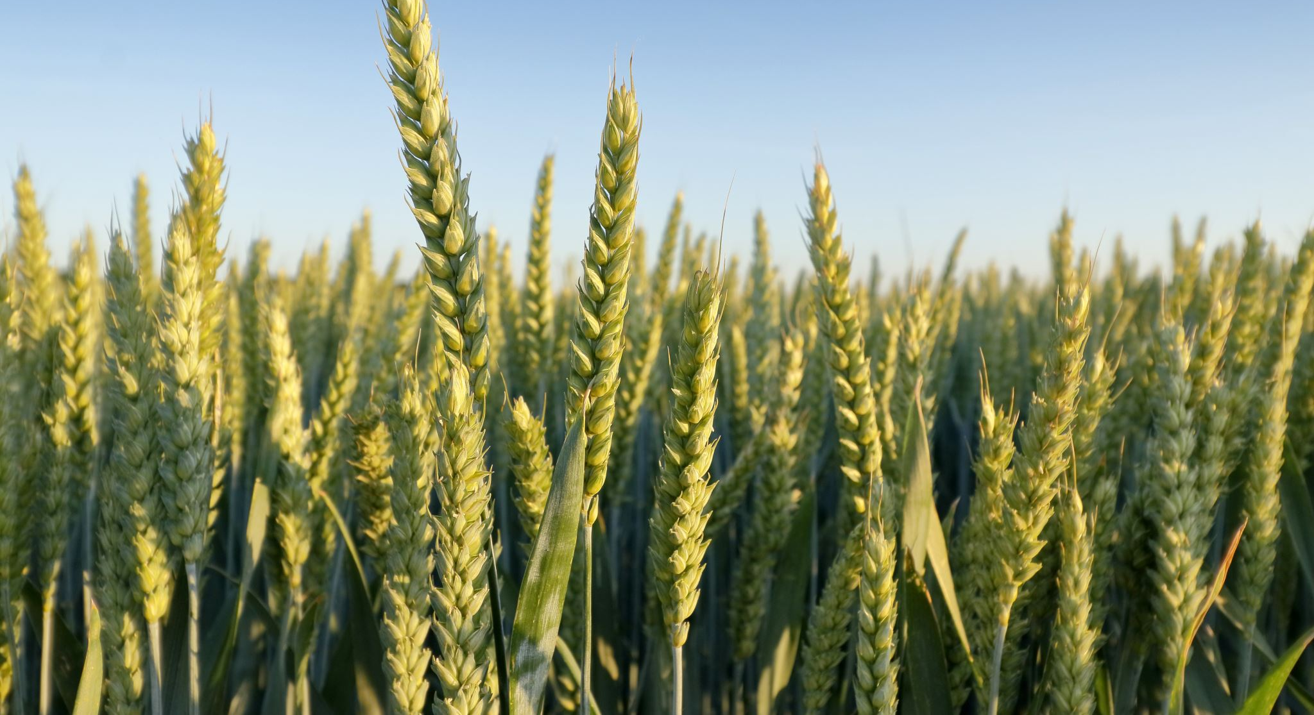
And
Dr. Barbara Wells
(1955-2022)
Barbara championed our crops and methods for collaborative and participatory RTB research. and participatory research in Dr Barbara Wells who was such a champion for our crops and collaborative and participatory research in RTB

Slide 5


Thank you!

