Slide 1
Operationalizing One Health in pastoralist settings

Slide 2
Module 3: Practice of One Health in HEAL sites
HEAL Standard Operation Procedure

Slide 3

Welcome to Day 2
Video
Your facilitator will play a video
Video 2: One Health for Humans, Environment, Animals and Livelihoods (OH4HEAL)
https://www.youtube.com/watch?v=MBQuVh5mHfM

Slide 4

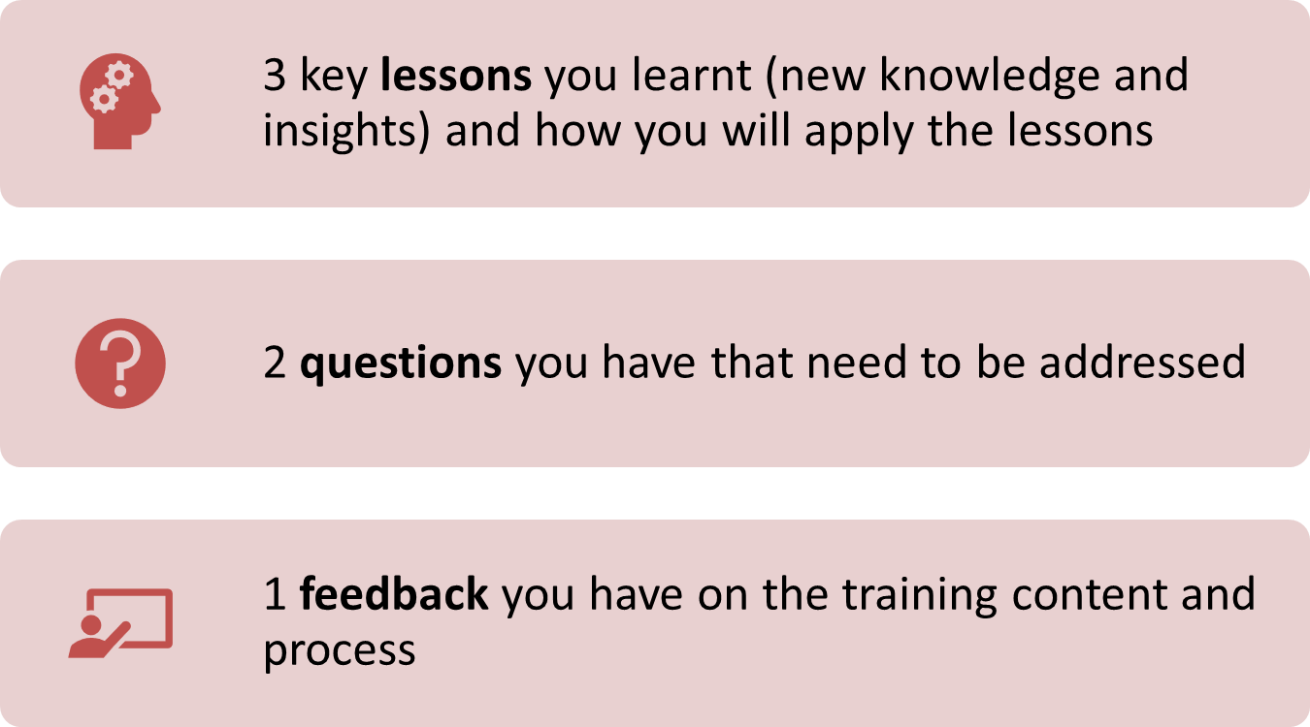
Re-cap Day 1
Reflection
Write down your key lessons from yesterday
Be prepared to share your responses in plenary
30 minutes

Slide 5
MSIP and OHTF in depth; OHU services, procurement and financing; and other elements

Slide 6
Intended learning outcomes
By the end of today, you will be able to:
describe the composition of the MSIP and OHTF and their different roles and responsibilities;
guide the process of establishing and maintaining MSIPs and OHTFs in intervention areas;
describe the role of HEAL partners with respect to MSIP and OHTF;
identify the sector-specific and cross-cutting services provided by OHUs in intervention areas;
describe guiding principles and processes for procuring pharmaceutical products and medical equipment;

Slide 7
Intended learning outcomes (continued)
describe current and expected future contributions of the project, government and community to sustainably financing OHUs;
describe the roles and responsibilities of the CBON;
discuss the process of establishing and maintaining CBON;
describe the roles and responsibilities of CRHWs; and
discuss the process of establishing and maintaining CRHWs

Slide 8
Topics
The following chapters of the SOP are covered in this session:
Chapter 4: Multi-stakeholder Innovation Platform (MSIP)
Chapter 5: One Health Task Force (OHTF)
Chapter 6: Operationalising the integrated health service delivery model
Annex 1: Community-based Observation Network
Annex 2: Community Rangeland Health Workers

Slide 9
Multi-stakeholder innovation platform (MSIP) in depth
Study circle
Your facilitator will:
  Divide you into 3 groups of people from different sectors
  Distribute definitions in the HEAL SOP
In groups:
  Study the topics assigned, enriching them with your HEAL project implementation experience
  Record your understanding/interpretation/experience of the topics on flipcharts
Be ready to teach others what you learned in plenary
60 minutes

Slide 10
Multi-stakeholder Innovation Platform (MSIP) in depth
Group 1 | Group 2 | Group 3
Composition (4.2) Dedicated roles (4.2.1) | Roles and responsibilities (4.5) Roles of HEAL partners (4.6) | Establishment (4.3) Maintenance (4.4) MEAL indicators (4.7)
What is the composition of the MSIP? What are the dedicated MSIP roles? Do similar groups already exist in this area which could form the basis of an MSIP? | What are the roles and responsibilities of MSIPs? Do you foresee any challenges with MSIPs discharging these responsibilities? How could these challenges be addressed? What is the role of HEAL partners with respect to MSIPs? | How are MSIPs established? What steps are followed? What is the frequency of MSIP meetings and what are the guiding agenda of the meetings? What challenges could be faced in the establishment and maintenance of an MSIP in your area? How could these challenges be addressed?
60 minutes

Slide 11

Multi-stakeholder Innovation Platform (MSIP)
Plays a key role in designing, implementing and monitoring OHUs
Meets monthly to analyze health-related problems, discuss data, and collectively identify solutions
MSIP
COMMUNITY-BASED PLATFORM comprising:
Local and religious leaders
Service providers
Traditional healers
Teachers/educators
Women representative
Youth representative
Businessmen/women

Slide 12
One Health Taskforce (OHTF) in depth
Study circle
Your facilitator will:
  Divide you into 3 groups of people from different sectors
  Distribute definitions in the HEAL SOP
In groups:
  Study the topics assigned, enriching them with your HEAL project implementation experience
  Record your understanding/interpretation/experience of the topics on flipcharts
Be ready to teach others what you learned in plenary
60 minutes

Slide 13
One Health Taskforce (OHTF) in depth
Group 1 | Group 2 | Group 3
Composition (5.2) Dedicated roles (5.2.1) | Roles and responsibilities (5.5) Roles of HEAL partners (5.6) | Establishment (5.3) Maintenance (5.4) MEAL indicators (4.7)
What is the composition of the OHTF? What are the dedicated OHTF roles? Do similar groups already exist in this area which could form the basis of an OHTF? | What are the roles and responsibilities of OHTFs? Do you foresee any challenges with OHTFs discharging these responsibilities? How could these challenges be addressed? What is the role of HEAL partners with respect to OHTFs? | How are OHTFs established? What steps are followed? What is the frequency of OHTF meetings and what are the guiding agenda of the meetings? What challenges could be faced in the establishment and maintenance of an OHTF in your area? How could these challenges be addressed?
60 minutes

Slide 14

One Health Taskforce (OHTF)
Provides overall steering and support by:
Appointing and supervising staff
Providing supplies
Maintaining relationship with community
Addressing challenges
OHTF
GOVERNMENT PLATFORM comprising:
Health department
Livestock department
Agriculture department
NRM department
District administration

Slide 15
Services delivered by the OHU
Group 1 | Group 2 | Group 3 | Group 4
Human health services (6.1.1) | Animal health services (6.1.2) | Rangeland health services (6.1.3) | Cross-cutting services (6.1.4)
30 minutes
Study circle
Your facilitator will:
  Divide you into 4 groups of people from different sectors
  Distribute topics in the HEAL SOP
In groups:
  Study the topics assigned
  Revisit the flip charts developed yesterday and:
    Strike through any services that are not provided by the OHU
    Add any additional services provided by the OHU on a sticky note

Slide 16





Services delivered by the OHU
HUMAN HEALTH
Antenatal care
Postnatal care
Family planning
Growth monitoring
Nutrition screening
Medical consultations
ANIMAL HEALTH
Disease surveillance
Vaccination
Disease treatment
Animal husbandry
Animal products
HUMAN HEALTH
ANIMAL HEALTH
COMMUNICATION
CROSS-CUTTING SERVICES
COORDINATION
RANGELAND HEALTH
Grazing management
Rangeland restoration
CAPACITY BUILDING
CROSS-CUTTING SERVICES
Environmental health
WASH, waste management, plastic removal
Capacity building
Education & awareness, gender integration
Data driven decision making
Community based observation network, MEAL
Outbreak response
COLLABORATION
RANGELAND HEALTH

Slide 17
Procurement and financing
Study circle
Your facilitator will:
  Divide you into 4 groups of people from different sectors
  Distribute definitions in the HEAL SOP
In groups:
  Study the topics assigned, enriching them with your HEAL project implementation experience
  Record your understanding/interpretation/experience of the topics on flipcharts
Be ready to teach others what you learned in plenary
60 minutes

Slide 18
Procurement and financing
Group 1 | Group 2 | Group 3 | Group 4
Logistics, resources management and procurement (6.3) Pharmaceutical products (6.3.1) | Logistics, resources management and procurement (6.3) Medical equipment (6.3.2) | Project contribution (6.4.1) Government contribution (6.4.2) | Community contributions (6.4.3) Insurance schemes (6.4.4)
Who is responsible for procurement and distribution of animal and human health supplies? Why is this important? What principles guide the procurement of pharmaceutical products? How do they align with the guiding principles discussed on Day 1? | What role do HEAL partners play in the procurement of animal and human health supplies? What principles guide the procurement of medical equipment? How do they align with the guiding principles discussed on Day 1? | In what ways does the HEAL project contribute to the integrated health service delivery model? Is this sustainable? In what was does the government contribute to the integrated health service delivery model? How is this expected to change over time? | In what ways do communities contribute to the integrated health service delivery model? How is this expected to change over time? What insurance schemes are expected to contribute to the integrated health service delivery model? Are these available in this area?
60 minutes

Slide 19
Logistics and resources management
OHU will align and integrate with the supply chain present in each country
Different arrangements in each country:
  OHU supplies are procured by local authority with OHU team responsible for stock records and onward movements. Local authority manages stock outs
  HEAL may support supply chain system to function without interruption when the country faces procurement issues (e.g. training, supportive supervision)

Slide 20
Financing
As OHUs become the preferred model for service delivery in pastoralist areas, government and community investment is expected to increase to ensure sustainable financing.
$
Government
contribution
Community
contribution
Project/donor
contribution
Time

Slide 21
Other elements
CBON 1 | CBON 2 | CRHW 1 | CRHW 2
Establishment of CBON Roles and responsibilities of CBON | Maintenance of CBON Roles of HEAL partners | Establishment of CRHWs Maintenance of CRHWs | Roles and responsibilities of CRHWs Roles of HEAL partners
How are CBON’s established? What steps are followed? Do you foresee any challenges with establishing a CBON in this area? How might these challenges be overcome? What are the roles and responsibilities of the CBON? | How are CBON’s maintained? What steps are followed? Do you foresee any challenges with maintaining a CBON in this area? How might these challenges be overcome? What is the role of HEAL partners and TRiM with respect to the CBON? | How are CRHWs established and maintained? What steps are followed? Do you foresee any challenges with establishing and maintaining CRHWs in this area? How might these challenges be overcome? | What are the roles and responsibilities of CRHWs? What is the role of HEAL partners with respect to CRHWs?
60 minutes

Slide 22
Summary of key points
Management and governance is a shared responsibility of the community (through the MSIPs) and the local government (through the OHTF)
  OHTF appoints 3 coordinators (from animal, environment, and human health) who will be responsible for the day-to-day management of the OHUs
  Communities nominate 5 members of the MSIP to be contact persons for OHU coordinators
OHUs provide both sector-specific and cross-cutting services

Slide 23
Summary of key points
Government and community contributions are central to maintaining the quality of services and sustainability of the OHUs beyond the project duration
HEAL will support/promote existing mechanisms and insurance schemes e.g.,
  Community-Based Health Insurance (CBHI)
  Co-payments and cost sharing by individuals

Slide 24
Action plan
Small group discussion
In groups by woreda/district:
  Make action plans to apply the training
  Record your discussion on a flipchart
  Place flip chart on wall
Be prepared to review and vote on the best action plan
15 minutes

Slide 25
Evaluation
Your facilitator will distribute two forms:
  Post-training evaluation – measures the level of learning achievement relative to the baseline you completed on day 1
  End-of-training survey – gathers participant feedback on the relevance, effectiveness of the content and training process
Both forms are anonymous and will help us improve the training
5 minutes

Slide 26
Thank you for your active participation
አመሰግናለሁ
mahadsanid
danke
merci
galatoomaa
asante
grazie

