Slide 1
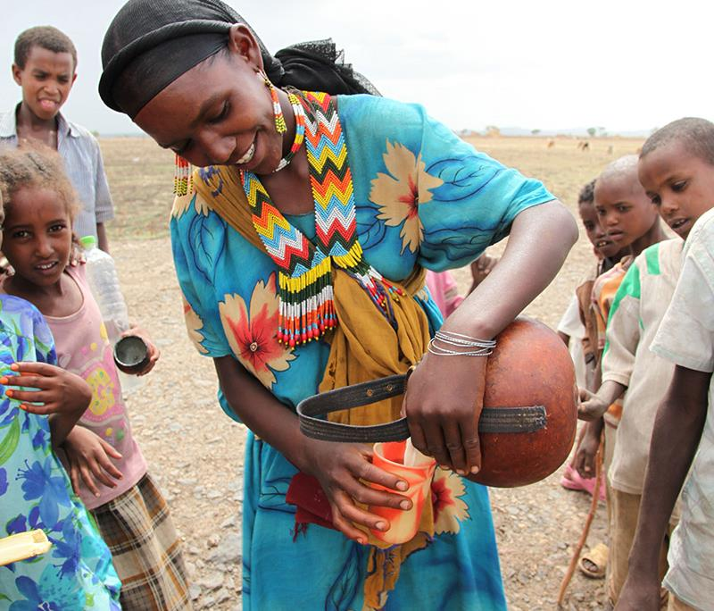
Gender in the LIVESTOCK CRP
Nicoline de Haan
CGIAR Livestock review and planning meeting, 10 June 2020

Slide 2
All things gender in LIVESTOCK
Livestock
genetics
Livestock livelihoods and agri-food systems
How do we work:
CG gender scientists contribute to the CRP (ILRI, ICRADA, CIAT)
Different percentage of time funded through CRP – from a few % (most common) to 20% (CRP gender coordinator)
Bilateral funding provides the rest – though usually small percentages from 6-15%
Trying to get gender led projects
Two entry points:
  At CRP level
  At flagship level
Three approaches:
  Influence
  Methods
  Evidence
Livestock
health
Feeds and forages
Livestock and the
environment

Slide 3
All things gender in LIVESTOCK
Livestock
genetics
Livestock livelihoods and agri-food systems
Cross flagships :
Picking up themes important to gender, not done in flagships, i.e.
  Entrepreneurship of women on genetics/animal health/forages
  Decision making at household on animal health, genetics and/or feeds
  Livestock as an asset to transform gender relations
to inform uptake of livestock innovations and role of livestock in empowerment
Livestock
health
Feeds and forages
Livestock and the
environment

Slide 4
All things gender in LIVESTOCK
At flagship level :
Have a gender expert working closely with the flagship
Genetics - Alessandra
Environment – Renee/ Dina
Animal health – Nicoline/ Wole
Forages – all (had PDF)
LLAFS – our home
All have technical expertise in the flagship areas
Flagship level gender work :
Gendered issues in forages
Gendered issues of access to animal health services
Gender framework for genetics
Livestock
genetics
Livestock livelihoods and agri-food systems
Livestock
health
Feeds and forages
Livestock and the
environment

Slide 5
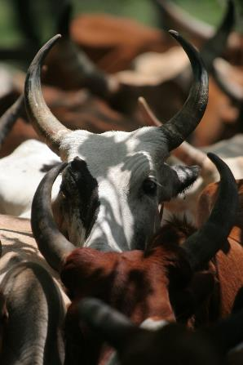
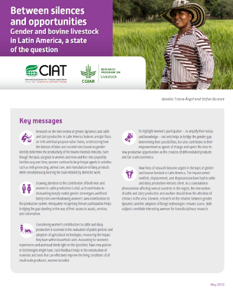
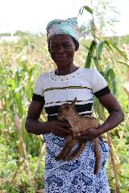
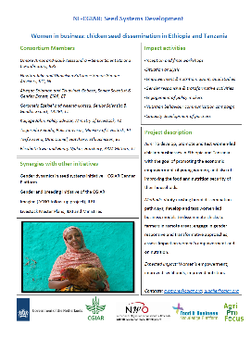
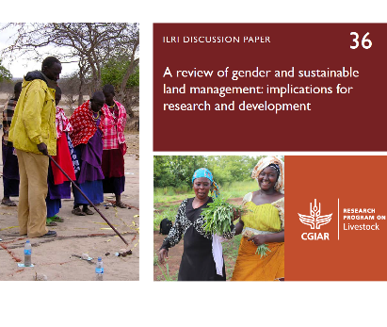
All things gender in LIVESTOCK: some highlights
1
2
3
Feed and forages
Animal health
LLAFS and policies
Community conversations on zoonotics
Phages and gender
Gender and vaccines: accommodative and
G-Feast
Bracharia study as part of GREAT
Livestock master plans: Bihar and beyond
4
5
LLAFS and Genetics
Environment
A review on gender and sustainable land management
Women in poultry business: Tanzania and Ethiopia

Slide 6
All things gender in LIVESTOCK: next steps
Themes to make whole (?)
  empowerment through livestock
  women in business
  scaling (Africa Rising, Feminization and LMPs)
  capabilities
Three discussion questions for today:
a) what gender legacies should LIVESTOCK leave?
b) how can ag/research contribute to gender equality?
c) what can you do about contributing to gender work in LIVESTOCK?
Product developed under controlled conditions
Proof of concept tested/piloted and assessed in real world conditions
Product ready to be taken up or adopted by public or private partner
Demonstrated uptake by public or private partner (next user)
Evidence of impact (e.g. adoption, development outcomes) for farmers/public (end users)
Stage 1
Stage 2
Stage 3
Stage 4
Stage 5
Key Flagship Product Lines
Discovery/ proof of concept
Field testing/piloting complete
Available for uptake
Demonstrated uptake
Wider impacts
Product = clearly defined strategic output/group of outputs

