Slide 1

Developing a Suitable Environment for Knowledge Management and the Importance of Leadership
Unit 2 of the Knowledge management in agriculture and rural development (KM4ARD) course

Slide 2
Overview of Unit 2
Purpose:
  Understand how a suitable environment is key for KM uptake
  Understand the importance of KM leadership in an organisation
  Identify the main challenges to effective KM and how to overcome them
  Identify the benefits, opportunities, risks and costs linked to KM
  Communicate the value of KM to others

Slide 3

What do we mean by suitable environment for KM?
Adequate level of trust
Good team dynamics
Enlightened management
Acceptance of diverse perspectives and new ideas
Tolerance for making mistakes
Other examples?
Notes:
Trainers notes
It is important to stress that this is an ideal situation, which very rarely occurs. But for KM to grow, there needs to be at least a minimum level of these 5 elements.
Other example?: ask participants “popcorn style” for 2-3 other examples (but move on quickly to the next slide).

Slide 4
Bottom-up vs top-down
Bottom-up
Open
Adaptable
Cooperative
Non-hierarchical
Incentives
Recognition
Top-down
Closed
Rigid
Competitive
Hierarchical
Disincentives
Disregard
Notes:
Trainers notes
Link from last slide: … so what are the characteristics of two very different environments
The point of this slide is to highlights how a bottom–up environment is much more KM friendly environment. A top-down environment make it more difficult – but not impossible - to implement KM.

Slide 5
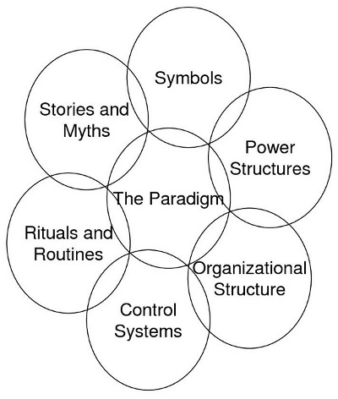
Exercise: map the KM-friendliness of your environment
The Paradigm: What the organization is about; what it does; its mission; its values.
Control Systems: The processes in place to monitor what is going on.
Organizational Structures: Reporting lines, hierarchies, and the way that work flows.
Power Structures: Who makes the decisions, how widely spread is power, and on what is power based?
Symbols: These include the way the organization is visualized (e.g. logos) or the language used to describe it (e.g. jargon).
Rituals and Routines: Management meetings, reports and so on may become more habitual than necessary.
Stories and Myths: build up about people and events, and convey a message about what is valued within the organization.
Johnson & Scholes' Cultural Web (1988)
Notes:
Trainers notes
Link from last slide: … so how KM-friendly is your environment? We will do an exercise to find out.
Introduce Johnson and Scholes Cultural Web diagram, which we’ll use to analyse the “KM friendliness” of your environment. Briefly go through what is meant by each circle.

Slide 6
Exercise: map the KM-friendliness of your environment
Take 20 minutes to go through individually the questions on the hand-out (page 1) and write down as keywords the dominant factors next to the circles (page 2)
Take another 5 minutes to ask yourself the analysis questions at the bottom
Did you learn anything interesting?
Johnson & Scholes' Cultural Web (1988)
Notes:
Trainers notes
See Unit 2 Exercise notes.

Slide 7

Different forms of leadership
Knowledge leadership: not necessarily from the top: KM leader role can be anywhere in hierarchy
Lead by example: KM champions
KM leaders: identify, encourage, groom KM champions
KM leaders: also influence management
Build relationships both ways
Notes:
Trainers notes
Link from last slide: KM needs leaders and champions in order to thrive, especially if the environment isn’t particularly KM-friendly
You can stress that a KM leader can be an official role in an organisation (e.g. KM Officer) or an unofficial one, where someone strongly believes in this way of working and – through his/her actions – is being a KM leader and bringing about change.
Build relationships both ways: i.e. up and down the hierarchical ladder.

Slide 8

KM leadership
Best case scenario:
One (or more) knowledge leader(s)
One (or more) knowledge champion(s)
The support of top and middle management
A handful of enthusiastic co-workers
A framework for action
Notes:
Trainers notes
Link from last slide: in a perfect world, this would be the best case scenario…
A framework for action: we will talk about action frameworks in Unit 3.

Slide 9

KM leaders/champions
They can make three important contributions:
Advocacy: spreading the KM message
Support: acting as representatives for KM initiatives or activities
Knowledge Brokering: linking colleagues to knowledge and information resources outside their immediate context
Notes:
Trainers notes
Link from last slide: so what kind of contributions can KM leaders and champions make?
These are basically the overall roles.

Slide 10

Main challenges to KM
Organisation/structure: hierarchical, top-down decision-making
People: aversion to change, lack of incentives
Routines/procedures: strategic or planned work isn’t reality, ad-hoc
Capacities: lack of human resources, skills, understanding
Technology: access, costs, skills
Notes:
Trainers notes
Link from last slide: so what are the challenges that KM leaders are up against? We have already talked about the issues with top-down structures but there are other big challenges that need to be tackled, such as …

Slide 11
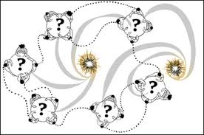
World Café - Overcoming KM challenges
Table discussions
3 rounds of approx. 15 minutes
Brainstorm ideas during each round
Move to a different table when the bell rings
Each table has a host and a question
Scribble ideas on tablecloth
Notes:
Trainers notes
Link from last slide: in order to unpack some of these challenges and try to come up with ideas to overcome them, we will be doing what is called a World Café…
See Unit 2 Exercise notes.

Slide 12
Questions? Comments?

Slide 13

Making the case: benefits of KM
Operational benefits: retrieving knowledge faster, gaining access to expertise
Functional benefits: minimizing duplication and “reinventing the wheel”, sharing knowledge across organisational boundaries
Organisational benefits: reducing costs, increasing innovation and visibility
Stakeholder benefits: better collaboration and enhanced coordination
Strategic benefits: importance in achieving impact or results
Notes:
Trainers notes
Link from last slide: …so we have discussed some of the main challenges to KM, let’s look at the benefits. We want to start to build a KM business case, to make others aware and show them what KM can do for them.
In each organisation, these can be different.

Slide 14
Promoting the benefits of KM
Different organizations can put more or less strategic emphasis on each benefits
“Sell” those most important to your management
Include quantitative measurements or estimates wherever possible (e.g. a KM initiative resulting in time savings, how much time would be saved if done other ways)
Notes:
Trainers notes
Link from last slide: …your context is crucial when promoting the benefits of KM.
Include quantitative…: it’s important to be as concrete as possible when promoting benefits.

Slide 15
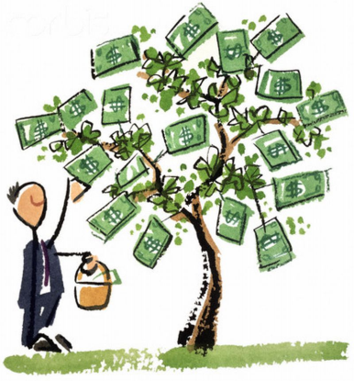
More potential quantifiable benefits
Reduced communications costs: more efficient internal dialogues, also from better use of technology
Reduced consultancy costs: from decreased need to seek external expertise
Reduced production costs: the other side of increased productivity and decreased duplication
Notes:
Trainers notes
Link from last slide: here are some more benefits that can be quantified…
Reduced communications…: of course, this is if your KM initiatives use technology.
Reduced consultancy…: same here, this is if your organisation hires consultants.
Reduced production…: if your organisation publishes content, either electronic or hard copies.

Slide 16
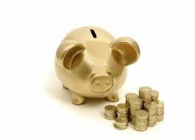
KM-related costs
KM costs vary greatly depending on the type of initiatives and activities which are planned
The costs usually fall into the following categories:
  Human resources/staff
  IT or ICTs
  Events/trainings/workshops
Notes:
Trainers notes
Link from last slide: …but it is also important to be able to cost out the KM expenditures in your context.

Slide 17

Assessing threats, identifying potential weaknesses
When making a case for KM, it is important to think about the risks associated
Identifying weaknesses and threats will put you in a much better position to plan for contingencies
You should also – of course - list all the positive aspects, the strengths and opportunities
Notes:
Trainers notes
Link from last slide: … beyond the costs, it is important to know what the other potential issues or stumbling blocks can be.
If you are trying to bring in KM, you might get a lot of push-back from management and colleagues. It’s good to think through what their potential arguments against KM might be.

Slide 18

Usefulness of SWOT analysis
Ask yourself these questions:
What are likely to be the biggest STRENGTHS of our KM case?
What are likely to be its biggest WEAKNESSES?
If pitching the KM case goes well, what are likely to be the biggest OPPORTUNITIES that it will bring to us?
And what are the biggest THREATS to it not going well?
Notes:
Trainers notes
Link from last slide: … and one of the best ways to identify the positive and the negative aspect is by asking yourself the following SWOT analysis questions
Doing a SWOT analysis helps you to be better prepared.

Slide 19

The KM elevator pitch
Good to prepare a KM “elevator pitch” as a promotional tool
Nick Milton from Knoco has a 3 question KM sales pitch that we should be able to do in 2 minutes.
So tell me:
  What's your point about KM?
  What's in it for me?
  What do you want me to do?
Notes:
Trainers notes
Link from last slide:… once you are armed with your SWOT results, you can come up with a KM promotional tool, which we are calling the “elevator pitch”
Explain that the term “elevator pitch” come from a situation where a person is in an elevator with a higher-up and has the time it takes for the elevator to get to his/her floor to explain or “sell” something in a way that is engaging to the listener.

Slide 20
Exercise :The KM elevator pitch
Think of your KM pitch and write down ideas
Find a partner and pair up
Share your “elevator pitches” and provide feedback
Find two more people and form a group of 4
Share your same “elevator pitches” once again and provide feedback
Who wants to share with the whole group?
Notes:
Trainers notes
Link from last slide:… here is how we are going to do the elevator pitch…
See Unit 2 Exercise notes.

Slide 21
Nick Milton’s example
"Knowledge Management is something new we are trying - a systematic way of ensuring that people at all levels have access to the knowledge they need to make the right decisions. It can save you time and money, save you from repeat mistakes made elsewhere in the past, and help you deliver a better result. I hope that you can work with me and support KM activities that can add some real value to our work."
Notes:
Trainers notes
Show this slide only if necessary as an example once people have done their pitches.

Slide 22
Questions? Comments?

Slide 23
Credits
This learning material was prepared by Lucie Lamoureux for CTA.
The Technical Centre for Agricultural and Rural Cooperation (CTA) is a joint international institution of the African, Caribbean and Pacific (ACP) Group of States and the European Union (EU). CTA operates under the framework of the Cotonou Agreement and is funded by the EU. For more information on CTA, visit www.cta.int
Disclaimer
This work has been made with the financial assistance of CTA. However, it remains under the sole responsibility of its author and never reflects CTA's nor the European Union's opinions or statements whatsoever. The user should make his/her own evaluation as to the appropriateness of any statements, argumentations, experimental technique or methods as described herein.
Copyright notice
Reproduction and the dissemination of these modules and supporting materials is encouraged under the terms of the Creative Commons Attribution License (https://creativecommons.org/licenses/by/4.0/legalcode), provided that appropriate acknowledgement is made:
  – of CTA's copyright, in accordance with the license Creative Commons 4.0, by including the name and the title of the article or chapter,
  – and that CTA's or the EU's endorsement of authors' views, products or services is not implied in any way, by including the disclaimer.
March 2015

