Slide 1





RESTORE
Launching WORkshop
Nov 08, 2024
Bojia E Duguma
EVA President
Notes:
On behalf of EVA executive board, I am very pleased to attend The Restore launching event
I am grateful to HE Dr Fikiru Regassa, for witnessing the RESTORE launch,
Mr Teressa – The EU for your generous and continued support,
Theo, ILRI Team, Regional Team, EVA secretariat office team for all the hard work to bring this project to a reality.

Slide 2

Background
EVA is One of the oldest and largest professional associations (2000) in the MOA
EVA remains a standing member in the National livestock policy development process:
[Dr Berhe G., Dr Berhanu A., HE Dr Fikru R.)
… ensuring quality veterinary services fostering partnerships with Gov and NGOs
Recall that the European Union’s support for the animal health of Ethiopia goes way back
RESTORE Implementation while Animal Health and Welfare Proclamation unlocks the ingrained challenges and increases the uptake of outcomes of our partnerships
Notes:
EVA had and continued to have stake in the livestock policy development of Ethiopia.
Dr Berehe – a dedicated professional who paved the way for the establishement of Ministry of Livestock Resoruces - Before moving to FAO Head quarters as Director of Animal Health and Production Division. We also had Dr Berhanu – at various Professional front - and and now HE Dr Fikru R – State Minister – leading the Livestock and Fisheries Development of sector of Ethiopia – spearheading and championing the Lemat Tirufat initiatives …

Slide 3

Integration of Animal Health (AH) in the livestock Value chain (LVC – PPD Project (2013)
Producers (pastoralist)
Livestock Market (Traders)
Distributors (Traders)
Processors (Slaughter houses)
Exporters, Consumers
AH
AH
AH
AH
AH
Notes:
Sanitary Mandate Contracting Scheme (SMCs)
Control of diseases (PPR, SGPox)

Slide 4
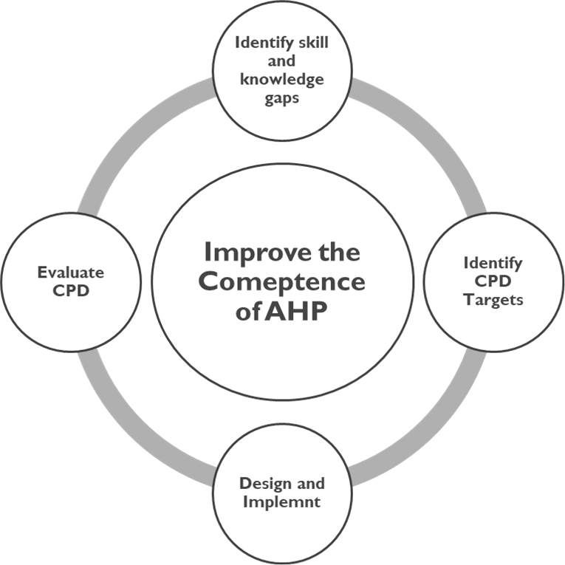

HEARD project: (Health of Ethiopian Animals (2019 – 2023) for rural development)
CPD Programmes
PPP models

Slide 5

Restore (Restoration of Livestock services in conflict and drought-affected areas of Ethiopia)
(July 24 – July 28)
Lead - ILRI – Theo and ILRI team, in partnership with EVA, Regional govt’s
Outcome: Sustained Recovery of the livestock system in target areas
Intermediate outcomes:
  Restoration of Livestock services delivery systems
  Integration of Public–Private Veterinary Services
  Improved Health and Food safety standards
  Improved fodder availability
  Improved hide and skin quality
Notes:
implementation comes at the time when the Animal Health and Welfare Proclamation is about to be endorsed

Slide 6
EVA Restore focus areas
1) Policy support:
    VSB, CPD framework, Rationalization Road Map
2) Fostering professional competency (CPD Training)
3) Evidence Generation: Policy support research
4) Upscaling PPP for better service delivery

Slide 7
EVA’s Expectations from Restore and beyond
Institutionalization and Operationalization of CPD Programmes
Establishment of Sustainable and Scalable PPP models
Strengthening Veterinary Education and Research (Forum)
  Animal Welfare Working Group (WTS)
  Equine Education Forum (SPANA, Equine Charities)
Establishing Public Private Partnership Forum
One Health One Welfare One Planet forum (USAID?) - EVA

Slide 8
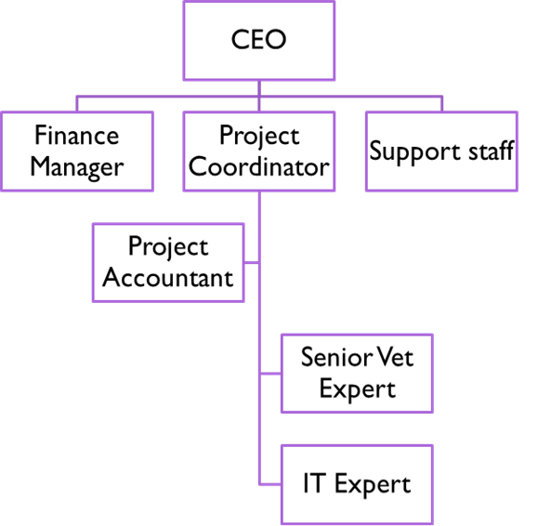
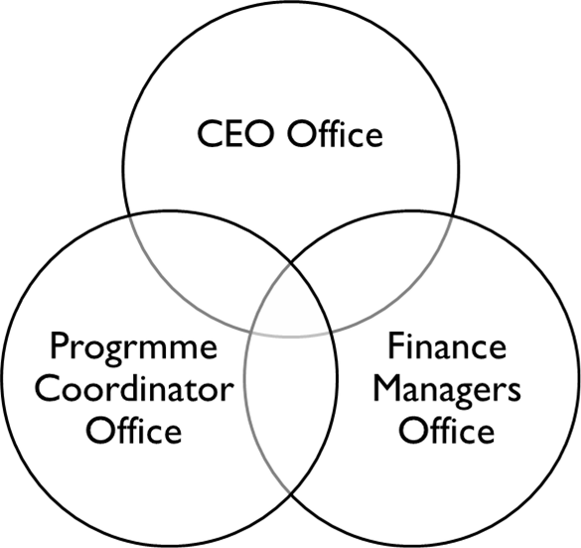

EVA’s readiness to execute the project

Slide 9
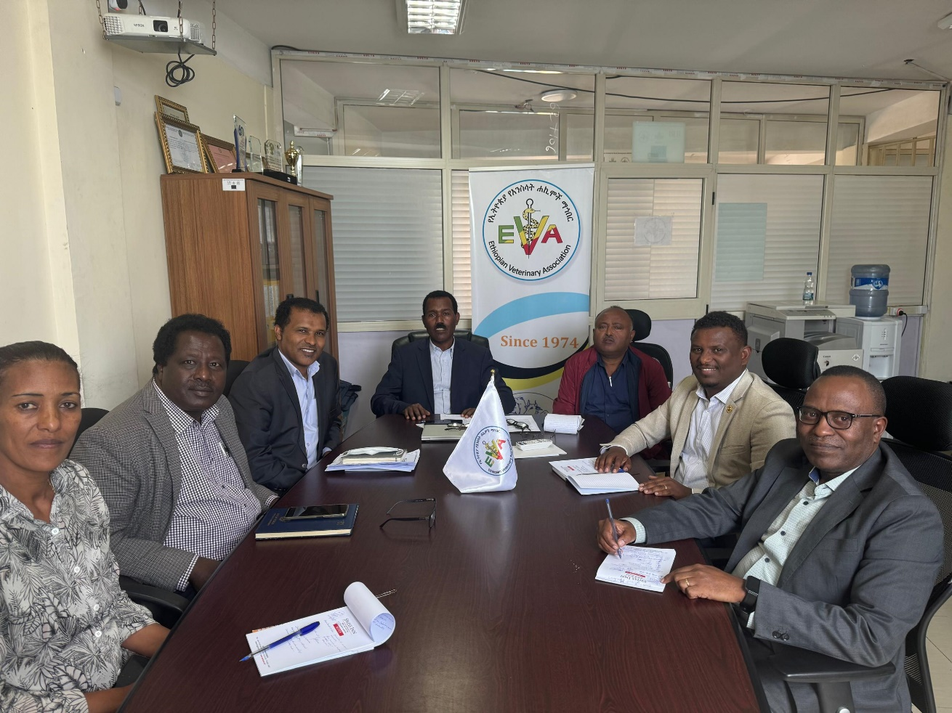
EVA executive board – Project management
Strengthening strategic partnerships with partners and stakeholders
Close follow-up of Project management
Ensuring compliance meeting donor and partner expectations
Notes:
EVA executive board will ensure effective planning, implementation

Slide 10
Thank you

