Slide 1
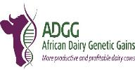
The African Dairy Genetic Gains program (ADGG)
Responding to Dairy Farmers’ Needs and Enabling Multiple Actors’ Capacities through Genetic Innovations
Okeyo A.M., Mrode R., Ojango J.M.K., Ekine C., Gebreyohanes G.
CTLGH phase 2 Launch
Nairobi, Kenya, 27th September 2022

Slide 2
The Challenges facing resource poor systems:
Farmers do not have access to productive and adapted livestock seedstocks that best suit their production systems
Inadequate access to various services and inputs, hence no sustained productivity gains
Farmers have very limited access to information to enable them extract optimum benefits for their livestock enterprises
No systematic and sustainable breeding or selection takes place

Slide 3
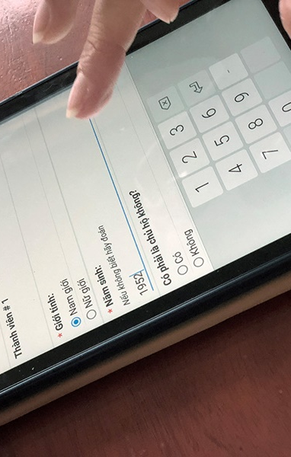
About ADGG
ADGG’s design enables co-identification the key challenges facing smallholder dairy systems and co-creates solutions to address these through innovative application of genomic and digital information technologies:
. Phenotyping across a wide range of very dispersed smallholder farms
. Plugging-in and crowd-sourcing of data from various sources
ADGG’s work includes driving improvements in national breeding schemes by producing and publishing breeding values for improved productivity and adaptation, based on performance data collected in the production environment
ADDG’s work is enabled by collaboration with key actors including Advanced research Institutions (ARIs), global and national dairy genetic companies, farmer organizations, national livestock seed regulators, national agricultural research and extension systems(NARES) to realize sustained genetic gains and scaled outcomes, which has been almost impossible to attain prior.
Notes:
My daughter asked me a question which I would like to ask you…..why do cows have bells on their necks? Incase their horns don’t work.
ADGG is designed to address things kthat are not working (key challenges) in the SHFS by innovatively coupling digital information technologies and the science of genomics. Mobile devices are used to capture data from these herds which are very dispersed and the digital data platform enables crowdsourcing of data from different sources.
ADGG’s one of what ADGG does is publishing breeding values to drive national breeding schemes using performance data captured in the actual production environment for improved productivity and adaptation.
ADGG is able to achieve her objectives which prior to this time has been almost impossible by working with several global and international partners.

Slide 4
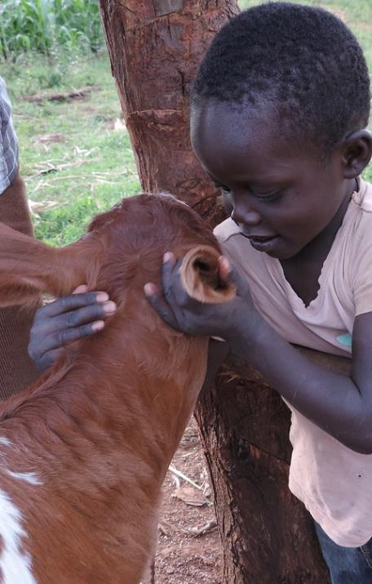
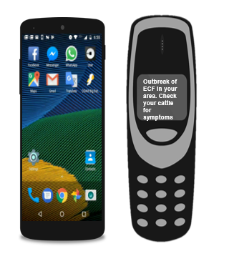
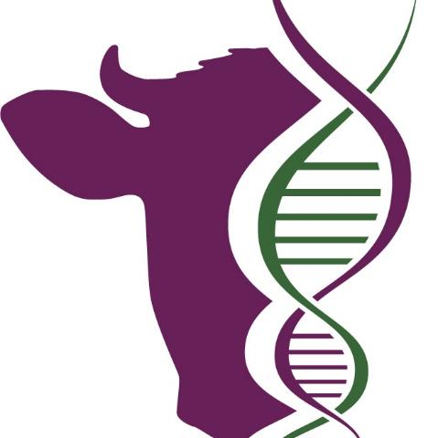
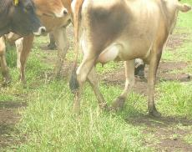
ADGG approach
Adapted, and Genetically superior "seed” animals for local production systems
Innovative coupling of digital technology and genomics
Genotypes adapted to local agro-ecology
Target appropriate genotypes to the agro-ecology
Use young bulls with a focus on production & adaptation
Local feed/fodder resource use efficiency
Economically and environmentally relevant Traits
Accelerate on-farm genetic gains
Milk Yield
Milk composition
Weight
Reproductive Performance
Heat tolerance
Survival rates
Lactation persistency
Mastitis incidences
Disease tolerance
Methane emission
Adaptability Indices
Digital platforms for on-farm performance tracking
Decision-support and Farmer-to-Farmer performance benchmarking
Smart use of records & genomics tools for selection and AI service delivery

Slide 5
Linkages with CTLGH
Scalable digital platform ready to interface with others, expandable to support several livestock species
  Presents opportunities for crowd-sourcing phenotypic data and genomic data from dispersed across locations also enhances data sharing across many disciplines/institutions and their effective management
Synergy with CTLGH:
  Co-hunt for genetic variants associated with specific aspects of productivity and resilience which may subsequently be incorporated into breeding schemes, edits of naturally occurring mutations, delivery through synchronization & emerging embryo technologies, surrogate sires)
Enable in-depth cohort studies & incorporation of disease/resilience traits into selection indices definitions
Co-creation of human and infrastructural capacities at all levels, including through AABNet
Links to global dairy genomic resources
Partnerships with global genetic companies (URUS, Genus)
    Generating robust genetic/genomic evaluation results, thus making local AI centers able to better compete with the global counterparts (Bull suitability indices)
    Initial steps for inter-country genetics evaluation platforms and eventually to Interbull

Slide 6
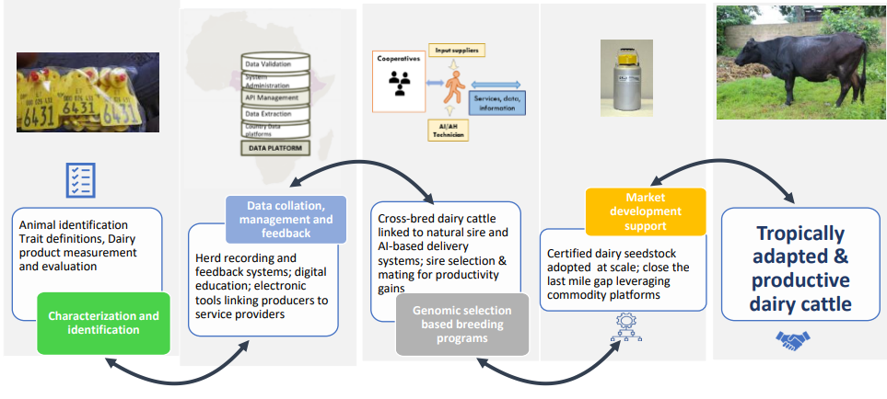
ADGG framework for sustainability

Slide 7
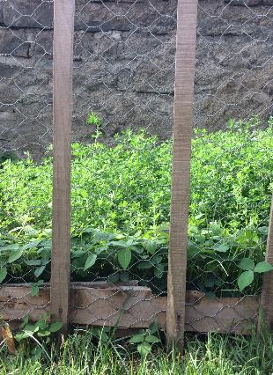
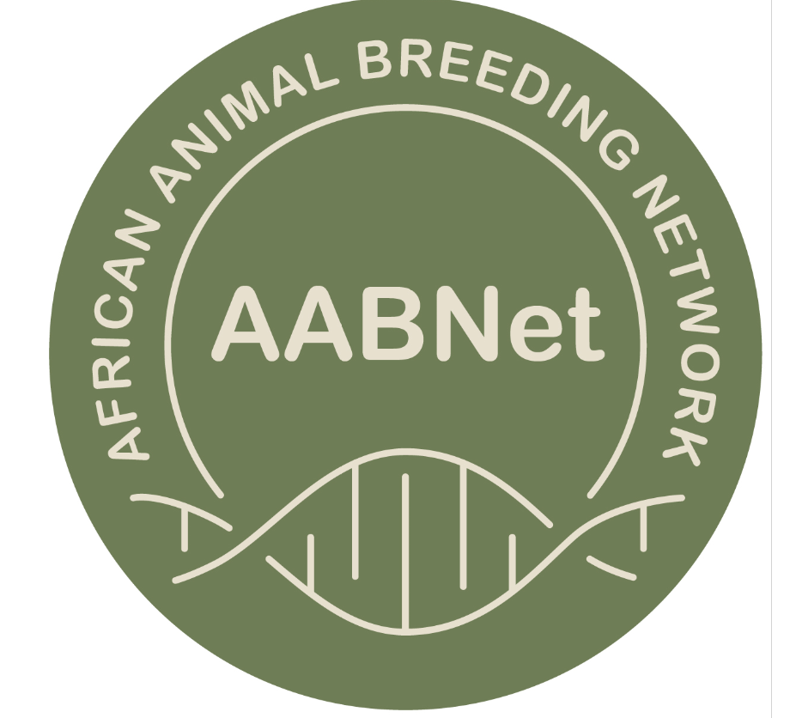




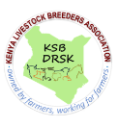
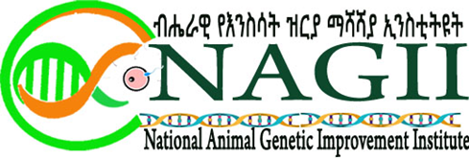








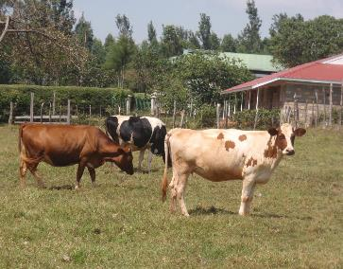



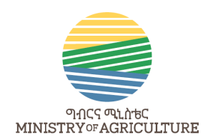

Partners
National/regional Institutions/govts.
Dairy Farmers & Farmer organizations

Slide 8
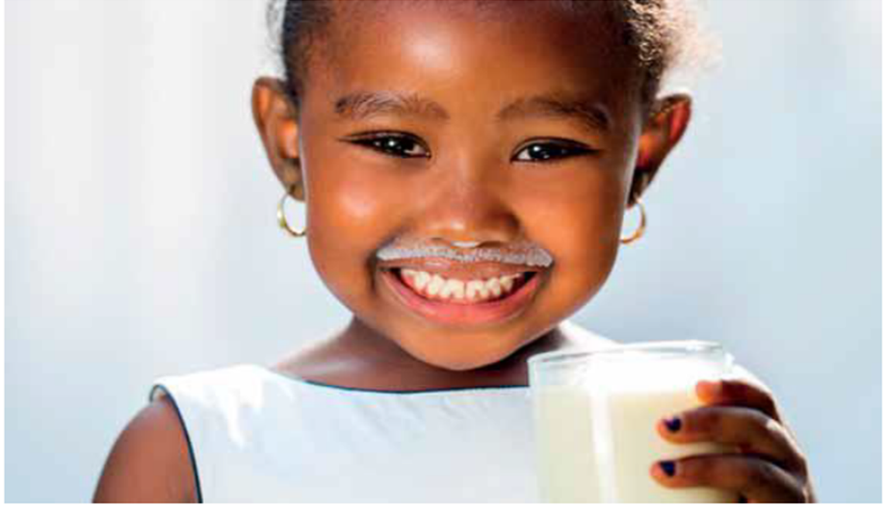
THANK YOU
Thank you for your attention

