Slide 1
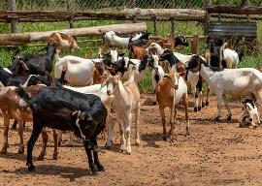
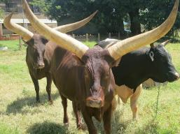
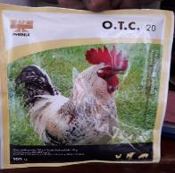
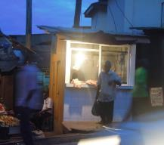







#BuildUganda
Boosting Uganda’s Investments in Livestock Development (2019-2023)
Introducing the Veterinary Public Health (VPH) component
Jolly Hoona (MAAIF), Annie Cook (ILRI), Anne Mayer-Scholl (BfR), Constanze Böning (VSF-G), Tinega Ong’ondi (VSF-G), Kristina Roesel (ILRI/FUB), James Bugeza (NaLIRRI)
#BuildUganda Stakeholder meeting, Kampala, Uganda
7 June 2019

Slide 2
Why this component
VPH new focus in the veterinary sector in Uganda (OIE GAP analysis, 2011)
in the past focused mostly on animal health at the production level
now expanded to the field of food safety and consumer protection
animal production slowly intensifies, awareness of the consumers increases with improved education, and export of local meat produce increases
→ OIE recommendation: The infrastructure for slaughtering has to be improved, and personnel in the field of meat (and generally food) inspection needs to receive targeted training.
For more information, see Terrestrial Animal Health Code, Chapter 6.1 “The role of Veterinary Services in food safety”
bulking

Slide 3
What we want to achieve
Objectives → Outcomes
Training
  Meat handlers on good hygienic practices (slaughter house personnel, butchers, meat transporters)
  Meat inspectors on carcass inspection and mobile reporting
  Public engagement of consumers
  Laboratory personnel (GLP and quality assurance)
  Consumers less exposed to food borne diseases
  Reduce occupational risks
2. Slaughterhouses as sentinels for zoonotic disease
→ Improved occupational health of meat handlers
→ Risk-based surveillance of zoonotic diseases in animals at slaughter

Slide 4
Who will benefit
Reduced burden zoonotic diseases in the Ugandan population
Targets:
slaughter personnel, butchers, meat transporters, meat inspectors
Beneficiaries:
Consumers
Slaughter personnel
Butchers
Meat inspectors
Public health sector
Reduced prev./inc. of zoonotic diseases
Reduced exposure to zoonotic diseases
Changes in capacity and behaviour of people
who prepare food
Interventions targeted at these outcomes could improve the quality and safety of food produced and available on the market.
Will these translate into impacts on health outcomes?
Changes in capacity and behaviour of meat processors, or retailers
Changes in capacity and behaviour of farmers and livestock keepers
Changes in capacity and behaviour of input supplies
© Nancy Johnson

Slide 5
What we will do
Training of meat handlers on Good Hygienic Practices
Baseline assessment: meat handlers’ knowledge and practices; hygiene indicators (cc), pathogen (Salmonella, Staph)
Consolidate and adapt existing materials for training of butchers
Assess suitability of consolidated training materials and delivery mode with stakeholders
Deliver the training
Endline study to assess success of the intervention
Curriculum for trainers and trainees for use by the private and public sector
Slaughterhouses as sentinels for zoonoses
Mapping slaughterhouses through key informants and GIS
Data review – published and unpublished literature
Prioritization of disease in slaughterhouses/ identification of critical control points – KII and FGD with vets, meat inspectors, public health staff
Ethnographic observation of slaughterhouses
Biological survey in animals and humans

Slide 6
Slaughterhouses as sentinels for zoonoses
Animal study | Human study
seroprevalence of zoonotic pathogens* in animals at slaughter | seroprevalence of zoonotic pathogens* in meat handlers
map the seroprevalence of zoonotic pathogens* per region | identify the risk factors for seropositivity to zoonotic pathogens in meat handlers
determine the carriage of pathogens in animals at slaughter (PCR) | assessment of training intervention on knowledge and hygiene
model the risk of pathogen transmission to workers

Slide 7
Pathogens to be studied
Cattle | Goats/sheep | Pigs | Meat handlers
M. bovis |  |  | TB
Taenia
 |  | Cysticercosis | Cysticercosis
Rift Valley fever |  |  | RVF
Brucellosis |  |  | Brucellosis
Leptospirosis
Non-typhoidal Salmonella, Staph. aureus (training)
 |  | Hepatitis E
 |  | Strep. suis

Slide 8
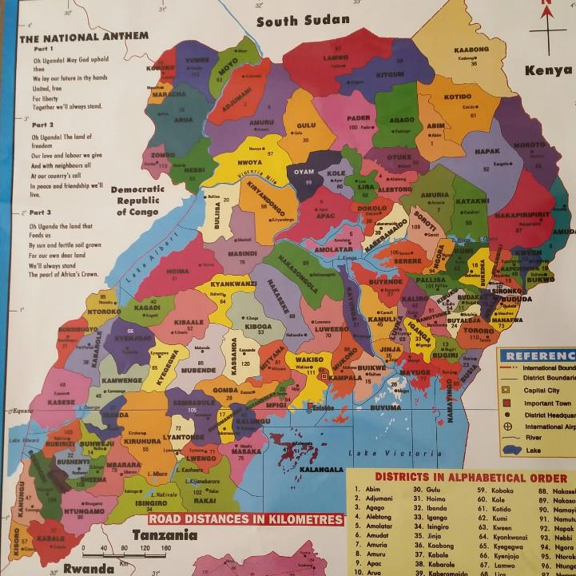
VPH
Arua
Lira
Soroti
Mbale
Kampala

Slide 9




Current partners
Any private sector stakeholders (slaughterhouses) interested in partnering?

Slide 10



Acknowledgements
This work is financed by BMZ
It is implemented by ILRI with MAAIF, BfR, VSF-G and FUB
It contributes to the CGIAR Research Programs on
Livestock and on Agriculture for Nutrition and Health

Slide 11
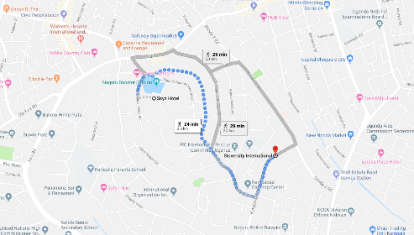
THANK YOU! WEBALE NYO!
International Livestock Research Institute (ILRI)
c/o Bioversity International
Plot 106, Katalima Road, Naguru
P.O. Box 24384, Kampala, Uganda
Phone: +256 392 081154/5
Email: ILRI-Uganda@cgiar.org

