Slide 1







Quantitative microbial risk assessment of salmonellosis from chicken and pork salad consumption in Cambodian households
SAFE FOOD, FAIR FOOD FOR CAMBODIA PROJECT
Rortana Chea, Sinh Dang-Xuan, Hung Nguyen-Viet, Johanna Lindahl, Delia Grace, Fred Unger, Sothyra Tum, Chhay Ty and Sofia Boqvist

Slide 2
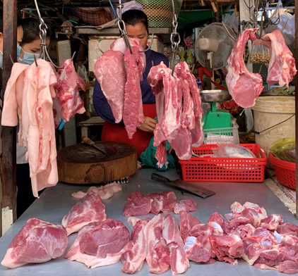
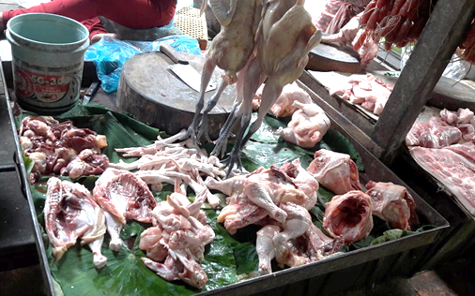
Key facts
Chicken and pork salad dishes are commonly consumed in Cambodian households
Salmonella spp. is one of the top 4 key global causes of diarrheal diseases, and often contaminates chicken meat
Risk captures likelihood and magnitude of health consequences (i.e., illness)

Slide 3
Chicken value chain in Cambodia
Slaughterhouse
Slaughter ,
Traditional Markets/Live bird
Traditional market sell chicken meat
Store in refrigerators and cook when need
or some markets sell live chicken, they can slaughter at time customer buy
Obtain,
Transport,
Hold,
Store few hours in room temperature (t=25 – 37 C), before cooking
Transport
Household
Vans, carts, yards
Prepare
Store
Consume
Re-use leftovers
Source of chicken
Intensive broiler farm,
Small and medium holder,
Backyard

Slide 4
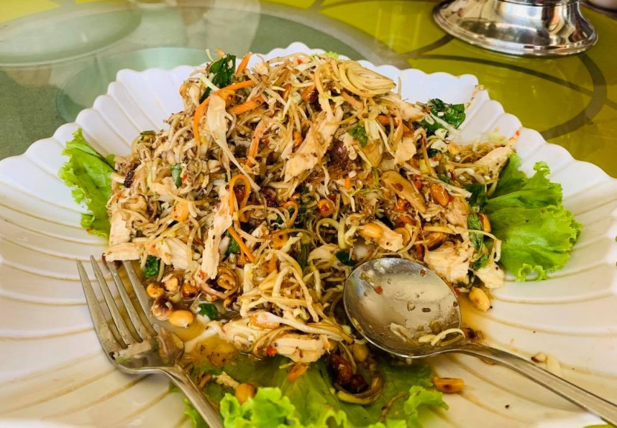
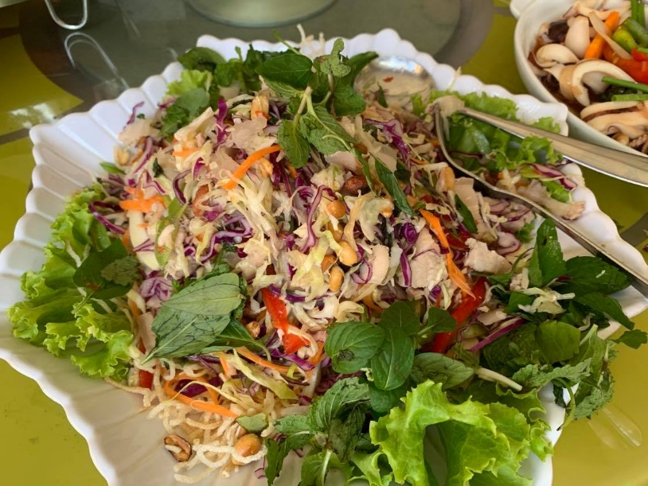
Objective
To develop a QMRA model and estimate the risk of salmonellosis due to consumption of contaminated chicken and pork salad prepared at Cambodian households over the course of one year

Slide 5
Develop QMRA model
Hazard Identification
Salmonella: leading foodborne pathogens cause foodborne illness (e.g., diarrhoea)
Chicken meat and pork are common sources and main harbours of Salmonella.
The concentration of Salmonella in chicken and pork sold in markets
Nation wide survey in 25 cities and provinces in Cambodia
Analyses | Chicken | Pork
No. of Salmonella positive samples (%) | 84 (41.7) | 85 (42.3)
Average MNP/g | 16.7 | 17.3

Slide 6

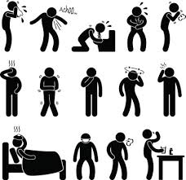
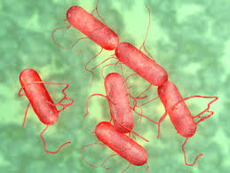
Develop QMRA model
2. Hazard characterization
  Salmonella grow and die off (market/transportation/home/cooking conditions)
  Dose-response model
The assessment of dose-response from Salmonella infection, Beta-Poisson: Haas et al. (1999): P_{inf} = 1 – (1 + d/β)-α
P_{inf} is the probability of infection, d is the dose ingested
α and β are the parameters of Salmonella in dose-response (Tenius, 2010)

Slide 7
Develop QMRA model
3. Exposure assessment
Human exposure pathways for Salmonella, estimates the quantities (dose) consumed
The frequency of meat consumption, the quantity of salad consumed
Household survey or Participatory (Focus group discussion-FGD)
Market survey in 25 cities and provinces
The concentration of Salmonella in chicken and pork sold in markets.
Handling practices at household level, and define potential scenarios of risk exposure
Salmonella cross-contamination experiment

Slide 8
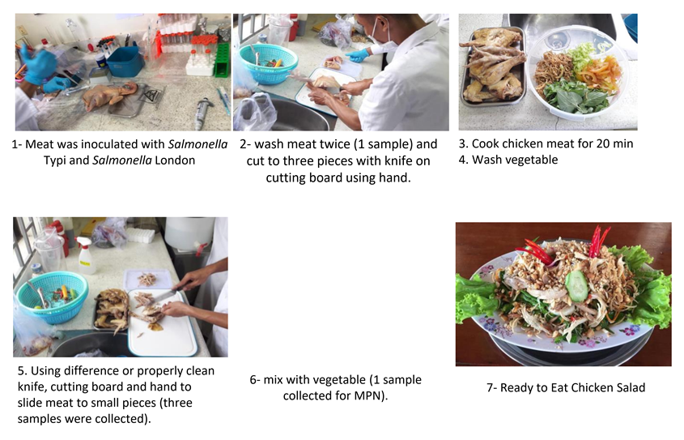
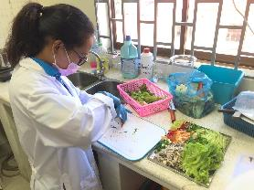
Develop QMRA model
3. Exposure assessment
Handling practices at household level, and define potential scenarios of risk exposure
Salmonella cross-contamination experiment

Slide 9
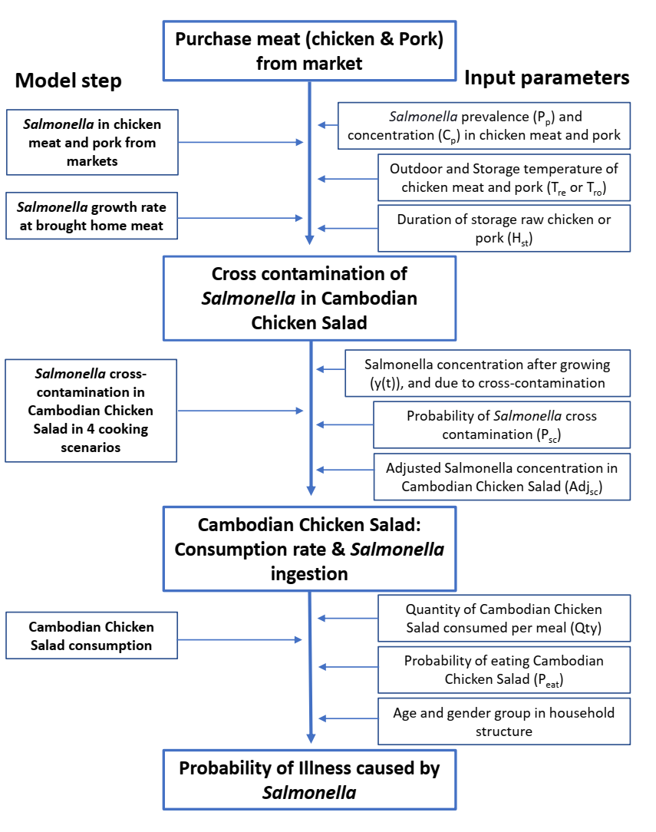
4. Risk characterization
QMRA model to combine data from literature with collected field data/information in Cambodia

Slide 10
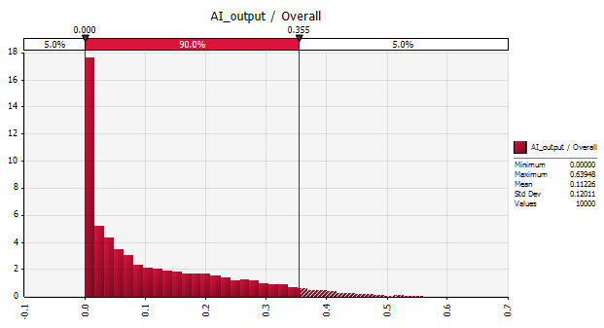
Estimate risk of salmonellosis
4. Risk characterization
The annual incidence rate of human salmonellosis due to chicken and pork salad consumption by age and gender groups in Cambodia
Age and gender groups | Estimated annual salmonellosis incidence rate (Mean (90% CI)) (%)
 | Consume chicken salad only | Consume pork salad consumption only | Consume chicken and pork salad
Overall | 11.15 (0 ̶ 35.06) | 4.0 (0 ̶ 21.3) | 14.5 (0 ̶ 33.5)
E.g., 1 out of 10 chicken salad consumers are at risk of salmonellosis annually
CI: Confidence interval

Slide 11
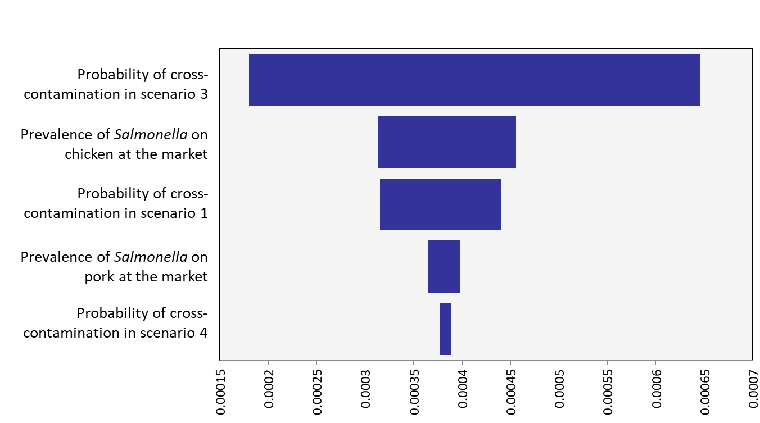
Estimate risk of salmonellosis
4. Risk characterization
Sensitivity analysis of influence factors on daily salmonellosis incidence due to consuming pork and chicken salad
The factors most influencing the estimate were probability of cross-contamination in preparing salad chicken
Followed by the prevalence of Salmonella on chicken in the markets

Slide 12
Conclusions and recommendations
This study is one of the first QMRA conducted for food safety in Cambodia
The risk of salmonellosis due to chicken and pork salad consumption were estimated and appeared to be high. One out of 10 chicken salad consumers are at risk of salmonellosis annually
Control measures may include improving the safety of retailed chicken and pork at markets and improving hygiene practices and equipment during salad preparation at household.

Slide 13
Thanks for your attention

Slide 14

THANK YOU

