Slide 1
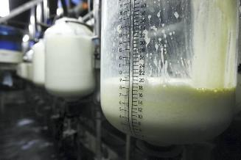
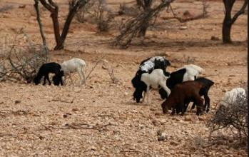
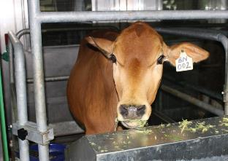






Current status of greenhouse gas emissions from the livestock sector in East Africa: A case study of Kenya
Daniel Korir
Mazingira Centre, ILRI; University of Melbourne
Conference on Africa’s Agricultural Productivity (CAAP), Nairobi, 8 October 2019

Slide 2
Introduction
Climate change is the greatest threat to humanity in the 21st century (Watts et al 2015).
Increasing greenhouse gases (GHGs) in the atmosphere: carbon dioxide, methane, nitrous oxide and fluorinated gases.
These gases have the capacity to absorb infrared radiation and re-radiate it back to earth’s surface.
Increase in earth surface temperatures–global warming.

Slide 3
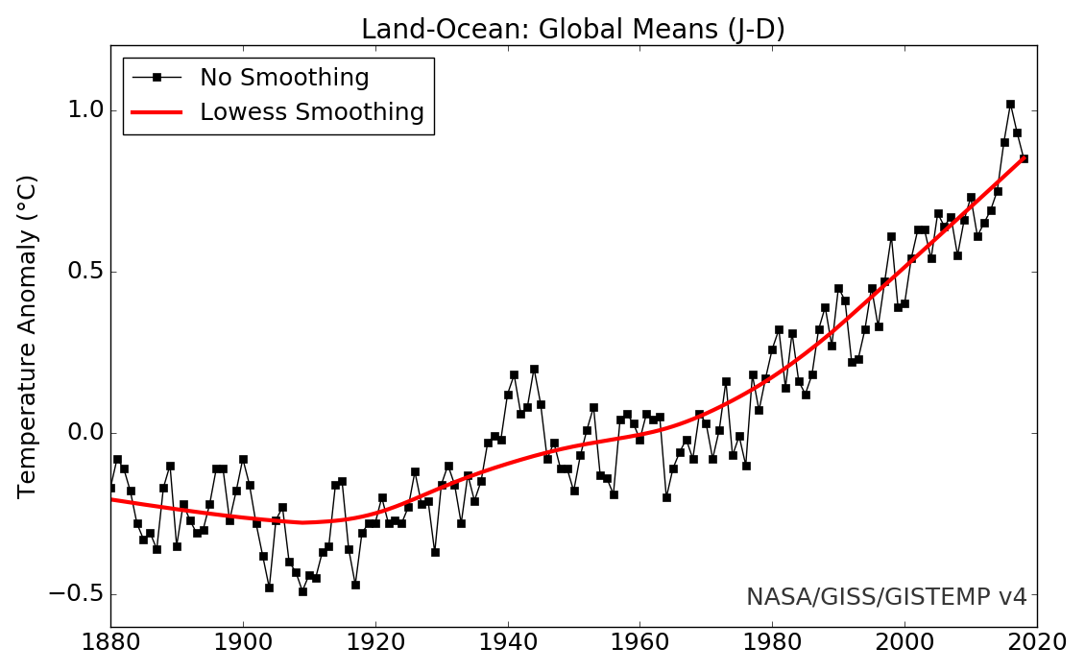
Increase in earth surface and ocean temperatures
CO₂ (ppm) 280 430
data.giss.nasa.gov/gistemp/graphs/graph_data/

Slide 4
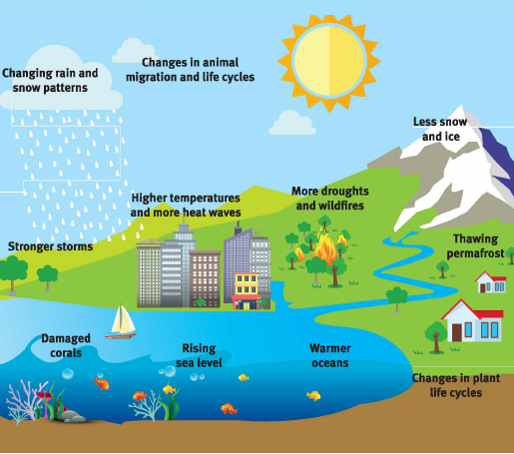
What are the effects of climate change?
If the current increase of GHG emissions continue, temperatures will rise to 1.5°C above pre-industrial levels by 2040 and 2°C by 2100*
Climate change will impact regions unevenly but least advanced countries will be particularly affected.
https://www.joboneforhumanity.org/global_warming
* Masson-Delmotte, et al., 2018

Slide 5
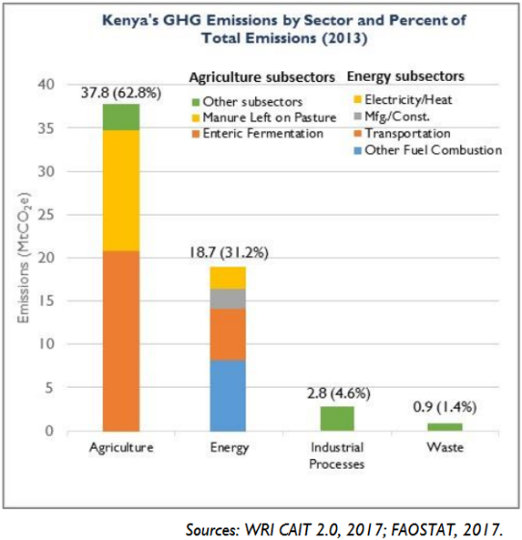
GHG emissions per sector
Livestock account for about 14% of total GHG globally; in Kenya, about 21%

Slide 6
Regional proportions
In sub-Saharan Africa, livestock are directly responsible for more than 70% of agricultural emissions, with enteric fermentation (up to 78%) by far the most important sources (Tubiello et al. 2014).
African ruminants account for estimated 14% of world’s enteric methane emissions (Tubiello et al. 2014) – about 5% of global meat production
Highest population growth in Africa and Asia –> drive demand for protein (meat and milk) of animal origin –> drive GHG emissions

Slide 7
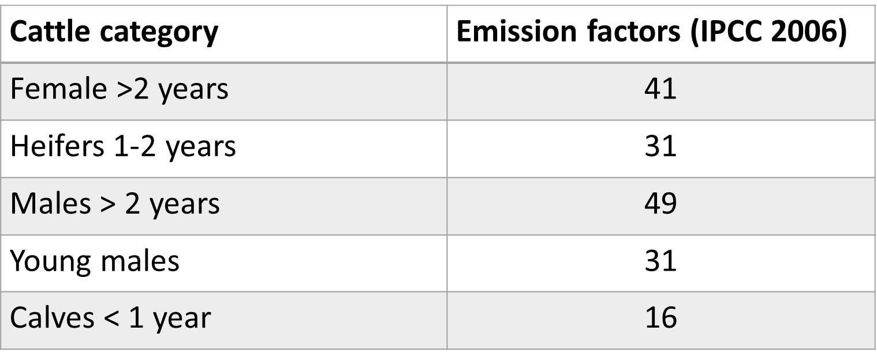
How are these figures arrived at?
Current GHG emissions data reported are based on IPCC Tier 1 methodology.
For enteric methane: National herd size per category *emission factors:
Accuracy? Sensitivity? Locality?
Units: kg per head per year

Slide 8
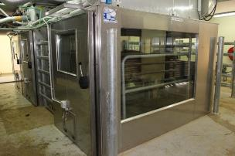
Current status of measurements
Lack of data on productivity of livestock systems in the region.
With the need to improve accuracy of reporting and intervention testing, there is the need to do more actual measurements.
Mazingira Centre (mazingira.ilri.org) (ILRI) is the only facility in the whole of sub-Saharan Africa with the capacity to carry out enteric methane measurements based on gold standard methodology (respiration chambers).

Slide 9
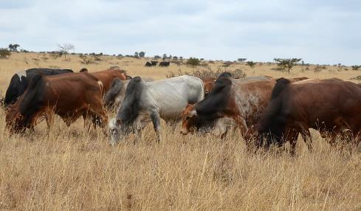
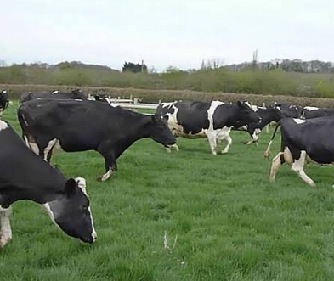
What do we know about the current EFs used?
The emission factors are based on research done in production systems in other regions that are likely to vary in the following ways with our systems:
Animals are not always fed at production levels–feed intake
More fibre/less digestible diets
www.shutterstock.com
Tropical diet
Temperate diet

Slide 10
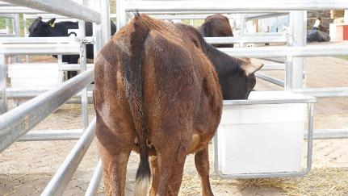
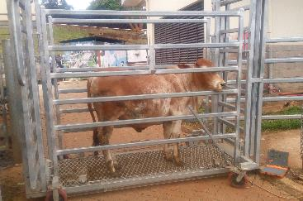

What have we done?
Exp.1: Restricted feeding trial was conducted with Boran steers.
Intakes was restricted at 40%, 60%, 80% and 100% of their maintenance energy requirements.
Intake, weight change and enteric methane production was measured using respiration chambers.
Intake measurements
Live weight change measurements
Enteric methane measurements

Slide 11
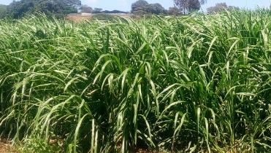
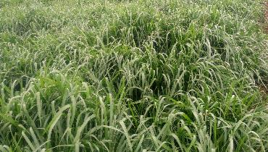
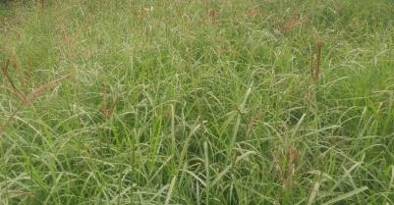
What have we done?
Exp. 2: Commonly grown grasses in smallholder set up in Kenya (Napier, Rhodes and Brachiaria) was fed to Boran steers in a controlled feeding trial.
Voluntary intake, weight gain and enteric methane production measured.
Napier
Brachiaria
Rhodes

Slide 12
Results
Exp1: Up to 12% increase in enteric methane at lower level of intake (40%) compared to maintenance intake (100%).
Exp2: Conversion found to be on the higher side of IPCC range (6.5±1%)
Parameter | Rhodes | Napier | Brachiaria | Feedlot values*
DMI (kg/100 kg LW) | 2.7ª | 2.5ª | 2.6ª | 3.0
OM digestibility (%) | 60.3ª | 64.0^{b} | 61.8^{a, b} | 76
ADG (g) | 403ª | 434ª | 469ª | 1700
CH₄ emission intensity (g/kg weight gain) | 288ª | 334ª | 294ª | 108
CH₄ conversion rate (% of GEI) | 6.92ª | 7.7^{b} | 7.28^{a, b} | 5.2
* Figures from Australian feedlot; Velasco et al 2014

Slide 13
How do these figures relate to current emissions
Majority of Kenyan cattle are fed on tropical grasses all year round – enteric methane emissions possibly on the higher side of IPCC EFs.
70% of Kenyan livestock are in arid and semi arid – short plant growing period – limited feed available - 12% increase – sub-maintenance nutrition.
Need for local research to contribute to a Tier 2 specific to these systems in east African countries.
FAO – interventions identified with GLEAM- need to test them then scale them up.

Slide 14
Looking into the future?
Human population will continue to increase – increased demand for protein of animal source –increase in GHG emissions – Ruminants or non ruminants?
Effects of climate change– decline in crop/fodder productivity – intensification – reduced GHG emission intensity.
Overall, we are likely to see an increase in net GHG emissions, BUT;
  Mitigation interventions put in place – better animal nutrition
  Capacity to adapt
are likely to slow down this expected increase. To what degree?

Slide 15





Thank you
Acknowledgment

