Slide 1
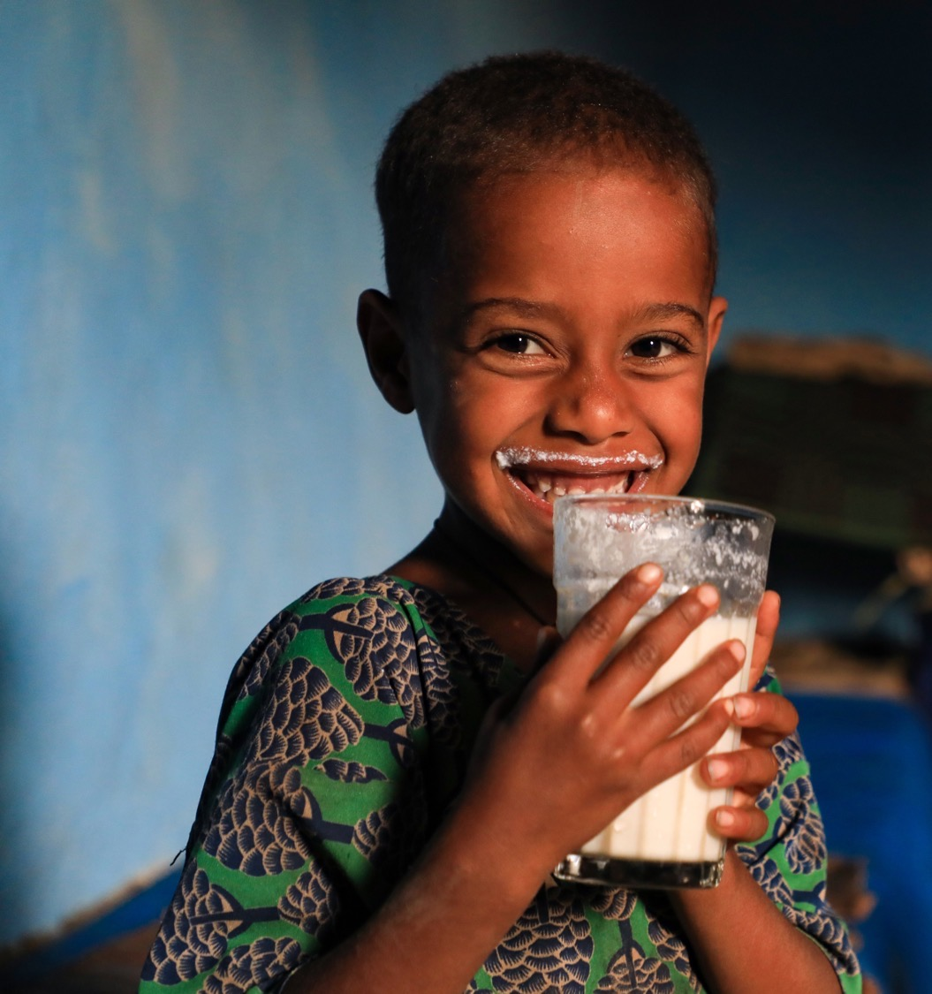

Shaping Africa’s Food Future through Sustainable Livestock Innovations
Appolinaire Djikeng
ILRI Director General
CGIAR Senior Director of Livestock-Based Systems
6 September 2024

Slide 2
Importance of livestock in global development

Slide 3
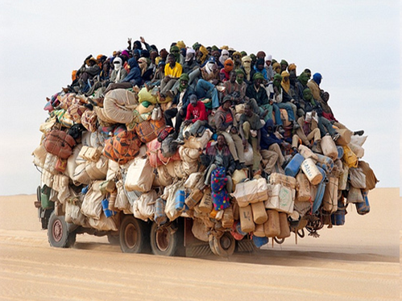
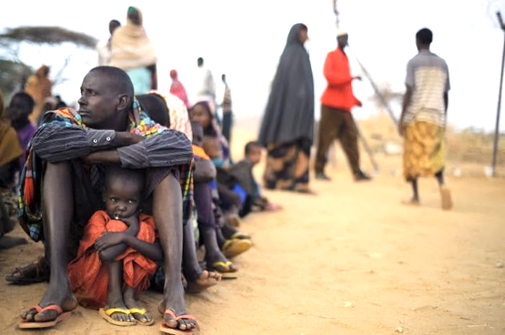
Rapid population increases
The development challenge
2050:
Asia 5.3 billion (+41%)
Africa 2.5 billion (+209%)
2100:
Asia 4.8 billion
Africa 4.5 billion
Urbanization
2018:
-55%
2050:
-68%
Demographic shifts
High income inequality
Climate change
Natural resource degradation

Slide 4
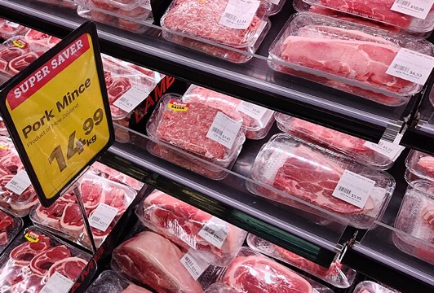
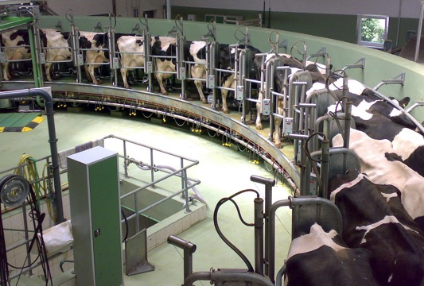
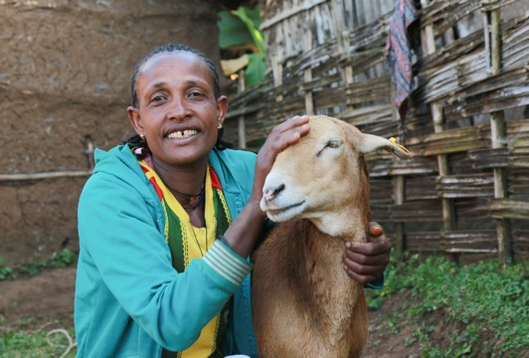
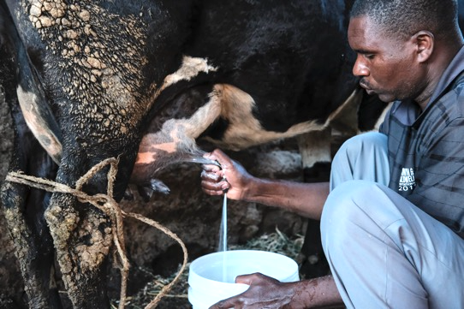
POTENTIAL PATHWAYS to meet the growing demand
Demand for food will keep growing
Import livestock products
Import livestock industrial production know-how
Especially in LMICs
Demand for milk, meat, eggs is driven by population, rising incomes and urbanization
Projected demand (2010 to 2030)
Beef & Poultry: >80%
Milk: >40%
Pork in SSA: >150%
Transform smallholder livestock systems
70% of livestock-derived foods consumed in LMICs are sourced in informal markets

Slide 5

Livestock systems are diverse
RISK, especially CLIMATE RISK, remains a disincentive for investments into technology to improve productivity
Pests and disease
Cost of inputs
Prices received for products
Market risk
Storage risk – loss of quality and health risks (e.g. aflatoxins)
Climatic risk
Conflicts over resources (Herder-farmer), including insecurity (Sahel, Horn of Africa)
Semi-intensive systems
Mixed crop-livestock systems
Pastoral systems
Each livestock system for different commodities (milk, meat, eggs) has a DIFFERENT PATHWAY to sustainability

Slide 6
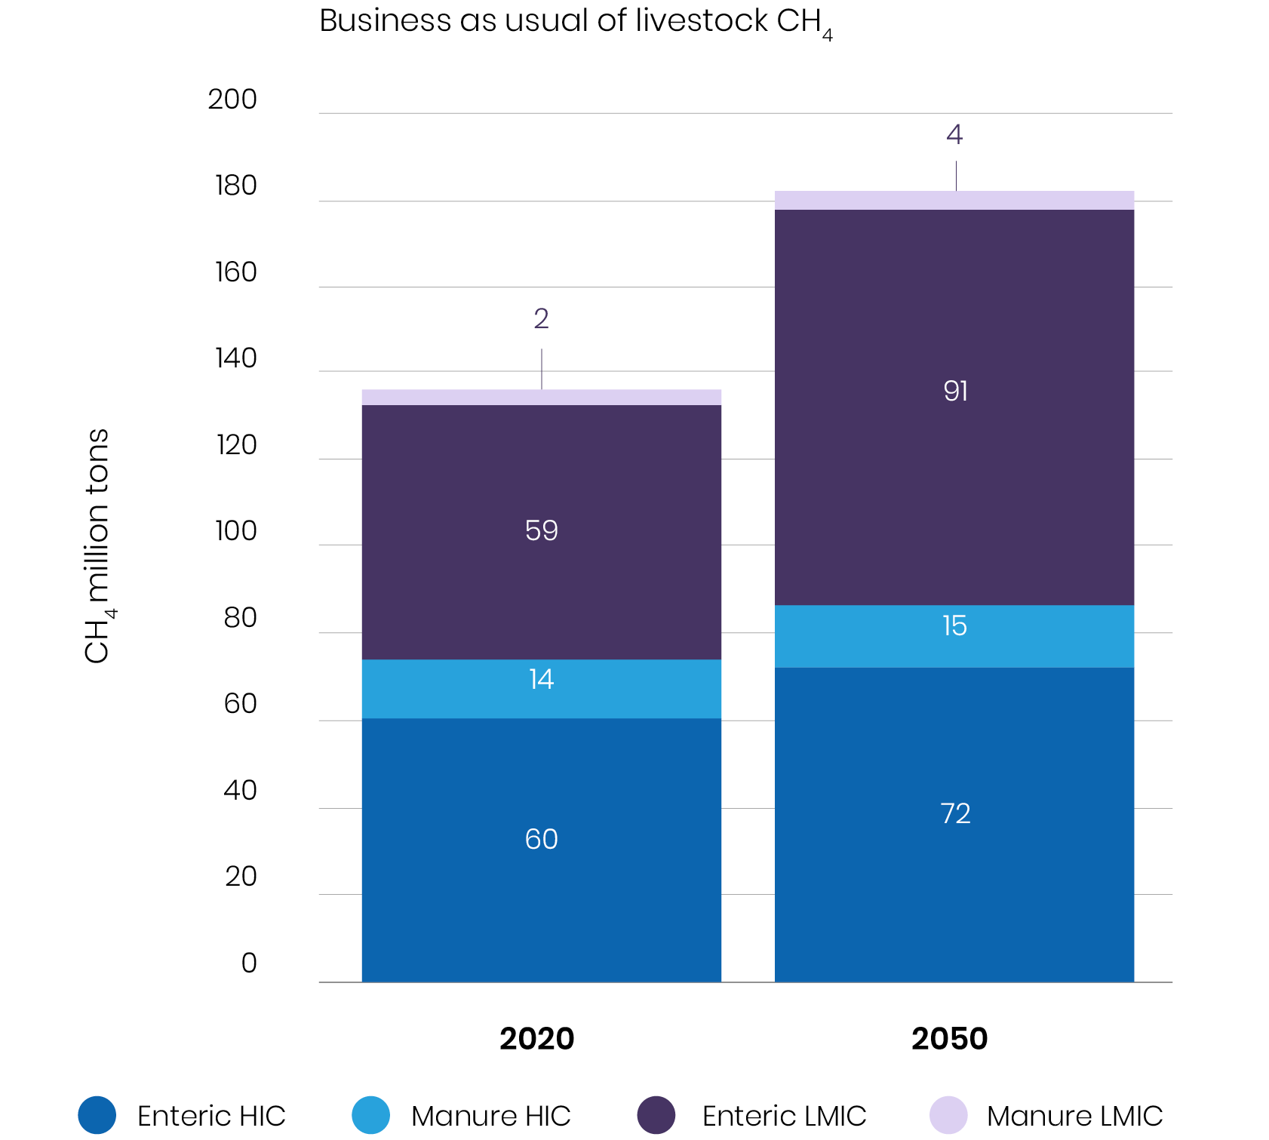
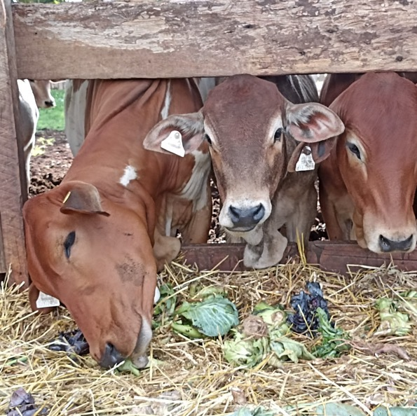
Reducing methane emissions from livestock

Slide 7
Strategy for solutions to climate change adaptation and mitigation in the targeted farming systems
Climate Smart Livestock Systems
Health, genetics, nutrition, environment, political economy, policy
Mitigation
Adaptation
Carbon sequestration in landscapes
Emissions reduction through feeds
Efficient low emission ruminants in breeding targets
Animal health (e.g. vaccination, parasite control etc.)
Measurement, Reporting, Verification
Climate tolerance in breeding targets
De-risking measures (e.g. insurance, climate information)
Coping with shocks and extreme events
Prediction (e.g. early warning, vector and disease spread)
Scaling resilient livelihoods
Tradeoffs & co-benefits
Farming systems
Supporting uptake of innovations by livestock keepers and other actors
(semi)-intensive, crop-livestock, pastoral systems
Delivery systems of inputs and services
Private sector engagement
Trade-off analysis
Policy coherence
Inclusivity
Outcomes
Low emissions development that supports productive, equitable livelihoods

Slide 8
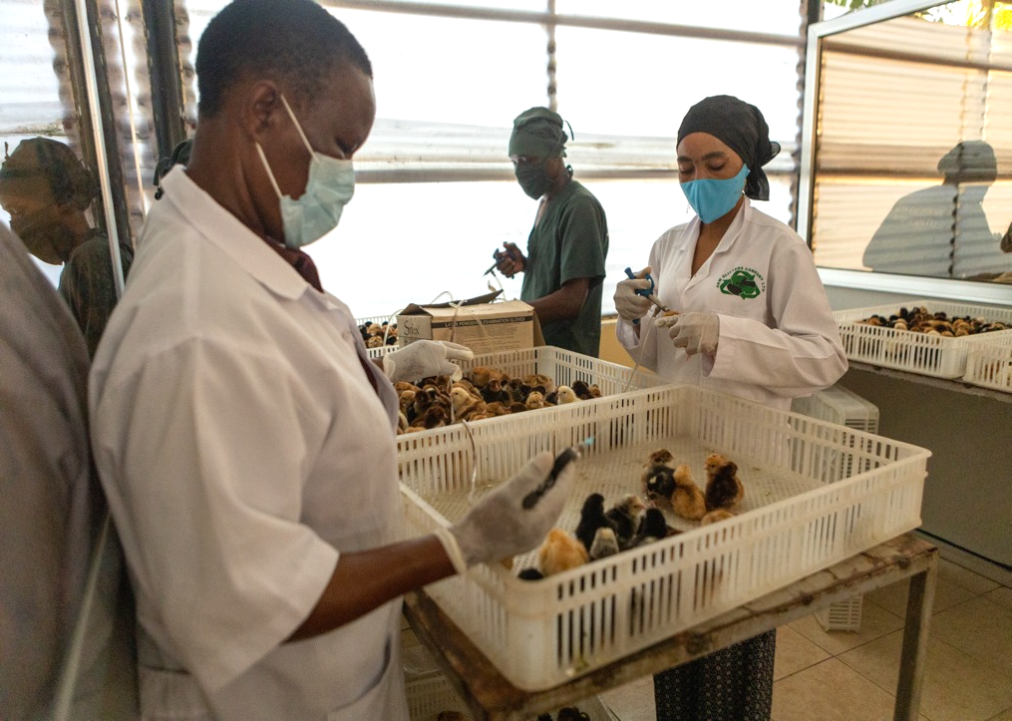

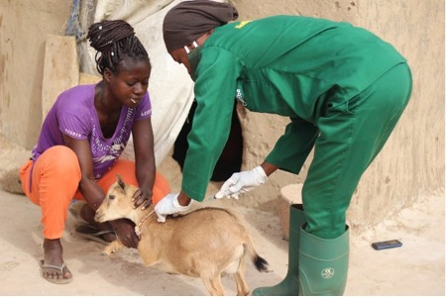
Vaccinating 1-month old chicks at woman-owned chicken business AKM Glitters in Tanzania.
ANIMAL HEALTH SOLUTIONS
Improved animal health and productivity
Managing infectious disease patterns
Baseline data on animal health-link to GHG
Develop and scale herd management packages
Risk mapping and epidemiological analyses
Climate-disease forecasting for early detection
A woman vet in Ghana vaccinates a goat. ILRI researchers are using gender responsive approaches to shift gender norms in rural communities.

Slide 9
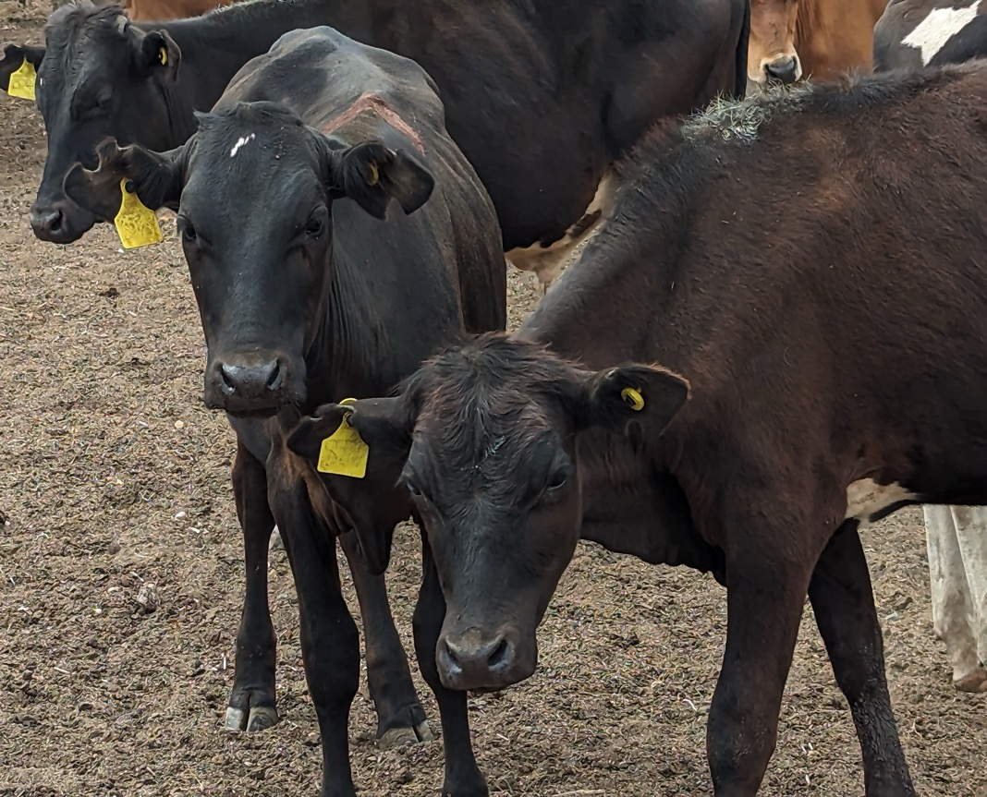

GENETIC SOLUTIONS
SLICK phenotype
Productivity and feed efficiency
Non-SLICK phenotype
Direct selection for lower methane emissions
Scalable digital platforms and tools
Scalable genomic prediction pipelines
Partnerships and networks
SLICK versus non-SLICK cattle are being compared for multiple traits, including heat stress, water intake, milk yield and quality, growth rates, reproduction, and tick resistance.

Slide 10
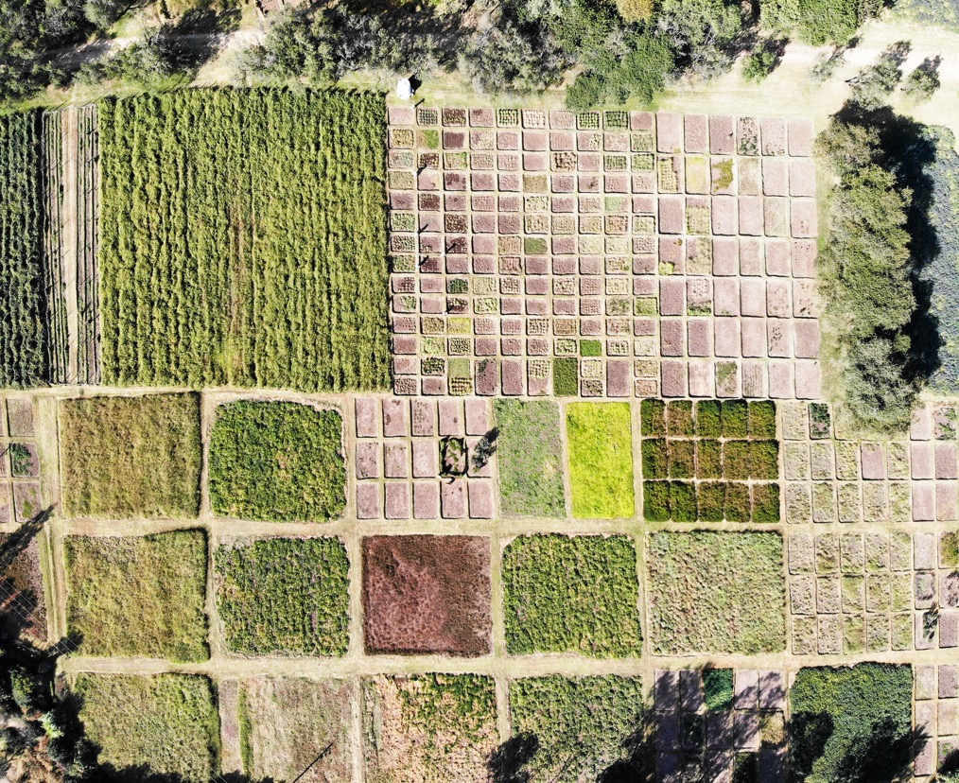

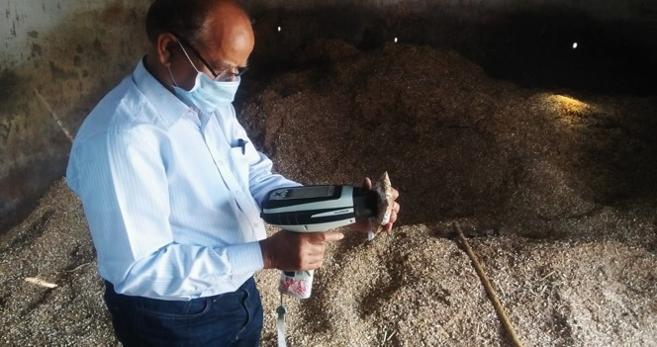
ANIMAL NUTRITION SOLUTIONS
Genetic improvement of feeds and forages
Feeding systems
Scaling application of digital ‘feed’ tools
Scaling feed processing
Release of new feed/food, forage cultivars and varieties
Seed systems
Aerial view of CGIAR’s forage field plot in Bishoftu, Ethiopia, supported by ILRI’s genebank, conserving 19,000 accessions from 1,000+ species—one of the world’s most diverse forage collections.
Near-infrared reflectance spectroscopy (NIRS) devices help make feed assessments simpler, cheaper, and more widely accessible.

Slide 11
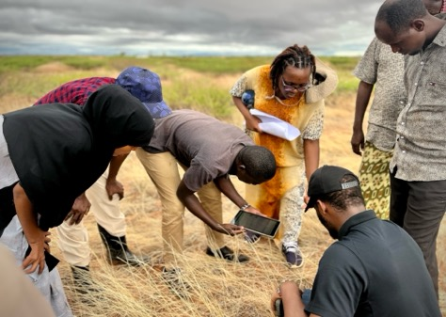

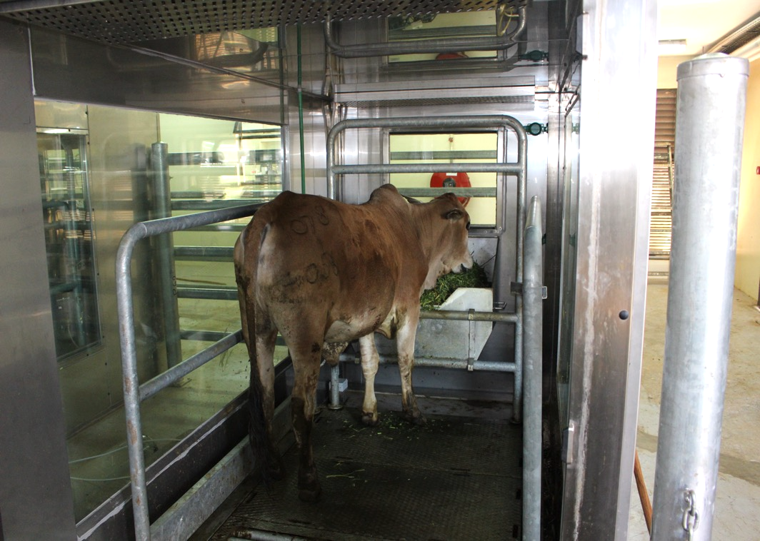
ENVIRONMENTAL SOLUTIONS
Researchers and community members in Wajir, Kenya, assess dryland conditions, as part of ILRI’s participatory rangeland management approach.
Establishing local emission factors and inventories
Ecosystem CO2, CH4 and H2O exchange in savanna
Baseline data from local breeds and systems
Test interventions that increase animal productivity, decrease emission intensities
Building local capacity in activity data, farm to national inventory, MRV
Scaling integrated systems and circular economy approaches
The animal respiration chamber at ILRI’s Mazingira Centre is used to accurately measure animal emissions of cattle.

Slide 12
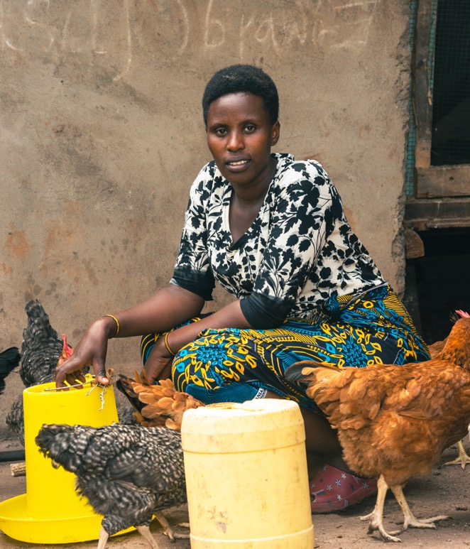
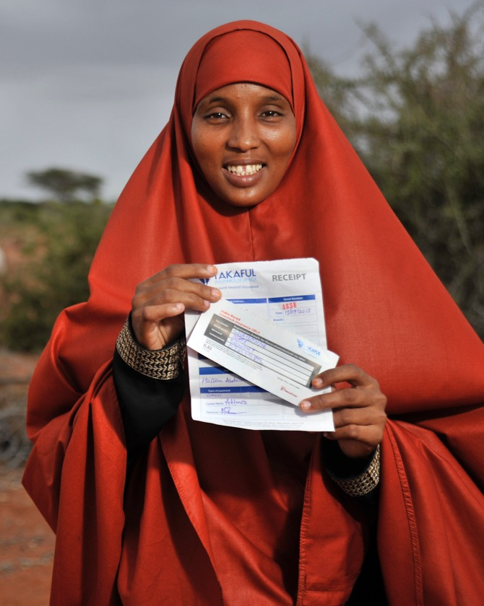
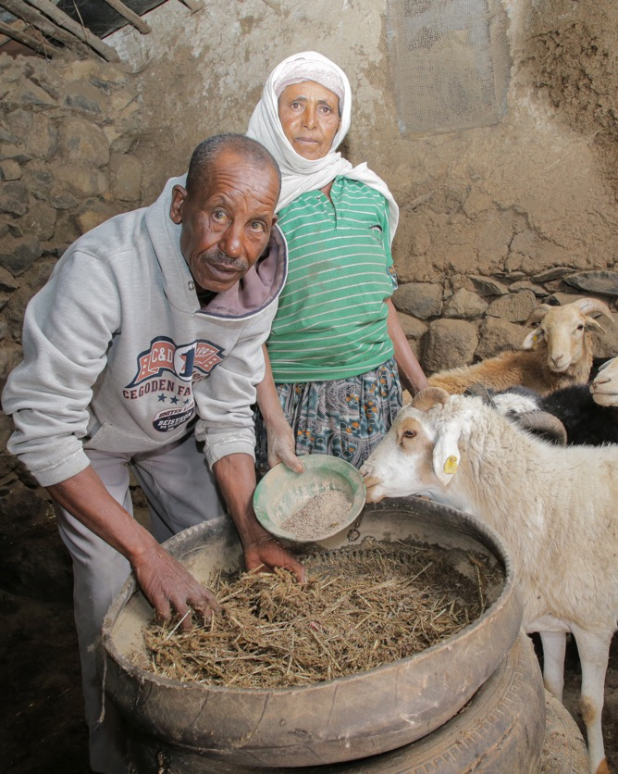
Women in business: chicken seed dissemination in Ethiopia and Tanzania
Index-based livestock insurance: pastoral households insured against climate shocks
Scaling climate-smart livestock adaptation practices developed by innovative farming households
Institutional innovations and solutions
Where livestock keepers are key partners in driving sustainable change

Slide 13
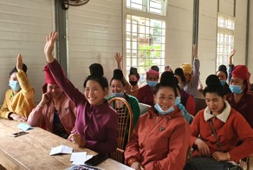
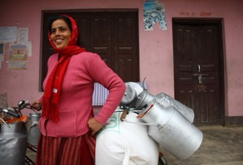
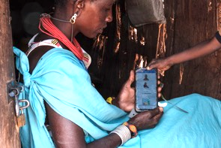
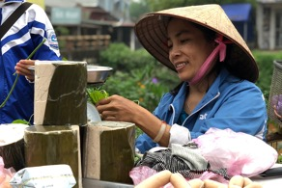
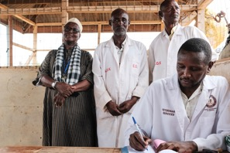
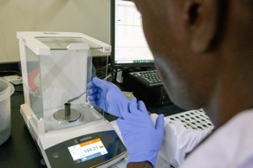
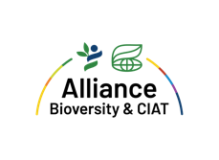




The livestock and climate solutions hub
A multi-stakeholder approach to transitioning LMIC’s livestock systems to net-zero, healthy, resilient, and profitable food systems by 2040
Our aim is to co-develop and scale net-zero emission livestock systems that build resilient, productive and equitable livelihood systems in LMICs
Multi-stakeholder platform
Co-design approaches for low-emission livestock development
Bundling technologies for greater productivity
Scaling solutions with partners
Strengthening livestock policies and increasing investments
Supporting regional and national emissions targets
In partnership with National Research Agencies, AU-IBAR, universities, private sector and government agencies
Notes:
Shorten the text
Contributing to regional and national emission targets

Slide 14
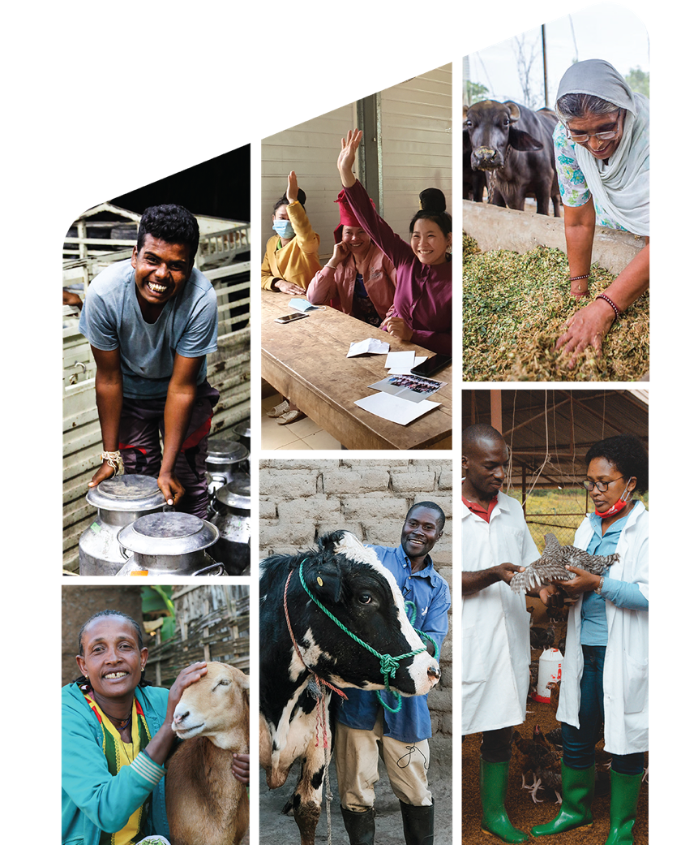

The International Livestock Research Institute (ILRI) works to improve peoples’ lives in low- and middle-income countries through livestock science that contributes to equitable and resilient livestock systems in order to deliver food systems transformation with climate and environmental benefits. Co-hosted by Kenya and Ethiopia, it has regional or country offices throughout Africa and Asia.
ILRI.org | CGIAR.org

Slide 15


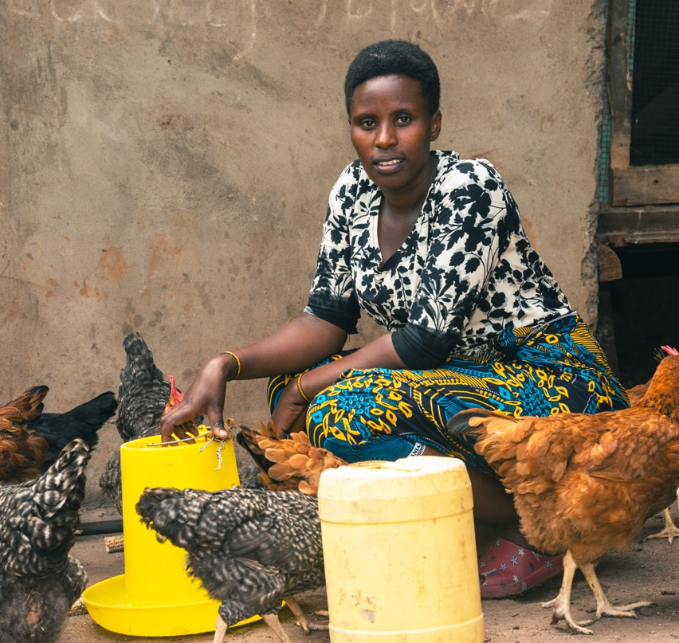
Growing women-led chicken businesses in Ethiopia and Tanzania
Using a gender-responsive approach – accommodative and transformative – to develop and promote women-led chicken businesses
Hatcheries sell chicks to brooders, who sell one-month-old chicks to farmers.
Farmers raise chickens for meat or egg production.
Improved access to chicken breeds and livestock services in remote regions in Tanzania.
Young women veterinarians recruited as vendors, providing business and animal health services.
Enhanced food and nutrition through chicken meat and egg consumption.
Increased income and better livelihoods for women and families involved.

Slide 16
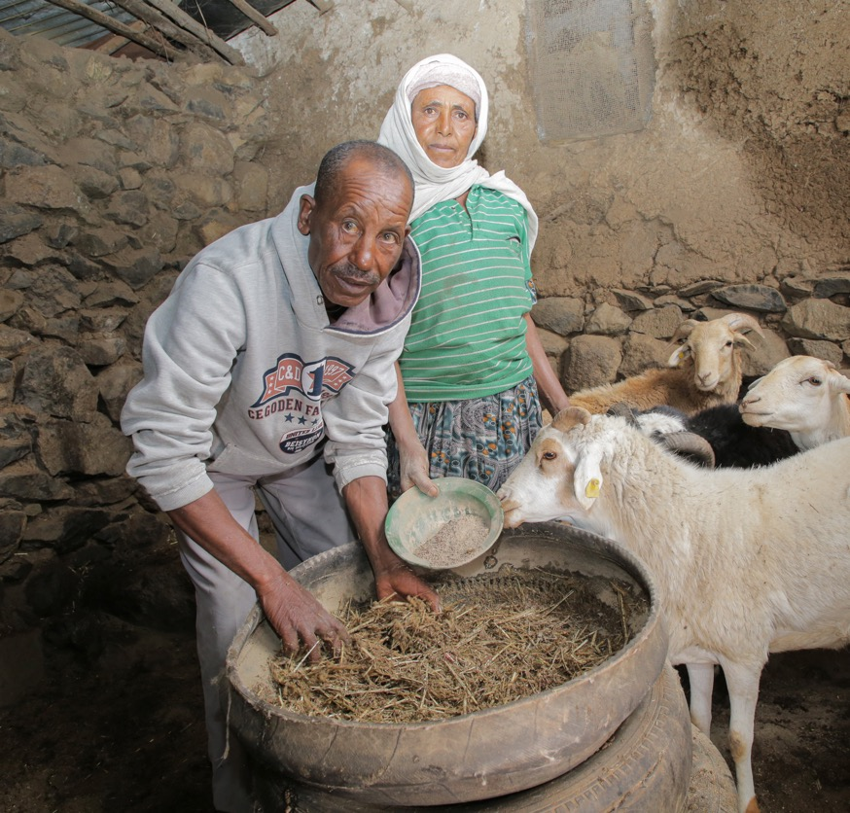






Climate-smart livestock farmers: adaptation pioneers (pioneer-positive deviance)
Farmer-led scaling and knowledge networks for climate-smart livestock management, using local adaptation innovations.
Positive deviant livestock households (pioneers) lead scaling efforts, supported by a network of partners.
Focus on men, women, and youth as key actors in the scaling process.
In 2023, 6 pioneer farmers in 2 Kenyan counties worked with 600+ households on climate-smart feed management.
In 2024, 39 new pioneers will expand the network, reaching up to 20,000 livestock keepers through citizen science and Farmer to Farmer Field Days.

Slide 17
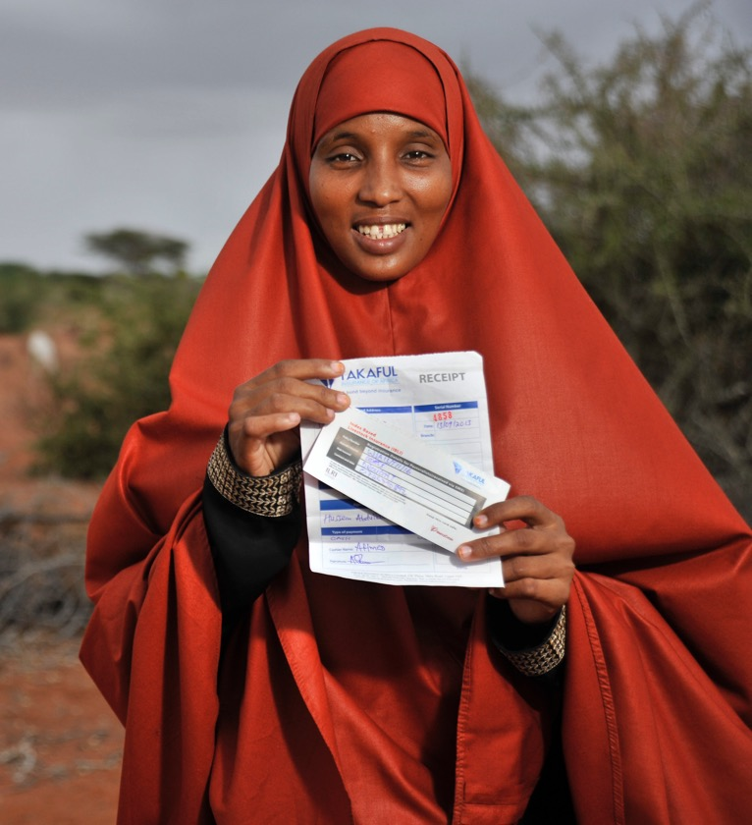
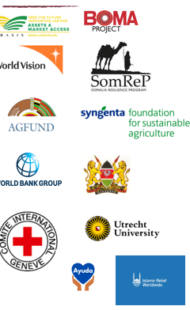


Index based livestock insurance:
protecting pastoralists from climate shocks
Insurance product for mobile pastoralists in drylands using satellite data to monitor forage conditions.
Payouts are triggered when vegetation levels drop below a predefined threshold.
Women account for 43% of the policy holders
100,000+ policies sold in Kenya and Ethiopia, covering 200,000 people; 250,000 more people covered under World Bank DRIVE project.
Households reduced distress sales of livestock by 36%, decreased the need to cut back on meals by 25%, and lowered reliance on food aid by 33%.
Since 2011, total payouts of US$ 11 million

Slide 18
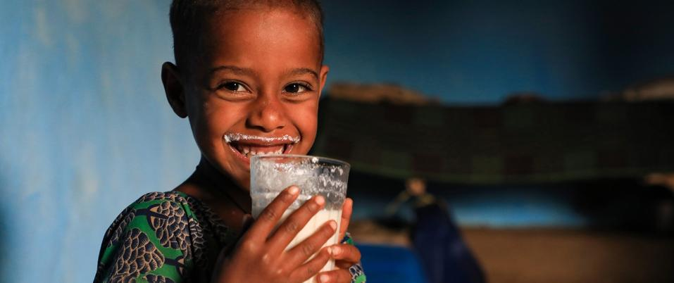
THANK YOU

