Slide 1
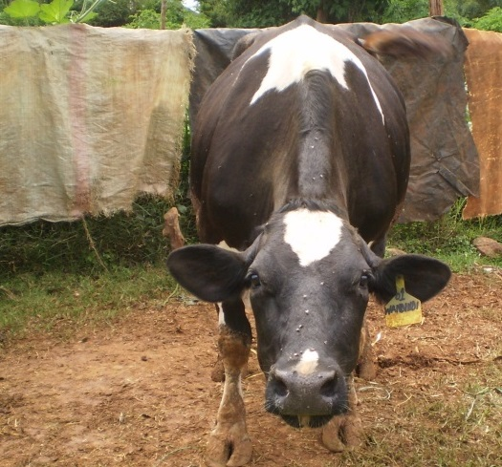
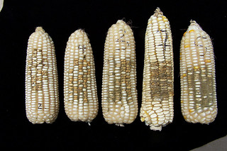
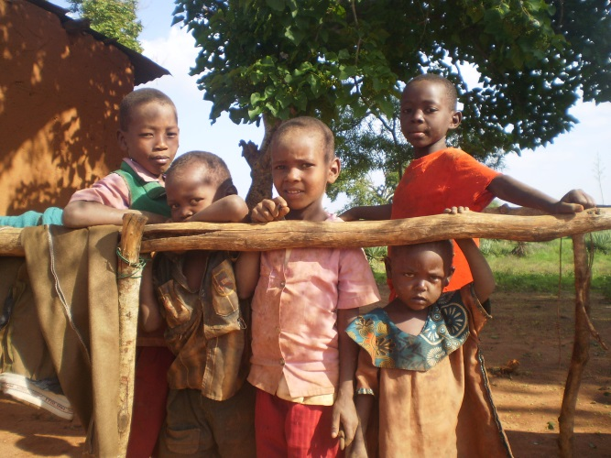


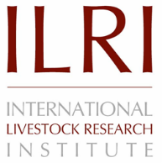



Aflatoxins in the dairy value chain: A challenge for the informal market?
Johanna Lindahl, Florence Mutua and Delia Grace
The 15th International Symposium on Veterinary Epidemiology and Economics
Chiang Mai, Thailand
13 November 2018

Slide 2
Presentation outline
Aflatoxins and livestock in low- and middle-income countries (LMIC)
Our work in Africa
What do we do about it?
  Mitigation strategies at different levels in Kenya

Slide 3
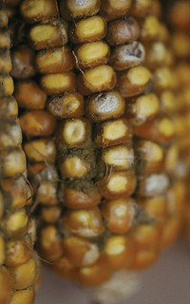
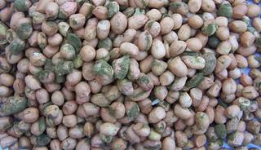
What are mycotoxins?
When some moulds grow on crops, they produce toxic substances that can remain in the crops
Moulds are ubiquitous
Photo by IITA. Aspergillus naturally infected groundnuts in Mozambique.
Photo by CIMMYT.

Slide 4
Aflatoxins
Toxic byproducts from Aspergillus fungi
  Mainly Aspergillus flavus
  Not all toxigenic
  Preference for maize, groundnuts, but also other cereals
  Staples!

Slide 5
Aflatoxins
Different kinds
  Invisible
  Odourless
  Tasteless
  Heat stable

Slide 6
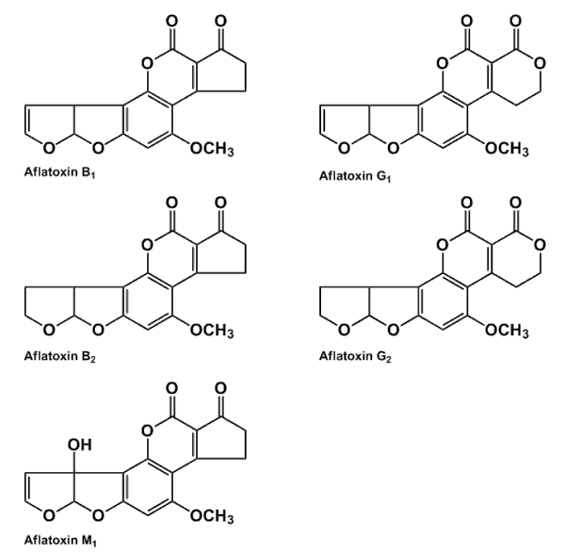
The health concerns
  Acute outbreaks can claim 100s of lives (Kenya outbreak 2004–05, 125 known fatal cases)
  4.5 billion people chronically exposed (estimate by US CDC)
    Cancer
    Immunosuppression
    Stunting

Slide 7
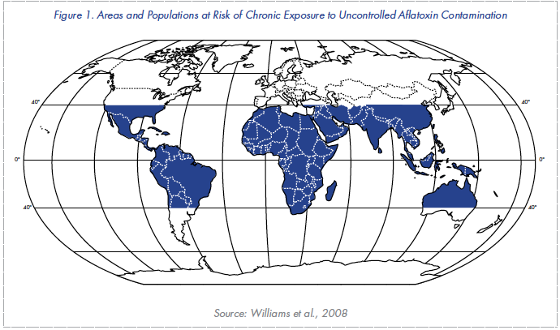
Aflatoxins are a global issue

Slide 8
CGIAR are global institutes
International Maize and Wheat Improvement Center (CIMMYT)
International Food Policy Research Institute (IFPRI)
International Crops Research Institute for the Semi-Arid Tropics (ICRISAT)
International Center for Tropical Agriculture (CIAT)
International Institute of Tropical Agriculture (IITA)
International Livestock Research Institute (ILRI)

Slide 9
Why focus on aflatoxins in Kenya?
  Kenya outbreak 2004–05: 125 known fatal cases
  884 women sampled in Eastern Province
    All had aflatoxin in the blood
    Exposure levels higher in poor people

Slide 10
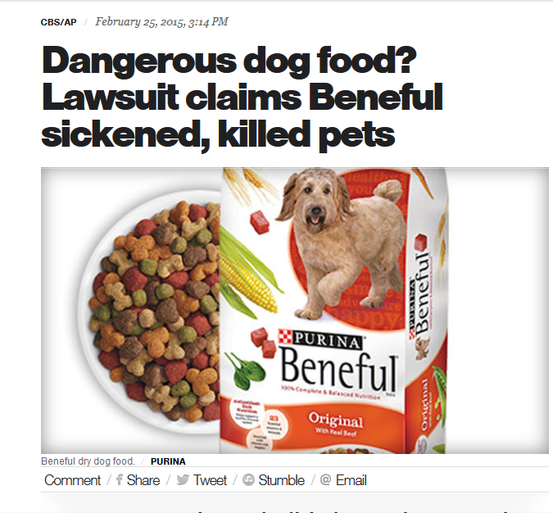
Why bother about aflatoxins and animals?
Animals are susceptible to aflatoxins: some more, some less
Animal suffering: an animal welfare issue
Reduced animal productivity
Aflatoxins in animal-source foods

Slide 11
Health effects observed
Liver damage
Gastrointestinal dysfunction, decreased appetite
Immunosuppression
Decreased reproductive function, decreased growth and decreased production
  Can we see these effects in low-producing animals?
  Little research in Africa in literature search
  Varying effects in all studies

Slide 12
Safe levels?
≤50 in young poultry
≤100 in adult poultry
≤50 in weaned pigs
≤200 in finishing pigs
<100 in calves
<300 in cattle
<100 in Nile tilapia
However depending on other factors!

Slide 13
Animal-source food
Aflatoxins are transferred to animal products
1-7% of aflatoxins in feed is metabolized and transferred to milk
Much lower transfer to meat and eggs
  Reduced if feeding is stopped

Slide 14

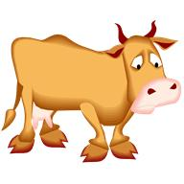

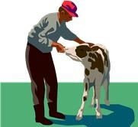

Agricultural services
Veterinary services
Economic flow
Feed producer
Feed seller
Milk retailer
Farmer
Consumer
Corn/feed purchased
Treatments
AB1
Aflatoxin flow
AB1-> AM1
AB1
AM1
Corn/feed produced at farm
AB1
AM1
Milk produced at farm
Human exposure
Farmer
Consumer

Slide 15
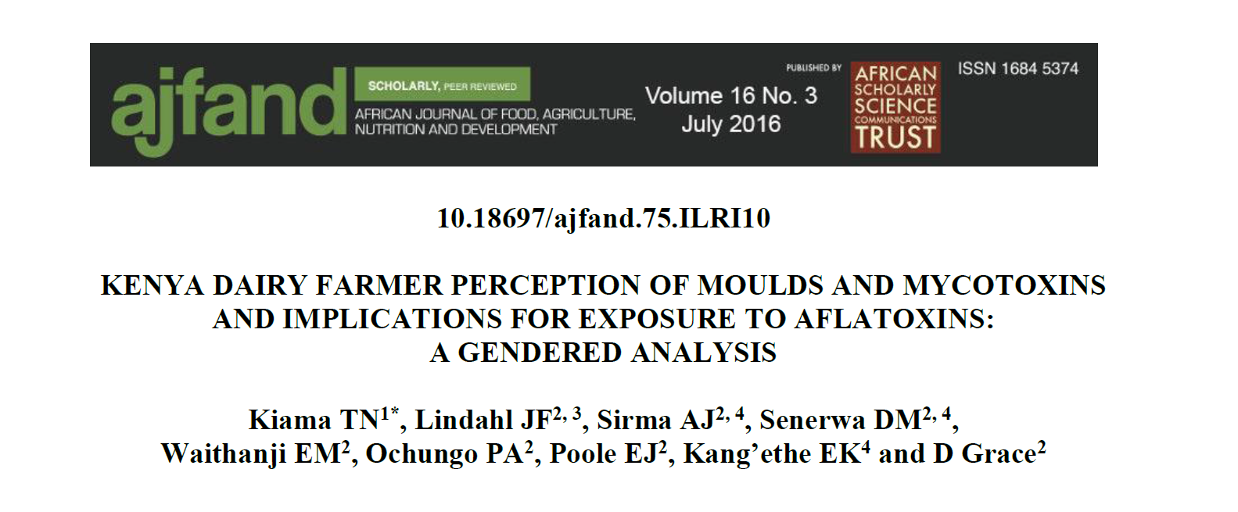
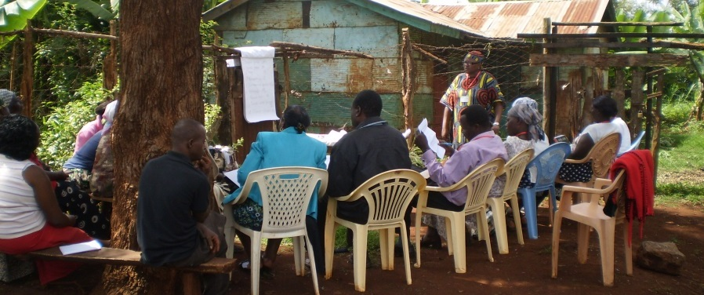
Aflatoxins in Kenya dairy
Qualitative study- understanding behaviour
Women have a greater role in deciding what to feed cattle
Common to feed mouldy food to livestock
Women more likely to report taste of maize as an indicator of moulds
Men and women share more decision-making than literature suggests
Men and women disagree which gender has responsibility

Slide 16
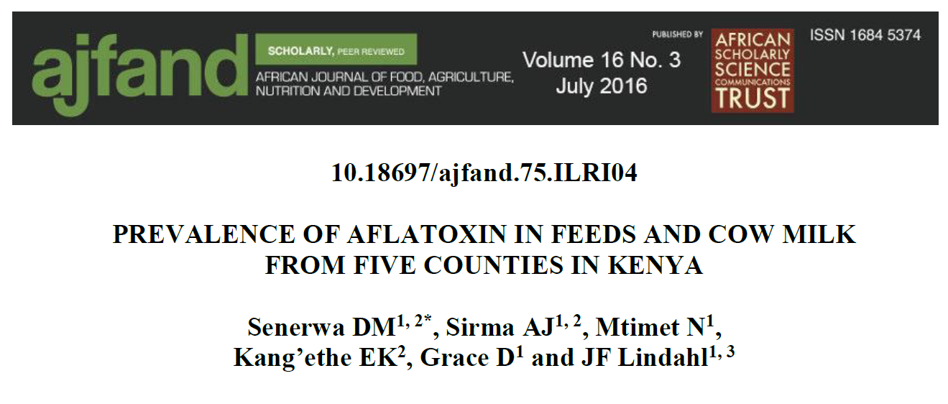
Kenya: Dairy value chain
Feed collected from five countiesª
  From farmers: 0.02 ppb to 9,661 ppb
  Samples exceeding 5 ppb
    25–100% of the feed in farms
    85.7–100% of the feed from feed retailers
    20–100% of the feeds from feed manufacturers
Milk samples: Up to 6999 ppt
  ª Mugangai et al. 2016

Slide 17
One-year survey
24 samples per month
Dagoretti: low-income area
Westlands: high-income area

Slide 18
One-year survey

Slide 19
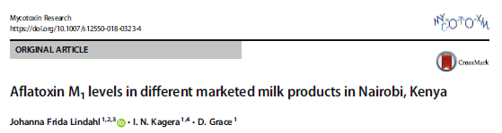
Producer | Number | Mean price KES/litre (range) | Mean aflatoxin M₁ levels (ng/kg) | Standard deviation | Min | Max | Geometric mean
Farmers | 75 | 65 (45-110) | 116.5 | 153.3 | <LOD | 1069.5 | 65.6 ª
Company A | 74 | 155 (80-610) | 57.0 | 43.9 | 7.6 | 272.3 | 46.4
Company B | 12 | 101 (90-120) | 296.9 | 206.1 | 59.0 | 743.3 | 226.9
Company C | 51 | 128 (60-233) | 37.2 | 33.9 | <LOD | 166.1 | 22.7 ^{b}
Company D | 37 | 125 (86-233) | 38.9 | 33.5 | <LOD | 156.1 | 23.7 ^{b}
Others | 42 | 176 (76-660) | 111.3 | 169.9 | 7.3 | 1078.5 | 68.0 ª
Table 2. Aflatoxin M₁ levels in milk samples of different origins purchased in Nairobi, Kenya
Geometric means with the same superscript were not significantly different
LOD: Limit of detection (2 ng/kg)

Slide 20
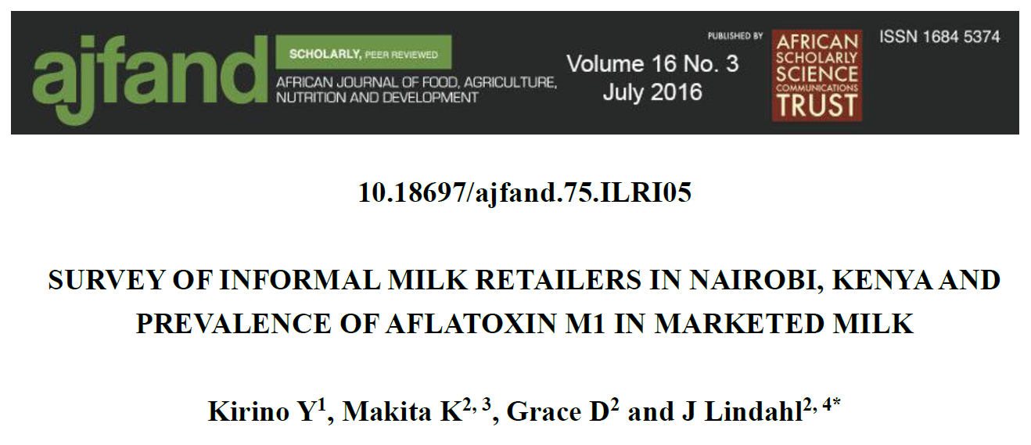
Kenya: Urban milk
Milk collected from informal milk retailers
  58% knew about aflatoxin, but only 6% thought milk was not totally safe after boiling
  Milk samples: mean aflatoxin M1 was 128.7 ppt, up to 1675 ppt. 55% of samples exceeded 50 ppt and 6% 500 ppt.
  Women consume 1 litre per day!
  Kiruni et al. 2016, Afr J Food, Nutr Ag Dev

Slide 21
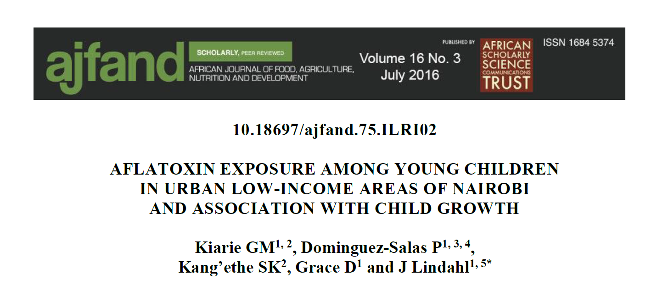
Kenya: Urban milk
Child exposure study
    Korogocho and Dagoretti
    41% of children were stunted
    98% of foods contained aflatoxin
    100% of milk contained AFM1
    Aflatoxin M1 exposure associated with decreased height-for-age score
  Kiarie et al. 2016, Afr J Food, Nutr Ag Dev

Slide 22
Mitigation options
Aflatoxins can be mitigated all along the dairy value chain
  Costs
  Implementation
  Side effects

Slide 23
1. Stop aflatoxin production
Corn/feed purchased
AB1
Aflatoxin flow
AB1-> AM1
AB1
AM1
Corn/feed produced at farm
AB1
AM1
Milk produced at farm
Human exposure
Farmer
Consumer

Slide 24
On the field: storage
Improved varieties: more resistant crops
Bio control: AflaSafe™, AflaGuard™
Improved drying
Improved storage
Good Agricultural Practices
Reduces aflatoxins for both humans and animals
Costly?

Slide 25
2. Stopping the bad feed
Corn/feed purchased
AB1
Aflatoxin flow
AB1-> AM1
AB1
AM1
Corn/feed produced at farm
AB1
AM1
Milk produced at farm
Human exposure
Farmer
Consumer

Slide 26
Objectives of feed standards
Protect humans from harmful aflatoxins in animal-source foods
Safeguard the benefits people derive from livestock
Protect value chain actors from bad products
Encourage fair trade, and economic growth through promoting standards and credibility

Slide 27
2. Stopping the bad feed
Feed regulations
Implementation
What do you do with illegal feed?
Costs?
Market incentives
Poor people?
Not sustainable

Slide 28
3. Within the cow
Corn/feed purchased
Binder
AB1
Aflatoxin flow
AB1-> AM1
AB1
AM1
Corn/feed produced at farm
AB1
AM1
Milk produced at farm
Human exposure
Farmer
Consumer

Slide 29
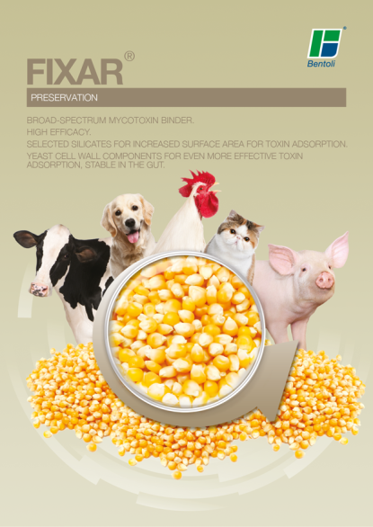
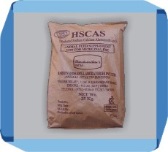
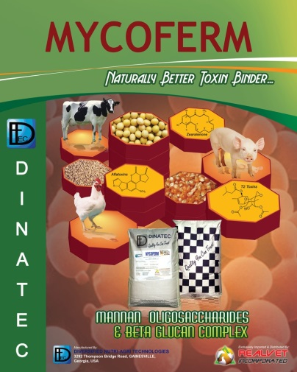
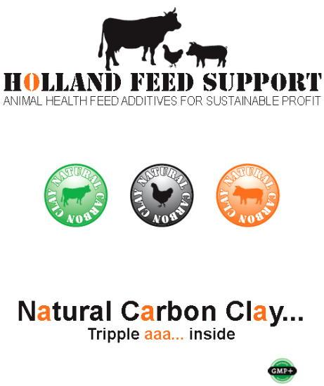
Standards for Anti-Mycotoxin Additives (AMAs) in Feeds
Clays (aluminosilicates)
Most effective binder but different clays vary in effectiveness. Up to 90% reduction.
Yeast/bacterial cell wall extracts
Provide other useful nutrients, but evidence on effectiveness is mixed
Other binders
Some are promising but less evidence of effectiveness

Slide 30
The case for binders
Multiple benefits:
Increase animal productivity
Reduce aflatoxins in animal-source foods
Create safe “sink” for aflatoxin
Improved animal welfare
Food safety/security tradeoff → win-win opportunity
Current trial will provide evidence on effectiveness

Slide 31
Reducing aflatoxins in milk using binders
Baseline survey to collect data on:
  Levels of aflatoxins in milk
  Feeding practices
  Farmer awareness
  Farmer willingness to use mitigation methods
  Farmer willingness to pay for binders or other mitigation methods

Slide 32
Study sites
Urban/peri-urban
  Kasarani
  Kisumu
20 trial farms and 10 control farms recruited in each site
  Given Novasil as a feed additive

Slide 33
Follow up
Regular follow up and endline survey of farmers
Compliance?
Concerns with adulteration

Slide 34
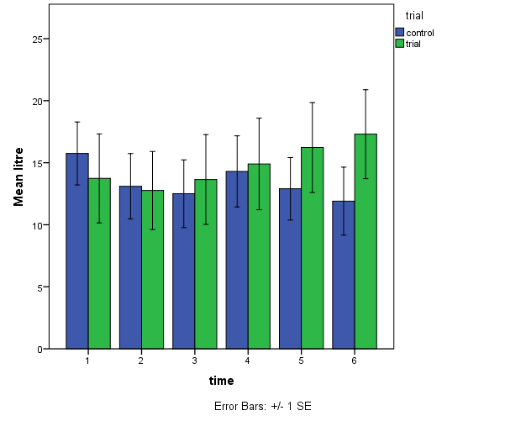
Trial results
Milk production

Slide 35
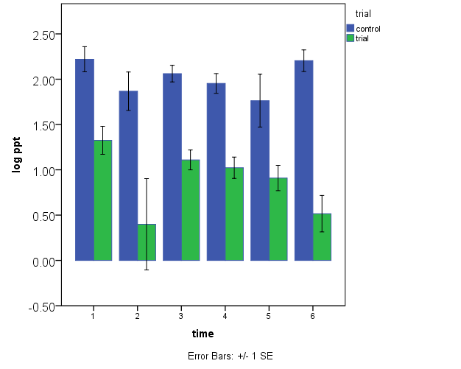
Aflatoxin M1 levels

Slide 36
4. In the milk?
Corn/feed purchased
AB1
Aflatoxin flow
AB1-> AM1
AB1
AM1
Corn/feed produced at farm
AB1
AM1
Milk produced at farm
Human exposure
Farmer
Consumer

Slide 37
4. In the milk
Biological control??
Research still ongoing
Pasteurization not working

Slide 38
5. Stopping consumption of contaminated milk
Corn/feed purchased
AB1
Aflatoxin flow
AB1-> AM1
AB1
AM1
Corn/feed produced at farm
AB1
AM1
Milk produced at farm
Human exposure
Farmer
Consumer

Slide 39
5. Stopping consumption
Legislation
Awareness and market incentives
Implementation
What do you do with illegal milk?
Costs?
Poor consumers?

Slide 40
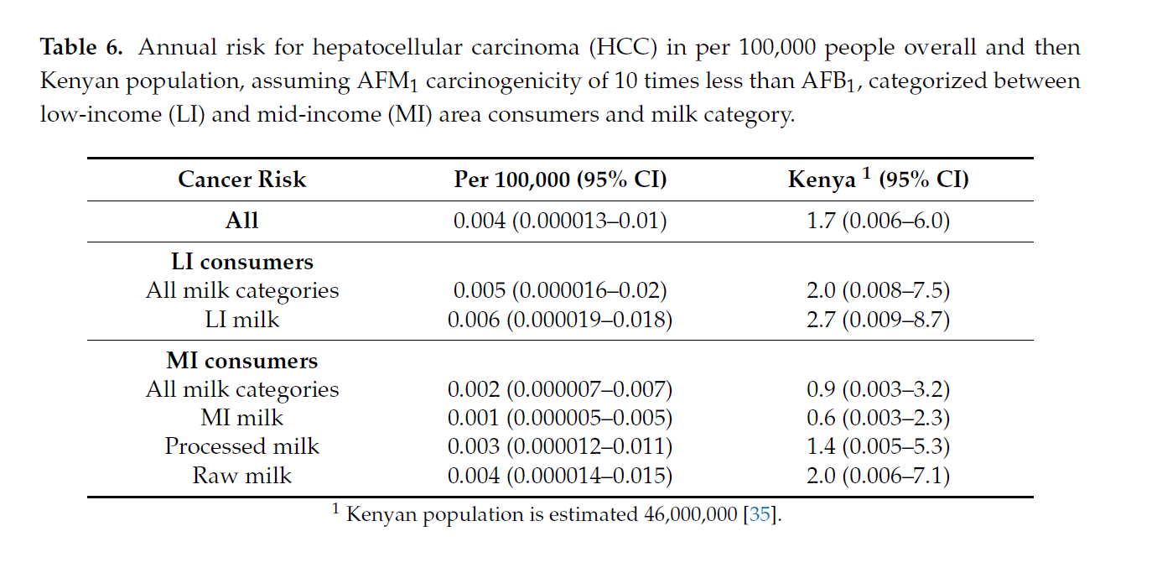
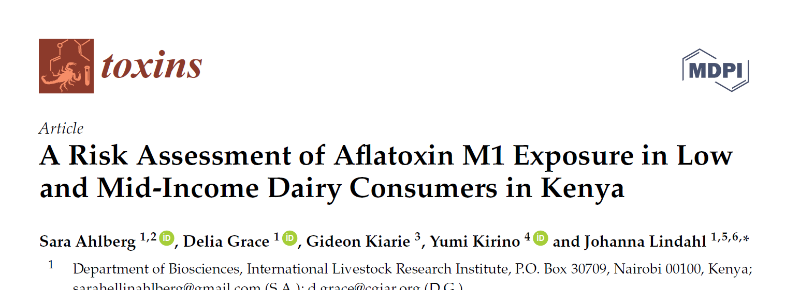
The actual risk?

Slide 41
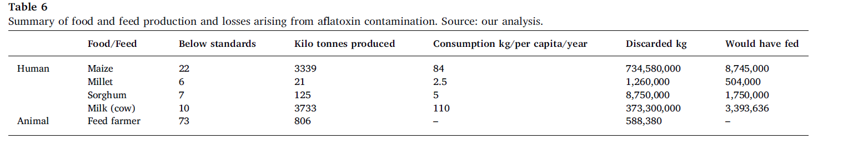
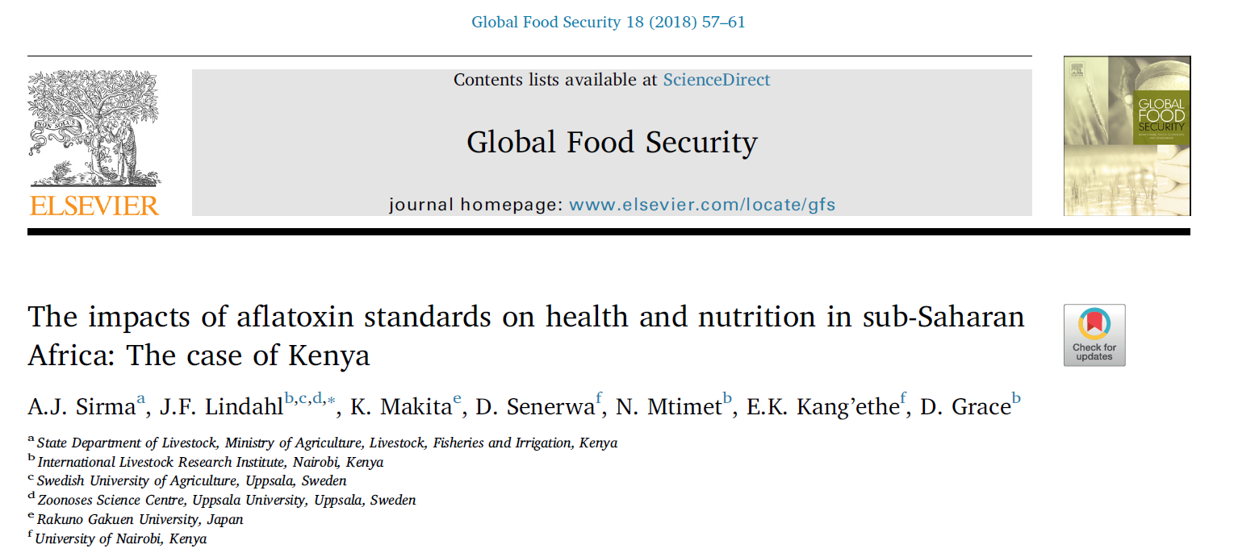
The consequences?
Risk assessment: 1416 HCC cases, 1346 deaths

Slide 42
The challenge
Food security
Food safety
Change:
To:
Improved food security
Improved food safety
Better health

Slide 43
Take-home messages
Livestock is affected by aflatoxins, and so are animal-sourced food
Livestock feed sector + binders can suck contaminated grain out of human food chain
Potential for regulation to cause harm (burden on agricultural sector, concentrating contaminated among poorest)
Need to research what works in each country

Slide 44
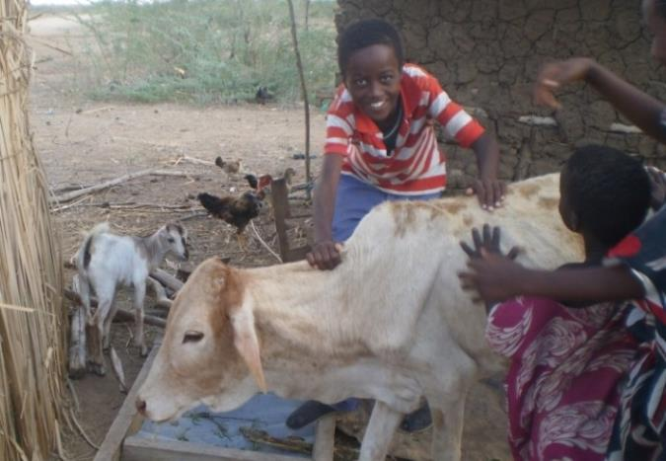
Conclusions
There is no silver bullet to eradicate aflatoxins
Animals may be both part of the problem and part of the solution

Slide 45
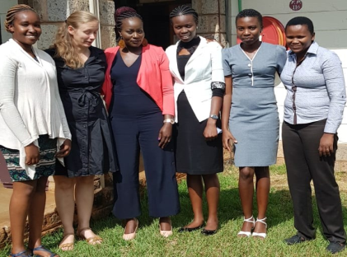


Acknowledgements
The Kenya work is financed by the Ministry of Foreign Affairs, Finland
in a partnership with the International Food Policy Research Institute (IFPRI), Luke Finland and the Biosciences in eastern and central Africa – International Livestock Research Institute (BecA–ILRI) hub
It contributes to the CGIAR Research Program on Agriculture for Nutrition and Health, led by IFPRI
Students: Irene Kagera, Maureen Mijide, Gladys Owino, Daniel Senerwa, Gideon Mwangi, Anima Sirma and Sara Ahlberg

