Slide 1

The future of sustainable livestock systems in low- and middle-income countries
Expert dialogue: The future of sustainable agriculture. Let’s think about… livestock
German Federal Ministry for Economic Cooperation and Development (BMZ)
28 June 2022
Shirley Tarawali
Assistant Director General, International Livestock Research Institute
Chair, Global Agenda for Sustainable Livestock
With inputs from: Mireille Ferrari, Susan MacMillan, Annabel Slater, Cynthia
Mugo, David Aronson, Polly Ericksen, Alessandra Galiè

Slide 2
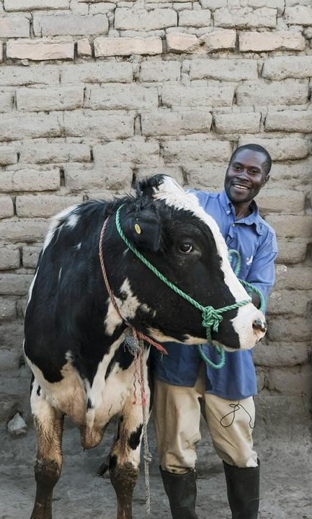
Key messages
Thinking about livestock
Status quo is not an option
… But change is an opportunity
01
02
In our quest for solutions, we must not over-simplify complexity
… Or complicate simplicity
Be aware of trade-offs; avoid unintended consequences; there are multiple pathways towards sustainable livestock outcomes
… Dichotomous debates are not helpful
03

Slide 3
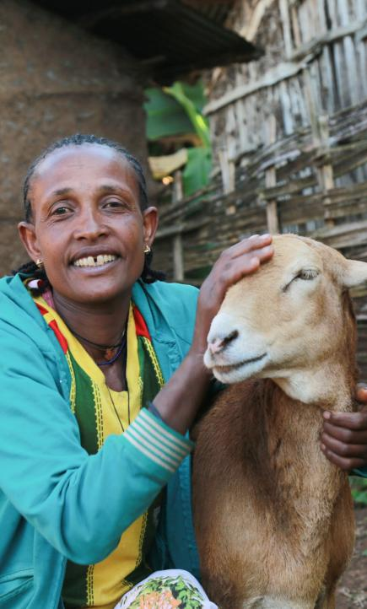






Transforming Food, Land, and Water Systems in a Climate Crisis
Livestock and CGIAR impact areas
Nutrition, health and food security: Animal source foods remain essential for proper nutrition and long-term health for most people in lower- and middle-income countries; and must be SAFE
Poverty reduction, livelihoods and jobs: Livestock are fundamental for the livelihoods of almost one in five people on the planet and in virtually every country on earth, for national economic growth
Gender equality, youth and social inclusion: The transformation of women’s livelihoods is impacted by livestock; the transformation of livestock food systems is impacted by women
Climate adaptation and mitigation: A sustainable
livestock sector presents many very big opportunities to adapt
to climate change and lower GHG emissions
Environmental health and biodiversity: Livestock
enterprises are integral to the planet’s future environmental
health and for supporting biodiversity

Slide 4
Livestock matter in LMICs

Slide 5
Demand for food will keep growing
Especially in LMICs
Demand for milk, meat, eggs is increasing fastest in LMICs driven by population, rising incomes and urbanization
Not based on significant over-consumption in LMICs (attention: ‘double burden’)
70% of livestock-derived foods consumed in LMICs are sourced in informal markets
Percentage changes in demand 2010 to 2030
Projections based on IMPACT model, Dolapo Enahoro (ILRI)

Slide 6
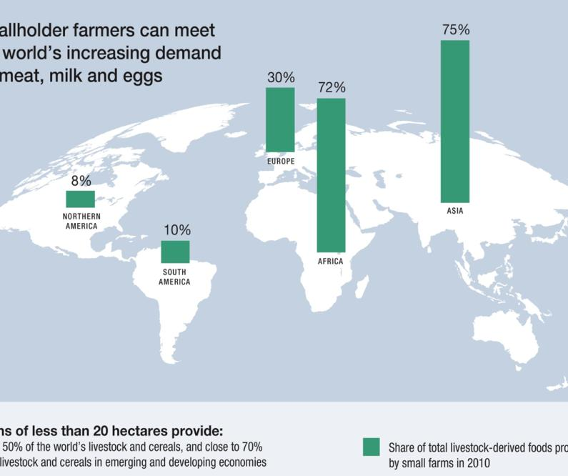
Share of total livestock-derived foods produced by small farms in 2010
Smallholder farmers currently provide most of the meat, milk and eggs AND staple cereals in LMICs
1.7 billion people derive some livelihood from livestock; over half a billion depend on livestock
Livestock are fundamental to many economies; provide income, jobs, and supporting risk mitigation
Livestock are the basis for farm sustainability, integrated livestock-food farms make food crop farming even possible for many in the Global South – circular bioeconomy in action!
Farms of less than 20 hectares provide:
Did you know...
Nearly 50% of the world’s livestock and cereals, and close to 70% of the livestock and cereals in emerging and developing economies
Livestock are integral to ‘circular bioeconomy’ which is the basis for most livestock production in LMICs

Slide 7
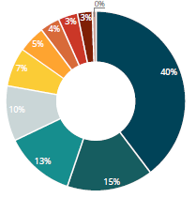
Global agricultural greenhouse gas emission sources
Livestock mitigation and adaptation strategies are critical
Enteric fermentation
Manure left on pasture
Manure management
Contribution of livestock emissions to GHGs must be mitigated, especially as demand for meat, milk and eggs increases
Adaptation measures needed: climate change already impacting livestock, placing increasing pressure on livelihoods and food supply
Also, livestock offer adaptation opportunities to climate change!
Manure applied to soils
Synthetic fertilizer
Rice cultivation
Crop residues
Cultivation organic soils
Burning – crop residue
Burning – savanna
Approx 65% of agricultural emissions are related to livestock production
FAO, Tubiello et al. 2014

Slide 8
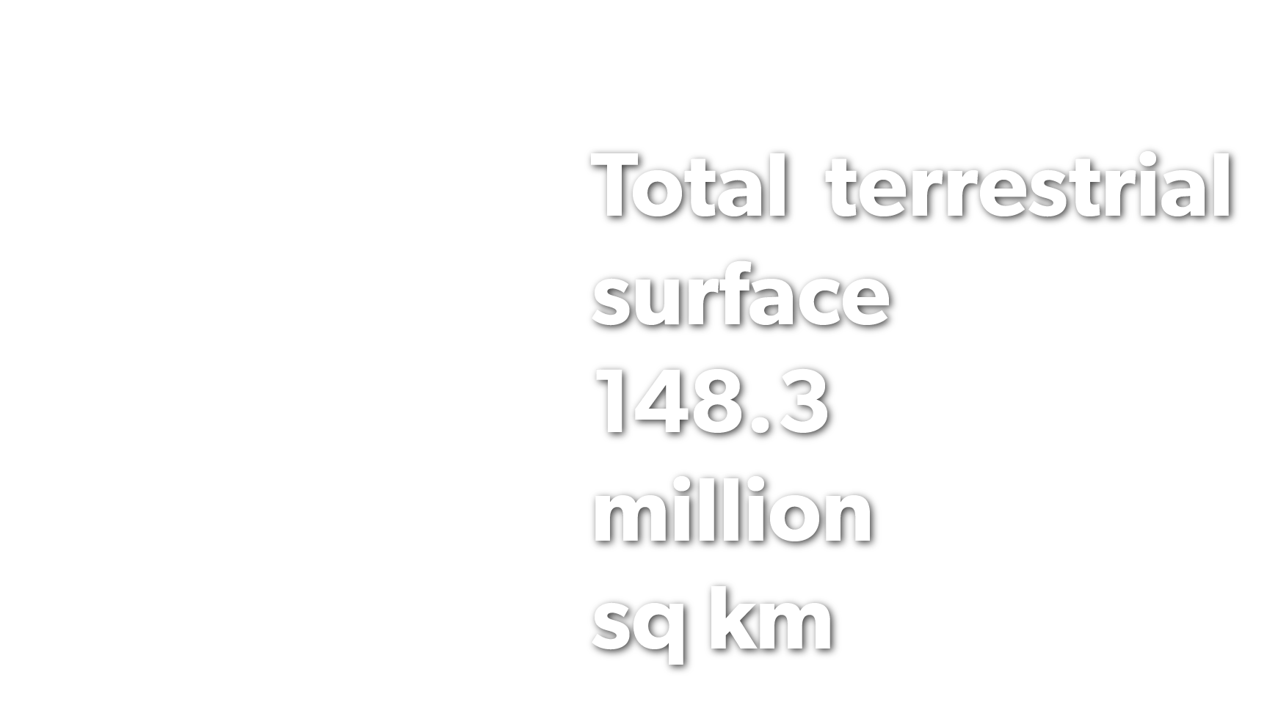

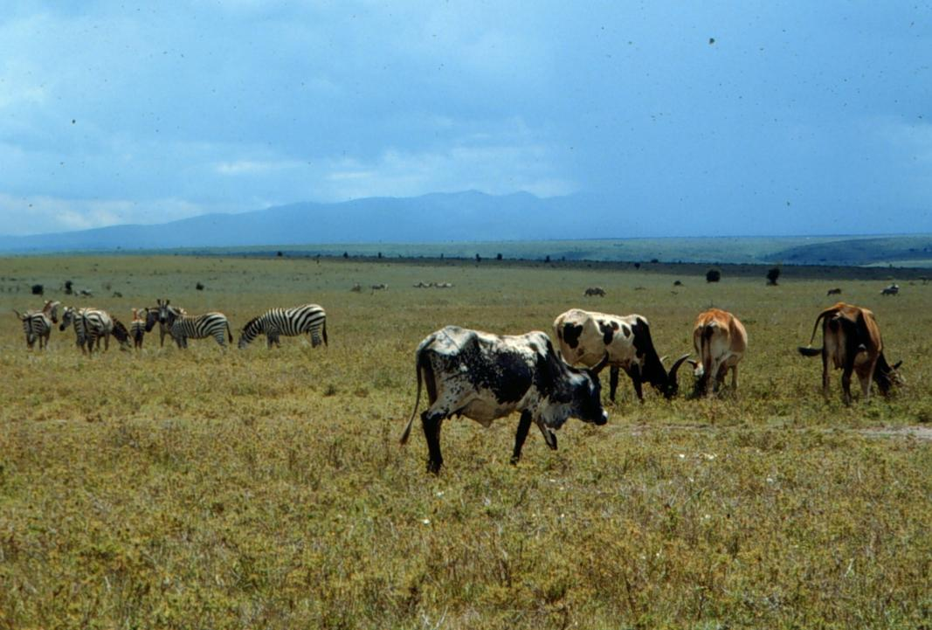
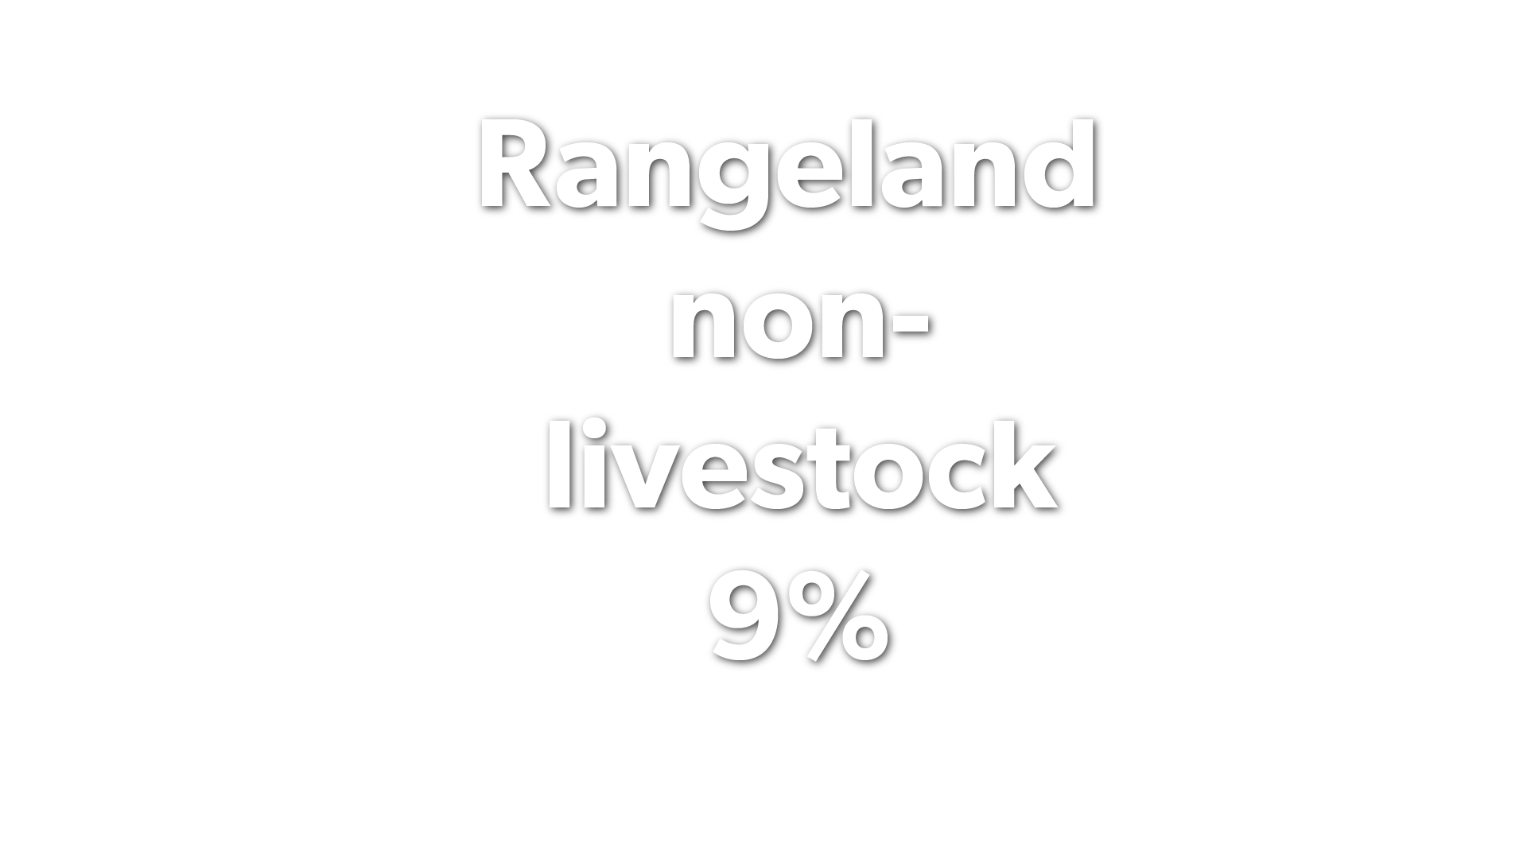
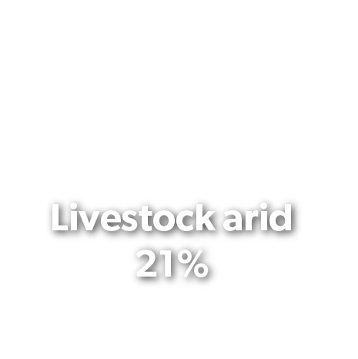
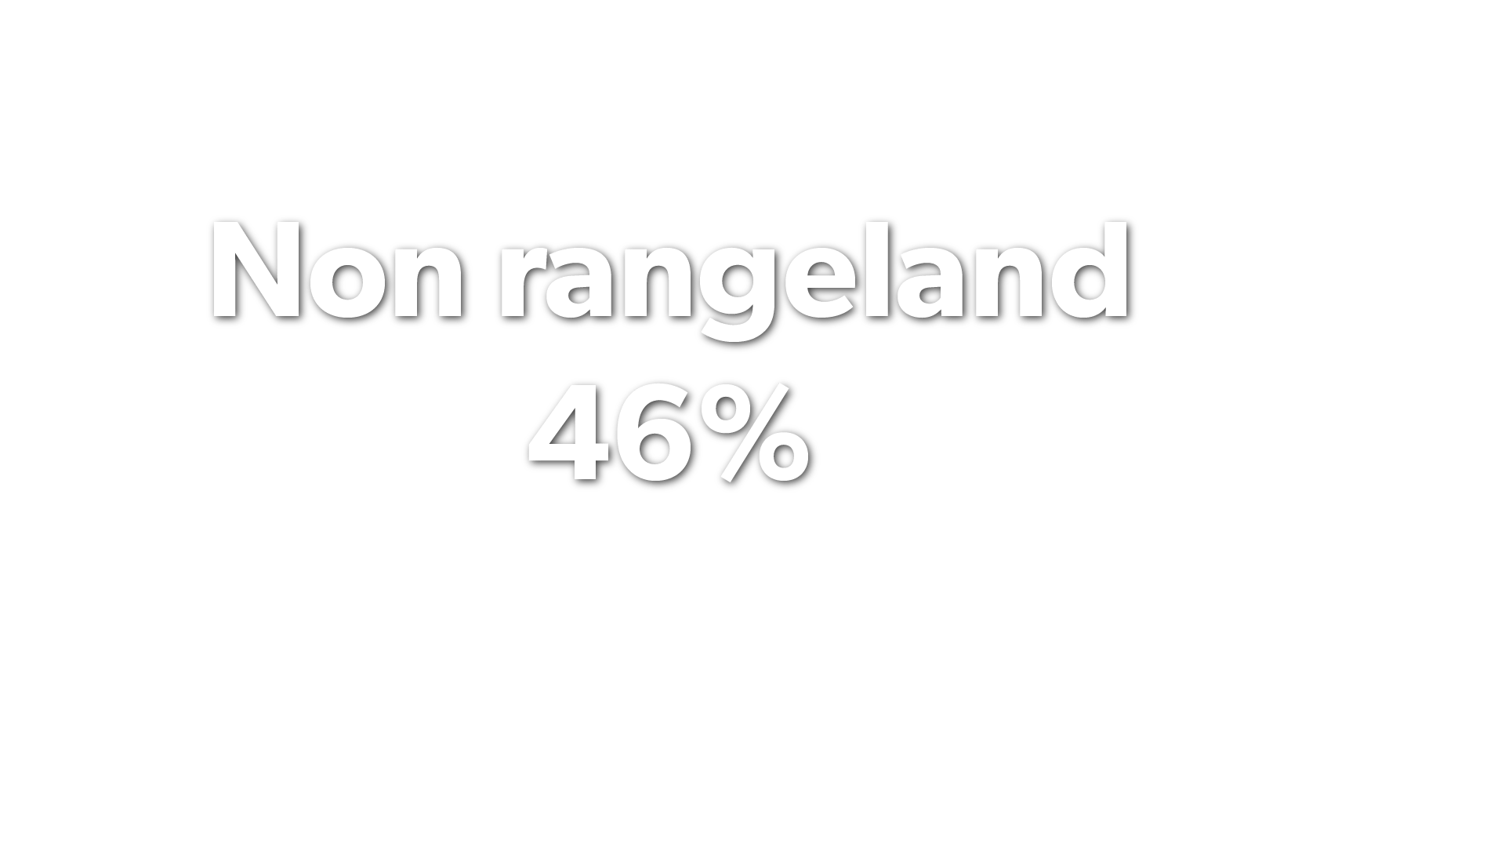
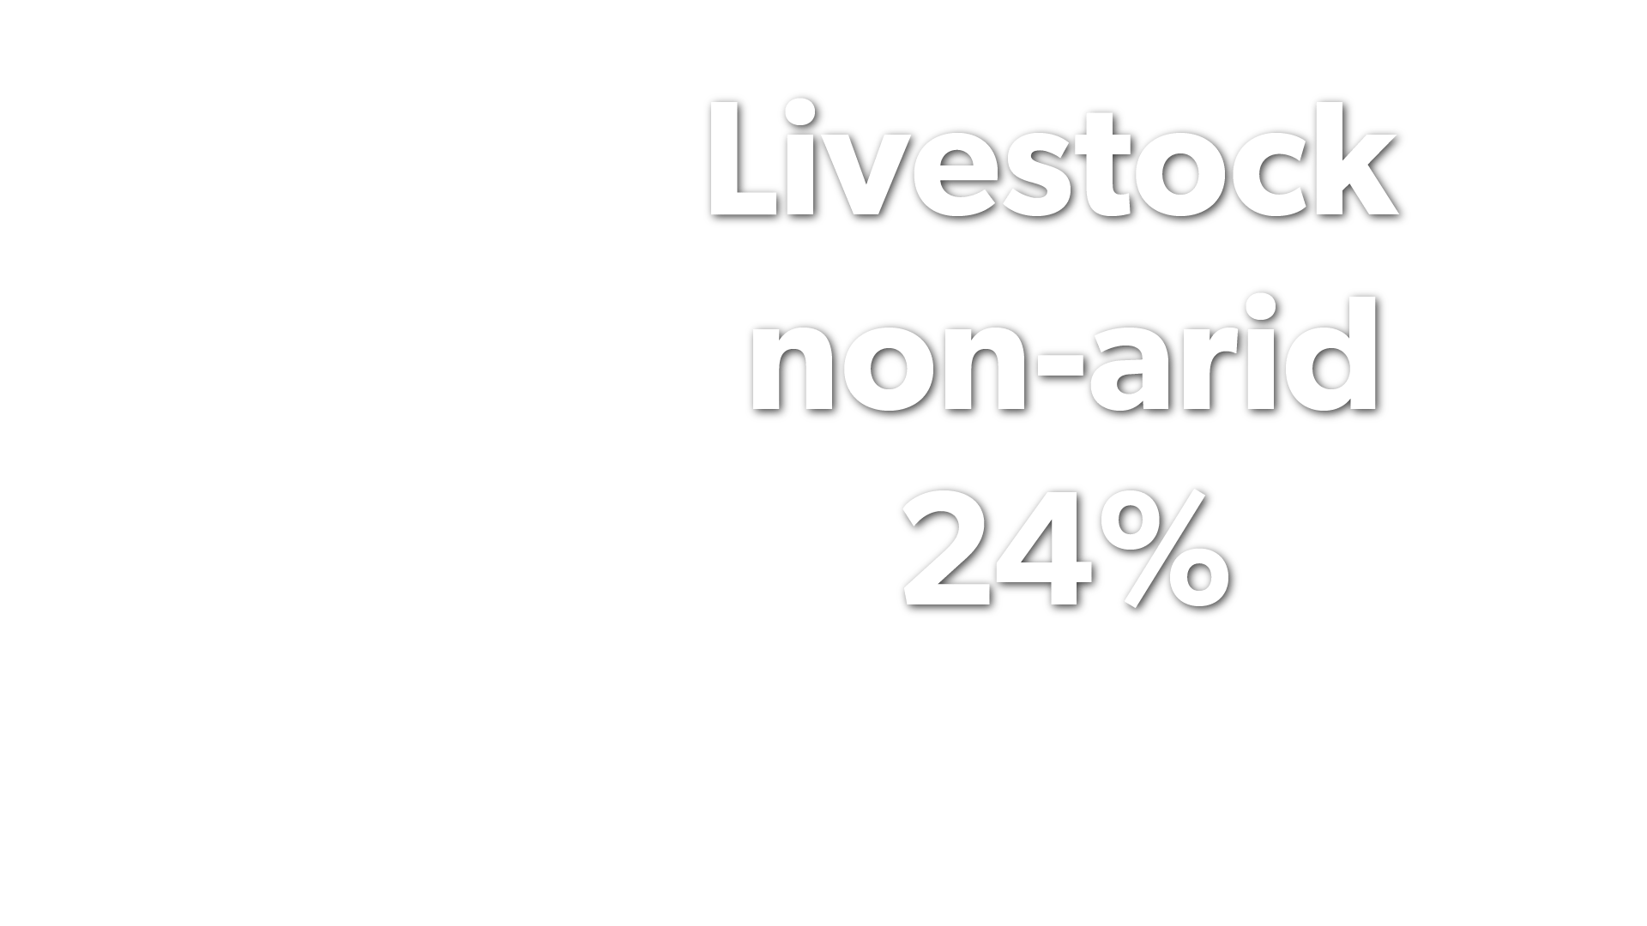
Well managed livestock systems can provide important ecosystem services
Rangeland management, especially by often-marginalized pastoral communities, provides multiple ecosystem services (biodiversity, c-sequestration)
Water used for livestock production in LMICs is almost entirely green water (=water that would have anyway fallen on the land)
Source: Rangelands Atlas, 2021

Slide 9
Nuances and contrasts

Slide 10
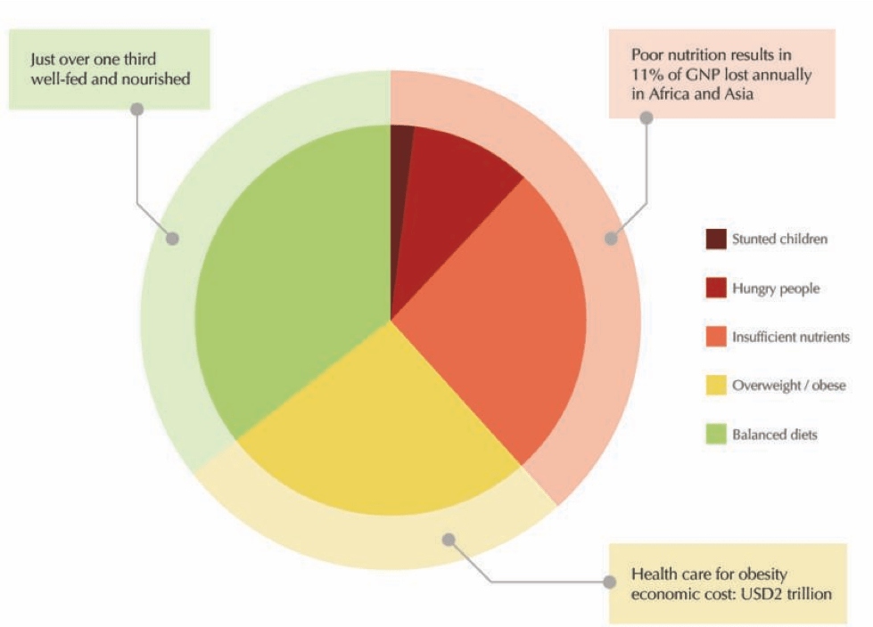
MESSAGE
Stop consuming animal products for the benefit of your health
However,
Meat, milk and eggs are essential dietary elements especially for most vulnerable
For least wealthy populations, a little more–not less–livestock-derived foods would contribute to significant positive nutritional outcomes
Sources: Data from FAO, IFAD, UNICEF, WFP and WHO, “The State of Food Security and Nutrition in the World 2018: Building Climate Resilience for Food Security and Nutrition”, 2018.; Development Initiatives Poverty Research Ltd, Global Nutrition Report 2017: Nourishing the SDGs, 2017.

Slide 11
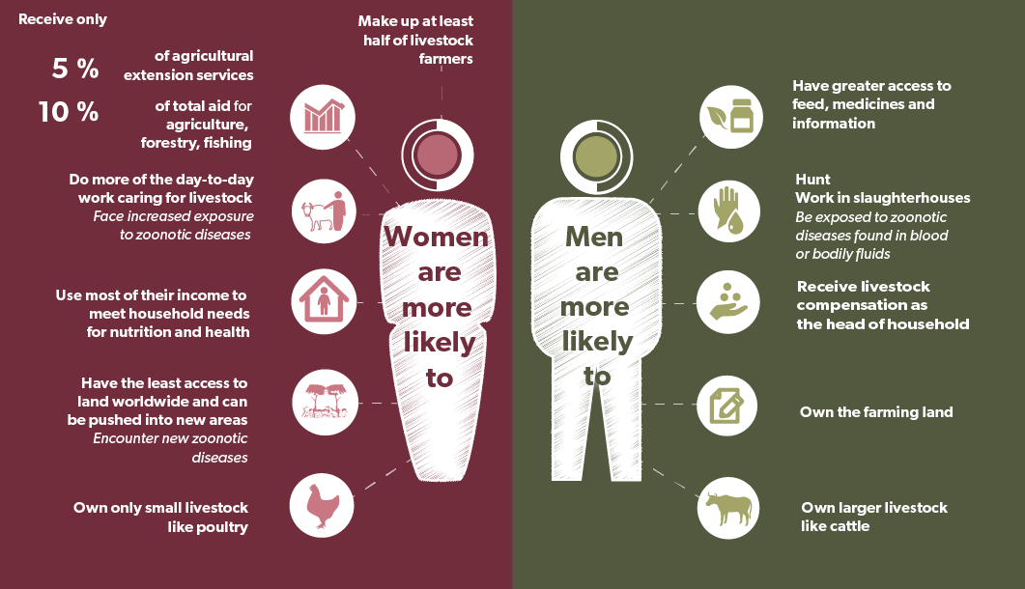
In LMICs…
MESSAGE
Transition away from animal production
However,
For over 500 million small scale livestock dependent households in LMICs, a ‘just transition’ includes improving the livelihood opportunities from animal agriculture
For women, in HICs, engagement in livestock enterprises is an option; in LMICs it’s a necessity
Women’s empowerment leads to healthier people, animals and environment. Livestock Pathways to 2030: One Health Brief 7. ILRI, 2021.

Slide 12
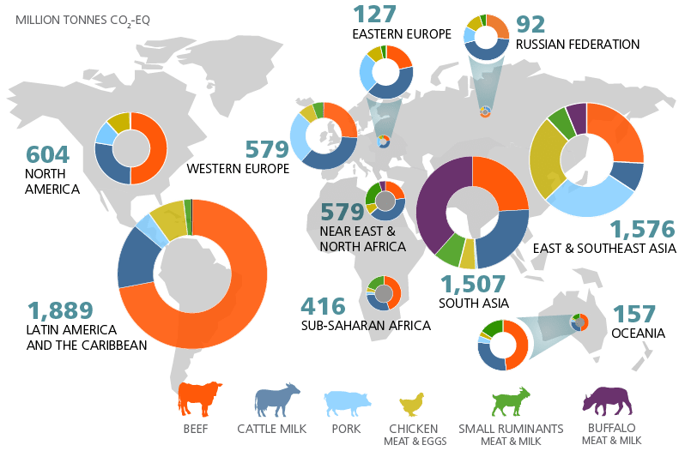
MESSAGE
Stop consuming animal foods to save the environment
However,
LMIC emissions (amounts and sources) vastly different from HIC: in aggregate and specifically
There are big opportunities for mitigation of GHG emissions in LMICs as part of sustainable livestock food systems transformation
Annual estimates from: https://www.fao.org/gleam/results/en/

Slide 13
Challenges

Slide 14
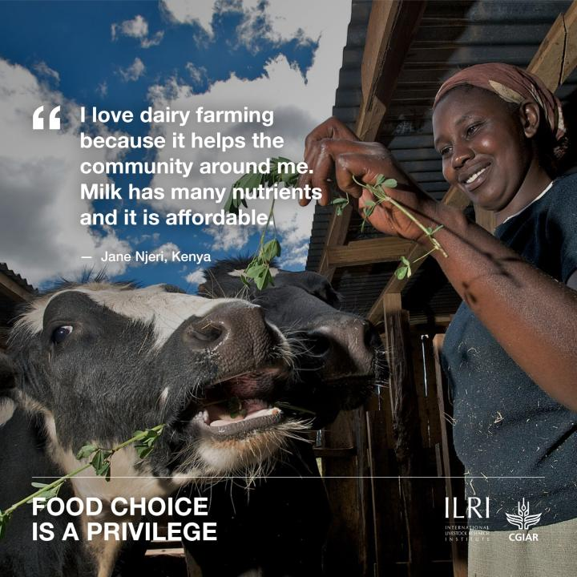
Challenges
Positive transition of today’s small-scale farms and pastoral systems in LMICs:
  More milk, meat and eggs
  Without causing environmental harm, food safety or disease hazards
  Addressing equality, equity for all
Climate change will lead to new pressures and unknowns
Failure to nuance messaging about livestock could jeopardize millions of livelihoods and impact on multiple development challenges

Slide 15
Options and solutions: no one-size fits all

Slide 16


Sustainable Animal Productivity for Livelihoods, Nutrition and Gender inclusion (SAPLING)
Transformation of livestock-based food systems to meet demand must also incorporate positive transitions for the environment, livelihoods, equity…..
Technologies and practices for sustainable productivity
Animal and herd health
Feeds and forages
Genetics and breeding
Evidence, decision and scaling
Competitive and inclusive livestock value chains
Co-design, co-development of context specific innovation packages
Livestock derived foods as part of diverse diets
Diet choices
Food safety
Bundling technological solutions (and bringing many new ones) for greater productivity with reduced environmental footprint, improved animal welfare
Local supply chains must be professionalized, supported by enabling policies
Gender equity and social inclusion
- Accommodative and transformative approaches

Slide 17
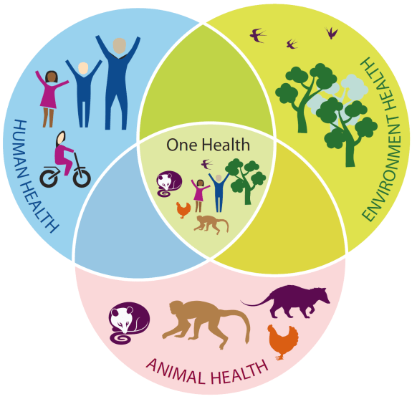
One Health
BMZ investment in ILRI One Health:
Euro 22 million (2019 to 2025)
Integral to improving food and nutrition security
RESPONSE THROUGH…
FOOD SAFETY
Opportunities to provide enabling regulatory environments, training, simple technologies and incentives to adopt food safety practices
Institutional coordination and action at every level for animal, human and environment health
Did you know...
Foodborne illnesses cost LMICs up to USD 110 bln annually!
PANDEMIC PREVENTION
ANTI-MICROBIAL RESISTANCE
Surveillance, detection and response at the animal level
Develop integrated approaches to understand the opportunities for mitigation without jeopardizing livelihoods and production

Slide 18
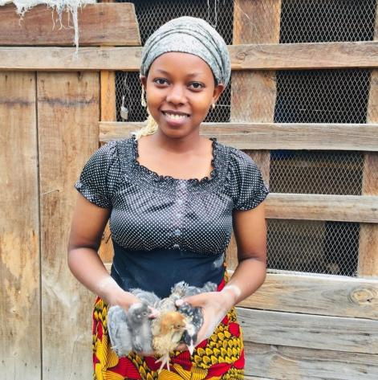
Intentional incorporation of opportunities for women
Chicken business in Ethiopia and Tanzania
Chicken business offers a rare and good income earning opportunity for young women
Reaching remote women with a ‘poultry package including marketing’ is effective
Addressing gender norms about women in chicken business at various levels (household, community, business, customers and trainings) is necessary for the women to benefit from poultry business
More systematic evidence is needed on impact of Gender Transformative Approaches and their potential for Gender Transformative Change.

Slide 19
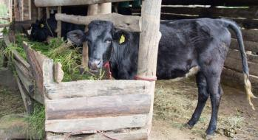
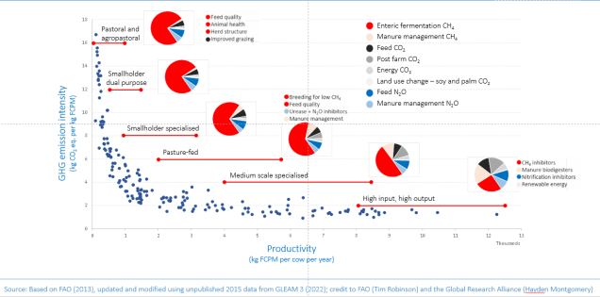
New IPCC Tier 2 emission factors for smallholders’ cows in Kenya
Measure and mitigate GHG emissions in context
Intensive: 50.6 kg /head/yr
Semi-intensive: 28.3 kg/head/yr
Industrial systems: 60-160 kg/head/year (depending on animal size and DM intake)
Sub-Saharan Africa Tier 1: 42kg/head/yr (female cattle)
Accurate emission metrics to assess interventions and access climate finance
Big opportunity to improve productivity and reduce emissions per unit of product without switching to industrial production
Dairy system characterization and emissions
German investment in Program for Climate Smart Livestock Euro 6.5 million

Slide 20
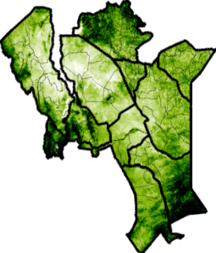
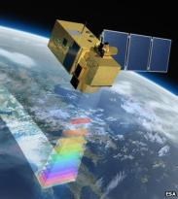
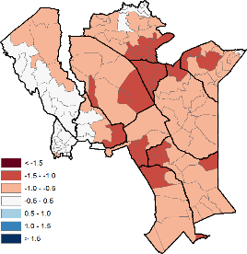
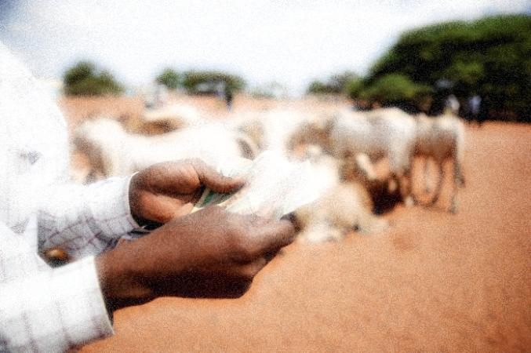
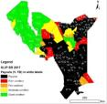
Satellite imagery used to assess forage availability
Livestock and climate adaptation (with mitigation co-benefits)
In spite of the uncertainty in climate science, livestock producers, traders, processers, and retailers need to adapt to future climate change
Example: Index-based livestock insurance:
  An innovation to provide better risk protection
  Viable alternative to humanitarian relief
  Helps to prevent vulnerable populations from losing too many livestock
  Potential to crowd-in investment and asset accumulation
Those who purchased insurance:
36% drop in distress sales of livestock
25% reduced likelihood of having to eat significantly smaller meals
33% reduction in dependence on food aid

Slide 21
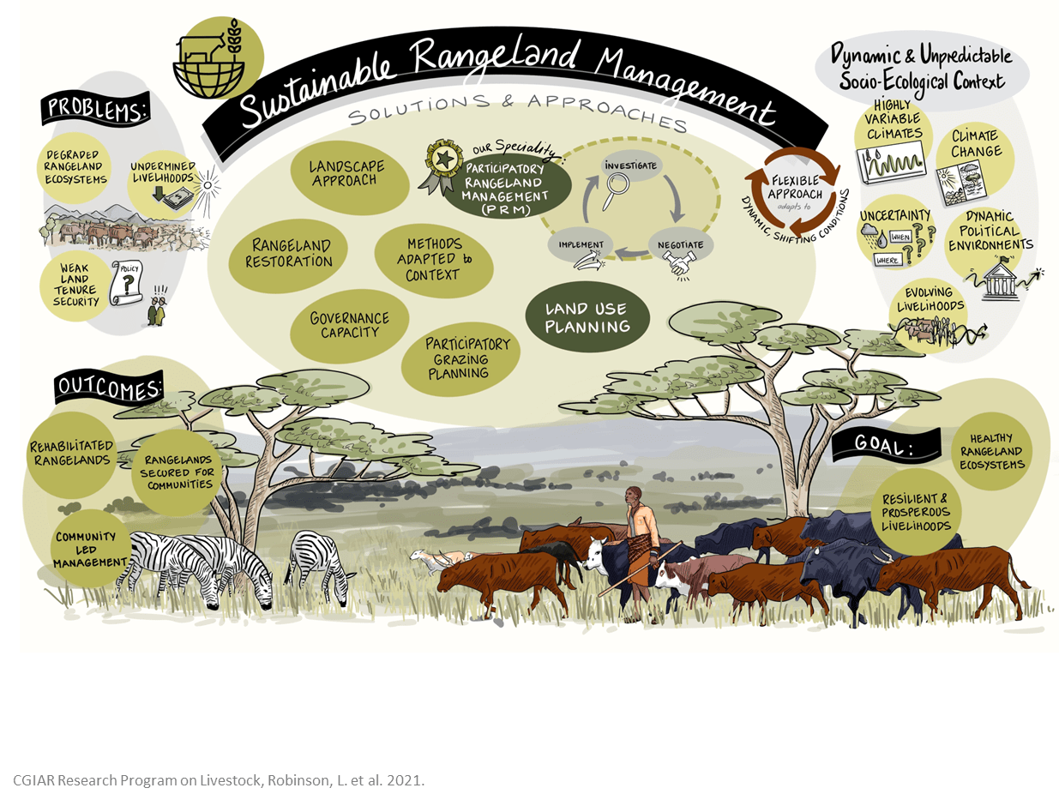
Sustainable rangeland management
Integrated options for sustainable rangeland management
Incentives and opportunities for environmental stewardship

Slide 22
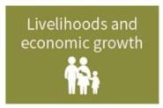

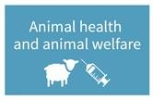
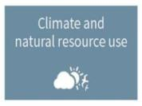
The Global Agenda for Sustainable Livestock
Vision: By 2030 sustainable, inclusive, resilient and diverse livestock systems across the world contribute significantly to Sustainable Development Goals (SDGs) of the UN Agenda 2030 and are integral to sustainable food systems
A unique, multi-stakeholder partnership operating in an open, consensual manner
Brings together diverse livestock stakeholders
  120 member organizations, 000s of stakeholders, all dimensions of the livestock sector
  From backyard one cow operation, pastoral/range-based systems, through emerging new businesses, to large scale commercial enterprises; producers, processors, covering every region of the world
  All stakeholder typologies: governments, private sector, NGO, research, investors, civil society and multilateral organizations
Evidence and practice change
Dialogue
Policy change

Slide 23
Multiple pathways towards sustainable livestock outcomes
…..affordable, accessible, balanced, nutritious diets that include the choice of healthy livestock-derived foods
…..healthy animals, safe food, healthy people….
…..every opportunity for every citizen and every nation to benefit fully from multiple livelihood and economic dimensions from sustainable livestock systems…..
…..inclusive, fair, equitable livestock systems……
…..efficient, low-carbon, sustainable livestock production that supports rather than harms the environment…..
….. a healthy planet, with rich biodiversity and sustainable water use…..

Slide 24
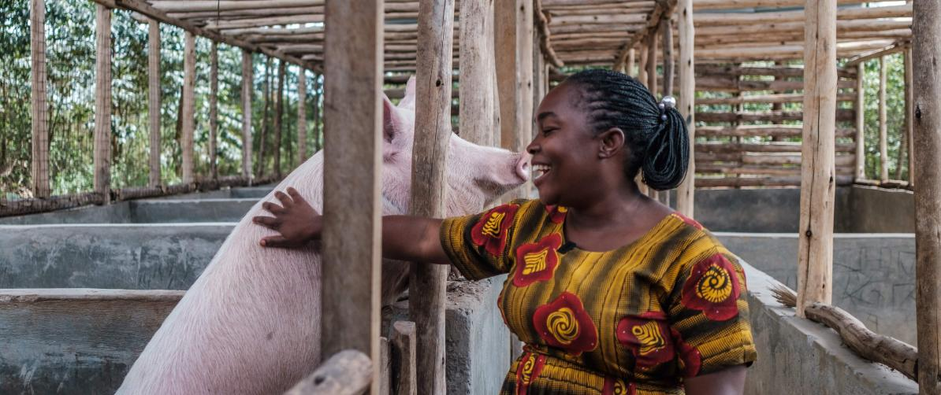
THANK YOU

