Slide 1
Monitoring and Evaluation conceptual frameworks and Management Information Systems at various levels
Caroline Kanyuuru
CRP on Livestock (ILRI)
Annual Meeting of the CGIAR MEL CoP, 12 October 2020

Slide 2
Introduction
The bigger goal is the ability to show a CGIAR systemic change through linkages at different levels
Conceptual framework and MIS are both critical – ppts try to show complementarity
MARLO experience - MIS linkages at project, country, centre

Slide 3
…intro
Project logic linkages – CRP, flagships, country ToCs
Indicators linkages at various levels
Evaluation
Take note of challenges and reflections

Slide 4
Linkages – MEL MIS

Slide 5
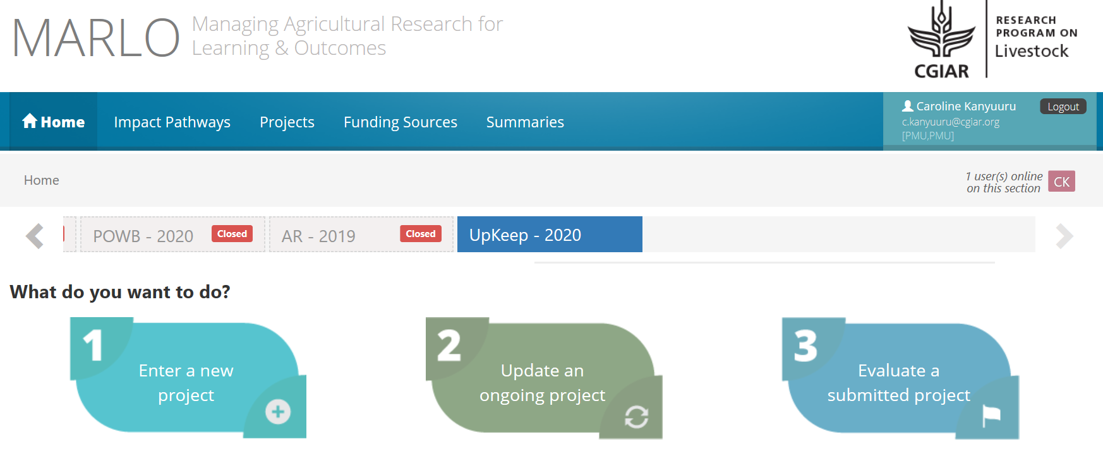

Slide 6
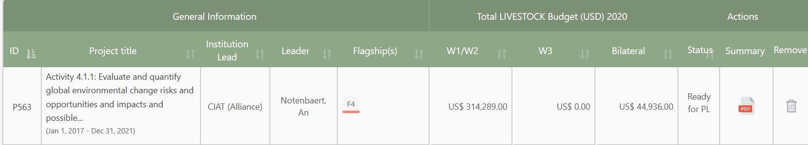
Program projects mapped to some center bilateral projects

Slide 7
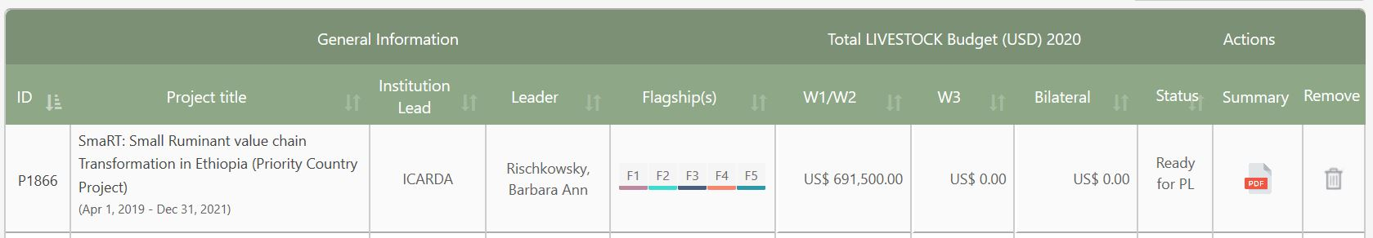
Priority country projects mapped under program projects

Slide 8
Challenges, opportunities and reflections
No linkages between program database (MARLO) and center database (I.e. One Corporate System etc)
Are MEL MIS linkage at various levels more useful/effective? How can we learn/improve?

Slide 9
Linkages – Project/program logic

Slide 10
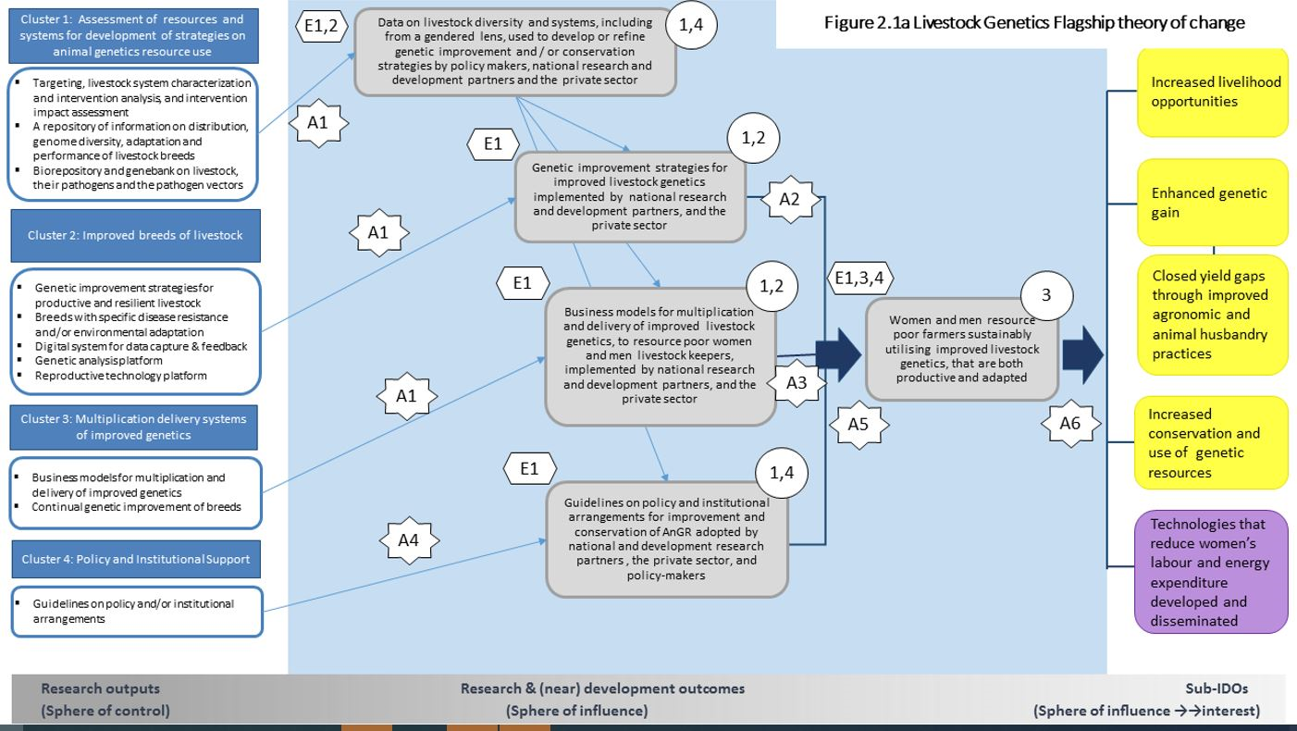
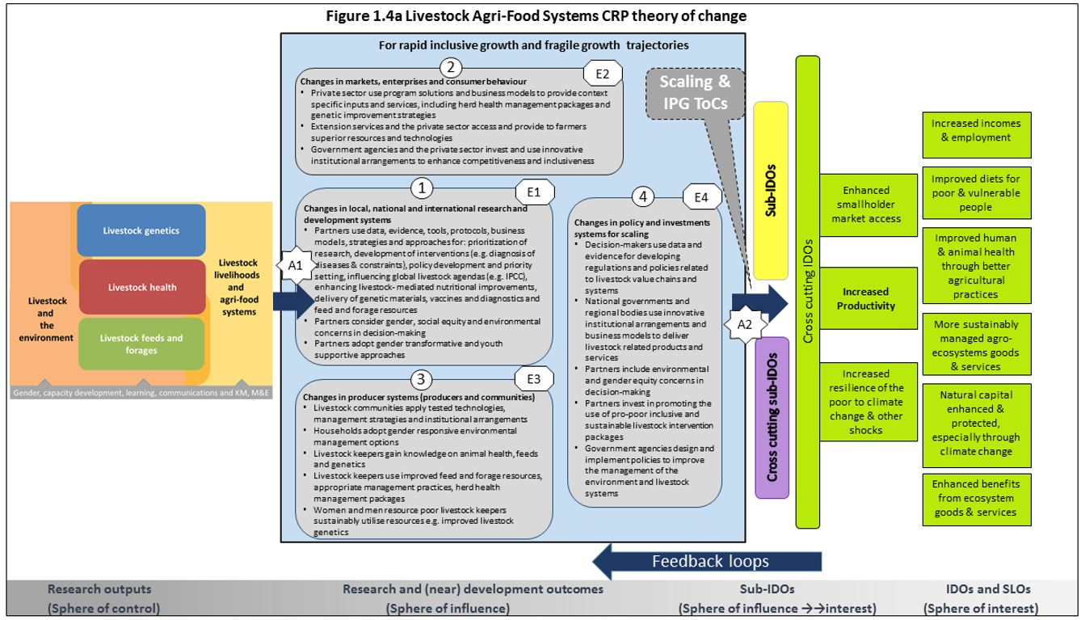
Linkages – Project/program logic
CRP ToC, flagship ToC, Country ToC developed separately – no clear linkage

Slide 11
...project/program logic
No bilateral ToCs/results frameworks/logframes linked to flagship ToCs – difficult to concretely measure & aggregate progress
Planning and reporting through MARLO borrows some elements from flagship ToCs but does not follow flagship ToC logic to measure progress

Slide 12
Challenges opportunities and reflections
ToCs (program, flagship, country, project) separately developed, difficult to aggregate information/show systemic change. How to improve?
The difference between AR4D vs development logic when developing project logic? Implications?

Slide 13
Linkages - Indicators

Slide 14
Linkages – indicators and assumptions
CRP and flagship ToCs defined assumptions - not tested
System level outcomes – not monitoring & reporting on any indicators at bilateral project level – to allow aggregation to system

Slide 15
…indicators
Program intermediate outcomes – monitoring attempted by policies and innovations indicators at mature stages (OICRs)-project uptake indicator not implemented
No clear linkages to bilateral project and country level intermediate indicators – to allow aggregation

Slide 16
...indicators
Program output indicators (CRRI)- policies, innovations, partnerships, participants in capacity development, altmetrics, peer review papers, project uptake – not followed served well in standardization
Not clearly linked to bilateral project output indicators

Slide 17
Challenges, opportunities and reflections
Indicators not available/aligned/monitored to aggregate data at project, country, program and system level
The mix of qualitative & quantitative indicators not clear
Stakeholders & partners roles/responsibilities when defining outcome indicators?

Slide 18
Linkages - Evaluations

Slide 19
Linkages – Evaluations/evidence
Based on quality assurance at SMO level
Evidence at System Level Outcomes was scarce
OICRs designed to capture outcomes – often lacked evidence
MELIA studies (ex ante-expost) initially scarce – SMO guidance building capacity

Slide 20
Challenges, opportunities and reflections
No prior evaluations plans
What evaluation criteria is important (relevance, efficiency, effectiveness, impact and sustainability) and at what level to demonstrate systemic change?

Slide 21
Interactive session
Participants views on challenges, opportunities and reflections raised were solicitated using voxvote
Results are in the next slides

Slide 22
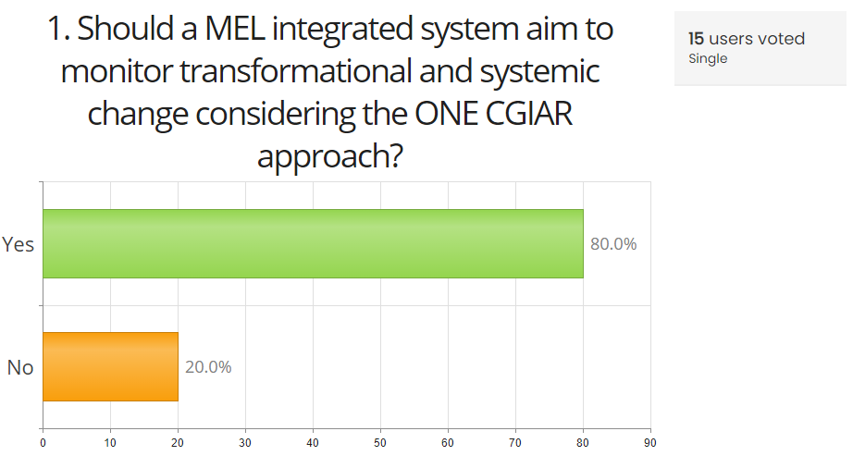

Slide 23
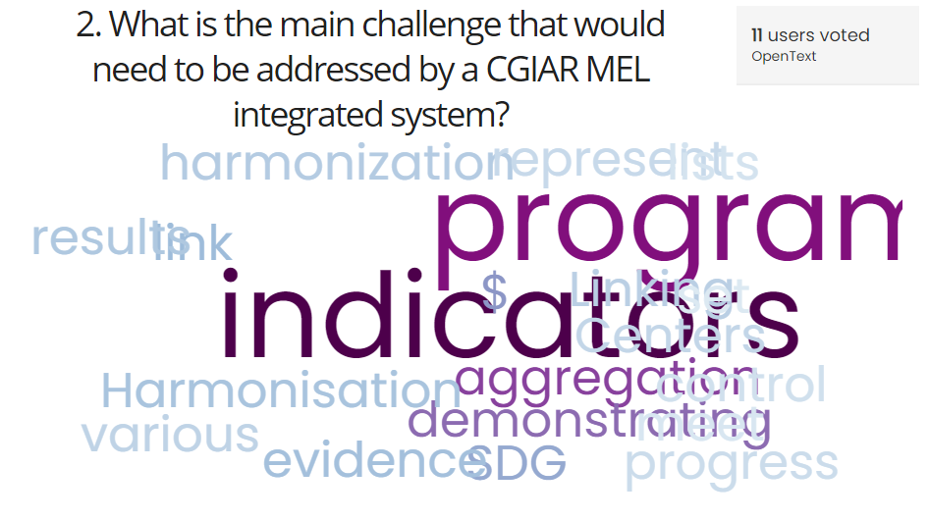

Slide 24
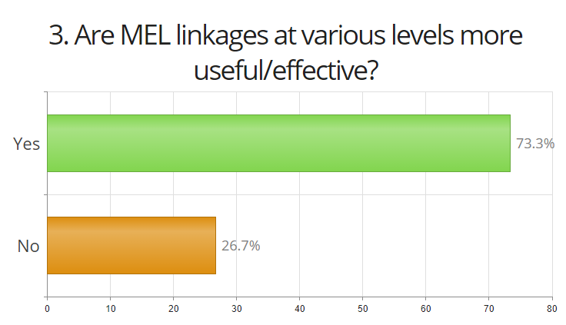

Slide 25
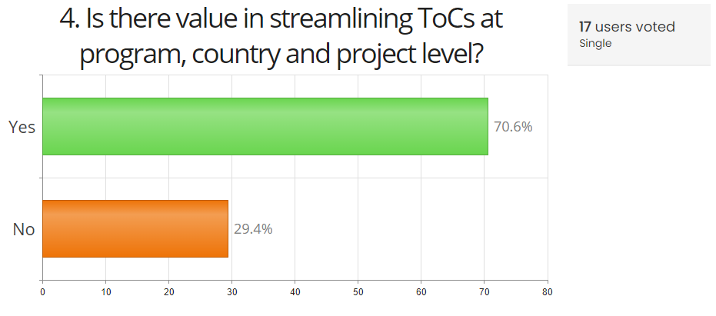

Slide 26
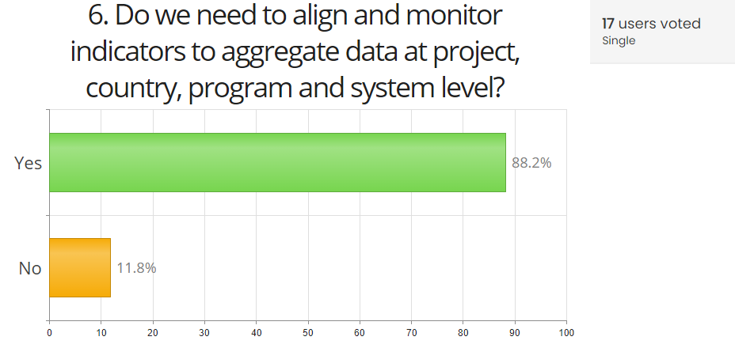

Slide 27
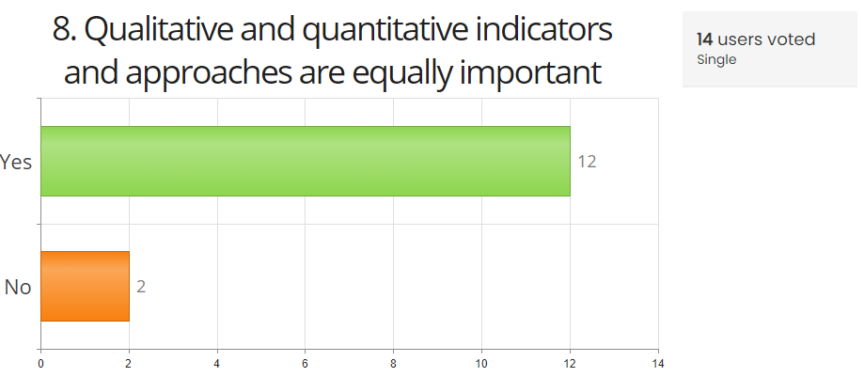

Slide 28
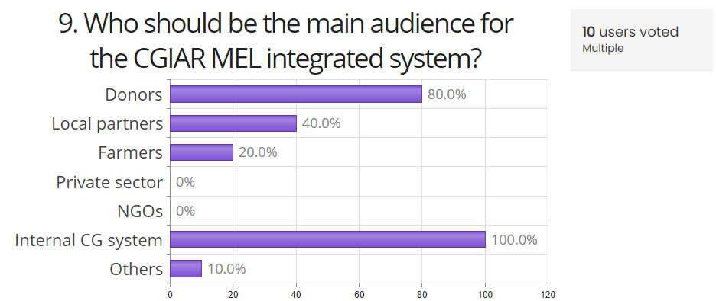

Slide 29
