Slide 1






Key influencers in Burkina Faso's poultry management: Insights from systems mapping and network analysis
Ziynet Boz¹, Michel Dione², Robyn Alders³, Assèta Kagambèga⁴, Theodore Knight-Jones⁵, Guy Ilboudo², Brice Ouedraogo², Sidonie Ima-Ouoba⁶, Claudia Ganser¹
¹University of Florida, USA; ²International Livestock Research Institute, Ouagadougou, Burkina Faso; ³Kyeema Foundation, Brisbane & Development Policy Centre, Australian National University, Australia; ⁴University Joseph Ki-Zerbo, Ouagadougou, Burkina Faso; ⁵International Livestock Research Institute, Addis Ababa, Ethiopia; ⁶Institute of Environment and Agricultural Research (INERA), Ouagadougou, Burkina Faso
8th World One Health Congress, 20-23 September 2024, Cape Town, South Africa
Feed the Future Innovation Lab for Livestock Systems

Slide 2

Why Livestock Matters in AFRICA
Food Security
Culture
Nutritional Security
Economic

Slide 3
Why Livestock Matters in AFRICA
Food Security
Valuable source of proteins and micronutrients
Key role in a balanced and healthy diet
Meat consumption modest, especially in areas with malnutrition
Culture
Nutritional Security
Economic

Slide 4
Why Livestock Matters in AFRICA
Food Security
Valuable source of proteins and micronutrients
Key role in a balanced and healthy diet
Meat consumption modest, especially in areas with malnutrition
Nutritional Security
From 1973-2013 per capita meat consumption rose from 13.7 to 16.2 kg (Latino et al., 2010)
By 2050 meat demand may triple, with significant implications on production and trade
Driven by population growth, urbanization, increased standard of living
Culture
Economic

Slide 5
Why Livestock Matters in AFRICA
Food Security
Valuable source of proteins and micronutrients
Key role in a balanced and healthy diet
Meat consumption modest, especially in areas with malnutrition
Nutritional Security
From 1973-2013 per capita meat consumption rose from 13.7 to 16.2 kg
Driven by population growth, urbanization, increased standard of living
By 2050 meat demand may triple, with significant implications on production and trade
Culture
Livestock accounts for 55% of total household income in pastoral system, and 1/3 in mixed crop-livestock systems (GCA, 2022)
Trade in livestock and livestock products in Africa is hampered by modest production levels
Economic

Slide 6
Why Livestock Matters in AFRICA
Food Security
Valuable source of proteins and micronutrients
Key role in a balanced and healthy diet
Meat consumption modest, especially in areas with malnutrition
Reinforce traditions and strengthen social relationships
One of the few assets women can own
However, gender imbalances exist
Nutritional Security
From 1973-2013 per capita meat consumption rose from 13.7 to 16.2 kg
Driven by population growth, urbanization, increased standard of living
By 2050 meat demand may triple, with significant implications on production and trade
Culture
Livestock accounts for 55% of total household income in pastoral system, and 1/3 in mixed crop-livestock systems
Trade in livestock and livestock products in Africa is hampered by modest production levels
Economic

Slide 7
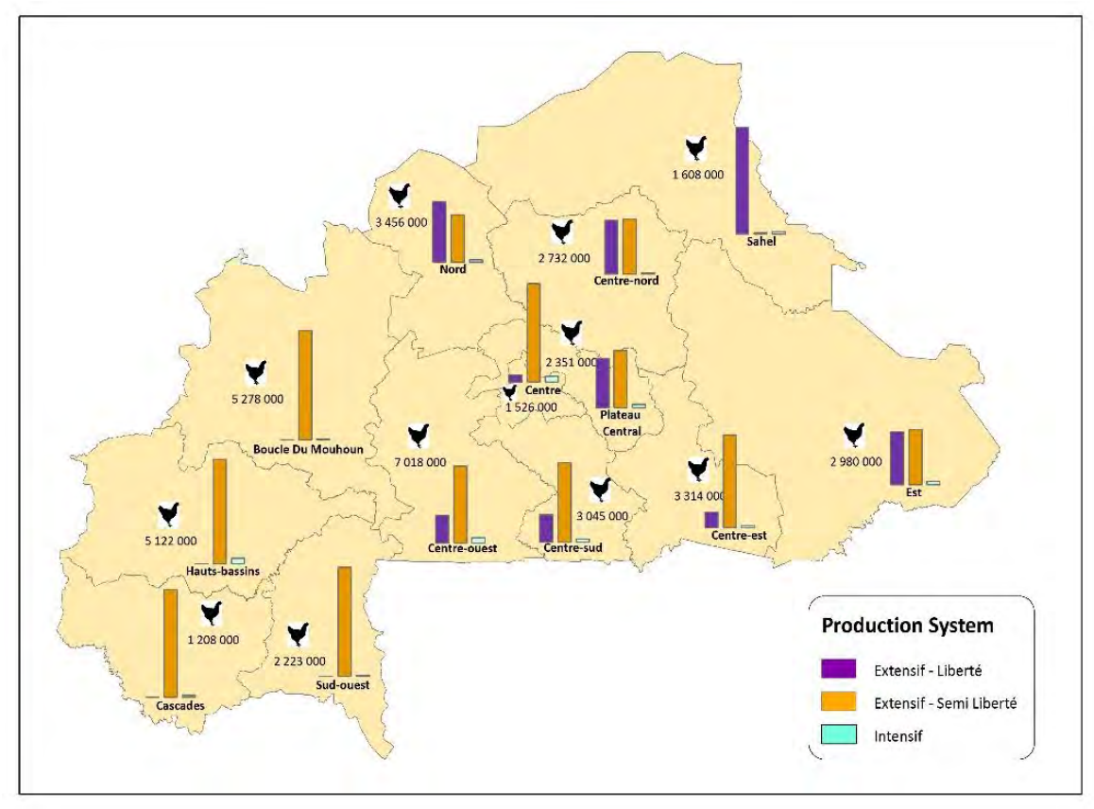
Livestock PRODUCTION IN BuRKINA FASO
Livestock production in Burkina Faso, number of animals (FAOSATAT, 2011)
First species in terms of number of heads
Most dynamic sector
90% contributed through traditional poultry farming
Chicken is widely consumed
Restaurant & street food consumption frequent
Poultry distribution by production system and heads in Burkina Faso (GLW 2010 & expert consultations)
Dione et al., 2021

Slide 8
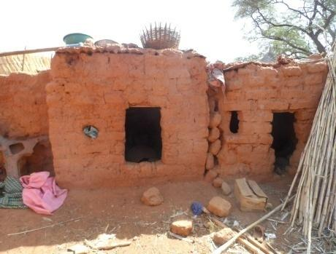
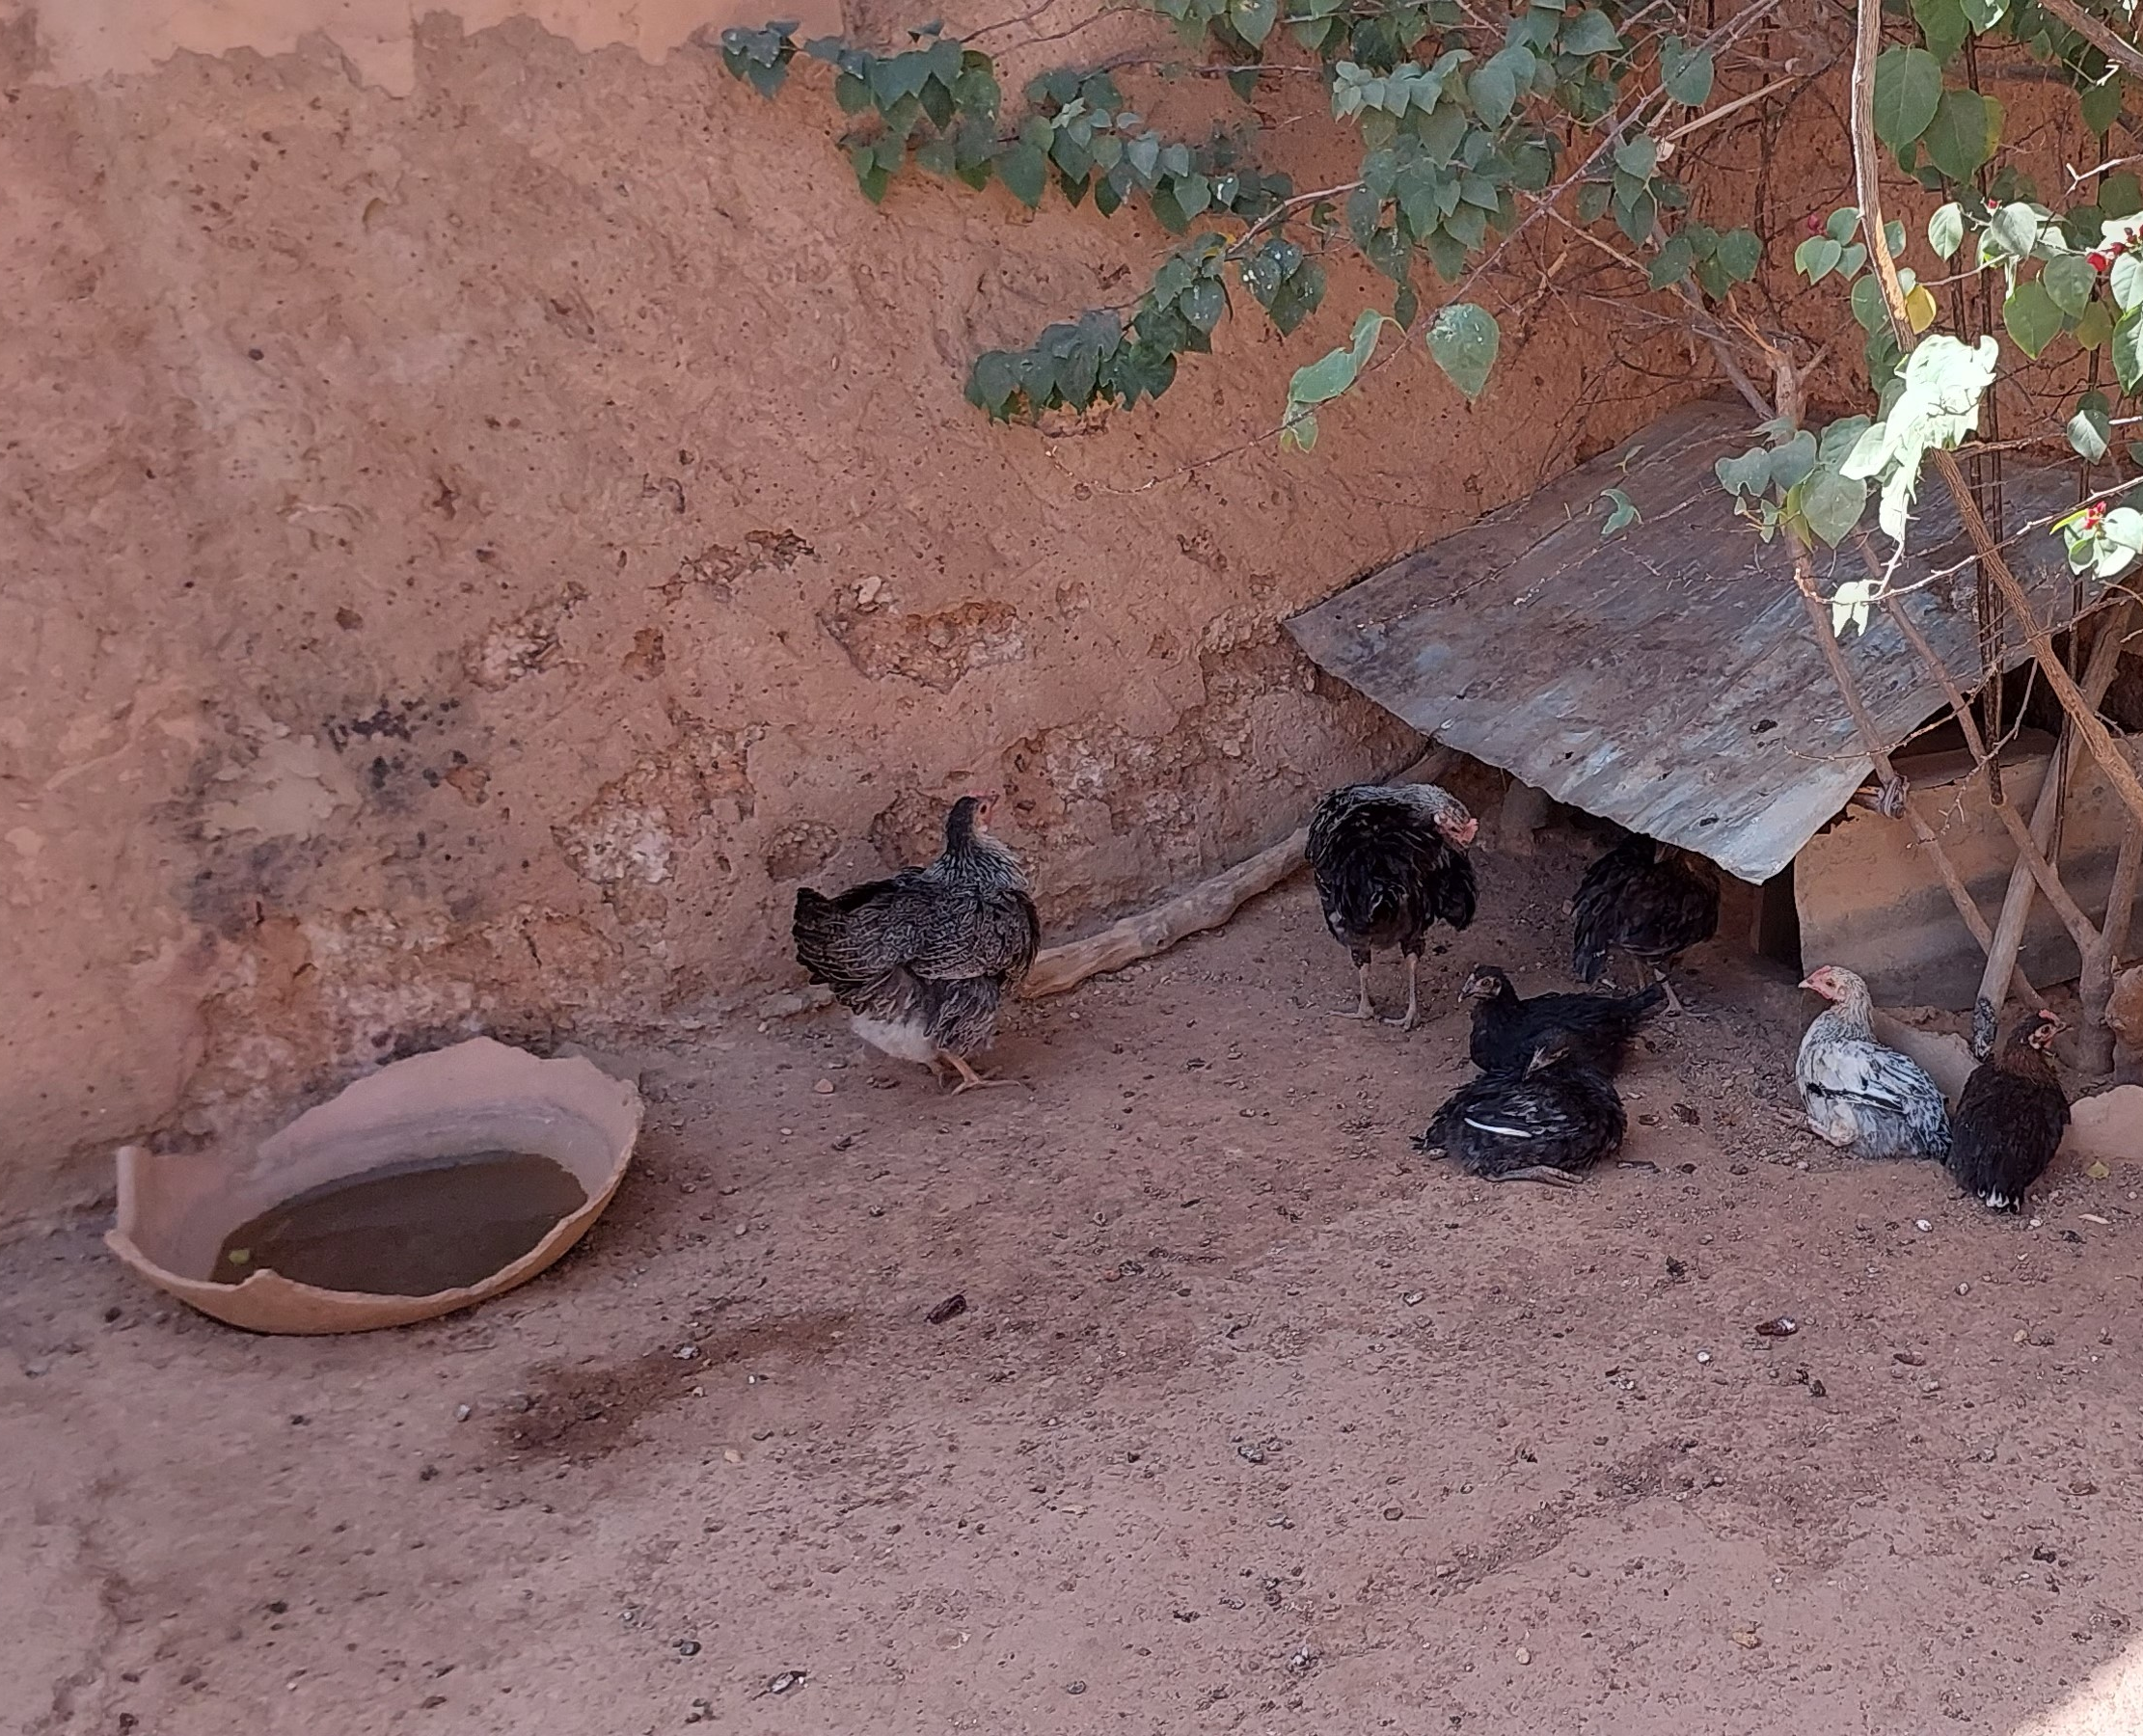
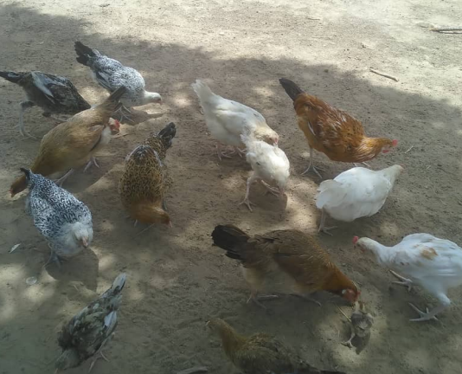
TRADITIONAL POULTY PRODUCTION
Largely free and scavenging flocks
Rudimentary husbandry
Austin 2016, Ilboudo 2015, Alders 2005

Slide 9
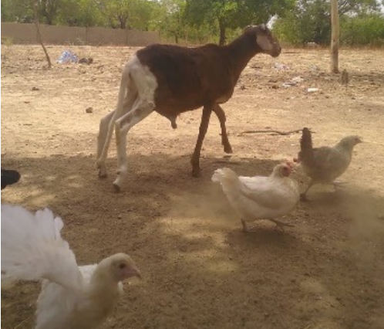
TRADITIONAL POULTY PRODUCTION
Preference for local breeds over introduced varieties
Cross-breeding and mixed flocks
Austin 2016, Ilboudo 2015, Alders 2005

Slide 10

Why TRADITIONAL Poultry Production Matters in BURKINA FASO
Food Security
&
Safety
Poultry contributes to 16.47% of meat consumed.
In 2017, 400,000 people fell ill due to consumption of poultry
Generally consume feed not edible by humans
Major role for religious and cultural practices, as well as social conventions
Culture
Nutritional Security
Value of poultry production is XOF 85 billion (USD 140 million)
Represents 6% of Burkina Faso’s GDP
Important source of income in rural regions, for the poor, and women
Poultry assets are almost exclusively managed by women and youth
Economic
Dione et al., 2021; FAO 2018

Slide 11
Why TRADITIONAL Poultry Production Matters in BURKINA FASO
Food Security
&
Safety
Poultry contributes to 16.47% of meat consumed.
Per capita consumption is 8 & 1 kg of meat and egg, respectively
In 2017, 400,000 people fell ill due to consumption of poultry
Major role for religious and cultural practices, as well as social conventions
Culture
Nutritional Security
Value of poultry production is XOF 85 billion (USD 140 millon)
Represents 6% of Burkina Faso’s GDP
Traditional poultry demand is expected to increase by 1,400 tons per year over the next 10 years
90 % attributable to traditional production systems
Important source of income in rural regions, for the poor, and women
Poultry assets are almost exclusively managed by women and youth
Economic
Dione et al., 2021; FAO 2018

Slide 12
Why TRADITIONAL Poultry Production Matters in BURKINA FASO
Food Security
&
Safety
Poultry contributes to 16.47% of meat consumed.
Per capita consumption is 8 & 1 kg of meat and egg, respectively
In 2017, 400,000 people fell ill due to consumption of poultry
Major role for religious and cultural practices, as well as social conventions
Culture
Nutritional Security
Value of poultry production is XOF 85 billion (USD 140 millon)
Represents 6% of Burkina Faso’s GDP
Traditional poultry demand is expected to increase by 1,400 tons per year over the next 10 years
90 % attributable to traditional production systems
Important source of income in rural regions, for the poor, and women
Poultry assets are almost exclusively managed by women and youth
Economic
Dione et al., 2021; FAO 2018

Slide 13
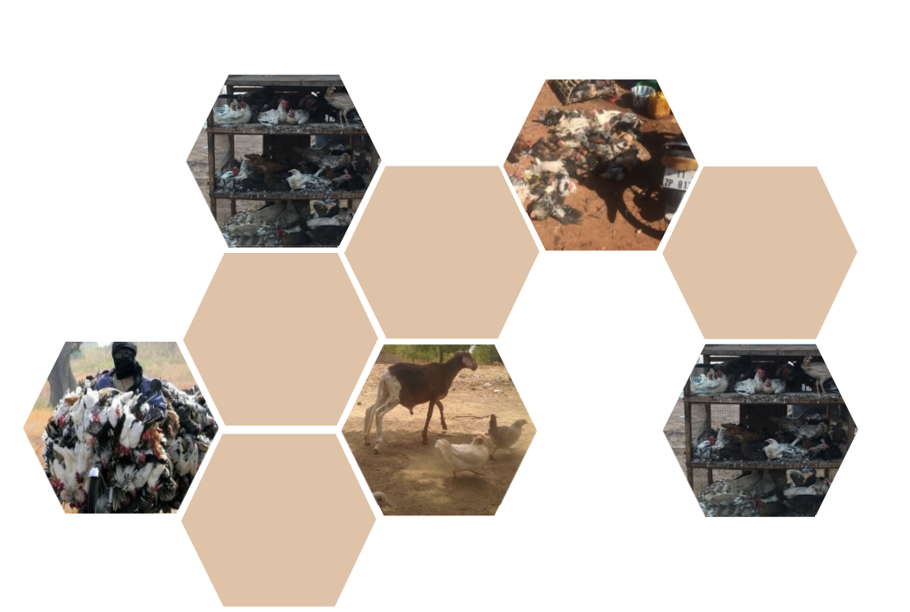
OPTIMIZING PRODUCTIVITY AND SUSTAINABILITY
THROUGH EFFECTIVE MANAGEMENT OF POULTRY SYSTEMS AND ITS COMPONENTS
SYSTEMS
COMPONENTS

Slide 14
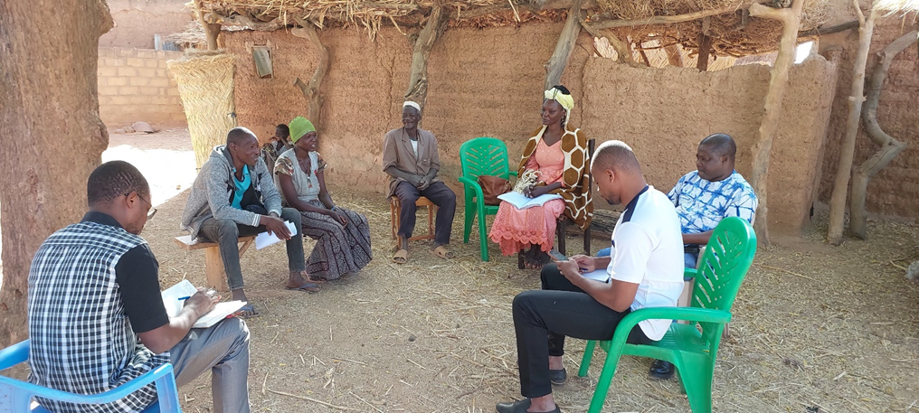
APPROACH
Qualitative interviews :
  Identify the integral components of traditional poultry production systems
  Describe the interactions between these components
Data synthesis through mixed-methods approach using Kumu Software
  Systems mapping
  Network analysis

Slide 15
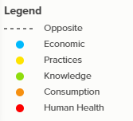
COMPONENTS OF TRADITIONAL POULTRY PRODUCTION SYSTEMS
Reporting of illness symptoms, medication usage, exposure to chicken feces, and through diet.
Household Illness

Slide 16
COMPONENTS OF TRADITIONAL POULTRY PRODUCTION SYSTEMS
Respondent knowledge on safe poultry keeping and hygiene interventions
Household Illness
Knowledge on Poultry Keeping & Hygiene

Slide 17
COMPONENTS OF TRADITIONAL POULTRY PRODUCTION SYSTEMS
Household Illness
Knowledge on Poultry Keeping & Hygiene
Access to sources for medication, feed, poultry health services, financial services, chicken distribution services, and cooperatives
Access to External Livestock Services

Slide 18
COMPONENTS OF TRADITIONAL POULTRY PRODUCTION SYSTEMS
Household Illness
Knowledge on Poultry Keeping & Hygiene
Access to External Livestock Services
Poultry Consumption
Consumption of produced and purchased protein and micronutrient sources

Slide 19
COMPONENTS OF TRADITIONAL POULTRY PRODUCTION SYSTEMS
Household Illness
Knowledge on Poultry Keeping & Hygiene
Access to External Livestock Services
Poultry Consumption
Household Economics
Includes considerations of income from all sources, and poultry income from sale of eggs, and meat.

Slide 20
COMPONENTS OF TRADITIONAL POULTRY PRODUCTION SYSTEMS
Household Illness
Knowledge on Poultry Keeping & Hygiene
Livestock Practices
Access to External Livestock Services
Poultry Consumption
Practices performed daily for the care of poultry, such as poultry enclosures, poultry feed and water, as well as disease management
Household Economics

Slide 21
COMPONENTS OF TRADITIONAL POULTRY PRODUCTION SYSTEMS
Household Illness
Knowledge on Poultry Keeping & Hygiene
Livestock Practices
Access to External Livestock Services
Poultry Consumption
Household Economics
Education level of head of household
Educational Level

Slide 22
COMPONENTS OF TRADITIONAL POULTRY PRODUCTION SYSTEMS
Household Illness
Knowledge on Poultry Keeping & Hygiene
Losses due to animal disease, reporting of clinical signs, number of sick birds, profit due to sale of poultry meat and eggs
Livestock Practices
Access to External Livestock Services
Poultry Consumption
Livestock Loss & Profits
Household Economics
Educational Level

Slide 23
COMPONENTS OF TRADITIONAL POULTRY PRODUCTION SYSTEMS
Cleaning of feces from chicken environment, processing of chicken feces, and wash practices
Household Illness
Knowledge on Poultry Keeping & Hygiene
Hygiene Practices
Livestock Practices
Access to External Livestock Services
Poultry Consumption
Livestock Loss & Profits
Household Economics
Educational Level

Slide 24
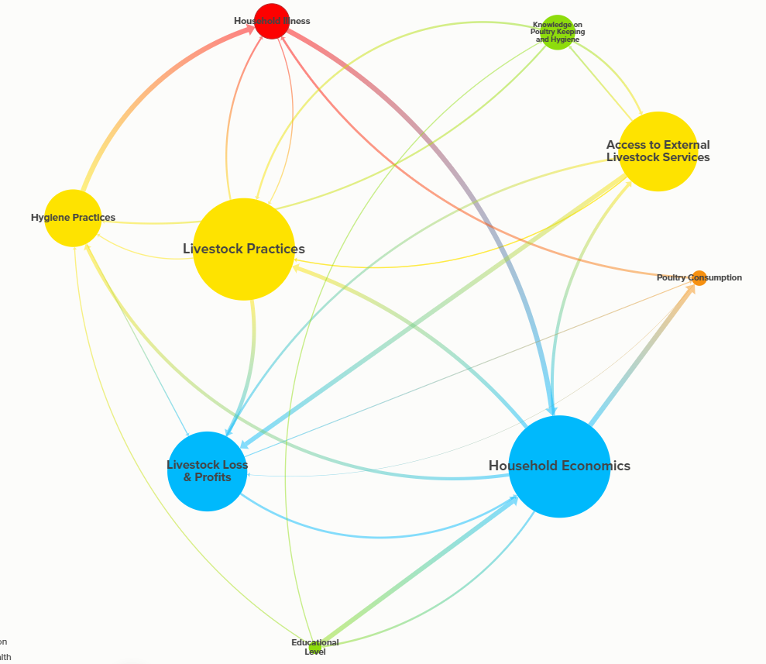

INTERACTION BETWEEN COMPONENTS

Slide 25
USING NETWORK theory to evaluate the importance of system components
Degree centrality: The number of direct connections a system component has
The most central components of poultry production systems were:
Household Economics
Livestock Practices
Livestock Loss & Profits

Slide 26
USING NETWORK theory to evaluate the importance of system components
Betweenness centrality: Measures the importance of a node on the flow between components of a system
The components with greatest control over the flow of information in poultry production systems were:
Livestock Loss & Profits
Household Economics
Access to External Services

Slide 27
USING NETWORK theory to evaluate the importance of system components
Closeness centrality: Measures the average shortest distance between connections in the system
Key components for intervention and influence in poultry systems were:
Household Economics
Livestock Loss & Profits
Education Level

Slide 28
USING NETWORK theory to evaluate the importance of system components
MICMAC Analysis: Identifies components based on their driving power and dependency in the network
Education Level had largest score, hence the greatest driving power in poultry production systems

Slide 29
USING NETWORK theory to evaluate the importance of system components
MICMAC Analysis: Identifies components based on their driving power and dependency in the network
Livestock Loss & Profits had the second largest score, underscoring its crucial role in economic dynamics in poultry production systems

Slide 30
USING NETWORK theory to evaluate the importance of system components
MICMAC Analysis: Identifies components based on their driving power and dependency in the network
Hygiene Practices & Poultry Consumption had the third largest scores, emerging as key drivers affecting public health and economic outputs

Slide 31
Conclusions
Pivotal components of traditional poultry production systems in Burkina Faso are associated with Education and Economic factors, due to their central role
These are strategic areas of intervention to catalyze gender-sensitive change across the system
Focus on these components may improve resiliency of the system, by reducing vulnerabilities and increasing productivity
System mapping coupled with network analysis is a valuable approach for achieving improvements to and communication within traditional poultry management systems, and can serve as foundation for complex quantitative analyses
Household Economics
Educational
Level
Livestock Loss & Profits

Slide 32
Disclaimer
This work was funded by the Bureau for Resilience and Food Security of the United States Agency for International Development (USAID) under agreement No. AID-OAA-L-15-00003 as part of the Feed the Future Innovation Lab for Livestock Systems and the Bill & Melinda Gates, Foundation OPP#1175487. Any opinions, findings, conclusions, or recommendations expressed here are those of the authors alone.
Acknowledgments: We thank all partners in Burkina Faso for their excellent collaboration.
Feed the Future Innovation Lab for Livestock Systems
University of Florida | Gainesville, FL
livestock-lab@ufl.edu | http://livestocklab.ifas.ufl.edu

Slide 33

This document is licensed for use under the Creative Commons Attribution 4.0 International Licence.
September 2024

