Slide 1
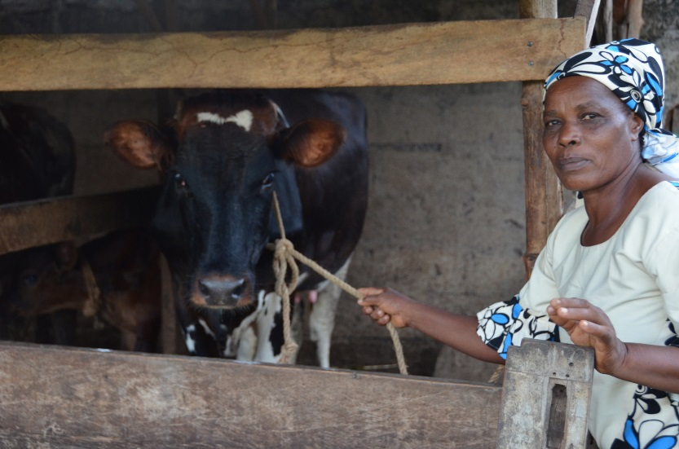
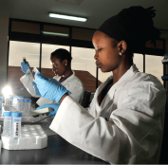
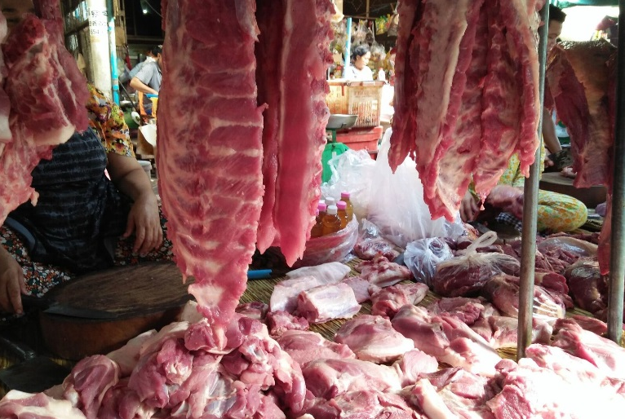


Food safety in Africa
Silvia Alonso
International Livestock Research Institute
Launch of Global Food Safety Partnership (GFSP) Report
FOOD SAFETY IN AFRICA: PAST ENDEAVORS AND FUTURE DIRECTIONS
Addis Ababa, Ethiopia, 11 February 2019
Notes:
There MUST be a CGIAR logo or a CRP logo. You can copy and paste the logo you need from the final slide of this presentation. Then you can delete that final slide
To replace a photo above, copy and paste this link in your browser: http://www.flickr.com/photos/ilri/sets/72157632057087650/detail/
Find a photo you like and the right size, copy and paste it in the block above.

Slide 2
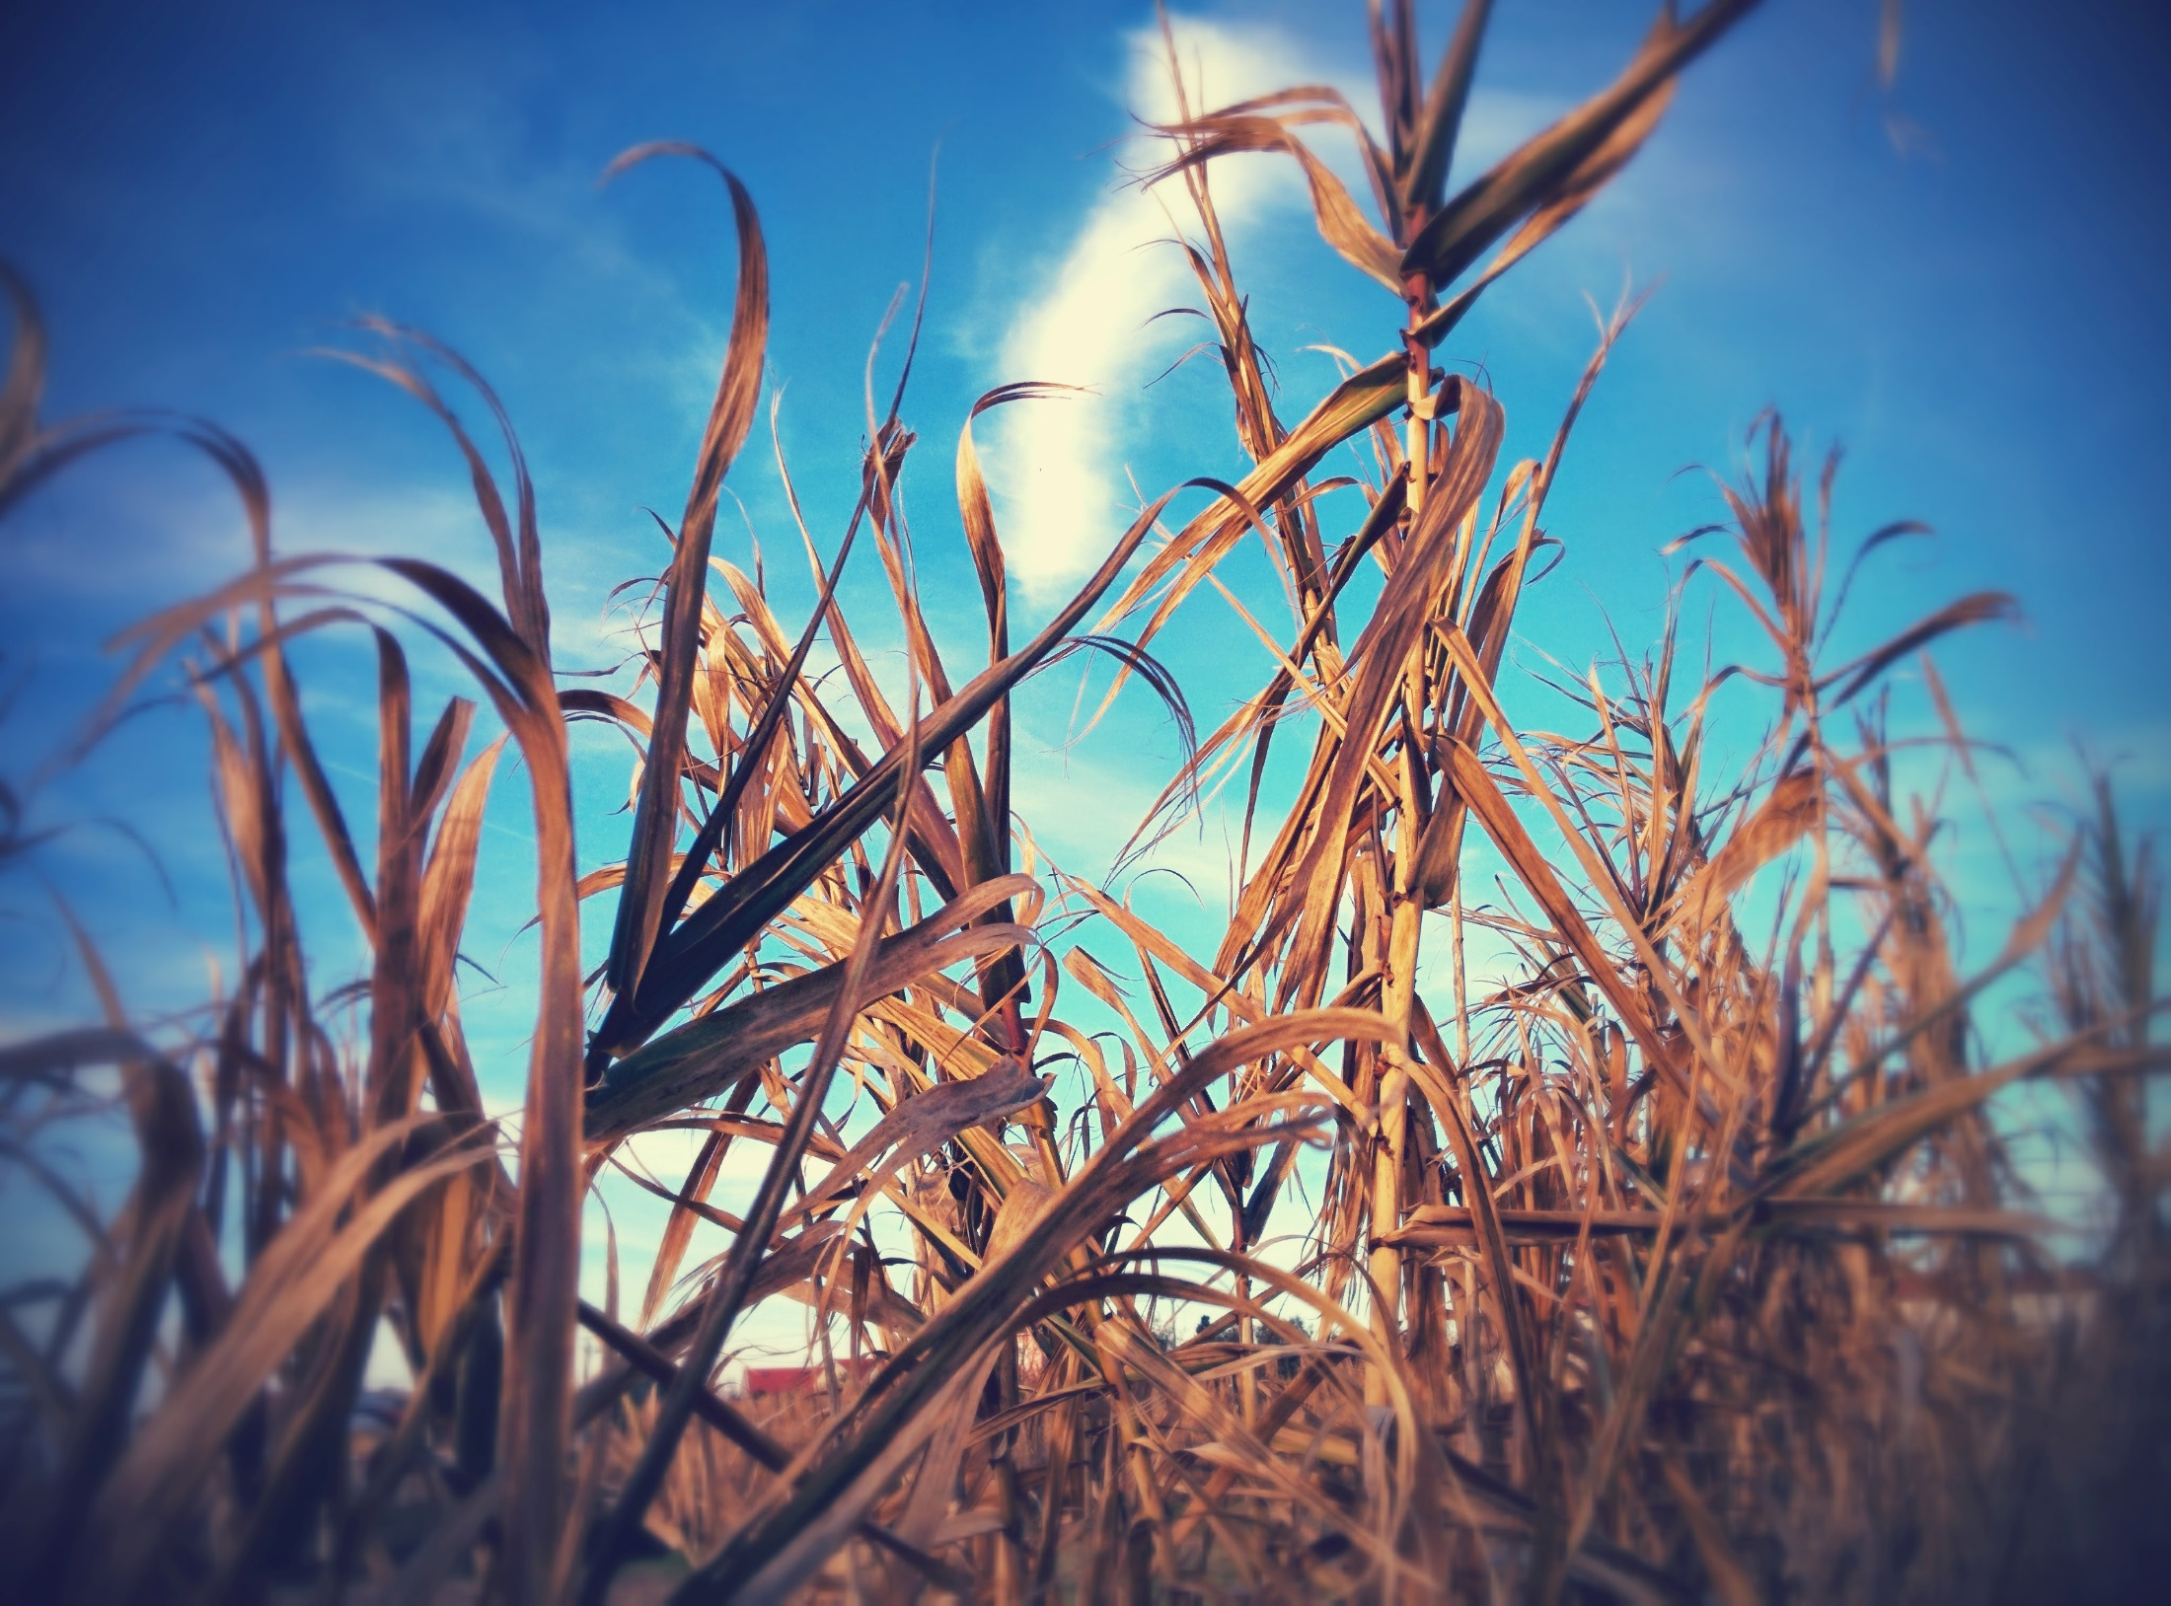
A changing
Food Safety
Landscape in Africa

Slide 3
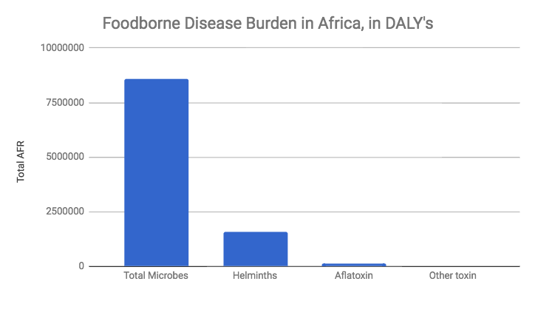
Why food safety matters
World Health Organization FERG report, 2015

Slide 4
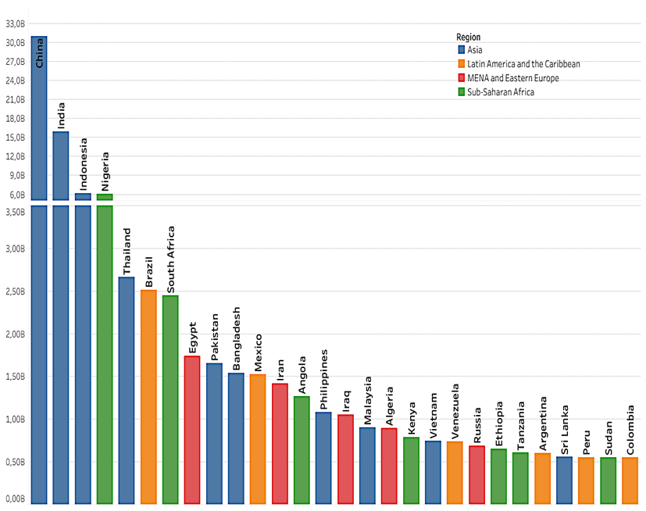
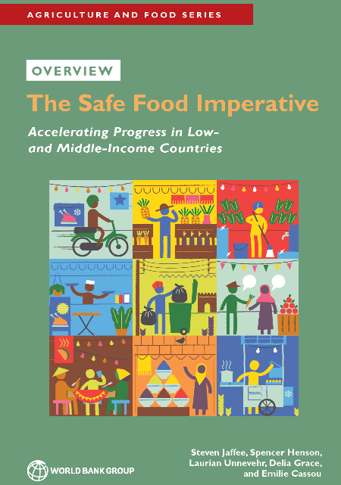
Why food safety matters
Food safety domestic costs in LMIC may be 20 times trade costs
Cost estimates for 2016 (US$ billion)
Productivity loss | 95
Illness treatment | 15
Trade loss or cost | 5 to 7
Based on WHO/FERG & WDI Indicators Database

Slide 5
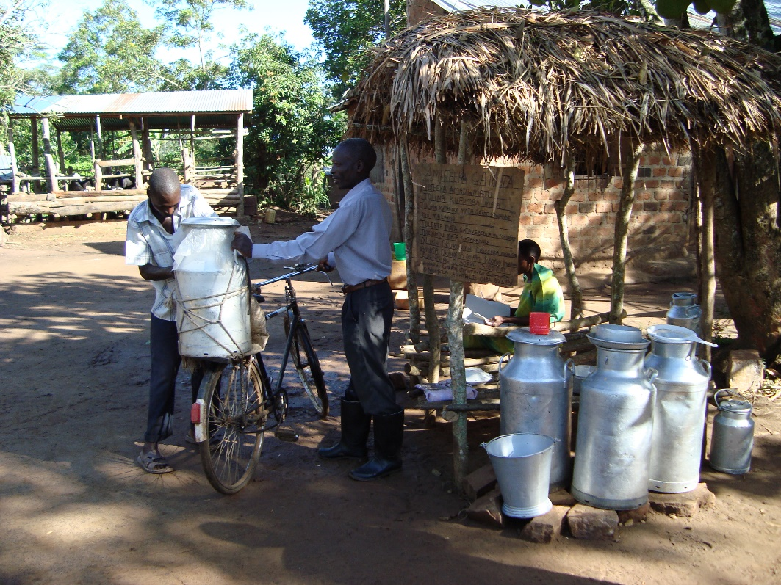
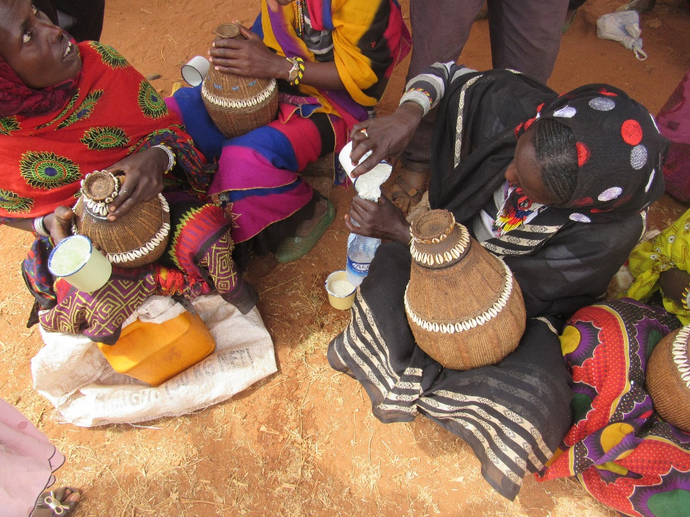
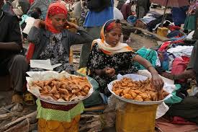
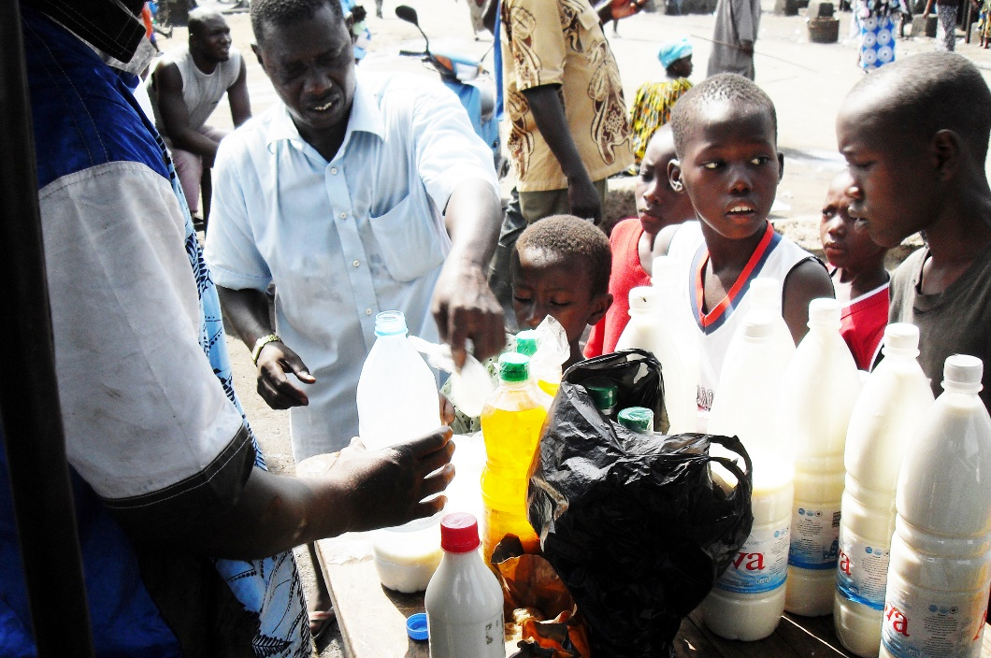

Slide 6
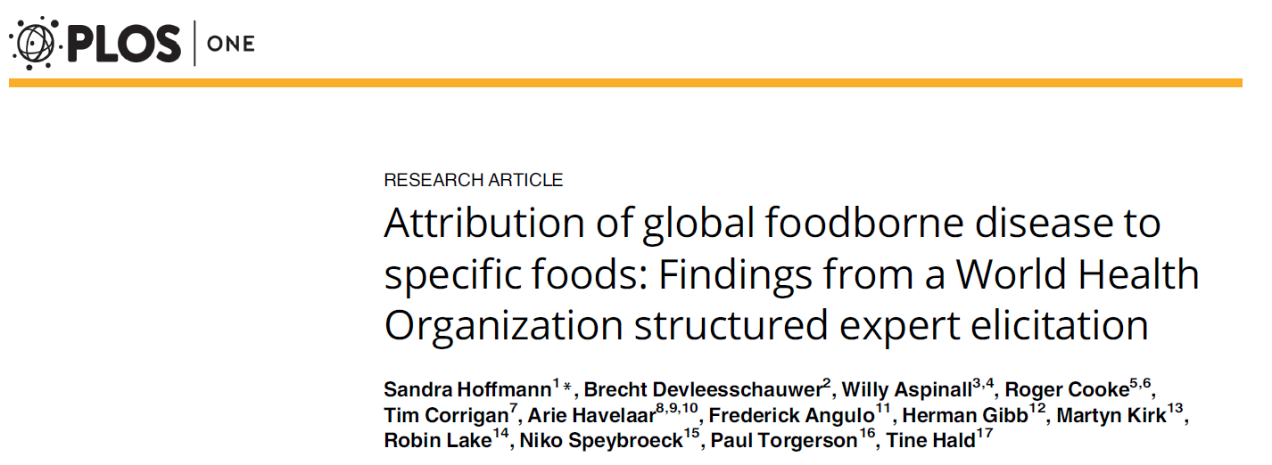
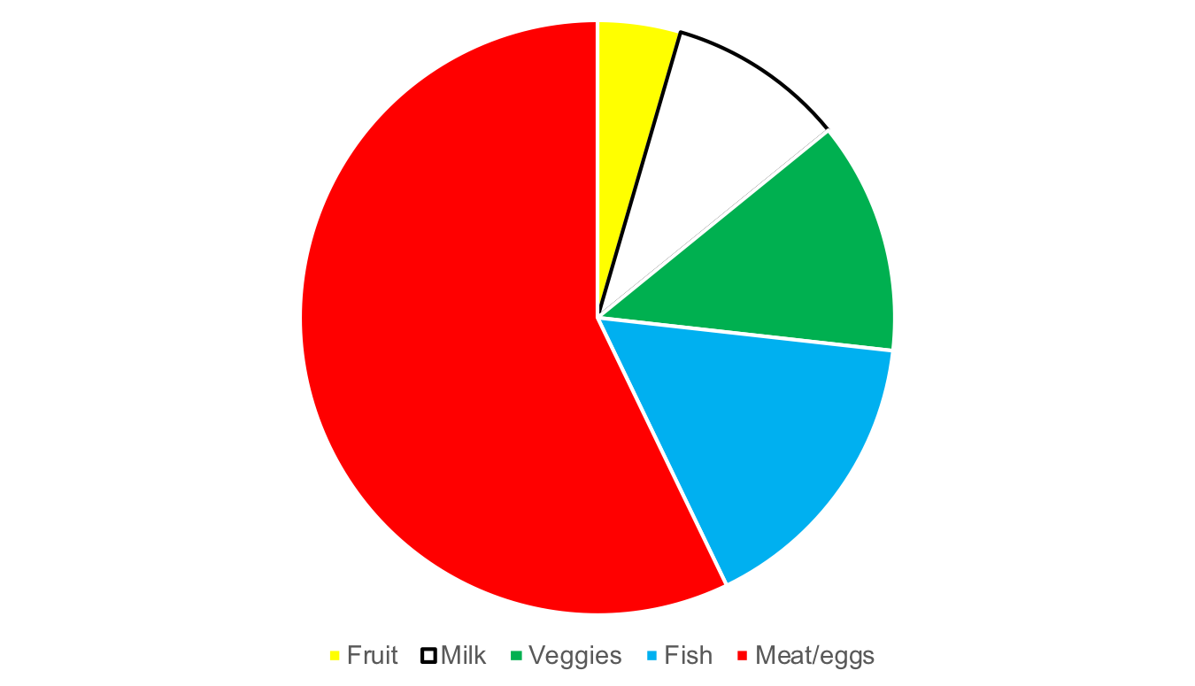
Foods implicated
Notes:
Two-thirds of human pathogens are zoonotic – many of these transmitted via animal source food (salmonellosis, EHEC, cryptosporidium)
Animal source food single most important cause of food-borne disease
Many food-borne diseases cause few symptoms in animal host (chicken and S. enteritidis, calf and E. coli O157:H7, oysters and V. vulnificus)
Many zoonotic diseases controlled most effectively in animal host/reservoir
Recent studies shown pre- ‘harvest’ stage most important for controlling food-borne pathogens

Slide 7
We can’t regulate our way to food safety
92% of Addis milk and 46% of Nairobi milk had aflatoxins over EU standards
36% of farmed fish from Kafrelsheikh exceed one or more MPL
30% of chicken from commercial broilers in Pretoria unacceptable for S. aureus
24% of boiled milk in Abidjan unacceptable S. aureus
Regulations are needed but not enough

Slide 8
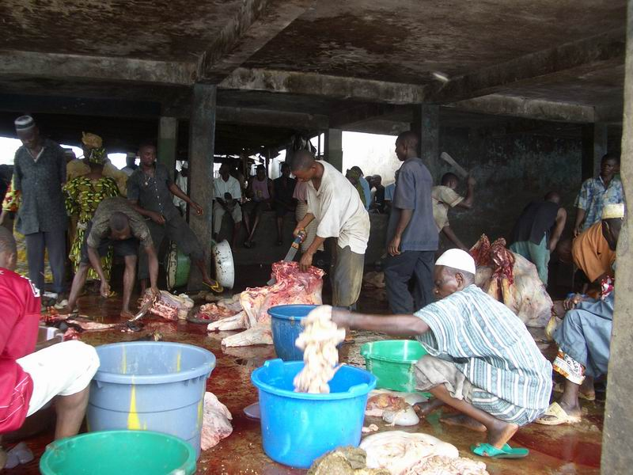
We can’t modernise our way to food safety

Slide 9
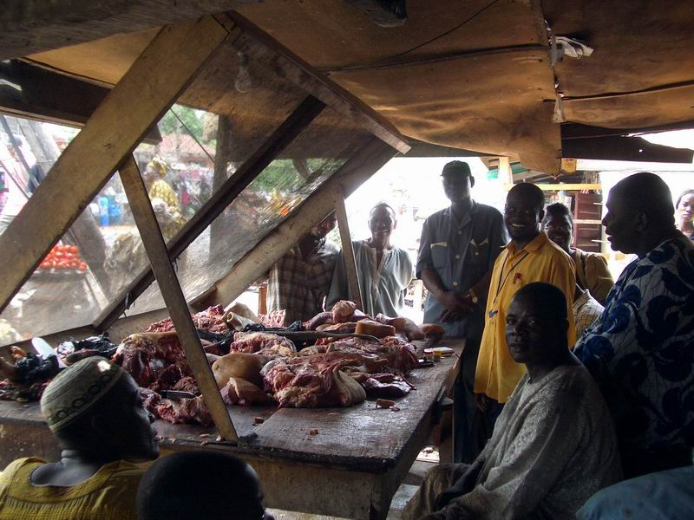
We can’t train our way to food safety
Knowledge – Needed, but goes only so far
Small scale pilots
  Show short-term improvements
  Effects not sustainable long-term
Capacity building useful if incentives in place
  E.g. Training + legitimising vendors
  Clear economic benefits
  Access to credit

Slide 10
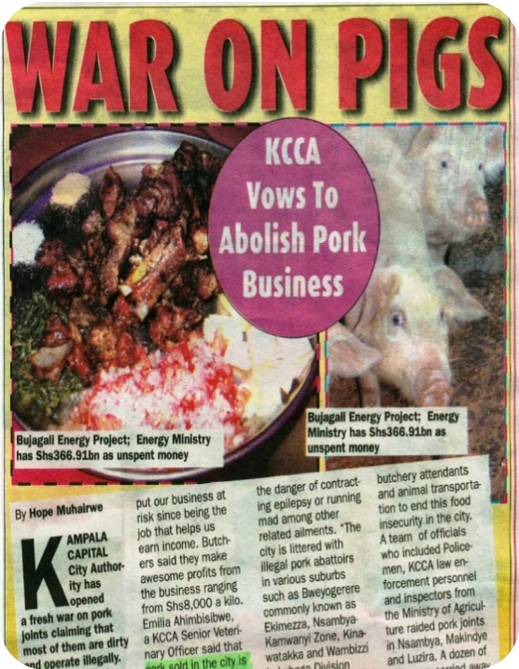
Increasing concerns over food safety
In 7 developing countries studied
Many/most reported concern over food safety
Willing to pay premium for food safety (younger, wealthier, town-residing, supermarket-shoppers willing to pay more for safety)
Buy less during animal health scares

