Slide 1


Reservoirs of pathogenic Leptospira species in Uganda
Lordrick Alinaitwe^{1,2,3}, Martin Wainaina⁴, Salome Dürr², Clovice Kankya³, Velma Kivali¹, James Bugeza¹, Martin Richter⁴, Kristina Roesel¹, Annie Cook¹ and Anne Mayer-Scholl⁴
¹Animal and Human Health program, International Livestock Research Institute, Kenya
²Veterinary Public Health Institute, University of Bern, Switzerland
³College of Veterinary Medicine, Animal resources and Biosecurity, Makerere University, Uganda
⁴Federal Institute for Risk Assessment, Germany
University of Bern Graduate School for Cellular and Biomedical Sciences Symposium
Bern, Switzerland
29 June 2023

Slide 2
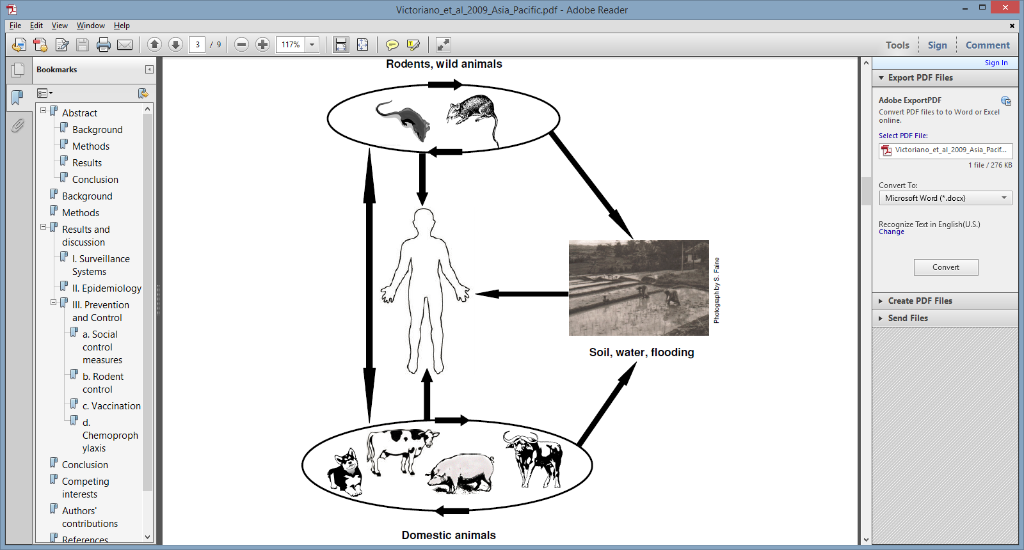
Leptospira and leptospirosis
Zoonotic bacteria, endemic in tropics
1,000,000 cases / 60,000 deaths annually
Host-serovar adaptation
Adopted from Victoriano et al., 2009: Leptospirosis in the Asia Pacific region. BMC Infect Dis.
2009 Sep 4;9:147. doi: 10.1186/1471-2334-9-147.

Slide 3

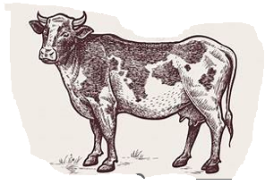
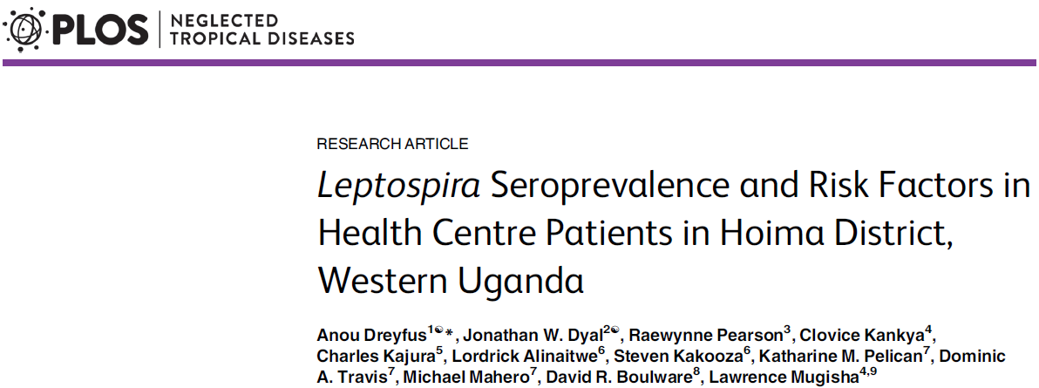
Human leptospirosis in Uganda…Implicate the cow!

Slide 4
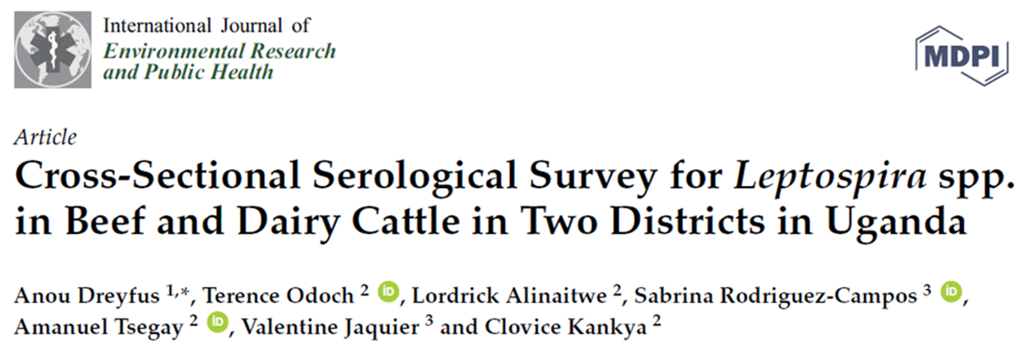
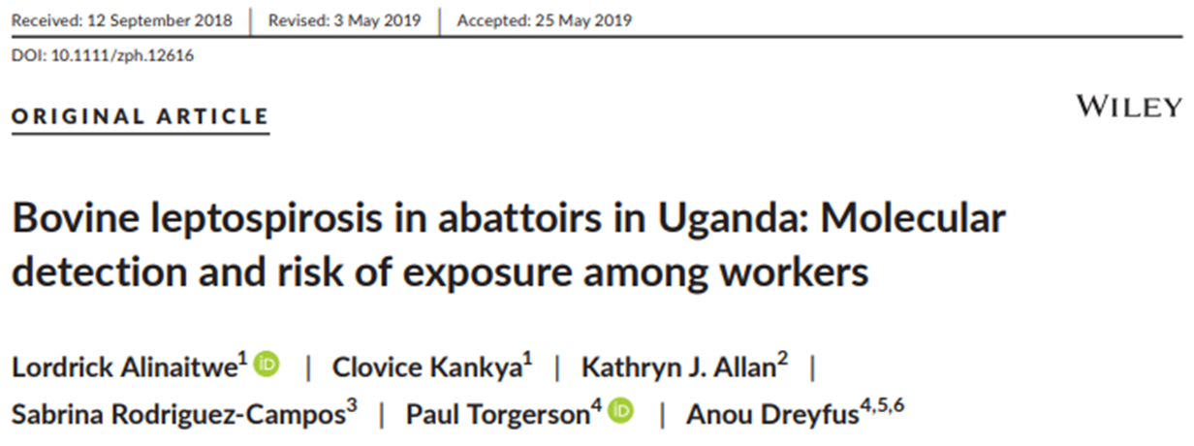

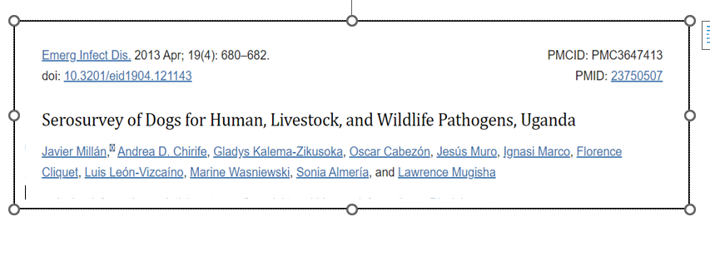
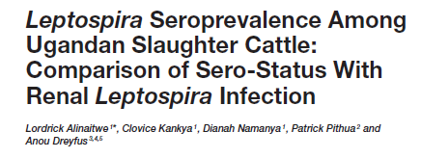
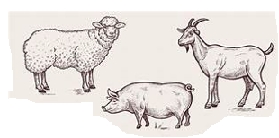
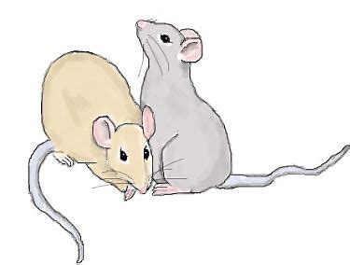
Animal leptospirosis…What evidence against the cow?
Prevention/control = Knowing infection sources, who is infected and what influences spread of infection

Slide 5
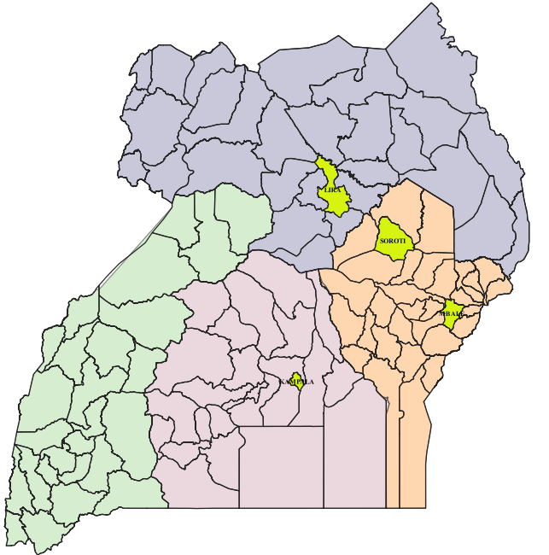

Overview of methods
Cross-sectional studies
Livestock (2030)
Cattle (820)
Goats (335)
Sheep (114)
Swine (761)
Environment
Small mammals (117)
Kidneys
Attribute Data
Laboratory Analysis
Realtime PCR, SLST,
MLST
Extent of Leptospira infection and circulating species/serogroups
5
29. June 2023, Bern
VPHI

Slide 6
Prevalence of Leptospira infection and circulating species
 | Cattle | Goats | Sheep | Pigs | Rodents& shrews | Total (Livestock)
NTest (NPos) | 820 (30) | 335 (6) | 114 (6) | 761 (3) | 117 (0) | 2030 (45)
% Pos (95%CI) | 4.25 * (2.91- 5.98) | 2.08 (0.91- 4.38) | 6.12* (2.69- 12.89) | 0.46 (0.12-1.31) | 0.00 (0- 3.55) | 2.58 (1.89-3.42)
SecY Typing
L. borgpetersenii | 11 | 1 | 0 | 0 |  | 12
L. kirschneri | 5 | 0 | 4 | 0 |  | 9
L. interrogans | 0 | 0 | 0 | 1 |  | 1
Pigs being significantly less infected due to husbandry practices
No infected rodents? …Yes

Slide 7
Characteristics of the trapped small mammals

Slide 8
Conclusion and next steps
Livestock are reservoirs
Finalize MLST, compare serogroups in apparently healthy human population
Statistical modelling to hypothesize pathways for .
human exposure
VPHI

Slide 9









Acknowledgments
Field and lab support
Ms Velma Kivali
Dr James Bugeza
Mr Ashiraf Lubega
Funding
Project implementation partners
Supervision and mentorship
Ass. Prof. Salome Durr
Ass. Prof. Clovice Kankya
Prof. Nicola Low
Dr Elizabeth A.J. Cook
Dr Anne Mayer-Scholl
Dr Kristina Roesel
Dr Sabrina Rodriguez
Dr Anou Dreyfus

Slide 10
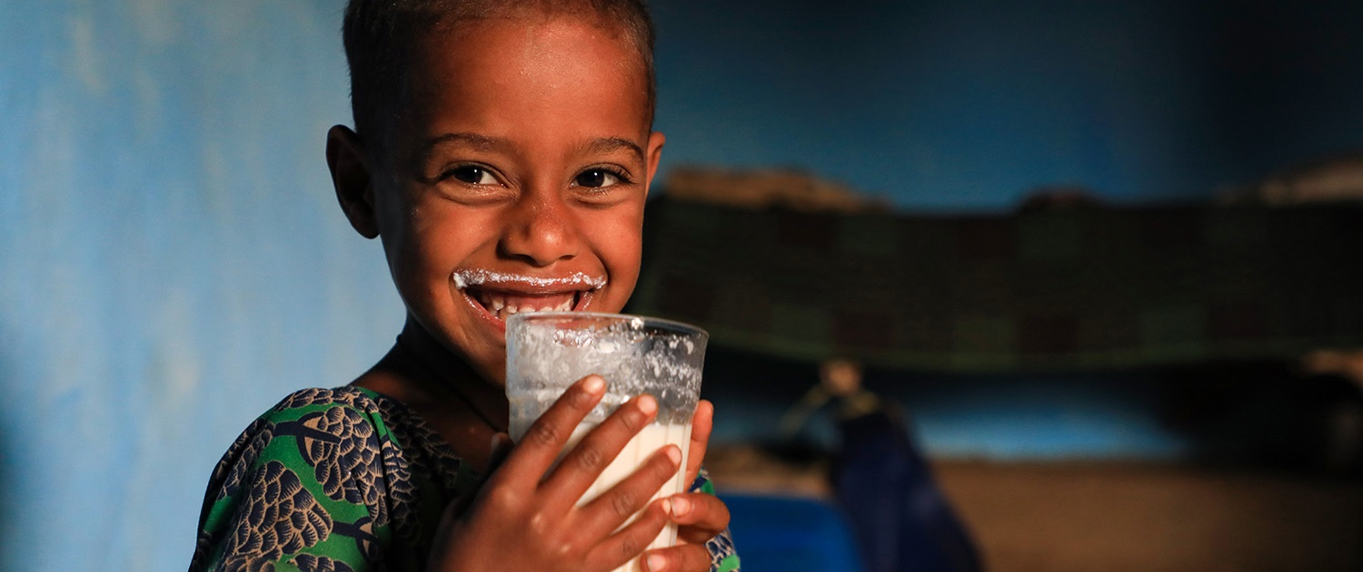
THANK YOU

