Slide 1
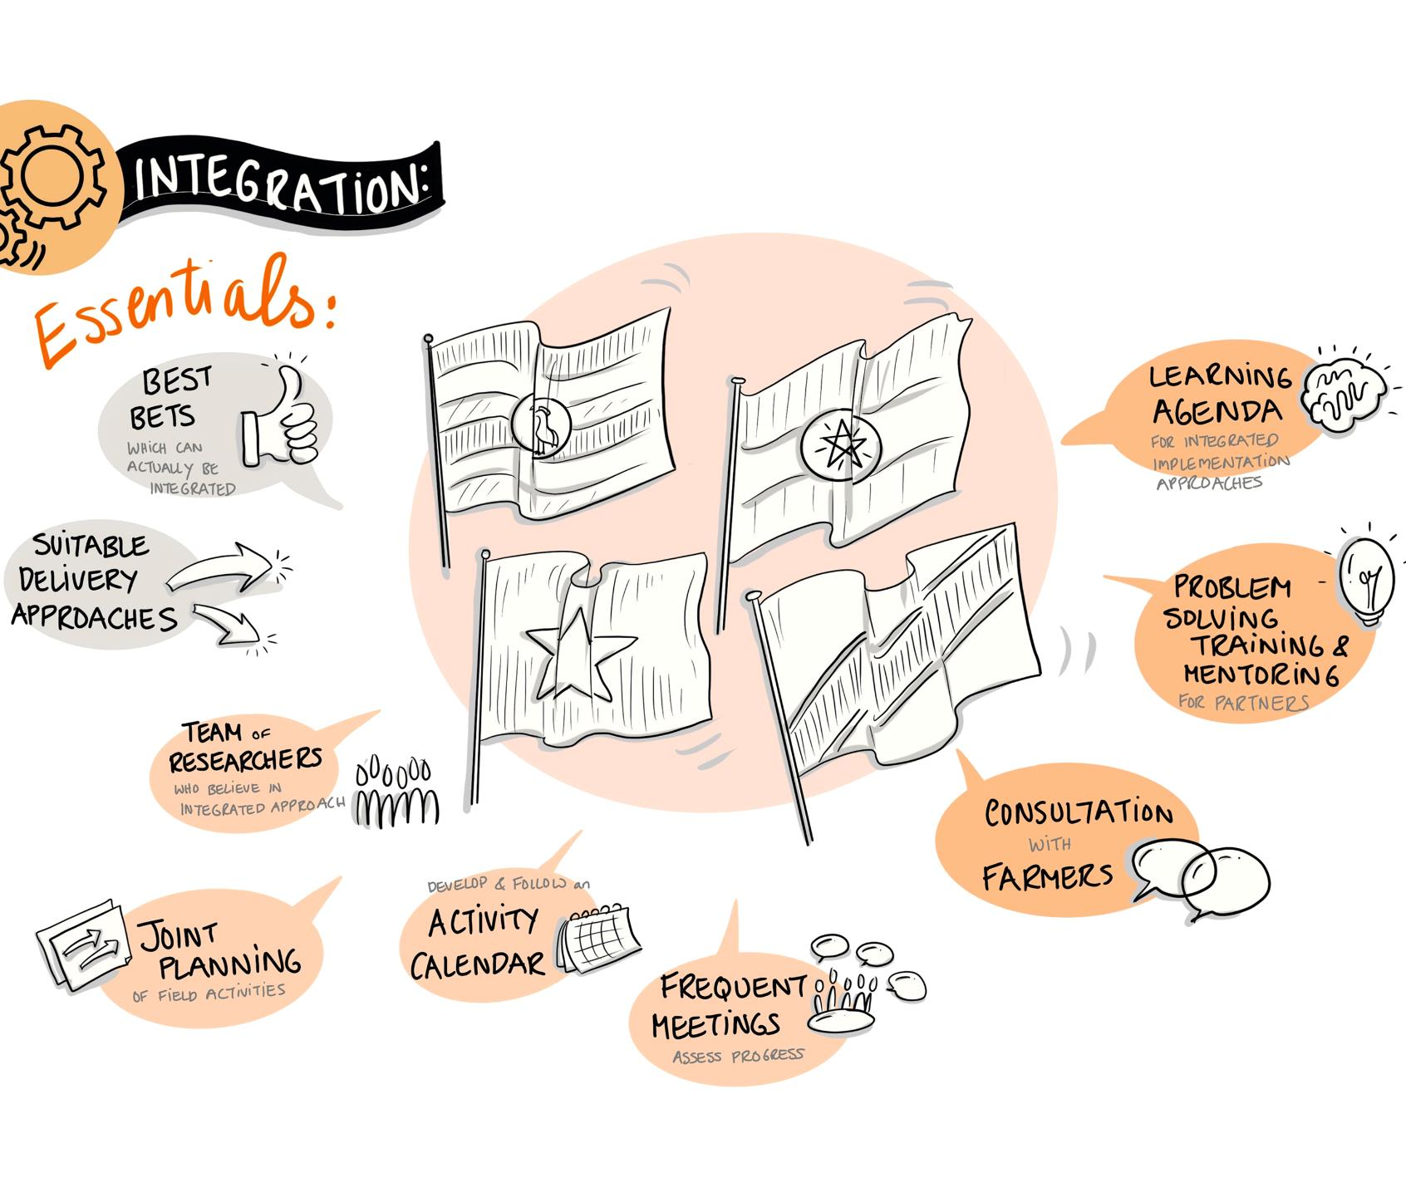
Priority country projects update
Peter Ballantyne
4th CRP Independent Steering Committee meeting, 8 October 2020

Slide 2
Outline
Introduction and focus of the country projects
COVID-19 impacts
Virtual learning - emerging lessons
Priorities for 2021
Vietnam in depth by Sabine

Slide 3
4 country projects
Small Ruminant value chain Transformation in Ethiopia (SmaRT Ethiopia)
Agri-entrepreneurship, technology uptake and inclusive dairy development in Tanzania (Maziwa Zaidi)
Improving pig productivity and incomes in Uganda through environmentally sustainable and gender inclusive integrated intervention packages (MorePORK)
Livestock-led interventions towards equitable livelihoods and improved environment in the North-West Highlands of Vietnam (Li-chăn)

Slide 4
Focus of the country projects
Translate ‘best bet’ research results to integrated pilot interventions, with partners, that have the potential to be scaled …
Involving all flagships and cross-cutting themes; following the same change pathways
Using consistent approaches - theories of change, monitoring, baselines, tools, …
In-country teams serve the whole effort
Support for partnerships, learning, scaling, integration, inter-disciplinarity, M&E, communications
Notes:
Page title minimum of 30 points and maximum
of two lines
Main point 6 point smaller than slide title
Bullet points 4 point less than main point
Font type is Calibri
It is advised in one slide maximum 6 bullets
We recommend you use images on slides
You can change partner logos on front page
You have to duplicate this slide for more inside pages

Slide 5
Pandemic effects
All countries experienced delays, some very significant, to field work, meetings and face to face partner interactions – but, local initiatives not relying on external inputs often continued
Field work and site visits starting up again … slowly
Significant delays to baselines and other surveys – except in Vietnam
Search for agile tools to help identify outcomes along the paths to impact by end of the CRP
Many positive adaptations to cope with the lockdown – more virtual interactions, online training, phone-surveys, etc.
Some countries have carried out new COVID-19-related studies and assessments
Notes:
Page title minimum of 30 points and maximum
of two lines
Main point 6 point smaller than slide title
Bullet points 4 point less than main point
Font type is Calibri
It is advised in one slide maximum 6 bullets
We recommend you use images on slides
You can change partner logos on front page
You have to duplicate this slide for more inside pages

Slide 6
Virtual exchanges
1. Virtual learning ‘week’ from 20-30 April 2020
Learn from implementation of the priority country projects
Emerging learning agenda in three areas
  Partnerships [moving forward with Helen]
  Scaling [moving forward with Iddo]
  Integration [moving forward with KIT]
2. CRP virtual meetings in mid June
Session on ways country projects facilitate integration
 | ET | TZ | UG | VN | all
# participants | 14 | 8 | 18 | 12 | 39
# posts & replies | 173 | 103 | 154 | 76 | 506
Notes:
Page title minimum of 30 points and maximum
of two lines
Main point 6 point smaller than slide title
Bullet points 4 point less than main point
Font type is Calibri
It is advised in one slide maximum 6 bullets
We recommend you use images on slides
You can change partner logos on front page
You have to duplicate this slide for more inside pages

Slide 7
Virtual learning week – A few insights
Dedicated funding provides incentive for more integration [ET, UG]
Integration has costs (time, planning, F2F meetings, engage with other disciplines, etc) [ET, UG, VN]
Standard/shared mechanisms (RHoMIS, intervention calendar, ICT platforms, CLEANED modelling, shared databases) can facilitate integration [ET, TZ, VN]
Some technical components integrate more naturally than others [ET, TZ]
Good partnerships takes effort (organize meetings, knowledge sharing, defining common agenda and language, etc) [ET, TZ, VN]
Different types of partners needed for implementation, sustainability, policy influence, scaling; constellation can change over time [ET, TZ, UG]
Start partner mapping early. Select intentionally and identify complementarities [UG]
Fostering trust is essential in partnerships [TZ, VN]
Some interventions scale more easily than others (make sure they are ‘simple’ enough?) [ET, VN]
Good partnerships and next users (private or public sector) are key to scaling [ET, TZ, UG]
Scaling takes time – we need to learn as we go [ET, TZ]
Notes:
Page title minimum of 30 points and maximum
of two lines
Main point 6 point smaller than slide title
Bullet points 4 point less than main point
Font type is Calibri
It is advised in one slide maximum 6 bullets
We recommend you use images on slides
You can change partner logos on front page
You have to duplicate this slide for more inside pages

Slide 8
Scaling self assessment
Notes:
Isabelle: because we haven’t started implementation, I don’t know how to answer! Due to the COVID situation we need to rethink our plans.

Slide 9
Partnership self assessment

Slide 10
Integration self assessment

Slide 11

Integration is …
  People from flagships and partners work together ‘as one’ – ‘integrated team’
  Collaborative design of flagship agenda’s and priorities with common theory of change, outcome pathways, deliverables and budgets – ‘integrated plan’
  Multiple interventions of different flagships tested and delivered in coordinated ways to target groups – ‘integrated delivery’
  Several different and complementary interventions are combined together to serve different objectives – ‘integrated intervention packages’
  Multiple interventions are aggregated together to reach target groups – ‘integrated platform’

Slide 12
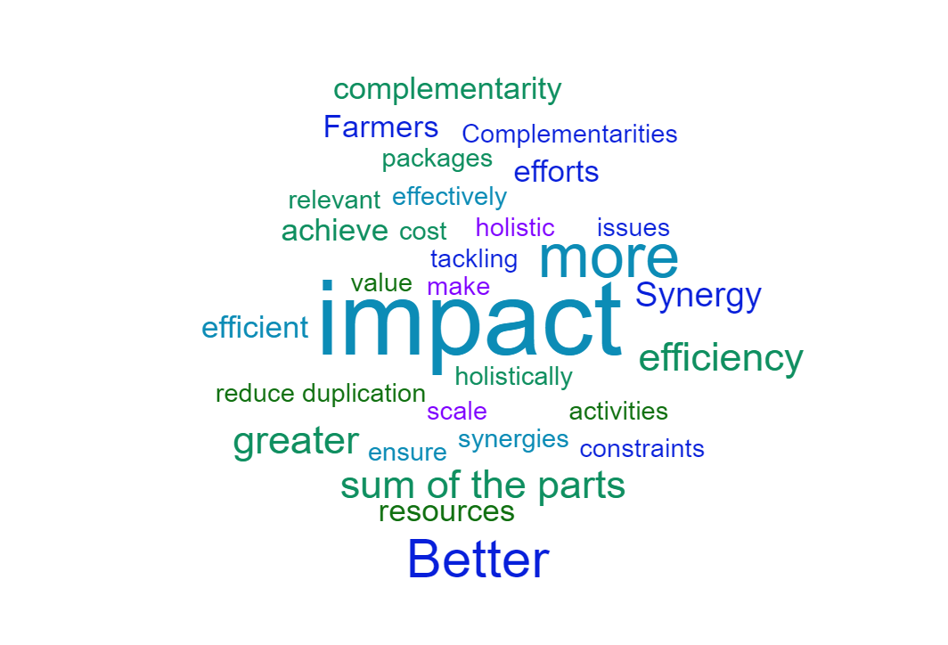
Why integrate our country activities?
Notes:
Page title minimum of 30 points and maximum
of two lines
Main point 6 point smaller than slide title
Bullet points 4 point less than main point
Font type is Calibri
It is advised in one slide maximum 6 bullets
We recommend you use images on slides
You can change partner logos on front page
You have to duplicate this slide for more inside pages

Slide 13
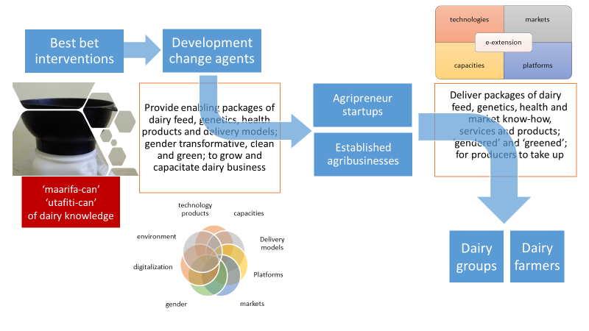
Integration ‘glue’ in Tanzania: dairy agripreneurs and demand driven technologies
ToC strategy | Integrated components | Medium to long term change
a. Increase capacity of dairy agribusiness (focus on youth and women) to: Bundle technologies Promote strategic alliances Grow portfolio of technologies traded Grow their businesses |  | i. Increased agribusiness performance: Increased product portfolio Bundled products/services Client orientation/outreach ii. Value chain actors adopt innovative packages iii. Improved business enabling environment.
b. Package and test profitable & environmentally sustainable technologies
c. Influence policy and investment
Environment
Gender
Feeds
Genetics
Health
Business
Models
Maziwa Zaidi partnership
Goal: Catalyze an inclusive and sustainable development of the dairy value chain

Slide 14
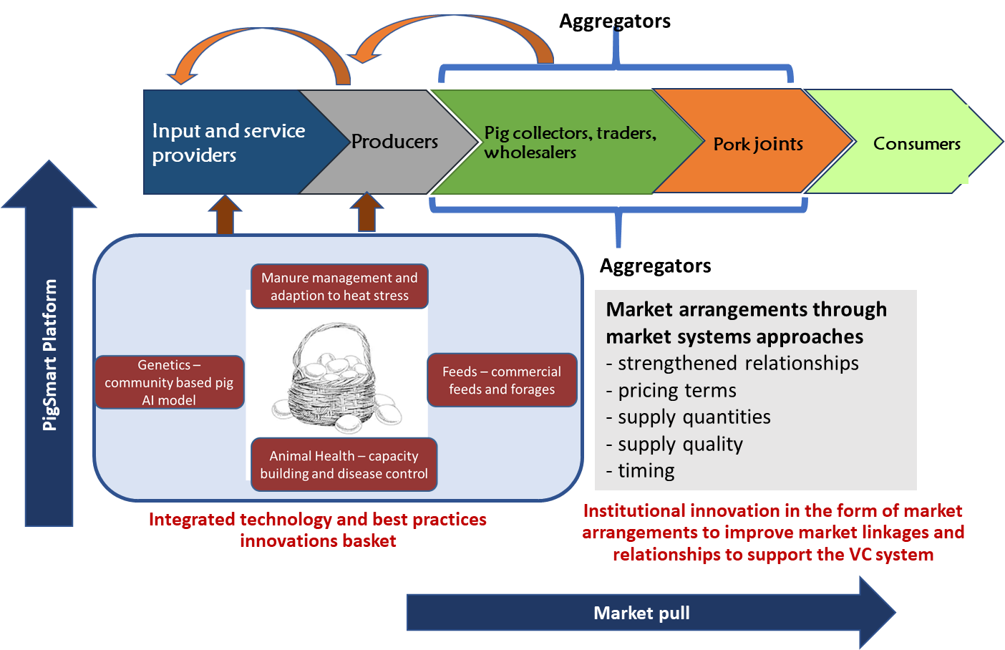
Improving incomes of pig value chain actors through marketing arrangements and sustainable integrated technology packages
Partnerships: private sector-led

Slide 15
Ethiopia - integrated planning and delivery
  Integrated planning to deliver SmaRT packs
  harmonized planning, site specific intervention calendars
  team meetings to 'think' and act collectively
  joint planning and coordinated field work saves resources and increases efficiency
  Integrated delivery because of SmaRT packs
  We mimic what happens on the ground and look for natural linkages: one activity produces an input or the enabling environment for another intervention
  Results in more holistic approach towards end beneficiaries
  Community conversations help to integrate the packages at local level

Slide 16
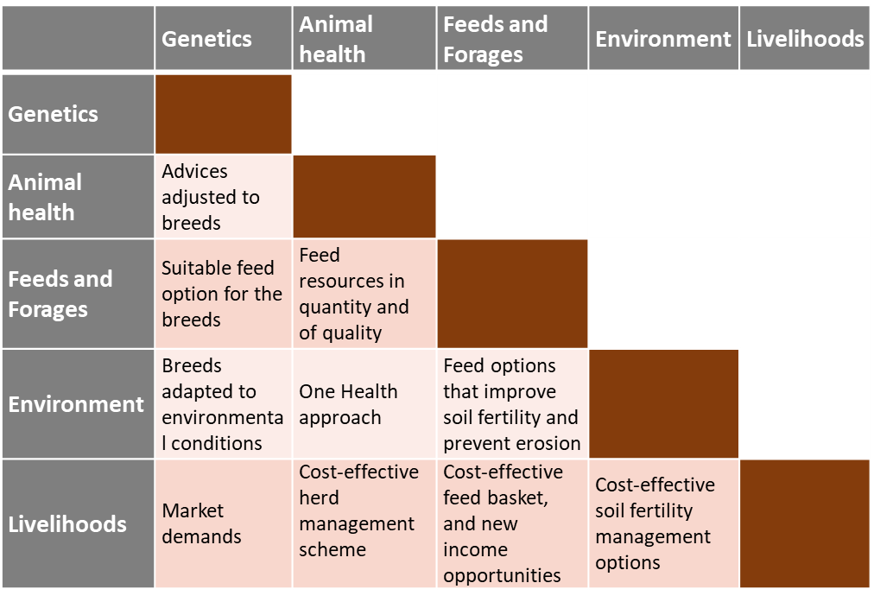
Vietnam - inter-flagship collaboration

Slide 17
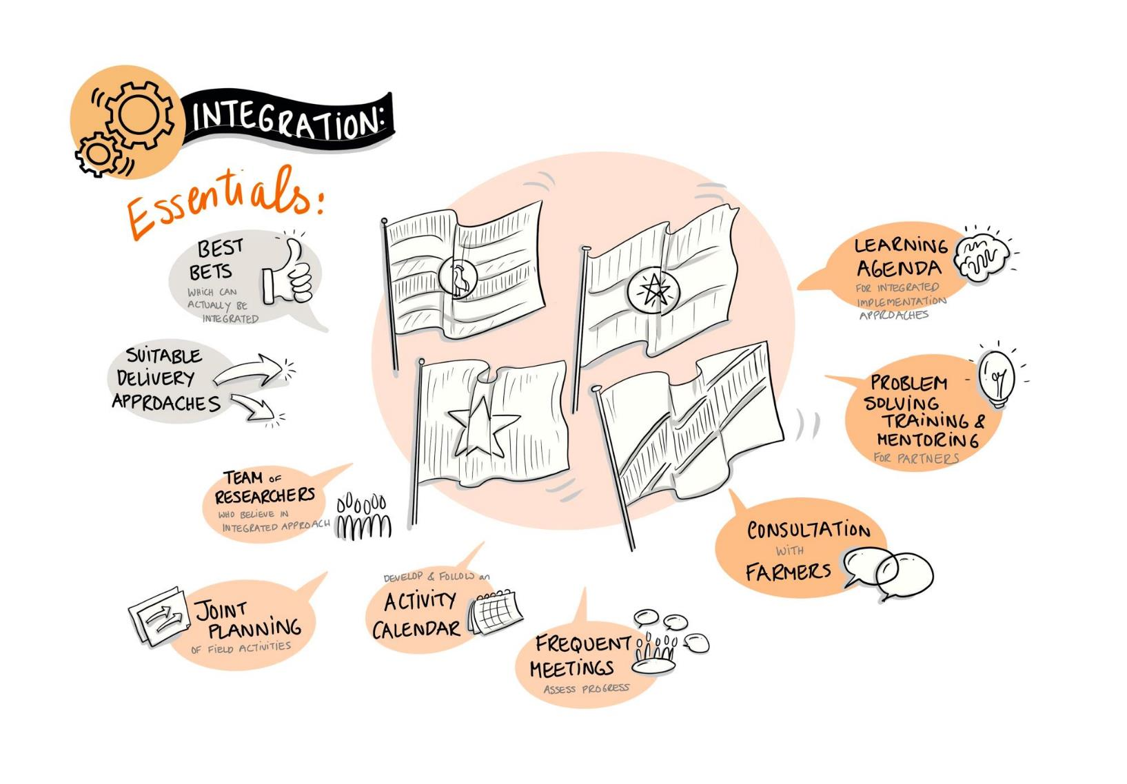

Slide 18
On the horizon …
  Urgency to deliver 2020 still-planned and 2021 planned activities
  In 2021, we must also measure progress towards outcomes, and who is contributing to this
  Implement ‘action’ learning agenda around integration, scaling, partnerships
  Document and communicate country project outcomes and legacies (the science, the development, the processes …)
  Plan for post 2021; beyond the CRP

