Slide 1


Insights discussion workshop
Social behavior change communication strategy for CGIAR Initiative on Sustainable Animal Productivity (SAPLING)
Nguyen Tuan Nghia¹, Tran Hoai Nam¹, Phan Tran Quoc Trung¹, Karen Marshall² and Chi Nguyen²
¹Thang Creative Agency
²International Livestock Research Institute (ILRI)
19 April 2024

Slide 2
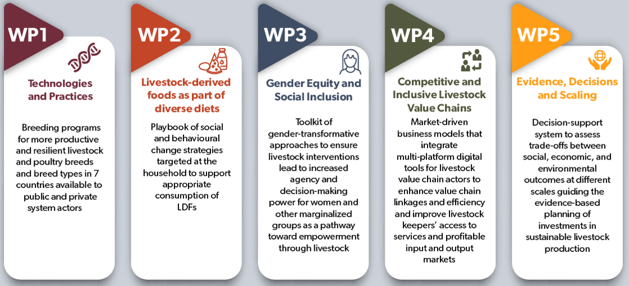
CGIAR Initiative on Sustainable Animal Productivity (SAPLING, 2022-2024)
Objective
This initiative aims to contribute to transforming the livestock sector in Vietnam, one of its seven focus countries, (others are Ethiopia, Kenya, Mali, Nepal, Tanzania and Uganda) to make them more productive, resilient, equitable and sustainable.
Specific objective for Vietnam: The Sustainable Animal Productivity Initiative will enable farmers of pigs, beef cattle and chickens to participate in inclusive value chains to achieve sustainable productivity gains and by these contribute to better livelihoods.
Project sites: Mai Son District, Son La Province

Slide 3
Developing a comprehensive strategy for Social Behavior Change
Objective: To create an effective strategy and activities, we need multidimensional, reliable, and in-depth information about the factors influencing behavior. This is achieved by combining quantitative and qualitative research methods.
Approach:
Multidimensional and comprehensive information collection
In-depth explanation of influencing factors
Verification and validation of critical information
Strategic planning orientation

Slide 4
Focus areas
Understanding & interpreting target audience
  Aspects: Opinions, feelings, attitudes, behaviors.
  Context: Social behavior change.
Exploring issues, motives & causes
  Identifying factors influencing behavior.
  Crafting effective strategies.

Slide 5
Field
study.

Slide 6
Field study
QUANTITATIVE RESEARCH GOALS
Identify and segment target audiences.
Analysis of influencing factors.
Measure the ability to change behavior.
A deeper understanding of local contexts and cultures.
Evaluating the effectiveness of communication activities.
Motivation and Barrier Analysis.
Understand concerns, prejudices, or misinformation.
QUANLITATIVE RESEARCH GOALS

Slide 7
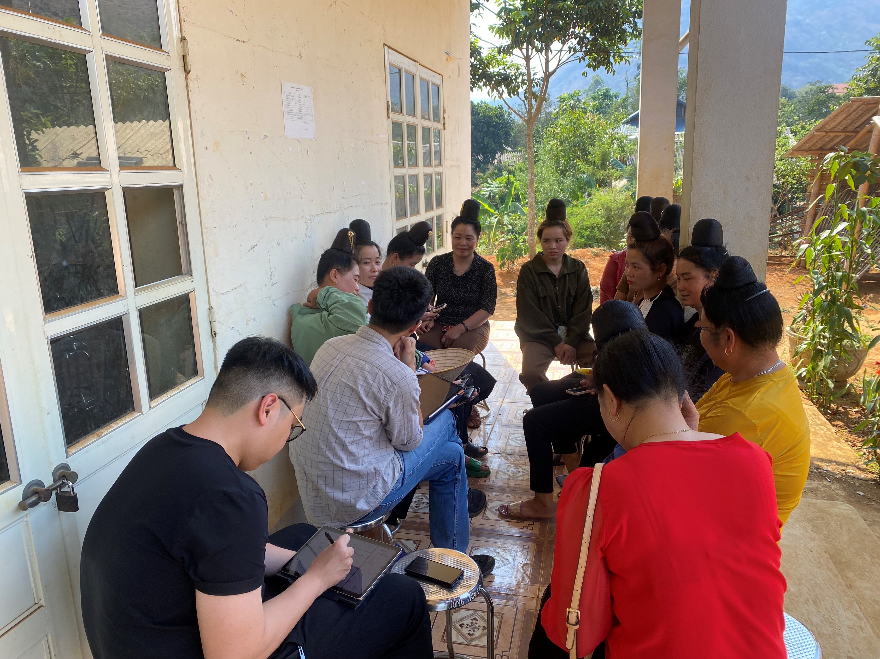
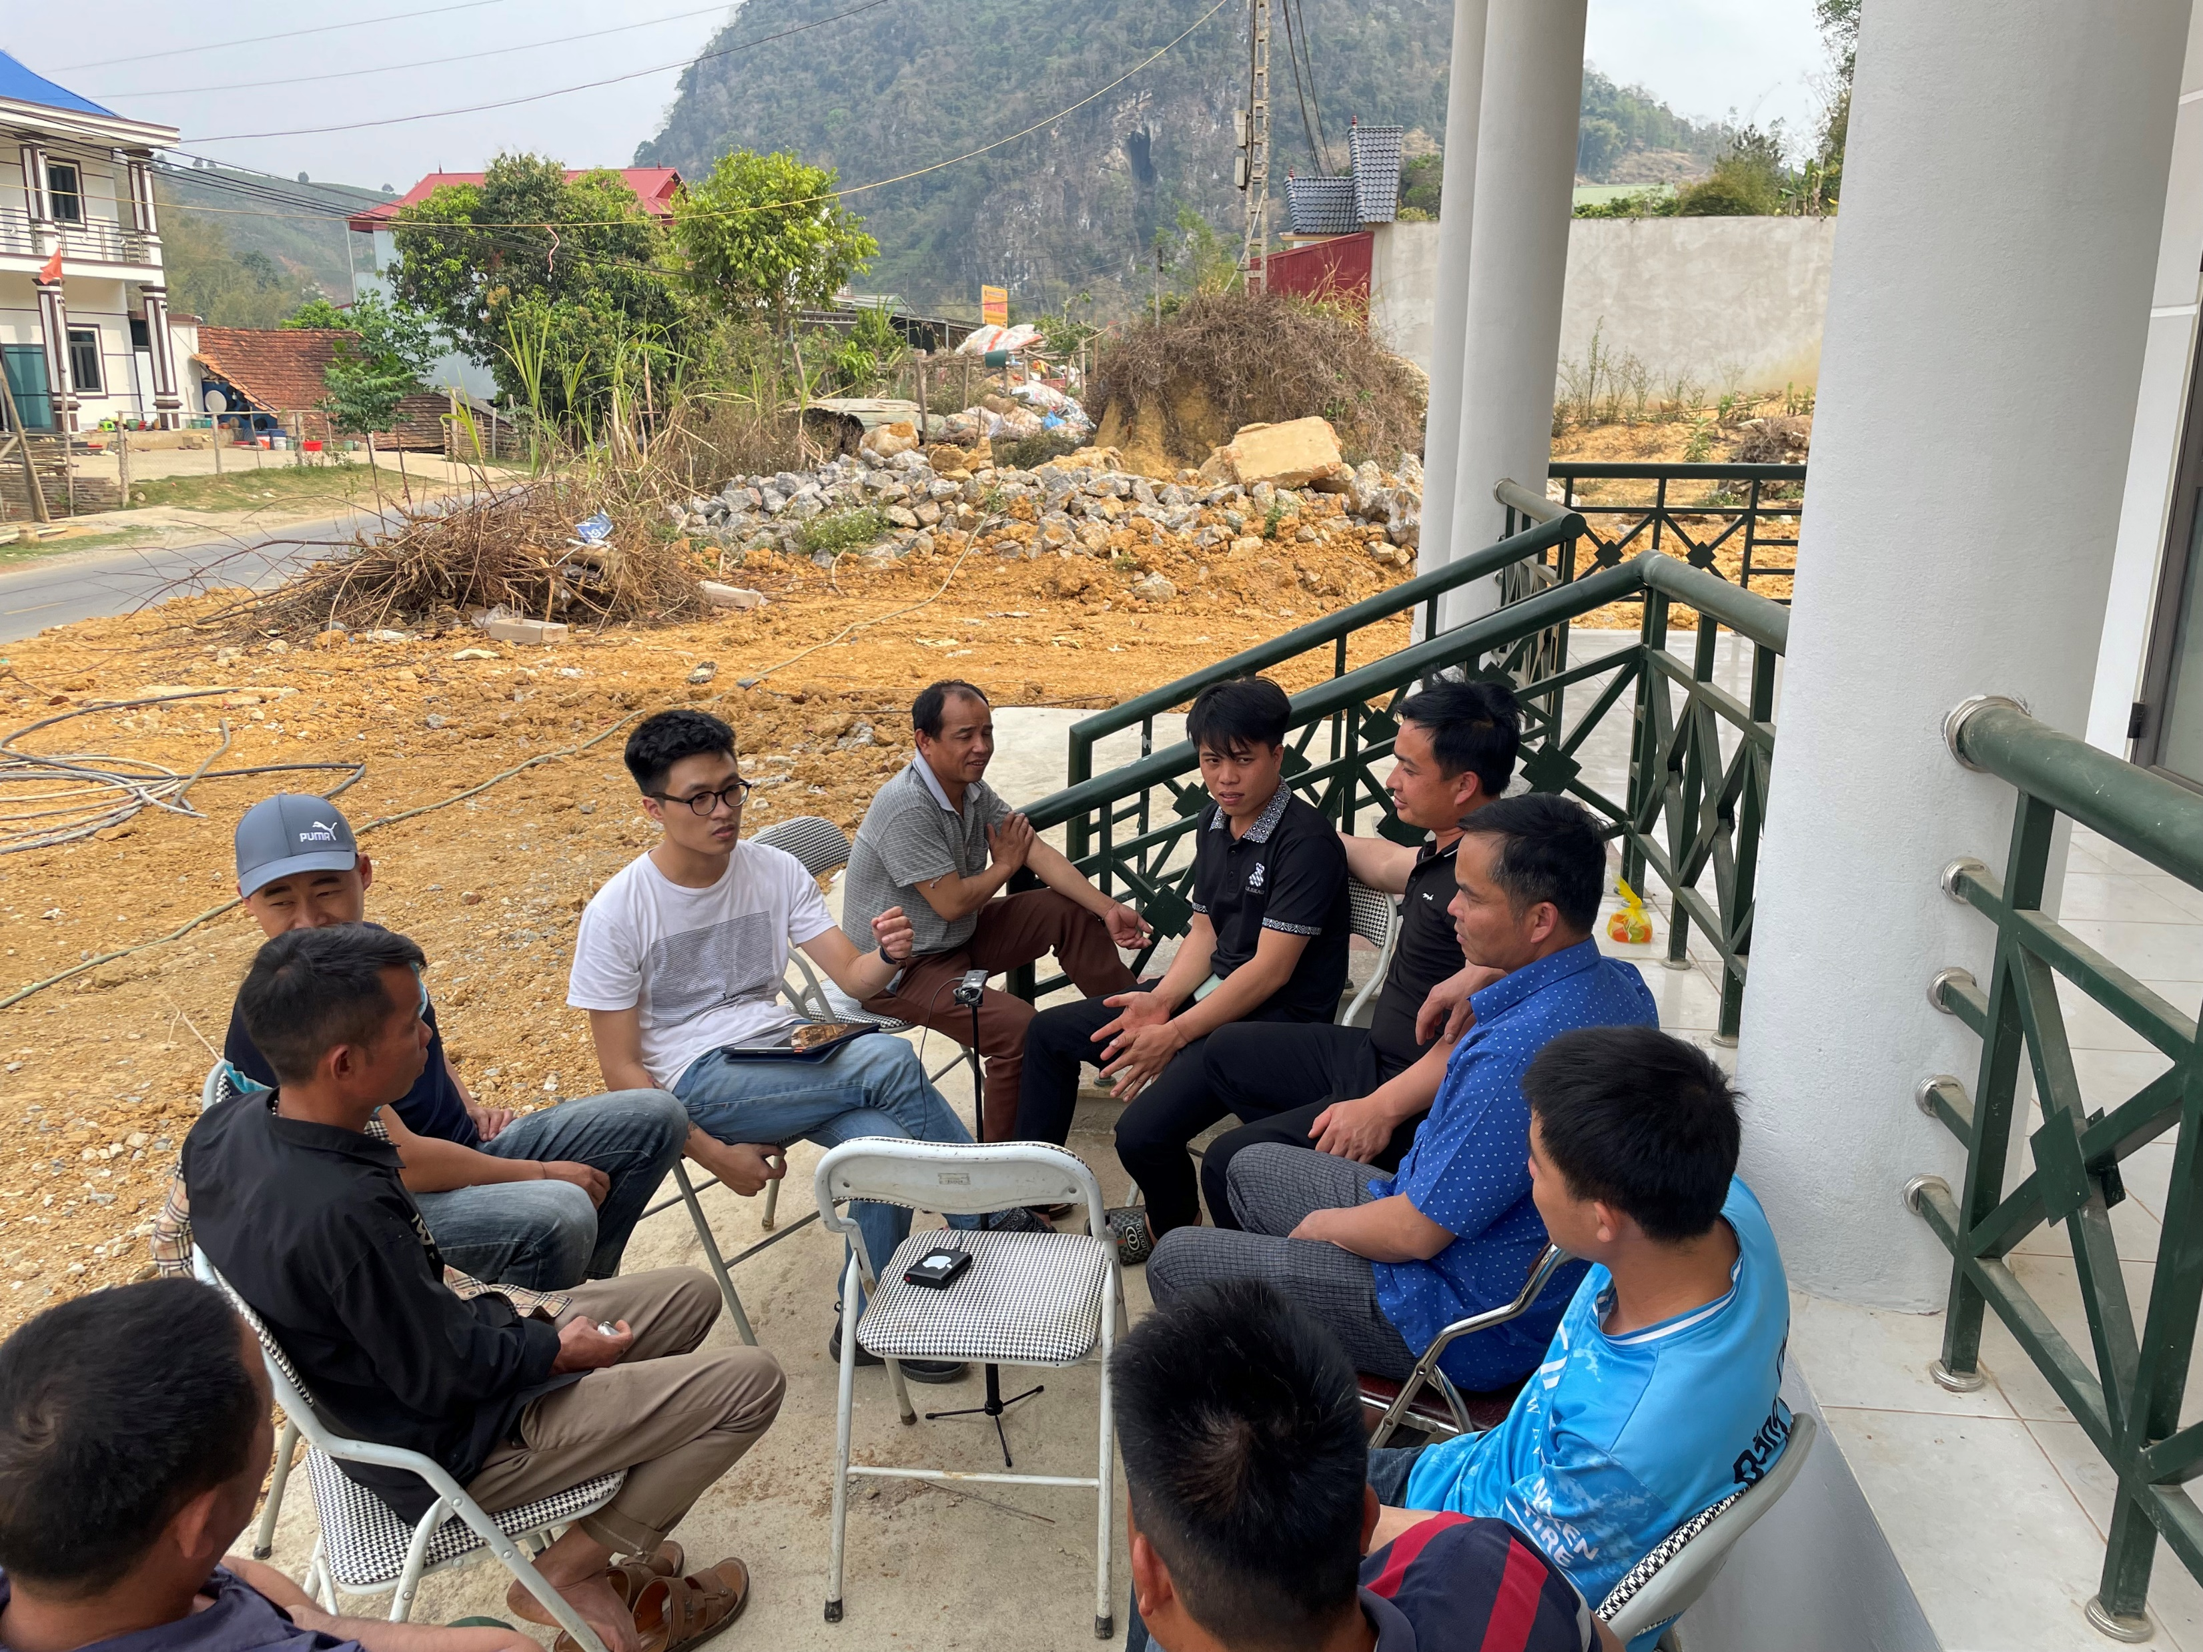
Field study

Slide 8
Analysis
approach.

Slide 9
Quantitative
analysis approach

Slide 10
Quantitative analysis approach
Behavior scoring
Our scoring system based on Linkert scale, we determine desired behavior according to the corresponding behavior change stages.
Behaviors 24 - 32
0 – 0.85 | Precontemplation/ Contemplation
0.86 – 1.71
1.72 – 2.57 | Preparation
2.58 – 3.43
3.44 – 4.29 | Action regularly
4.3 – 5.15
5.16 - 6 | Maintanance
Behaviors 33 - 34
0 – 0.79 | Precontemplation/ Contemplation
0.8 – 1.59 | Preparation
1.6 – 2.39
2.4 – 3.19 | Action regularly
3.2 – 4 | Maintanance

Slide 11
Rural – Behavior score
Behavior Question | Male | Female
What is your experience with pig AI? | 1.2 | 1.08
What is your experience with cattle AI? | 1.08 | 1.00
Describe your feelings and thoughts about using better breeds (where better breeds and both productive and adapted to the local environment)? | 2.39 | 1.94
Describe your feelings and thoughts about using, artificial insemination (25) | 1.97 | 1.88
Describe your feelings and thoughts about constructing or upgrading your animal housing | 2.92 | 2.54
Describe your feelings and thoughts about the applying biosecurity practices for livestock | 3.22 | 2.64
Describe your feelings and thoughts about about using livestock vaccines | 3.36 | 2.78
Describe your feelings and thoughts about the use of new balanced and nutritionally appropriate livestock diets. | 3.11 | 2.24
Describe your feelings and thoughts about feed preservation e.g. silage making (30) | 3.17 | 2.60
Describe your feelings and thoughts about growing new types of forages for livestock feed | 3.36 | 2.92
Describe your feeling and thoughts about joining a farmer group on pig and cattle keeping (for better access to inputs and markets) | 2.80 | 2.26
Do you currently use criteria to evaluate livestock performance? | 1.39 | 0.98
How do you feel about this opinion: "Self-assessment of profit from livestock keeping is essential and helps improve the family's economic situation."? | 3.13 | 2.72

Slide 12
Town – Behavior score
Behavior Question | Male | Female
What is your experience with pig AI? | 2.32 | 2.315
What is your experience with cattle AI? | 1.62 | 1.429
Describe your feelings and thoughts about using better breeds (where better breeds and both productive and adapted to the local environment)? | 4.44 | 4.14
Describe your feelings and thoughts about using, artificial insemination (25) | 2.56 | 2.57
Describe your feelings and thoughts about constructing or upgrading your animal housing | 4.24 | 4.76
Describe your feelings and thoughts about the applying biosecurity practices for livestock | 5.32 | 5.00
Describe your feelings and thoughts about about using livestock vaccines | 5.00 | 5.28
Describe your feelings and thoughts about the use of new balanced and nutritionally appropriate livestock diets. | 4.28 | 3.76
Describe your feelings and thoughts about feed preservation e.g. silage making (30) | 4.72 | 4.38
Describe your feelings and thoughts about growing new types of forages for livestock feed | 4.96 | 5.38
Describe your feeling and thoughts about joining a farmer group on pig and cattle keeping (for better access to inputs and markets) | 4.28 | 3.71
Do you currently use criteria to evaluate livestock performance? | 1.76 | 1.52
How do you feel about this opinion: "Self-assessment of profit from livestock keeping is essential and helps improve the family's economic situation."? | 3.04 | 2.95

Slide 13
Qualitative
analysis approach

Slide 14
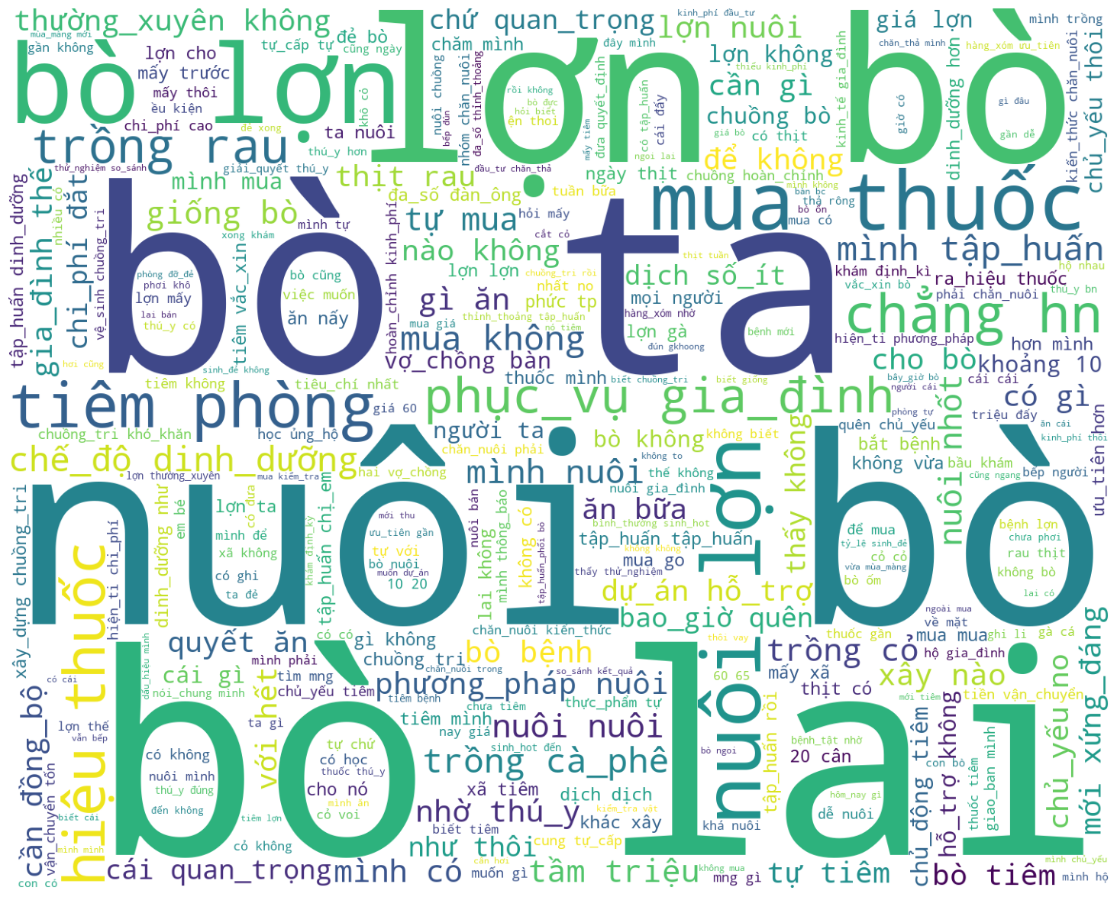
Qualitative analysis approach
Word Cloud
We use a vectorizer algorithm that can quantify the importance or relevance of string representations (words, phrases, etc) in a dicussion or amongst a collection of dicussions.
Local cattle breed
Buying medicine
Vaccinated
Crossbreed cattle breed

Slide 15
Qualitative analysis methodology
Word Relationship
We use a machine learning algorithm that automatically discovers the relationship between words and phrases in a dicussion or amongst a collection of dicussions.
Finance (0.999758)
Accessibility
(0.99973136)
Training course (0.9997514)
Knowledge (livestock raising)
Income
(0.9997412)
Time
(0.9997378)

Slide 16
WordCloud – ALL MALE – Important keywords
Buying medicine
Local cattle breed
Vaccinated
Crossbreed cattle breed
All Male

Slide 17
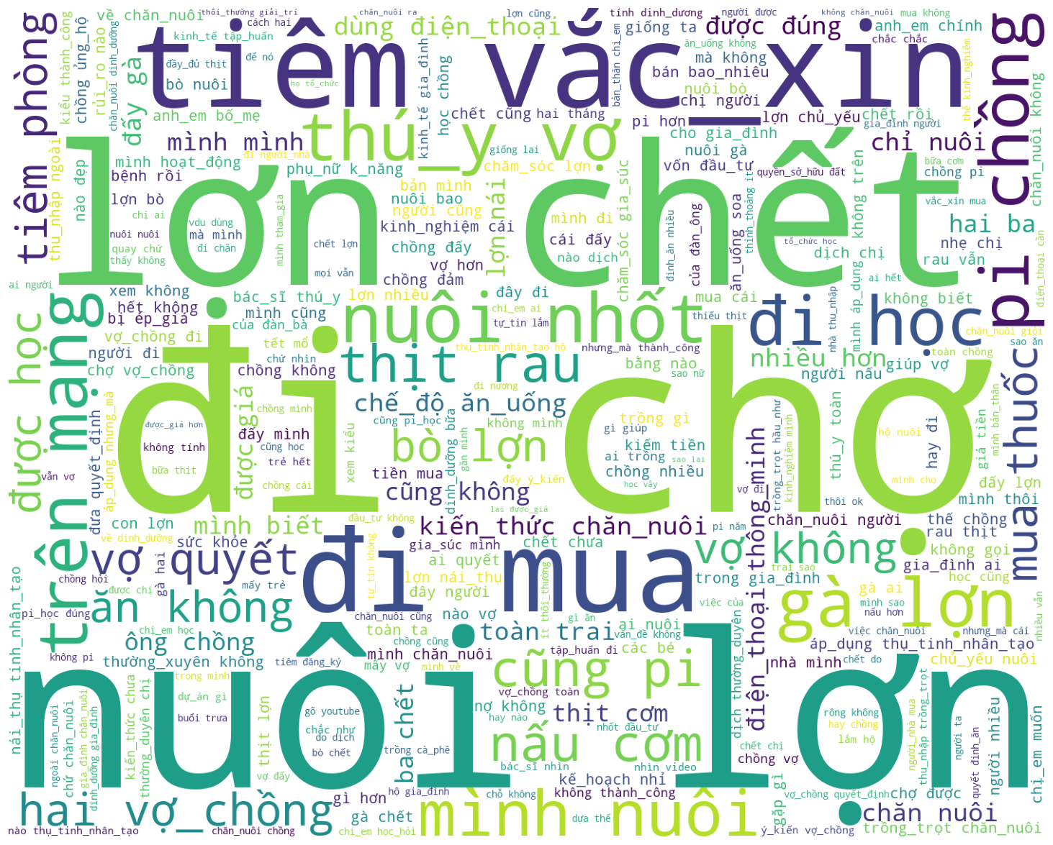
WordCloud – ALL FEMALE – Important keywords
Vaccinated
Pig died
livestock rasing with housing
Go to training session to learn
Buying food
On the Internet
Raising Pig

Slide 18
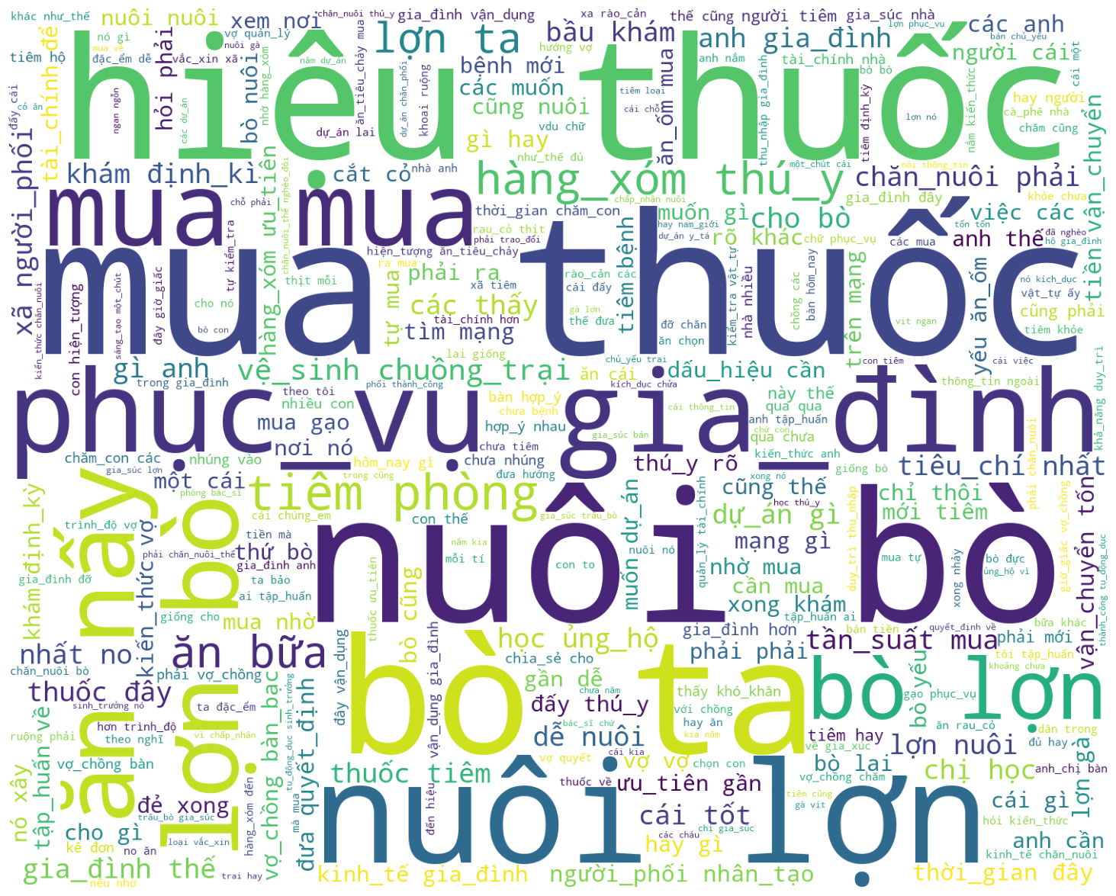
WordCloud – RURAL MALE – Important keywords
Pharmacy
Neighbor
Buying medicine
Local breed cattle

Slide 19
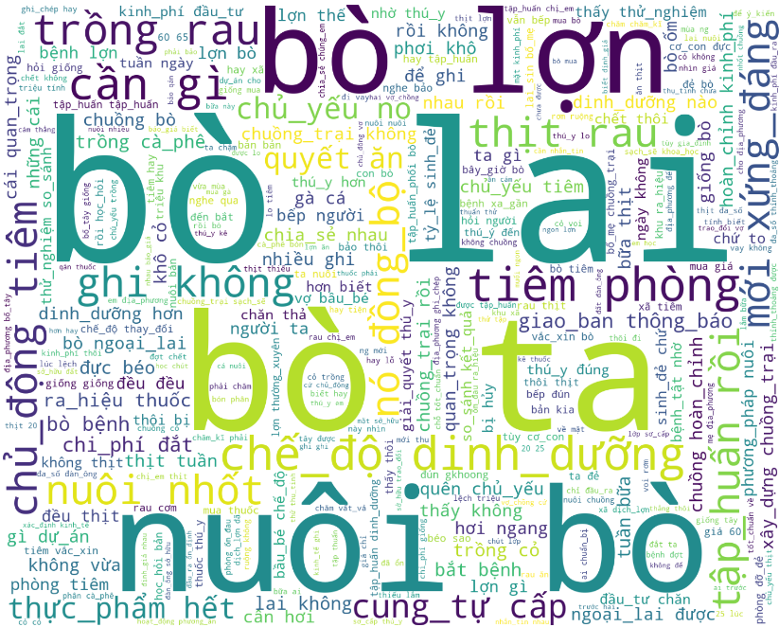
WordCloud – TOWN MALE – Important keywords
Crossbreed cattle breed
Local cattle breed
Rasing with housing
proactively vaccinate
self - sufficient

Slide 20
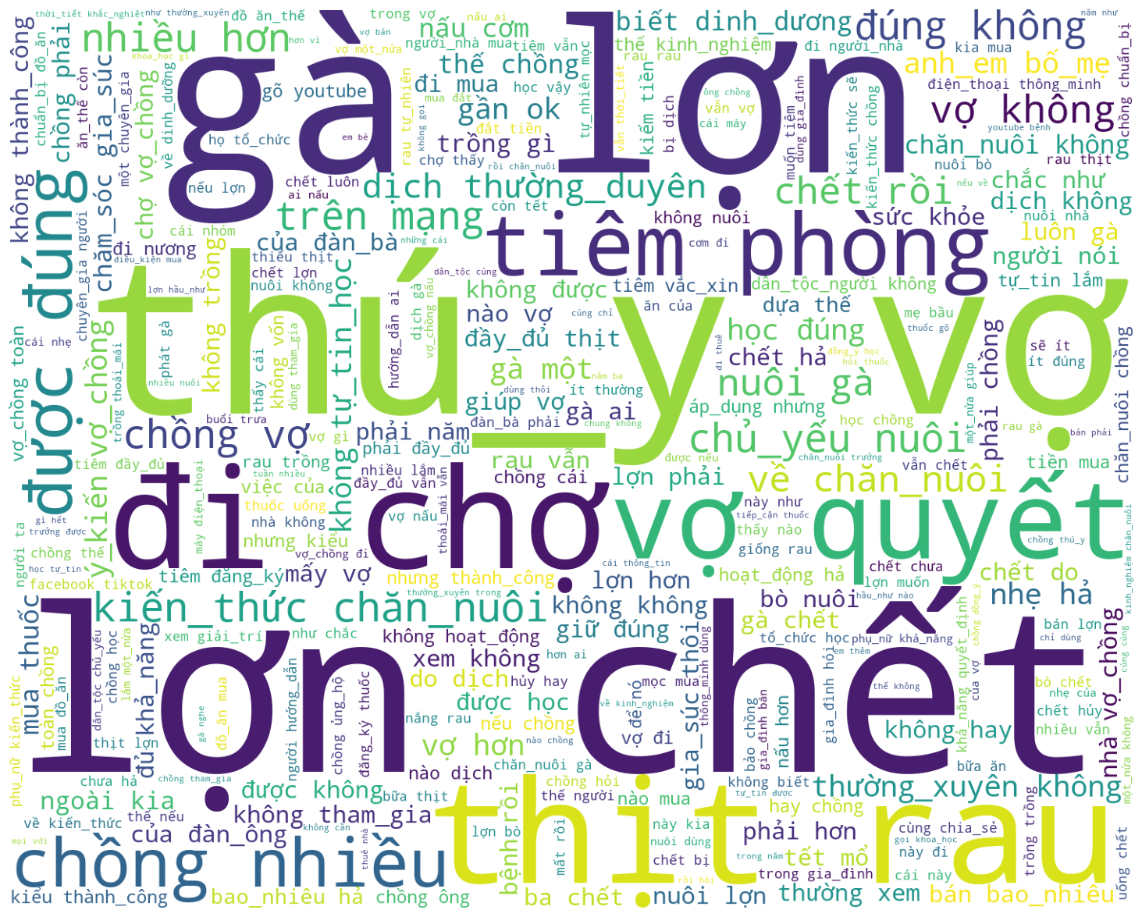
WordCloud – RURAL FEMALE – Important keywords
Chicken and Pig
veterinarian
wife make a decision
Buying food
Pig died
Meat and vegetable
livestock raising knownledge

Slide 21
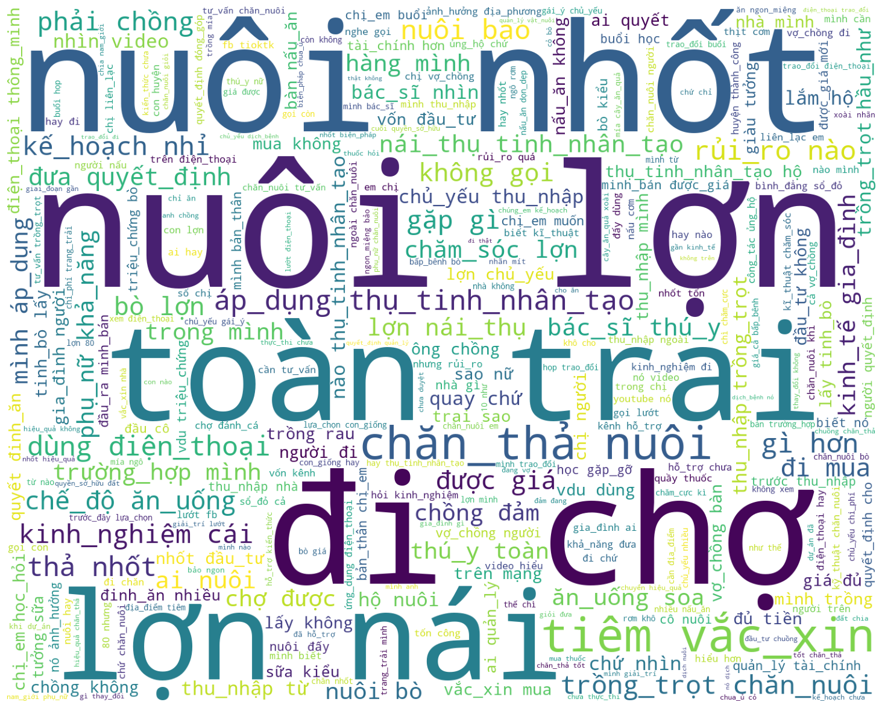
WordCloud – TOWN FEMALE – Important keywords
Raising animal with housing
Raising pig
Buying Food
Sow

Slide 22
Research
insights.

Slide 23
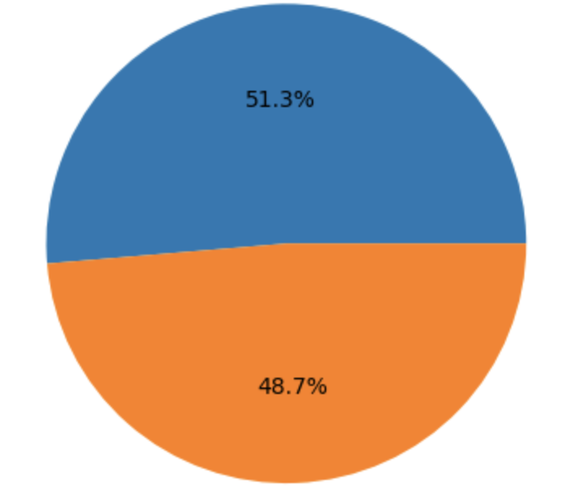
Research insights - Demographics
Information of participants:
Female
Education level | Male (%) | Female (%)
Illiteracy | 5.41 | 4.73
Primary school | 4,31 | 7.75
Secondary and high school | 39.64 | 38.79
College and university | 0.68 | 1.35
Male

Slide 24
Research insights
We divided insights from quantitative and qualitative studies into three components of SAPLING project as follow:
Livestock
Marketing
Breeds and gestation
Feeding and nutrition
Artificial insemination and natural mating
Animal health, vaccine and medicine
Housing
Human nutrition
Animal source food in daily meals
Diet for pregnant women and young children
Gender
Decision-making process
Knowledge and personal growth for women
Land and property ownership

Slide 25
Livestock

Slide 26
Research insights - Livestock
1. Marketing
This is the most discussed and consistent issue in all interview groups. Households struggle with the sales output of livestock.
Traders greatly influence the sales of livestock. The selling price of cattle and pigs is agreed upon by both parties (mostly verbally), fluctuating based on the situation. There are two types of traders, and the prices of the two types have no significant differences: local and city traders. However, traders are also under price pressure from other buyers.
The main sales of cattle are for meat. Therefore, when the meat is bought at a low price, people lose the motivation to raise cattle. This is also why cross-breeding cattle is not attractive to the locals despite being more efficient but costly and with low output. Instead, people choose local castles because they are cheaper, easy to care for, and can be consumed within the household when necessary.
The main sales of pigs are breeds and meat.
  For selling piglets, the breeding period is short (2 weeks to 1 month). Despite the short breeding period, sales in many places are not guaranteed. Some households that can guarantee sales output for piglets are quite successful.
  For selling meat, the breeding period is longer (counted in months). Because the output price is not guaranteed, people are not very interested in this type of breeding. People mostly raise pigs for household consumption on special occasions.
Each village typically has 1-2 households that raise a large number of cattle or pigs (ranging from 50 to 100 animals). Those raising pigs dominate these households due to the faster turnover time, which means a faster capital recovery. Households raising a large number of livestock tend to have more stable sales output.
Many households use Facebook groups as a distribution channel. However, these distribution channels are only suitable for small quantities.
Notes:
Many households (or relatives, neighbors) losing their investment due to a drop in pigs or cattle prices has led to a fear of new investment on livestock.
However, this situation only occurred around 6 years ago, when the market prices of pigs and cattle started to decrease. From 2010 to 2016, many households still invested in pigs and cattle.

Slide 27
Research insights - Livestock
1. Marketing (continue)
If the sales output issue is solved, there's a high chance that households will be motivated to invest in livestock breeding and applying best practices for their livestock.
Through the survey, many households believe that knowledge leads to livelihood improvement. Upon further questioning, the consulting team finds that they are:
  Lacking a reliable source of knowledge.
  Lacking motivation and opportunities to practice livestock-rearing knowledge.

Slide 28
Research insights - Livestock
2. Breeds and gestation
Most town villages understand different breeds well, between local and improved breeds. Their knowledge mainly relates to:
  Duration of animal rearing before selling.
  Cost of rearing.
  Disease resistance.
  Nutrition for livestock.
However, rural villages lack knowledge about improved breeds due to a lack of training and access to semen or a veterinarian.
Local cattle breeds are more commonly raised because:
  People think livestock sales prices are low and sales output is unstable, so they do not want to invest much in selecting breeds.
  Local breeds are deemed suitable for local conditions, easy to raise, and less prone to disease.
Local pig breeds are more commonly raised because:
  The cost and effort required to raise local pigs are less.
  The output for pork is not high, so even though hybrid breeds have higher productivity, they require more investment in terms of cost and effort; hence, most households do not choose them.
The families are willing to adopt new breeds if they have stable sales in terms of price and quantity and have higher efficiency.
When choosing breeds for livestock, households often consult with breed sellers and observe their neighbors. Some husbands can search for more information about breeds on YouTube.
Notes:
Many households (or relatives, neighbors) losing their investment due to a drop in pigs or cattle prices has led to a fear of new investment on livestock.
However, this situation only occurred around 6 years ago, when the market prices of pigs and cattle started to decrease. From 2010 to 2016, many households still invested in pigs and cattle.

Slide 29
Research insights - Livestock
3. Feeding and nutrition
Households that have raised improved breeds have learned about the breed before raising them. Therefore, they know there is a need for a different nutritional regime for livestock. These families often grow food and buy bran. They also practice feed preservation (e.g. silage making).
Households who raised improved breeds understand that feeding and nutrition play an important role in the effectiveness of their livestock raising. However, with local breeds, households often graze cows and traditional feed for pigs. The difference comes from the breeding goals of the two breeds.
  Families that raise improved breeds have the goal of selling breeds or meat.
  Families raise native breeds mainly to serve family meals.
Households' knowledge about nutrition comes from four main sources:
  Experience: Mainly applied to native breeds.
  Advice from seed or bran sellers.
  Search for information on YouTube.
  Observation and get advice from neighbors and friends.
Knowledge about nutrition for livestock does not yet have a comprehensive and easily accessible source of information.

Slide 30
Research insights - Livestock
4. Artificial insemination and natural mating
Most households in the town villages have been introduced to and have practiced artificial insemination or had local veterinarians assist.
The cost of implementing artificial insemination is not too high. The procedure for those who have been guided is not complicated and is not a barrier if guided or performed by someone. Community members can assist or help each other.
Most households said they mainly apply artificial insemination for pigs rather than cattle. The three main reasons are:
  Artificial insemination in pigs is simpler to carry out than in cattle.
  Artificial insemination in pigs results in healthy, attractive, disease-resistant offspring that can be sold at high prices.
  People are concerned about the success rate of artificial insemination (as it is an investment for them) and its economic effectiveness (rearing time, income, cost).
  Many local sow and cow are not qualified for artificial insemination.
Most households in rural villages, especially those with no intervention before, do not know about artificial insemination, and most have not implemented it.
Difficulties in artificial insemination:
  Do not know how to do it
  The success rate is not high due to lack of experience and knowledge
  Health of the offspring
  Fear of disease and rearing method after successful artificial insemination (especially feed for cattle, price for pigs).

Slide 31
Research insights - Livestock
4. Artificial insemination and natural mating (continue)
For some households, especially in rural towns, artificial insemination for pigs does not incur significant costs (including both financial and non-financial costs). However, many households consider artificial insemination (for cattle and pigs) not highly important. The two main reasons are:
  Most households (especially in rural villages) raise pigs and cattle for self-sufficiency, not economic development. Therefore, investing in artificial insemination is not deemed necessary.
  They still find natural mating reliable because (1) it saves time and effort and (2) many people in their community still practice natural insemination.
The frequency of artificial insemination is directly proportional to the number of pigs a household has. Households that raise more pigs have a higher frequency of artificial insemination and vice versa. Economic benefits mainly influence this. Specifically, households that rely on livestock (especially pig farming) as their main source of income frequently apply artificial insemination.

Slide 32
Research insights - Livestock
5. Animal health, vaccine and medicine
Disease has been a major factor affecting livestock in recent years. Therefore, drugs and vaccines are factors that most villagers consider important and greatly influence their decision on animal rearing. Villagers think they are not notified when a disease is about to occur. Usually, when they hear the news, it is too late, and they have to cull, or the herd has died.
Few villagers proactively vaccinate. Vaccines for livestock are mainly administered in two ways: (1) vaccination by the state and (2) vaccination by the breeder.
Villagers learn about medicine when they detect health problems in their livestock. These problems are quickly detected because people take care of their livestock daily. They also understand the need to buy medicine quickly, especially for pigs, who can get sick and die within a day.
Health assessment for livestock is based on experience, usually:
  Weight
  Movement
  Diet
Most villagers self-learn about medicine through two channels:
  Online: YouTube and Google. Learning about medicine can take time, as villagers have to find videos that match the condition of their livestock.
  Offline: Call or meet directly with the drug seller
In some villages, villagers do not trust the expertise of the village veterinarian. Most households also self-assess that they know little about disease prevention and medicine. They also concluded that there was not enough training related to this topic.

Slide 33
Research insights - Livestock
5. Animal health, vaccine and medicine (continue)
In rural villages, access to medicine is limited, so villagers prioritize local breeds deemed more disease-resistant.
Most people have lost money in their investments in livestock, primarily due to disease outbreaks and the impact of market outputs. These two reasons are interconnected. This has led people to understand the importance of vaccines and the necessity for regular vaccination. However, they face two main challenges to carry out vaccination on time:
  Determining the appropriate time for vaccination
  Limitation in accessing vaccines
Some households directly purchase vaccines at pharmacies. However, it is mainly households living near the town center.
When pigs/cattle get sick, the first point of contact is usually the local/village vet. However, in some villages, the local vet has little time to visit each household because the commune is difficult. In many cases, the cattle/pigs have died due to lack of timely treatment, impacting the household’s livelihood.
Some husbands express a desire to have a mobile application to assist in livestock care.
These losses create a reluctance to invest in livestock. Several households shared that livestock only makes up a maximum of 20% of their total income. Fewer households rely on livestock as their main livelihood and primarily for consumption.
As a result, households that do not prioritize livestock tend to neglect knowledge and skills such as artificial insemination and vaccination, as they deem these skills unnecessary.

Slide 34
Research insights - Livestock
6. Housing and Bookkeeping
Housing for pigs and cattle is mainly built based on experience or information from the internet.
Pig pens are more common as local pig-rearing conditions also require pens. Villagers clean pig pens based on their experience.
Housing for cattle is common for improved breeds. In villages with a lot of land and not raised for sale, local cattle are free-roaming to save housing costs. For cross-breed cattle, households understand that housing is mandatory to ensure their health. Housing for households is considered a significant investment, especially in rural villages.
Households applying artificial insemination methods (particularly for pigs) tend to focus more on knowledge about housing.
Households often do not record livestock data because, according to them, self-memorization will be faster and more effective if they raise a small number of livestock.

Slide 35
Human
Nutrition

Slide 36
Research insights – Nutrition
1. Nutrition in Daily Meals
For the communes close by, food security is not a severe problem. Households can choose to eat meat, vegetables, and rice daily.
Most people do not have clear criteria to evaluate the nutritional quality of the household. The most common evaluation criterion is the level of satiety after a meal. Therefore, there are many meat and meatless meals (uneven nutrient distribution).
For remote communes, many households do not have enough meat to eat 3 to 4 days a week for the following reasons:
  Do not have enough money
  Difficult access to the market
  Not enough livestock for meat
  No perceived need for daily meat consumption.
The wife is the main person overseeing the family's meals. The husband saids they also cook when the wife is busy. This division depends on the working hours of the husband and wife. However, wives usually make decisions about food in daily meals.
Some women understand that good nutrition is essential to the family's health. However, they lack nutrition information and often choose food based on experience.

Slide 37
Research insights – Nutrition
2. Nutrition for Pregnant Women and Newborns
Households with young children or pregnant women know they need additional nutrition. However, nutrition usually means adding meat or catering to the desires of pregnant women. Families do not have much knowledge of nutrition for women and newborns.
Households do not see the necessity of special nutrition principles. However, both husbands and wives care about their children’s health and will supplement nutrition if possible.

Slide 38
Gender

Slide 39
Research insights – Gender
Female Participation in Financial Management and Household Livelihood
For Thai people, the wife primarily holds the family's money because men consider wives to be more careful and caring. Wives also believe they are better at handling money because husbands often spend money on recreational activities (drinking).
For Mong people, either wives and husbands can hold the household's finances. The husband holds the family's finances for those in rural villages because the wife lacks knowledge. However, this is not always the case. Finances are also divided according to responsibilities (the husband often goes shopping at the market or buys medicine for livestock due to difficult travel conditions, so the husband is the one to go and hold the money related to these expenses)
Because households are busy and struggle with livelihoods, the participation of both men and women is needed. The division of labor usually depends on expertise, experience, and health. Women mainly take care of livestock or less physically intensive farming activities. Men often take care of tasks requiring better health and more traveling. This is particularly clear in Mong villages due to difficult travel conditions.

Slide 40
Research insights – Gender
2. Decision-making
In Thai families, the wife has good access to knowledge, so she can make decisions. However, both husbands and wives always discuss things with each other before making a decision. In Mong families, the wife knows less, so she usually does not make decisions; mainly, the husband asks, and the wife agrees or disagrees.
In town villages and among Thai people, men support women in training, knowledge sharing, and household livelihood activities, including trading. The only condition for women's activities is not to go overnight.
In remote Mong villages, the wife usually does not actively make decisions related to livestock because she feels she lacks much knowledge.
Men are aware of the need to ask their wives' opinions before making decisions and discuss with their wives before making important decisions in the family (choosing breeds, building houses, buying and selling valuable items).
Women are aware of the need for discussion between spouses.

Slide 41
Communication

Slide 42
Research insights – Communication
Most people, both men and women under 35 years old, use smartphones. Only a few people over 40 do not use smartphones. However, they still use traditional button phones.
For offline communication channels:
  The main source of information is direct communication with friends and neighbors. Each village is usually small and everyone in the village knows each other.
  In remote areas where houses are far apart, people rarely meet and talk to each other. These areas also lack communication materials (banners, posters, standees).
  Most villages have loudspeakers, and people often listen to them. However, people do not remember much information from the loudspeakers.
  In some villages, people have farmer groups that meet two or three times a year, usually during the harvest season, to share information and experiences.
  Besides, there are also channels from veterinary stations, drug stores, and breed selling establishments.
For online communication channels:
  Apps for entertainment: Facebook, TikTok
  Apps for information search: Youtube, Google (then click on Youtube to watch videos)
  The information that families consume is mainly in the form of quick information (reel on Youtube or TikTok videos)
  Apps for communication: Zalo, Facebook
  Not many families have TVs. Young people mainly use their phones to access information.

Slide 43
Research insights – Communication
Their habits of using phone apps are quite simple and passive, mainly operations such as searching, browsing, viewing information. In simulated situations, the information flow they receive is also quite simple, going through a maximum of 4 steps: Search - Browse - Choose - View.
Many families shared that they lose a lot of time in the browsing and choosing steps. For example, when a cow/pig has a problem, they often use Youtube as a place to search for information. However, the thumbnail on Youtube is not very clear about the breed of cow or pig they have, so they spend a lot of time choosing a suitable video. Then, they also spend a lot of time watching and choosing the segment that provides the information they need in the video. In many cases, they spend about 3 hours to find the necessary information.
In addition to applications, people have a habit of actively searching for information from "successful models" in the village - commune (as presented above, each village will have an individual with a large scale of livestock). They often talk to/about this role model.

Slide 44

THANK YOU!

