Slide 1
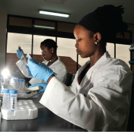
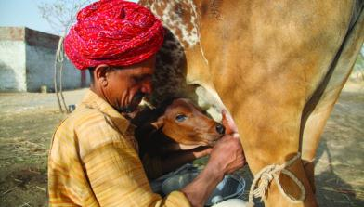
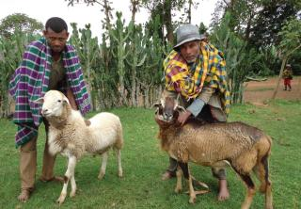


An update on the Global Livestock Advocacy for Development project
Shirley Tarawali
GASL guiding group meeting
Rome, 6-7 March 2018

Slide 2


















Agenda 2030’s Sustainable Development Goals
Livestock contribute to all 17 of the SDGs and directly to at least 8 of the goals.

Slide 3









Agenda 2030’s Sustainable Development Goals
Livestock contribute indirectly to all 17
of the SDGs and directly to at least 8 of the goals.

Slide 4
Agenda 2030’s Sustainable Development Goals
Livestock contribute indirectly to all 17
of the SDGs and directly to at least 8 of the goals.
Negative press about, and low investments in, livestock development jeopardize Agenda 2030.

Slide 5
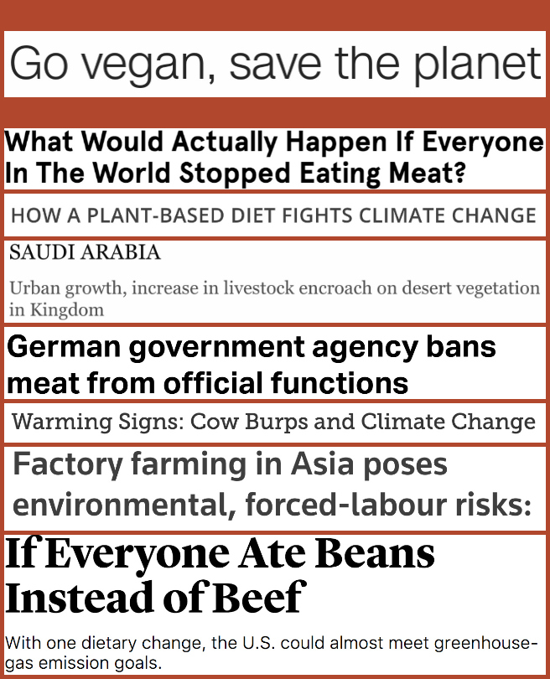
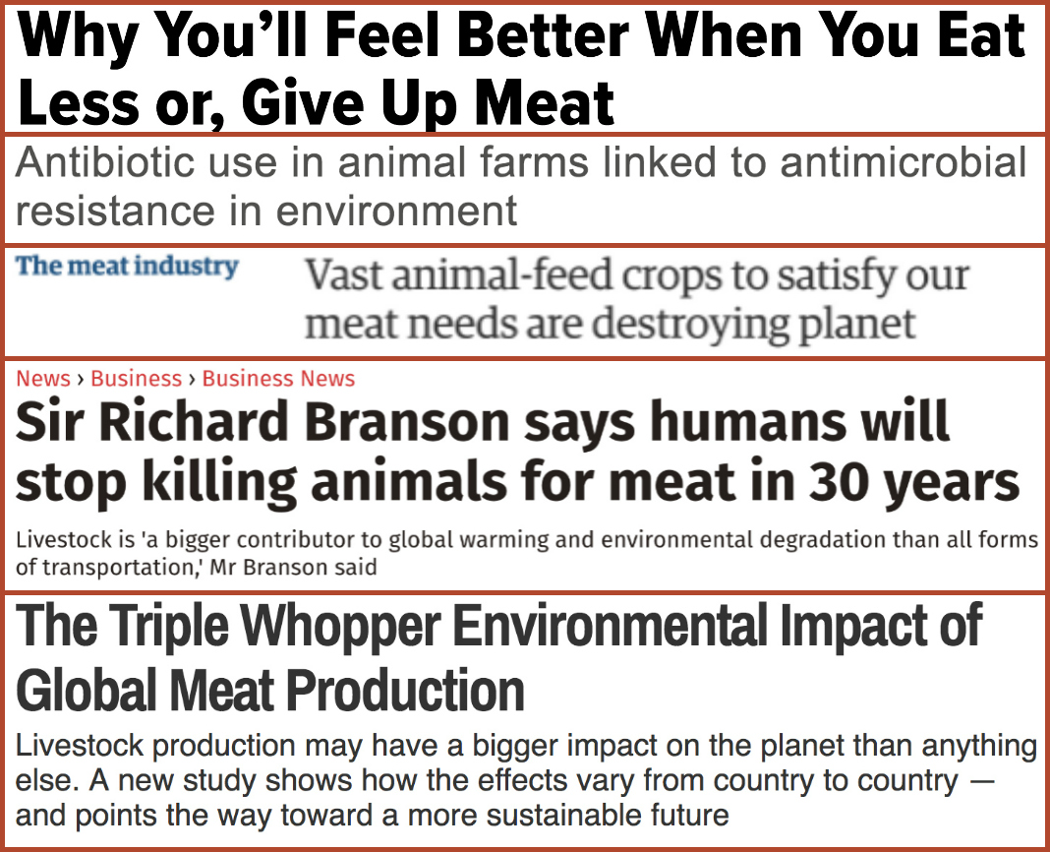
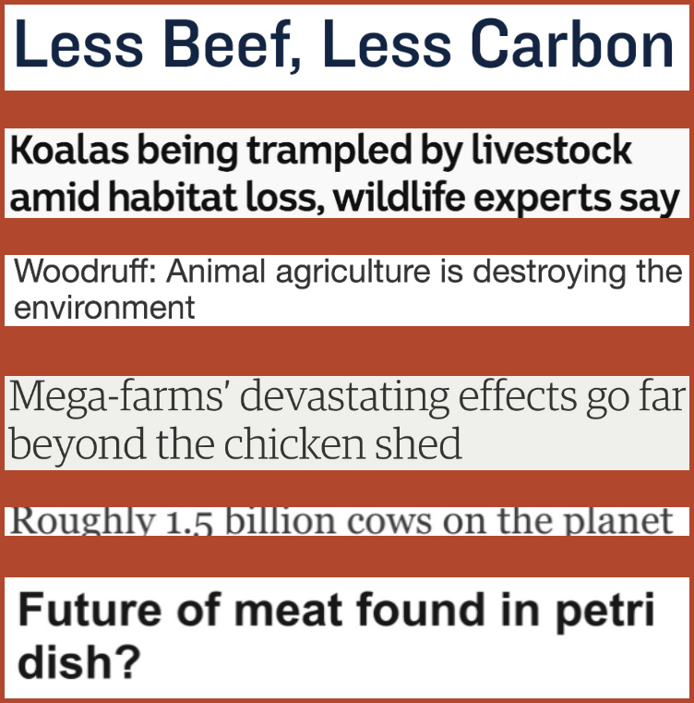
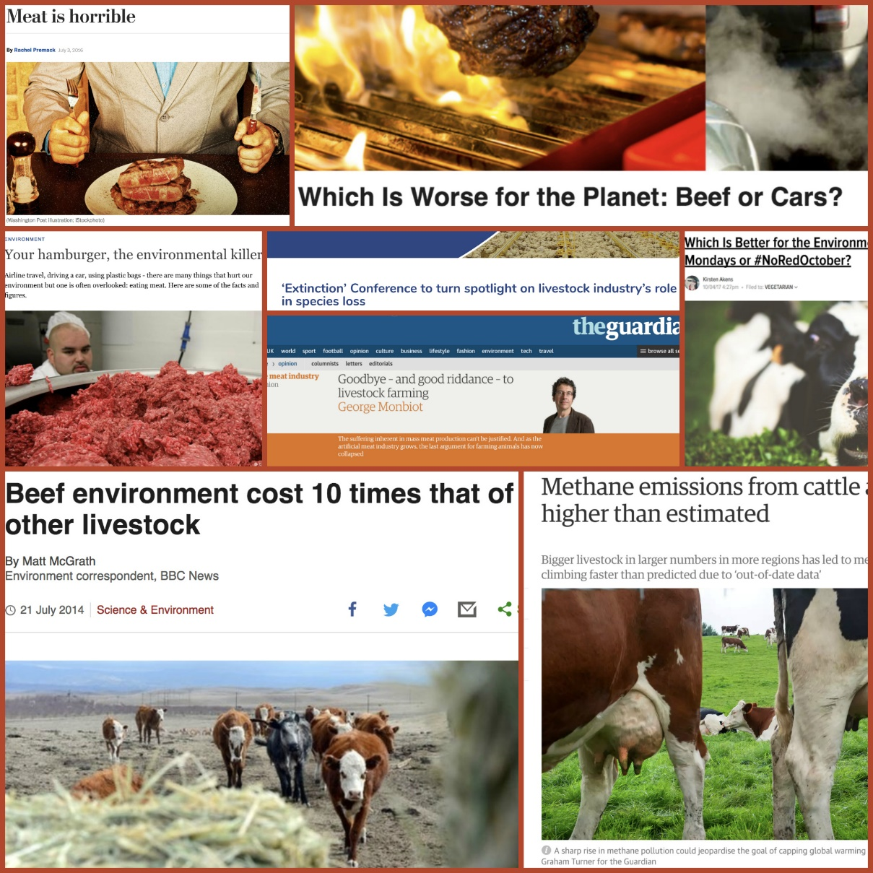
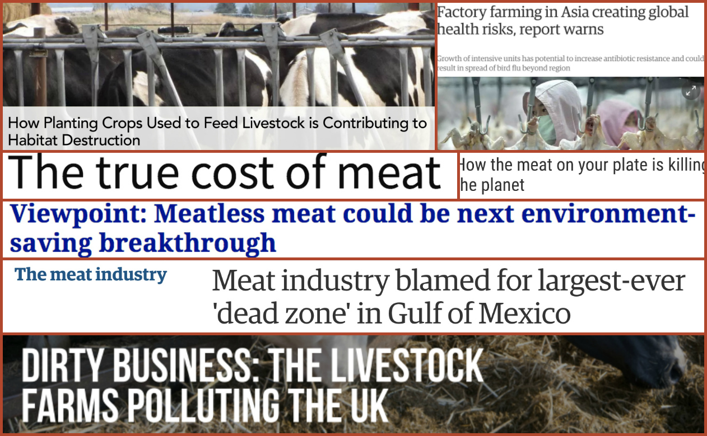

Slide 6
The evidence [and data] supporting investment in sustainable livestock is scattered and not always equally robust
Notes:
This and the next slide are examples of the messages ‘we’ publish; Main point to make is that the hard evidence behind these is scattered, mixed and perhaps not robust enough.

Slide 7
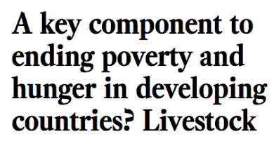

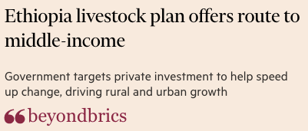
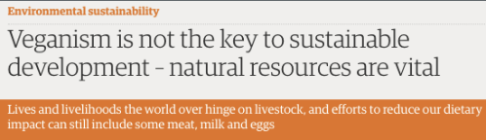
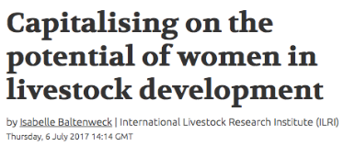
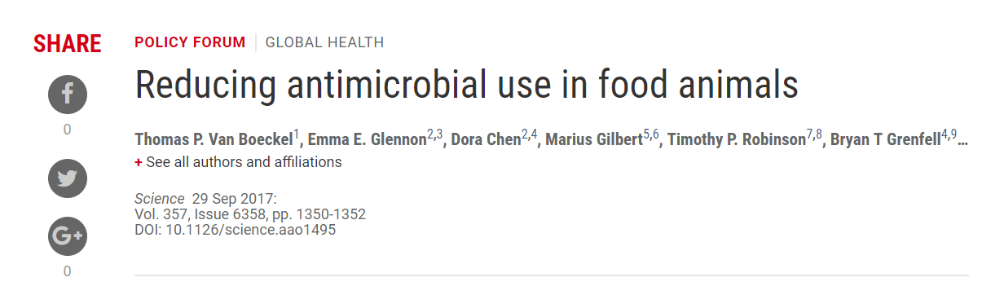
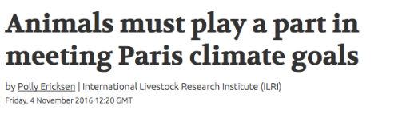
How rigorous is the evidence behind the messages we communicate?

Slide 8
Global Livestock Advocacy for Development
GLAD project
Financed by the Bill and Melinda Gates Foundation
Implemented by ILRI with Emerging Ag and Marchmont Communications engaging with many partners

Slide 9
Project Starting Points
Underfunding of the livestock sector in developing countries is partly due to a global lack of awareness and understanding of livestock as well as negative views of livestock by some people.
Lack of awareness is compounded by inaccessible and inconsistent evidence and data
Notes:
Two reasons why we exist: investors need knowledge; evidence needs to be organized to be used

Slide 10
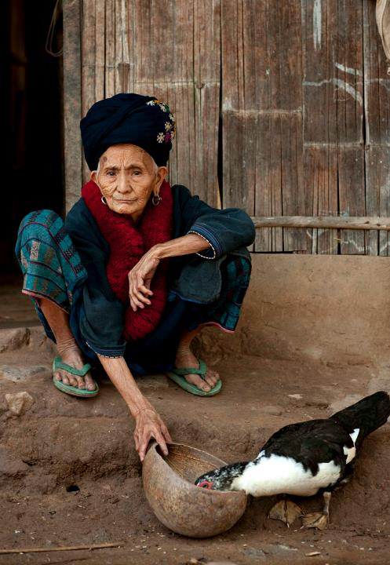
Goal
Increase the amount of ODA for livestock

Slide 11
GLAD work
Evidence and creative content
  Audit and message testing
  Evidence collation
  Issue synthesis/products
  Communications ‘toolkit’
Convening and engagement
  Global advocacy and policy engagement
  Targeted advocacy
  Media outreach (‘bursts’)
Capacity development
  Event(s)
  Blended learning
  Facilitate a community of practice [and champions]

Slide 12
Evidence work
Collated and distilled evidence on sustainable livestock and:
  Growth and livelihoods
  Gender
  Animal and human health
  Nutrition
  Environment and climate change
For each: Series of statements/messages, with associated argumentation, evidence, facts, references; basis for set of messages or statements we can all use and reference.
Validating and fact-checking with LD4D community and others
Basis for web product in June 2018; as well as wider influencing efforts

Slide 13
Insights from media and stakeholder stocktaking
Most frequently reported aspect of livestock coverage in global media was its contribution to greenhouse gases
Media coverage often linked to big events/crises
Developed world stories dominate headlines
Much media messaging treats livestock as a product (meat or milk); not as a tool for development
Four out of 12 key development stakeholders interviewed say livestock is viewed largely or somewhat negatively
Three said livestock is not visible at all in development dialogues
Notes:
This slide has a few points from the media and stakeholder audits from last year. Reinforcing the messages from the previous slides; with a few points from the interviews marchmont had with individuals in a few organizations important in the sector.

Slide 14
Convening and engagement
Side event HLPF July 2016
High-level advocacy event and tour: CFS43 , Rome, October 2016
Expert group meeting, SDG2, New York, June 2017
High-level advocacy events and tour: HLPF, New York, July 2017
UN general assembly late in 2017 approved resolutions that included three provisions regarding the livestock sector.
GFFA, Germany January 2018 (communique)

Slide 15
Capacity development
October 2017: meeting and training
Under development: blended learning products
D-group ‘community of practice’ underway

Slide 16
Targeting strategies
Notes:
Optional – examples of 2 complementary influencing strands emerging from all this. To be followed by ilri and partners

Slide 17
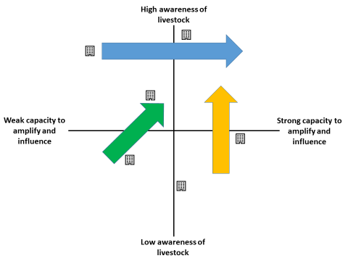
Typologies…
(ILRI-LGA….)
livestock aware but limited capacity to amplify messages and exert influence
livestock unaware but significant capacity to amplify messages and exert influence

Slide 18
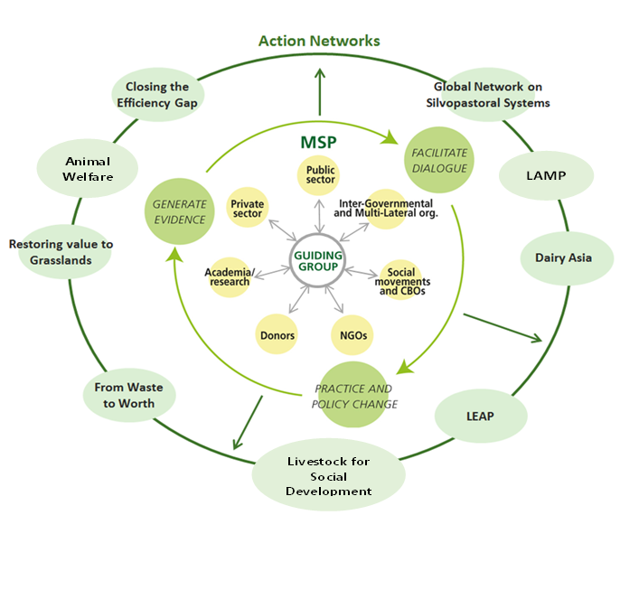
Making the whole greater than the sum of the parts……..
Global-regional-local
Implementation
Evidence, lessons
HOW to invest
LGA
GLAD
WHY invest
Communicate
LD4D
DATA for evidence

