Slide 1
Conceptual understanding of Water-Energy-Food (WEF) nexus
Tafadzwa Mabhaudhi
13 June 2023
WEF Nexus Masterclass 2023

Slide 2
Outline
What is nexus ?
Nexus configurations
WEF nexus concept
WEF nexus research
Difference with other integrated methods
Criticisms of the WEF Nexus Concept
Conclusion

Slide 3

What is nexus ?
The word nexus, (from the Latin “nectare”), means “to connect”. It has been used in philosophy, cell biology and economics. This word conveys the interactions (dependencies or interdependencies) between two or more elements.
According to the background paper of the Bonn 2011 Nexus Conference, the nexus approach is defined as “an approach that integrates management and governance across sectors and scales”

Slide 4

Background
What is the WEF nexus?
Water uses energy, energy uses water, agriculture needs both. Humankind and our increasingly urban societies need all three. However, the resources continue depleting.
Challenges, facts and figures
In 2030, 47% of the world's population will be living in areas of high water stress, southern Africa will be the most affected
By 2050, global population is expected to reach 9 billion. 70% more food will be needed
Agriculture accounts for roughly 70% of water use (over 60% in South Africa)
Hydropower provides 20% of the world's electricity and is the main energy source in southern Africa
By 2030 humankind will need 30% more water, 40% more energy and 10% of existing crop land for biofuels

Slide 5
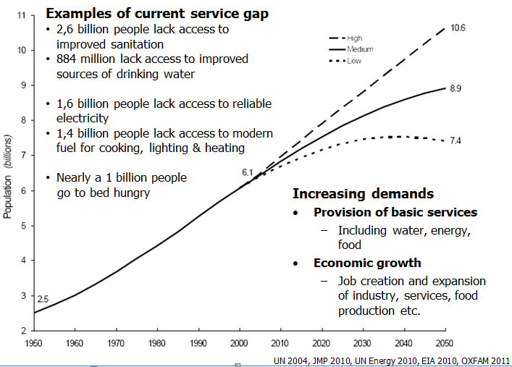
Background

Slide 6
Benefits of Nexus Approaches
Uncover synergies
multi-sectoral systems analysis reveals that urine separation technology (UST), which requires less water than conventional methods, could lead to a 10% reduction in water needs, lowering the energy use in water supply by about 10% and wastewater treatment by nearly 25%
Detect trade-offs among sectors,
Trade-offs occur in drier regions where farmers choose between multiple types of crops that have different water and energy demands
Unveiling unexpected consequences
biofuels emissions were proposed as part of the solution to increased CO2 from burning fossil fuels, but unexpected side effects occurred (e.g. water scarcity as their production, processing and distribution)
Promote cooperation, coordination and policy coherence
A nexus approach has been incorporated into a hydro-economic systems model and scenario analysis to investigate resource security and allocation in a River Basin
Address SDGs
The achievement of the SDGs requires all relevant stakeholders to work together and manage the synergies and trade-offs among different management or governance sectors (for example, food, health, water and energy)

Slide 7





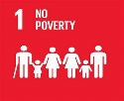








Nexus Configurations
They are several nexus configurations or examples (e.g. Women–water nexus, Food–energy nexus, etc).
Nexus example | SDGs
Food–energy–water nexus
Water–food–energy–climate nexus
Energy–poverty–climate nexus
Food–biodiversity nexus
Food, energy, water, and health nexus
Women–water nexus
Mining–water nexus
Urban–water–energy–climate nexus

Slide 8

Nexus Configurations
  Most nexus studies focus on two sectors, such as energy and water, water and food, food and energy or food and biodiversity;
  Amongst the various nexus configurations, the water-energy-food (WEF) nexus has garnered particular interest.
      due to the finite and indispensable nature of each of these resources;
      ever-increasing demand for them due to population growth and changes in consumption patterns.

Slide 9
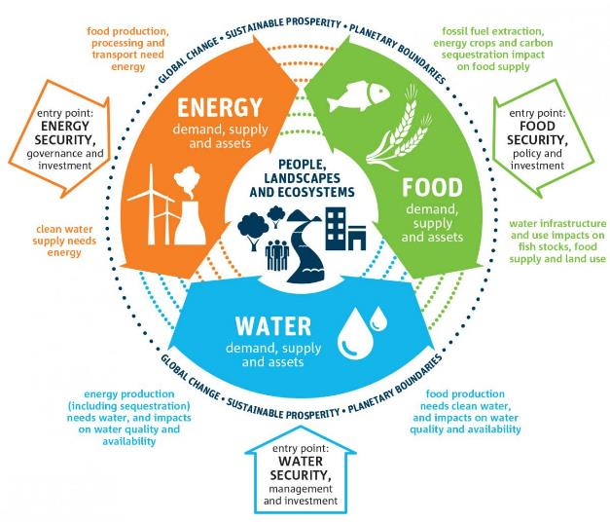
WEF Nexus Concept
The connections between the water, energy, food and ecosystems, together with the synergies, conflicts and trade-offs that arise from their management (e.g. water for food and food for water,….)
A multicentric lens for assessing integrated resources management and sustainable development in the past decade
It can be used as a:
  Conceptual framework
  Analytical tool
  Discourse

Slide 10
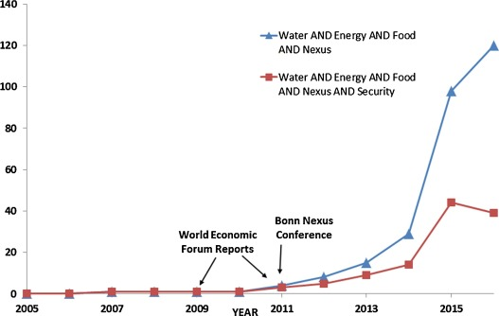
WEF Nexus Research: Its evolution
2030
Circular models (the basis for SDGs)
  Cross-sectoral management
  Quantitative relationships in resources management
  Priority areas for intervention
  Synergies and trade-offs
  Inclusive economic growth
After 2015
Cross-sectoral approaches
Transformational change
Circular models
2011 World Economic Forum
Sustainable Development Goals (SDGs)
Towards transformational change and sustainable development
Drivers of change
  Population increase
  Rapid urbanisation
  Resource degradation
  Agriculture expansion
  Resource insecurity
  Climate change
Before 2011
Sector-centric approaches
Integrated water resources management
Linear models

Slide 11
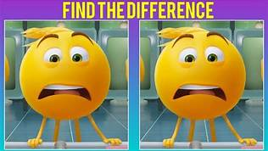
Difference with other integrated methods
Integrated Water Resources Management (IWRM), soft path, planetary boundaries
  being water-focused (e.g. IWRM)
  Failure to garner the necessary cross-sectoral support to move an integrated management concept beyond its core sector
  suffered from implementation problems
WEF nexus
  builds on many of these approaches
  multicentric, with each sector being treated with equal importance, removes the institutional“silos” that are so prevalent in governance and policy circles
  emphasizes on the importance of understanding linkages among sectors
  stronger demand for operationalization

Slide 12
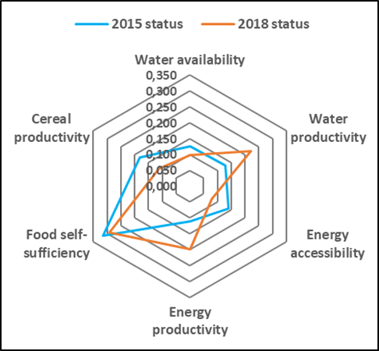
Monocentricism vs polycentricism
Circular and polycentric approaches
Cross sectoral resource planning and management
Interact with the present. but also mirroring into the future
Expedite the resilience building initiatives
Create a balanced system through use of smart technologies
Linear and monocentric approaches
Sector-based resource planning and management
Divergent sector-based policies
Aggravate contemporary crises
Focus on the present situation
VS
Transformative approaches seek to build resilience and adaptation through scenario planning. and achieve an urban circular economy
Consequences of monocentricism in urban planning
An imbalanced economy

Slide 13

Criticisms of the WEF nexus
The critiques are at the three levels: concept, application, and outcome/impact
At the concept level:
    not “new”
    still evolving and relatively immature
    narrative but not useful in applications
    lack of common definitions, methods, and frameworks
    not fully acknowledged on the ground and lacks publicity due to underrepresentation of private sectors and media in its activities

Slide 14
Conclusion
The WEF nexus approach is still evolving.
Much of the research has been conceptual, gaps on its implementations hinder its adoption.
More research is needed to address criticisms
  such as WEF related datasets at multiple scales
  inclusion of women and livelihood in WEF assessment
There is a broader adoption of the WEF nexus in international and national policies

Slide 15


Thank You!
More information at:
cgiar.org/initiative/nexus-gains
Contact:
Tafadzwanashe.Mabhaudhi@lshtm.ac.uk
This work was carried out under the CGIAR Initiative on NEXUS Gains, which is grateful for the support of CGIAR Trust Fund contributors: www.cgiar.org/funders
© 2024 International Water Management Institute. Some rights reserved.
This work is licensed under a Creative Commons Attribution-Noncommercial 4.0 International Licence (CC BY-NC 4.0).

